Slide 1

Housekeeping Notice
Please mute your handphone during class

Slide 2

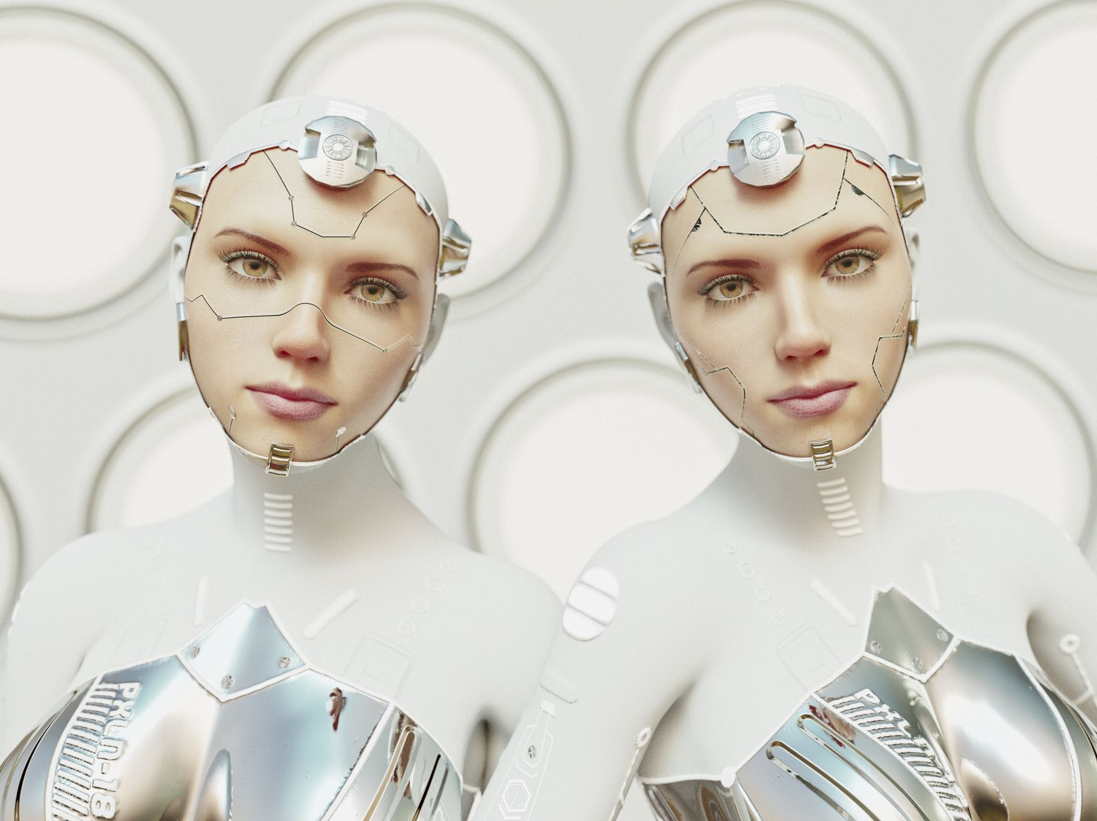

TPB 6323 Password Authentication and Biometrics
Chapter 7
Biometric Physiological Traits and Modalities – Part: Face
Notes:
2

Slide 3
Objectives
Identify the characteristics of the face technologies
Become familiar with the face recognition methodology
Look at the advantages and disadvantages of various face recognition algorithms

Slide 4

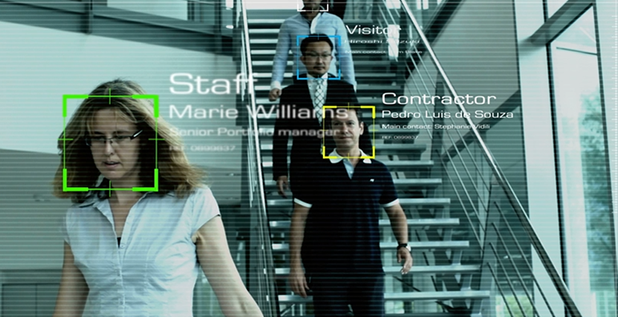
Face Biometrics
It is the most popular biometrics.
It is used by everyone every day.
The first defining characteristic that we use to identify someone.

Slide 5
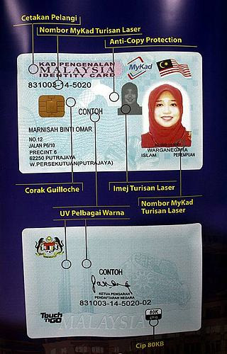
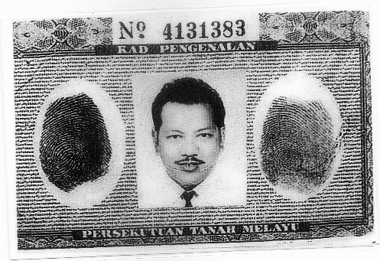
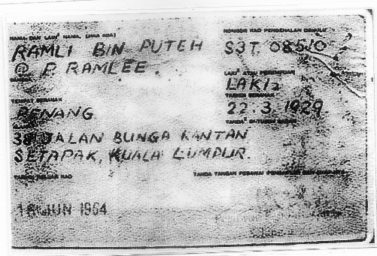
Face Biometrics
Example: for Malaysian, the IC (identity card) contains the photo IDs (picture of the person face) to proof the identity.

Slide 6
Face Recognition
Is a “passive” biometric task.
Not much people’s cooperation is needed.
Unobtrusive nature – makes it more suitable for wide range surveillance & security applications.

Slide 7
Face Recognition
Involves computer recognition of personal identity based on geometric or statistical features derived from face images.
Widely used in commercial, law enforcement & military applications, such as airport security & access control, building (i.e., embassies) surveillance & monitoring, etc.

Slide 8
Face Recognition
Strengths:
Has the ability to leverage existing image acquisition equipment.
Can search against static images such as driver’s license photographs.
The only biometric able to operate without user cooperation.

Slide 9
Face Recognition
Weaknesses:
Changes in acquisition environment reduce matching accuracy.
Changes in physiological characteristics reduce matching accuracy.
Has potential for privacy abuse due to non-cooperative enrollment & identification capabilities.

Slide 10

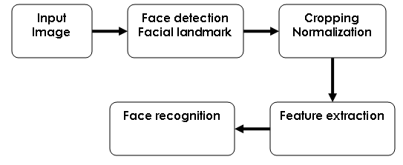

Face Recognition System

Slide 11
Face Recognition System
When an input image is presented to the face recognition system, the system first performs face detection and facial landmark detection, e.g.: the detection of the centers of the eyes.
The system then implements the normalization and cropping procedures, which perform the following three tasks:

Slide 12
Face Recognition System: Normalization and Cropping Procedures
Spatial normalization – aligns the centers of the eyes to predefined locations & fixes the number of pixels between the eyes (interocular distance) via rotation & scaling transformations.
Facial region extraction – crops the facial region that contains only the face, so that the performance of face recognition is not affected by the factors not related to face itself, e.g.: hair styles.
Intensity normalization – converts the facial region to a vector by concatenating its rows (or columns), then normalizes the pixels in the vector to zero mean and unit variance.

Slide 13
Face Recognition System
The system then extracts features with high discriminating power for face recognition.
Finally, face recognition is performed to recognize whose face the image belongs to.

Slide 14
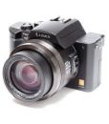

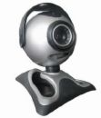
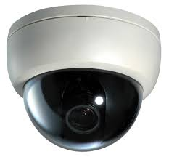
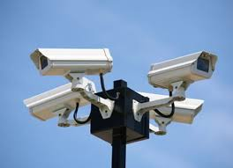
Image Acquisition (Input Image)
Can acquire faces from almost any static camera, video system, web camera, cell phones, and CCTV systems that generates images of sufficient quality & resolution.

Slide 15
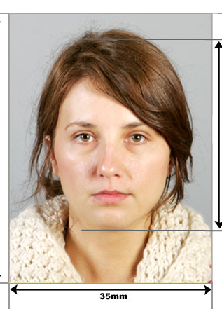
Image Acquisition (Input Image)
Ideal image:
Using a high-resolution camera.
Users directly facing the camera.
With moderate lighting of the face.
Practical only in a controlled environment, i.e., passport photo

Slide 16

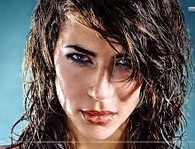
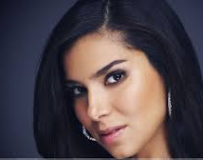
Face Detection
Primary Challenges – quality of face images:
Distance from camera reduces facial size.
Users not looking directly at the camera.
A gap between the threshold for locating faces in a field of view & locating usable faces.
Problem of lighting.
Makeup.

Slide 17
Normalization
Purpose: to overcome variations in orientation & distance.
Basic characteristics such as the middle of the eyes are located & used as a frame of reference.
The facial image can be rotated clockwise or counterclockwise to straighten the image along a horizontal axis.
The face can then be magnified.

Slide 18
Normalization
Face images are cropped such that the ovoid facial image remains.
Color images are normally converted to black & white in order to facilitate initial comparisons based on grayscale characteristics.

Slide 19
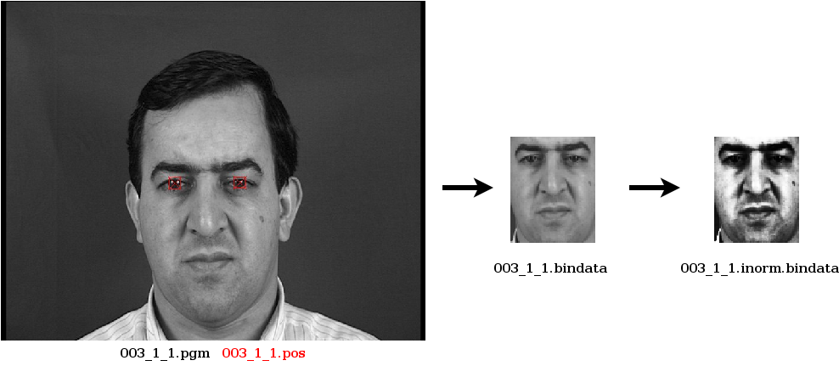
Normalization

Slide 20
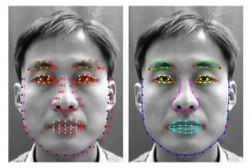
Feature Extraction
Local-based approach
Perceive & recognize human faces by extracting the prominent characteristics on the faces like eyes, nose & mouth together with their geometry distribution & the shape of face.

Slide 21
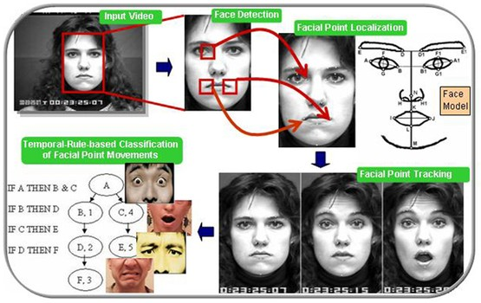

Slide 22
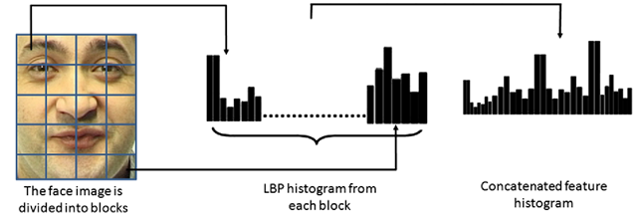
Feature Extraction
Global approach
Treat the entire image to find an effective representation of the face

Slide 23
Feature Extraction
Robust face recognition scheme finds low dimensional feature representation for:
Data compression purposes:
Curse of dimensionality – some features are not important
Enhanced discrimination abilities for subsequent image classification.
The most popular and fundamental method – Principal Component Analysis (PCA) or sometimes known as Eigenface.

Slide 24
PCA/ Eigenface
Unsupervised linear transformation techniques
Ignores class labels
Goal: to find the directions (known as principal components) that maximize the variance in a dataset
General idea:
Consider a 256X256 face image, which is equivalent to 65536-dimensional vector, it can be compressed by reducing the dimension based on the number of images in the face database

Slide 25
PCA/ Eigenface
Roughly translated as “one’s own face”.
It features distinctive facial characteristics.
The vast majority of faces can be reconstructed by locating distinctive features from approximately 100 to 125 Eigenfaces.
This technique is best utilized in well-lit, frontal image capture situations

Slide 26
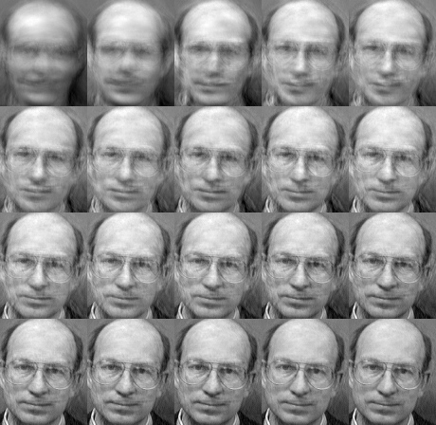

Slide 27
How does PCA work?
Define the face space: acquire a training set of images and calculate eigenfaces from them
When a new face is encountered, project it onto the set of eigenfaces and calculate a set of weights
Check if the image is a “face” by calculating the distance to the face space. Use a threshold to make decision

Slide 28
How does PCA work?
If it is a face, classify the person as known or unknown by comparing the weight pattern of the image to the known weight patterns. Simple Euclidean distance between weights vectors may be used, any other distance metrics can be used too
The system can be made more “intelligent” by using several images of the same person's face and by updating eigenfaces from time to time when new faces are encountered

Slide 29
LDA/ Fisherfaces
Linear Discriminant Analysis (LDA)/ Fisherfaces
Generalization method of Fisher Linear Discriminant
Supervised linear transformation techniques
LDA finds the vectors in the underlying space that best discriminate among classes
Aims to increase the inter-class variability while minimizing intra-class variability (maximize the separation between multiple classes)

Slide 30
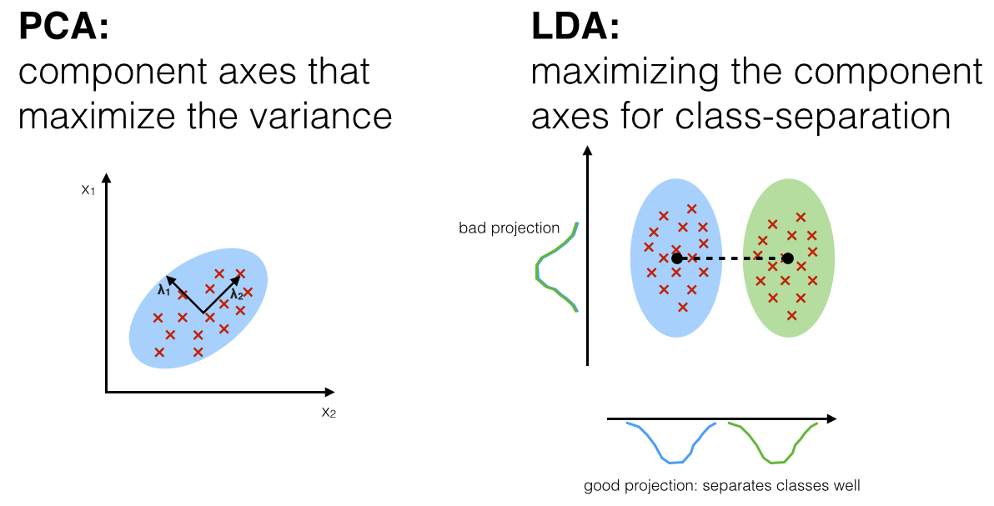
PCA vs. LDA

Slide 31
ICA
Independent Component Analysis (ICA)
Generalization of PCA (nonlinear) – sensitive to high-order relationships
Believes that most of the important information may be contained in the high-order relationships among pixels
Minimizes both second-order and higher-order dependencies in the input data and attempts to find the basis along which the data (when projected onto them) are statistically independent

Slide 32
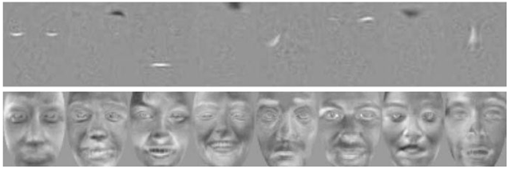
ICA
Basis images obtained with ICA:
Architecture I (top) and II (bottom)

Slide 33
Evolutionary Pursuit (EP)
Is an eigenspace-based adaptive approach
Use genetic algorithm (GA) to determine the optimal basis for encoding human faces
Searches all the possible subspaces to derive the best features
Technically believed to perform better than other PCA, LDA, and ICA.

Slide 34
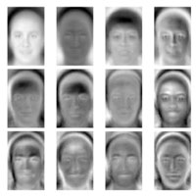

Slide 35
LPP/ Laplacianface
Locality Preserving Projections (LPP) approach
Face images are mapped into a face subspace for analysis
Finds an embedding that preserves local information, and obtains a face subspace that best detects the essential face manifold structure
Different from PCA and LDA which see only the Euclidean structure of face space

Slide 36
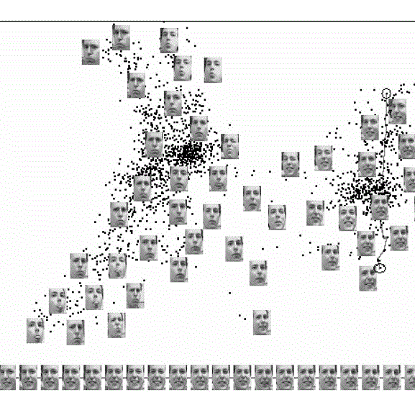
LPP/ Laplacianface
Able to eliminate and reduce the unwanted variations resulting from changes in lighting, facial expression, and pose

Slide 37
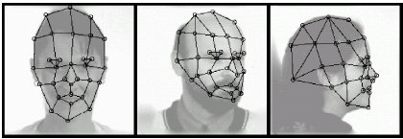
Elastic Bunch Graph Matching (EBGM)
All human faces share a similar topological structure.
Faces are represented as graphs, with nodes positioned at fiducial points. (eyes, nose...) and edges labeled with 2-D distance vectors.
Recognition is based on labeled graphs.

Slide 38
Standard Face Database
When benchmarking an algorithm, it is recommendable to use a standard test data set for researchers to be able to directly compare the results.
Choice of an appropriate database to be used should be made based on the task given:
Aging, expressions, lighting etc.

Slide 39
Standard Face Database
Some popular face data sets, included but not limited to:
The color FERET Database, USA.
Yale Face Database
AT&T "The Database of Faces"
PIE Database, CMU
List of useful face databases can be found here: http://www.face-rec.org/databases/

Slide 40
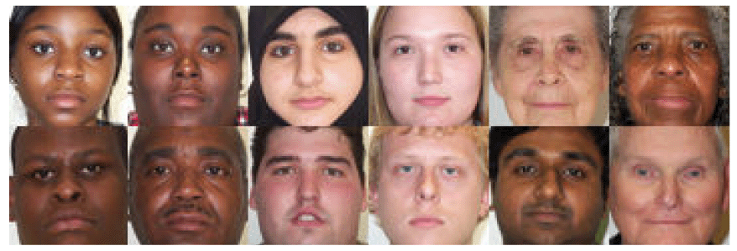
Standard Face Database
The FERET Database
The FERET program set out to establish a large database of facial images that are gather independently from the algorithm developers
Contain 1564 sets of color images for a total of 14, 126 images that includes 1199 individuals and 365 duplicate sets of images

Slide 41
Standard Face Database
The Yale Face Database
Contains 165 grayscale images in GIF format of 15 individuals.
There are 11 images per subject, one per different facial expression or configuration: center-light, w/glasses, happy, left-light, w/no glasses, normal, right-light, sad, sleepy, surprised, and wink.

Slide 42
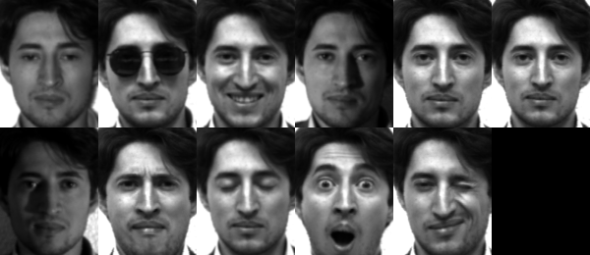
The Yale Face Database

Slide 43
Standard Face Database
AT&T "The Database of Faces" (formerly "The ORL Database of Faces")
Ten different images of each of 40 distinct subject
For some subjects, the images were taken at different times, varying the lighting, facial expressions (open / closed eyes, smiling / not smiling) and facial details (glasses / no glasses)

Slide 44
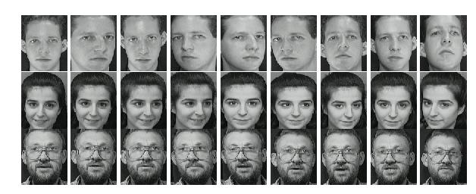
AT&T "The Database of Faces"

Slide 45
Standard Face Database
PIE Database, CMU
A database of 41,368 images of 68 people, each person under 13 different poses, 43 different illumination conditions, and with 4 different expressions

Slide 46
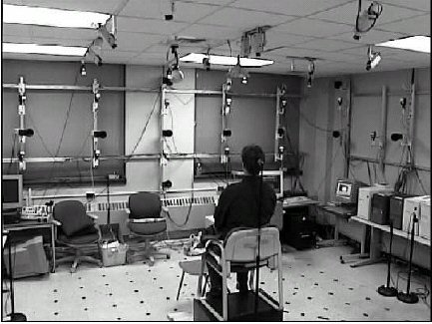
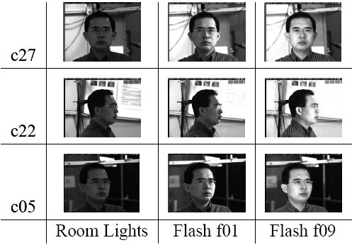
PIE Database

Slide 47
Emerging Face Technologies
2.5D, 3D, 4D face recognition
Popular approach: Active Appearance Models (AAM)
Sometimes related to Active Shape Model (ASM)
Statistical model of face shape and appearance
Available in a set of images, together with the coordinates of landmarks
Demo available at: http://dynface4d.isr.uc.pt/demos.php

Slide 48
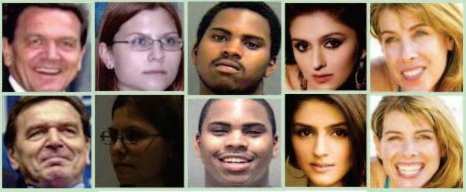
Emerging Face Technologies
Wild face recognition
Challenges: street surveillance, public watch list, etc. where you cannot control the way of images being taken
Unconstraint face database: Labeled Faces in the Wild Home (LFW) database, downloadable from:
http://vis-www.cs.umass.edu/lfw/

Slide 49
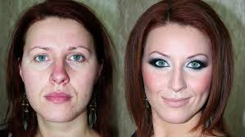
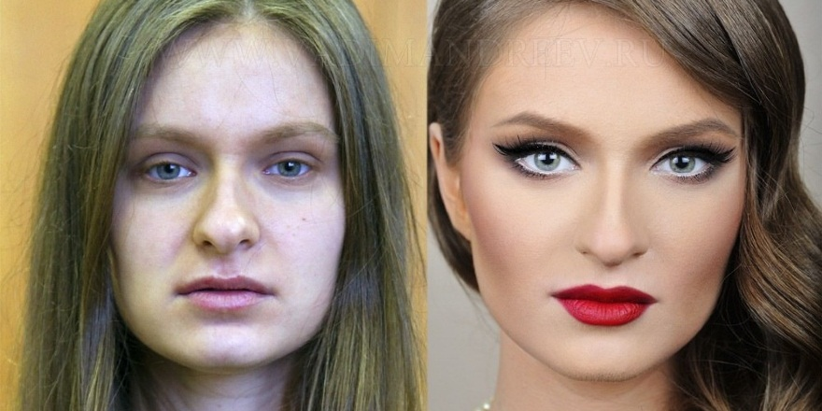
Emerging Face Technologies
Makeup face recognition
Can you recognize them?
How to train the machine to recognize them?

Slide 50
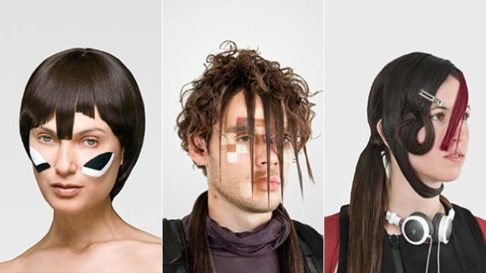
Emerging Face Technologies
Camouflage Makeup – Anti-Face War Paint
Serve as camouflage against facial recognition technology
Asymmetrical haircuts can obscure one eye and radically change the way your face is framed
Makeup styles which disabled the face recognition system to identify cheekbones or a forehead

Slide 51
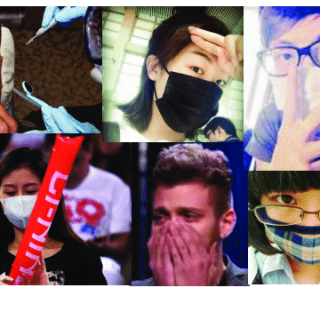
Emerging Face Technologies
Occluded face recognition
Facial occlusion, such as sunglasses, scarf, mask etc., is one critical factor that affects face recognition performance.
Unfortunately, faces with occlusion are quite common in the real world, especially in uncooperative scenarios.
E.g., wearing face mask becomes a common practice after Covid pandemic.

