Slide 1
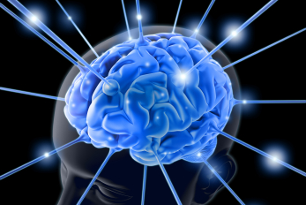
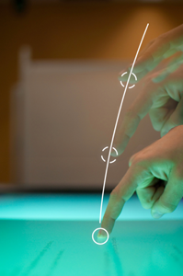
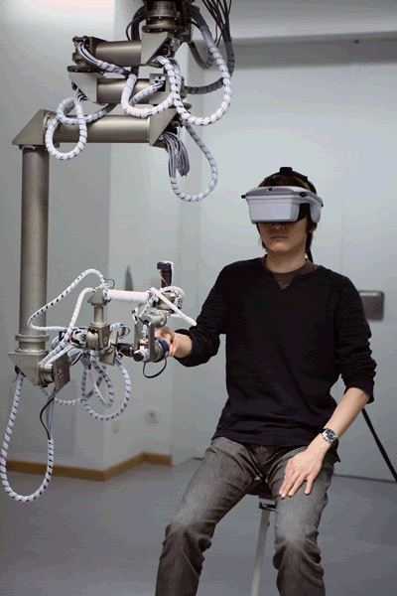
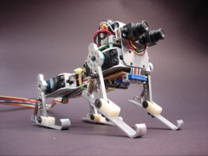
Opportunities and Importance of “Human Computer Interaction” Research
Dr. Khandaker Tabin Hasan
Prepared by M. Arifur Rahman
Presentation

Slide 2
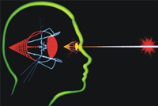
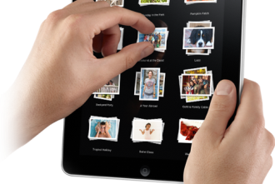
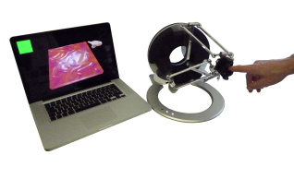
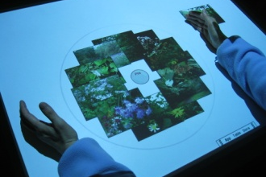
What is HCI- Human Computer Interaction?

Slide 3
A survey undertaken by 350 US companies on over 8000 projects revealed that one third of the projects were never completed and one half succeeded only partially, that is, with partial functionalities, major cost overruns, or significant delays (Standish Group, 95). Managers identified poor requirements as the major source of problems (about half of the responses) - more specifically, the lack of user involvement (13%), requirements incompleteness (12%), changing requirements (11%), unrealistic expectations (6%), and unclear objectives (5%). This summed up 47% of failure is due to the absence of Methodology of Interaction Design which spruces up from the field of Human Computer Interaction (HCI), more generally called “Human Machine Interactions”.

Slide 4
The $300 Million Button
The problem: The problem wasn’t as much about the form’s layout as it was where the form lived. Users would encounter it after they filled their shopping cart with products they wanted to purchase and pressed the Checkout button. It came before they could actually enter the information to pay for the product.
The solution: The designers fixed the problem simply. They took away the Register button. In its place, they put a Continue button with a simple message: “You do not need to create an account to make purchases on our site. Simply click Continue to proceed to checkout. To make your future purchases even faster, you can create an account during checkout.”
The results: The number of customers purchasing went up by 45%. The extra purchases resulted in an extra $15 million the first month. For the first year, the site saw an additional $300,000,000.

Slide 5
Future computer users will never know or bother about five things - 1. What processor(s) they are using 2. How much memory do they have 3. How much storage do they use 4. What is the speed of their Internet and 5. What exactly a computer is But they (will) always bother about one thing - how they would be interacting with them..

Slide 6
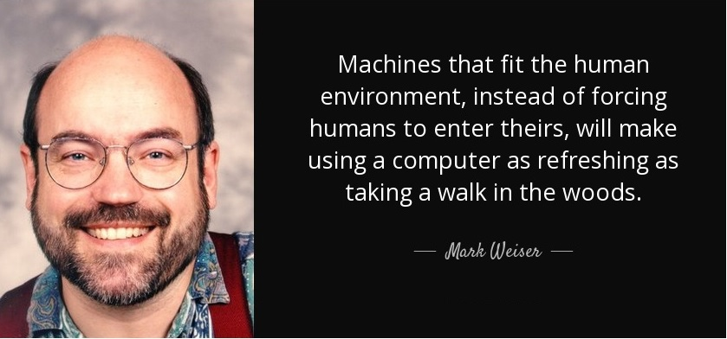
Mark Weiser's vision
Mirror, mirror on the wall, who’s the fairest of them all?
“Thou, O Queen, art the fairest in the land,” said the mirror.
Weiser outlined a set of principles describing ubiquitous/pervasive computing: (1996)
The purpose of a computer is to help you do something else.
The best computer is a quiet, invisible servant.
The more you can do by intuition the smarter you are; the computer should extend your unconscious.
Technology should create calm, "that which informs but doesn't demand our focus or attention."

Slide 7
ALIENATION (Marx) : The process whereby the worker is made to feel foreign to the products of his/her own labor. The design of the product and how it is produced are determined, not by the producers who make it (the workers), nor by the consumers of the product (the buyers), but by the capitalist class who besides accommodating the worker's manual labour also accommodate the intellectual labour of the engineer and the industrial designer who create the product in order to shape the taste of the consumer to buy the goods and services at a price that yields a maximal profit.

Slide 8
Data-Process Model (DPM)
Basic System
Environment
Data
Process
Complex System
Data
Process
Data
Process
Data
Process

Slide 9
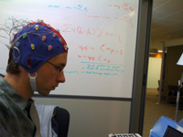

Interaction Modalities
Touch
Gesture
Haptic
Visual
Speech
Brain

Slide 10
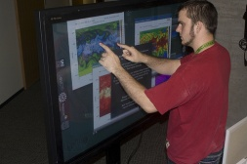
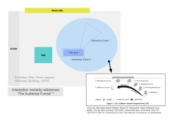
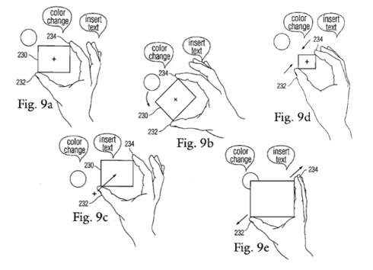
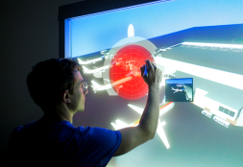
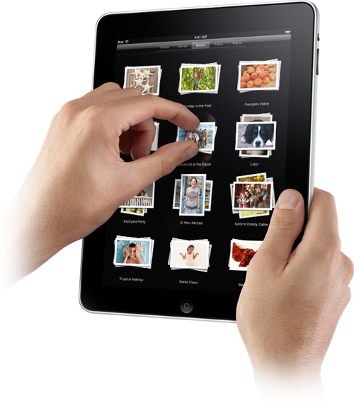
Touch

Slide 11
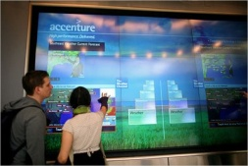
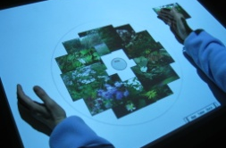
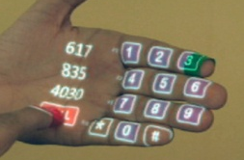
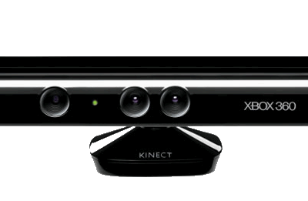
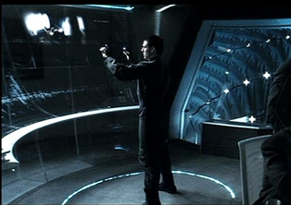
Gesture

Slide 12
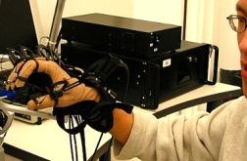
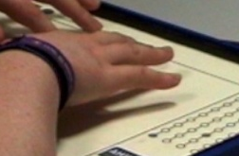

Haptic

Slide 13
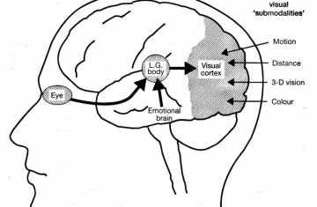
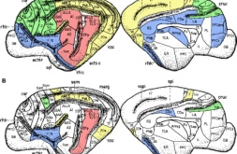
Visual

Slide 14
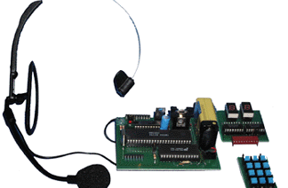
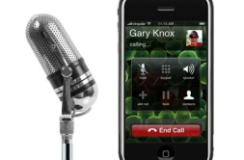
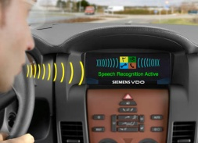


Speech

Slide 15
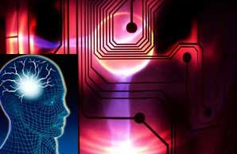
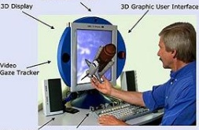

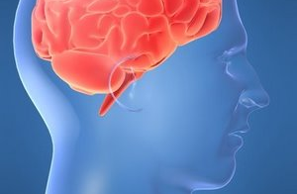
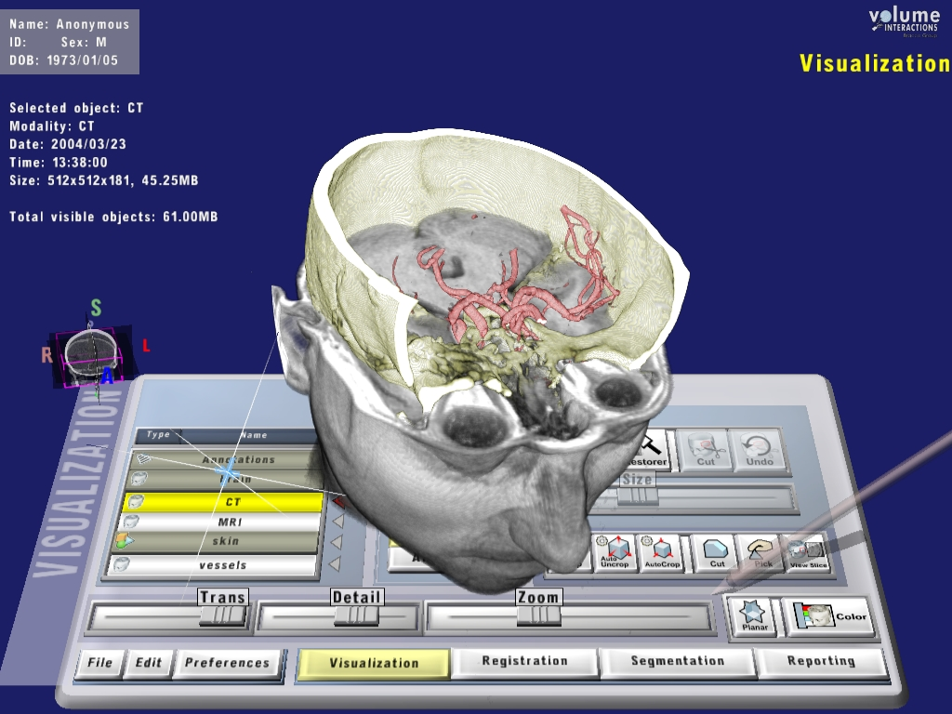
Brain

Slide 16
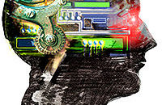
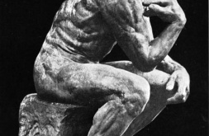

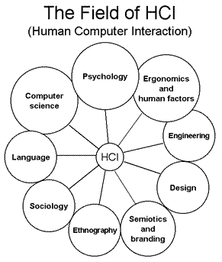

HCI Supporting Areas
Human Computer Interaction (HCI) is a multi-disciplinary field and designing an effective interactive system from a single discipline in isolation is almost impossible.
Computer science, cognitive and behavioral psychology, anthropology, sociology, ergonomics, industrial design, and more...

Slide 17
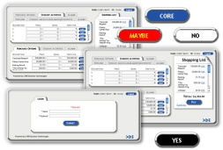
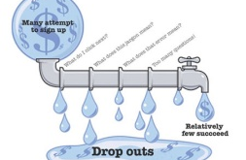
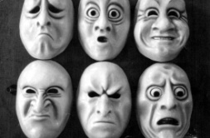
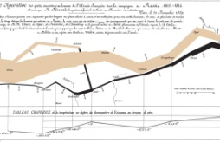
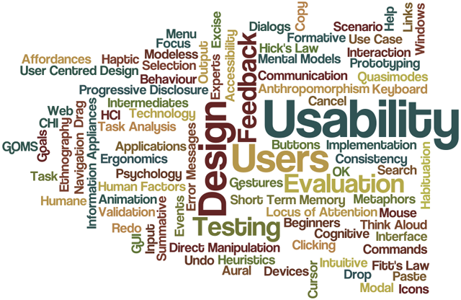
Domains
Interaction design
Usability
User modeling
CSCW (Social computing)
Affective interaction
Info visualization
Ubiquitous and pervasive computing
Intelligent systems
Context-aware computing
Health HCI
Privacy and security
UI/UX

Slide 18
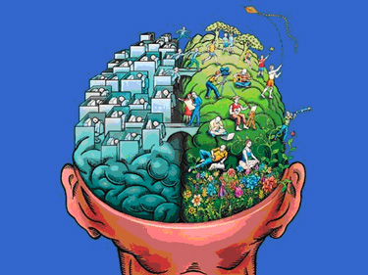
Conclusion

Slide 19
Questions & Answers
Questions?

