Slide 1





MEMORY MATCHING
GAME
START!

Slide 2



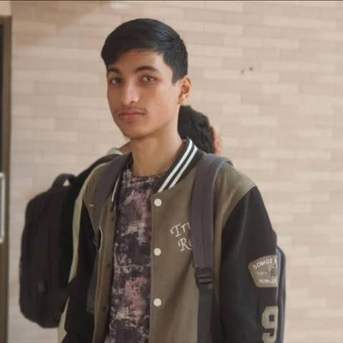
TEAM-04
TANJIM FARAH
SOHAIL KABIR
FARDIN SARKER

Slide 3
OVERVIEW
-
Type: Interactive Desktop Game
-
Language: Java
-
Purpose: A fun and educational game aimed at enhancing memory and cognitive skills.

Slide 4
RULES
-
Match pairs of identical cards by remembering their positions.
-
Players win by matching all pairs within the least number of attempts.

Slide 5

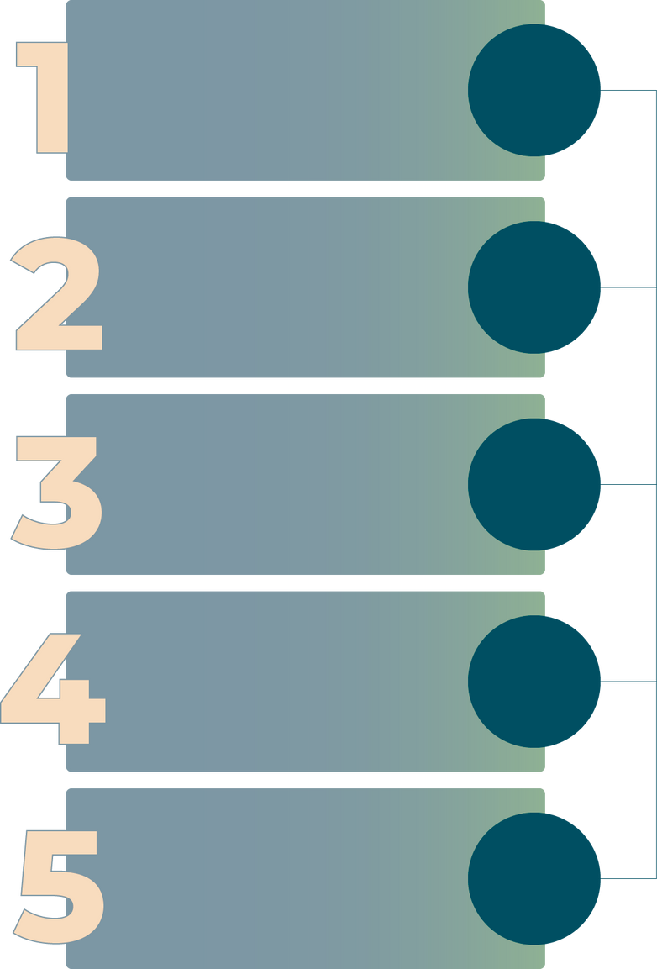
SYSTEM ARCHITECTURE
START
USER
INTERACTION
User Interaction: Clicks cards
Game Logic: JavaFX handles event-driven logic for card matching
GAME
LOGIC
Result Feedback: Popup alerts when the game is finished.
RESULT
FEEDBACK
Tools Used: JavaFX for GUI and Randomization for shuffling cards
END

Slide 6

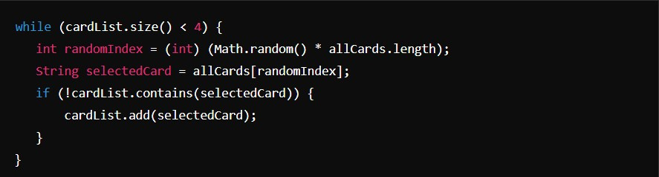
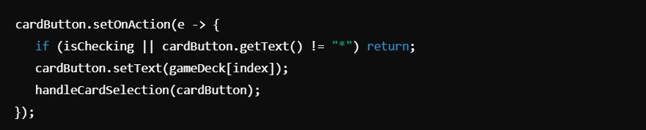
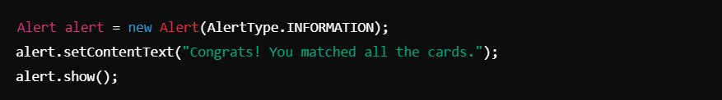
RANDOM CARD SELECTION:
IMPLEMENTATION
DYNAMIC CARD FLIPPING:
COMPLETION ALERT:

Slide 7
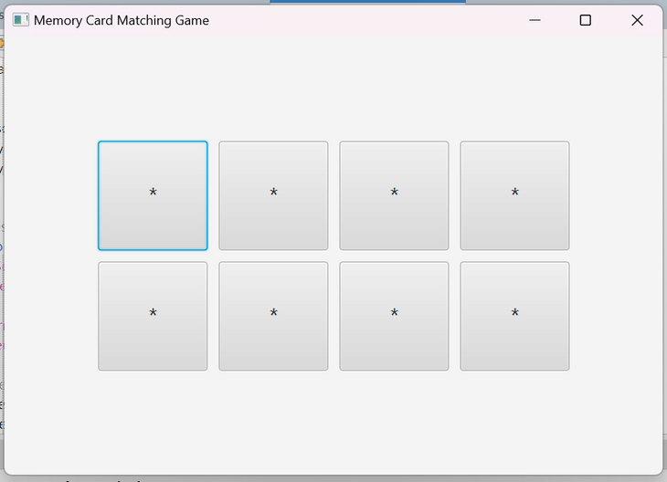
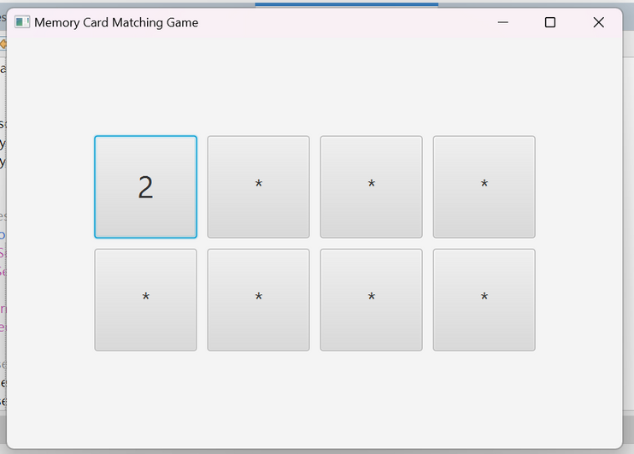
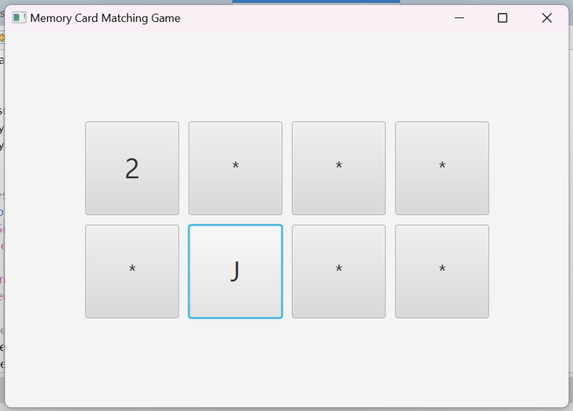
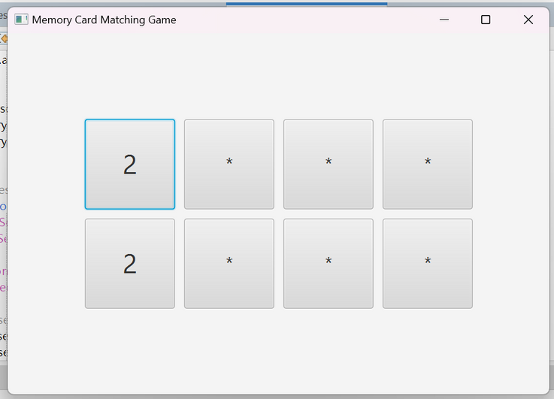
INTERFACE
Players are presented with cards arranged in a grid and in hidden state.
Clicking on a card reveals the hidden card number.
When players click on cards that do not match, they are visible for a few moments and become hidden again
When two cards match, they stay revealed throughout the game.

Slide 8
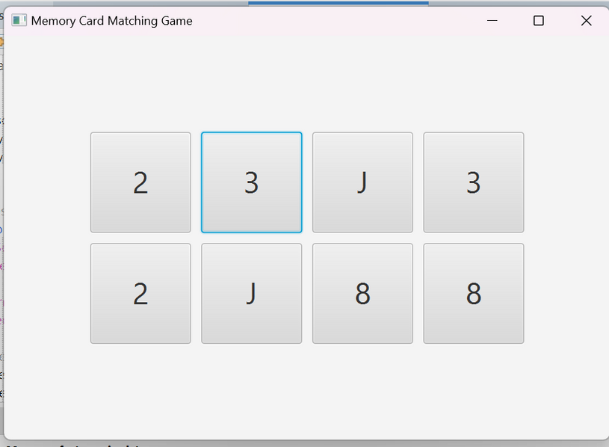
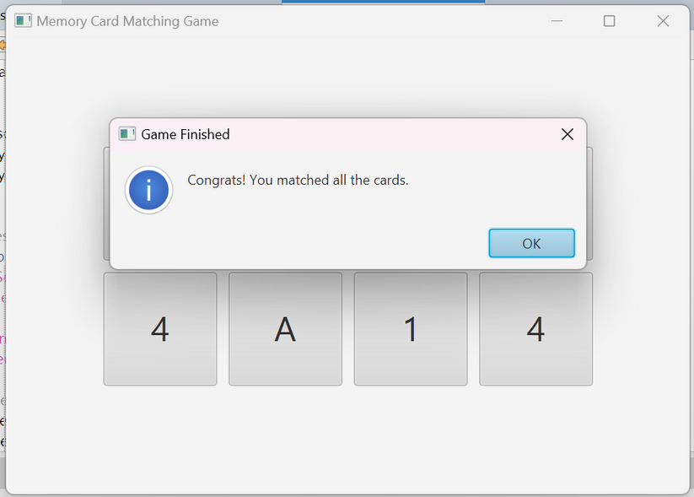
INTERFACE
When all cards successfully match, the whole deck is revealed.
The user is congratulated for completing the game.

Slide 9

CHALLENGES AND SOLUTIONS
Challenge: Preventing rapid clicks during card checks
Solution: Used “PauseTransition” to introduce a delay between actions
Challenge: Shuffling without duplicates
Solution: Java’s “Collections.shuffle()” ensured randomness.

Slide 10

FUTURE ENHANCEMENTS
MULTIPLAYER
SOUND EFFECTS AND ANIMATION
LEADERBOARD

Slide 11
CONCLUSION
THE MEMORY CARD MATCHING GAME DEMONSTRATES HOW JAVAFX CAN CREATE FUN AND EDUCATIONAL APPLICATIONS. THE PROJECT SHOWCASES SKILLS IN GUI DESIGN, EVENT-DRIVEN PROGRAMMING, AND CREATIVE THINKING

Slide 12
THANK YOU FOR
PLAYING
SEE YOU NEXT TIME!
QUESTIONS ARE WELCOME

