Slide 1
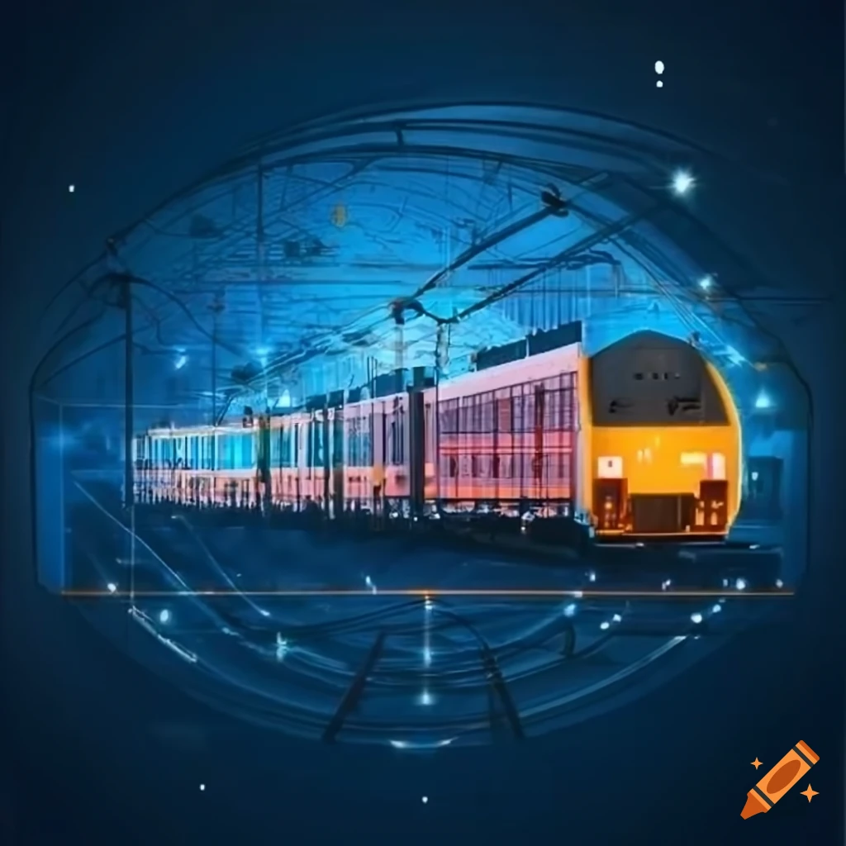
Railway Management System
TEAM MEMBERS
Nusrat Nowshin (2104010202153)
Borsha Das (2104010202181)
Tanjina Tabassum (2104010202182)
Punam Barua (2104010202185)

Slide 2
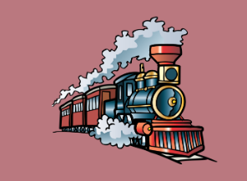
Outlines
Introduction
Motivation
Features
Methodology
Database Design
Workflow
Selected Screenshots
Limitations and Future work
Conclusion
References

Slide 3

Introduction
A Railway Management System uses advanced technologies like GPS and data analytics to optimize train scheduling, real-time tracking, and resource management. It enhances operational efficiency, safety, and passenger experience while reducing delays and costs.

Slide 4
Motivation
1. Complex Railway Operations.
2. Automation of Critical Processes.
3. Real-Time Data Monitoring.
4. Predictive Analytics for Optimization.
5. Enhanced Passenger and Freight Experience.
6. Cost Efficiency.

Slide 5

Features
Passenger Management
Train operations Management

Slide 6
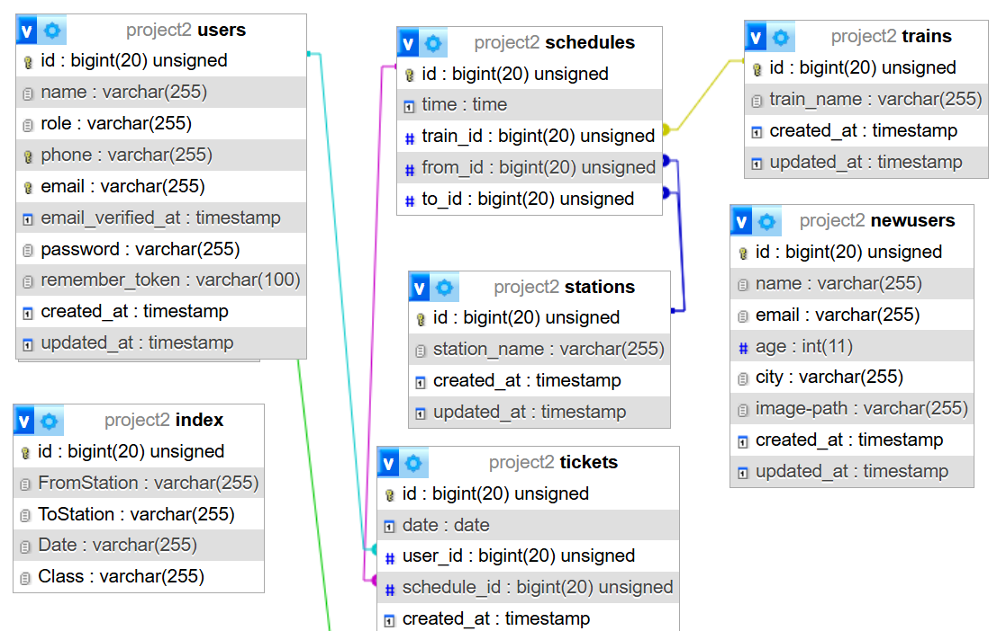
Methodology
Database Design:

Slide 7
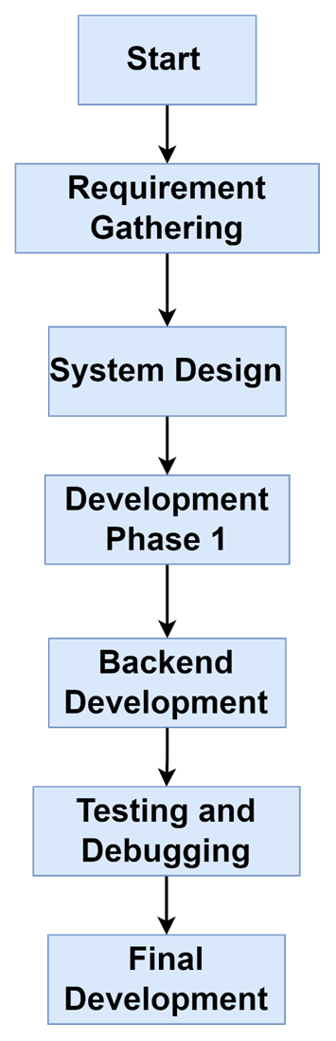
Workflow:

Slide 8
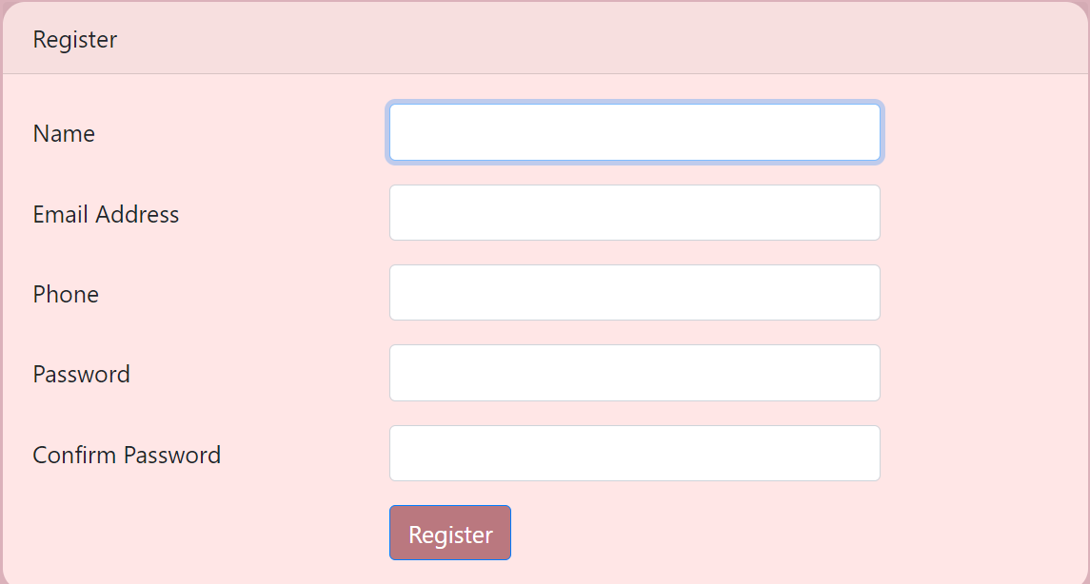
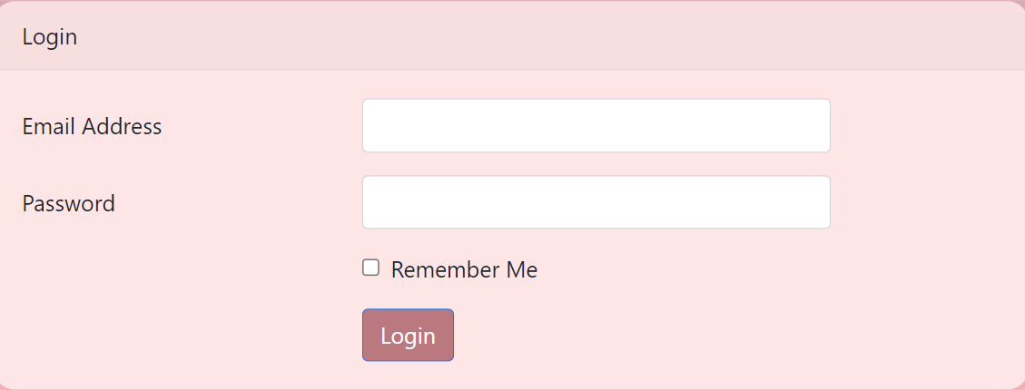
Selected Screenshots
User Interface Page

Slide 9
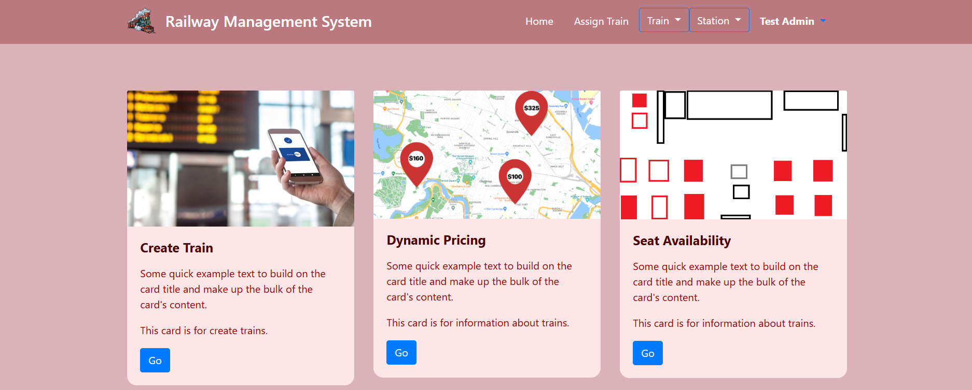
Admin Panel

Slide 10
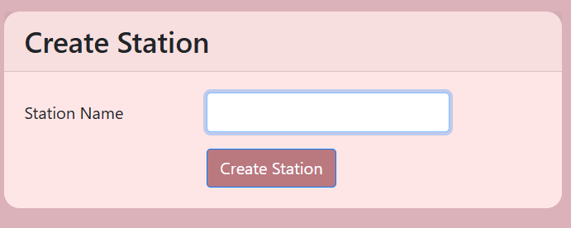
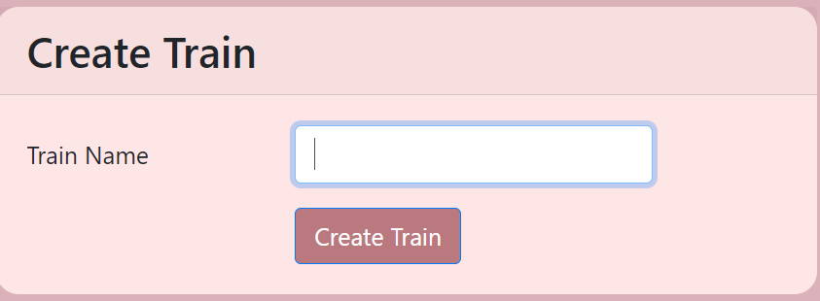
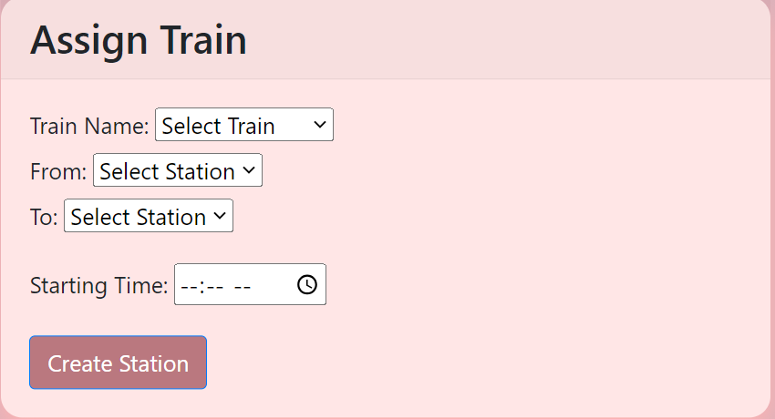
Insert intro and assign train Database from the Admin Panel

Slide 11
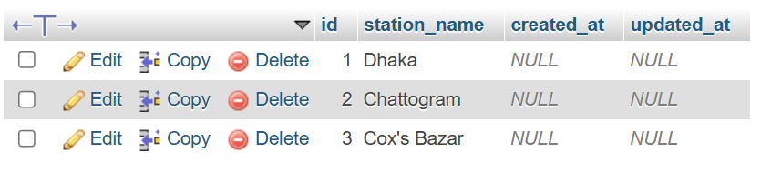
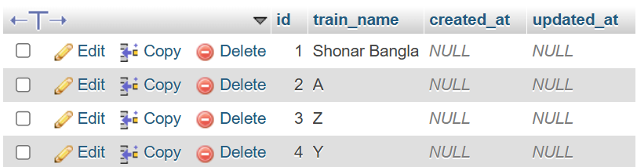
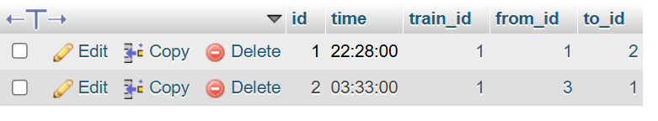
Tables
Station:
Train:
Assign Train:

Slide 12
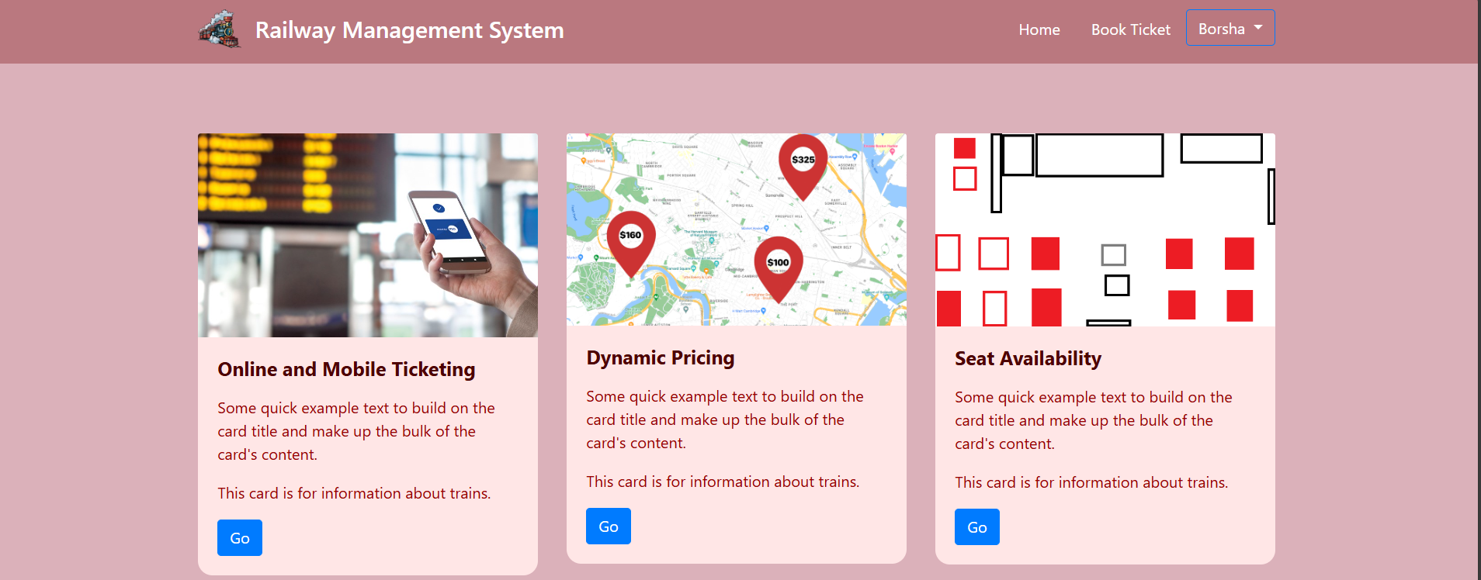
User Panel

Slide 13
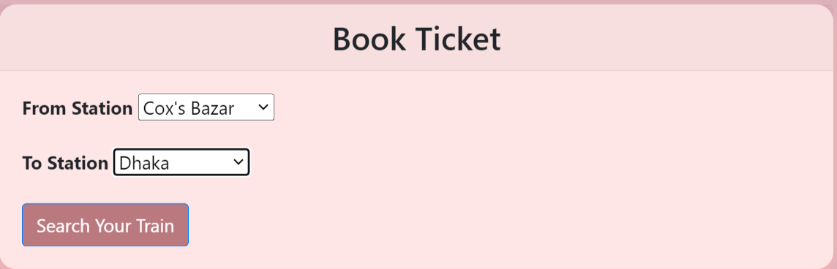
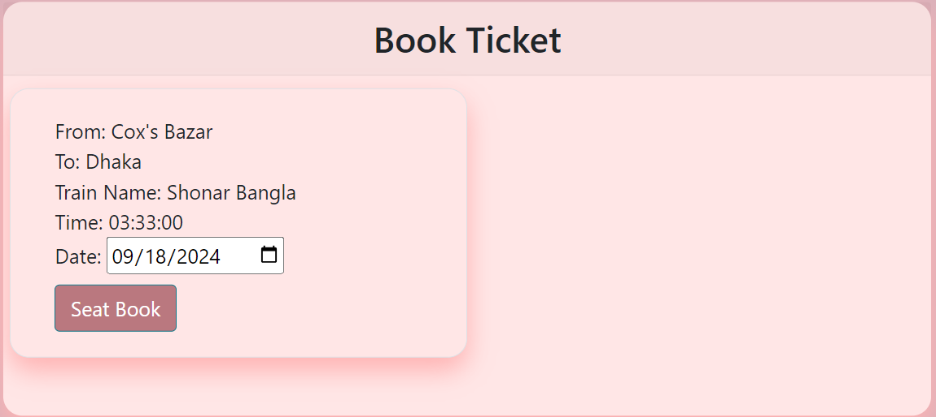
Book Ticket

Slide 14
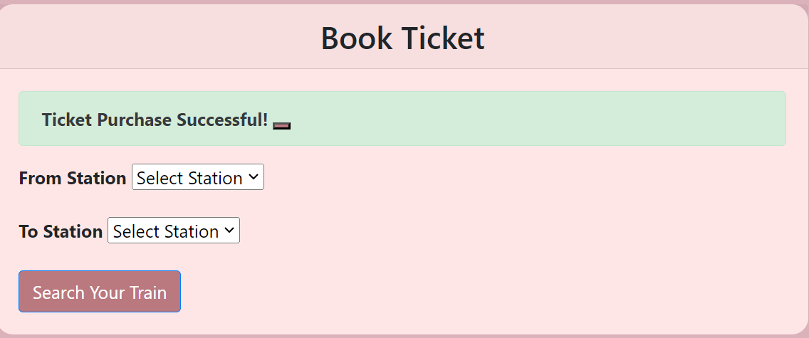
Table
Tickets:

Slide 15
Limitations
Usability Challenges.
Integration Issues.
Real-Time Data Processing.
Operational Delays.
Cost of Implementation.
Future work
Improved Automation for Maintenance.
Integration with Global Positioning Systems (GPS).
Enhancing Passenger Experience.
Further Optimization of Real-Time Data Processing.
AI-Powered Customer Support

Slide 16
Conclusion
Enhanced Efficiency: The user experience and operational efficiency are enhanced via admin and user panels.
Admin Panel: Facilitates user account administration and scheduling management.
User Panel: Provides alerts, profile management, and real-time information.
Overall Impact: Improves processes, eliminates inefficiencies, and offers insights.
Future Advantages: Establishes a standard for comparable management systems.

Slide 17
Reference
G. M. D, A. K. Scariah, L. R. Pannapara, M. Jessica, and J. Joseph, “Smart ticketing system for railways in smart cities using software as a service architecture,” in International conference on I-SMAC (IoT in Social, Mobile, Analytics and cloud), 2017, pp. 828–833.
T. Chen, Z. Zhou, and J. Zhang, Railway Passenger Service Mode on ”Internet +”. Springer International Publishing, 2018.
M. Arnone, T. Delmastro, G. Giacosa, M. Paoletti, and P. Villata, “The potential of eticketing for public transport planning: The piedmont region case study,” Transportation Research Procedia, vol. 18, pp. 3–10, June 2016.
W. He, Y. He, and M. M. Tentzeris, “Modeling, design and experimentation of a uhf rfid tag antenna embedded in railway tickets,” in IEEE Antennas and Propagation Society International Symposium (AP-S), vol. 2015, October 2015, pp. 1416–1417.
J. Yang, J. Zhou, D. Fan, and H. Lv, “Design of intelligent recognition system based on gait recognition technology in smart transportation,” Multimedia Tools and Applications, vol. 75, no. 24, pp. 17 501–17 514, 2016.

Slide 18
THANK
YOU

