Slide 1
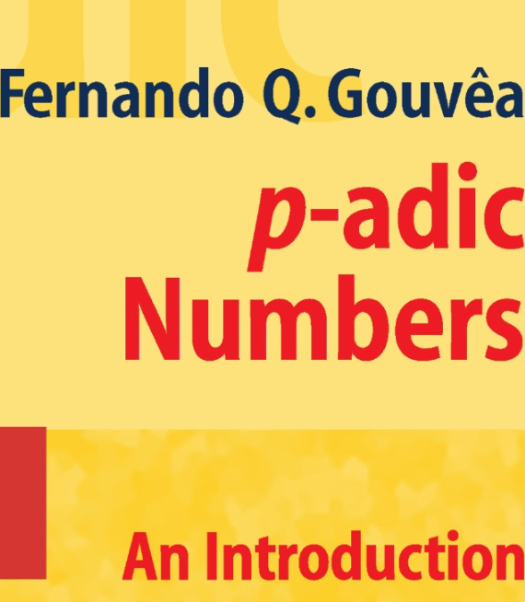

Slide 2


Slide 3


Slide 4
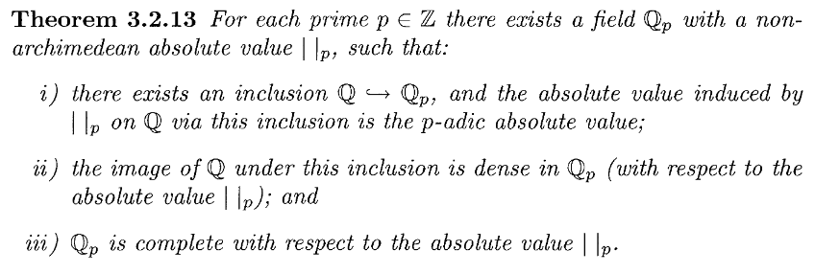


Slide 5


Slide 6


Slide 7
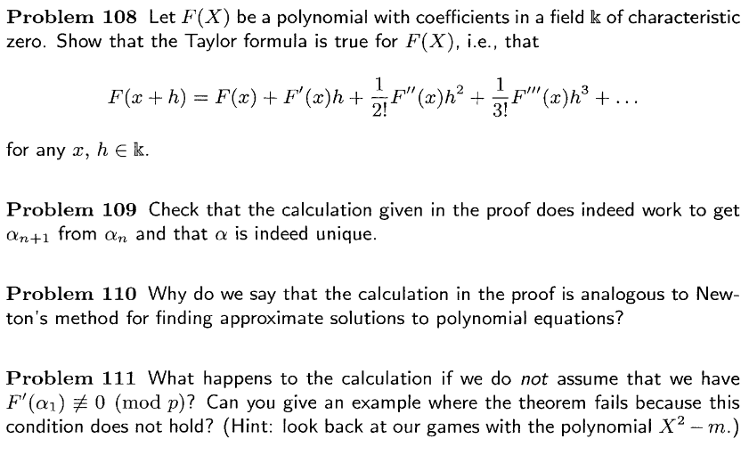

Slide 8


Slide 9


Slide 10


Slide 11
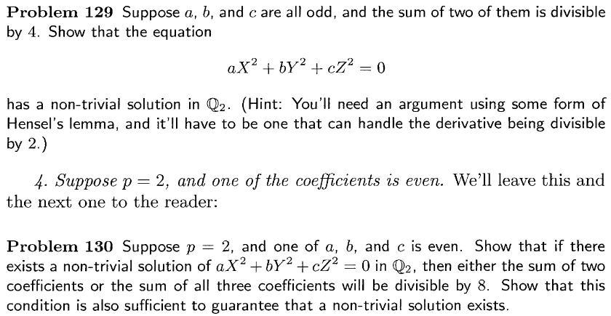

Slide 13


Slide 14
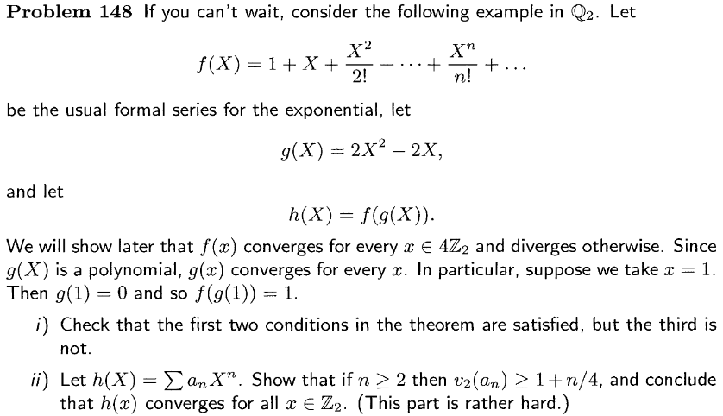


Slide 15


Slide 16


Slide 17


Slide 18
Finished

Slide 19
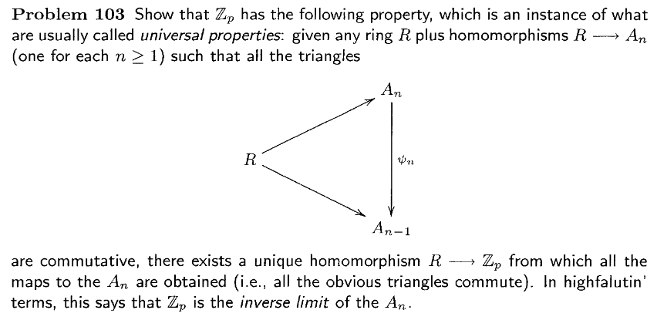

Slide 20

Only if.

Slide 21
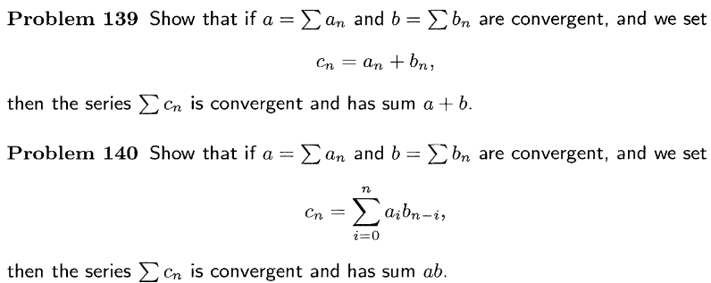

Slide 22


