Slide 1
WEATHER TREND FORECASTING
Technical Analysis Report
Global Weather Repository — Cleaning, EDA, Anomaly Detection & Multi-Model Forecasting
PM Accelerator · Data Science Tech Assessment

Slide 2
PROJECT OVERVIEW
Objective & Dataset
Analyze the Global Weather Repository dataset (Kaggle) to uncover trends and forecast future weather conditions.
154,946 rows across 41 features — 211 raw country labels, hourly-updated readings.
Time span: May 2024 through July 2026 (~2 years), enough to see a full seasonal cycle.
Full scope covered: data cleaning, EDA, anomaly detection, climate & geospatial analysis, multi-model forecasting, cross-validation, and feature importance.
154,946
rows analyzed
41 → 34
features after redundancy removal
192
standardized countries
7
forecasting models compared
2

Slide 3
DATA CLEANING & PREPROCESSING
A Reusable, Traceable Cleaning Pipeline
Duplicates
Mixed-language labels
Checked both strictly and on a semantic key (lat/lon/timestamp) — caught 1 hidden duplicate a naive check would miss.
Standardized 4,318 rows where country names appeared in Russian, Chinese, Portuguese, German, Arabic, etc. (211 → 192 countries).
Redundant columns
Outliers & missing values
Correlation matrix (≥0.99) identified 7 duplicate-unit columns (°F/°C, mph/kph, etc.) — dropped for a leaner 34-feature set.
One reusable cap_and_impute() function: cap physically impossible values to NaN, then drop (<5% impact) or group-median impute (≥5% impact).
3

Slide 4
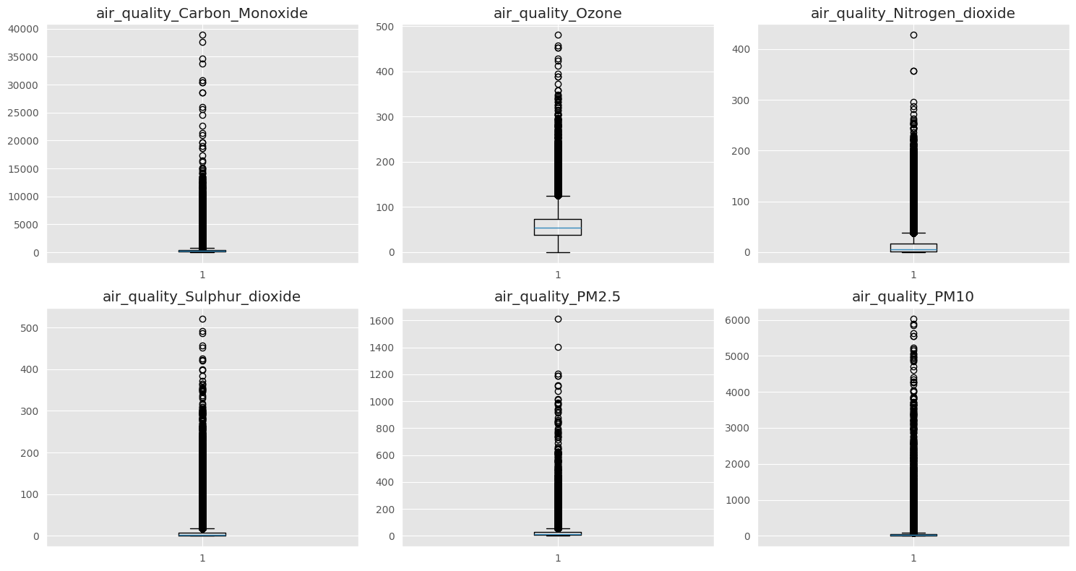
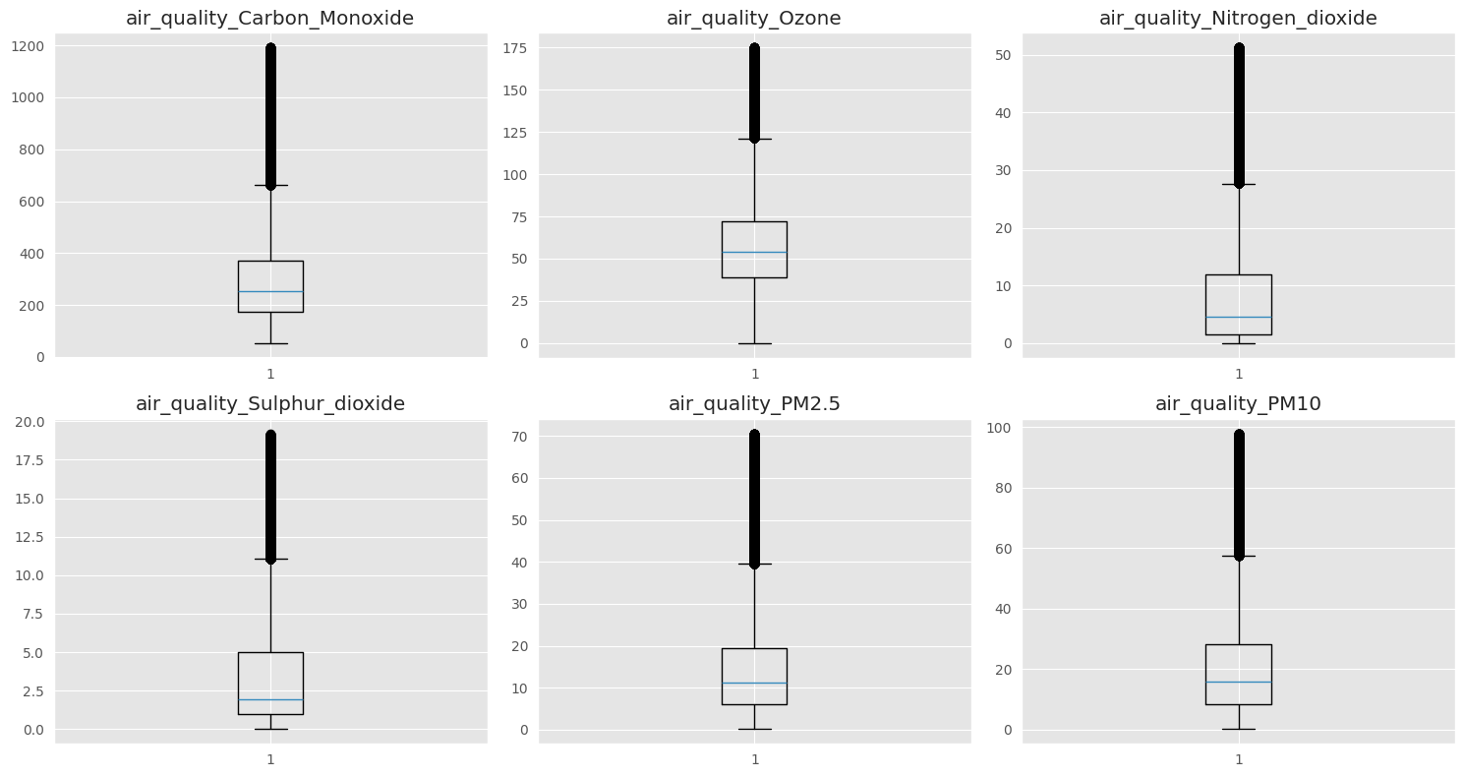
DATA CLEANING & PREPROCESSING
Outlier Treatment: Air Quality Readings
Before treatment
After 3×IQR capping + group-median imputation
No official sensor ceiling for pollution readings, so a wider 3×IQR bound (not the usual 1.5×) was used deliberately — wide enough to catch sensor glitches without discarding genuine extreme-pollution events.
4

Slide 5
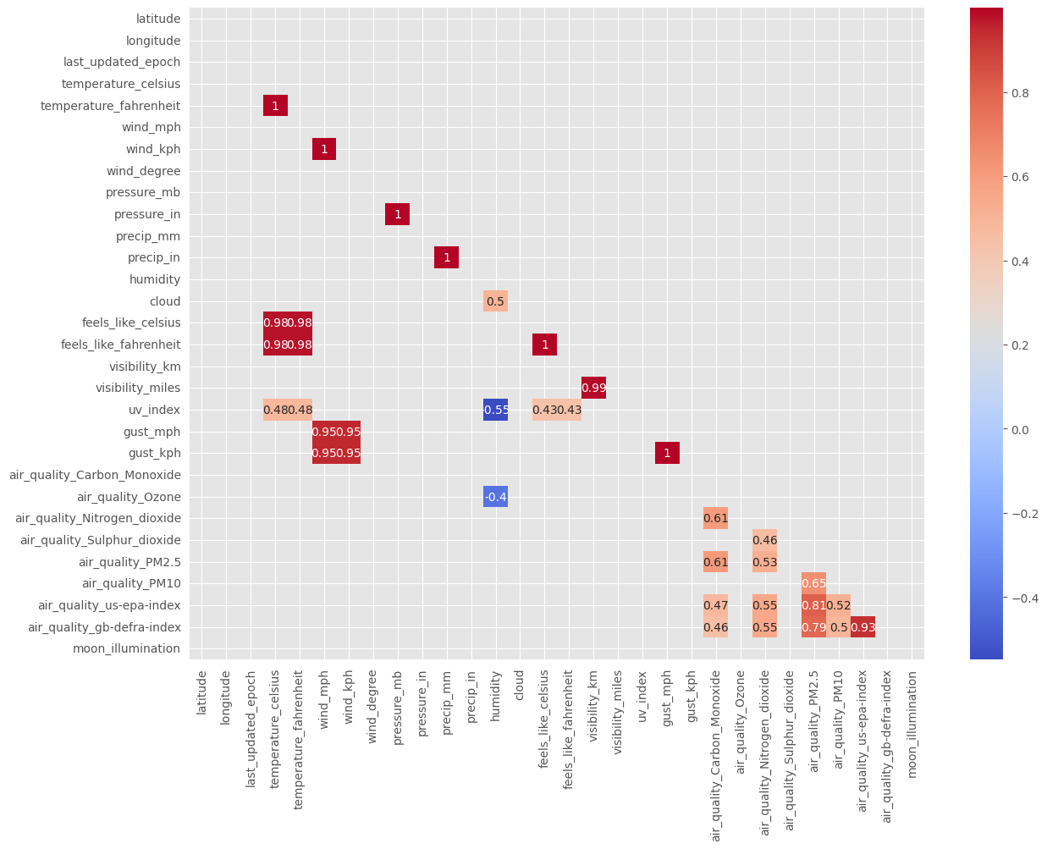
EXPLORATORY DATA ANALYSIS
Correlation Matrix — Trimming Redundancy
Filtered heatmap (|corr| ≥ 0.4) surfaces the meaningful relationships and hides noise.
Pairs at corr ≥ 0.99 are unit duplicates, not real signal (e.g. temperature_celsius vs. temperature_fahrenheit).
7 redundant columns dropped, reducing the feature space from 41 to 34 without losing information.
5

Slide 6
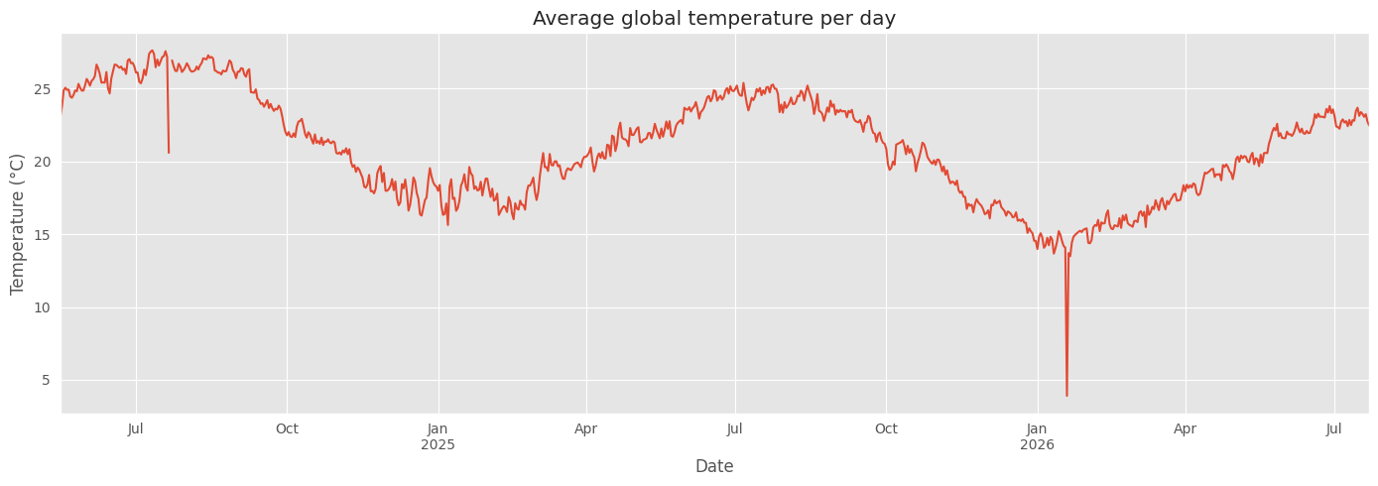
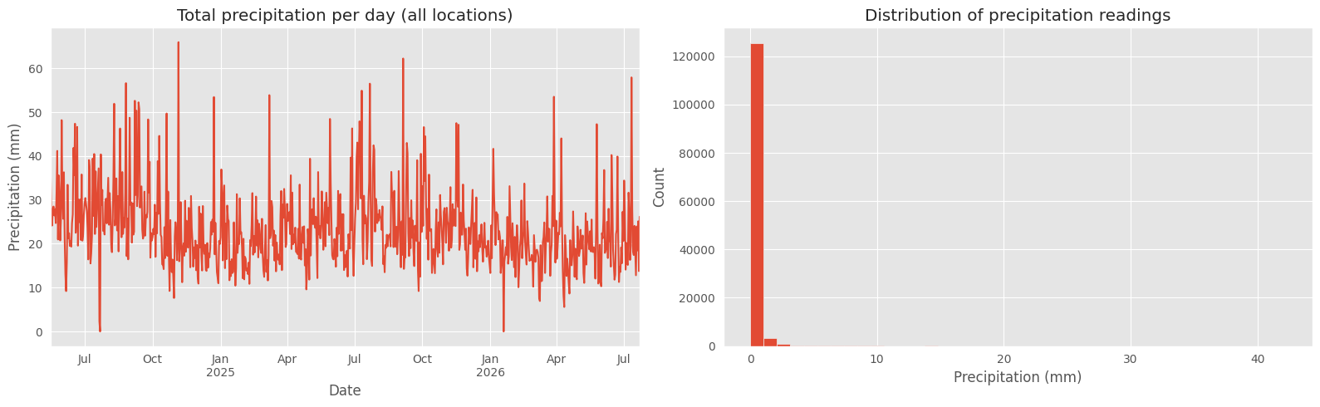
EXPLORATORY DATA ANALYSIS
Global Temperature & Precipitation Trends
Daily average global temperature — clear seasonal cycle visible across the ~2-year span.
Precipitation is spiky (most days dry) — a histogram alongside the time series makes the distribution readable.
6

Slide 7
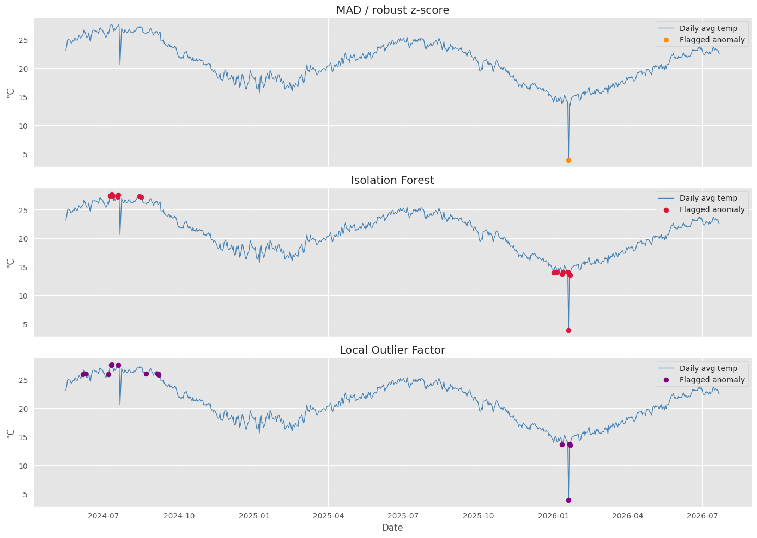
ADVANCED EDA
Anomaly Detection — Three Methods, One Signal
Robust z-score (MAD)
1 anomalous day
Isolation Forest
16 anomalous days
Local Outlier Factor
13 anomalous days
Flagged by both IF & LOF
7 days — strongest candidates
With no ground truth for global weather, agreement across methods — not a single score — is the useful signal.
7

Slide 8
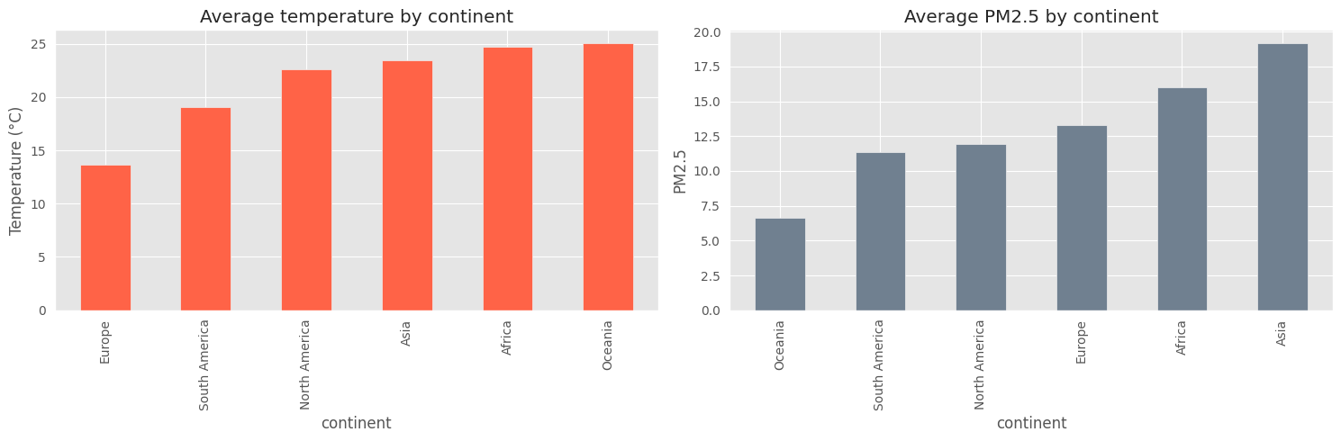
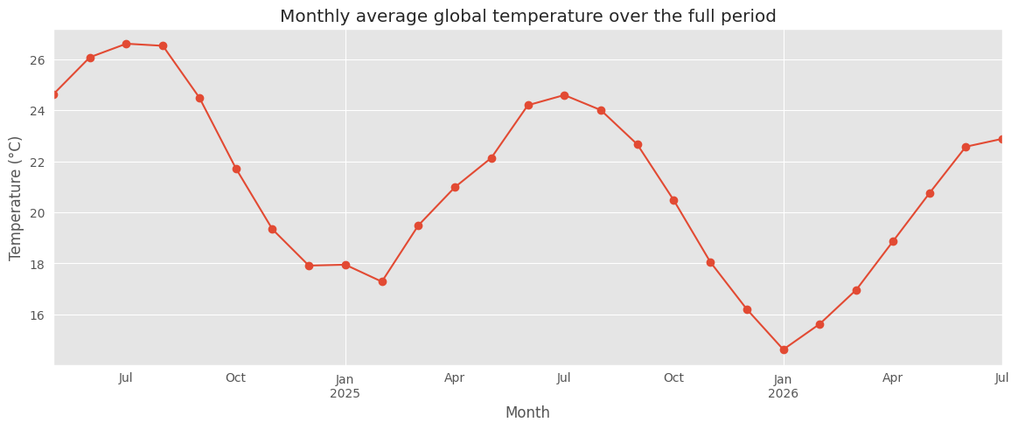
ADVANCED EDA
Climate Patterns by Continent & Hemisphere
Average temperature & PM2.5 by continent
Monthly global temperature over the full ~2-year period
Averaging globally hides that seasons run opposite between hemispheres — Northern and Southern hemisphere temperatures were tracked separately (monthly) rather than blended into one misleading global curve.
8

Slide 9
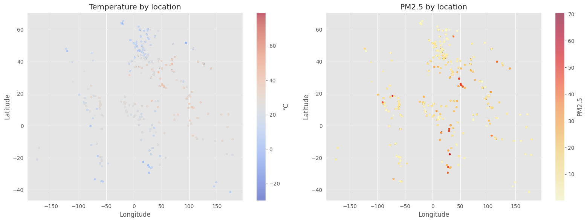
ADVANCED EDA
Spatial Analysis — Geographic Patterns
Latitude/longitude scatter, colored by value, gives a quick geographic read without needing a full GIS library.
Temperature map (left) shows the expected equatorial-to-polar gradient.
PM2.5 map (right) highlights regional pollution hotspots independent of temperature.
9

Slide 10
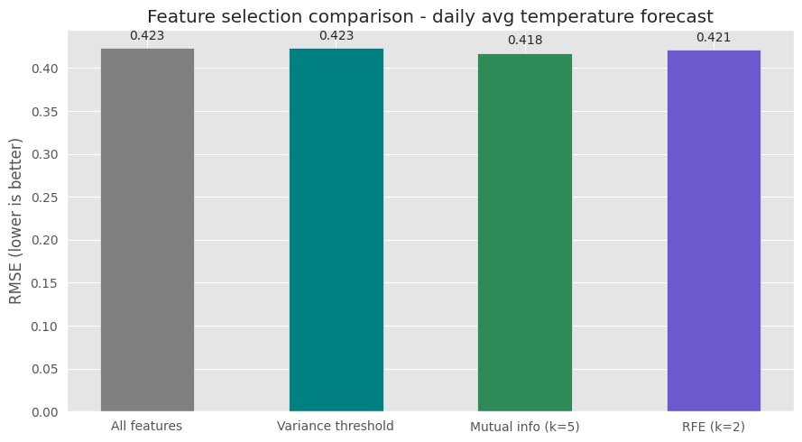
FORECASTING PIPELINE
Feature Selection — Confirming the Feature Set
Variance threshold, mutual information (SelectKBest), and RFE were each tested against the full 6-feature set.
lag_1 and rolling_mean_7 consistently rank first across every method — a "yesterday plus recent trend" signal.
None of the reduction methods beat using all 6 hand-engineered features by a meaningful margin.
Decision: keep the full feature set — pruning wasn't earning its complexity here.
10

Slide 11
FORECASTING
Seven Models, One Fair Comparison
Global daily-average temperature forecast using lag features, rolling mean, and calendar features — chronological 80/20 split, no shuffling.
Model | MAE | RMSE | R²
Linear Regression | 0.313 | 0.384 | 0.977
Ensemble (avg) | 0.319 | 0.388 | 0.977
Naive (persistence) | 0.315 | 0.398 | 0.976
Gradient Boosting | 0.340 | 0.411 | 0.974
Random Forest | 0.358 | 0.445 | 0.970
Seasonal Naive | 0.580 | 0.738 | 0.916
Prophet | 1.321 | 1.529 | 0.641
ARIMA | 3.816 | 4.527 | -2.146
Naive persistence ("tomorrow = today") is a strong baseline — the models must beat it to justify their complexity.
Linear Regression narrowly wins the single 80/20 split; the Ensemble is close behind.
ARIMA and Prophet are univariate — they ignore humidity, wind, and air quality entirely, and both underperform.
11

Slide 12
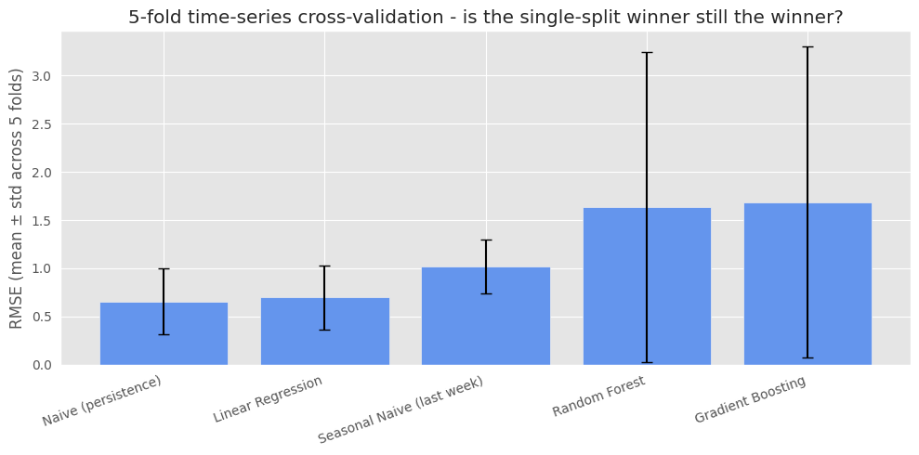
FORECASTING
Robustness Check — Does the Winner Hold Up?
A single 80/20 split is one snapshot of "the future." A 5-fold rolling-window time-series cross-validation was run to check whether that conclusion holds up.
Single-split winner:
Linear Regression
5-fold CV winner:
Naive (persistence)
A difference of a few folds can flip "best" on a ~2-year series — this discrepancy is reported rather than hidden.
12

Slide 13
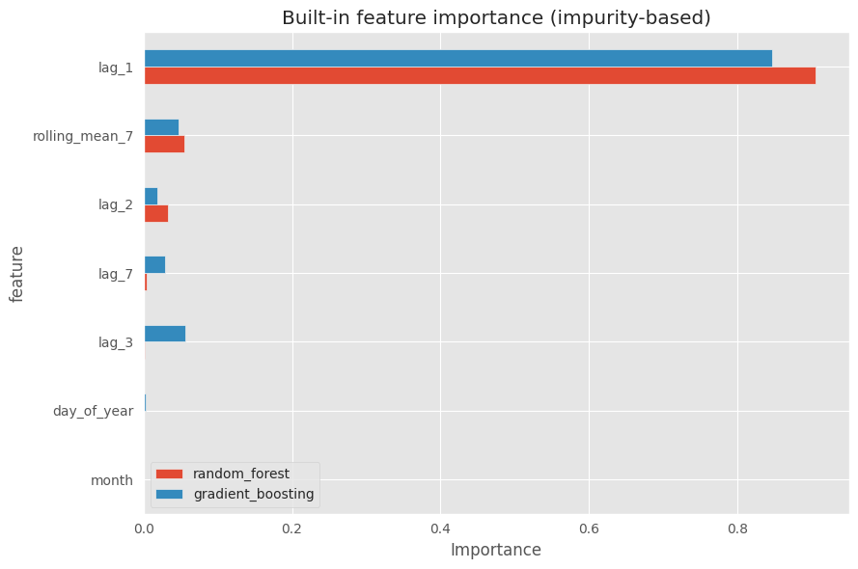
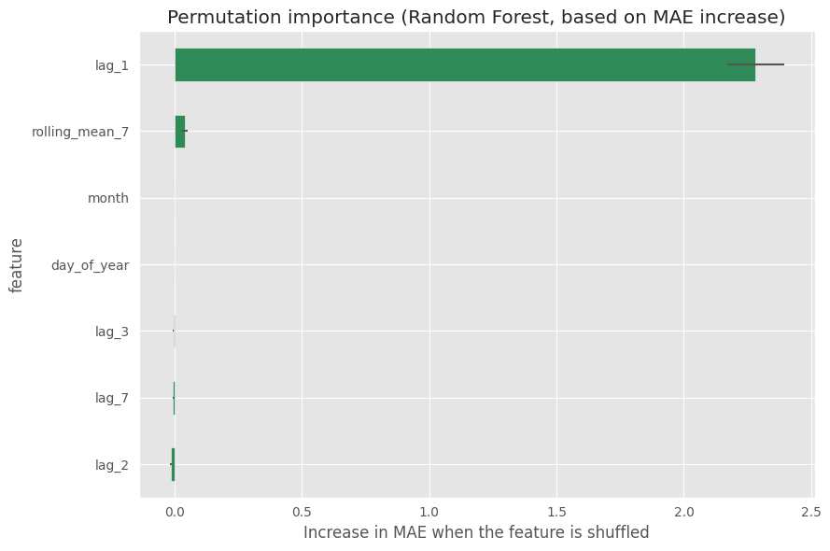
FEATURE IMPORTANCE
Which Features Actually Drive the Forecast?
1. Built-in (impurity-based) importance
2. Permutation importance (model-agnostic)
13

Slide 14
WRAP-UP
Key Insights & Honest Limitations
What the analysis shows
Limitations, acknowledged
lag_1 (yesterday) and rolling_mean_7 are the dominant predictive signal across every feature-selection and importance method.
Anomaly detection agreement (3 methods) is more trustworthy than any single method alone.
Seasonality is real but hemisphere-dependent — never average it away globally.
The CV robustness check overturns the single-split winner — naive persistence, not Linear Regression, is the more trustworthy choice.
ARIMA/Prophet are univariate and ignore humidity, wind, and air quality entirely.
Forecasting targets one aggregated global series; per-location forecasting was out of scope but would be the natural next step.
14

Slide 15
Thank You
Weather Trend Forecasting — Cleaning through Forecasting, in one traceable pipeline.
Full notebook, code, and methodology available on request.

