Slide 1

Visualization Of UV-maps for Polygonal​ Meshes as a 3D Morphing​
Relatore: Prof. Marco Tarini
A. A. 2023 / 2024
Candidato: Giorgio Sepe
Matr. 02786A
UNIVERSITÀ DEGLI STUDI DI MILANO
FACOLTÀ DI SCIENZE E TECNOLOGIE

Slide 2
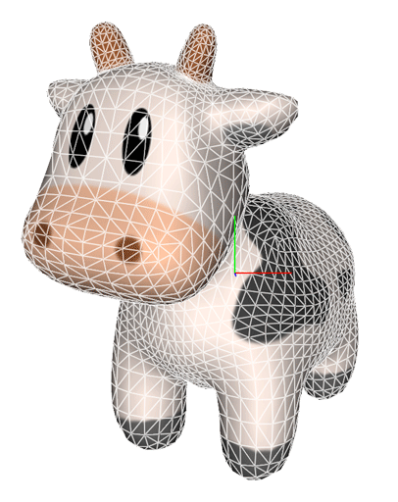
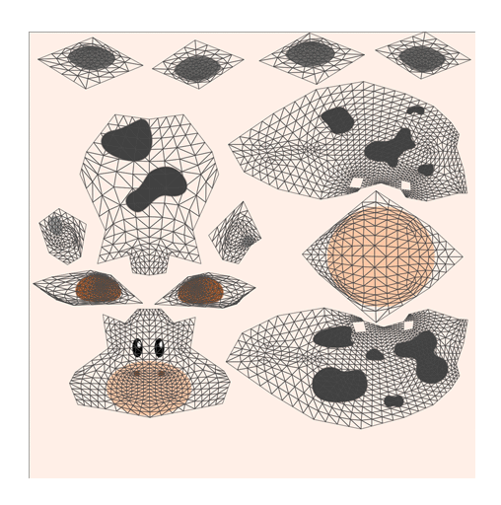
Background: Meshes and Textures
Polygon Mesh
Vertices V
Faces F
Texture Map
2D array of texels
x,y,z
u,v
UV-map
/16
Notes:
proiettare

Slide 3





Background: Generation of UV-maps
3D digital
artist
Geometry processing algorithms
Maya
Blender
MudBox
[Lévy, B. et al. (2002)]
x,y,z
u,v
UV-map
/16

Slide 4

Objective: Visualization of UV-maps
x,y,z
u,v
UV-map
/16
Notes:
dunque l'obiettivo è quello di visualizzare in modo chiaro e intuitivo in cosa consistono

Slide 5




Objective: Visualization of UV-maps
Intended uses:
Geometry Processing Researchers
x,y,z
u,v
Digital Artists
(e.g. games)
UV-map
Computer Graphics Teaching
/16

Slide 6
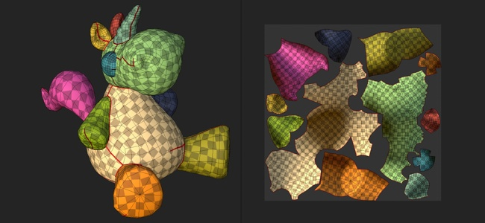
Classic
UV-map Visualization Techniques
2D grid
over
3D shape
3D shading
over
2D domain
/16
Notes:
Introduci Morphing

Slide 7
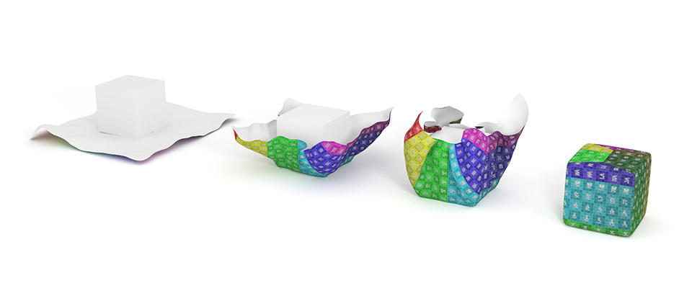
A Better UV-map Visualization
The goal is to provide an intuitive animation and show the relationship between 3D and 2D in an evident way.
/16
Notes:
Spiega morphing

Slide 8
The Main Challenge
How to generate a “good” morphing between xyz and uv.
Note: The morphing is entirely made up (not defined in the data => no “ground truth”).
/16
Notes:
Data una

Slide 9
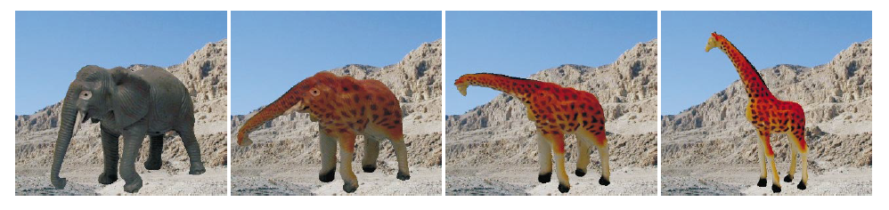
3D Morphing: State of the Art
A comparison of mesh morphing methods for 3 D shape optimization
Deeply studied for generic surfaces.
[1] «As-Rigid-As-Possible Shape Interpolation» Alexa et al. - TOG 2006
[2] «Poisson Shape Interpolation» Xu et al. - SSPM 2005
[3] «A Comparison of Mesh Morphing Methods …» Staten et al. - IMR 2012
Our situation is very specific
Image from [1]
/16

Slide 10
3D Morphing: Our Approach in a nutshell*
STEP 1:
determine per-triangle
trajectory
STEP 2:
enforce surface continuity
LOCAL
GLOBAL
*we tested several variants for each step
/16
Notes:
Approccio local global

Slide 11
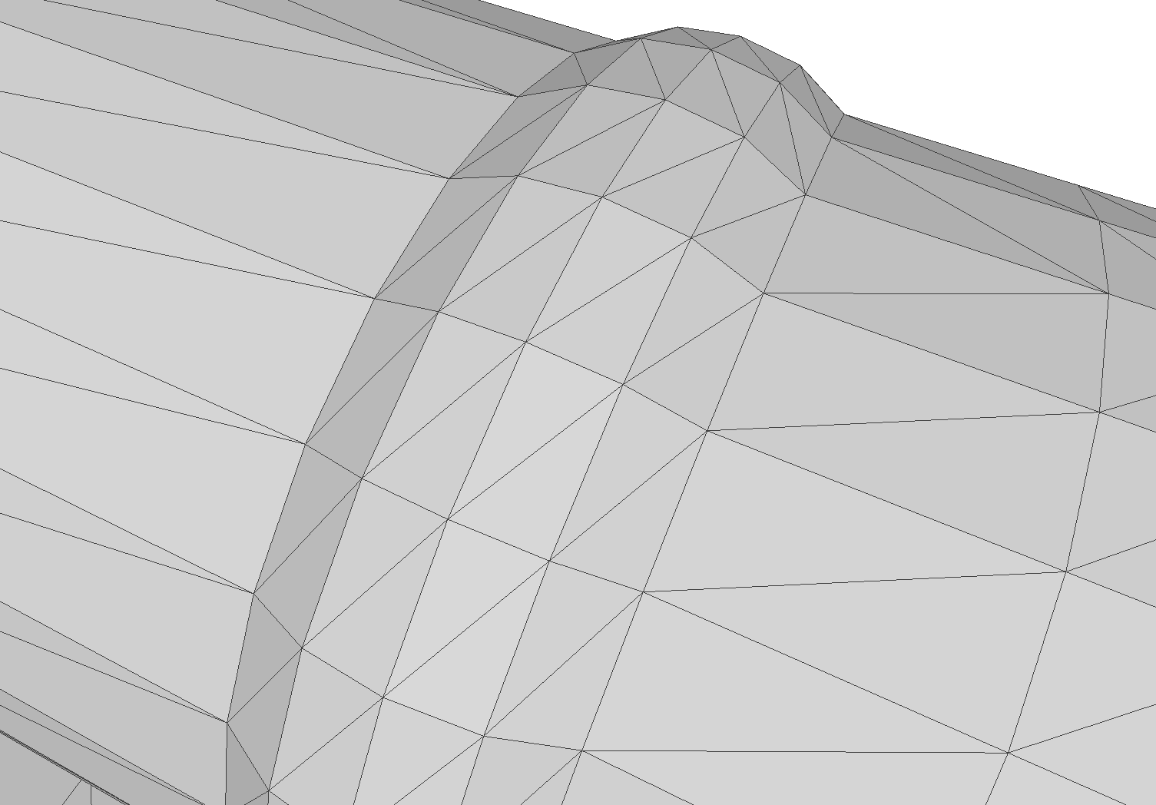
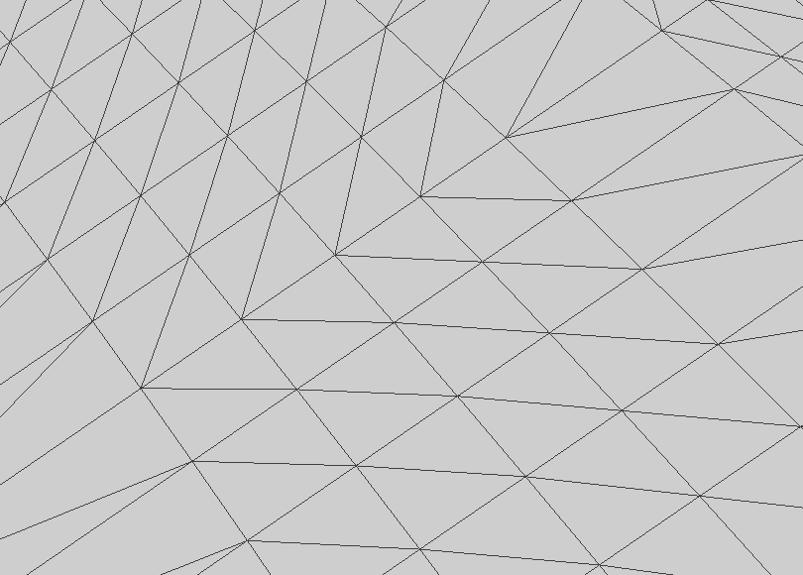
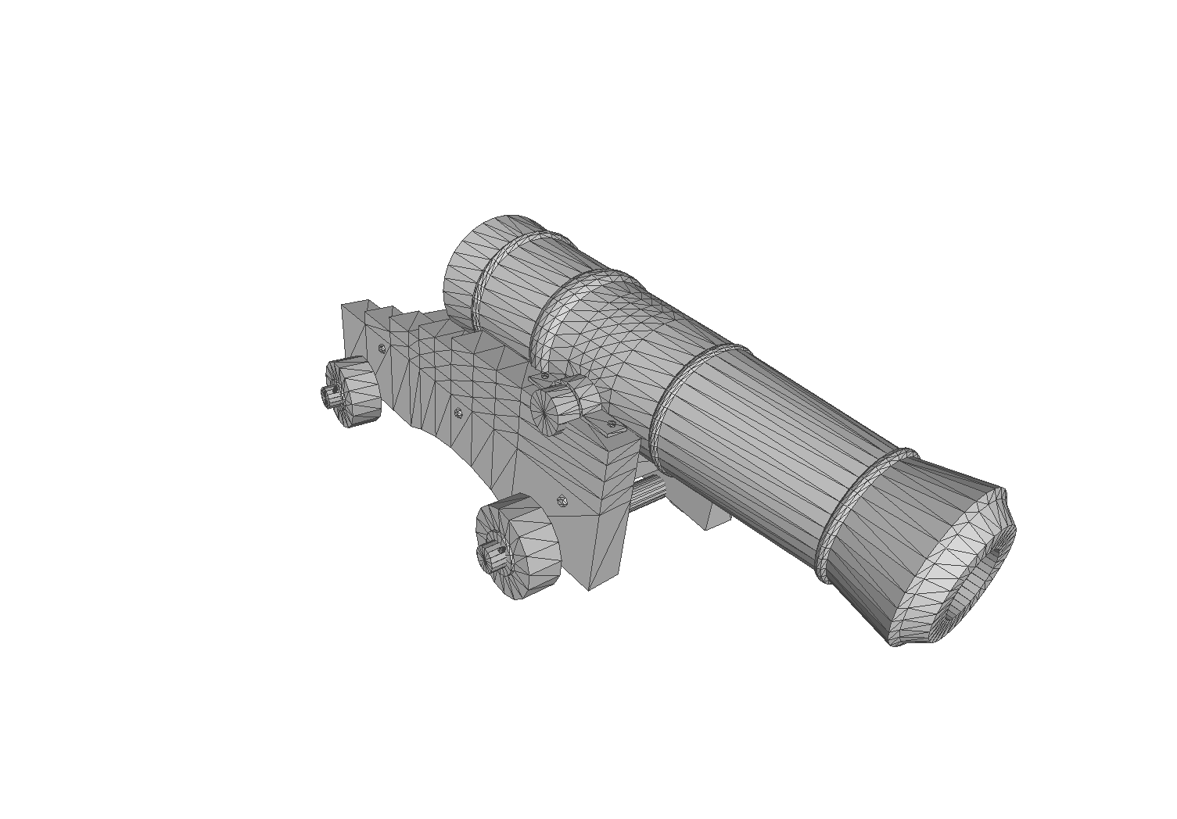
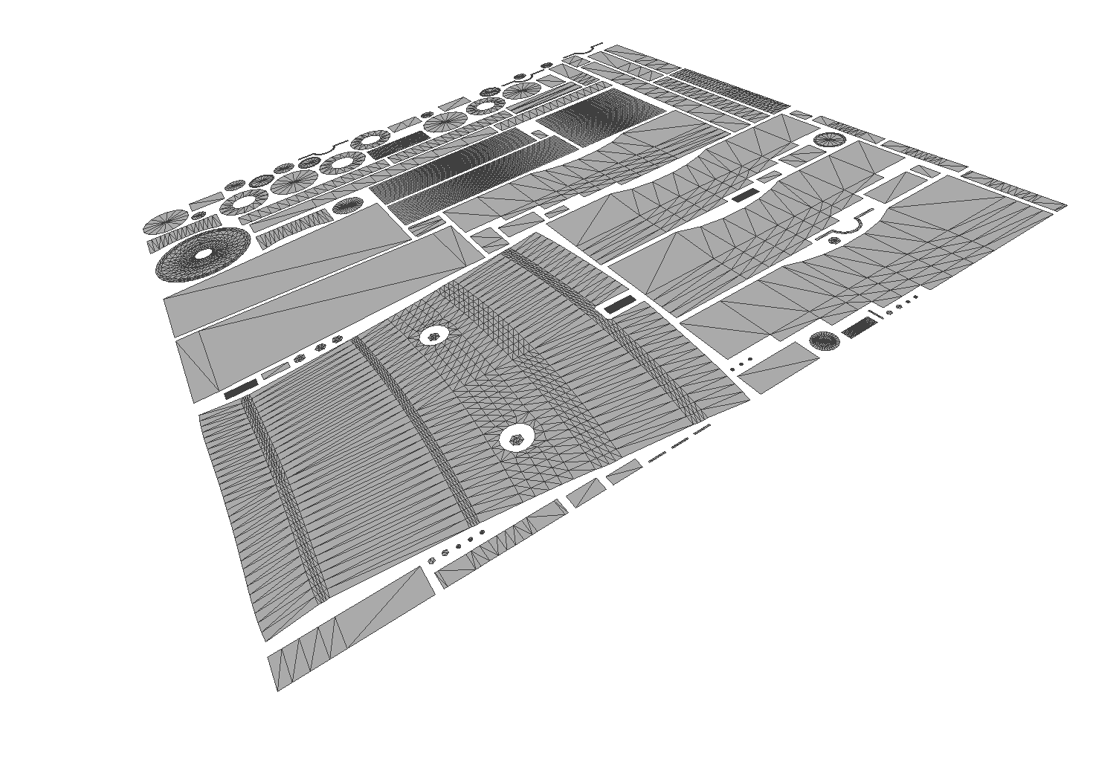





Local Step: Per-Triangle Trajectory
x,y,z
u,v
/16
Notes:
Osservaione
Definire il percorso del morphing

Slide 12
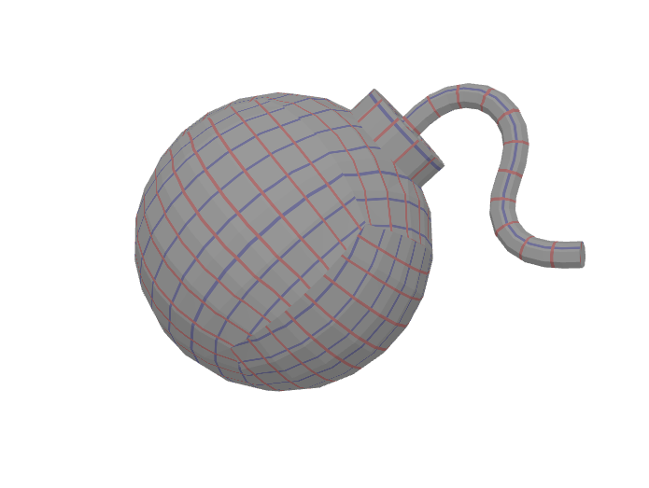
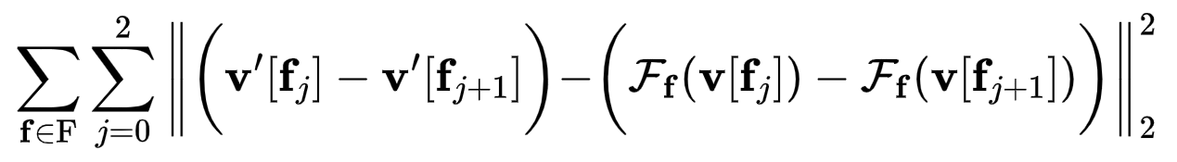
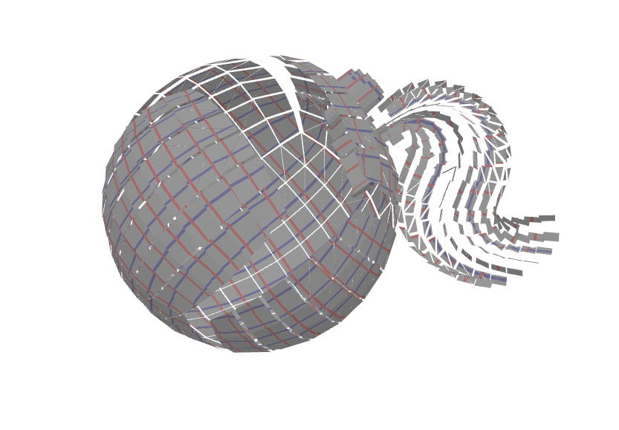
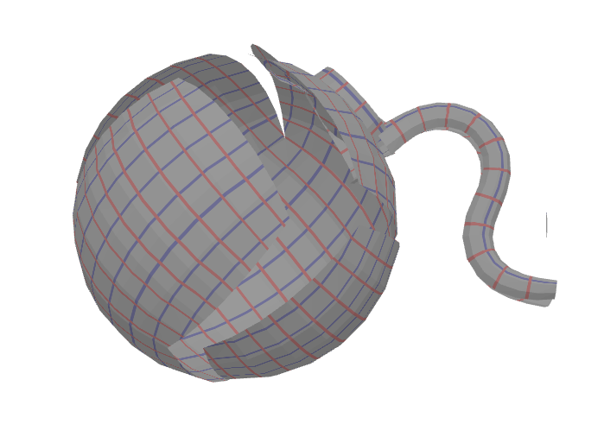
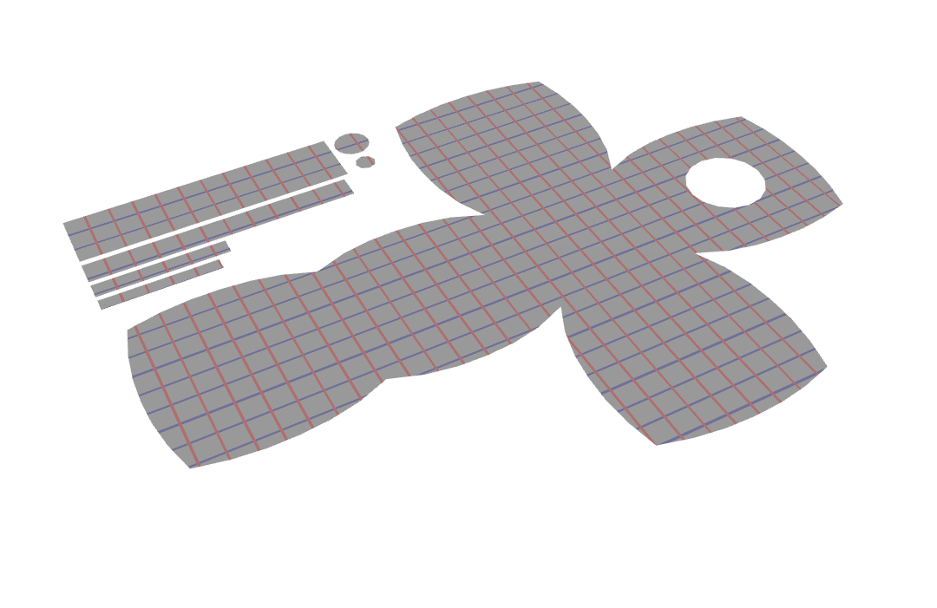
Global Step: Surface Continuity Enforcement
t = 0
(3D) Mesh
t = 0.5
t = 1
Surface continuity enforcement
Dual Quaternion Interpolation
(2D) Texture
/16
Notes:
Una volta applicato il primo step

Slide 13
Demo

Slide 14


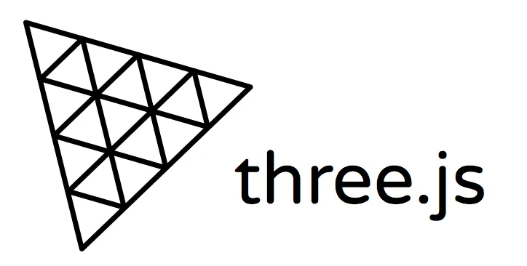

Employed Technologies
Geometry Processing
3D Rendering
User Interface
/16
Notes:
Lo abbiamo implementato in questo modo perchè: cambio slide

Slide 15



Side Objectives
Accessibility:
Using a web app, easy to use, few parameters.
Generality:
Usable on any type of Mesh
With different characteristics:
Tiling, injectivity, number of island, different texel densities, etc.
Efficiency:
Fast to use without the need of performing hardware.
/16

Slide 16
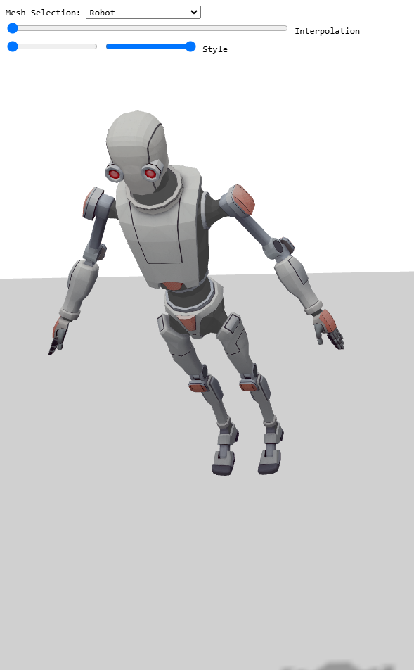
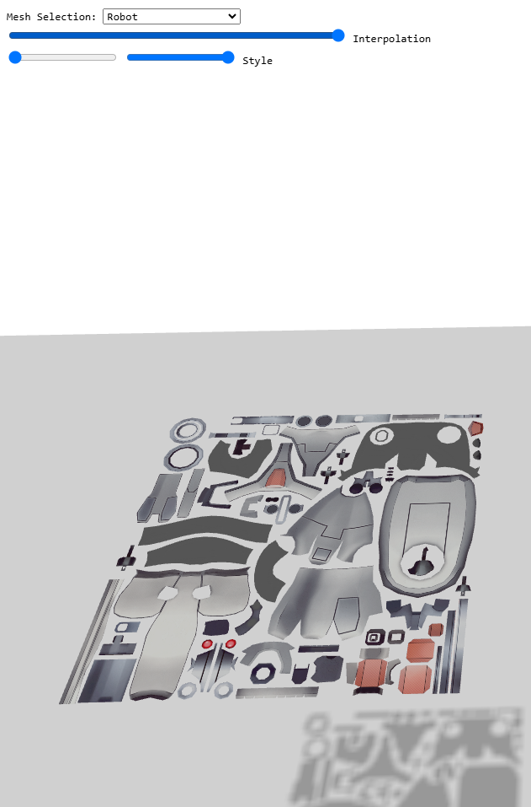
Conclusions & Future Work​
Developed an innovative approach to uv-maps visualization.
Effective visual results.
Collect quantitative data conduting user studies.
/16

