Slide 1

Insights and Analysis on Healthcare Management Organization (HMO) Data

Slide 2
TABLE OF CONTENTS
Primary Goal
Different Phases in Analysis
Understanding the Data
Data Cleaning
Exploratory Data Analysis
Prediction Models
Shiny App
Results
Actionable Insights & Recommendations

Slide 3
PRIMARY GOAL
The primary goal of this project is to provide actionable insight based on the data available to predict which customers will be expensive.
And to provide recommendations that will help to lower the healthcare costs of the customers to HMO.
Our team used various algorithms to analyze the key factors which lead to expensive healthcare costs.
And we deployed different predictive modelling techniques to provide actionable insights using data analysis.

Slide 4
DIFFERENT PHASES IN ANALYSIS
Phase 1
Loading the data with appropriate libraries
Phase 2
Data Cleaning
Phase 3
To generate different prediction models
Phase 4
Create Shiny App for the user with the best predictive model
Phase 5
Conclusion
Understanding the data
And explore data by using statistical methods and visualization
And compare the model results to find the best model
Actionable Insights

Slide 5
VARIABLES ANALYZED
Age
Location
Location Type
Physically Active
Smoker
BMI
Hypertension
Gender
Yearly Physical
Education Level
Married
Number of Children
Cost

Slide 6
UNDERSTANDING THE DATA
As we know that every dataset consists of many null values which are not required in the data analysis so our team took care of them.
After cleaning the Null values we searched for any outliers which may distort the data and affect the computation.
We also looked for the data which needs to be converted to ensure that our model could read the data.
Different types of values present are:
Binary values: Location type, Smoker, Physically active.
Numeric Values: Age, BMI, No of Children, Cost.

Slide 7
UNDERSTANDING THE DATA
CONT..
The sample's age distribution ranged from 18 to 66, with a mean age of about 39. BMI levels were in the range of 16 to 53, with a mean of 31.
With a mean of $4,043, the insurance cost has a wide range, ranging from only $2 to $55,715. This indicates that the cost variable has several exceptionally high values that tilt it to the right.
We can observe 67% of the people are married and 75% of the people exercise actively which gives us the insight that all the married people are healthy ☺.
48.3% are females, just below 75% live in urban areas and nearly 20% of the customers are smokers and only 25% of the customers are physically active.

Slide 8
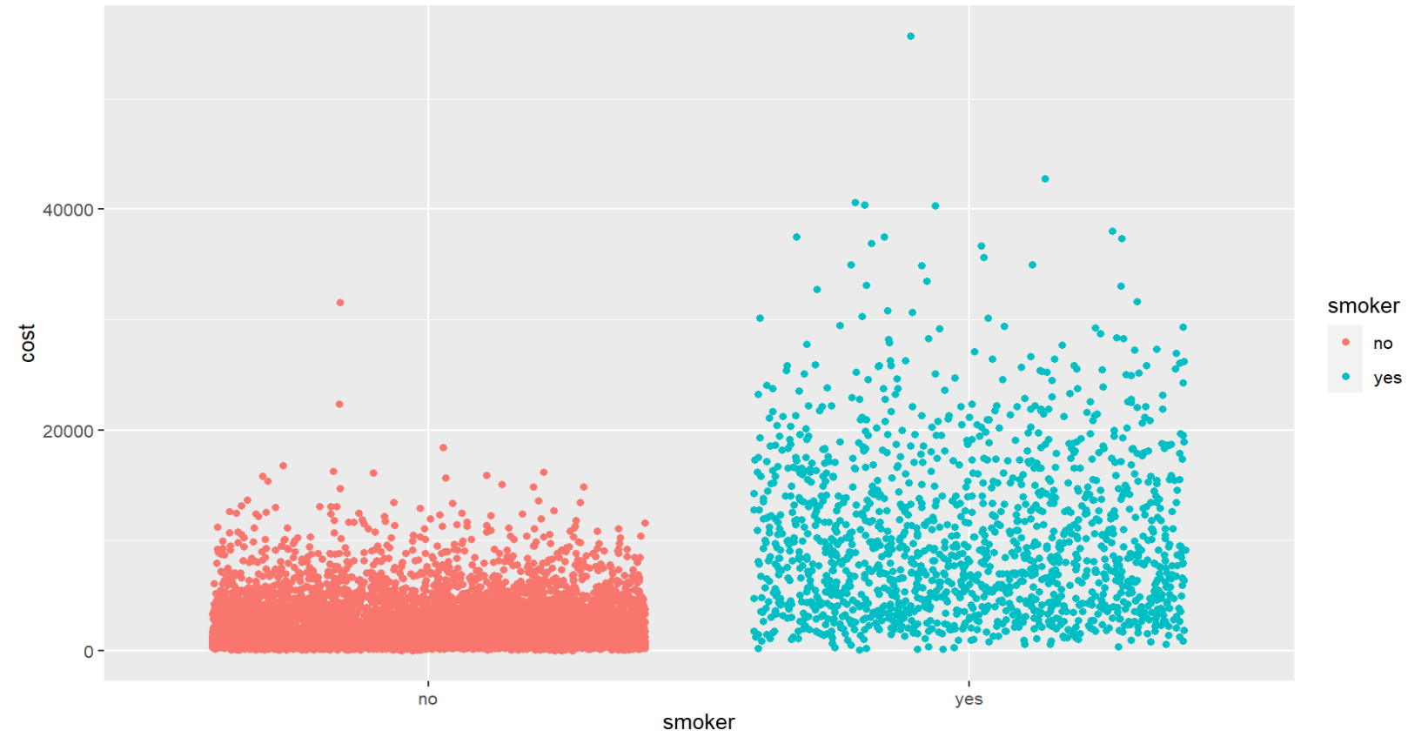
EXPLORATORY ANALYSIS
-> From the jittter plot of cost v/s smoker we can see the pattern of some people who are smoking are paying high costs.
-> Also we can see from the plot, some people who are smoking are also paying low cost and there are few people who are non smoking but paying cost above 15k probably due to some other factors.

Slide 9
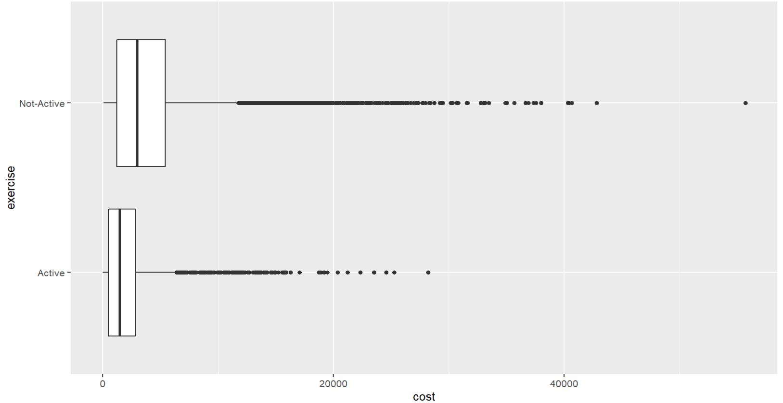
EXPLORATORY ANALYSIS
CONT..
-> We can notice that there are outliers in this box plot of cost vs exercise
-> We need to remove the outliers pertaining to the cost so that it may not effect the modelling stage

Slide 10
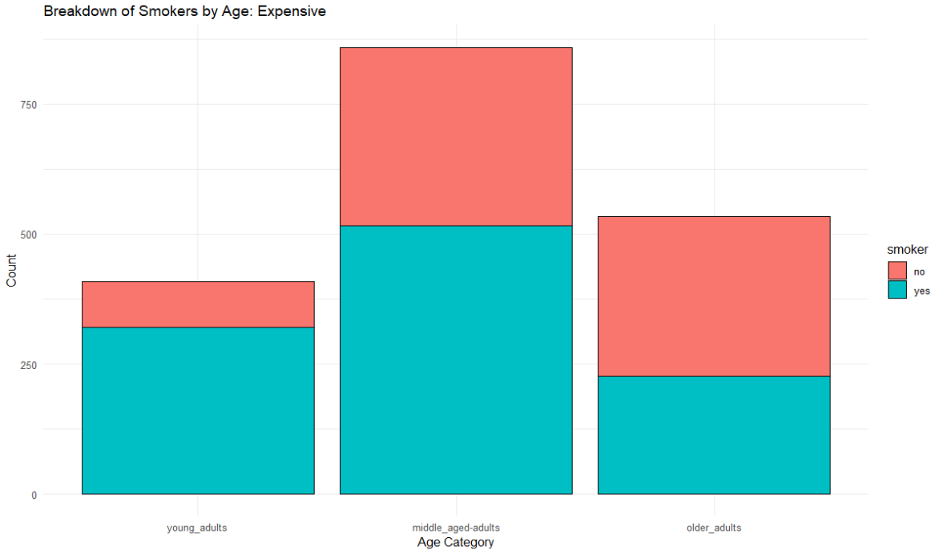
EXPLORATORY ANALYSIS
CONT..
-> Most young adults in the who were in the expensive bracket were smokers.
-> The majority of middle-aged adults in the expensive bracket were smokers.
-> Smoking was not a big factor in older adults, probably because age related health treatments played a big factor

Slide 11
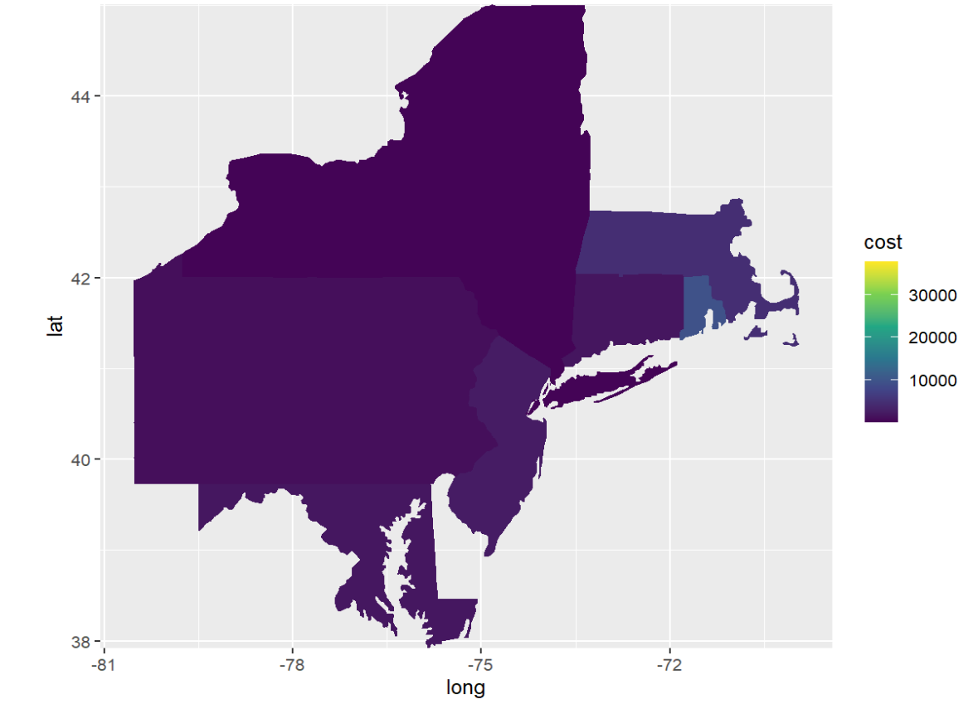
VISUALIZATIONS
-> Map
-> Observation :
Highest Cost : Rhode Island

Slide 12
PREDICTION MODELS
For each model type, we have adjusted the data so that the model will be able to read the data.
We first used linear modeling to help us understand the significance of each variable.
After understanding the importance of each variable, we ran the rules association model which is an unsupervised machine learning model. This provided us with the set of variables that in combination were linked to high cost.
We ran 2 models based on the relevant variables: rpart and SVM
SVM is a supervised machine learning model with an accuracy rate of 86.81% and rpart is an unsupervised machine learning model with an accuracy of 50%.
Based on the results we selected the model which is having highest accuracy and sensitivity.

Slide 13
SHINY APP
Here our team created a UI that is helpful to the user to easily upload files and determine the customers who are expensive or not expensive.
This is a user-friendly website that allows the user to know the data easily because we have included Exploratory Analysis by displaying the histograms, maps, and scatterplots on various types of data to provide clear insight for the users.
Then to know how accurately the model is working we have also included a section that contains the Confusion Matrix. This allows the user to understand the model in and out.
And we have also included another section “Results”, that allows the user to determine which customers are expensive and not expensive. This section represents the binary values of the results.

Slide 14
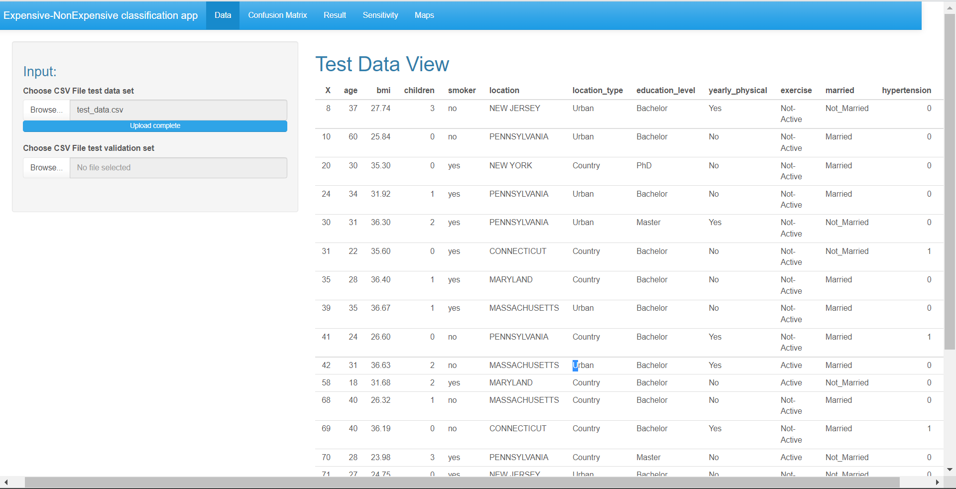
SHINY WEBSITE FOR USER

Slide 15
ACTIONABLE INSIGHTS
Business Constraint/Risks
Our Recommendation
-> If we are predicting a customer who is going to be expensive based on certain attribute, we need to make sure that mis- prediction does not happen, for example a person who is actually expensive and we predict him as not expensive this will lead to huge capital loss and operational cost to the HMO
-> So, our model should be recommending in a sensible way
-> Run anti-smoking campaigns targeting children and younger adults, while promoting a healthier lifestyle for everyone.
-> Based on the model sensitivity we can target low cost customers and run promotions/offers, as well as increase medical insurance premiums to expensive customers, which can lead to capital growth for HMO

Slide 16

THANK YOU

