Slide 1
题目选讲
陈梓天

Slide 2
Racing Gems
You are playing a racing game. Your character starts at the x axis (y = 0) and proceeds up the
race track, which has a boundary at the line x = 0 and another at x = w. You may start the race
at any horizontal position you want, as long as it is within the track boundary. The finish line is
at y = h, and the game ends when you reach that line. You proceed at a fixed vertical velocity v,
but you can control your horizontal velocity to be any value between −v/r and v/r, and change it
at any time.
There are n gems at specific points on the race track. Your job is to collect as many gems as
possible. How many gems can you collect?
Input
The first line of input contains four space-separated integers n, r, w, and h (1 ≤ n ≤ 105
, 1 ≤ r ≤ 10,
1 ≤ w, h ≤ 10^9
). Each of the following n lines contains two space-separated integers xi and yi
,
denoting the coordinate of the ith gem (0 ≤ xi ≤ w, 0 < yi ≤ h). There will be at most one gem
per location.
The input does not include a value for v.
Output
Print, on a single line, the maximum number of gems that can be collected during the race.

Slide 3
Coverage
A cellular provider has installed n towers to support their network. Each tower provides coverage
in a 1 km radius, and no two towers are closer than 1 km to one another. The coverage region of
this network is therefore the set of all points that are no more than 1 km away from at least one
tower. The provider wants as much of this region as possible to be connected, in the sense that a
user at any point within a connected subregion can travel to any other point within the connected
subregion without having to exit the subregion. Their current installation of towers may or may
not already form a single connected region, but they have the resources to build one more tower
wherever they want, including within 1 km of an existing tower.
Given that the provider is able to build one more tower, what is the maximum number of towers
(including the one just built) that can be included within a single connected subregion of coverage?
Input
The first line consists of a single integer n (1 ≤ n ≤ 5,000), denoting the number of existing towers.
Next follow n lines each with 2 space-separated real numbers xi
, yi (0 ≤ xi
, yi ≤ 105
), denoting the
location of tower i in km. It is guaranteed that the optimal number of towers will not change even
if the coverage radius of all the towers is increased or decreased by one millimeter.
Output
Print, on a single line, a single integer denoting the maximum number of towers that can be within
a single connected subregion of the network after installing one additional tower.

Slide 4
Problem J — limit 2 seconds
Olympics
The weightlifting event is up next at the Olympic games, and it’s time to impress your fans! To
accomplish your sequence of lift attempts, you have a constant strength S and a decreasing energy
reserve E. For each attempt, you may choose any positive (not necessarily integer) weight W. If
S ≥ W, the lift succeeds and your energy goes down by Esucc. If S < W, the lift fails and your
energy goes down by Efail. You may continue attempting lifts as long as E > 0. If at any point
E ≤ 0, you can make no further attempts. Your score is the maximum weight in kg that you
successfully lift, or 0 if all attempts failed.
Ideally, you should lift at exactly your strength limit. However, you do not know your strength.
You only know that you can definitely lift the 25 kg Olympic bar, and that the maximum conceivable
lift adds 100 kg on each side for a total of 225 kg. How close to an optimal score can you guarantee?
That is, what’s the smallest d for which you can ensure a score of at least S − d?
Input
The input consists of a single line containing three space-separated integers E, Esucc, and Efail
(1 ≤ E, Esucc, Efail ≤ 107
).
Output
Print, on a single line, the minimum d, rounded and displayed to exactly 6 decimal places.
Sample Input Sample Output
1 3 3 112.500000
Sample Input Sample Output
12 3 3 13.333333
Sample Input Sample Output
3000 2 3 0.000000

Slide 5
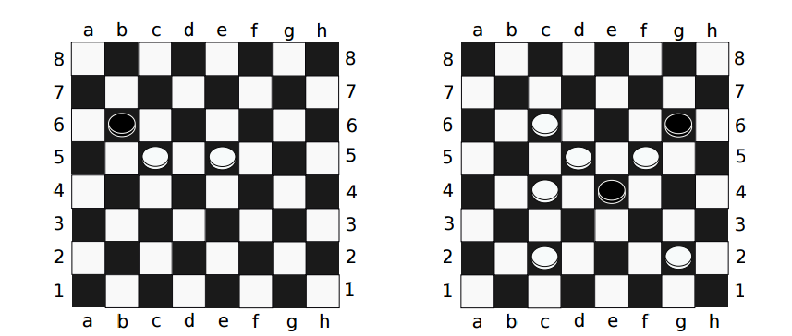
Checkers

Slide 6
以上题目出自http://codeforces.com/gym/100820/

Slide 7
hdu5045

Slide 8
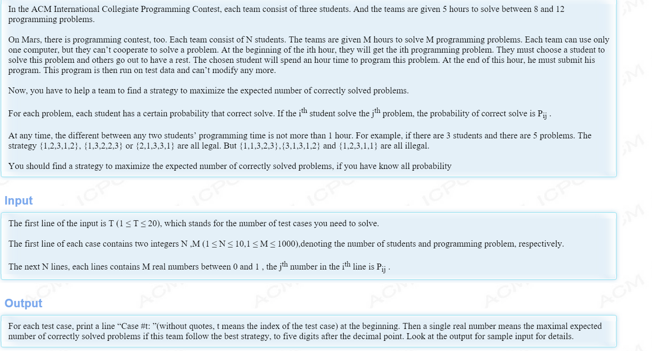

Slide 9
AIM Tech Round (Div. 1)
AIM Tech Round (Div. 1)

Slide 10
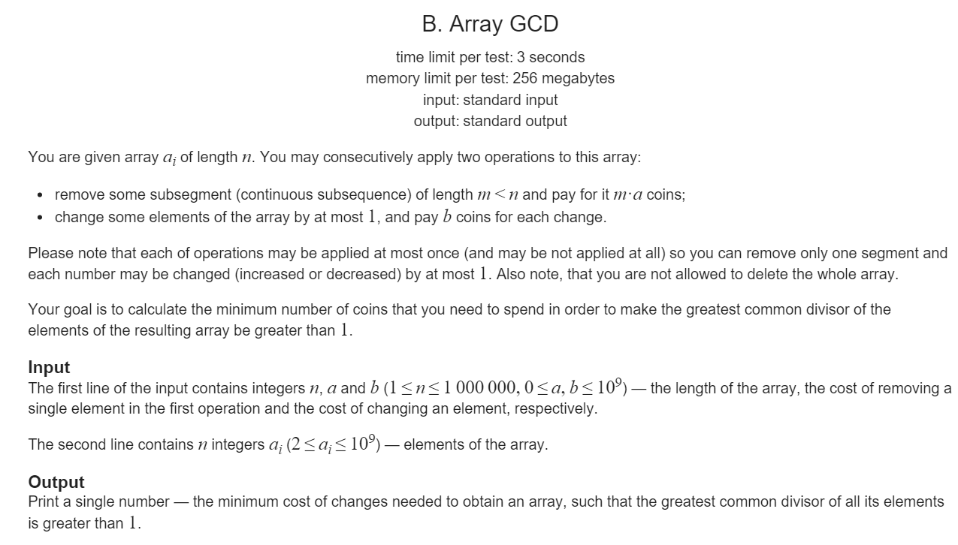

Slide 11
[i,j)
x[j-1]-x[i]<=D
max(Pi,Sj)-min(pi,sj)<=D
max(pi^2,Pi^2,sj^2,Sj^2)+max(xi^2,x[j-1]^2)<=D^2
假设|xi|>=|Xj-1|
1.j+
2.j-
3.j-
4.j-
O(n)

Slide 12
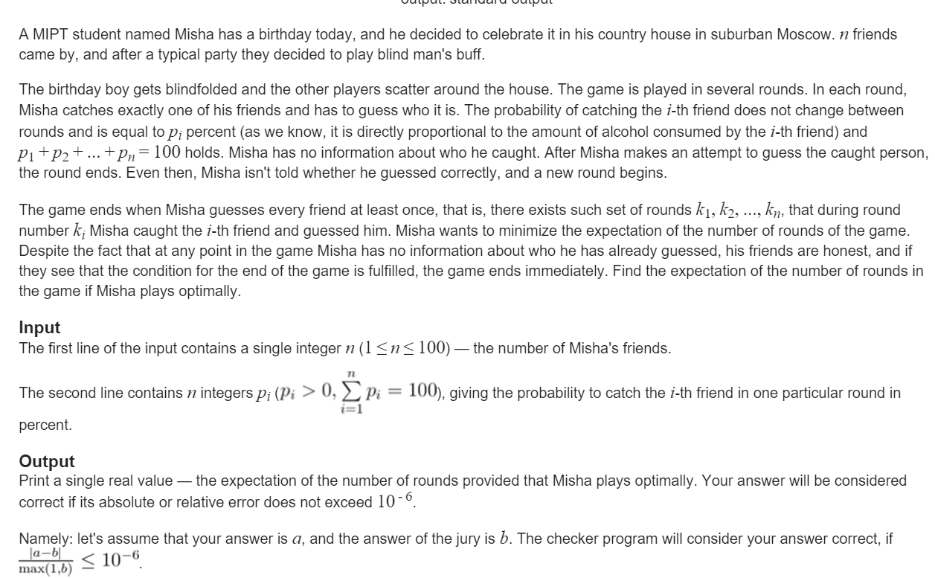

Slide 13
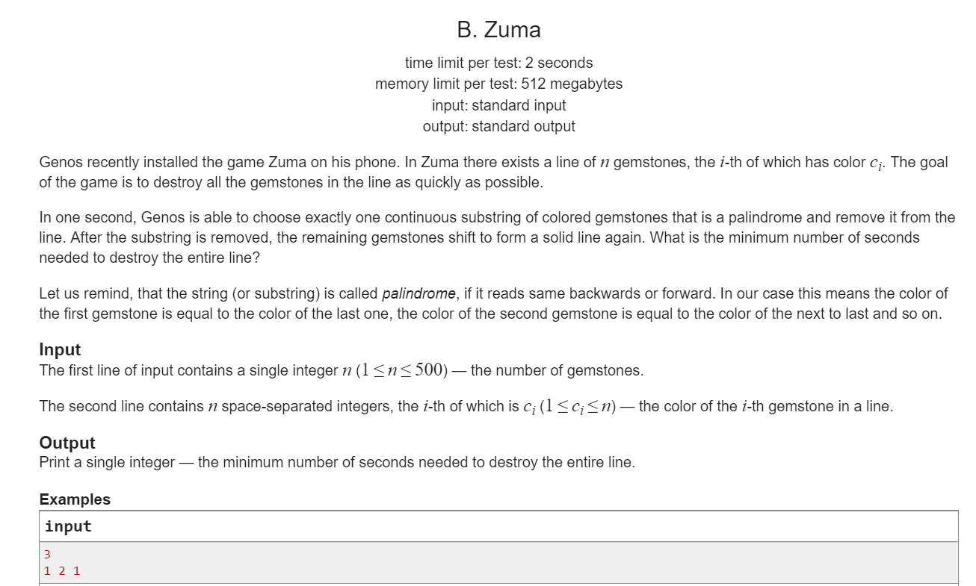

Slide 14
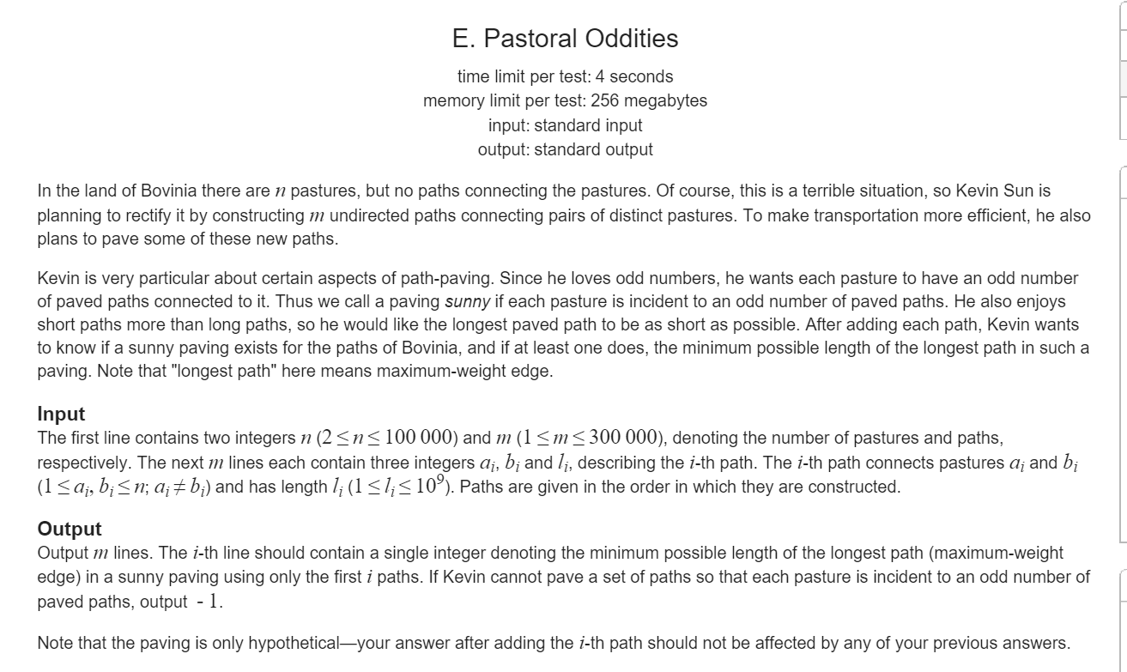

Slide 15
CF334.E
这是一道很diao的题
被各国特色做法过了：
China： Link-Cut-Tree
美国人：神分治
毛子：奇怪的dfs+线段树

Slide 16
如果森林中每棵树的点的数目为偶数,那么就存在一种题目要求的染边方案.问题转化为:求若干组边,使得加上这些边所有连通分量的点的数目都是偶数.
启发式合并并查集 （可还原 logn）
尽量合并不会变劣
[l,r,ll,rr]
处理[l,r] 的询问 答案在[ll,rr]之间
mid=(l+r)>>1 则dfs(ll,mid-1,ans[mid],rr) ,dfs(mid+1,rr,ll,ans[mid])
复杂度O(mlogmlogn)

Slide 17
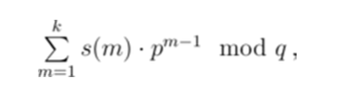
CF333E
n个展品，q个操作 常量k
每个展品有价值v,重量w
1.加一个v‘，w'的展品
2.删除一个展品
3.问不超过k的包能装走的产品的最大值
1 ≤ n ≤ 5000, 1 ≤ k ≤ 1000
(1 ≤ q ≤ 30 000)
1 ≤ vi ≤ 1 000 000, 1 ≤ wi ≤ 1000
p = 10^7 + 19 and q = 10^9 + 7.

Slide 18
我们把第i个询问的集合记为Si.假设有8个询问,那么我们可以先求这8个询问的集合的交的dp,然后从树根递归下去.每个子节点的S其实可以由父节点的S添加若干元素得到,所以每个子节点的dp数组也可以由父节点的dp数组通过添加物品重新求dp数组的方法得到.记3类型的询问的个数为qn,注意到每个物品最多只能被添加O(logqn)次(也就是树高).

Slide 19
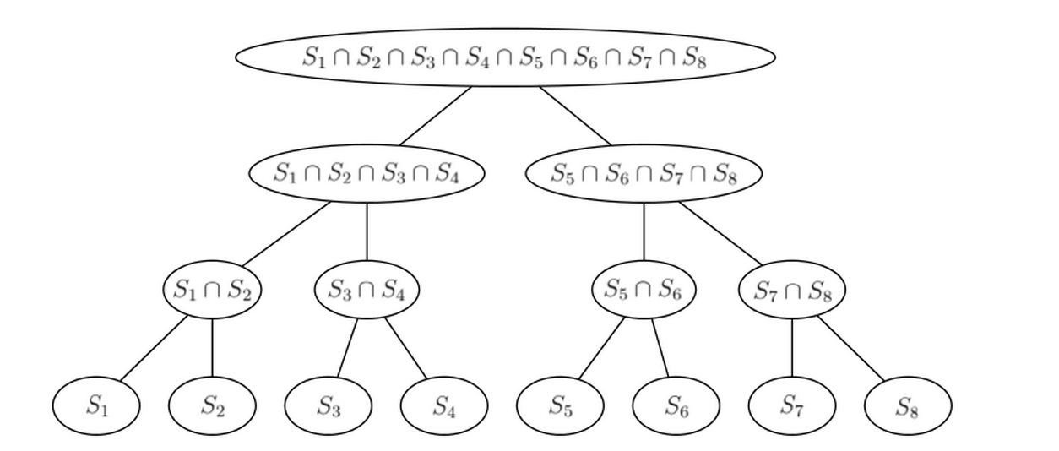

Slide 20
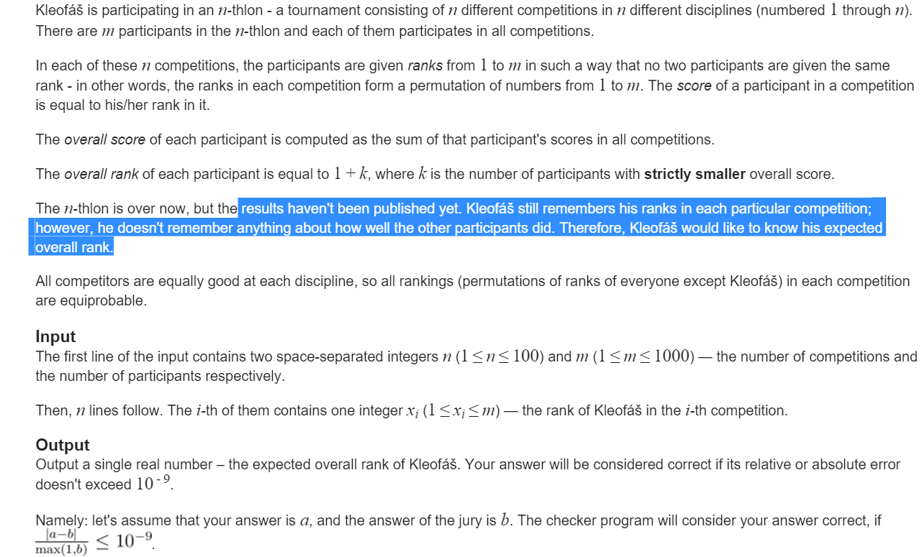

Slide 21
