Slide 1
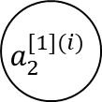
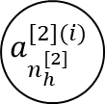
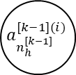

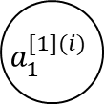
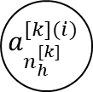
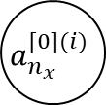
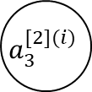
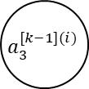


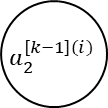
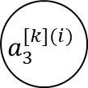


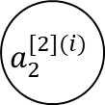


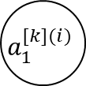


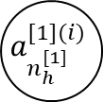

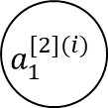




$$a_{1}^{[0](i)}$$
$$a_{1}^{[1](i)}$$
$$a_{1}^{[2](i)}$$
$$a_{1}^{[k−1](i)}$$
$$a_{1}^{[k](i)}$$
$$x_{1}^{(i)}$$
$${\hat{y}}_{1}^{(i)}$$
$$a_{2}^{[0](i)}$$
$$a_{2}^{[1](i)}$$
$$a_{2}^{[2](i)}$$
$$a_{2}^{[k−1](i)}$$
$$a_{2}^{[k](i)}$$
$${\hat{y}}_{2}^{(i)}$$
$$x_{2}^{(i)}$$
$$a_{3}^{[0](i)}$$
$$a_{3}^{[1](i)}$$
$$a_{3}^{[2](i)}$$
$$a_{3}^{[k−1](i)}$$
$$a_{3}^{[k](i)}$$
$${\hat{y}}_{3}^{(i)}$$
$$x_{3}^{(i)}$$
$$a_{n_{x}}^{[0](i)}$$
$$a_{n_{h}^{[1]}}^{[1](i)}$$
$$a_{n_{h}^{[2]}}^{[2](i)}$$
$$a_{n_{h}^{[k−1]}}^{[k−1](i)}$$
$$a_{n_{h}^{[k]}}^{[k](i)}$$
$$x_{n_{x}}^{(i)}$$
$${\hat{y}}_{n_{y}}^{(i)}$$

Slide 2
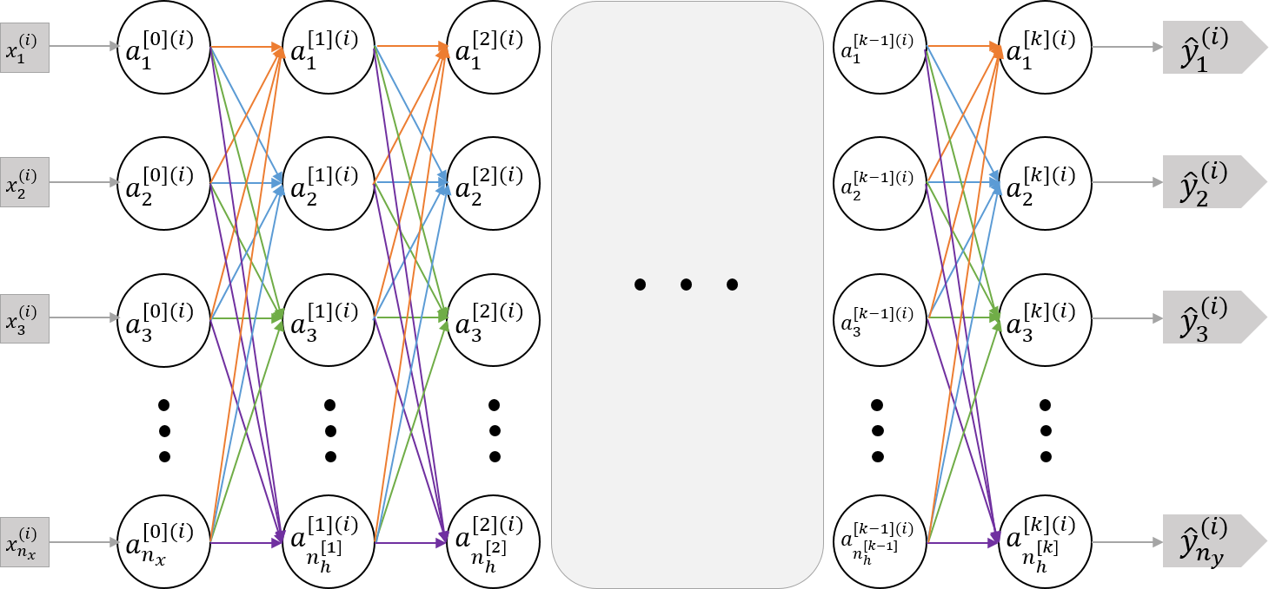
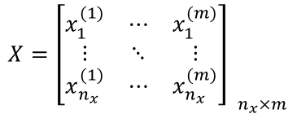
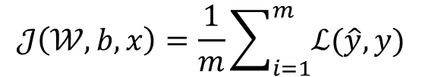

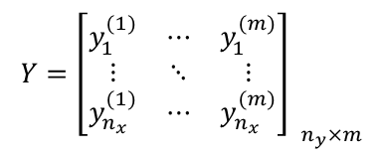

$$x^{(i)}$$
$$y^{(i)}$$
$${X=\left[\begin{matrix}x_{1}^{(1)} & ⋯ & x_{1}^{(m)} \\ ⋮ & ⋱ & ⋮ \\ x_{n_{x}}^{(1)} & ⋯ & x_{n_{x}}^{(m)}\end{matrix}\right] }_{n_{x}×m}$$
$${Y=\left[\begin{matrix}y_{1}^{(1)} & ⋯ & y_{1}^{(m)} \\ ⋮ & ⋱ & ⋮ \\ y_{n_{x}}^{(1)} & ⋯ & y_{n_{x}}^{(m)}\end{matrix}\right] }_{n_{y}×m}$$
$$𝒥\left(𝒲,b,x\right)=\frac{1}{m}\sum_{i=1}^{m}{ℒ(\hat{y}, y)}$$

Slide 3
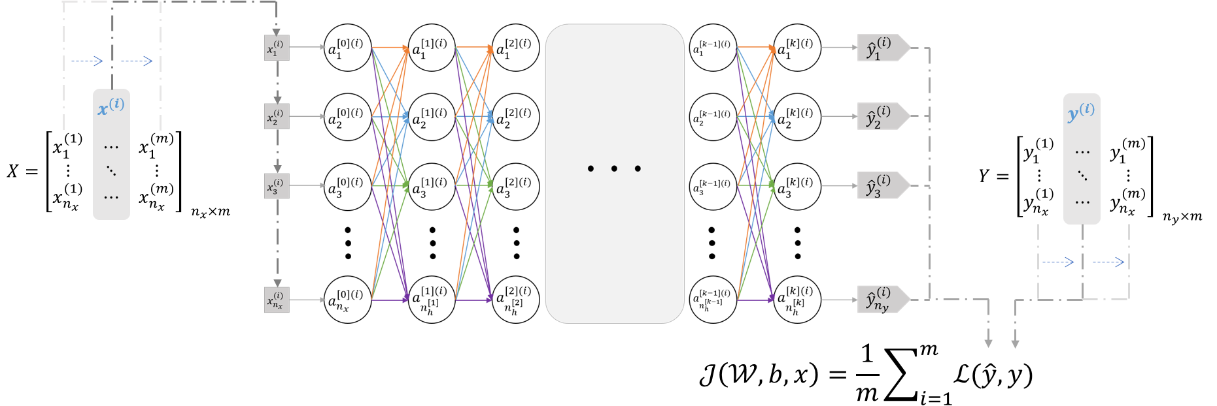
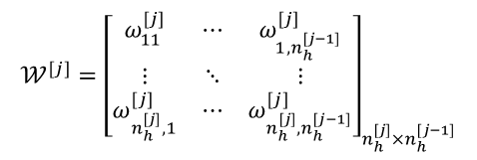
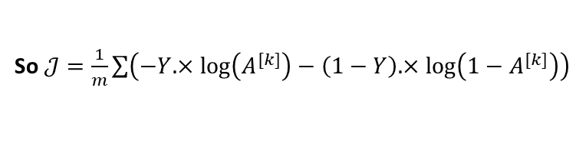
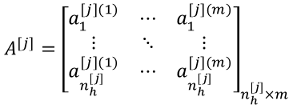





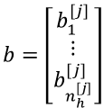
$$z^{[j](i)}=𝒲^{[j]}a^{[j−1](i)}+b^{[j]}$$
$$a^{[j](i)}=g^{[j]}\left(z^{[j](i)}\right)$$
$$a^{[j](i)}$$
Where $ℒ(\hat{y}, y)$=$−{y^{\left(i\right)}}^{T}\log\left({\hat{y}}^{\left(i\right)}\right)−{\left(1−y^{(i)}\right)}^{T}\log\left(1−{\hat{y}}^{(i)}\right)$
extend
$$A^{[j]}={\left[\begin{matrix}a_{1}^{[j](1)} & ⋯ & a_{1}^{[j](m)} \\ ⋮ & ⋱ & ⋮ \\ a_{n_{h}^{[j]}}^{[j](1)} & ⋯ & a_{n_{h}^{[j]}}^{[j](m)}\end{matrix}\right]}_{n_{h}^{[j]}×m}$$
$$Z^{[j]} =𝒲^{[j]} A^{[j−1]} +B^{[j]}$$
$$A^{[j]} =g^{[j]}\left( Z^{[j]} \right)$$
So $𝒥=\frac{1}{m}\sum{\left(−Y.×\log\left(A^{[k]}\right)−\left(1−Y\right).×\log\left(1−A^{[k]}\right)\right)}$
extend
$$=\left[\begin{matrix}a^{[j](1)} & ⋯ & a^{[j](m)}\end{matrix}\right]$$
$$𝒲^{[j]}={\left[\begin{matrix}ω_{11}^{[j]} & ⋯ & ω_{1,n_{h}^{[j−1]}}^{[j]} \\ ⋮ & ⋱ & ⋮ \\ ω_{n_{h}^{[j]},1}^{[j]} & ⋯ & ω_{n_{h}^{[j]},n_{h}^{[j−1]}}^{[j]}\end{matrix}\right]}_{n_{h}^{[j]}×n_{h}^{[j−1]}}$$
$$b=\left[\begin{matrix}b_{1}^{[j]} \\ ⋮ \\ b_{n_{h}^{[j]}}^{[j]}\end{matrix}\right]$$

Slide 4
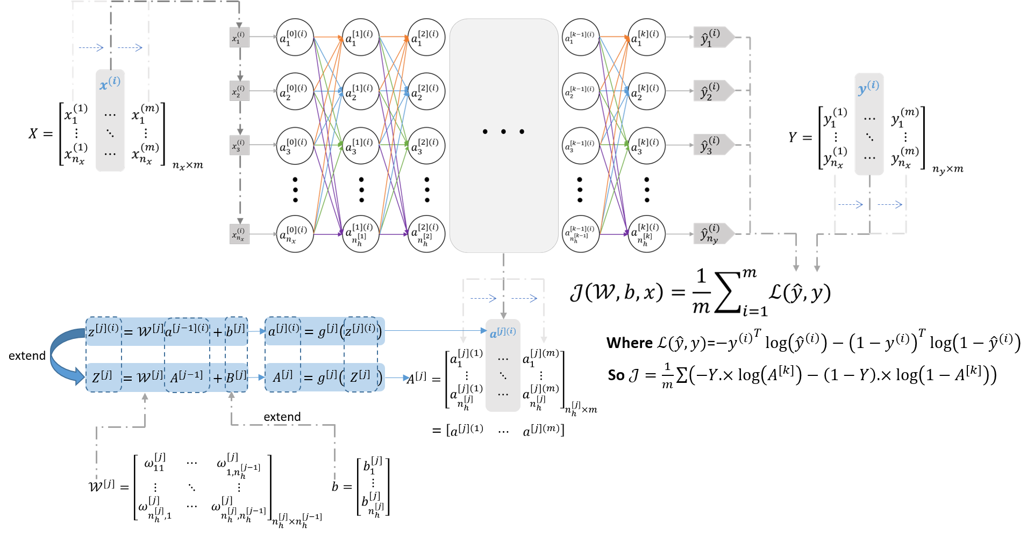



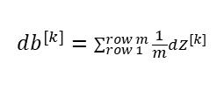




$$dA^{[k]}=\frac{∂}{∂A^{[k]}}𝒥=\frac{1}{m}\left(\frac{−Y}{A^{[k]}}+\frac{1−Y}{1−A^{[k]}}\right)$$
$$db^{[k]}=\sum_{row 1}^{row m}{\frac{1}{m}dZ^{[k]}}$$
$$d𝒲^{[k]}=\frac{1}{m}dZ^{[k]}{A^{[k−1]}}^{T}$$
$$dZ^{[k]}=\frac{∂𝒥}{∂A^{[k]}}\frac{∂A^{[k]}}{∂Z^{[k]}}=\frac{1}{m}\left(A^{[k]}−Y \right)$$
$$d𝒲^{[k−1]}=\frac{1}{m}dZ^{[k−1]}{A^{[k−2]}}^{T}$$
$$dZ^{[k−1]}=\frac{1}{m}\left({W^{[k]}}^{T}dZ^{[k]} .× {g^{[k−1]}}^{′}\left(Z^{[k−1]}\right)\right)$$
$$⋮$$
$$⋮$$
$$d𝒲^{[1]}=\frac{1}{m}dZ^{[1]}{A^{[0]}}^{T}$$
$$dZ^{[1]}=\frac{1}{m}\left({W^{[2]}}^{T}dZ^{[2]} .× {g^{[1]}}^{′}\left(Z^{[1]}\right)\right)$$

Slide 5
































$$+1$$
$$+1$$
$$+1$$
$$+1$$
$$x_{0}^{(i)}$$
$$a_{1}^{(1)}$$
$$a_{1}^{(2)}$$
$$a_{1}^{(3)}$$
$$a_{1}^{(k−1)}$$
$$a_{1}^{(k)}$$
$${[h_{θ}(x^{(i)})]}_{1}$$
$$x_{1}^{(i)}$$
$$x_{2}^{(i)}$$
$$a_{2}^{(1)}$$
$$a_{2}^{(2)}$$
$$a_{2}^{(3)}$$
$$a_{2}^{(k−1)}$$
$$a_{2}^{(k)}$$
$${[h_{θ}(x^{(i)})]}_{2}$$
$$x_{3}^{(i)}$$
$$a_{3}^{(1)}$$
$$a_{3}^{(2)}$$
$$a_{3}^{(3)}$$
$$a_{3}^{(k−1)}$$
$$a_{3}^{(k)}$$
$${[h_{θ}(x^{(i)})]}_{3}$$
$$x_{n_{x}}^{(i)}$$
$$a_{n_{x}}^{(1)}$$
$$a_{s_{2}}^{(2)}$$
$$a_{s_{3}}^{(3)}$$
$$a_{s_{k−1}}^{(k−1)}$$
$$a_{s_{k}}^{(i)}$$
$${[h_{θ}(x^{(i)})]}_{n_{y}}$$

Slide 6
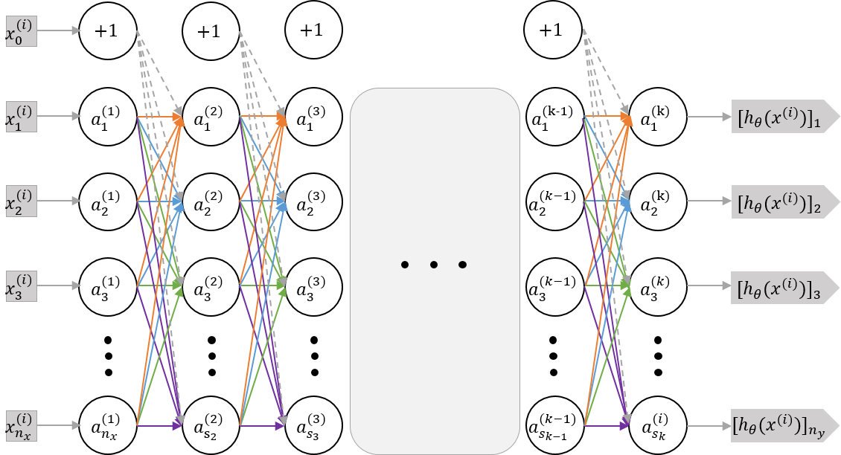

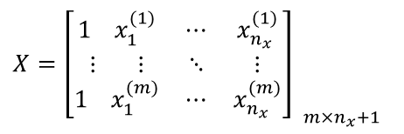

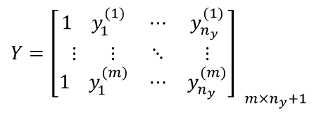
$${X=\left[\begin{matrix}1 x_{1}^{(1)} & ⋯ & x_{n_{x}}^{(1)} \\ ⋮ ⋮ & ⋱ & ⋮ \\ 1 x_{1}^{(m)} & ⋯ & x_{n_{x}}^{(m)}\end{matrix}\right] }_{m×n_{x}+1}$$
$${Y=\left[\begin{matrix}1 y_{1}^{(1)} & ⋯ & y_{n_{y}}^{(1)} \\ ⋮ ⋮ & ⋱ & ⋮ \\ 1 y_{1}^{(m)} & ⋯ & y_{n_{y}}^{(m)}\end{matrix}\right] }_{m×n_{y}+1}$$
$$x^{(i)}$$
$$y^{(i)}$$
$$𝒥\left(Θ\right)=\frac{1}{m}\sum_{i=1}^{m}{\sum_{k=1}^{s_{k}}{\left\{−y_{k}^{(i)}\log\left[{\left(h_{Θ}\left(x^{\left(i\right)}\right)\right)}_{k}\right]−\left(1−y_{k}^{(i)}\right)\log\left[1−{\left(h_{Θ}\left(x^{(i)}\right)\right)}_{k}\right]\right\}}}$$

Slide 7

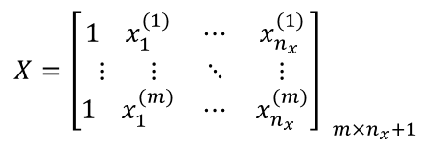

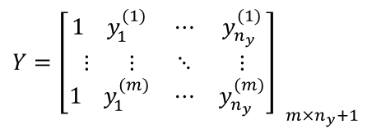
$${X=\left[\begin{matrix}1 x_{1}^{(1)} & ⋯ & x_{n_{x}}^{(1)} \\ ⋮ ⋮ & ⋱ & ⋮ \\ 1 x_{1}^{(m)} & ⋯ & x_{n_{x}}^{(m)}\end{matrix}\right] }_{m×n_{x}+1}$$
$${Y=\left[\begin{matrix}1 y_{1}^{(1)} & ⋯ & y_{n_{y}}^{(1)} \\ ⋮ ⋮ & ⋱ & ⋮ \\ 1 y_{1}^{(m)} & ⋯ & y_{n_{y}}^{(m)}\end{matrix}\right] }_{m×n_{y}+1}$$
$$x^{(i)}$$
$$y^{(i)}$$
$$𝒥\left(Θ\right)=\frac{1}{m}\sum_{i=1}^{m}{\sum_{k=1}^{s_{k}}{\left\{−y_{k}^{(i)}\log\left[{\left(h_{Θ}\left(x^{\left(i\right)}\right)\right)}_{k}\right]−\left(1−y_{k}^{(i)}\right)\log\left[1−{\left(h_{Θ}\left(x^{(i)}\right)\right)}_{k}\right]\right\}}}$$

Slide 8






$$y$$
$$𝓙\left(θ\right)$$
$$h_{θ}\left(x\right)=θx$$
$$x$$
$$θ$$
$$θ$$

Slide 9


$$h_{θ}\left(x\right)=θx$$
$$y$$
$$𝓙\left(θ\right)$$
$$x$$
$$θ$$
$$θ$$

Slide 10


$$y$$
$$h_{θ}\left(x\right)=θx$$
$$𝓙\left(θ\right)$$
$$x$$
$$θ$$
$$θ$$

Slide 11





$$𝓙\left(θ\right)$$
$$\frac{d𝓙(θ)}{dθ}<0$$
$$θ$$
$$θ$$
$$θ≔θ−α\frac{d𝓙(θ)}{dθ}$$

Slide 12





$$𝓙\left(θ\right)$$
$$\frac{d𝓙(θ)}{dθ}>0$$
$$θ$$
$$θ≔θ−α\frac{d𝓙(θ)}{dθ}$$
$$θ$$

Slide 13

$$𝓙\left(θ\right)$$
$$θ$$
$$θ$$

Slide 14




$$θ_{2}$$
$:𝓙\left(θ\right)$大
$:𝓙\left(θ\right)$小
$$θ_{1}$$

Slide 15


$$θ_{2}$$
$:𝓙\left(θ\right)$大
$:𝓙\left(θ\right)$小
$$θ_{1}$$

Slide 16






$$\min_{θ}{𝓙\left(θ\right)}$$
$$100$$
$$200$$
$$300$$
$$400$$
$$no. of iteration$$

Slide 17
$$\min_{θ}{𝓙\left(θ\right)}$$
$$100$$
$$200$$
$$300$$
$$400$$
$$no. of iteration$$

Slide 18




$$y$$
$$h_{θ}\left(x\right)=θ_{0}+θ_{1}x+θ_{2}x^{2}+θ_{3}x^{3}$$
$$h_{θ}\left(x\right)=θ_{0}+θ_{1}x+θ_{2}\sqrt{x}$$
$$h_{θ}\left(x\right)=θ_{0}+θ_{1}x+θ_{2}x^{2}$$
$$x$$

Slide 19










$$if h_{θ}\left(x\right)>threshold, predict y=1$$
$$else predict y=0$$
$$y$$
$$h_{θ}\left(x\right)=θ^{T}x=θ_{0}+θ_{1}x$$
$$1$$
$$0.5$$
$$threshold$$
$$0$$
$$x(size)$$
$$bad result$$

Slide 20









$$if h_{θ}\left(x\right)>threshold, predict y=1$$
Set $h_{θ}(x)=g\left(θ^{T}x\right)>0.5$
$$else predict y=0$$
Where $θ^{T}x>0$
Set $h_{θ}\left(x\right)=g\left(θ^{T}x\right)<0.5$
$$y$$
Where $θ^{T}x<0$
$$x<\frac{{−θ}_{0}}{θ_{1}}⇒θ^{T}x=θ_{0}+θ_{1}x<0$$
$$x>\frac{{−θ}_{0}}{θ_{1}}⇒θ^{T}x=θ_{0}+θ_{1}x>0$$
$$1$$
$$0.5$$
$$threshold$$
$$0$$
$$x=\frac{{−θ}_{0}}{θ_{1}}$$
$$x(size)$$

Slide 21








$$if h_{θ}\left(x\right)>threshold, predict y=1$$
Set $h_{θ}(x)=g\left(θ^{T}x\right)>0.5$
$$else predict y=0$$
Where $θ^{T}x>0$
$$x_{2}$$
Set $h_{θ}\left(x\right)=g\left(θ^{T}x\right)<0.5$
Where $θ^{T}x<0$
$$θ^{T}x=θ_{0}+θ_{1}x_{1}+θ_{2}x_{2}>0$$
$$θ^{T}x=θ_{0}+θ_{1}x_{1}+θ_{2}x_{2}<0$$
$$x_{1}$$

Slide 22
$$if h_{θ}\left(x\right)>threshold, predict y=1$$
Set $h_{θ}(x)=g\left(θ^{T}x\right)>0.5$
$$else predict y=0$$
Where $θ^{T}x>0$
$$x_{2}$$
Set $h_{θ}\left(x\right)=g\left(θ^{T}x\right)<0.5$
Where $θ^{T}x<0$
$$θ^{T}x=θ_{0}+θ_{1}x_{1}+θ_{2}x_{2}+θ_{3}x_{1}^{2}+θ_{4}x_{2}^{2}<0$$
$$θ^{T}x=θ_{0}+θ_{1}x_{1}+θ_{2}x_{2}+θ_{3}x_{1}^{2}+θ_{4}x_{2}^{2}>0$$
$$x_{1}$$

Slide 23
Non-convex
$$𝓙\left(θ\right)$$
$$θ$$

Slide 24


$$x_{2}$$
$$x_{1}$$
Class 1:
Class 2:
Class 3:

Slide 25












$$x_{2}$$
$$x_{2}$$
$$h_{θ}^{\left(1\right)}(x)$$
$$x_{1}$$
$$x_{2}$$
$$x_{1}$$
$$h_{θ}^{\left(2\right)}(x)$$
Class 1:
$$x_{1}$$
Class 2:
$$x_{2}$$
Class 3:
$$h_{θ}^{\left(i\right)}\left(x\right)=P^{\left(i\right)}\left\{y=1|x;θ\right\} (i=1, 2, 3)$$
$$h_{θ}^{\left(3\right)}(x)$$
$$x_{1}$$

Slide 26


Price
Price
Size of house
Size of house
$$θ_{0}+θ_{1}x+θ_{2}x^{2}$$
$$θ_{0}+θ_{1}x+θ_{2}x^{2}+θ_{3}x^{3}+θ_{4}x^{4}$$

Slide 27
unregulated
regulated
Price
too big lamda
Size of house

Slide 28




Slide 29
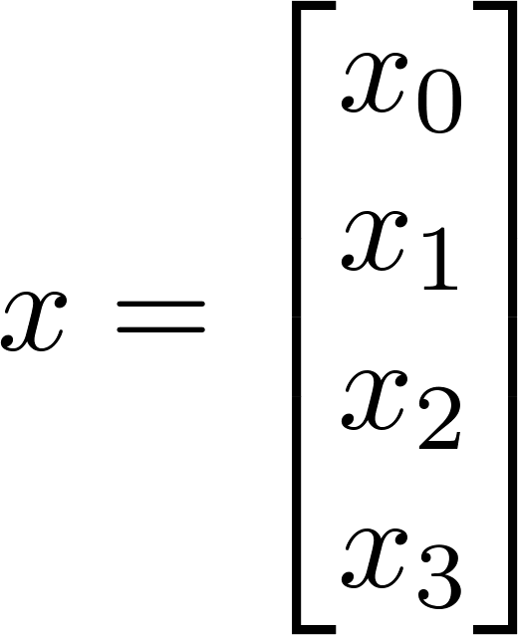

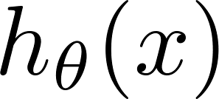





$$x_{0}$$
Bias unit $x_{0}=1$
compute unit $=\frac{1}{1+e^{−θ^{T}x}}$

Slide 30


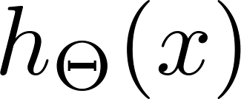







$$x_{0}$$
$$x_{0}$$
Bias unit $x_{0}=1$
Layer 1
Layer 2
Layer 3
_{Hidden layer}

