Slide 1
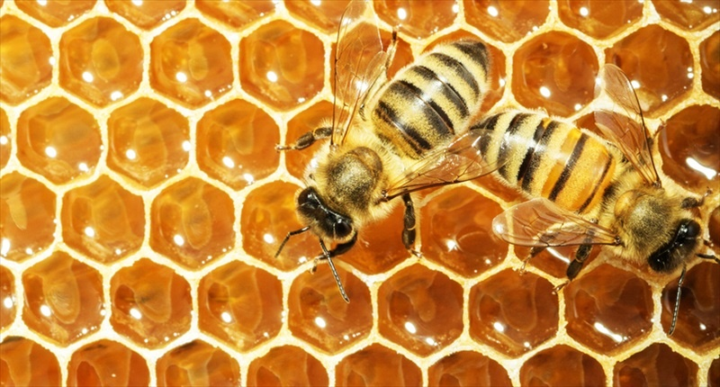
Cells in PicoLisp
Idea: @tankf33der
Review: @Regenaxer
Revision: 23
June 2020
CC0

Slide 2
Fundamental overview
CELL

Slide 3
+-----+-----+
| CAR | CDR |
+-----+-----+
The PicoLisp reference says:
1. A cell is a pair of machine words, which traditionally are called CAR and CDR in the Lisp terminology.
2. These words can represent either a numeric value (scalar) or the address of another cell (pointer).
3. All higher level data structures are built out of cells.

Slide 4
+-----+-----+
| CAR | CDR |
+-----+-----+
The PicoLisp reference says:
1. A cell is a pair of machine words, which traditionally are called CAR and CDR in the Lisp terminology.
2. These words can represent either a numeric value (scalar) or the address of another cell (pointer).
3. All higher level data structures are built out of cells.
// src/pico.h
typedef struct cell {
struct cell *car;
struct cell *cdr;
} cell, *any;
Yes, two identical types

Slide 5
+-----+-----+
| CAR | CDR |
+-----+-----+
The PicoLisp reference says:
1. A cell is a pair of machine words, which traditionally are called CAR and CDR in the Lisp terminology.
2. These words can represent either a numeric value (scalar) or the address of another cell (pointer).
3. All higher level data structures are built out of cells.
// src/pico.h
typedef struct cell {
struct cell *car;
struct cell *cdr;
} cell, *any;
Yes, two identical types
Yes, can store identical values

Slide 6
+-----+-----+
| CAR | CDR |
+-----+-----+
The PicoLisp reference says:
1. A cell is a pair of machine words, which traditionally are called CAR and CDR in the Lisp terminology.
2. These words can represent either a numeric value (scalar) or the address of another cell (pointer).
3. All higher level data structures are built out of cells.
// src/pico.h
typedef struct cell {
struct cell *car;
struct cell *cdr;
} cell, *any;
Yes, two identical types
Yes, can store identical values
Yes, cells are everywhere

Slide 7

+-----+-----+
| CAR | CDR |
+-----+-----+
The PicoLisp reference says:
1. A cell is a pair of machine words, which traditionally are called CAR and CDR in the Lisp terminology.
2. These words can represent either a numeric value (scalar) or the address of another cell (pointer).
3. All higher level data structures are built out of cells.
// src/pico.h
typedef struct cell {
struct cell *car;
struct cell *cdr;
} cell, *any;
Yes, two identical types
Yes, can store identical values
Yes, cells are everywhere
// src/pico.h
typedef struct heap {
cell cells[CELLS];
struct heap *next;
} heap;

Slide 8
+-----+-----+
| CAR | CDR |
+-----+-----+
The PicoLisp reference says:
1. A cell is a pair of machine words, which traditionally are called CAR and CDR in the Lisp terminology.
2. These words can represent either a numeric value (scalar) or the address of another cell (pointer).
3. All higher level data structures are built out of cells.
// src/pico.h
typedef struct cell {
struct cell *car;
struct cell *cdr;
} cell, *any;
Cells in heap under
full control by GC
Yes, two identical types
Yes, can store identical values
cell
|
+-----------+-----------+
| | |
Number Symbol Pair
|
|
+--------+-----------+-----------+
| | | |
NIL Internal Transient External
Yes, cells are everywhere
// src/pico.h
typedef struct heap {
cell cells[CELLS];
struct heap *next;
} heap;

Slide 9
Fundamental overview
LIST

Slide 10
cell
|
+-----------+-----------+
| | |
Number Symbol Pair
|
|
+--------+-----------+-----------+
| | | |
NIL Internal Transient External
A list is not part of data type hierarchy.

Slide 11
cell
|
+-----------+-----------+
| | |
Number Symbol Pair
|
|
+--------+-----------+-----------+
| | | |
NIL Internal Transient External
The PicoLisp reference provides recursive definition:
A list is a sequence of one or more cells (cons pairs), holding numbers, symbols, or cons pairs.
|
V
+-----+-----+
| any | | |
+-----+--+--+
|
V
+-----+-----+
| any | | |
+-----+--+--+
|
V
...

Slide 12
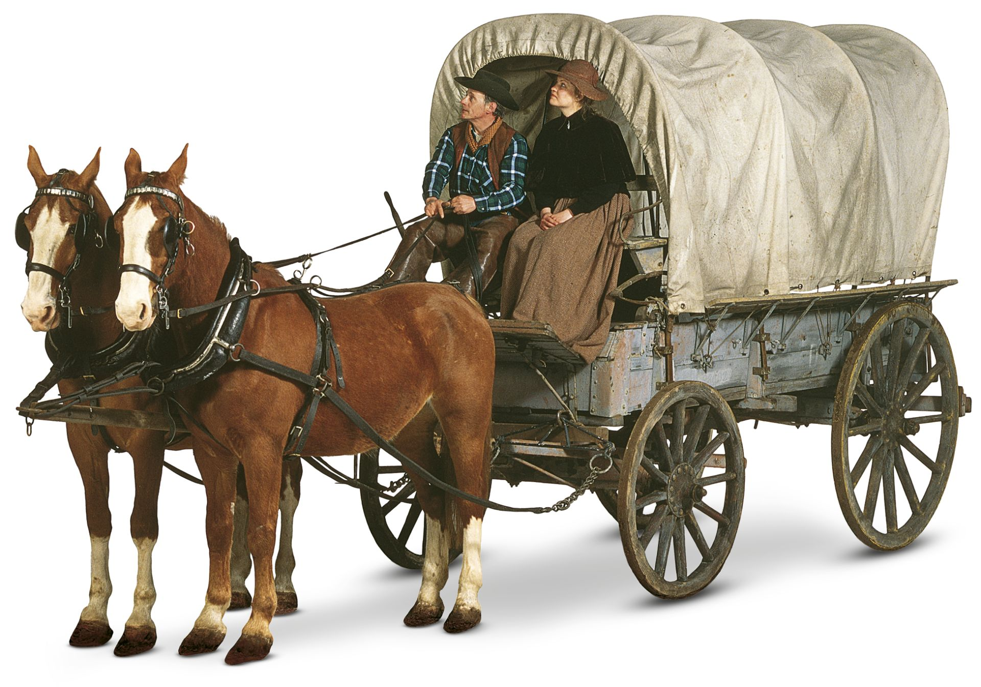
cell
|
+-----------+-----------+
| | |
Number Symbol Pair
|
|
+--------+-----------+-----------+
| | | |
NIL Internal Transient External
The PicoLisp reference provides recursive definition:
A list is a sequence of one or more cells (cons pairs), holding numbers, symbols, or cons pairs.
CAR
CDR

Slide 13
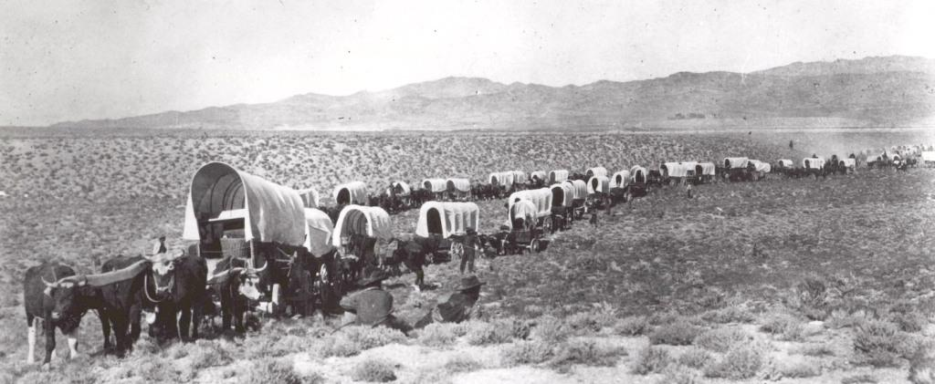
cell
|
+-----------+-----------+
| | |
Number Symbol Pair
|
|
+--------+-----------+-----------+
| | | |
NIL Internal Transient External
The PicoLisp reference provides recursive definition:
A list is a sequence of one or more cells (cons pairs), holding numbers, symbols, or cons pairs.
List is like wagon train

Slide 14
cell
|
+-----------+-----------+
| | |
Number Symbol Pair
|
|
+--------+-----------+-----------+
| | | |
NIL Internal Transient External
The PicoLisp reference provides recursive definition:
A list is a sequence of one or more cells (cons pairs), holding numbers, symbols, or cons pairs.
This is a list
if CDR of last cell
points to NIL
Remember!
+---+---+ +---+---+
| 1 | --+--->| 2 |---+---> NIL
+---+---+ +---+---+
+---+---+
| 1 | 2 |
+---+---+
If atom in CDR then this is a dotted pair

Slide 15
Construct and view

Slide 16
$ pil +
: (cons 1 2)
-> (1 . 2)
: (cons 1 2 3)
-> (1 2 . 3)
: (list 1 2 3)
-> (1 2 3)
:

Slide 17
$ pil +
: (cons 1 2)
-> (1 . 2)
: (cons 1 2 3)
-> (1 2 . 3)
: (list 1 2 3)
-> (1 2 3)
:
CONStruct cell or sequence of cells are straightforward.

Slide 18
$ pil +
: (cons 1 2)
-> (1 . 2)
: (cons 1 2 3)
-> (1 2 . 3)
: (list 1 2 3)
-> (1 2 3)
:
Construct cell or sequence of cells are straightforward.
Function view will help understand cell structure:
: (cons 1 2)
-> (1 . 2)
: (view @)
+-- 1
|
2
-> 2
:

Slide 19
$ pil +
: (cons 1 2)
-> (1 . 2)
: (cons 1 2 3)
-> (1 2 . 3)
: (list 1 2 3)
-> (1 2 3)
:
Construct cell or sequence of cells are straightforward.
Function view will help understand cell structure:
: (cons 1 2)
-> (1 . 2)
: (view @)
+-- 1
|
2
-> 2
Legend:
+ is CELL
- is CAR
| is CDR
: (cons 1 2 3)
-> (1 2 . 3)
: (view @)
+-- 1
|
+-- 2
|
3
-> 3
: (list 1 2 3)
-> (1 2 3)
: (view @)
+-- 1
|
+-- 2
|
+-- 3
-> NIL

Slide 20
$ pil +
: (cons 1 2)
-> (1 . 2)
: (cons 1 2 3)
-> (1 2 . 3)
: (list 1 2 3)
-> (1 2 3)
:
Construct cell or sequence of cells are straightforward.
Function view will help understand cell structure:
: (cons 1 2)
-> (1 . 2)
: (view @)
+-- 1
|
2
-> 2
Legend:
+ is CELL
- is CAR
| is CDR
: (cons 1 2 3)
-> (1 2 . 3)
: (view @)
+-- 1
|
+-- 2
|
3
-> 3
: (list 1 2 3)
-> (1 2 3)
: (view @)
+-- 1
|
+-- 2
|
+-- 3
-> NIL
After practice you will manipulate and view structures in mind.
Nothing special, right?

Slide 21
Modify CAR

Slide 22
The PicoLisp reference for function set says:
(set 'var 'any ..) -> any
Stores new values any in the var arguments.
See also setq, val, swap, con and def.
: (set 'L '(a b c) (cdr L) 999)
-> 999
: L
-> (a 999 c)
Variable: Either a symbol
or a cons pair

Slide 23
The PicoLisp reference for function set says:
(set 'var 'any ..) -> any
Stores new values any in the var arguments.
See also setq, val, swap, con and def.
: (set 'L '(a b c) (cdr L) 999)
-> 999
: L
-> (a 999 c)
In case of cell it modify CAR:
$ pil +
: (set 'L (cons 1 2))
-> (1 . 2)
: (set L 3)
-> 3
: L
-> (3 . 2)
: (set L (cons 1 2))
-> (1 . 2)
: L
-> ((1 . 2) . 2)

Slide 24
Modify CDR

Slide 25
The PicoLisp reference for function con says:
(con 'lst 'any) -> any
Connects any to the first cell of lst, by (destructively) storing any in the CDR of lst.
See also set and conc.
: (setq C (1 . a))
-> (1 . a)
: (con C '(b c d))
-> (b c d)
: C
-> (1 b c d)

Slide 26
The PicoLisp reference for function con says:
(con 'lst 'any) -> any
Connects any to the first cell of lst, by (destructively) storing any in the CDR of lst.
See also set and conc.
: (setq C (1 . a))
-> (1 . a)
: (con C '(b c d))
-> (b c d)
: C
-> (1 b c d)
Remember:
o) modify CDR of dotter pair is just modification
o) modify CDR of list is DESTRUCTIVENESS
: (set 'L (cons 1 2))
-> (1 . 2)
: (con L 22)
-> 22
: L
-> (1 . 22)

Slide 27
The PicoLisp reference for function con says:
(con 'lst 'any) -> any
Connects any to the first cell of lst, by (destructively) storing any in the CDR of lst.
See also set and conc.
: (setq C (1 . a))
-> (1 . a)
: (con C '(b c d))
-> (b c d)
: C
-> (1 b c d)
Remember:
o) modify CDR of dotter pair is just modification
o) modify CDR of list is DESTRUCTIVENESS
: (set 'L (cons 1 2))
-> (1 . 2)
: (con L 22)
-> 22
: L
-> (1 . 22)
: (set 'L (list 1 2 3))
-> (1 2 3)
: (view @)
+-- 1
|
+-- 2
|
+-- 3
-> NIL
: (con L 22)
-> 22
: (view L)
+-- 1
|
22
-> 22

Slide 28
The PicoLisp reference for function con says:
(con 'lst 'any) -> any
Connects any to the first cell of lst, by (destructively) storing any in the CDR of lst.
See also set and conc.
: (setq C (1 . a))
-> (1 . a)
: (con C '(b c d))
-> (b c d)
: C
-> (1 b c d)
Remember:
o) modify CDR of dotter pair is just modification
o) modify CDR of list is DESTRUCTIVENESS
: (set 'L (cons 1 2))
-> (1 . 2)
: (con L 22)
-> 22
: L
-> (1 . 22)
Direct path to two wagons is lost
and they will be GC eventually
: (set 'L (list 1 2 3))
-> (1 2 3)
: (view @)
+-- 1
|
+-- 2
|
+-- 3
-> NIL
: (con L 22)
-> 22
: (view L)
+-- 1
|
22
-> 22

Slide 29
The PicoLisp reference for function con says:
(con 'lst 'any) -> any
Connects any to the first cell of lst, by (destructively) storing any in the CDR of lst.
See also set and conc.
: (setq C (1 . a))
-> (1 . a)
: (con C '(b c d))
-> (b c d)
: C
-> (1 b c d)
Remember:
o) modify CDR of dotter pair is just modification
o) modify CDR of list is DESTRUCTIVENESS
: (set 'L (cons 1 2))
-> (1 . 2)
: (con L 22)
-> 22
: L
-> (1 . 22)
: (set 'L (list 1 2 3))
-> (1 2 3)
: (view @)
+-- 1
|
+-- 2
|
+-- 3
-> NIL
: (con L 22)
-> 22
: (view L)
+-- 1
|
22
-> 22
Any destructive functions behaves the same way.
No dark corners anymore.

Slide 30

Happy coding!

