Slide 1
INDR 100
INTRODUCTION TO INDUSTRIAL ENGINEERING
Lecture #16
Linear Programming
Ceyda Oğuz
coguz@ku.edu.tr
Koç University

Slide 2
Agenda of the Day
How to Build a Good Model?
Mathematical Programming Model Types
Graphical Representation
Analysis of Solutions
Notes:
Class Exercise: Filsiz Boya Company
Bir önceki derste anlattım, buradan çıkarttım

Slide 3
How to Build a Good Model?
Main considerations in building a model:
ease of understanding the model
ease of detecting errors in the model
ease of computing the solution
units of measurement, scaling the coefficients, robustness

Slide 4
How to Build a Good Model?
Ease of understanding the model:
  use mnemonic (related) names for variables and constraints
Ease of detecting errors in the model:
  avoid formulation errors
    unbounded or infeasible models are usually indicators of error
    examine if a known solution is feasible
    examine if the optimal solution makes sense
    include sensible bounds on decision variables
Notes:
Nimonik (hatırlatıcı, things that help us to remember)

Slide 5
How to Build a Good Model?
Ease of computing the solution:
  realistic assumptions may simplify the model
  some procedures may detect redundancies and fix some variables to reduce the problem size
  some models have a special structure, which can be exploited to solve these models easily, e.g., assignment problem, transportation problem
  some models can be decomposed into smaller models
Units of measurement:
  make sure that left-hand-side and right-hand-side of the constraints have the same units
  disparity in the sizes of coefficients leads to unstable models
Notes:
Units of measurement: scale variables da vardı ama ne demek olduğunu anlamadığım için kaldırdım

Slide 6
Mathematical Programming Model Types
Mathematical Programming models are categorized in 3 main groups according to the nature of the decision variables and type of objective function and constraints:
    Linear Programming (LP)
    Nonlinear Programming (NLP)
    Integer Programming (IP)
Pure integer Programming (IP)
Mixed-integer Linear Programming (MILP)
Mixed-integer Nonlinear Programming (MINLP)
Mathematical Programming models can also be considered in two different classes according to the parameters involved:
    Deterministic Models:
      all of the problem data is known and fixed
    Stochastic Models:
      some or all of the variables in the problem can have random values

Slide 7
Mathematical Model: Linear Programming
A Linear Programming (LP) model aims to maximize or minimize a linear function, subject to a set of linear constraints.
Hence an LP model consists of:
  A set of decision variables.
  A linear objective function.
  A set of linear constraints.

Slide 8
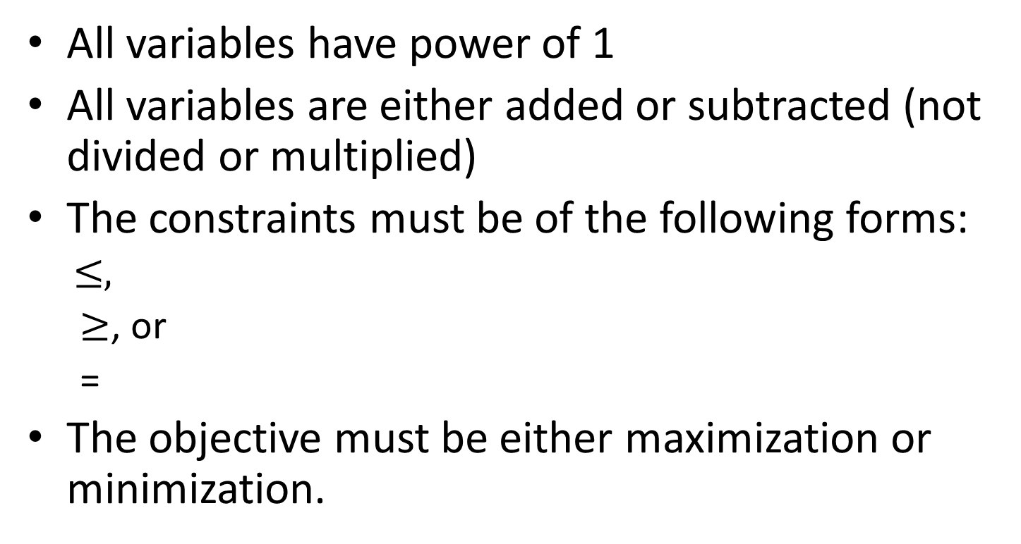
Linear Programming
All variables have power of 1
All variables are either added or subtracted (not divided or multiplied)
The constraints must be of the following forms:
  $$≤,$$
  $≥$, or
  =
The objective must be either maximization or minimization.

Slide 9
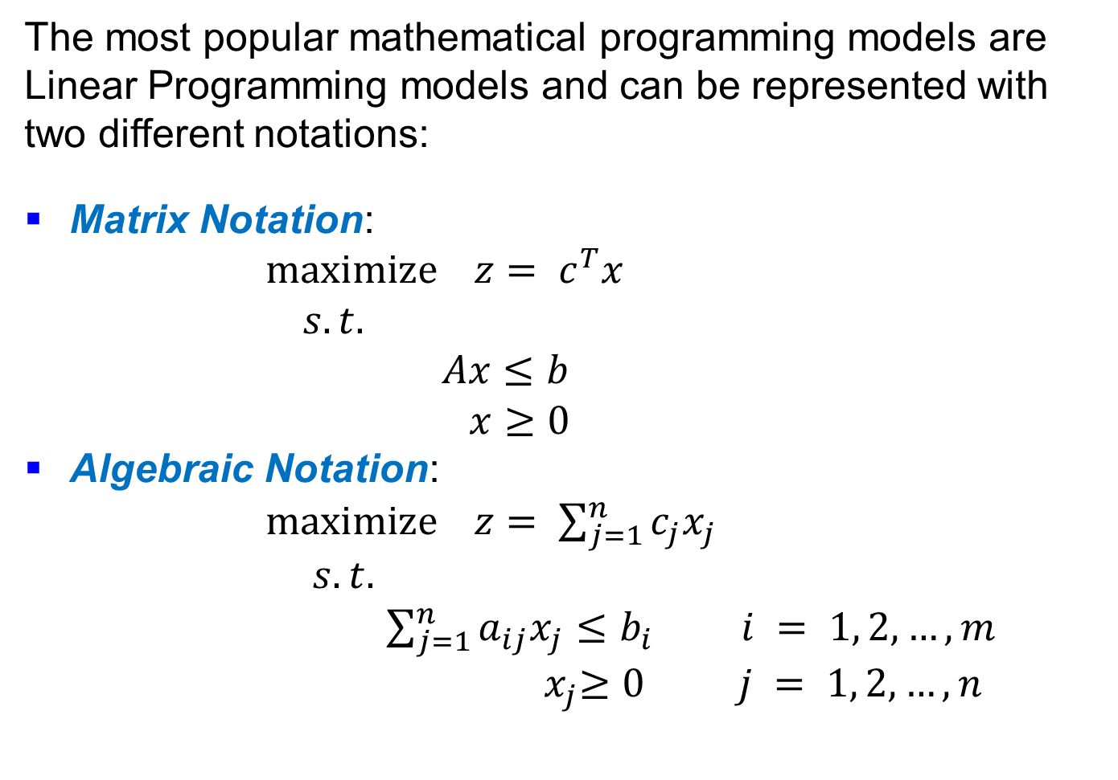
Linear Programming Models
The most popular mathematical programming models are Linear Programming models and can be represented with two different notations:
Matrix Notation:
$\operatorname{maximize}{z}= c^{T}x$
$s.t.$
$Ax≤b$
$x≥0$
Algebraic Notation:
$\operatorname{maximize}{z}= \sum_{j=1}^{n}{c_{j}x_{j}}$
$s.t.$
$\sum_{j=1}^{n}{a_{ij}x_{j}}≤b_{i }i = 1, 2, …,m$
${ x}_{j}≥0 j = 1, 2, …,n$

Slide 10
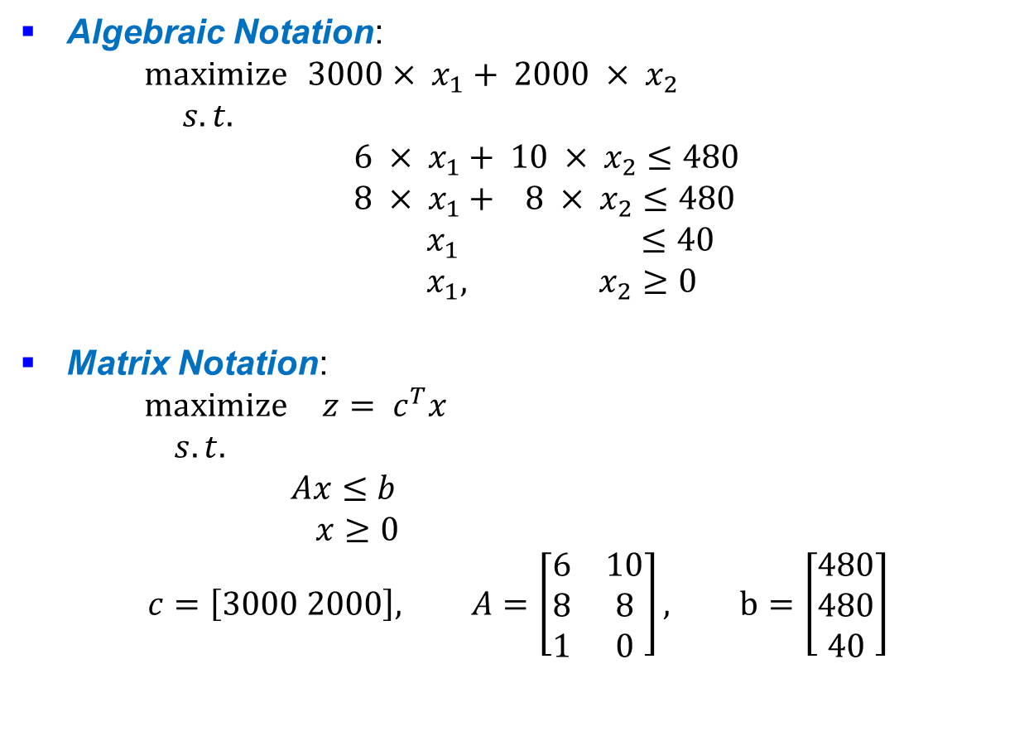
Linear Programming Example:
Automotive Manufacturing Plant
Algebraic Notation:
$\operatorname{maximize}{3000}× x_{1}+ 2000 × x_{2}$
$s.t.$
$6 × x_{1}+ 10 × x_{2}≤480$
$8 × x_{1}+ 8 × x_{2}≤480$
${ x}_{1} ≤40$
${ x}_{1}, { x}_{2} ≥0$
Matrix Notation:
$\operatorname{maximize}{z}= c^{T}x$
$s.t.$
$Ax≤b$
$x≥0$
$$c=\left[3000 2000\right], A=\left[\begin{matrix}6 & 10 \\ 8 & 8 \\ 1 & 0\end{matrix}\right], b=\left[\begin{matrix}480 \\ 480 \\ 40\end{matrix}\right]$$

Slide 11
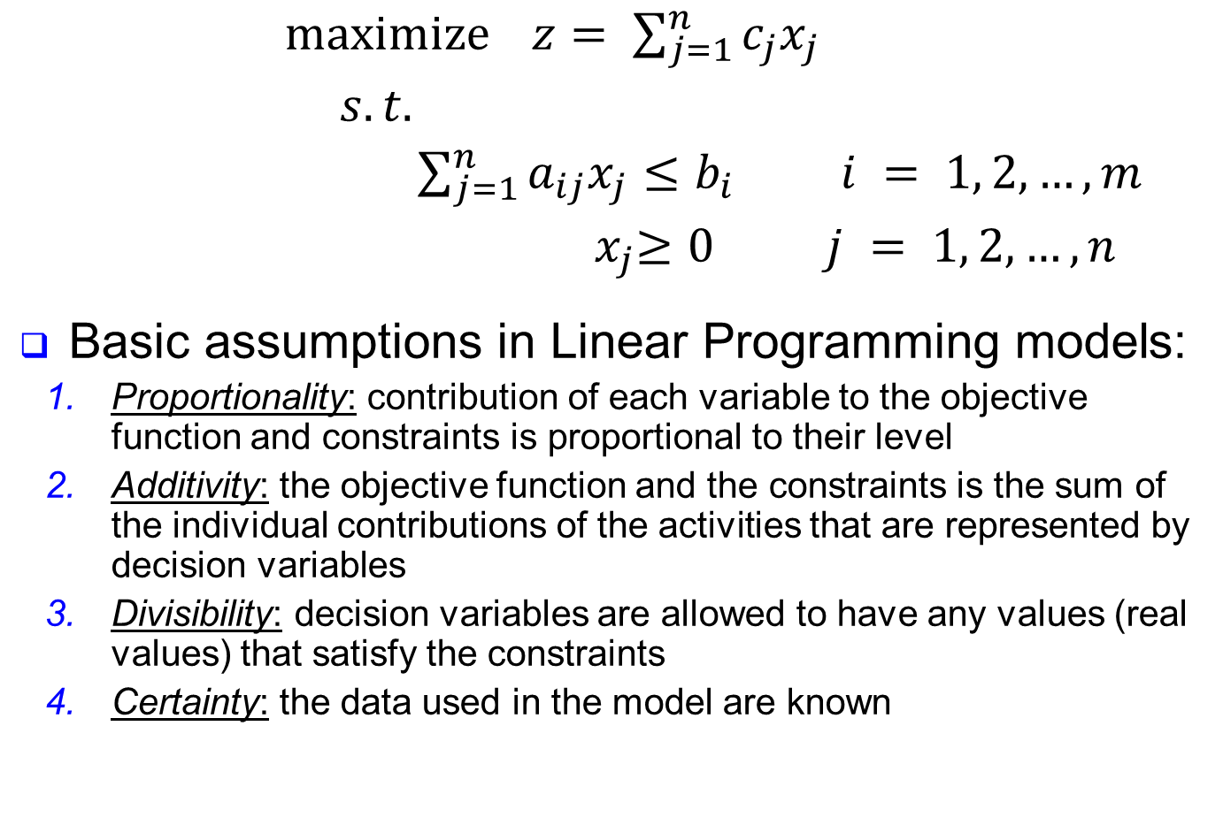
Linear Programming Models
$\operatorname{maximize}{z}= \sum_{j=1}^{n}{c_{j}x_{j}}$
$s.t.$
$\sum_{j=1}^{n}{a_{ij}x_{j}}≤b_{i }i = 1, 2, …,m$
${ x}_{j}≥0 j = 1, 2, …,n$
Basic assumptions in Linear Programming models:
    Proportionality: contribution of each variable to the objective function and constraints is proportional to their level
    Additivity: the objective function and the constraints is the sum of the individual contributions of the activities that are represented by decision variables
    Divisibility: decision variables are allowed to have any values (real values) that satisfy the constraints
    Certainty: the data used in the model are known

Slide 12
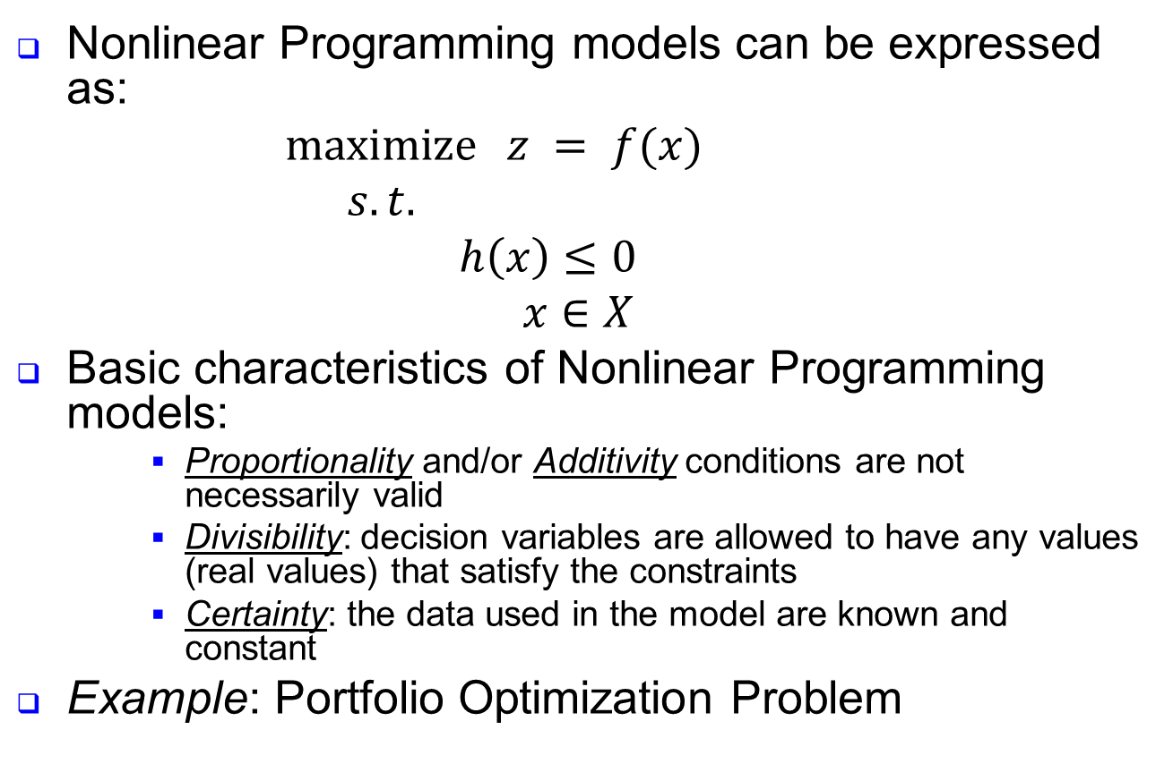
Nonlinear Programming Models
Nonlinear Programming models can be expressed as:
$maximize ⁡z = f(x)$
$s.t.$
$h\left(x\right)≤0$
$x∈X$
Basic characteristics of Nonlinear Programming models:
    Proportionality and/or Additivity conditions are not necessarily valid
    Divisibility: decision variables are allowed to have any values (real values) that satisfy the constraints
    Certainty: the data used in the model are known and constant
Example: Portfolio Optimization Problem

Slide 13
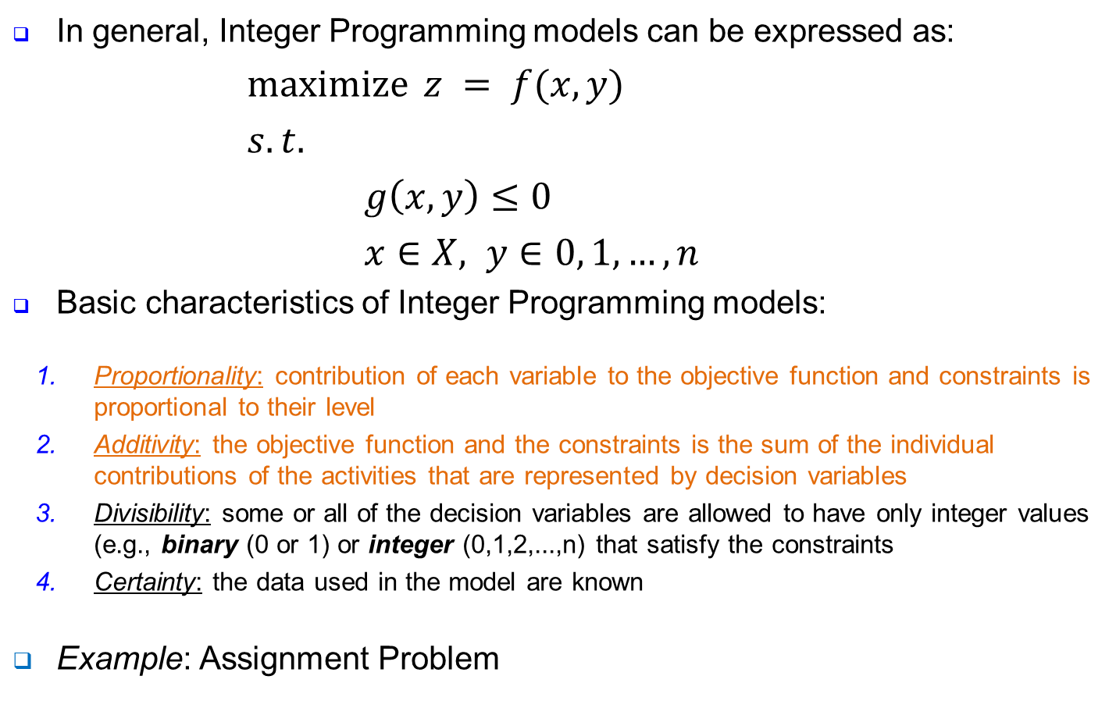
Integer Linear Programming Models
In general, Integer Programming models can be expressed as:
$maximize ⁡z = f(x, y)$
$s.t.$
$g\left(x, y\right)≤0$
$x∈X, y∈0, 1, …, n$
Basic characteristics of Integer Programming models:
    Proportionality: contribution of each variable to the objective function and constraints is proportional to their level
    Additivity: the objective function and the constraints is the sum of the individual contributions of the activities that are represented by decision variables
    Divisibility: some or all of the decision variables are allowed to have only integer values (e.g., binary (0 or 1) or integer (0,1,2,...,n) that satisfy the constraints
    Certainty: the data used in the model are known
Example: Assignment Problem

Slide 14
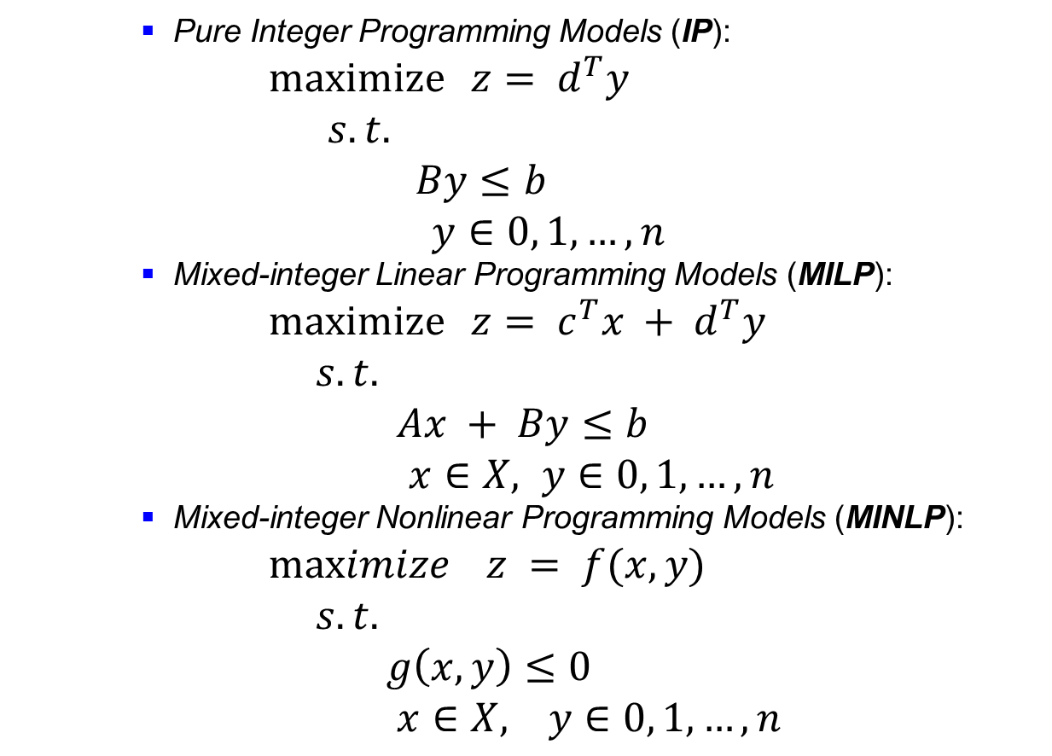
Basic Forms of Integer Programming Models
    Pure Integer Programming Models (IP):
$\operatorname{maximize}{z}= d^{T}y$
$s.t.$
$By≤b$
$y∈0, 1, …, n$
    Mixed-integer Linear Programming Models (MILP):
$\operatorname{maximize}{z}= c^{T}x + d^{T}y$
$s.t.$
$Ax + By≤b$
$x∈X, y∈0, 1, …, n$
    Mixed-integer Nonlinear Programming Models (MINLP):
$maximize ⁡z = f(x, y)$
$s.t.$
$g\left(x, y\right)≤0$
$x∈X, y∈0, 1, …, n$

Slide 15
Example: Automotive Manufacturing Plant
Process Flow Diagram:
Problem Data:
Vehicle
Body
Paint
Shop
Painted Vehicle
Assembly
Shop
Finished Vehicle
Shop
Processing Time (min/unit)
Available Time
(min/day)
Truck
Car
Paint 6 10 480
8
480
Assembly
8
Profit
(TL/unit)
3000
2000
The marketing division reports that it would be impossible to sell more than 40 trucks a day.

Slide 16
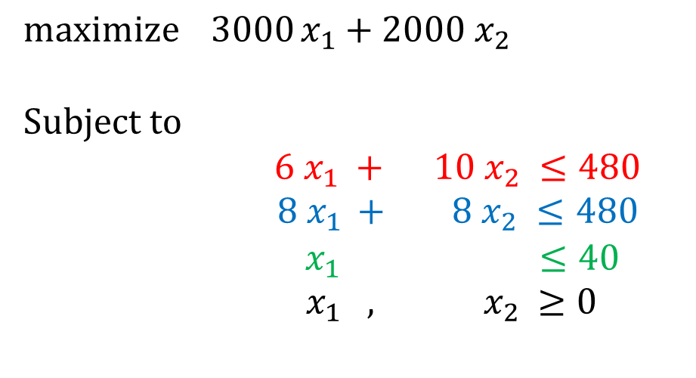
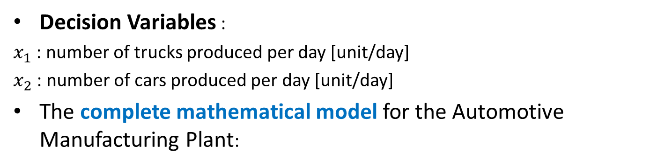
Example: Decision Variables
Decision Variables :
$x_{1}$ : number of trucks produced per day [unit/day]
$x_{2}$ : number of cars produced per day [unit/day]
The complete mathematical model for the Automotive Manufacturing Plant:
$$\operatorname{maximize}{3000}x_{1}+2000 x_{2}$$
Subject to
$$6 x_{1} + 10 x_{2} ≤480$$
$8 x_{1 }+ 8 x_{2} ≤480$
${ x}_{1} ≤40$
$x_{1} , { x}_{2} ≥0$
Constraint 1
Constraint 2
Constraint 3
Nonnegativity constraint

Slide 17
Graphical Representation
What can be shown?
The objective function and the constraints of the model, and
Solutions to the problem through the model

Slide 18
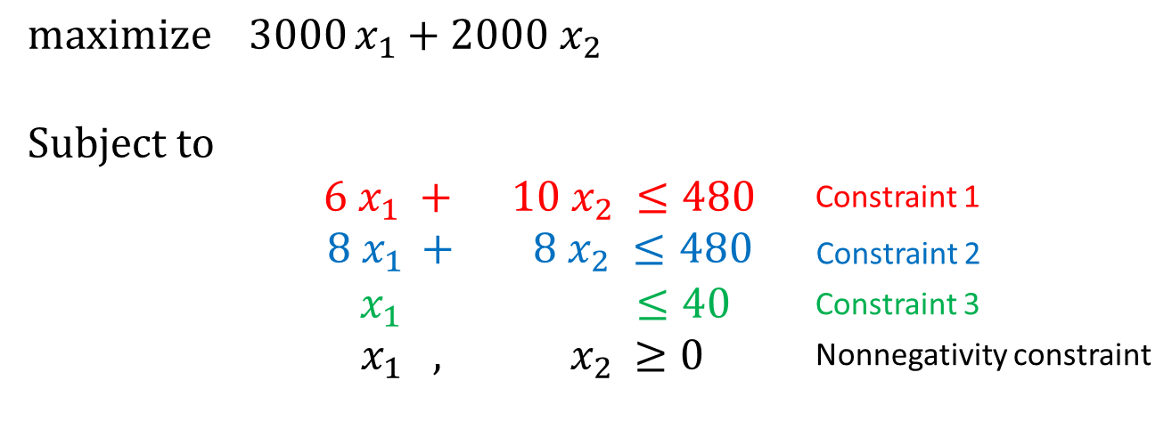
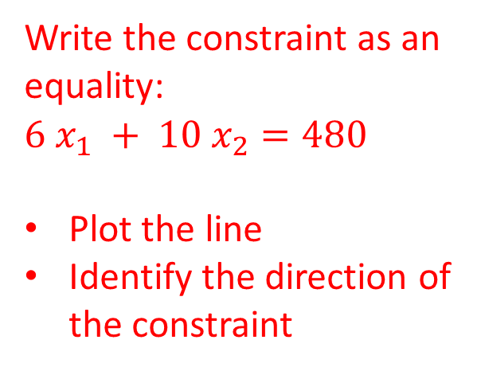

Graphical Representation of the Problem
$$6 x_{1} + 10 x_{2} ≤480$$
Constraint 1
Write the constraint as an equality:
$$6 x_{1} + 10 x_{2}=480$$
Plot the line
Identify the direction of the constraint
x
2
10 20 30 40 50 60 70
Constraint 1
50 60 70 80
^{x}₁
10
20
30
40

Slide 19


Graphical Representation of the Problem
$$8 x_{1 }+ 8 x_{2} ≤480$$
Constraint 2
Write the constraint as an equality:
$$8 x_{1} +8 x_{2}=480$$
Plot the line
Identify the direction of the constraint
x
2
Constraint 2
10 20 30 40 50 60 70
Constraint 1
50 60 70 80
^{x}₁
10
20
30
40

Slide 20
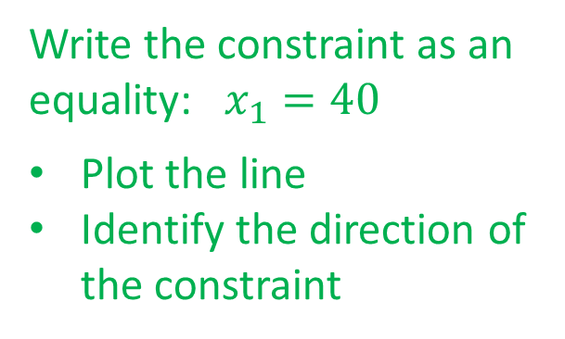

Graphical Representation of the Problem
Write the constraint as an equality: $x_{1}=40$
Plot the line
Identify the direction of the constraint
$${ x}_{1} ≤40$$
Constraint 3
x
2
Constraint 3
Constraint 2
10 20 30 40 50 60 70
Constraint 1
50 60 70 80
^{x}₁
10
20
30
40

Slide 21

Graphical Representation of the Problem
Write the constraints as an equality
Plot the lines
Identify the direction of the constraint
$$x_{1} , { x}_{2} ≥0$$
Nonnegativity constraints
x
2
Constraint 3
Constraint 2
10 20 30 40 50 60 70
Constraint 1
50 60 70 80
^{x}₁
10
20
30
40

Slide 22
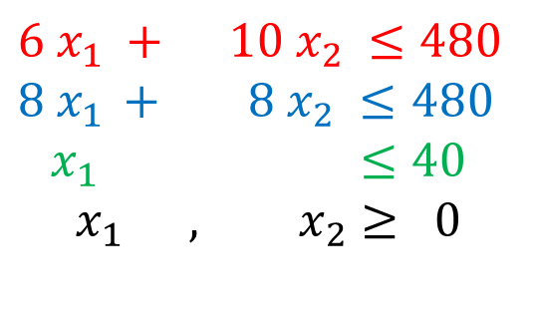
Graphical Representation of the Problem
$$6 x_{1} + 10 x_{2} ≤480$$
$$8 x_{1 }+ 8 x_{2} ≤480$$
${ x}_{1} ≤40$
$$x_{1} , x_{2}≥ 0$$
x
2
Constraint 3
The set of all points
that satisfy all the
constraints of the
model is called a
Constraint 2
10 20 30 40 50 60 70
Feasible region
Constraint 1
50 60 70 80
^{x}₁
10
20
30
40

Slide 23
Solution of Problems
Solution: A solution to a mathematical model is obtained by specifying certain values for decision variables.
    Example: x₁ = 0, x₂ = 0 is a solution
Graphical Representation of the Automative Manufacturing Plant Problem:
x
2
Constraint 3
Constraint 2
10 20 30 40 50 60 70
Feasible region
Constraint 1
50 60 70 80
^{x}₁
10
20
30
40

Slide 24
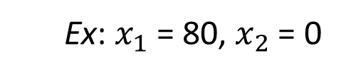
Analysis of Solutions
Solution: A solution to a mathematical problem is obtained by
specifying certain values for decision variables. Solutions are
categorized as follows:
  Infeasible Solutions: If a solution does not satisfy at least one of the constraints, then the solution is infeasible.
x
2
Infeasible
10 20 30 40 50 60 70
  Ex: $x_{1}$ = 80, $x_{2}$ = 0
Constraints 2 and 3 are not satisfied.
Feasible
50 60 70 80
^{x}₁
10
20
30
40

Slide 25
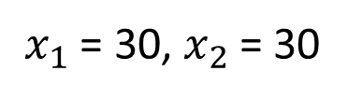
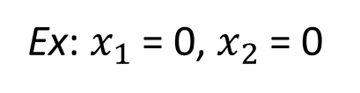
Analysis of Solutions
Solution: A solution to a mathematical problem is obtained by
specifying certain values for decision variables. Solutions are
categorized as follows:
Feasible Solutions: If a solution satisfies all of the constraints, then the solution is feasible.
x
2
10 20 30 40 50 60 70
Ex: $x_{1}$ = 0, $x_{2}$ = 0
or
$x_{1}$ = 30, $x_{2}$ = 30
50 60 70 80
^{x}₁
10
20
30
40

Slide 26
Analysis of Solutions
Solution: A solution to a mathematical problem can be idenfied by the points in the feasible region as follows:
x
2
Interior Points
Boundary Points
An extreme point (vertex) is the intersection of constraints that lies at the boundary of the feasible region.
10 20 30 40 50 60 70
Extreme Points
50 60 70 80
^{x}₁
10
20
30
40

Slide 27
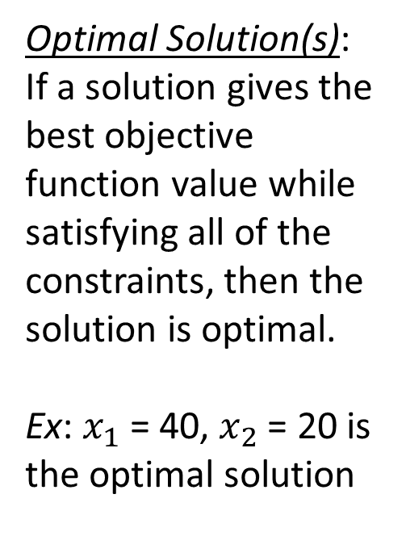
Analysis of Solutions
Solution: A solution to a mathematical problem is obtained by
specifying certain values for decision variables. Solutions are
categorized as follows:
Optimal Solution(s): If a solution gives the best objective function value while satisfying all of the constraints, then the solution is optimal.
Ex: $x_{1}$ = 40, $x_{2}$ = 20 is the optimal solution
x
2
10 20 30 40 50 60 70
50 60 70 80
^{x}₁
10
20
30
40

Slide 28

Analysis of Solutions
Solution: A solution to a mathematical problem is obtained by
specifying certain values for decision variables. Solutions are
categorized as follows:
x
2
Unbounded Solution(s): If a solution can be made infinitely large without violating any of the constraints in the problem, then the solution is unbounded.
Constraint 3
$$\operatorname{maximize}{3000}x_{1}+2000 x_{2}$$
Constraint 2
10 20 30 40 50 60 70
Constraint 1
50 60 70 80
^{x}₁
10
20
30
40

