Slide 1
INDR 100
INTRODUCTION TO INDUSTRIAL ENGINEERING
Introduction to Logistics
Koç University

Slide 2
Logistics vs. Supply Chain Management
What is "Supply Chain Management?"
Supply Chain Management is the integration of key business processes from end user through original suppliers, that provides products, services, and information that add value for customers and other stakeholders.
What is "Logistics Management?"
Logistics is that part of the supply chain process that plans, implements, and controls the efficient, effective flow and storage of goods, services, and related information from point of origin to point of consumption in order to meet a customers' requirements.
Notes:
Logistics is a specialized field of its own comprised of shipping, warehousing, courier services, road/rail transportation, and air freight.

Slide 3
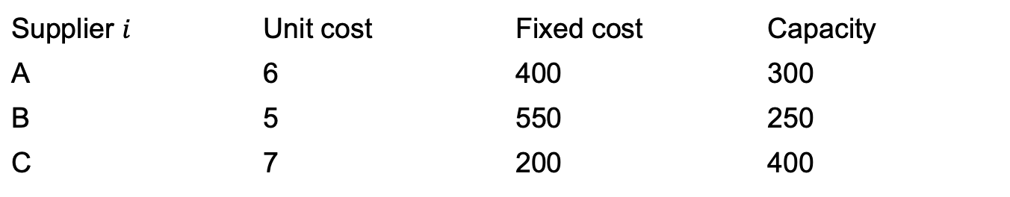
Supplier selection problem
A firm needs 500 units of a component.
It can buy from 3 suppliers.
If a supplier is used, there is a fixed contracting cost.
Each supplier also has a capacity and a unit cost.
The firm wants to minimize total cost.
Supplier $i$ | Unit cost | Fixed cost | Capacity
A | 6 | 400 | 300
B | 5 | 550 | 250
C | 7 | 200 | 400

Slide 4
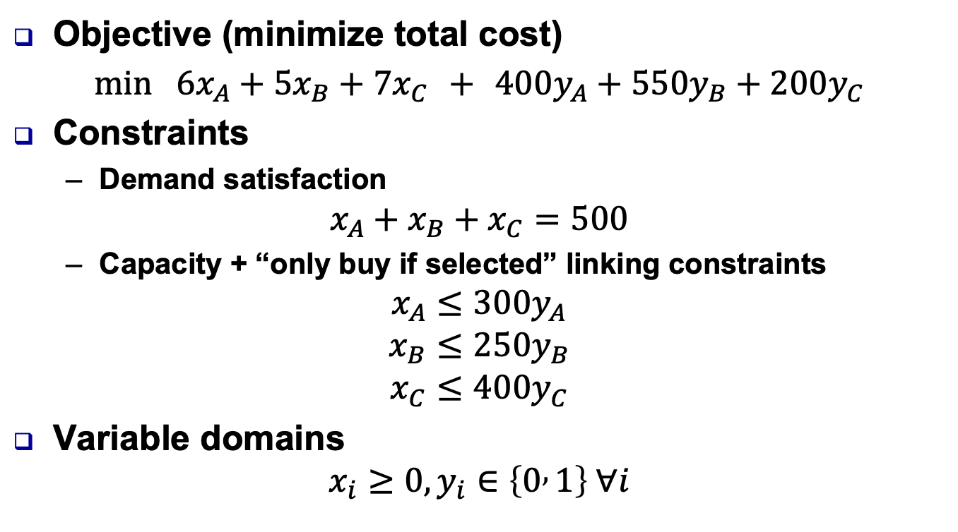
MILP model
Objective (minimize total cost)
$$\min{ }6x_{A}+5x_{B}+7x_{C} + 400y_{A}+550y_{B}+200y_{C}$$
Constraints
  Demand satisfaction
$$x_{A}+x_{B}+x_{C}=500$$
  Capacity + “only buy if selected” linking constraints
$$x_{A}≤300y_{A}$$
$$x_{B}≤250y_{B}$$
$$x_{C}≤400y_{C}$$
Variable domains
$$x_{i}≥0, y_{i}∈\left\{0 , 1\right\} ∀i$$

Slide 5
Class Exercise
Now assume that it is required that if a supplier is selected at least 200 items must be purchased from that suppliers.

Slide 6
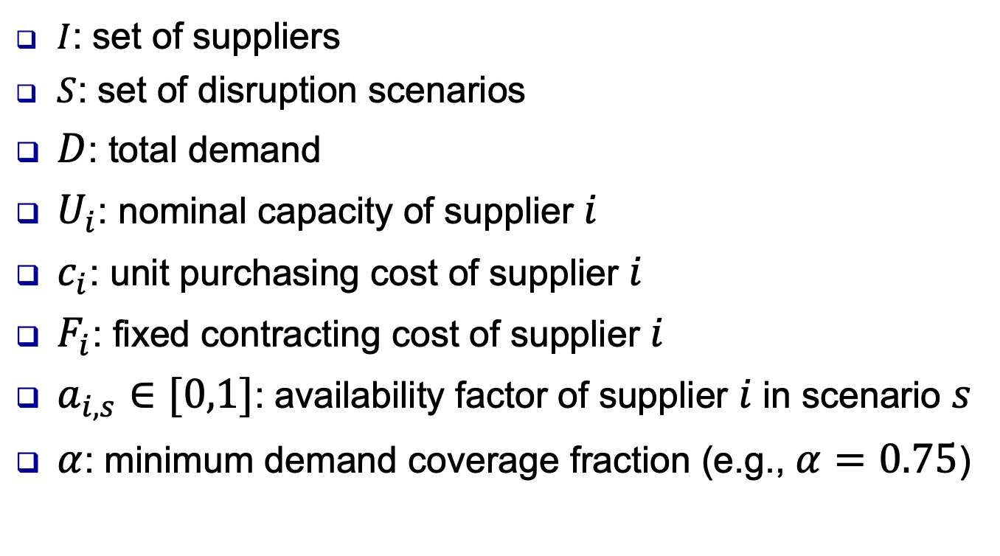
Robust Supplier Selection under Correlated Disruptions
$I$: set of suppliers
$S$: set of disruption scenarios
$D$: total demand
$U_{i}$: nominal capacity of supplier $i$
$c_{i}$: unit purchasing cost of supplier $i$
$F_{i}$: fixed contracting cost of supplier $i$
$a_{i,s}∈[0,1]$: availability factor of supplier $i$in scenario $s$
$α$: minimum demand coverage fraction (e.g., $α=0.75$)

Slide 7
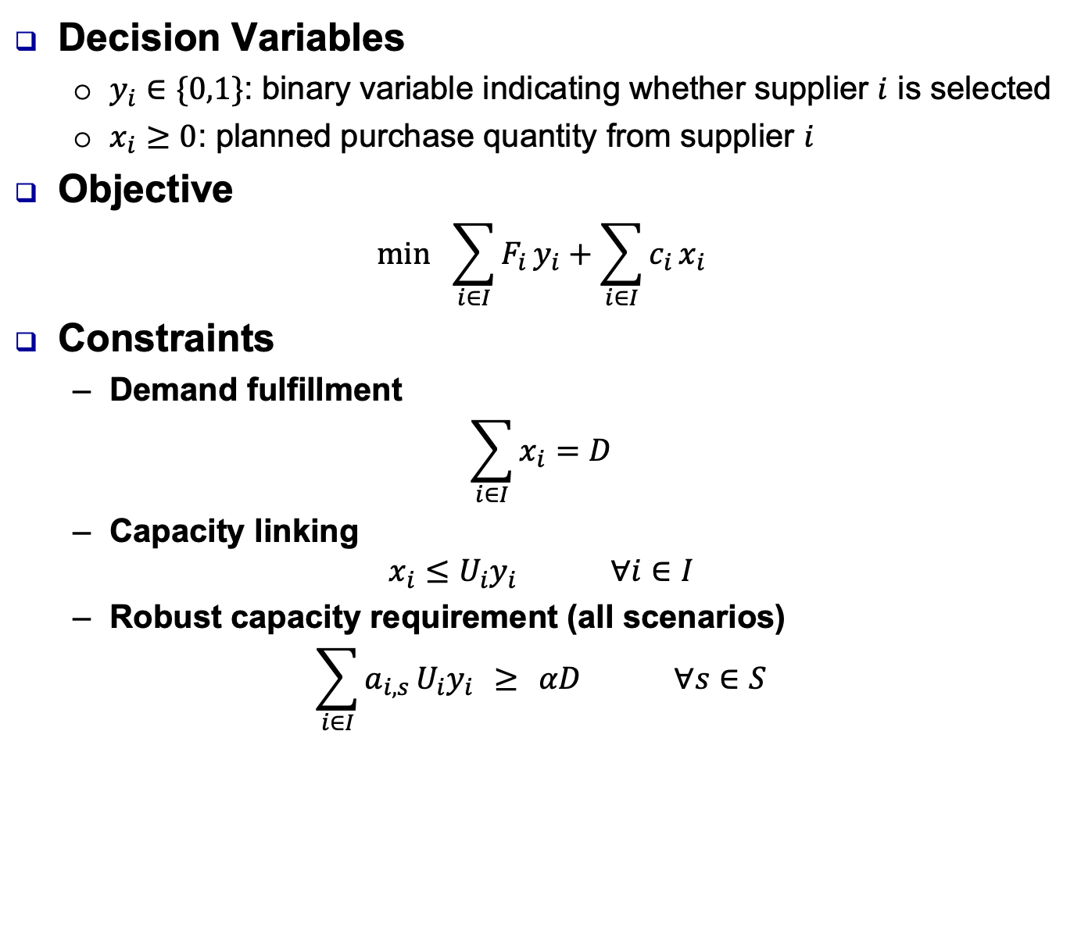
MILP model
Decision Variables
  $y_{i}∈\{0,1\}$: binary variable indicating whether supplier $i$ is selected
  $x_{i}≥0$: planned purchase quantity from supplier $i$
Objective
$$\min{ }\sum_{i∈I}{F_{i}}y_{i}+\sum_{i∈I}{c_{i}}x_{i}$$
Constraints
  Demand fulfillment
$$\sum_{i∈I}{x_{i}}=D$$
  Capacity linking
$$x_{i}≤U_{i}y_{i} ∀i∈I$$
  Robust capacity requirement (all scenarios)
$$\sum_{i∈I}{a_{i,s}}U_{i}y_{i} ≥ αD ∀s∈S$$

Slide 8
Why Logistics as part of Industrial Eng.?
Logistics is an ever-growing sector in Turkey
People with an education on Logistics, esp. Industrial Engineers, are in high demand in this sector
You can have a focused education in Logistics and Supply Chain as part of the Industrial Engineering curriculum
  By taking
    INDR 483 Supply Chain Modeling and Analysis (Fall)
    INDR 484 Logistics Management (Spring)
  And by taking at least one of the following courses:
    INDR 420 Network Models and Optimization
    INDR 430 Decision Analysis
    INDR 440 Project Management
    INDR 460 Operations Research Applications
    INDR 471 Service Operations Analysis

Slide 9
Logistics Mission
Logistics deals with the planning and control of material flows and related information in organizations.
Broadly speaking, its mission is to provide the right materials at the right place and at the right time,
while optimizing a given performance measure
subject to a given set of constraints!

Slide 10


Importance of Transportation
A typical supply chain structure
Raw Material Sources
Consumers
Suppliers
Manufacturers
Distributors
Retailers
Customers
Logistics is an ever-growing sector in Turkey
logistics
Transportation cost: 39% of all logistics cost

Slide 11
Cost distribution within logistics
Transportation: 39%
Warehousing and distribution: 25%
Inventory holding and losses: 24%
Order processing: 6%
Administrative: 4%

Slide 12
Full Truckload Distribution
A company operates several warehouses that supply products to a set of geographically dispersed customers.
Each warehouse has a limited amount of inventory available for shipment.
Deliveries are made using full-truckload transportation, where each truck has a fixed carrying capacity and incurs a lane-specific cost depending on the warehouse–customer pair.
Multiple trucks can be dispatched on the same lane if needed.
The company must decide how many trucks to send from each warehouse to each customer so that customer demands are satisfied and warehouse capacity limits are respected, while minimizing total transportation cost.

Slide 13
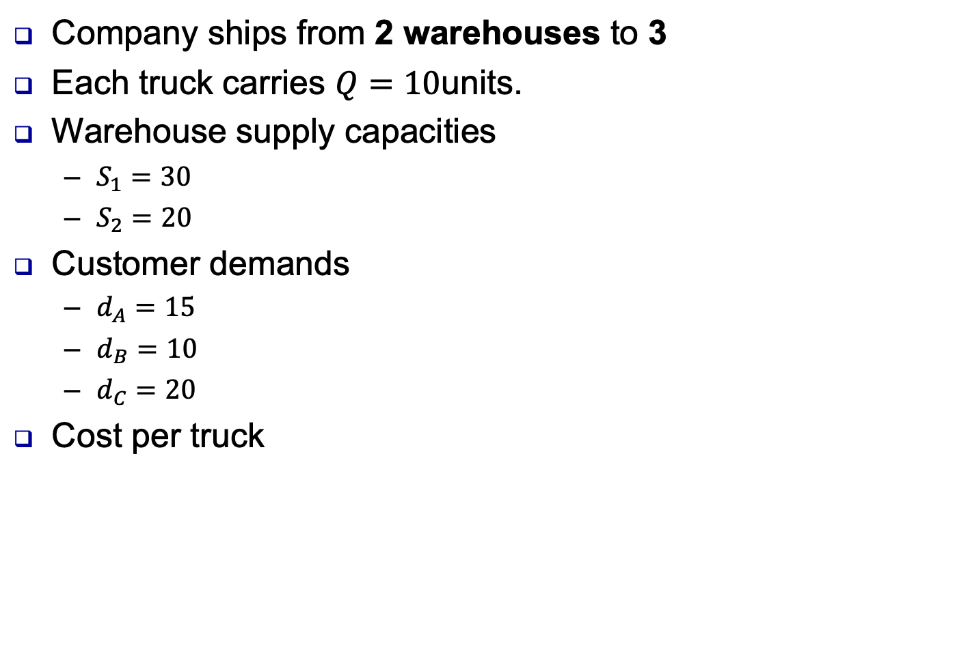
Full Truckload Distribution
Company ships from 2 warehouses to 3
Each truck carries $Q=10$units.
Warehouse supply capacities
  $S_{1}=30$
  $S_{2}=20$
Customer demands
  $d_{A}=15$
  $d_{B}=10$
  $d_{C}=20$
Cost per truck
 | Customer A | Customer B | Customer C
Warehouse 1 | 40 | 30 | 50
Warehouse 2 | 35 | 45 | 30

Slide 14
Class Exercise
A company is planning to open distribution centers (DCs) to serve a set of retail stores.
Each potential DC has a fixed opening cost and a limited capacity.
Each store has a known demand, and shipping one unit of product from a DC to a store incurs a unit transportation cost.
The company must decide:
  Which DCs to open, and
  How much to ship from each open DC to each store,
so that all store demands are satisfied at minimum total cost.

Slide 15
Class Exercise
DC (i) | Fixed opening cost (F_i) | Capacity (U_i)
1 | 500 | 60
2 | 400 | 50
3 | 300 | 40
Store (j) | Demand (d_j)
A | 30
B | 40
C | 30
(unit transportation cost) | A | B | C
DC 1 | 4 | 6 | 5
DC 2 | 5 | 4 | 6
DC 3 | 6 | 5 | 4

Slide 16
Less Than Truckload (LTL) Distribution
Vehicle routing in LTL transportation
  Typical questions:
    Given a set of customer orders for a given planning period, is it FEASIBLE and PROFITABLE to add another order with specific characteristics?
    Given a set of customer orders for a given planning period, what is the most cost-efficient way to satisfy them?
  Clearly the second question has to be answered to be able to decide about the first question!
INDR 484 Logistics Management

Slide 17
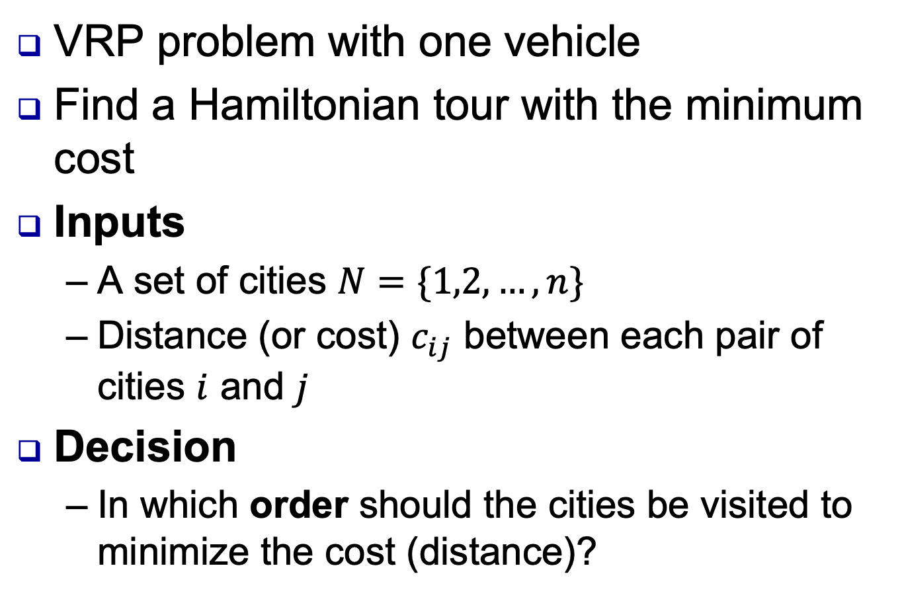
Travelling salesman problem
VRP problem with one vehicle
Find a Hamiltonian tour with the minimum cost
Inputs
  A set of cities $N=\{1,2,…,n\}$
  Distance (or cost) $c_{ij}$ between each pair of cities $i$ and $j$
Decision
  In which order should the cities be visited to minimize the cost (distance)?

Slide 18
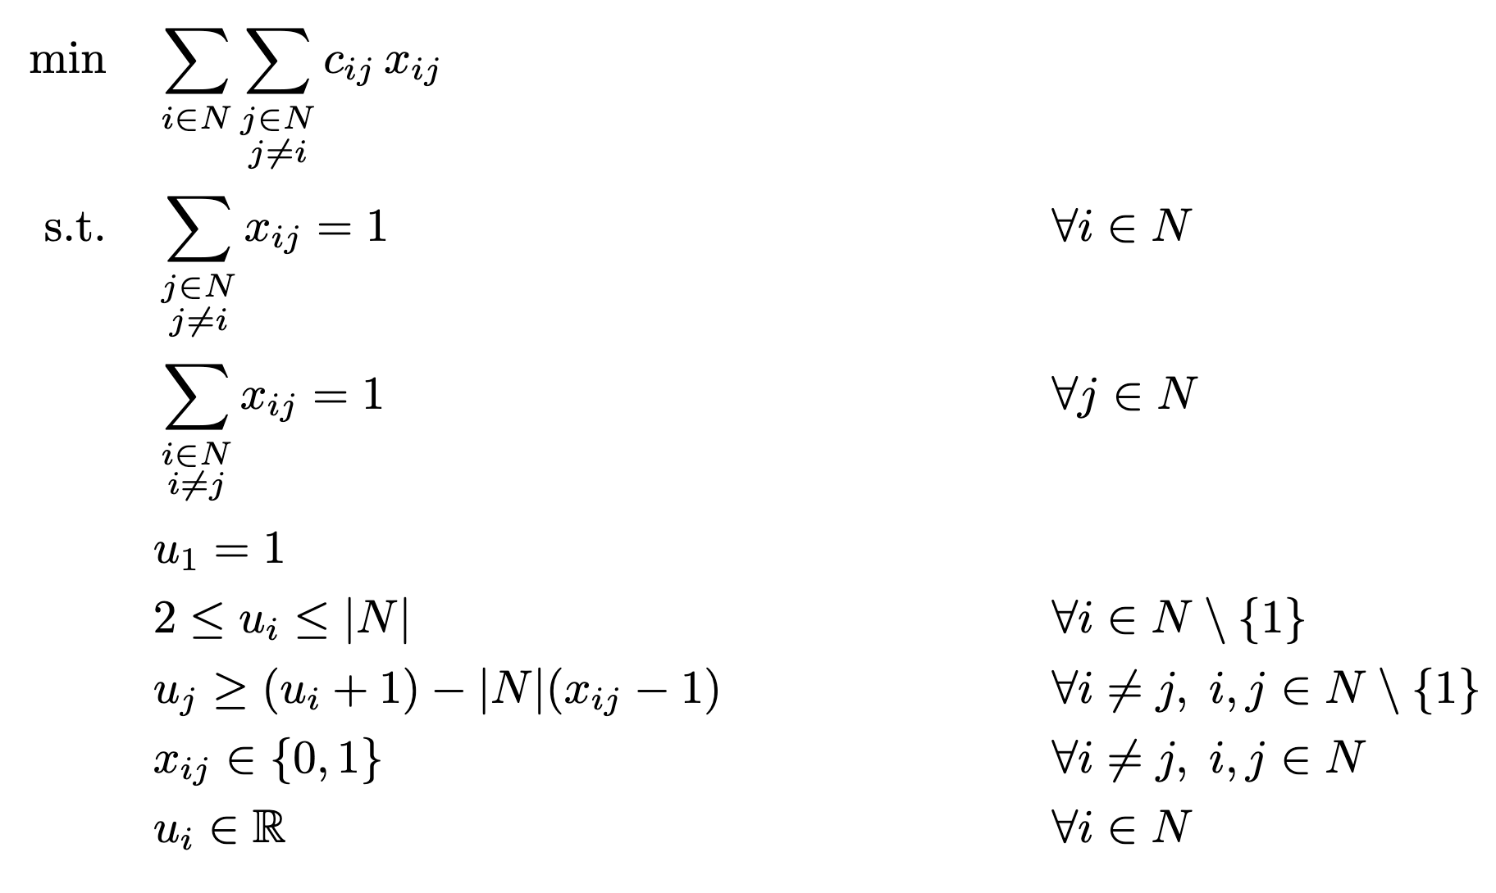
Miller Zemlin Tucker (MTZ) Formulation
+

Slide 19
Nearest Neighbor Heuristic
Idea
  Start from a city and repeatedly visit the closest unvisited city until all cities are visited, then return to the start.

Slide 20
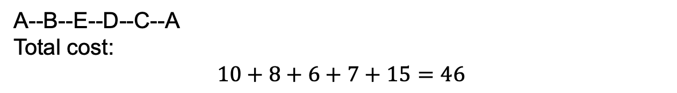
Nearest Neighbor Heuristic
Example
From/To | A | B | C | D | E
A | – | 10 | 15 | 20 | 12
B | 10 | – | 9 | 10 | 8
C | 15 | 9 | – | 7 | 11
D | 20 | 10 | 7 | – | 6
E | 12 | 8 | 11 | 6 | –
A--B--E--D--C--A
Total cost:
$$10+8+6+7+15=46$$

Slide 21
2-opt Heuristic for improvement
Choose two node disjoint edges and remove from the tour
Reconnect the nodes by adding two new edges
Calculate the improvement
If there is improvement make the swap, if not check another pair
Stop when no pair provides an improvement

Slide 22
2-opt improvement
From/To | A | B | C | D | E
A | – | 10 | 15 | 20 | 12
B | 10 | – | 9 | 10 | 8
C | 15 | 9 | – | 7 | 11
D | 20 | 10 | 7 | – | 6
E | 12 | 8 | 11 | 6 | –
A--B--E--D--C--A total cost 46
Try:
- Remove C--A and B--E (total cost 15+8 =23)
- Add C--B and A--E (total cost 9+12 =21)
New tour A--B--C--D--E--A with length 46-2=44

Slide 23
Class Exercise
From / To | A | B | C | D | E | F
A | 0 | 10 | 15 | 20 | 12 | 18
B | 10 | 0 | 9 | 14 | 8 | 11
C | 15 | 9 | 0 | 7 | 10 | 6
D | 20 | 14 | 7 | 0 | 11 | 9
E | 12 | 8 | 10 | 11 | 0 | 13
F | 18 | 11 | 6 | 9 | 13 | 0
Start from A and apply nearest neighborhood heuristic to find an initial TSP tour
Apply 2-opt improvement until you find an improvement

Slide 24
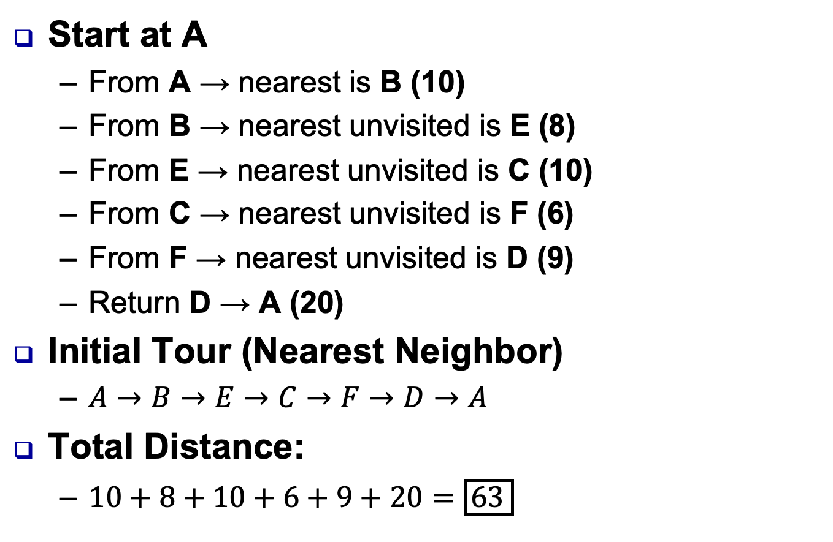
Class Exercise
Start at A
  From A → nearest is B (10)
  From B → nearest unvisited is E (8)
  From E → nearest unvisited is C (10)
  From C → nearest unvisited is F (6)
  From F → nearest unvisited is D (9)
  Return D → A (20)
Initial Tour (Nearest Neighbor)
  $A→B→E→C→F→D→A$
Total Distance:
  $10+8+10+6+9+20=\boxed{63}$

Slide 25
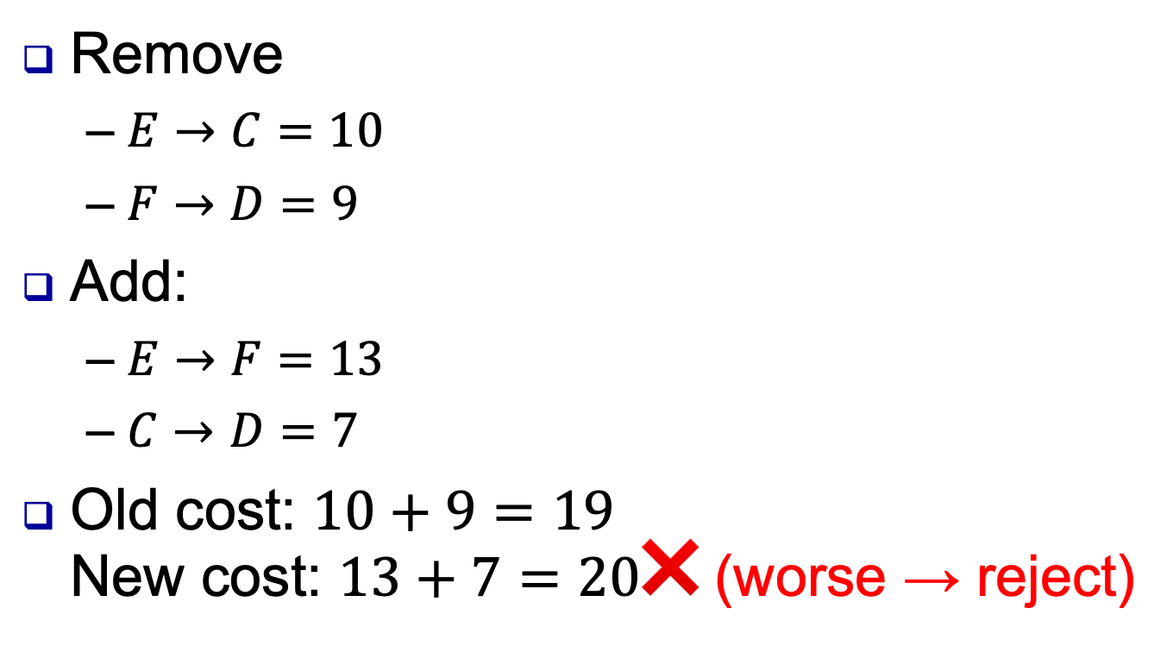
Class Exercise
Remove
  $E→C=10$
  $F→D=9$
Add:
  $E→F=13$
  $C→D=7$
Old cost: $10+9=19$
New cost: $13+7=20$❌ (worse → reject)

Slide 26
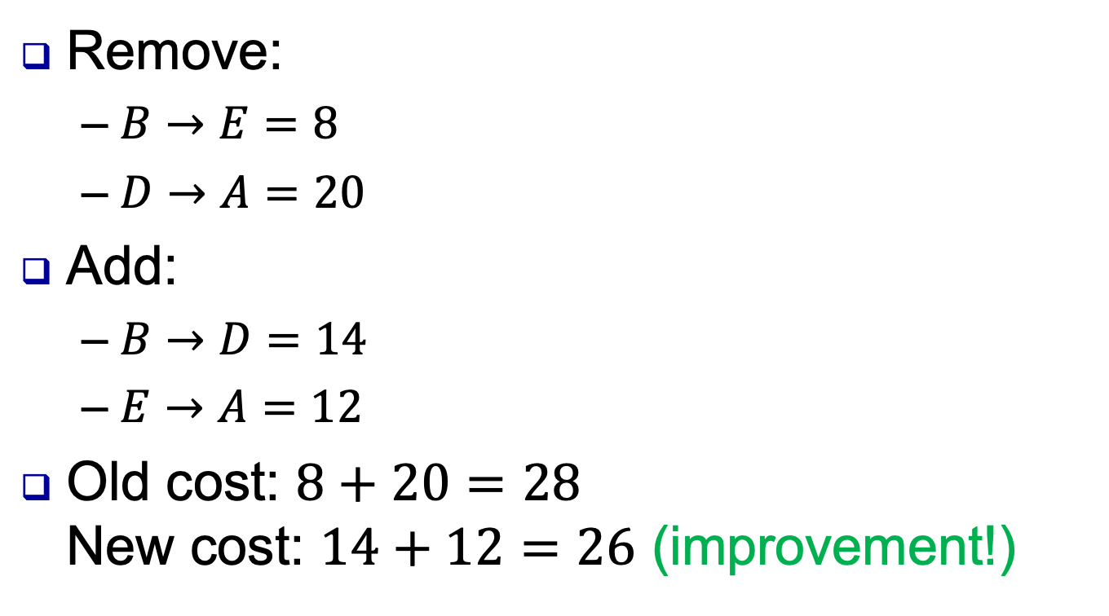
Class Exercise
Remove:
  $B→E=8$
  $D→A=20$
Add:
  $B→D=14$
  $E→A=12$
Old cost: $8+20=28$
New cost: $14+12=26$ (improvement!)

