Slide 1
Mathematical Models
Examples of mathematical models:
  mathematical programming models
  simulation models
  econometric models

Slide 2
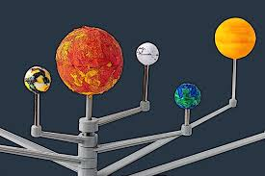
Simulation models
  Definition: A simulation model is a mathematical representation of a real system that allows us to study how it behaves over time under different conditions.

Slide 3
Simulation models
  What we need to build a simulation model:
  System: what we are studying (e.g., coffee shop, factory, hospital)
  Entities: things moving through the system (customers, parts, patients)
  Events: arrivals, service starts, departures
  Logic (data): how the system behaves
  Outputs: performance measures (waiting time, utilization, cost)

Slide 4
Simulation models
  Where industrial engineers use it:
  Manufacturing: machine reliability, production line flow
  Service systems: hospitals, banks, airports
  Logistics: warehouse operations, delivery routing
  Transportation: traffic signal timing, parking management

Slide 5
Simulation models
  Be careful with inputs:
  Garbage in, garbage out
    Collect real world data
    Use theory about potential distributions
    Conduct fitness tests

Slide 6
Simulation models
Validation is the process of checking whether a simulation model accurately represents the real-world system it is meant to imitate.
A model is valid if its outputs behave like the real system’s outputs within an acceptable level of accuracy.
Validation answers the question: Does my model capture reality well enough to be useful?

Slide 7
Validation methods
1. Compare model output with real-world data
- Check whether averages, variances, distributions, or performance measures match observed historical data.
2. Face validity
- Ask domain experts (e.g., managers, operators) if the model’s logic and behavior look reasonable and realistic.
3. Sensitivity analysis
- Change input parameters and see if the model behaves in a believable and consistent way.
- Test the model with very high or very low input values to see if it reacts logically.
4. Trace / step-through debugging
- Follow individual entities (customers, jobs, vehicles) through the simulation to check if the logic works as intended.
5. Comparison with simpler models
- Compare results with theoretical formulas (e.g., M/M/1 queue results), or
simpler hand-made calculations.
- Compare with the results with a simpler but validated simulation

Slide 8
Example
Coffee shop simulation
  Stochastic and time varying customer arrivals
    One customer arrival per minute
  Stochastic service times for the servers (baristas)
    One barista prepares two orders in three minutes
  Customers get impatient and bulk the system if the waiting queue is long
    Customers go to another shop if the queue length is more than five

Slide 9
Class exercise
Setting:
1 barista
FIFO (first-come, first-served) queue
No balking or reneging
Shop opens at time 0, system initially empty
For each customer, find:
  Service start time
  Service completion (departure) time
  Waiting time in queue
Compute:
  Average waiting time
  Maximum queue length
  Barista utilization during the period from the first arrival until the last departure.
Customer | Interarrival time | Service time
1 | 1 | 4
2 | 3 | 2
3 | 2 | 6
4 | 4 | 3

Slide 10
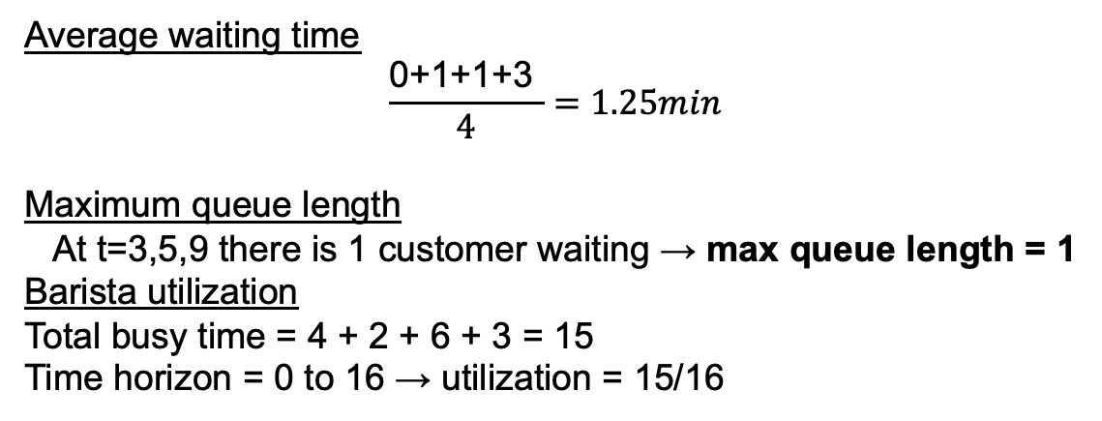
Class Exercise
Cust | Arrival | Service time | Service start | Departure | Waiting time
1 | 1 | 4 | 1 | 5 | 0
2 | 4 | 2 | 5 | 7 | 1
3 | 6 | 6 | 7 | 13 | 1
4 | 10 | 3 | 13 | 16 | 3
Average waiting time
$$\frac{\text{0+}\text{1+1+3 }}{4}=1.25min$$
Maximum queue length
At t=3,5,9 there is 1 customer waiting → max queue length = 1
Barista utilization
Total busy time = 4 + 2 + 6 + 3 = 15
Time horizon = 0 to 16 → utilization = 15/16

