Slide 1
Mathematical Models
Examples of mathematical models:
  mathematical programming models
  simulation models
  econometric models

Slide 2
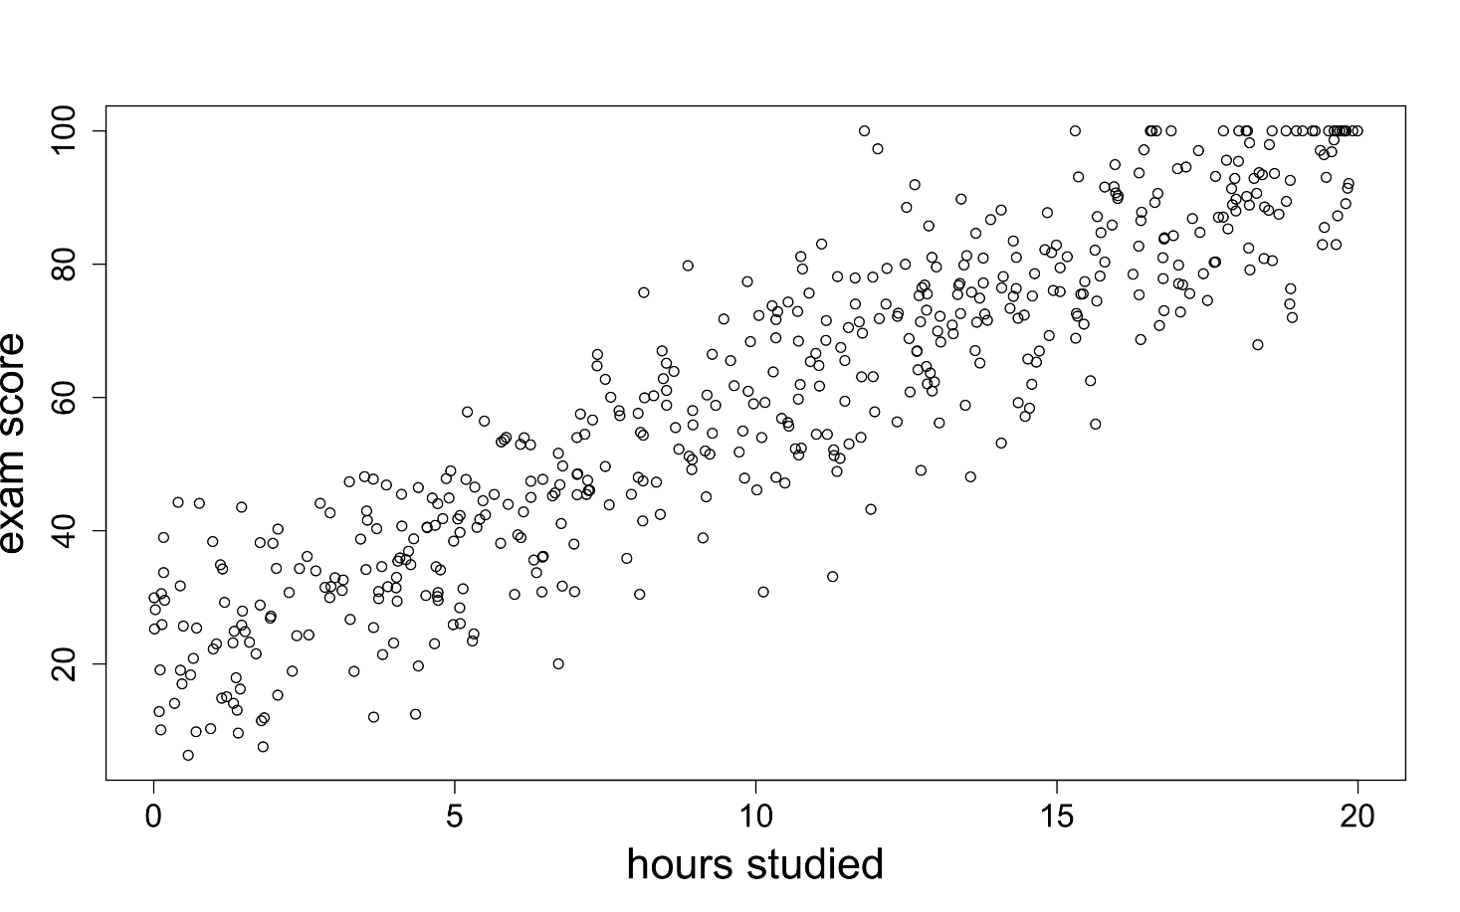
Econometric models
  Definition: Using statistical models to quantify relationships in data to support decisions.
  Causation vs Correlation

Slide 3
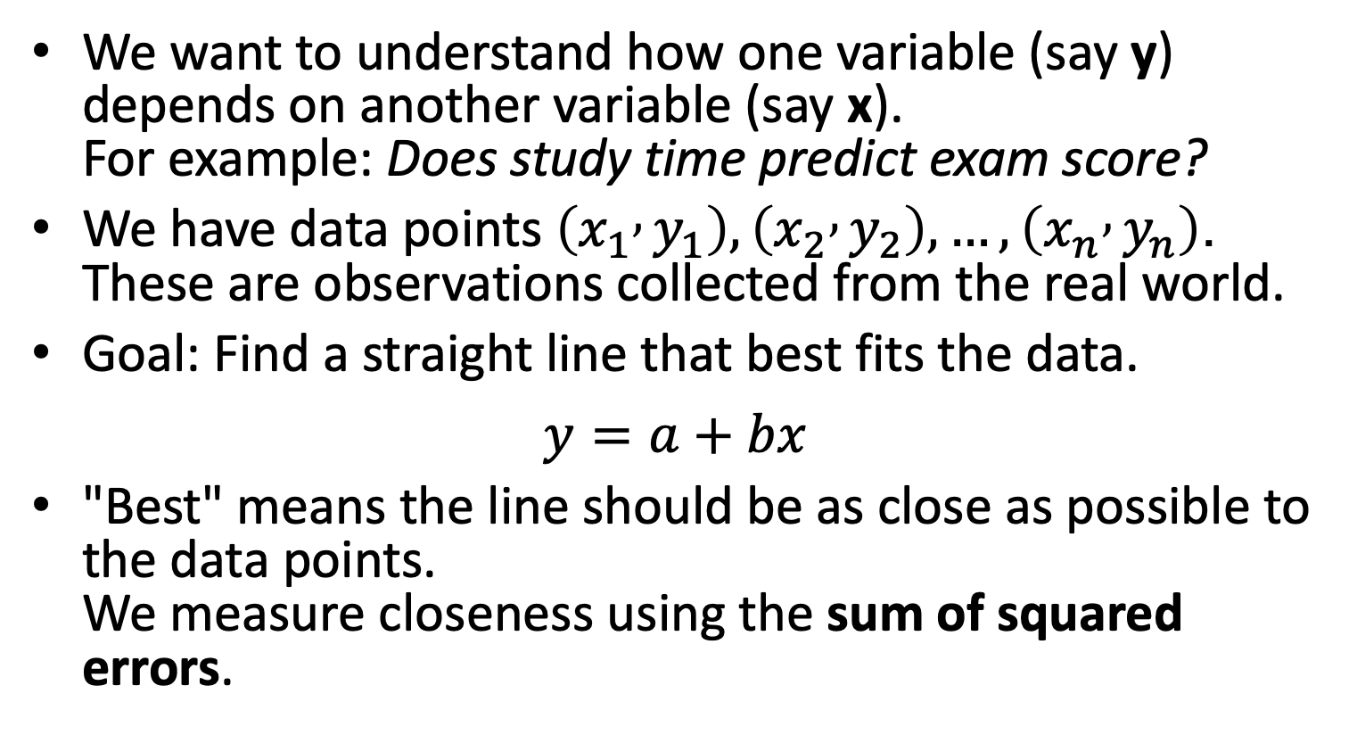
Ordinary Linear Regression
We want to understand how one variable (say y) depends on another variable (say x).
For example: Does study time predict exam score?
We have data points $\left(x_{1} , y_{1}\right),\left(x_{2} , y_{2}\right),…,\left(x_{n} , y_{n}\right)$.
These are observations collected from the real world.
Goal: Find a straight line that best fits the data.
$$y=a+bx$$
"Best" means the line should be as close as possible to the data points.
We measure closeness using the sum of squared errors.

Slide 4
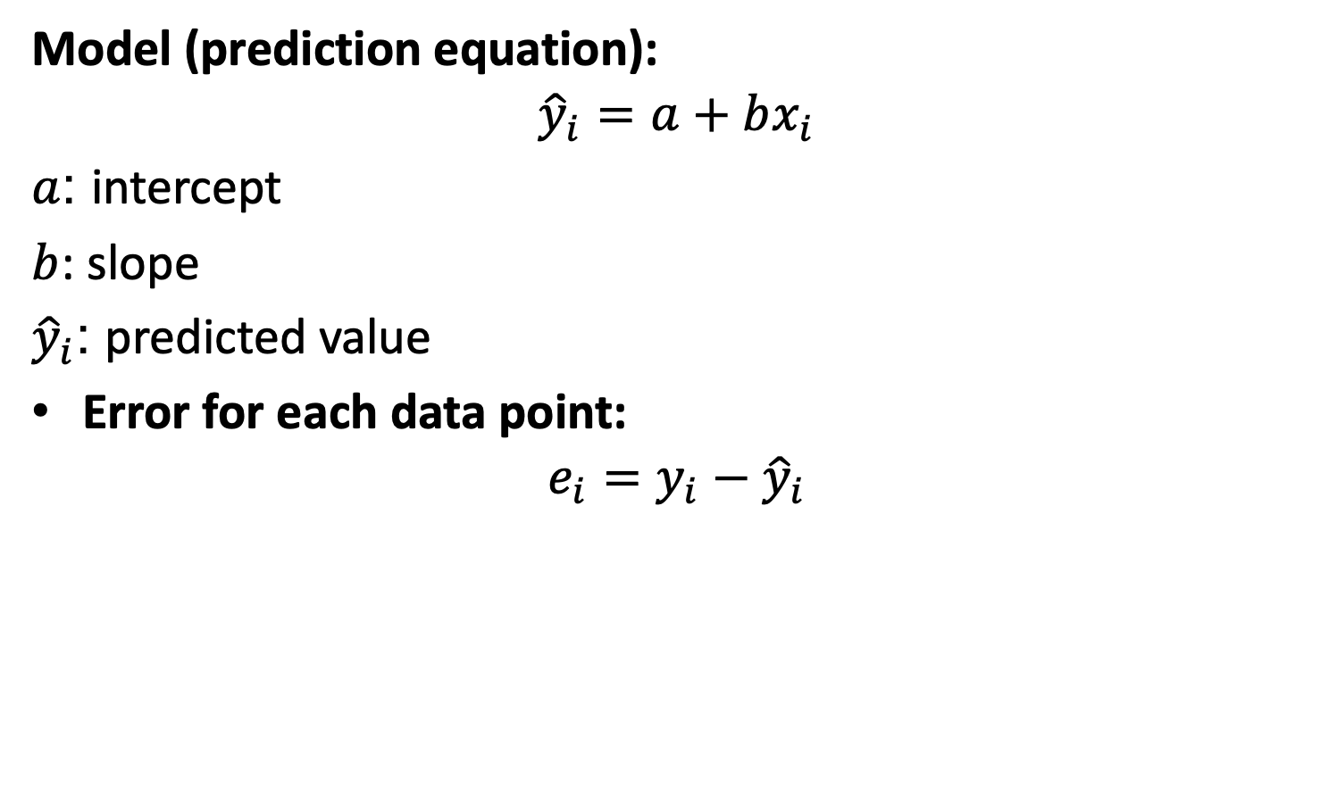
Ordinary Linear Regression
Model (prediction equation):
$${\hat{y}}_{i}=a+bx_{i}$$
$a$: intercept
$b$: slope
${\hat{y}}_{i}$: predicted value
Error for each data point:
$$e_{i}=y_{i}−{\hat{y}}_{i}$$

Slide 5
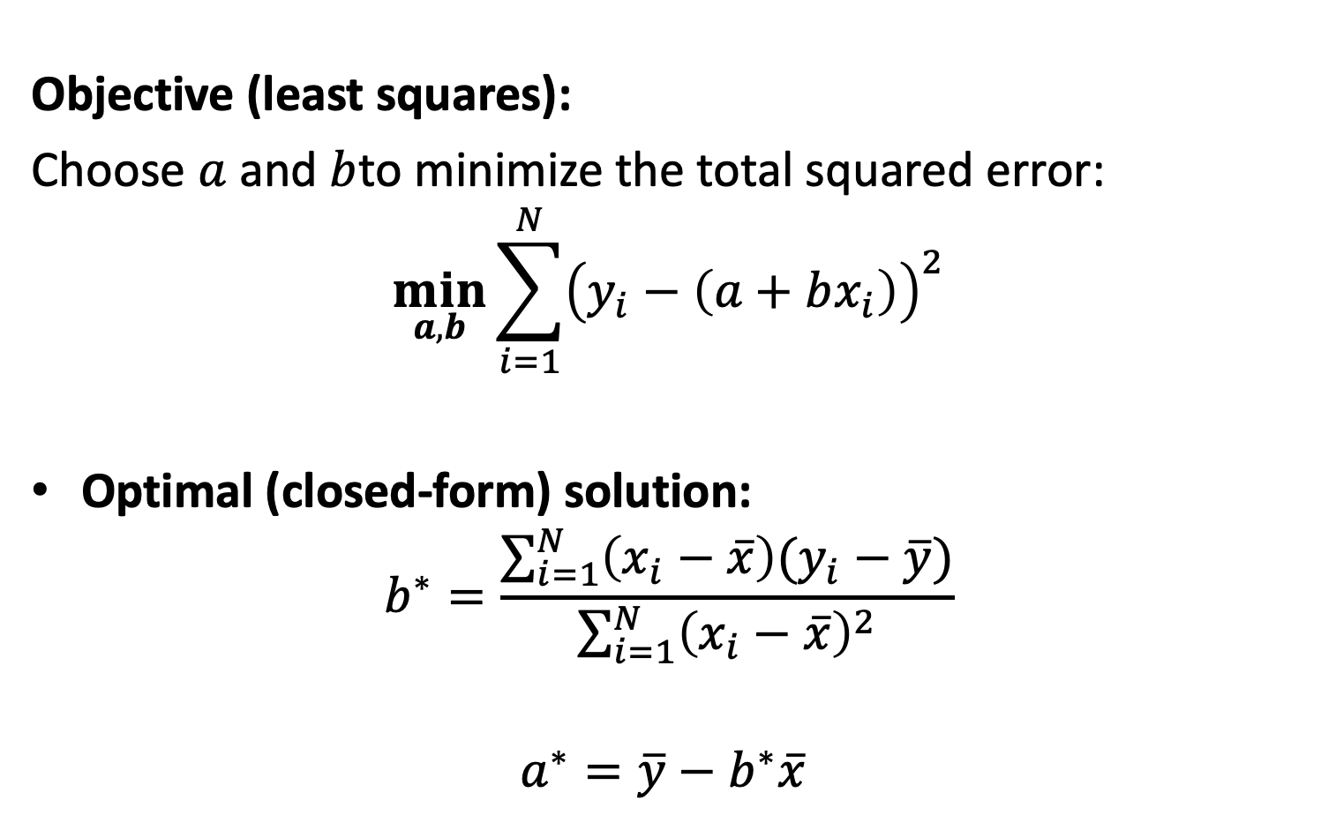
Ordinary Linear Regression
Objective (least squares):
Choose $a$ and $b$to minimize the total squared error:
$$\min_{a,b}{\sum_{i=1}^{N}{{\left(y_{i}−\left(a+bx_{i}\right)\right)}^{2}}}$$
Optimal (closed-form) solution:
$$b^{∗}=\frac{\sum_{i=1}^{N}{\left(x_{i}−\overline{x}\right)(y_{i}−\overline{y})}}{\sum_{i=1}^{N}{{\left(x_{i}−\overline{x}\right)}^{2}}}$$
$$a^{∗}=\overline{y}−b^{∗}\overline{x}$$

Slide 6

Ordinary Linear Regression
Example:
Student | Hours (x) | Score (y)
S1 | 1 | 50
S2 | 2 | 55
S3 | 3 | 65
S4 | 4 | 70
- Step 1: Compute averages
$$\overline{x}=\frac{1+2+3+4}{4}=2.5$$
$$\overline{y}=\frac{50+55+65+70}{4}=60$$
- Step 2: Compute the numerator and denominator
$\sum_{i=1}^{N}{\left(x_{i}−\overline{x}\right)(y_{i}−\overline{y})}$ $=\left(−1.5\right)\left(−10\right)+\left(−0.5\right)\left(−5\right)+\left(0.5\right)\left(5\right)+\left(1.5\right)\left(10\right)$ = 35
$\sum_{i=1}^{N}{{\left(x_{i}−\overline{x}\right)}^{2}}$ $={\left(−1.5\right)}^{2}+{\left(−0.5\right)}^{2}+{\left(0.5\right)}^{2}+{\left(1.5\right)}^{2}=5$
- Step 3: Compute slope and intercept
$$b^{∗}=35/5=7$$
$$a^{∗}=\overset{ˉ}{y}−b\overset{ˉ}{x}=60−7\left(2.5\right)=60−17.5=42.5$$
Step 4: Final regression line:
$$\hat{y} =42.5+7x$$

Slide 7
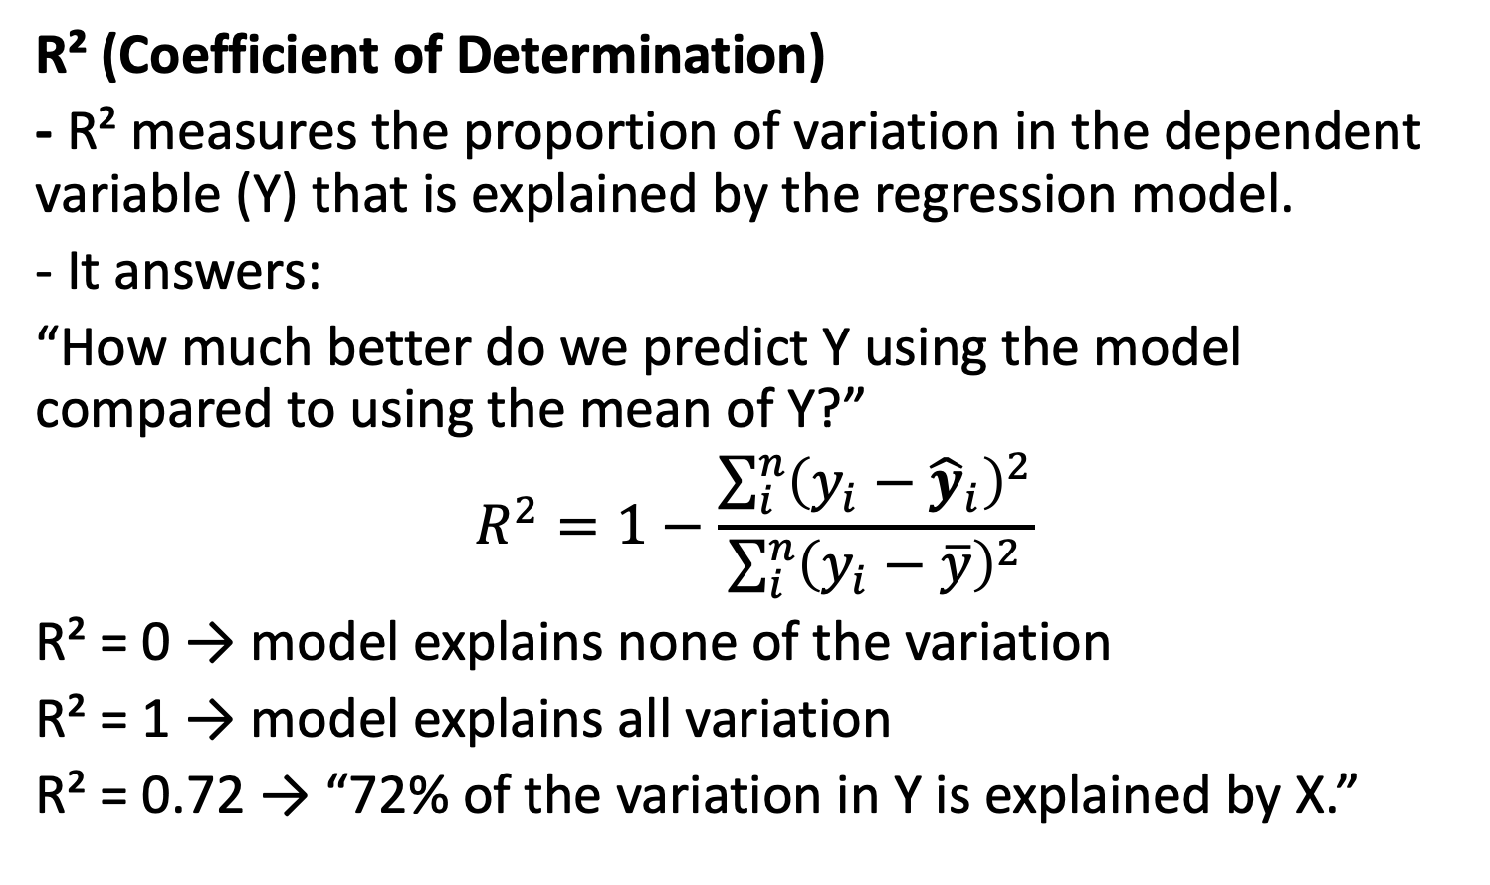
How well does our regression line fit the data?
R² (Coefficient of Determination)
- R² measures the proportion of variation in the dependent variable (Y) that is explained by the regression model.
- It answers:
“How much better do we predict Y using the model compared to using the mean of Y?”
$$R^{2}=1−\frac{\sum_{i}^{n}{{\left(y_{i}−{\hat{y}}_{i}\right)}^{2}}}{\sum_{i}^{n}{{\left(y_{i}−\overline{y}\right)}^{2}}}$$
R² = 0 → model explains none of the variation
R² = 1 → model explains all variation
R² = 0.72 → “72% of the variation in Y is explained by X.”

Slide 8
Example: mtcars
Column | Meaning | Units | Example Interpretation
mpg | Miles per gallon (fuel efficiency) | miles/gallon | Higher = more fuel-efficient
cyl | Number of cylinders in the engine | count | 4, 6, or 8 cylinders
disp | Engine displacement | cubic inches | A measure of engine size (larger = more powerful)
hp | Horsepower | horsepower | Higher = stronger engine
drat | Rear axle ratio | – | Affects acceleration and fuel consumption
wt | Weight of the car | 1000 lbs | 2.5 means 2500 lbs
qsec | 1/4 mile time | seconds | Lower = faster acceleration
vs | Engine shape/type | 0 = V-engine, 1 = straight engine | V engines are usually more powerful
am | Transmission type | 0 = automatic, 1 = manual | Manual often gives better mpg
gear | Number of forward gears | count | 3, 4, or 5 gears
carb | Number of carburetors | count | More carburetors = more airflow → more power

Slide 9
Class Exercise
Day | Temperature (x) | Iced-coffee sales (y)
1 | 18 | 40
2 | 20 | 50
3 | 22 | 55
4 | 25 | 65
Find the linear regression model to estimate sales using temprature.
Calculate the R2 value

Slide 10
Econometrics
Econometrics = regression + economic reasoning + causal interpretation attempts.
Econometric models often include:
indicator variables (also called dummy variables)
nonlinear terms (quadratic, logs)
interaction terms
endogeneity issues (later…)

Slide 11
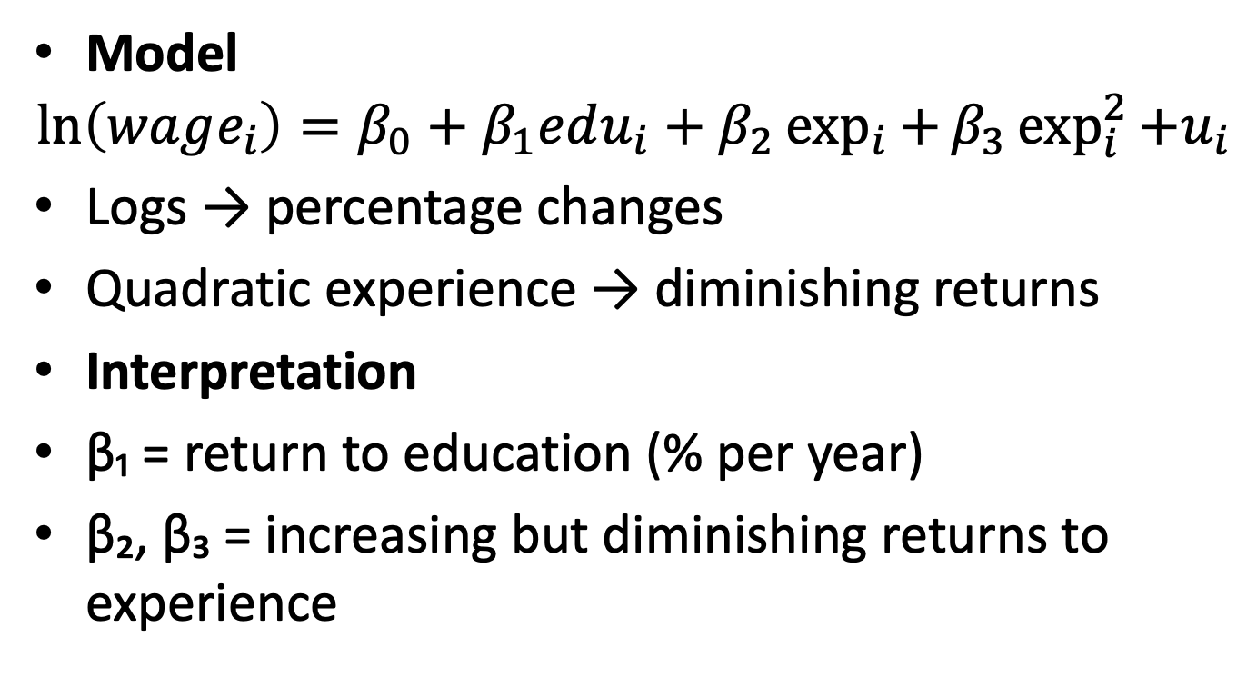
Example 1: Wage Equation
(Mincer Equation)
Model
$$\ln\left(wage_{i​}\right)=β_{0}​+β_{1}​edu_{i}+β_{2}\exp_{i}{+}β_{3}\exp_{i}^{2}{+u_{i}​}$$
Logs → percentage changes
Quadratic experience → diminishing returns
Interpretation
β₁ = return to education (% per year)
β₂, β₃ = increasing but diminishing returns to experience

Slide 12
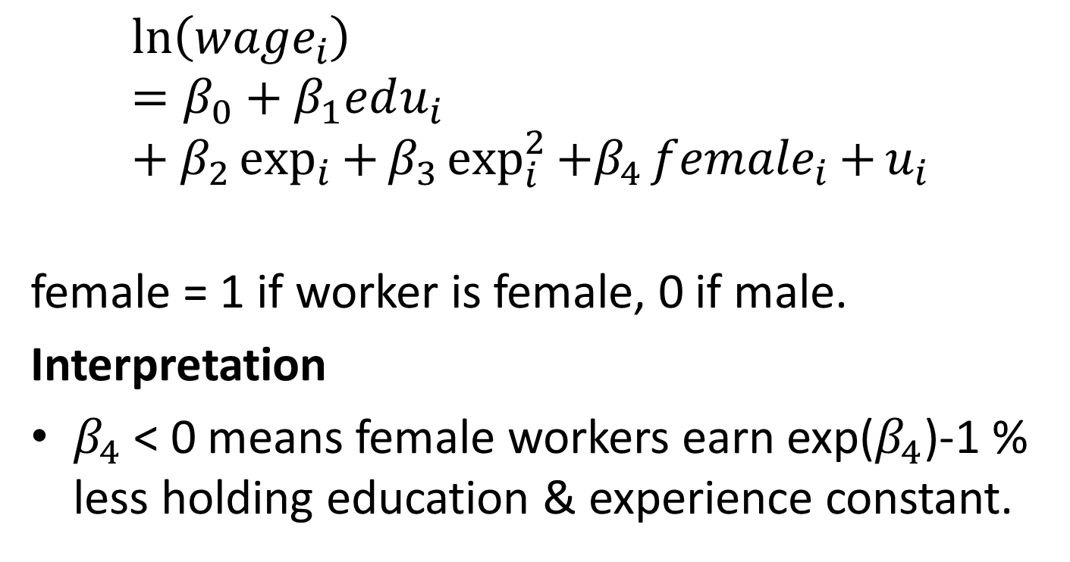
Example 2: Gender Wage Gap (Dummy Variables)
$$\ln\left(wage_{i​}\right)=β_{0}​+β_{1}​edu_{i}+β_{2}\exp_{i}{+}β_{3}\exp_{i}^{2}{+β_{4}{female}_{i}{+}u_{i}​}$$
female = 1 if worker is female, 0 if male.
Interpretation
$β_{4}$ < 0 means female workers earn exp($β_{4}$)-1 % less holding education & experience constant.

Slide 13
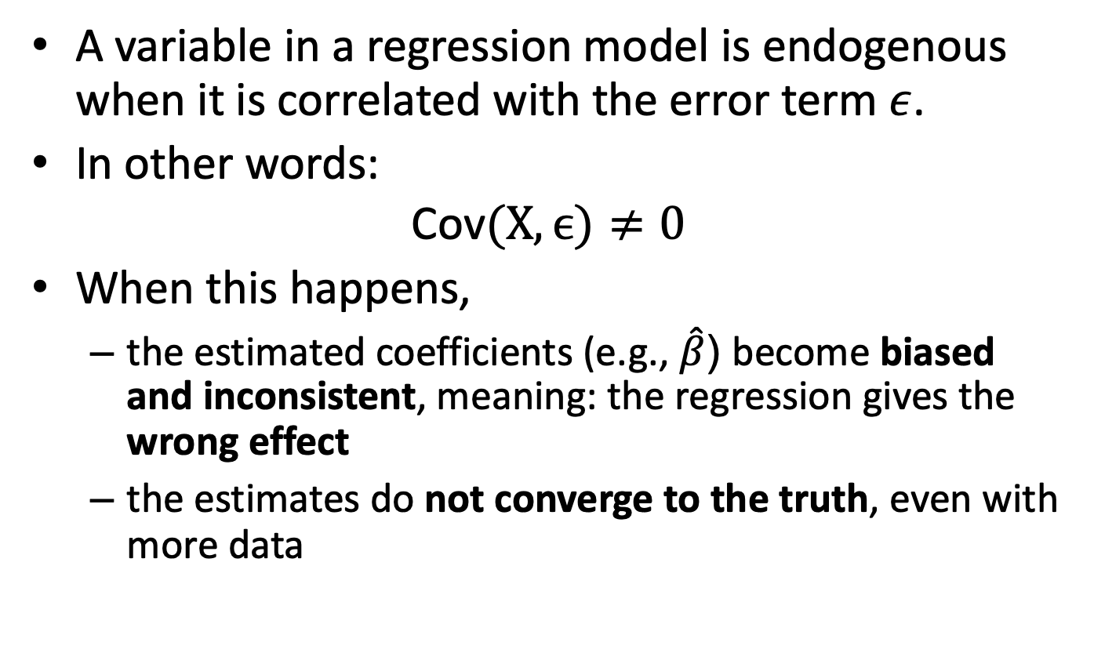
Endogeneity issues
A variable in a regression model is endogenous when it is correlated with the error term $ε$.
In other words:
$$\text{Cov}(X,ϵ)≠0$$
When this happens,
  the estimated coefficients (e.g., $\hat{β}$) become biased and inconsistent, meaning: the regression gives the wrong effect
  the estimates do not converge to the truth, even with more data

Slide 14
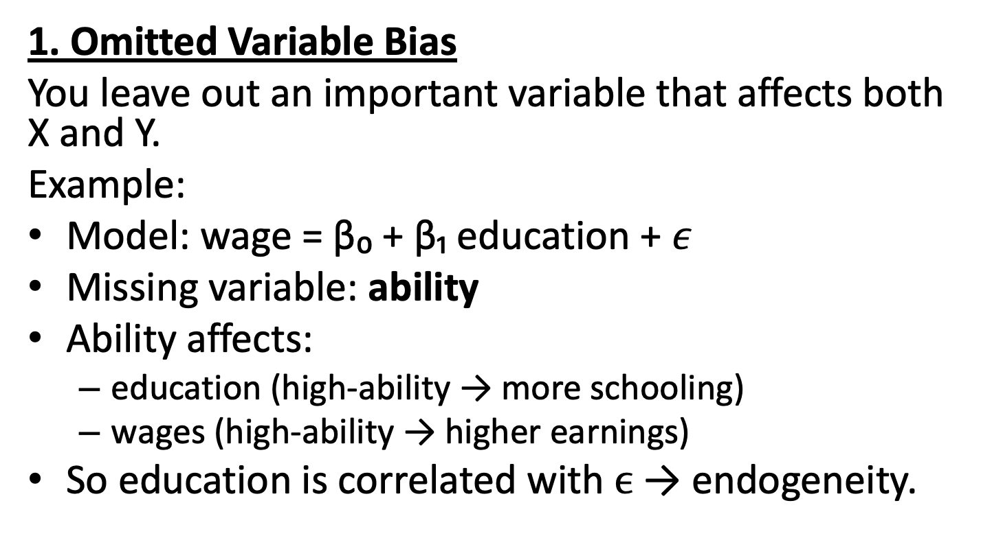
Why Does Endogeneity Happen?
1. Omitted Variable Bias
You leave out an important variable that affects both X and Y.
Example:
Model: wage = β₀ + β₁ education + $ε$
Missing variable: ability
Ability affects:
  education (high-ability → more schooling)
  wages (high-ability → higher earnings)
So education is correlated with $ϵ$ → endogeneity.

Slide 15
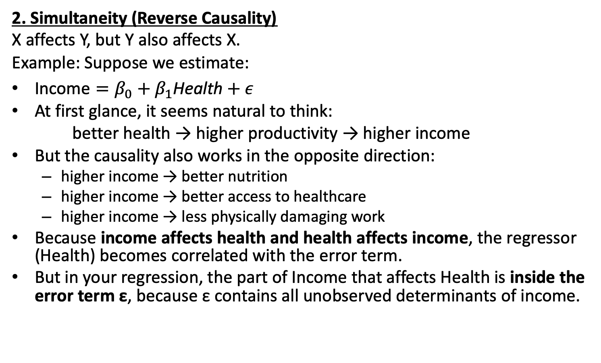
Why Does Endogeneity Happen?
2. Simultaneity (Reverse Causality)
X affects Y, but Y also affects X.
Example: Suppose we estimate:
$\text{Income}=β_{0}+β_{1}\text{Health}+ε$
At first glance, it seems natural to think:
better health → higher productivity → higher income
But the causality also works in the opposite direction:
  higher income → better nutrition
  higher income → better access to healthcare
  higher income → less physically damaging work
Because income affects health and health affects income, the regressor (Health) becomes correlated with the error term.
But in your regression, the part of Income that affects Health is inside the error term ε, because ε contains all unobserved determinants of income.

Slide 16
Why Does Endogeneity Happen?
3. Measurement Error
When X is measured with error, especially systematic error.
Example:
self-reported income

