Slide 1
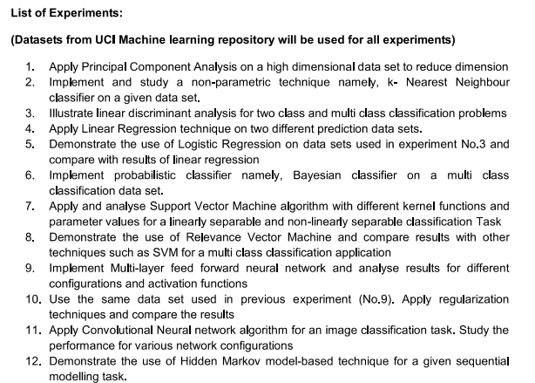

Slide 2
1.Principal component analysis(PCA)
Objective: To find a new set of dimensions for a high dimensional data such that all the new dimensions are orthogonal (linearly independent ) and ranked according to the variance of data among them.
Steps: i)Load the dataset ,import all the basic libraries, do the exploratory data analytics(EDA). ii)Data standardisation iii)Computing Eigen vectors and Eigen values iv)Eigen Decomposition of the covariance matrix v)selecting the principal components. vi)PCA to be done with sci kit package also.
Metrics: i)Scree plot :How much variance each component explains ii)Factor loading –how a variable and principal component is correlated.
Dataset used.
1985 Automobiles dataset- https://www.kaggle.com/datasets/toramky/automobile-dataset
Additional exercise: Simultaneous Principal component analysis (SPCA)can be tried and deployed

Slide 3
All the exercises will have Exploratory data analytics (EDA) listed below
1) shape of the dataset-to give the dimensions of the dataframe from CSV or JSON or from different data sources
2)The head and tail of the data frame, the distribution of each attribute with Histogram plots
3)The correlation plot, pair plot, correlation matrix
4)Heat map of correlation plot
5)outlier detection with box plot
6)data types of the data frame
7)Renaming the columns if necessary
8)converting from categorical to integer for target dependent variables either using pandas or using vlookup in excel
9)fill the null values ,null column values with mean ,median or mode values.
10)Statiscal summary of the dataset, giving mean ,median and quartile values.
11)one hot encoding of categorical variables or the whole X (set of independent variables ) if necessary.
12.Perform all SQL query like processing with pandas.
All the exercises after manual implementation, can use scikit packages with corresponding functions for easier deployment.

Slide 4
2.K nearest neighbour
Objective: To learn and deploy K-nearest neighbours(KNN or K-NN), non parametric(doesnot make any assumption on the underlying data) supervised classification algorithm.
Which uses proximity of data points to classify the grouping of an individual data point.
Steps:
1.Select K number of neighbours (we can use elbow method to select number k).’.
2.Calculate the Euclidean distance of K number of neighbours
3. Take k nearest neighbours to our Euclidean distance.
4. Count the number of points in each category of neighbours
5.Assign the new data point to a category for which the number of neighbours is maximum
Metrics: i)classification accuracy ii) classification report that displays precision,recall,f1 and support ,confusion matrix,ROC curve, we can validate with k-fold cross validation
Dataset used.
UCI_Breast Cancer Wisconsin (Original)

Slide 5
3.Linear Discriminant analysis(LDA)
Objective: To learn and deploy Linear discriminant analysis for binary and multiclass classification.
Steps:
1. Assumption- Each attribute is bell shaped (Gaussian),each attribute has same variance around mean,
2.LDA works on Baye’s theorem, P(Y/x)=P(X/Y)P(Y)/P(X)
3. Randomly generate 1000 points from a normal distribution with mean 1 and variance 1 and we call it as group 1 and similarly for group 2 also. The probability of each group is 0.5.
4. Calculate the mean ,of group 1 and group 2 and the standard deviation also
5. Plugging in the corresponding values in the discriminant function for group 1 and group 2 , the new data point P(X=x) will be classified according to the discriminant function values for group1 and group2.
Metrics: i)classification accuracy ii) classification report that displays precision,recall,f1 and support ,confusion matrix,ROC curve, we can compare LDA with the limitations of logistic regression which is prone to overfitting, works well only in binary classification problems
Dataset used: https://www.kaggle.com/datasets/hesh97/titanicdataset-traincsv additional exercise:

Slide 6

4.Linear Regression
Objective: To learn and deploy Linear regression for prediction ,a supervised ML, to predict the dependent variable from a set of independent variables (uni variate or multivariate linear regression).
Steps:
1. calculate the slope using the formula
2. compute the y intercept. C=y-mx
3. substitute the values in the final equation is y-mx+c.
4.For a multiple linear regression we use the formula
5.Use the scatter plot and line of regression to see the best fit of our model
Metrics:
Mean square error (MSE) value=1-Sum of squares error (SSE)/sum of squares Total (SST) we can use scikit model also with scikit cross validation to validate our linear regression model
Dataset used: https://www.kaggle.com/code/sudhirnl7/linear-regression-tutorial -medical cost dataset to predict individual medical costs billed by health insurance.
Additional exercise: here are actually 14 variants to linear regression model, and one polynomial regression can be tried.

Slide 7
5.Logistic regression.
Objective: To learn and deploy Logistic regression for classification problems.
Steps:
1.The target variable is the categorical variable,
2.implement standardization with Z score normalization.
3.Feature vector matrix and parameter or weight matrix is initliazed.
4.Define the sigmoid function
5.The log loss function is taken as the cost function of logistic regression I
6. The first order derivative of the log loss cost function gives us the gradient descendent expression, take the vectorized form of the expression
7.Define the classification function, the whole logistic regression can be written as a class with the above functions with the fit function having the cost function definition in it. The whole data set has to be spllit to X train ,X test before given to fit function.
Metrics:
The same classifcation metrics given in LDA classification , but logistic works better with scikit sklearn functions, LDA and logistic regression to be compared.
Dataset used: make_classification dataset from sklearn is best for implementation of logistic regression from scratch.
Additional exercise: multinomial logistic regression.

Slide 8
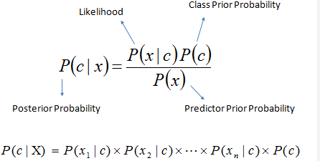
6.Bayesian Classifier.
Objective: To learn and deploy Bayesian classifier where the classification is a latent variable that is probabilistically related to the other observed variables.
Steps:
1Maximum a Posteri(MAP)=
2.Get X,y from the data set attributes, calculate prior probability of classes.
3.calculate likelihood table for all features
4.calculate posterior probability for each class with naïve Baye’s equation. The class with the maximum probability is the outcome of the prediction
Metrics:
Accuracy , confusion matrix, log loss and AUC ROC.
Dataset used: census income dataset.
Additional exercise: Gaussian naïve Baye’s, multinomial naïve Baye’s

Slide 9

7. Support vector machines. (SVM)
Objective: To learn and deploy Support Vector machines, supervised machine learning algorithm used in binary classification problems.
Steps:
1. The SVM is represented mathematically, w is the weight vector,x is the input and b is the bias
2. The initial fit function to find X,y, X_train ,X_test, y_train,y_test
3.The cost function and compute the gradient of the cost function, go for minimum stochastic gradient descendent
4. linear, nonlinear, polynomial, radial basis function (RBF), and sigmoid are the kernel functions that can be used in SVM ,we can use sci kit package for the above functions with visualization..
Metrics: can go for cross validation with accuracy, the same metrics for classification
Dataset used: spam mail classification dataset
Additional exercise: apart from linear and non linear, the RBF and sigmoid functions can be tried out in SVM

Slide 10
8. Relevance vector machines. (RVM)
Objective: To learn and deploy Relevance vector machines, a pattern recognition algorithm, used as classification and regression.
Steps:
1. RVM can be implemented in R with the CRAN package, with RVM function, with x, y, type, kernel, the list of hyper parameters, the alpha vector, the initial noise variance, noise variance fix, number of iterations, tolerance of termination criteria, termination criteria, convergence, fitness and cross validation
Metrics:
Both SVM and RVM metrics can be compared with R for multiclass classification.
Dataset used: sequence of data can be generated
Additional exercise: RVM can be implemented in rapid miner.

Slide 11
9. Multi layer feed forward neural network
Objective: To deploy a multilayer feed forward neural network in python for classification and for regression.
Steps:
1. Create a baseline neural network (NN) with X,y ,hidden units ,activation function,learning rate,epochs, batch size, regularization parameter also.
2.Define Loss function and optimizer.
3. Multi layer Feed forward neural networks, can be implemented with keras and Tensor flow and the model loss and model accuracy graph can be visualized with train and test data.
4. Hyperparameters to tune are the number of neurons, activation function, optimizer, learning rate, batch size, and epochs.
Metrics: The same metrics for regression and classification given in the previous models.
Dataset used: MNIST dataset,IRIS dataset
Additional exercise:
Tensorflow board visulaizations tools for Multilayer feed forward neural networks,

Slide 12
10. Multi layer feed forward neural network with regularization techniques
Objective: To deploy a multilayer feed forward neural network in python for classification and for regression with two regularization techniques.such as L2 regularization and drop out.
Steps:
1. L can be any loss function (such as the cross-entropy loss function). Now, for L2 regularization we add a component that will penalize large weights.
2. Dropout regularization
Dropout involves going over all the layers in a neural network and setting probability of keeping a certain nodes or not.
3. Hyperparameters to tune are the number of neurons, activation function, optimizer, learning rate, batch size, and epochs.
Metrics: The same metrics for regression and classification given in the previous models.
Dataset used: MNIST dataset,IRIS dataset
Additional exercise:
Batch normalization regularization can be carried out.

Slide 13
11. Convolutional neural network for classification.
Objective: To deploy a Convolutional neural network to perform image classification tasks
Steps:
1. loading data , reshaping data , checking the shape after reshaping , normalizing the pixel values , defining model , adding convolution layer , adding pooling layer , adding fully connected layer , adding output layer , compiling the model ,and fitting the model .
Metrics: The same metrics for regression and classification given in the previous models.
Dataset used: MNIST dataset.
Additional exercise:
ResNet,MobileNetV1 CNN architecture models can be used with different datasets.

Slide 14
12. Hidden markov model.
Objective: To deploy a Hidden markov model(HMM) ,generative probabilistic model for a sequential modelling task,.
Steps:
1.Get the time line data and identify hidden variable, observed variable, transitioning from current state to a new state based on a condition, emission data transition and initial state transition(prior probability).
2.use of viterbi algorithm to compute the most likely sequence of latent states that produced certain sequence of observations.
Metrics: likelihood of test data, predicting parts of data given others..
Dataset used: https://www.gold.org/goldhub/data/gold-prices
Additional exercise:
Timeseries data with Defi
.

