Slide 1
Early detection of Parkinson's disease using machine learning
Presented by
124156079 Sankaranarayanan S
124156080 Upendar S
124157042 Peshwar Rajesh
Guided by
PROF JEYASHEELA RAKKINI M J AP-II / SOC
SASTRA Deemed to be University, School of Computing

Slide 2
Base Paper
Base Paper Title: Early detection of Parkinson’s disease using machine learning
Year of Publication:2023
Publisher Name: Aditi Govinda , Sushila Palwe
Publishing Site: Sciencedirect/Procedia
Base Paper Link: https://www.sciencedirect.com/science/article/pii/S1877050923000078

Slide 3
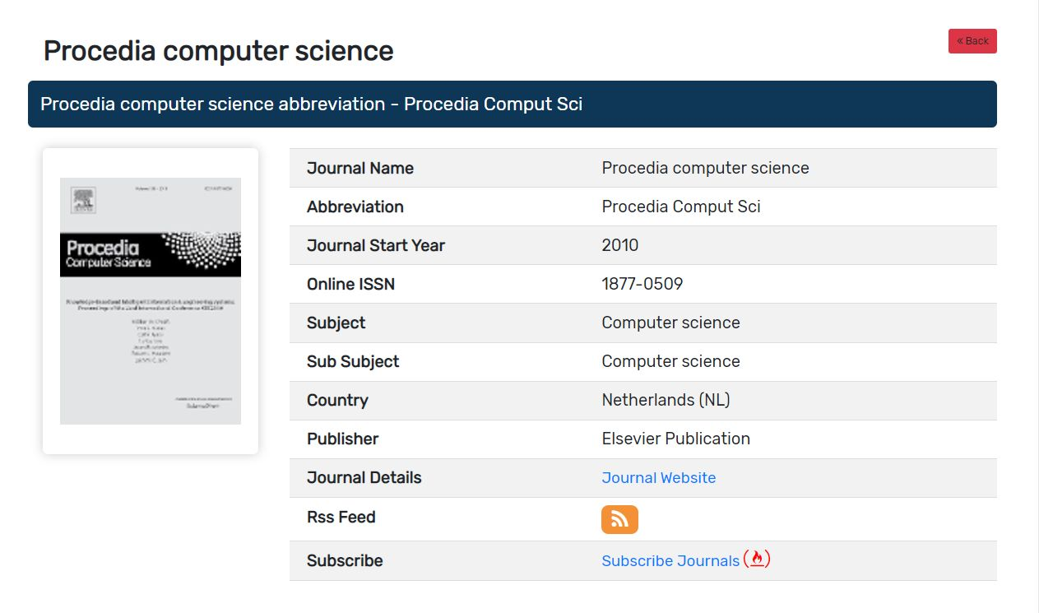
SCOPUS paper

Slide 4
Abstract
Parkinson's disease (PD) is a kind of is a neurodegenerative disorder affecting 60% of people over the age of 50 years, which is quite significant. Patients with Parkinson’s (PWP) face mobility challenges and speech difficulties, making physical visits for treatment and monitoring a hurdle. PD can generally be treated through early detection, thus enabling patients to lead a normal life. The rise of an aging population over the world emphasizes the need to definitely detect PD early, remotely and accurately in a big way. This paper highlights the use of machine learning techniques in telemedicine to detect PD in its early stages. Research has been basically carried out on the multidimensional voice program (MDVP) audio data of 30 PWP and healthy people during training of 4 machine learning (ML) models.Comparison of results of classification by Support Vector Machine (SVM), particularly Random Forest, K-Nearest Neighbors (KNN) and Logistic Regression models, for all intents and purposes yield basically Random Forest classifier as the generally ideal Machine Learning (ML) technique for detection of PD. Random Forest classifier model particularly has a detection accuracy of 91.83% and sensitivity of 0.95. Through the findings of this paper, we aim to go for all intents and purposes that promote the use of ML in telemedicine, thereby providing a new lease of life to patients suffering from Parkinson's disease.

Slide 5
Literature Survey
Paper name | Author & year | Method used | Result | flaws
Prediction of Parkinson's disease using XGBoost | Ezhilin Freeda S; Ezhil Selvan T C; Vishnu Durai R S Year:2022 | In this paper they used XgBoost | Decision Tree:83.6% Random forest: 91.1% XgBoost : 92.2% accuracies | Limited training data Biased data Overfitting Interpretability
Improved KNN algorithm with information entropy for the diagnosis of Parkinson's disease | Zhaozhao Fang Year:2022 | they used knn with entropy | Improved knn:93.88% KNN:91.84% Random Forest : 91.84% accuracies | Lack of transparency
A hybrid approach to Parkinson disease classification using speech signal: the combination of smote and random forests | Kemal Polat Year:2022 | They used combination of SMOTE and Random Forest algorithm | Hybrid:94.89% Only Randomforest: 87.03% Accuracies | Limited Sample Size: Feature Selection Lack of External Validation
Predicting UPDRS Motor Symptoms in Individuals With Parkinson's Disease From Force Plates Using Machine Learning | Trevor Exley; Sarah Moudy; Rita M. Patterson; Joonghyun Kim; Mark V. Albert Year: 2022 | Libraries used are Tensorflow, Keras, SKLearn, Pandas, Numpy, MatPlotlib, and XGBoost. | XGBoost: 86.5% KNN:96.7% | Limited Sample Size Unclear Combination of CNN and SVM
Prediction of Parkinson's Disorder: A Machine Learning Approach | Debasis Patnaik; Mavis Henriques; Ashin Laurel Year: 2022 | Decision Tree and Catboost algorithm are used as it’s a classification problem | 86% weighted average accuracy | Insufficient Justification for Feature Selection Limited Sample size

Slide 6
Paper name | Author & year | Method used | Result | flaws
Mining genetic and transcriptomic data using machine learning approaches in Parkinson's disease | Su, Chang, Jie Tong, and Fei Wang. Year:2020 | Exploratory data analysis and sample survey on how it can be done using knn,Bayesian and deep learning approaches | clear acceleration in our knowledge and ability to apply machine learning models to genetic and transcriptomic data in PD study | Challenging machine learning approaches to make further breakthroughs in thoroughly understanding pathogenesis of the disease
Early diagnosis of Parkinson’s disease using machine learning algorithms | Zehra Karapinar Senturk Year:2020 | they used feature sampling to increase accuracy of models | Algo acbfs accafs CART 85.23 90.76 SVM 79.98 93.84 ANN 80.25 91.54 | Lack of transparency How they did feature extraction etc.
Early Detection of Parkinson’s Disease Using Deep Learning and Machine Learning | Wu Wang; Junho Lee; Fouzi Harrou; Ying Sun Year:2020 | Feed forward custom deep learning method is used and compared with other 12 ml models | Deep learning accuracy score: 96.45% on average | Limited Sample Size
Application of deep learning in detecting neurological disorders from magnetic resonance images: a survey on the detection of Alzheimer’s disease, Parkinson’s disease and schizophrenia | Manan Binth Taj Noor1 , Nusrat Zerin Zenia1 , M Shamim Kaiser1 , Shamim Al Mamun1 and Mufti Mahmud2 Year: 2020 | CNN,DBN,DAE, RNN,DBN,PNN | The pros, cons, and performance of these DL techniques for the neuroimaging data have been summarized. Max usage of CNN is reported | Insufficient info in the dataset Non-standardized acquisition of images which can cause issues due to different dataset
A Deep Learning Based Method for Parkinson’s Disease Detection Using Dynamic Features of Speech | Changqin Quan, Kang Ren , Zhiwei Luo Year : 2021 | The proposed deep learning method innovatively combines the dynamic articulation transition features with Bidirectional LSTM model to capture time-series characteristics of continuous speech signals. | The proposed method remarkably improves the accuracy of PD detection over traditional machine learning models using static features. | Lack of sufficient data

Slide 7
Problem Statement
Parkinson's disease is a neurodegenerative disorder that affects millions of people worldwide. It is a progressive disease that leads to a variety of motor and non-motor symptoms, including tremors, rigidity, and bradykinesia. Early detection of Parkinson's disease is critical for timely intervention, as the disease is not curable but can be managed with medication and therapy. Machine learning techniques can aid in the early detection of Parkinson's disease, and addressing this problem has the potential to significantly improve patient outcomes.
The problem statement is: Parkinson's disease is a major health concern that affects millions of people worldwide, and early detection of the disease is crucial for timely intervention. Machine learning can be used to develop accurate predictive models that can identify individuals at risk of developing Parkinson's disease at an early stage. This approach has the potential to improve patient outcomes by enabling earlier intervention and management of the disease. However, there is a need to develop robust and reliable machine learning models that can accurately detect Parkinson's disease, which requires extensive data collection and analysis. Therefore, the development of effective machine learning models for early detection of Parkinson's disease is a critical area of research.

Slide 8
Objective of the Proposed Work
The objective of a project aimed at early detection of Parkinson's disease using Machine learning can be summarized as follows:
Develop Accurate Predictive Models
Improve Patient Outcomes
Reduce Healthcare Costs
Enable Better Research
Promote Early Intervention

Slide 9
Methodology
We take a Database and preprocess the data
Then using train data and test data we can train the model and validate the results and finally our ML model will predict if the input sample has Parkinson’s disease or not.
Algorithm for approach 1: Models are trained on 22 attributes of data
• Collect MDVP audio data from PPPMI and UCI databases
• Perform data analysis to detect skew, imbalance and distribution of variables in data
• Scale the data to common range using Standard Scaler
• Split dataset into testing and training sets, where training data is 75% of total
• Train SVM, logistic regression, random forest and KNN models.

Slide 10
Algorithm for approach 2: Principal Component Analysis (PCA) is applied to identify 5 key attributes
• Collect MDVP audio data from PPPMI and UCI databases
• Perform data analysis to detect skew, imbalance and distribution of variables in data
• Scale the data to a common range using Standard Scaler
• Identify variance in every column of data and apply Principal Component Analysis (PCA) to identify 5 most relevant features to model training, out of 22 attributes.
• Split dataset into testing and training sets, where training data is 75% of total
• Retrain SVM, logistic regression, random forest and KNN models.
• Compare classification results using confusion matrix, ROC-AUC curve and accuracy
Algorithm for approach 3: Imbalance removal in dataset
• Collect MDVP audio data from PPPMI and UCI databases
• Perform data analysis to detect skew, imbalance and distribution of variables in data
• Scale the data to common range using Standard Scaler
• Split dataset into testing and training sets, where training data is 75% of total
• Retrain SVM, logistic regression, random forest and KNN models.
• Compare classification results using confusion matrix, ROC-AUC curve and accuracy Figure

Slide 11
Hardware and Software Requirements
Hardware: Laptop
Software : VS CODE / JUPYTER NOTEBOOK
OS: Windows 11/10

Slide 12
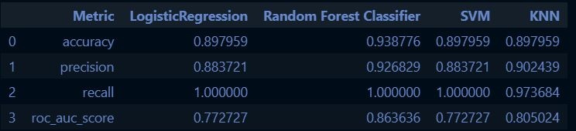
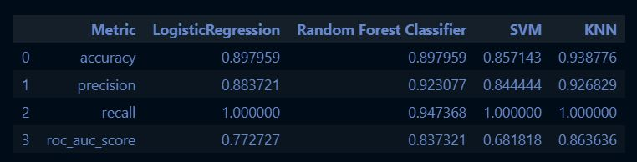
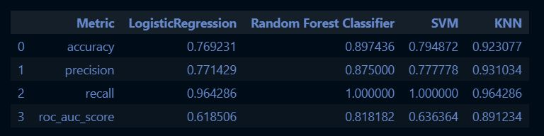
Implementation Screen shot
Alg 1:
Alg 2:
Alg 3:

Slide 13
References
[1] TC, Ezhil Selvan, and Vishnu Durai RS. "Prediction of Parkinson's disease using XGBoost." 2022 8th International Conference on Advanced Computing and Communication Systems (ICACCS). Vol. 1. IEEE, 2022.
[2] Fang, Zhaozhao. "Improved KNN algorithm with information entropy for the diagnosis of Parkinson's disease." 2022 International Conference on Machine Learning and Knowledge Engineering (MLKE). IEEE, 2022.
[3] Polat, Kemal. "A hybrid approach to Parkinson disease classification using speech signal: the combination of smote and random forests." 2019 scientific meeting on electrical-electronics & biomedical engineering and computer science (EBBT). Ieee, 2019.
[4] Exley, Trevor, et al. "Predicting UPDRS Motor Symptoms in Individuals With Parkinson's Disease From Force Plates Using Machine Learning." IEEE Journal of Biomedical and Health Informatics 26.7 (2022): 3486-3494.
[5] Patnaik, Debasis, Mavis Henriques, and Ashin Laurel. "Prediction of Parkinson's Disorder: A Machine Learning Approach." 2022 Interdisciplinary Research in Technology and Management (IRTM). IEEE, 2022

Slide 14


