Slide 1

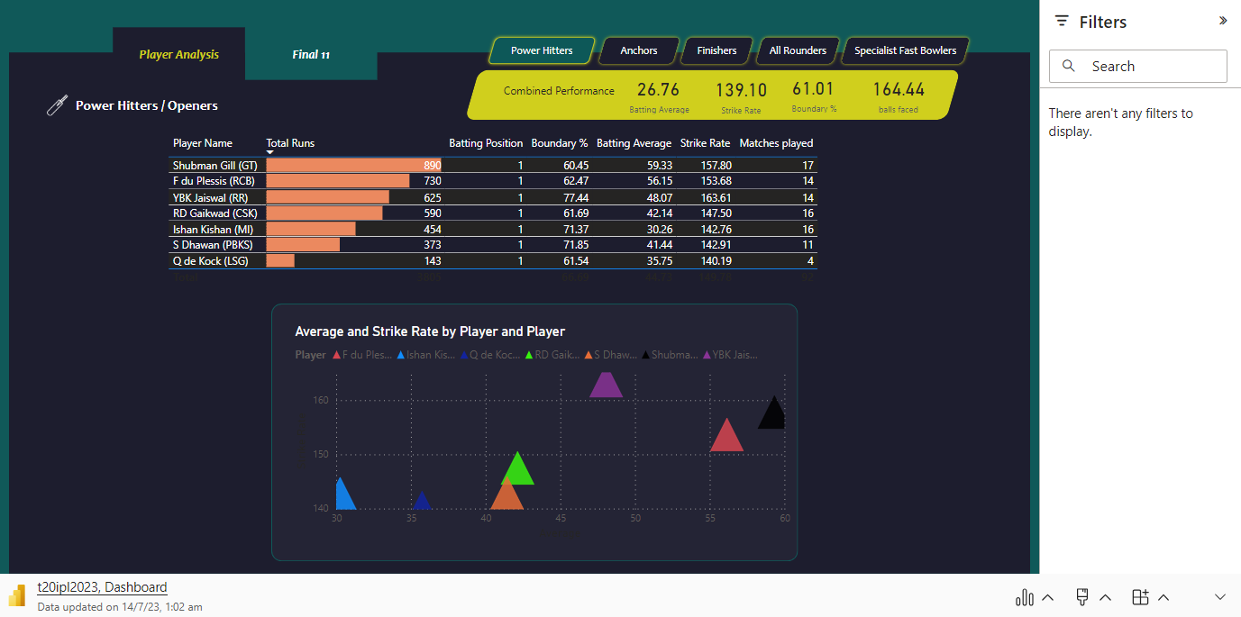
Microsoft Power BI

Slide 2
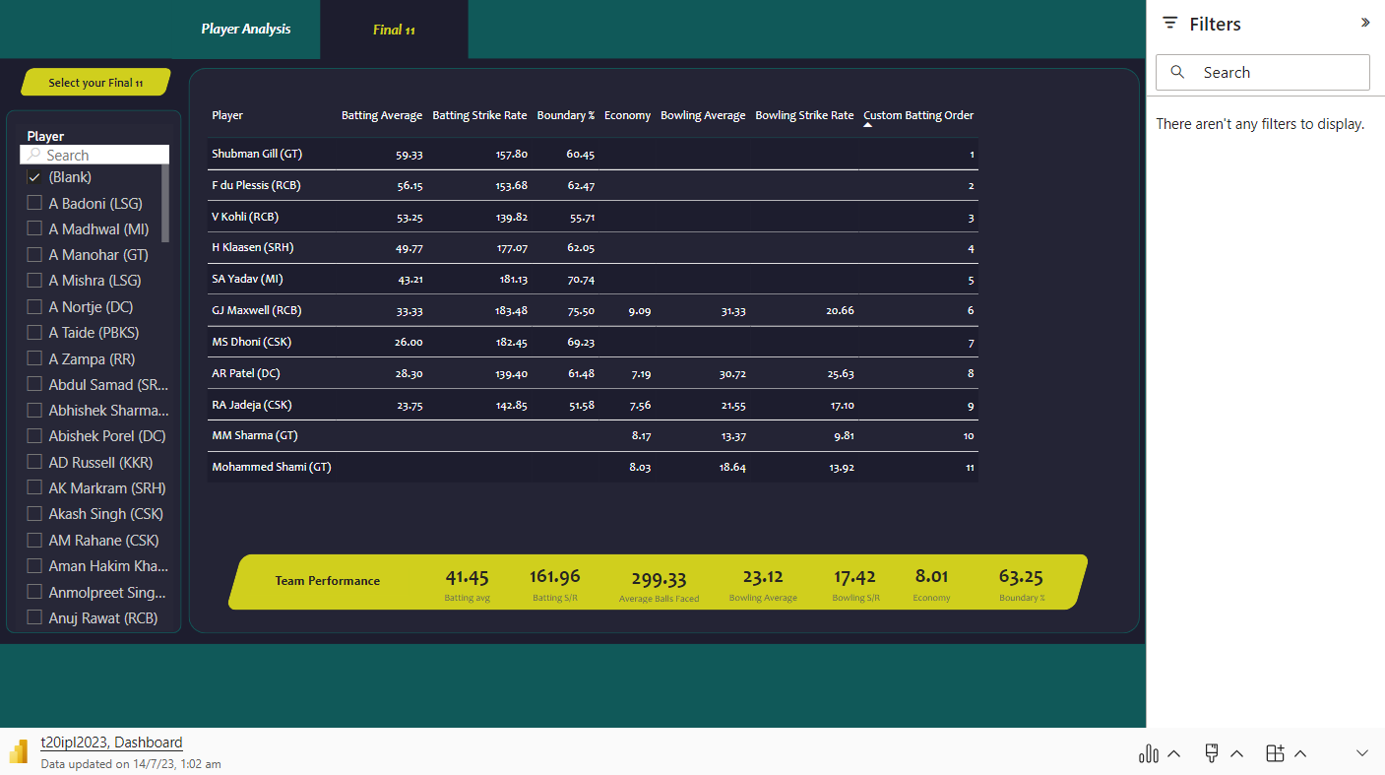
Insert
My Add-ins

