Slide 1
Migrating to Windows Azure SQL Database
Name
Title
Microsoft Corporation

Slide 2

Agenda
DACFx & Import / Export Service
SQL Server Data Tools
Other Migration Tools
Best Practices
Notes:
Slide Objectives:
Outline the Agenda
Transition:
The topics discussed in the presentation focus on two main tools.
Speaking Points:
DAC Framework and then Import/Export Service
SQL Server Data Tools
Other Tools
Best Practices
Notes:
Any notes go here

Slide 3
DAC Fx and the SQL database Import / Export Service

Slide 4

Terminology
Some Definitions
DAC – Data-tier Application
DACFx – DAC Framework
DACPAC –Schema only artifact
BACPAC – Deployment artifact containing schema and data
Notes:
Slide Objectives:
Define the terminology and definitions used in this section of the deck.
Transition:
The DAC has been around for quite a while but it will be helpful to make sure the terminology is understood, especially in light of the new artifact introduced in SQL Server 2012.
Speaking Points:
DAC – a self-contained deployment entity that defines all of the objects of a SQL Server database which can be packaged into a single portable artifact.
DACFx – the client-side tools for building and processing DAC packages and export files
DACPAC – File format used by the DACFx to represent the full definition of an application.
BACPAC – File format used by the DACFx to represent the full definition of an application as well as its data.
Notes:

Slide 5
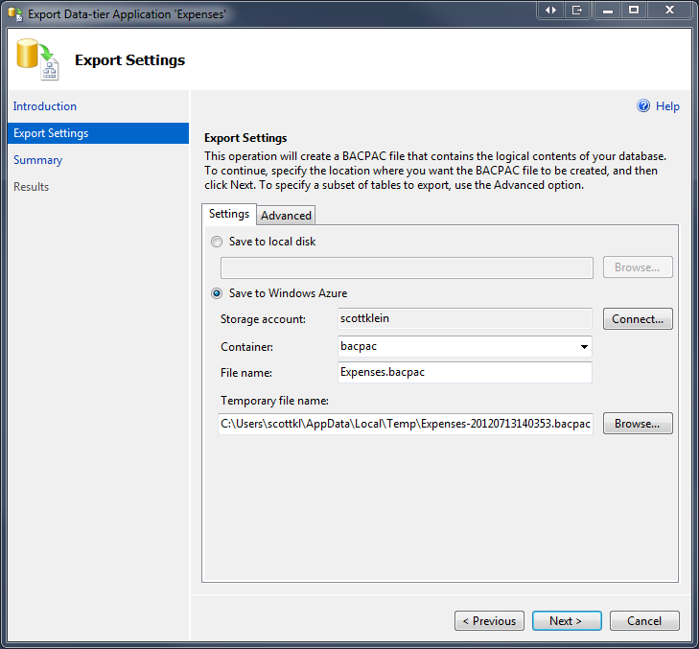
DAC Fx (DAC Framework)
Client DAC Components
DACFX client library installed automatically by SQL Server
No need for additional client libraries or MSIs
Wizards provided in SSMS to create and distribute DACPAC/BACPAC
Simplify packaging and deployment of databases
Notes:
Slide Objectives:
Understand the DAC Framework and how it is used to package and deploy databases on-premises and to SQL Dataase
Transition:
A major component of the Import/Export service and Data-Tier Applications is the DAC Framework. The client side DAC Framework allows customers to export a BACPAC from their on-premise database, once exported, customers can transfer the BACPAC to their BLOB storage account and use the service to import their database to SQL Azure. The upcoming transport service can also be used to move large (or large numbers of) BACPACs to and from BLOB storage as the service is ready to work with this pipeline as soon as it’s available.
Speaking Points:
The DAC Framework is a set of client libraries installed with SQL Server
The client side tools require the DAC Framework and other components to be installed, and run on your local machine.
Notes:
Databases exported to a BACPAC using the client side tools can be uploaded to Windows Azure BLOB storage and imported using the service. Similarly, databases exported to a BACPAC using the service can be imported using the client side tools.
The DAC framework provides a set of services for database developers and administrators and is currently available in two forms:
Hosted services such as the new SQL Database Import/Export Service – The service tools do not require any of the DAC components to be installed on your machine. Jobs are submitted against at Microsoft service running in Windows Azure. The actual Import/Export is preformed in the service.
Redistributable client side tools such as the DAC Framework – The client side tools require the DAC Framework

Slide 6
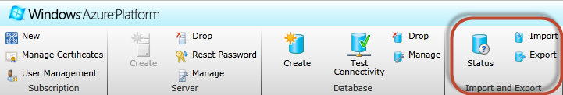
Import/Export Service
Simplified Migration
Import/Export between Windows Azure SQL Database and Blob Storage
Export and Import a logical backup file (BACPAC) containing schema definition and data
Copy databases between SQL Database servers
Migrate from SQL Server on-premises to SQL Database
Notes:
Slide Objectives:
Simplified database migration using the Import/Export service
Transition:
The new Import/Export Service for SQL Database is now live. The service will directly import or export between a SQL Database instance and Windows Azure BLOB storage. The service complements the client side tools already available. Databases exported to a BACPAC using the client side tools can be uploaded to Windows Azure BLOB storage and imported using the service. Similarly, databases exported to a BACPAC using the service can be imported using the client side tools.
Speaking Points:
Copy databases between Windows Azure SQL Database servers, or to migrate databases between the SQL Server Database Engine and Windows Azure SQL Database.
The SQL Database Import/Export Service creates a logical backup (BACPAC) file containing the schema definition and table data of a database in Windows Azure SQL Database.
Bypass any need for client libraries or MSIs
Requires you to have a Windows Azure Storage Account
Database export is an asynchronous operation. Use the Import Export Request Status window to track the progress.
Notes:
An export operation performs an individual bulk copy of the data from each table in the database so does not guarantee the transactional consistency of the data. You can use the Windows Azure SQL Database copy database feature to make a consistent copy of a database, and perform the export from the copy.

Slide 7





Architecture
Windows Azure
Blob Storage
SQL Database
DAC Fx Import/Export service
SQL Database
Blob Storage
SQL Database Service Import / Export
BACPAC
Copy
DACFx
Import/Export Service
On-Premises
SQL Server 2005, 2008/R2, 2012
DAC Fx
Client-Side Tools (SSMS and SSDT)
BACPAC
Upload/
Download
Import / Export Request (REST)
On-Premises
Client-side Import/Export
Notes:
Slide Objectives:
Understand the underlying architecture used for the Import / Export service and BACPAC
Transition:
The architecture utilizes many of the Windows Azure features and represents the utilization of both on-premises services as well as Windows Azure services. Both on-premises and cloud services utilize the new BACPAC format in which both schema and data are encapsulated into the artifact.
Speaking Points:
Client-side Import/Export via DAC Framework and client-side libraries via SQL Server 2012 or Azure Import Export Service Client
Hosted Windows Azure DAC Framework Import/Export service utilized by the Windows Azure Management Portal
BACPAC artifact containing both Schema AND Data
Notes:
Any notes go here

Slide 8
Service Benefits
Included with the Service
Automated Service Endpoint
Integrated Portal Experience
Performance via data center side deployment
Connection Resiliency
Selective Export
Progressive Status Reporting
Notes:
Slide Objectives:
Highlight the great built-in benefits of the service
Transition:
There are several key benefits included with the Import / Export service and the DAC framework that make these services viable as a migration solution.
Speaking Points:
Performance- The service has implemented a new connection pooling and parallelization strategy to deliver significantly improved performance for all types of databases. While actual results may vary, the average import or export should now be approximately three times faster! ALSO - we do all the processing, so we can handle multiple import/export requests all over the world and you don’t need to do anything other than submit some simple import/export requests
Resiliency - Several connectivity issues both transient and permanent have been identified and addressed in order to provide a more reliable experience.
Selective Export - Customers who only want to export certain tables for performance reasons or because the data doesn’t change often can provide a list of tables to export. The resultant BACPAC will contain the full schema definition plus the table data only for the specified tables. The selectively exported BACPAC can be imported just like a fully exported BACPAC. For now, the sample EXE must be used to submit these types of requests. Customers using the service’s REST endpoints directly can always bypass the EXE.
Progressive Reporting - The current progress for a request will be shown as a percentage in order to provide better feedback on the current state of the request.
Notes:
Any notes go here

Slide 9
Requirements
On-Premises
SQL Server 2012
All necessary components are installed
SQL Server* 2008 R2, 2008, 2005
Data-tier Application Framework
ScriptDOM
System CLR Types
Windows Azure
Storage Account
SQL Database Server
Note:
The dependencies are not needed if you plan on only using the service
Notes:
Slide Objectives:
Highlight the requirements for using the Import/Export service and the DAC Framework
Transition:
There are specific requirements depending on if you are using only using the Import/Export service, or if you plan on using any of the client libraries.
Speaking Points:
You can either install SSMS and get all the components for free –or- install the specific dependencies and call the APIs directly and/or use the reference CLI which is here: http://sqldacexamples.codeplex.com/releases/view/80705
2012 – All necessary component installed
2008 R2 to 2000 – DACFx, T-SQL Language Service, ScriptDOM, SMO, System CLR Types, DAC ImportExport Service Client Executable (1.6)
To use the service you need to have a Windows Azure storage account and SQL Database server setup already. You only need to use the EXE or the wizard in the Windows Azure Management portal to perform the import/export. You don’t need all the dependencies if you plan on only using the service
Notes:
Any notes go here

Slide 10
Limitations
Not Supported
SQL Variant Data Type
No transactional consistency
Database must be SQL Database compatible
Secrets not migrated (passwords, encrypted procs, etc.)
No support for SQL Server 2000
Notes:
Slide Objectives:
Point out some of the current limitations of the Import/Export service and the DAC Framework.
Transition:
While the DAC Framework and Import/Export service provide the most comprehensive and efficient method for database migration, there are some limitations in the service.
Speaking Points:
Source database should be in Read-Only mode while export occurs (or have no write activity against it)
No Transactional Consistency
Database must be SQL Database compatible
No Support for SQL Server 2000
Encrypted objects, password, etc. not migrated
Notes:
The key to this slide is that the database MUST be SQL Database “ready”. Neither the DAC Framework (via the client assemblies) or the Import/Export service will be able to migrate if the database is not in the appropriate format for SQL Database. SQL Server Data Tools is the most efficient in prepping a database for SQL Database.

Slide 11
Import / Export Service
demo
Notes:
Demo – Using the Import / Export Service
Use the Import/Export service to export a SQL Database instance to BLOB storage
Use the Export Data-Tier Application option in SQL Server 2012 to export a database to a BACPAC.
Use the Import Data-Tier Application to import the BACPAC into SQL Database
Optional:

Slide 12
SQL Server Data Tools

Slide 13
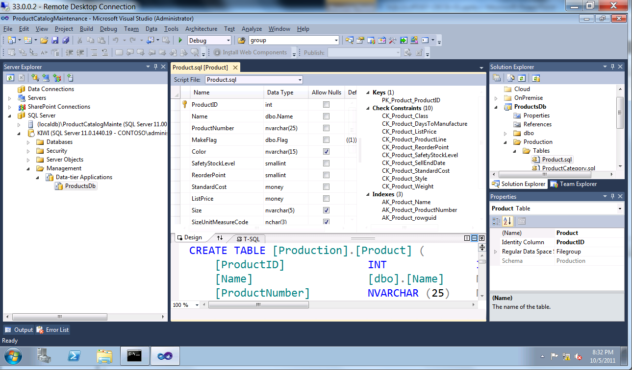
SQL Server Data Tools
Foundation
Declarative, model based database development
Integrated Tools
Application development integration
SQL Server and SQL Database Support
Connected and offline with local testing
Change Detection
Notes:
Slide Objectives:
Provide an overview of the foundation of SQL Server Data Tools
Transition:
SQL Server Data Tools was built are some core foundations and ideas that help developers with all areas of application development and management.
Speaking Points:
Declarative – Abstract the schema into a model-based environment. This model is then used as a validational concept.
Integrated – Modern language services integration providing intellisense, refactoring, navigate dependencies, etc.
Application Dev Environment – Familiar Visual Studio tooling environment
SQL S – Targets SQL Server 2005 and above, including Windows Azure SQL Database, providing an environment in which an on-premises database can be migrated into Windows Azure SQL Database.
Connected – New in SSDT is the ability to work in a connected state adding an online experience to the toolset.
Change Detection – Detects changes and database drift and allows for those changes to be migrated into your environment
Notes:
Any notes go here

Slide 14
SQL Server Data Tools
Key Benefits
Connected Development
Project Based Development
Schema Deployment
Notes:
Slide Objectives:
Provide an overview of the key
Transition:
SQL Server Data Tools is a continuation and evolution of the Visual Studio SQL Server Database projects as we move the project into the SQL Server realm. A lot of time has spent adding connected functionality, project based development to improve workflow and other collaboration features, and schema development to unify the data deployment story across SQL Server.
Speaking Points:
Connected Development -> Bring the connected development environment for SQL Server into Visual Studio as a first class citizen by adding the navigation structure that you are familiar with (T-SQL editor, IntelliSense, Schema Comparison, Designers).
Project Based Development -> 1st Class T-SQL Support (Go To Definition, Find All References, Refactoring), Isolated (Source Code Based, F5 Debugging & Testing), Integrated (Source Code Control), Schema Insight (Point-in-time snapshots, T-SQL Static Code Analysis)
Schema Deployment -> Declarative (Model Based, Incremental Schema Deployment), Multi-Targeting (SQL Server 2005 – 2012 & SQL Database), Standard Formats (DACPAC, SQL Script), DAC (Format, Engine, API & REIST)
Notes:
Any notes go here

Slide 15
SSDT
demo
Notes:
Demo – Using SQL Server Data Tools
In SQL Server Object Explorer (in Visual Studio 2012), select on-premises database.
Create New Project
Set Target Platform to SQL Azure
Create Empty Database project
Create a New Comparison
Uncheck unsupported object types
Execute comparison
Update empty project

Slide 16
Other Migration Tools

Slide 17
Additional Migration Tools
Microsoft and 3rd Party Tools
Generate Scripts Wizard
BCP
SSIS
SQL Database Migration Wizard
Migration Assistants
Notes:
Slide Objectives:
Touch on a other migration utilities and tools that can help with the migration process to SQL Database.
Transition:
SQL Server Migration Assistant (SSMA) v5.2 is now available. SSMA simplifies database migration process from Oracle/Sybase/MySQL and Microsoft Access to SQL Server and SQL Database. SSMA automates all aspects of migration including migration assessment analysis, schema and SQL statement conversion, data migration as well as migration testing to reduce cost and reduce risk of your database migration project.
Speaking Points:
Generate Scripts Wizard – Generate and Publish Scripts Wizard creates Transact-SQL scripts for your local database.
BCP – Used to import large numbers of new rows into SQL Server tables or to export data out of tables into data files. Does NOT do schema.
SSIS – You can transfer data to Windows Azure SQL Database by using SQL Server 2008 Integration Services. In SQL Server 2008 R2 or later, the Import and Export Data Wizard provides support for SQL Database. Difficult to do schema.
SQL Database Migration Wizard – Wizard driven application provides the ability select which the SQL objects, creates SQL scripts suitable for SQL Database, and allows you to migrate data between on-premise SQL Server 2005 or 2008 and SQL Database servers, as well as between two or more SQL Databases in the same or different data centers. Not supported by Microsoft.
Migration Assistants – Simplifies and automates database migration process from Oracle/Sybase/MySQL and Microsoft Access to SQL Server and Windows Azure SQL Database.
Notes:
http://blogs.msdn.com/b/ssma/archive/2012/01/31/microsoft-sql-server-migration-assistant-ssma-5-2-is-now-available.aspx

Slide 18
Considerations and Best Practices

Slide 19
Migration Considerations
Things to Keep in Mind
Database Size
Objects
Data
Data Types
Frequency
Transactional Consistency
Technology Proficiency
Easiest != Best
You can pick more than one…
Notes:
Slide Objectives:
Considerations when looking at different migration strategies
Transition:
There are a lot of choices when deciding the best available migration strategy for a given environment. When looking at all of the options, there are a few things that should be considered
Speaking Points:
Database Size – How big is the database and how long will it take to migrate using each tool?
Frequency – Is this a one-time migration or is this a recurring migration? This, along with the database size, will have an impact on the tool selected.
Transactional Consistency -
Technology Proficiency – Will someone need to be trained to use a specific tool or is the knowledge already in house?
Notes:
With the Import/Export service and the DAC Framework, migration to SQL Database has been made nearly painless and simple. This tool, along with SSDT, should be the main focus of migrations, but many of the additional tools can provide great insight into supported objects, and how migrations will work in different environments.

Slide 20
Consider the Options
Tools | Schema | SQL Database Compat Checks | Data | Data Transfer Efficiency | Notes
BCP | No | N/A | Yes | Good | Efficient transfer of data to existing table
SSMS Generate Scripts wizard | Yes | Some | Yes | Poor | Good for smaller databases Has explicit option for SQL Database script generation
SQL Server Import & Export Data | No | N/A | Yes | Good | Simple UI on top of SSIS; also available in SSMS
SSIS | No | N/A | Yes | Good | Most flexibility
SQL Database Migration Wizard | Yes | Yes | Yes | Good | Great capabilities; e.g. evaluate trace files Open source on CodePlex; Not supported by MSFT
DAC (BACPAC) | Yes | Yes | Yes | Good | Entity containing all database objects including data Full SQL Database support
DAC Database Import/Export | Yes | Yes | Yes | Good | Export/import of DAC plus data with DAC framework Service for cloud-only support coming soon
SQL Database Copy | Yes | N/A | Yes | Good | Create transactionally consistent copy of SQL Database instances Currently within the same data center
Notes:
Slide Objectives:
Provide a side-by-side comparison of the tools and their options
Transition:
As a quick visual comparison, this table provides a great look into many of the tools discussed. This table shows some critical information regarding objects and performance and additional notes for each tool.
Speaking Points:
Some tools don’t migrate schema, thus the schema must already exist
Data Transfer Efficiency is relative as it is determined by primarily network connection bandwidth, but the size of the database also plays a factor.
Notes:

