Slide 1
CURBING ATTRITION WITH DATA

Slide 2
SCOPE OF PRESENTATION
BUSINESS CASE
PRELIMINARY FINDINGS
SUMMARY OF DATASET
EXPLORATORY DATA ANALYSIS
1
2
3
4
5
MACHINE LEARNING APPLICATION
6
PRODUCT SHOWCASE
7
Q & A

Slide 3
BUSINESS CASE
1
The Problem Statement

Slide 4
ATTRITION IS A MAJOR PROBLEM
How can we use the data of employers and employees to reduce attrition rates in a company?

Slide 5
“Attrition is defined as a loss of employees through a natural process and an employer will not fill the vacancy left by the former employee”

Slide 6
TACKLING THE PROBLEM
Sourcing the Data
Preparing the
Data
Exploring the Data
Machine
Learning
Generating Insights

Slide 7
2
PRELIMINARY FINDINGS

Slide 8
$33,251 USD
13.2% Attrition Rate
2 Months
cost of productivity loss due to attrition
In the tech sector, higher than any other sector
Average time required to bring knowledge workers up to speed

Slide 9
SUMMARY OF DATASET
3
Overview & Steps Taken to Clean and Prepare Data

Slide 10

SOURCE OF DATASET
https://www.kaggle.com/pavansubhasht/ibm-hr-analytics-attrition-dataset

Slide 11
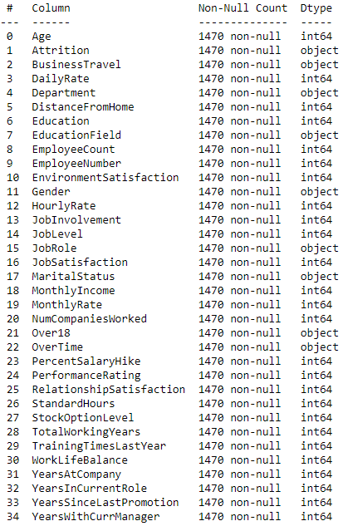
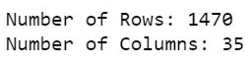
NUMBER OF ROWS & COLUMNS
There are a total of
35 Columns and 1470 Rows
The data does not contain any missing values

Slide 12
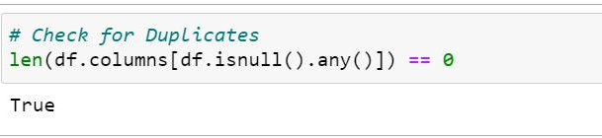
DUPLICATE DATA

Slide 13
4
DATA PREPARATION
Data Cleaning and More

Slide 14
REMOVING UNWANTED COLUMNS

Slide 15
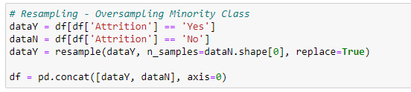
PREPARATION FOR RESAMPLING

Slide 16
RENAMING COLUMNS

Slide 17
SPLITTING THE DATA

Slide 18
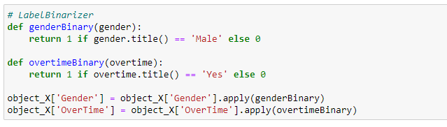
LABEL BINARIZER

Slide 19
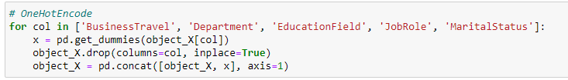
ONE HOT ENCODING

Slide 20
5
EXPLORATORY DATA ANALYSIS

Slide 21
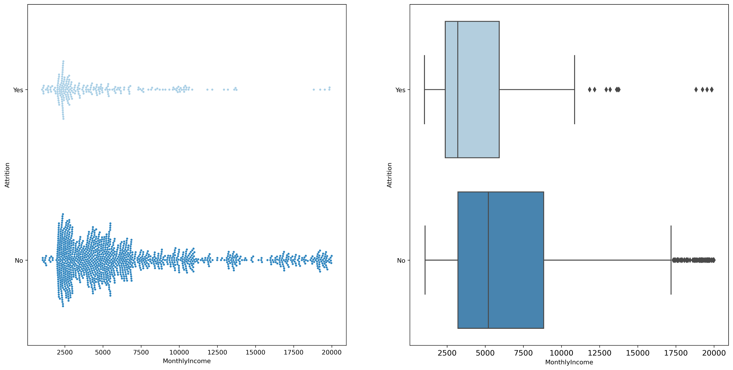
MONTHLY INCOME AND ATTRITION
Hypothesis: Employees with lower income have higher chance of being attrited
ANOVA
F_score = 38.5 (3 S.F.)
P_value = 7.15e-10 (3 S.F.)
Conclusion
At 99% confidence interval, there is a statistical relation between MonthlyIncome and Attrition

Slide 22
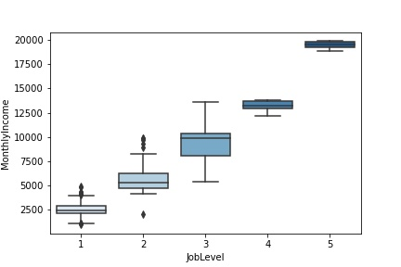
MONTHLY INCOME AND JOBLEVEL
ANOVA
F_score = 24.2 (3 S.F.)
P_value = 1.93e-59 (3 S.F.)
Conclusion
At 99% confidence interval, there is a statistical relation between MonthlyIncome and JobLevel

Slide 23
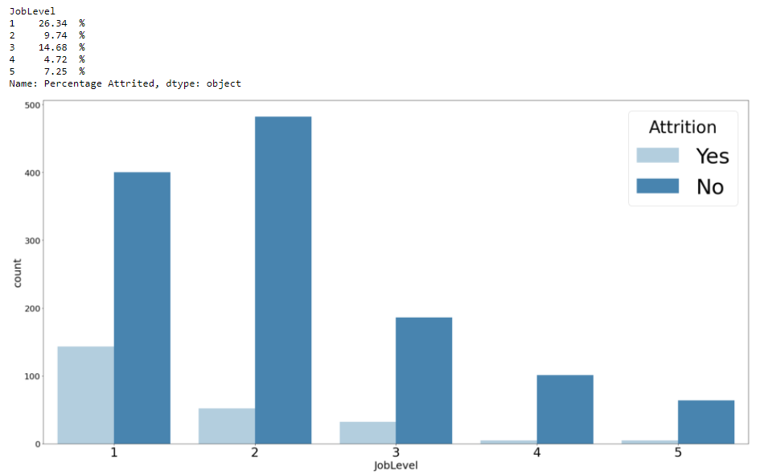
JOBLEVEL AND ATTRITION
Chi2 Test
Chi2_value = 24.94 (3 S.F.)
P_value = 5.92e-07 (3 S.F.)
Conclusion
At 99% confidence interval, there is a statistical relation between OverTime and Attrition

Slide 24
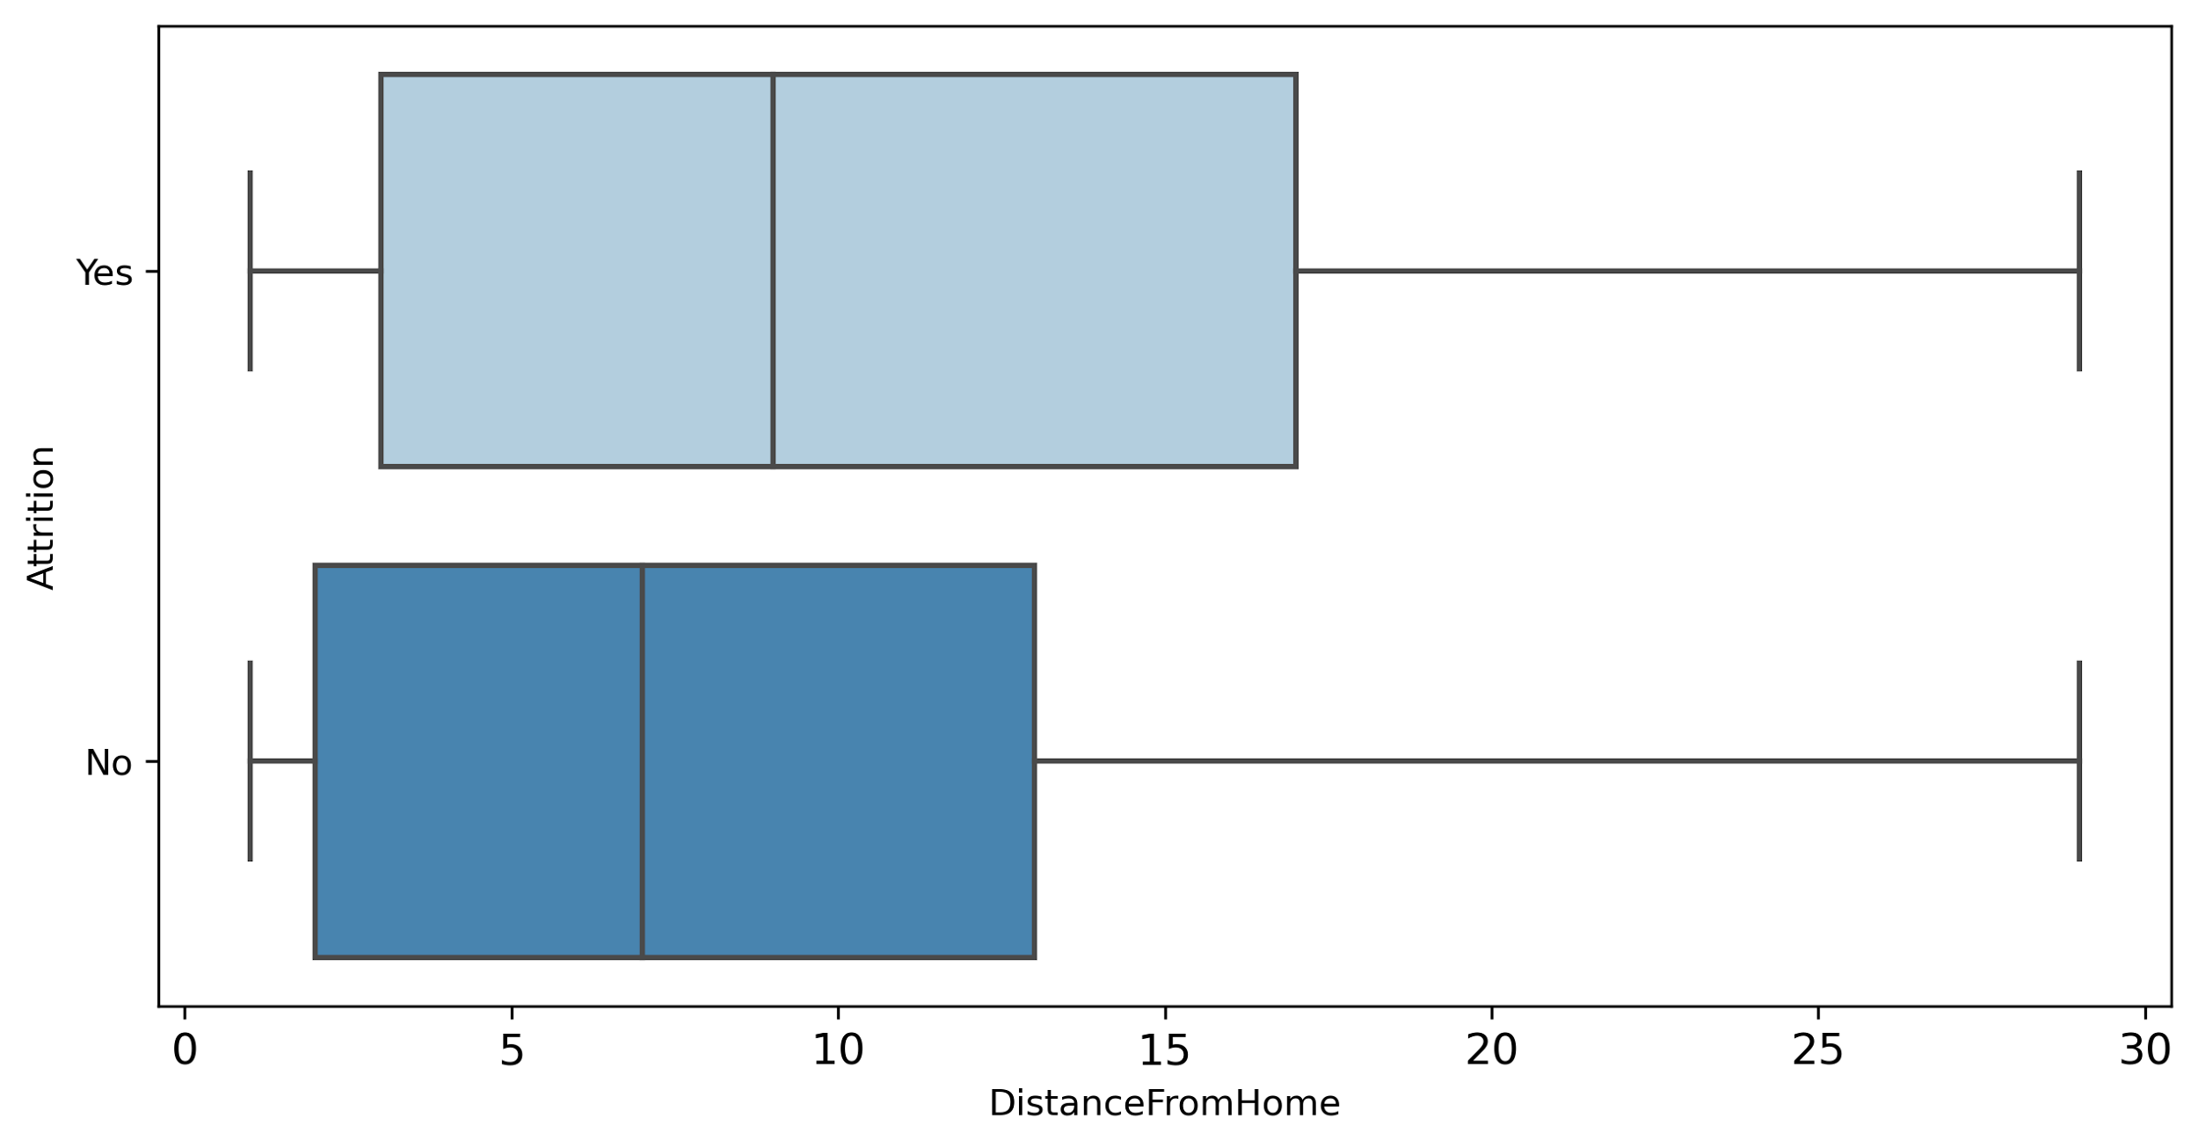
DISTANCEFROMHOME AND ATTRITION
Hypothesis: Employees who live further from workplace are more likely to be attrited
ANOVA
F_score = 8.97 (3 S.F.)
P_value = 0.00279 (3 S.F.)
Conclusion
At 99% confidence interval, there is a statistical relationship between DistanceFromHome and Attrition

Slide 25
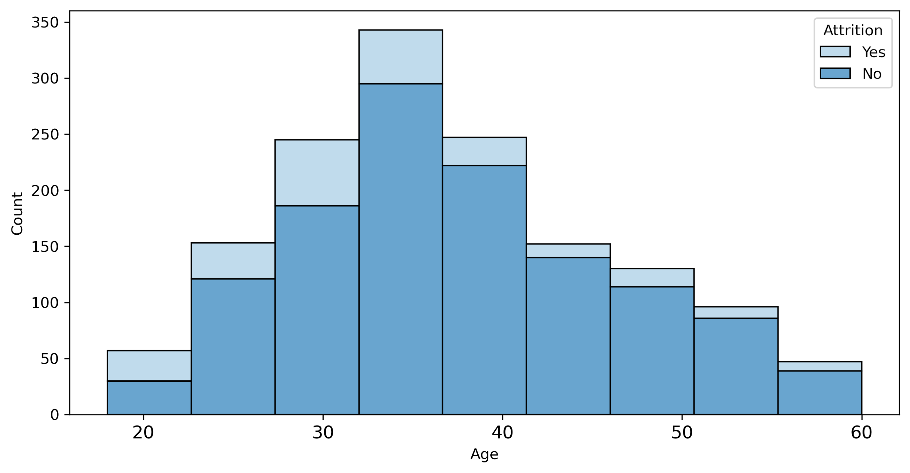
AGE AND ATTRITION
Hypothesis: Older employees are more likely to be attrited
ANOVA
F_score = 38.2 (3 S.F.)
P_value = 8.36e-10
Conclusion
At 99% confidence interval, there is a statistical relationship between Age and Attrition.

Slide 26
AGE AND ATTRITION
Hypothesis: Older employees are more likely to be attrited
Younger
ANOVA
F_score = 38.2 (3 S.F.)
P_value = 8.36e-10
Conclusion
At 99% confidence interval, there is a statistical relationship between Age and Attrition.

Slide 27
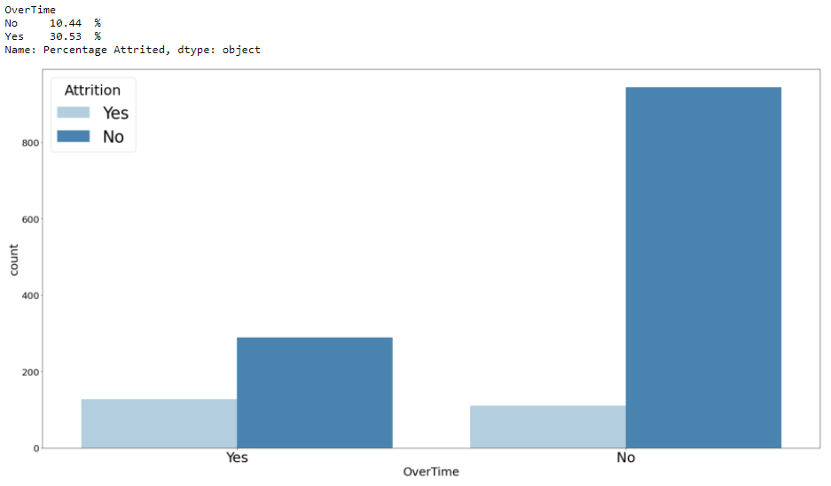
OVERTIME AND ATTRITION
Hypothesis: Employees who work overtime have higher chance of being attrited
Chi2 Test
Chi2_value = 63.8 (3 S.F.)
P_value = 1.35e-15
Conclusion
At 99% confidence interval, there is a statistical relation between OverTime and Attrition

Slide 28
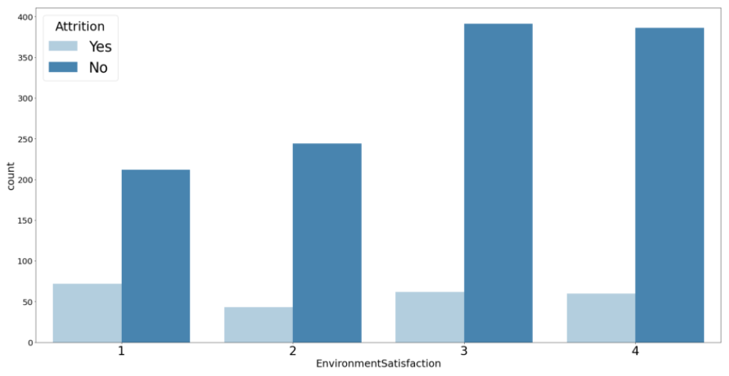
ENVIRONMENTSATISFACTION AND ATTRITION
Hypothesis: Employees with lower environment satisfaction are more likely to be attrited
Chi2 Test
Chi2_value = 6.89 (3 S.F.)
P_value = 0.00867 (3 S.F.)
Conclusion
At 99% confidence interval, there is a statistical relation between EnvironmentSatisfaction and Attrition

Slide 29
6
MACHINE LEARNING APPLICATION

Slide 30
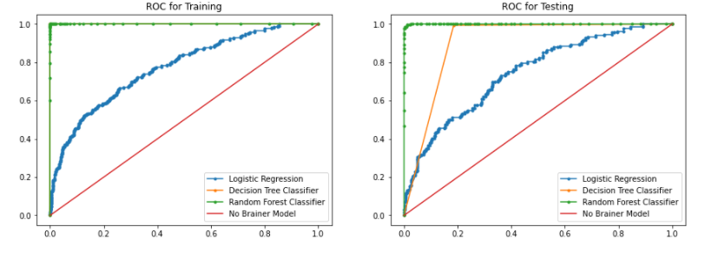
CLASSIFICATION WITH RANDOM FOREST
Why Random Forest?
Based on the ROC and AUC, we concluded that Random Forest is the best algorithm among the three to solve this problem

Slide 31
PREDICTING WITH RANDOM FOREST
WHAT IS A RANDOM FOREST
WHAT ARE WE PREDICTING AND OPTIMIZING FOR
Ensemble model using classification and regression problems
Build on top of many Decision Trees
Typically used in supervised machine learning
People who are at risk of being attrited, identifies as not at risk of being attrited
Minimise False Negative Rate
Maximise True Positive Rate

Slide 32
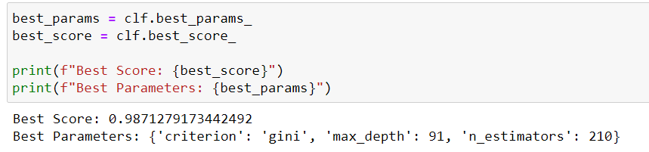
HYPERPARAMETER TUNING
Perform hyperparameter tuning to search for the best set of hyperparameters
10-Fold Cross-Validation

Slide 33
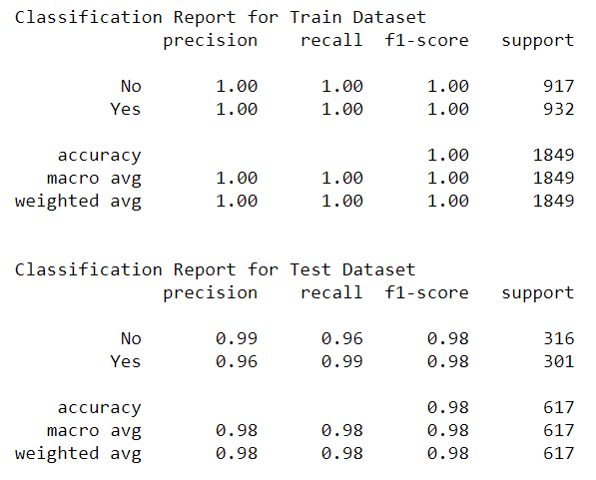
EVALUATION OF MODEL
Evaluation
True Positive Rate (Recall) is 99.3%
False Negative Rate is 0.7% (1 - Recall)
Did we achieve our intended outcome?
YES

Slide 34
THANK YOU
Any Questions?

