Slide 1

DSCI-521 Project
Group 7
Naga Venkata Surya Sai Tanmai Raavi
Sai Vasavi HarshaVardhan Gupta Somisetty
Akhil Songa
Sri Teja Kumar Reddy Tetali

Slide 2
Aim of the project
Develop a Machine Learning model to predict Human Activity based on sensor Data

Slide 3
Overview of our project
This Project is aimed at developing a ML model about the user's physical activity based on sensor data.
Primarily there are Two main sensors used to generate the dataset: Gyroscope and Accelerometer
Gyroscope : For identifying Position in 3D space
Accelerometer: For measuring Acceleration in 3D Space

Slide 4

Potential applications
Assist Smart Wearables manufacturers to bring-in exciting features like Workout Monitoring, Calorie Tracking.
Develop Applications which can monitor the efficiency with which muscles contract and expand during workout
Disrupt the robotic limbs industry, as it can assist people with disabilities in smartly in pre-maturely predicting the movement being made

Slide 5
Dataset
The dataset is publicly available on UCI.
The dataset contains sensor readings from 2 different sensors worn by the participants, while they performed different physical activities.
It contains data from 10 participants, who were asked to perform 12 different physical activities, including walking, standing, jumping, and cycling.
Each instance in the dataset consists of 12 sensor readings and a label that indicates the corresponding activity.
The sensors included in the dataset are the accelerometer and a gyroscope attached to the right wrist and left ankle of the subject.

Slide 6
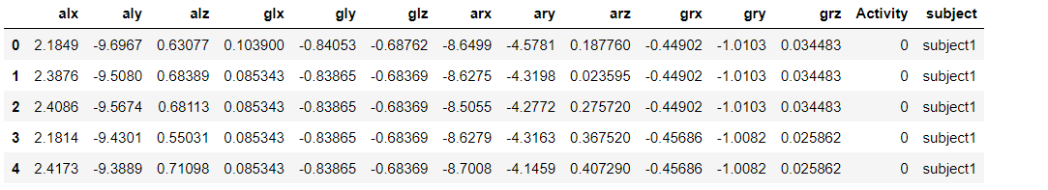
Sample Data Set

Slide 7
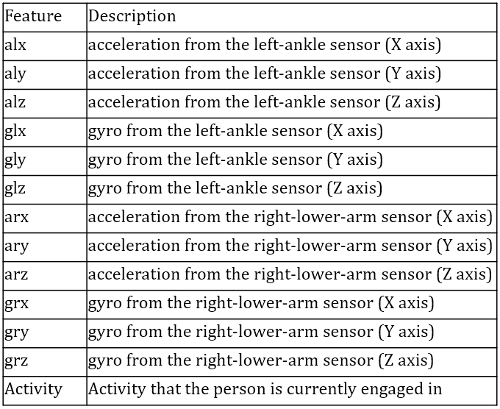
Attributes in the dataset

Slide 8
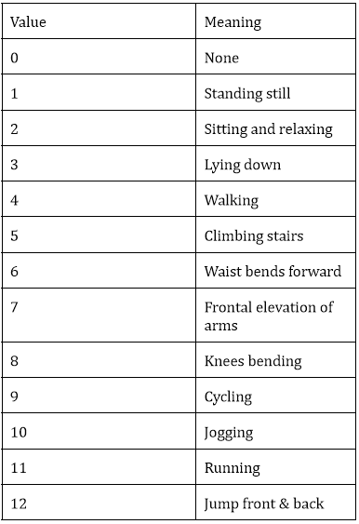
Categories of Activities recorded

Slide 9
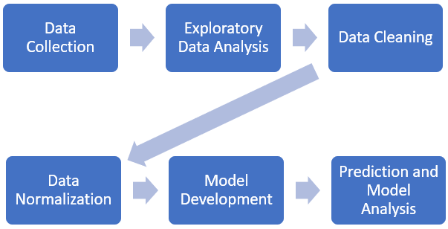
Our Approach

Slide 10
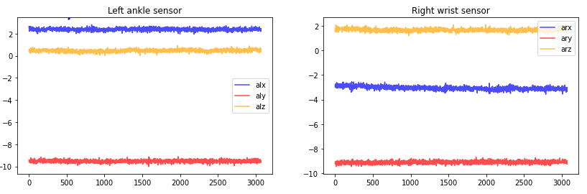
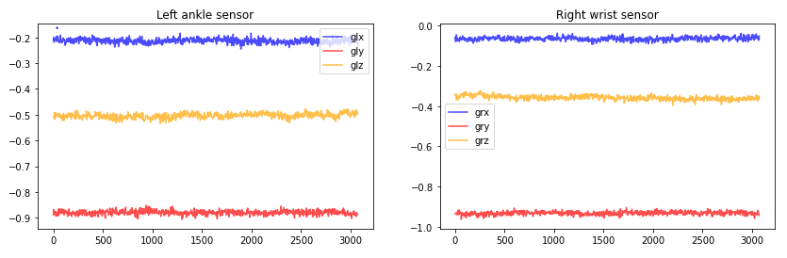
Standing Still

Slide 11
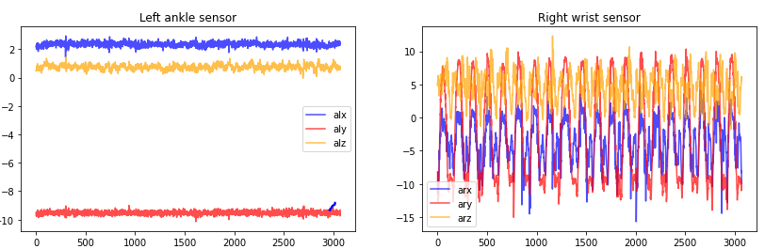
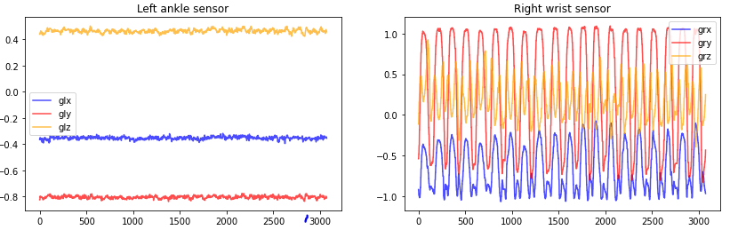
Line Graph Frontal Elevation of Arms

Slide 12
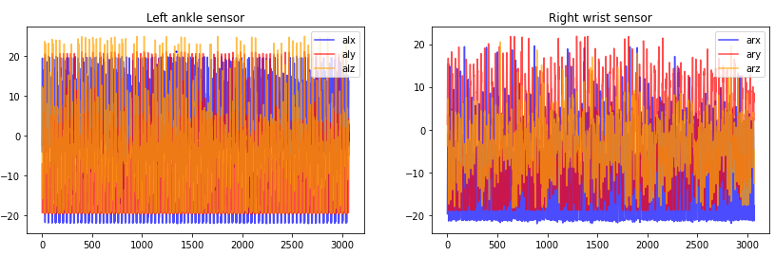
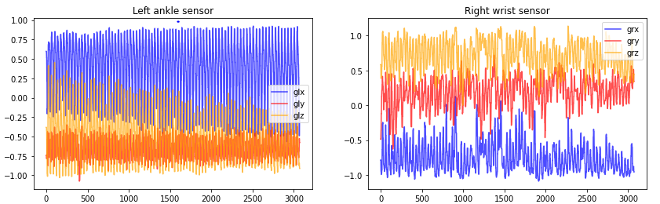
Line Graph of Running

Slide 13
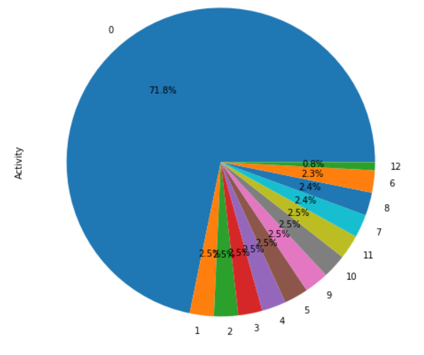
Before resampling

Slide 14
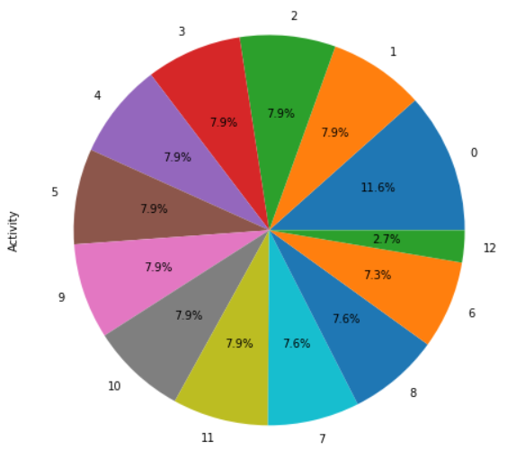
After resampling

Slide 15
Models used
As the task is multi-class classification, we used the following models for training our dataset:
Logistic Regression
K-Nearest Neighbors
Random Forest Classifier

Slide 16
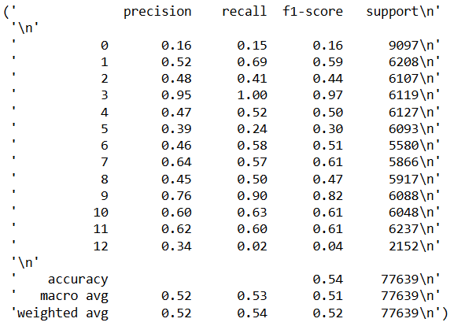
Performance of Logistic Regression

Slide 17
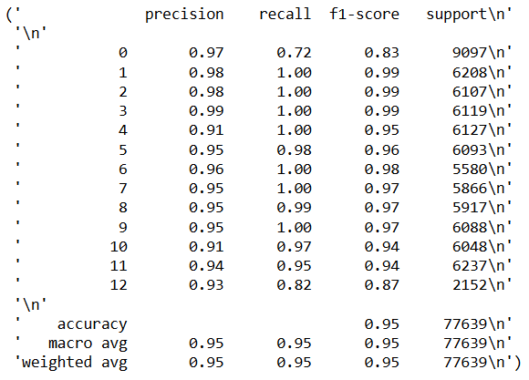
Performance of KNN

Slide 18
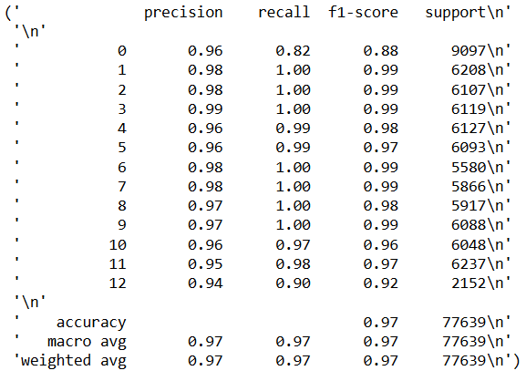
Performance of Random-Forest Classifier

Slide 19
Challenges Faced
& Future Scope
The axis of the sensors is not clearly mentioned, making it difficult to manually visualize the movement, which creates confusion.
The data is unevenly distributed, with most of the data falling into Activity 0, which is None. To address this, we downsampled the data.
If we include a heart rate sensor in this experiment, we could improve the project further.
It is challenging to predict extra activities using only multiple predefined activities.

Slide 20
Individual Skills and contributions
Team Member 1 :
Sai Vasavi Harshavardhan Gupta Somisetty - Machine Learning, Data Visualization, Data collection and pre-processing, Data Transformation Previous Degree:- BTech in Computer Science Current Program:- M.S in Data Science
Team Member 2 :
Naga Venkata Surya Sai Tanmai Raavi - Domain Knowledge of Sensors, Exploratory Data Analysis, Data Normalization, Machine Learning Modelling, Parameter Tuning
Previous Degree:- BTech in Computer Science Current Program:- M.S in Data Science

Slide 21
Team Member 3 :
Akhil Songa - Domain Knowledge of Sensors, Exploratory Data Analysis, Data Visualization, Neural Networks
Previous Degree:- BTech in Computer Science Current Program:- M.S in Data Science
Team Member 4 :
Sri Teja Kumar Reddy Tetali - Machine Learning, Data collection, Data Preprocessing, Data Collection and Pre-Processing, Data visualization, Machine Learning.
Previous Degree:- BTech in Computer Science Current Program:- M.S in Data Science

