Slide 1
CSE 3102: Database systems project
Project title: Hotel Management System

Slide 2
Hotel management System
Functionalities:
User:
Users can create their own account.
User can apply for room reservation.
Users can see their own history.
Users can see the rooms in the hotel. Users can also the status of the room and can reserve according to status.
Admin:
Admin can create and edit the rooms.
Admin also can manage the room.
Admin can manage the reservation system.

Slide 3
Home page
Two different homepages for user and admin in our system.

Slide 4
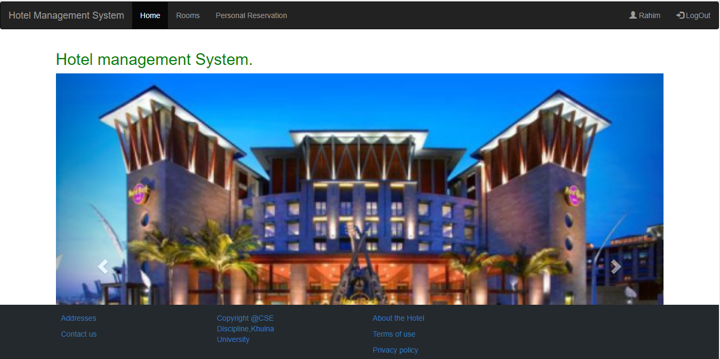
User Home Page

Slide 5
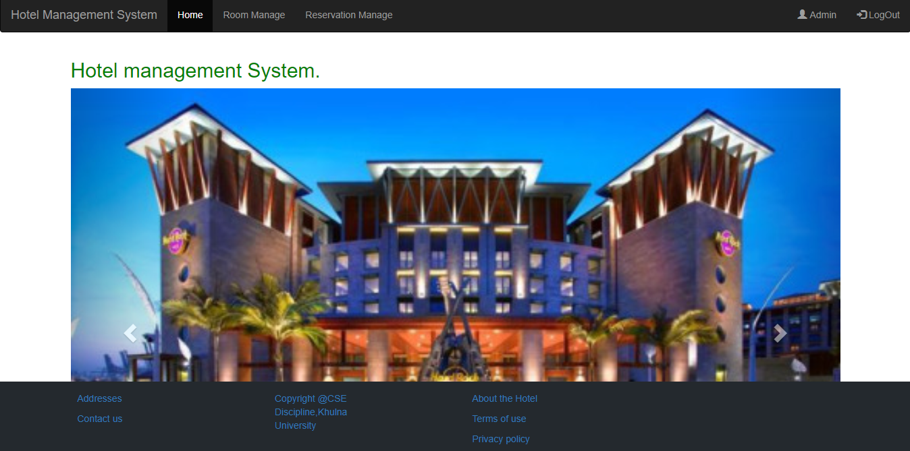
Admin Home Page

Slide 6
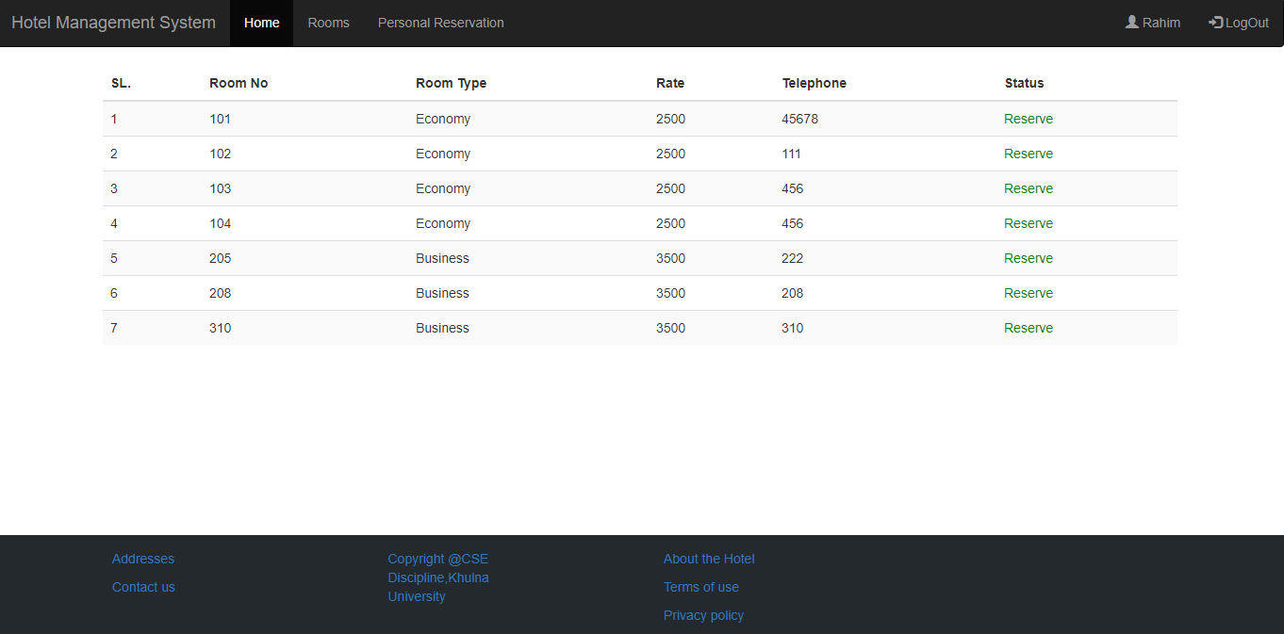
User can see the room list and can also reserve the room.

Slide 7
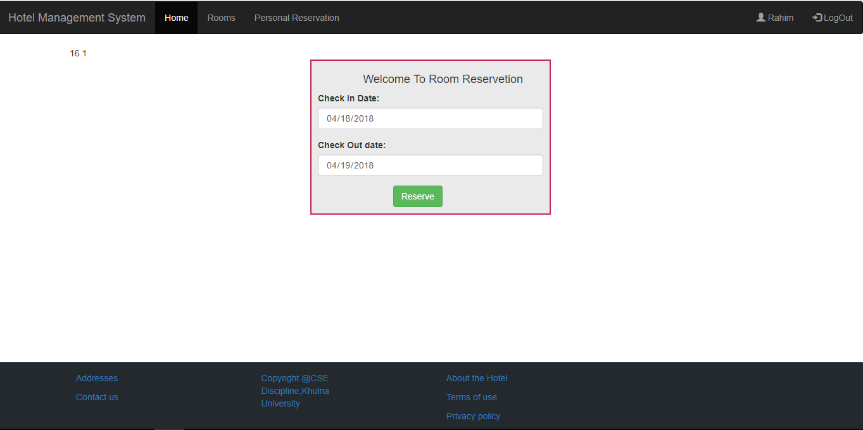
Room Reservation

Slide 8
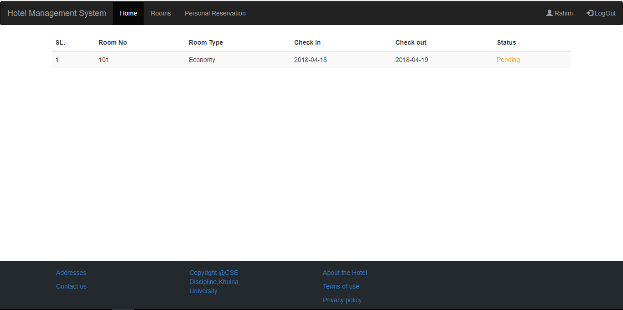
User can See the history of reservation.

Slide 9
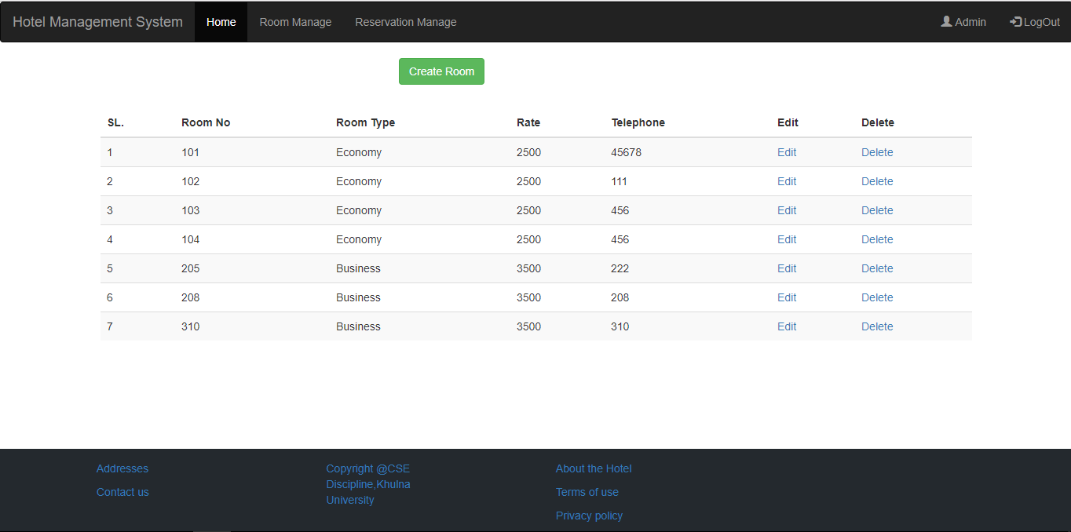
Admin can manage and create new room

Slide 10
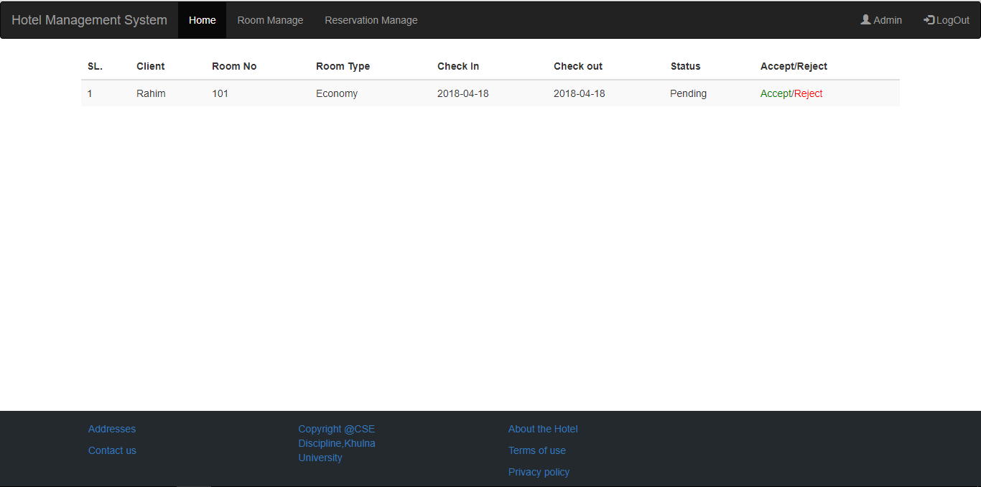
Admin Can manage the reservation.

Slide 11
Thank You

