Slide 2

Generative AI Accelerator
29th September 2025
Notes:
Let’s get started.
Hi everyone.
Welcome.

Slide 3
x
Where we are?
Intro to Generative AI
- Intro to AI
- History and evolution of AI
- Discriminative vs Generative AI
- AI Landscape
- Open Source vs Proprietary LMs
- Responsible AI - Ethics, Bias etc
LLM Foundations
- Transformers Intuition
- Next Token Prediction - LLM Training Phases
- Pre-training/ Post-training
- Model behaviour parameters - Different types of LLMs
- Limitations of LLMs
Prompt Engineering
- Prompting Techniques
- CoT/Tool Calling
- Prompt Evaluation
- Prompt Optimization - Context Engineering - Prompt Hacking/ Jailbreaks
RAG Systems
- RAG basics
- Different types of RAG
- RAG Evaluation
- Improving RAG performance
Designing LLM Systems
- Choosing the right stack
- Evaluating LLM systems
- Design Tradeoffs: Latency/Cost
- Performance Optimization
- Security and Privacy
- Case Study - Product Search
AI Agents
- Intro to Agents - Tool Use and Memory
- Workflow vs Agents - Agent orchestration patterns
- Agent Evaluation
- Model Context Protocol (MCP)
Capstone Project
- Project to apply your learnings
- Demo Day
Notes:
Here’s a quick overview of what we’ll be covering in this program.
We start with Intro to Generative AI — we’ll build a shared understanding of what AI is, trace its history, understand the difference between discriminative and generative AI, explore the AI landscape, and touch on responsible AI principles like ethics and bias.
Next, we’ll dive into LLM Foundations — here, we’ll break down how transformers work, what next-token prediction really means, and go over the phases of training an LLM. We’ll also cover model parameters, the different types of LLMs, and their limitations so you understand both capabilities and constraints.
From there, we move into Prompt Engineering — learning prompting techniques, tool calling, evaluation, optimization, context engineering, and even how prompts can be hacked or jailbroken so you can design robust systems.
Then we’ll get hands-on with RAG Systems — Retrieval Augmented Generation — where we’ll learn the basics, the different RAG architectures, how to evaluate them, and ways to improve performance.
We’ll follow this with Designing LLM Systems — selecting the right stack, evaluating systems, understanding tradeoffs between latency and cost, optimizing for performance, ensuring security, and working through a real-world case study on product search.
The next section is AI Agents — we’ll explore what agents are, how they use tools and memory, how they differ from workflows, orchestration patterns, evaluation methods, and the Model Context Protocol.
Finally, we’ll wrap with a Capstone Project where you’ll apply everything you’ve learned in a real-world context, and present your work on Demo Day. A quick note — the prerequisite is a basic understanding of Python. So if you haven’t worked with Python before, would be to great to get the basics done. We have also sent a python tutorial in the welcome email.
This program doesn’t assume any prior background in AI or ML, so some of the early content might feel a bit familiar and redundant if you’ve been dabbling in Generative AI already. But we’ll be building up to more advanced, hands-on topics soon — there’s something in here for everyone.
Thanks in advance for your patience and openness as we bring everyone along

Slide 4
Evaluating RAG Systems How do we measure if Retrieval Augmented Generation really works?
Notes:
“RAG means we retrieve the right facts from trusted sources and then generate the answer with an LLM.
Instead of expecting the model to ‘know everything,’ we ground it in external knowledge so answers are current, contextual, and citable.”
Transition: “Before we build it, let’s surface the problems RAG actually solves.”

Slide 5
Why evaluate RAG?
LLMs ≠ Truth Engines:
Large Language Models generate fluent text, not verified facts.
RAG ≠ Perfect Grounding:
Retrieval adds context, but irrelevant or missing documents can still mislead the model.
Real-World Impact:
Inaccurate responses can cause misinformation in customer support, wrong recommendations, or compliance risks in enterprises.
Evaluation = Feedback Loop:
It helps identify whether the problem lies in:
1️⃣ Retrieval → wrong or missing documents
2️⃣ Generation → hallucinated or incomplete answers
3️⃣ Grounding → weak connection between retrieved context and final output
👉 Without systematic evaluation, you can’t improve.
Notes:
🎤 Speaker Notes — Slide 2: Why Evaluate RAG?
“When we build RAG systems, it’s tempting to assume that because we’re retrieving context from a trusted knowledge base, the outputs will automatically be correct or grounded.
But in reality, that’s not always the case.”
“Let’s start with the first point — LLMs are not truth engines.
They are trained to predict the most likely next word, not the most accurate next word.
So even when the model is retrieving context from our database, it can still fabricate details, merge unrelated facts, or summarize inaccurately — all while sounding completely confident.
In other words, fluency ≠ factuality.”
“Second — RAG doesn’t guarantee perfect grounding.
The retrieval step itself can fail. Maybe the embedding model misunderstood the query. Maybe the chunking strategy broke important context across multiple documents.
So even though the system retrieved something, it might not be the right something.
And if retrieval is wrong, the LLM will faithfully hallucinate based on wrong input — producing grounded nonsense.”
“Third — the impact of poor evaluation is real.
Imagine a customer support chatbot confidently giving an outdated policy answer.
Or an internal compliance assistant summarizing a regulation incorrectly.
These mistakes aren’t just technical bugs — they can have real business and reputational consequences.”
“That’s why we need to evaluate RAG systems systematically.
Evaluation tells us where the failure happens — is it:
1️⃣ The retrieval stage (wrong or missing docs)?
2️⃣ The generation stage (the model misinterprets retrieved info)?
3️⃣ Or the grounding stage (where the answer doesn’t align with the context)?
By measuring each of these, we can isolate issues and improve iteratively.”
“And here’s the key takeaway:
Without evaluation, you can’t improve.
You might think your RAG system is performing well simply because its answers ‘sound right.’
But unless you measure retrieval precision, answer faithfulness, and grounding accuracy — you’re operating blind.”
“In the next few slides, we’ll break down how to evaluate these layers — and introduce you to frameworks like RAGAS, which give us standardized metrics to quantify RAG quality.”

Slide 6
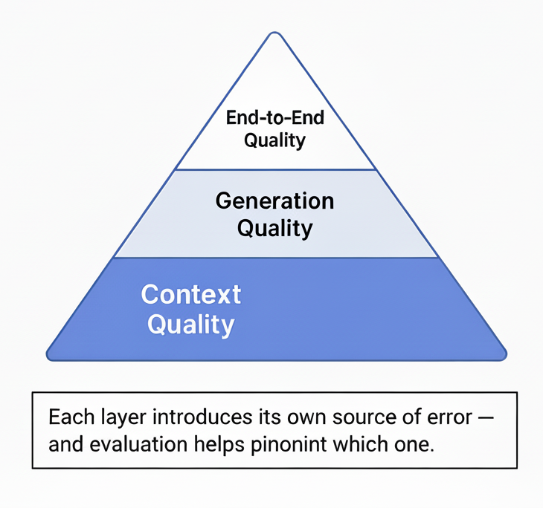
What exactly do we evaluate in a RAG system?
1. Retrieval Quality ➡️ Did we fetch the right context?
- Are the retrieved documents relevant to the query?
- Do they contain the evidence needed to answer it?
- Metrics: Context Precision, Context Recall, NDCG
2. Generation Quality ➡️ Did the model use the context correctly?
- Is the answer faithful to the retrieved information?
- Does it avoid adding facts not supported by context?
- Metrics: Faithfulness, Factual Consistency
3. End-to-End Quality ➡️ Did the final answer satisfy the user’s query?
- Is the answer relevant, correct, and complete?
- Is it coherent and well-structured?
- Metrics: Answer Relevancy, Correctness, Similarity
Notes:
🎤 Speaker Notes — Detailed
“Now that we know why evaluation is necessary, let’s look at what exactly we’re evaluating.”
“Every RAG system can be thought of as a three-stage pipeline — retrieval, generation, and final response.
Each of these stages introduces its own kind of error, so we evaluate them separately.”
“Let’s start with Retrieval Quality.
This is about whether the system is even fetching the right information.
For example, if I ask ‘When was Walmart founded?’ and my retriever pulls up documents about Walmart’s e-commerce strategy, the rest of the pipeline is already doomed — no matter how smart the model is.
Metrics like context precision and context recall help quantify this:
Precision tells us how many retrieved chunks are actually relevant.
Recall tells us how many relevant chunks we missed.
Think of it like search relevance — garbage in, garbage out.”
“Next comes Generation Quality.
Here, we ask: Did the model faithfully use the retrieved context?
Sometimes the model retrieves the right facts but still hallucinates — adding numbers, names, or claims that aren’t in the context.
So we measure faithfulness and factual consistency — basically checking if every part of the answer can be supported by retrieved evidence.”
“Finally, we evaluate End-to-End Quality.
Even if retrieval and faithfulness are perfect, the user experience depends on how well the final answer addresses the question.
Here we look at answer relevancy and correctness — did the user’s question actually get answered, and is it semantically similar to the ideal answer?
For example, if I ask, ‘What are Walmart’s core business segments?’ — an answer about its founders may be factually correct but irrelevant.
That’s a failure of end-to-end evaluation.”
“So the big picture looks like this:
Retrieval checks what we found.
Generation checks what we said about it.
End-to-end evaluation checks whether the user’s need was met.
These three layers form the backbone of all RAG evaluation frameworks — including RAGAS, which we’ll explore next.”

Slide 7
Challenges in Evaluating RAG Systems
1️⃣ No single “ground truth”
Open-ended queries may have multiple correct answers.
Hard to compare text semantically (not word-by-word).
2️⃣ Context quality varies
Retrieved docs can be partially correct or incomplete.
Relevance and factuality don’t always align.
3️⃣ Human judgment is expensive
Manual review takes time and requires expertise.
Annotators may disagree on what’s “faithful.”
4️⃣ Automated metrics can mislead
BLEU/ROUGE ignore meaning.
LLM-as-Judge may introduce bias or drift.
Notes:
Speaker Notes — Detailed
“Now that we’ve seen the main evaluation dimensions, let’s talk about why RAG evaluation is tricky in practice.”
“The first challenge is that RAG tasks rarely have a single correct answer.
For instance, if I ask, ‘What were Walmart’s key AI initiatives in 2024?’
there could be several equally valid summaries depending on the retrieved docs.
Traditional metrics like accuracy or BLEU can’t capture this nuance — because they treat any wording difference as an error.”
“The second challenge is that the retrieved context itself can vary in quality.
Maybe some documents are perfectly relevant, some partially, and others totally off-topic.
The LLM might still produce a coherent answer — but it may draw on the wrong evidence.
That’s why measuring ‘faithfulness’ is so important — to check whether every statement in the answer is traceable to retrieved text.”
“The third challenge is human evaluation cost.
The most reliable way to measure factuality is to have people read both the context and the response.
But at scale — say, hundreds of RAG outputs per day — that’s expensive and inconsistent.
Even human evaluators often disagree on what counts as ‘correct’ versus ‘plausible.’”
“And finally, automated metrics can mislead.
Older text-similarity scores like BLEU and ROUGE care about matching words, not meaning.
On the other hand, modern methods like using GPT-4 as a ‘judge’ introduce their own biases — the judge might favor fluent text over factual text, or score inconsistently across runs.”
“So the key takeaway here is that evaluating RAG isn’t about counting exact matches — it’s about measuring semantic alignment and factual grounding.
That’s exactly where frameworks like RAGAS come in — they define standardized, interpretable metrics for each of these challenges.”

