Slide 1

Faculty Name : Dr. Latha AP Designation: Assistant Professor
Course Name: Database Management Systems Course Code: [IPCC]22IS54
Credits: 3:0:1
Sem: 4th B

Slide 2
Course objectives
Know the fundamentals of database management systems, transactions and related concepts
Study E-R model and relational model for designing database.
Understand normalization techniques for designing good database.
Learn writing SQL queries for the given requirements.

Slide 3
Course Outcomes
CO1 | Interpret and explore the related concepts of database management systems and transactions.
CO2 | Apply database design models to real time scenarios.
CO3 | Practice and apply SQL to the specified requirements
CO4 | Develop applications using relational and NoSQL database.

Slide 4
TEXT BOOKS
Fundamentals of Database Systems, Ramez Elmasri and Shamkant B. Navathe, 7th Edition,2017,Pearson.
2. Database management systems, Ramakrishnan, and Gehrke, 3rd Edition, 2014, McGraw Hill

Slide 5
Module 1- INTRODUCTION
Database
Data
Examples
Properties of database
DB represents mini world
Logically coherent collection of data
Data for specific purpose

Slide 6
Module 1- INTRODUCTION
A database has
some source from which data is derived,
some degree of interaction with events in the real world,
and an audience that is actively interested in its contents.
A database can be of any size and complexity
A database may be generated and maintained manually or it may be computerized

Slide 7
Module 1- INTRODUCTION
A database management system (DBMS) is a computerized system that enables users to create and maintain a database.
The DBMS is a general-purpose software system that facilitates the processes of defining, constructing, manipulating, and sharing databases among various users and applications.

Slide 8
Module 1- INTRODUCTION
Defining a database :
specifying the data types, structures, and constraints of the data to be stored in the database.
Constructing the database:
storing the data on some storage medium that is controlled by the DBMS.
Manipulating a database:
includes functions such as querying the database to retrieve specific data, updating the database to reflect changes in the miniworld, and generating reports from the data
Sharing a database:
allows multiple users and programs to access the database simultaneously

Slide 9
Module 1- INTRODUCTION
Application program
accesses the database by sending queries or requests for data to the DBMS.
A query
causes some data to be retrieved
A transaction
causes some data to be read and some data to be written into the database.

Slide 10
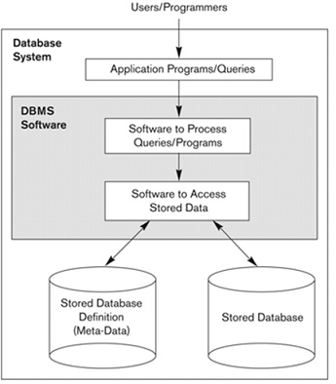
Module 1- AN EXAMPLE

Slide 11
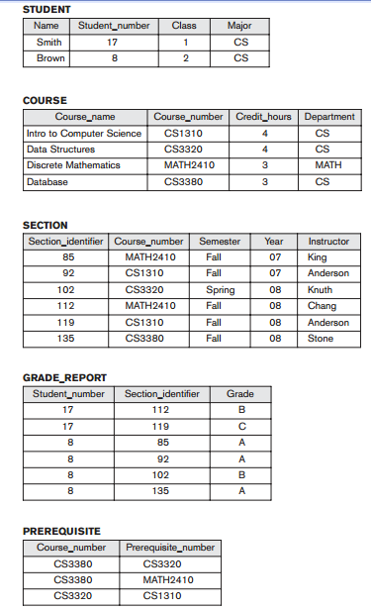
Module 1- AN EXAMPLE

Slide 12
AN EXAMPLE
Design of a new application for an existing database or design of a brand new database starts off with a phase called requirements specification and analysis.
These requirements are documented in detail and transformed into a conceptual design that can be represented and manipulated using some computerized tools .
The design is then translated to a logical design that can be expressed in a data model implemented in a commercial DBMS.
The final stage is physical design, during which further specifications are provided for storing and accessing the database

Slide 13
Characteristics of the Database Approach
In traditional file processing, each user defines and implements the files needed for a specific software application as part of programming the application.
Example: 1. Grade reporting office 2. Accounting office
Both users- interested in same data, maintains different files.
Redundancy occurs.

Slide 14
Characteristics of the Database Approach
In the database approach, a single repository maintains data that is defined once and then accessed by various users repeatedly through queries, transactions, and application programs.
The main characteristics of the database approach versus the file-processing approach are the following:
■ Self-describing nature of a database system
■ Insulation between programs and data, and data abstraction
■ Support of multiple views of the data
■ Sharing of data and multiuser transaction processing

Slide 15
Self-Describing Nature of a Database System
Meta-data - DBMS catalog, which contains information such as the structure of each file, the type and storage format of each data item, and various constraints on the data.
New database such as NOSQL systems, do not require meta-data.
They contain self-describing data that includes the data item names and data values together in one structure

Slide 16
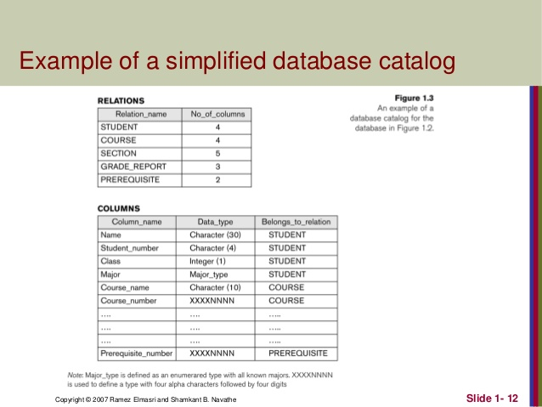
Self-Describing Nature of a Database System

Slide 17
Insulation between Programs and Data, and Data Abstraction
In traditional file processing, the structure of data files is embedded in the application programs.
The structure of data files is stored in the DBMS catalog separately from the access programs – called as Program – Data independence

Slide 18
Insulation between Programs and Data, and Data Abstraction
An operation (also called a function or method) is specified in two parts.
The interface (or signature) of an operation includes the operation name and the data types of its arguments (or parameters).
The implementation (or method) of the operation is specified separately and can be changed without affecting the interface.
Program – Operation Independence

Slide 19
Insulation between Programs and Data, and Data Abstraction
Data abstraction: allows program-data independence and program-operation independence
Conceptual representation: Does not include many of the details of how the data is stored or how the operations are implemented.
Data model: It is a type of data abstraction that is used to provide this conceptual representation

Slide 20
Support of Multiple Views of the Data
A view may be a subset of the database or it may contain virtual data that is derived from the database files but is not explicitly stored.
A multiuser DBMS whose users have a variety of distinct applications must provide facilities for defining multiple views

Slide 21
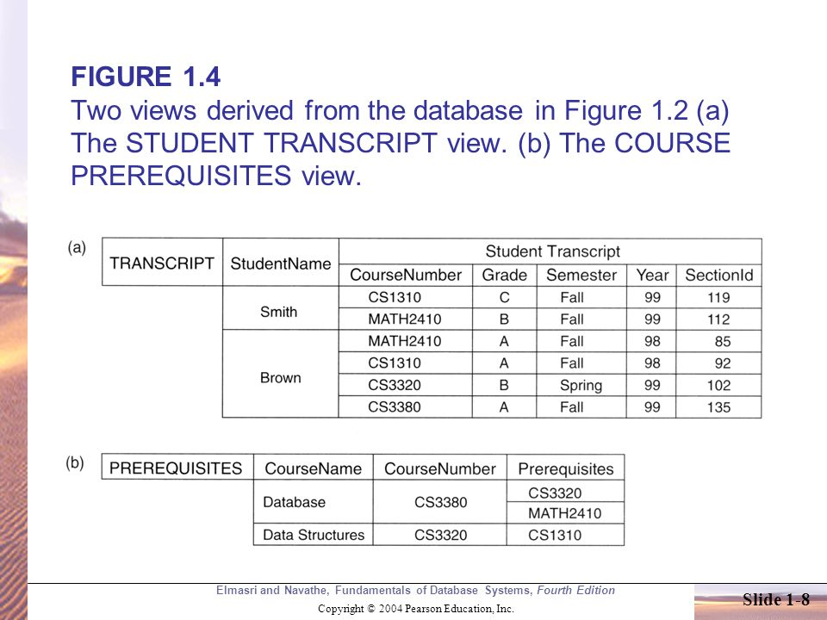
Support of Multiple Views of the Data

Slide 22
Sharing of Data and Multiuser Transaction Processing
The DBMS must include concurrency control.
Online transaction processing (OLTP) applications.
A transaction is an executing program or process that includes one or more database accesses.
The DBMS must enforce several transaction properties.
The isolation property ensures that each transaction appears to execute in isolation from other transactions, even though hundreds of transactions may be executing concurrently.
The atomicity property ensures that either all the database operations in a transaction are executed or none are.

Slide 23
Advantages of Using the DBMS Approach
Controlling Redundancy
Restricting Unauthorized Access
Providing Persistent Storage for Program Objects
Providing Storage Structures and Search Techniques for Efficient Query Processing
Providing Backup and Recovery
Providing Multiple User Interfaces
Representing Complex Relationships among Data
Enforcing Integrity Constraints
Permitting Inferencing and Actions Using Rules and Triggers

Slide 24
Advantages of Using the DBMS Approach
Additional Implications of Using the Database Approach
Potential for Enforcing Standards.
Reduced Application Development Time
Flexibility
Availability of Up-to-Date Information.
Economies of Scale

Slide 25
When Not to Use a DBMS?
The overhead costs of using a DBMS are due to the following:
High initial investment in hardware, software, and training
The generality that a DBMS provides for defining and processing data
Overhead for providing security, concurrency control, recovery, and integrity functions

Slide 26
Data Models, Schemas, and Instances
Data abstraction
Data model—a collection of concepts that can be used to describe the structure of a database
Dynamic aspect or behavior of a database application - allows the database designer to specify a set of valid user-defined operations that are allowed on the database objects.

Slide 27
Categories of Data Models
High-level or conceptual data models
Low-level or physical data models
Representational (or implementation) data models
Conceptual data models use concepts such as entities, attributes, and relationships.
Entity
Attribute
Relationship
Entity–relationship model

Slide 28
Categories of Data Models
Representational or implementation data models are the models used most frequently in traditional commercial DBMSs.
They include Relational data model & network and hierarchical models
Representational data models represent data by using record structures and hence are sometimes called record-based data models.
Access path is a search structure that makes the search for particular database records efficient.
An index is an example of an access path that allows direct access to data using an index term or a keyword.

Slide 29
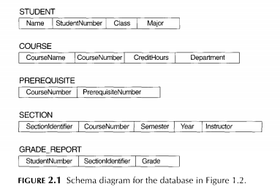
Schemas, Instances, and Database State
The description of a database is called the database schema, which is specified during database design and is not expected to change frequently.
A displayed schema is called a schema diagram.

Slide 30
Schemas, Instances, and Database State
Each object in the schema—such as STUDENT or COURSE—a schema construct.
The data in the database at a particular moment in time is called a database state or snapshot. It is also called the current set of occurrences or instances in the database.
The distinction between database schema and database state is very important. When we define a new database, we specify its database schema only to the DBMS. At this point, the corresponding database state is the empty state with no data. We get the initial state of the database when the database is first populated or loaded with the initial data.

Slide 31
The Three-Schema Architecture
The goal of the three-schema architecture is to separate the user applications from the physical database.
In this architecture, schemas can be defined at the following three levels:
The internal level
The conceptual level
The external or view level

Slide 32
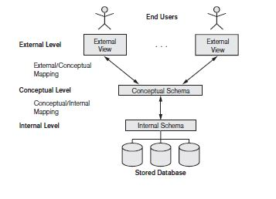
The Three-Schema Architecture

Slide 33
The Three-Schema Architecture
The internal level has an internal schema, which describes the physical storage structure of the database.
The conceptual level has a conceptual schema, which describes the structure of the whole database for a community of users.
The external or view level includes a number of external schemas or user views.

Slide 34
Data Independence
Data independence is defined as the capacity to change the schema at one level of a database system without having to change the schema at the next higher level.
Two types of data independence are:
Logical data independence is the capacity to change the conceptual schema without having to change external schemas or application programs.
Physical data independence is the capacity to change the internal schema without having to change the conceptual schema.

Slide 35
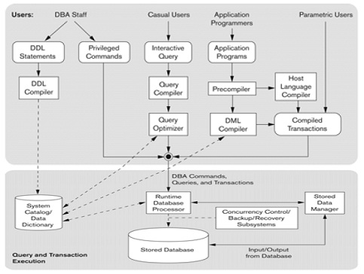
The Database System Environment
DBMS Component Modules

Slide 36
DBMS Component Modules
Operating system (OS)
Buffer management module
Stored data manager module
Interactive query
Query compiler
Query optimizer
Precompiler
Runtime database processor
System catalog
Concurrency control and backup and recovery systems

Slide 37
Database System Utilities
Database utilities help the DBA manage the database system. Common utilities have the following types of functions:
Loading
Backup
Database storage reorganization
Performance monitoring

Slide 38
Tools, Application Environments, and Communications Facilities
Data dictionary (or data repository) system
Information repository
Application development environments
Communications software
DB/DC system

Slide 39
UNIT 1 – Chapter 2
Entity-Relationship model: A sample Database Application; Entity types, Entity Sets, Attributes and Keys; Relationship types, Relationship Sets, Roles and structural Constraints; Weak Entity types; ER Diagrams, Naming Conventions and Design issues.

Slide 40

A Sample Database Application
A sample database application, called COMPANY
The COMPANY database keeps track of a company’s employees, departments, and projects

Slide 41
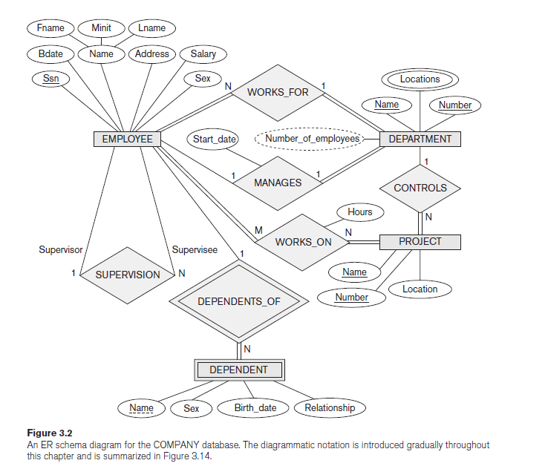
A Sample Database Application

Slide 42
Entity Types, Entity Sets, Attributes, and Keys
Entities and Attributes
An entity may be an object with a physical existence (for example, a particular person, car, house, or employee) or it may be an object with a conceptual existence (for instance, a company, a job, or a university course).
Attributes—the particular properties that describe it. For example, an EMPLOYEE entity may be described by the employee’s name, age, address, salary, and job.

Slide 43
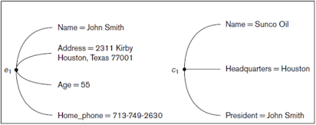
Entities and Attributes

Slide 44
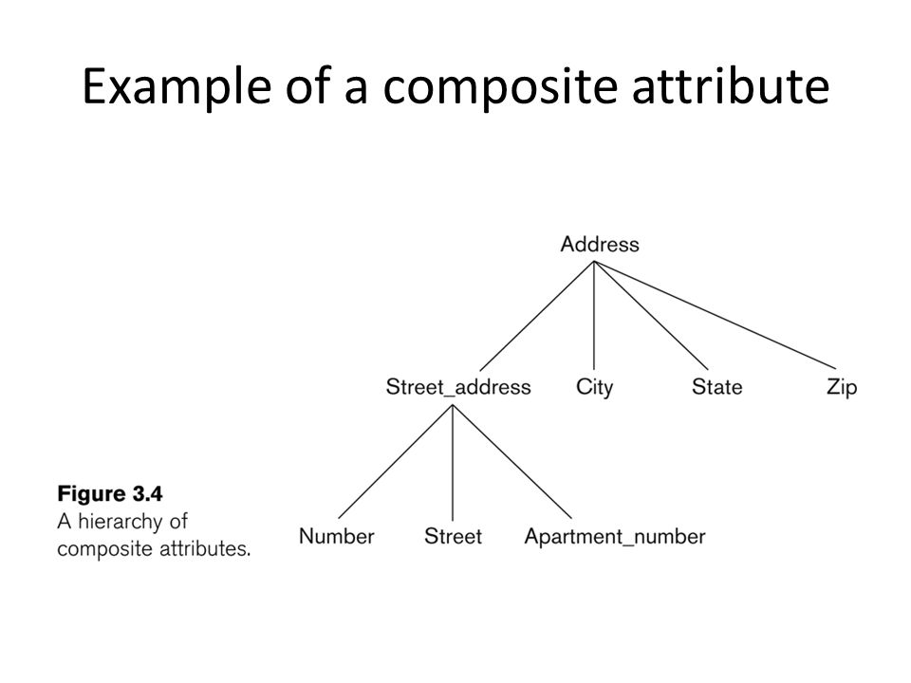
Entities and Attributes
Composite versus Simple (Atomic) Attributes.
Composite attributes can be divided into smaller subparts, which represent more basic attributes with independent meanings.
Attributes that are not divisible are called simple or atomic attributes.

Slide 45
Entities and Attributes
Single-Valued versus Multivalued Attributes
Age is a single-valued attribute of a person.
Colors attribute for a car, or a College_degrees attribute for a person- multivalued
Stored versus Derived Attributes
Age attribute of a person – derived
Birth_date attribute of a person - stored

Slide 46
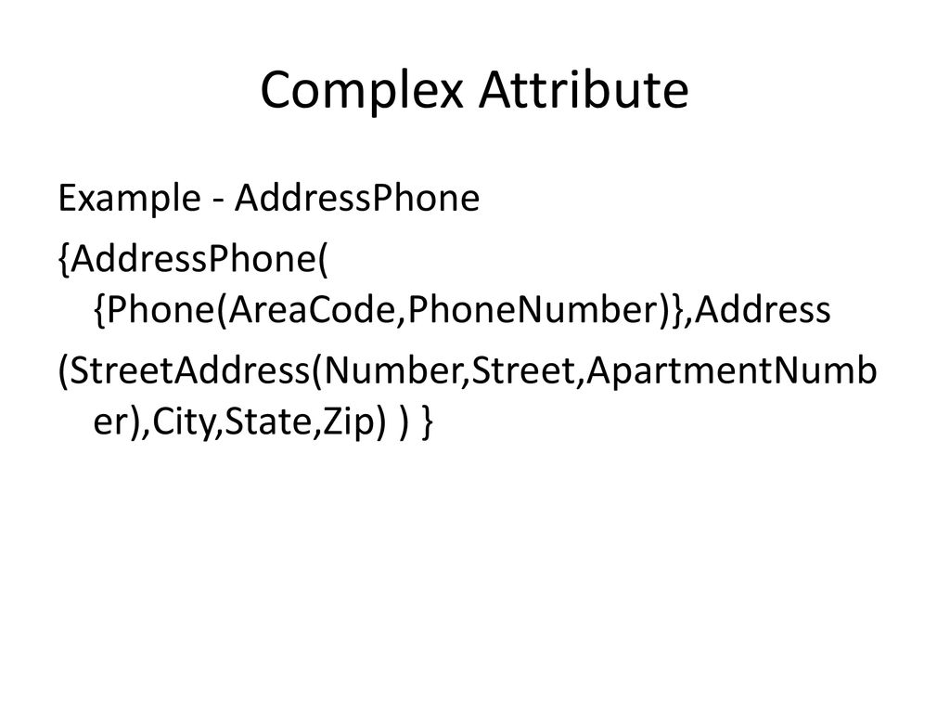
Entities and Attributes
NULL Values
An address of a single-family home would have NULL for its Apartment_number attribute, and a person with no college degree would have NULL for College_degrees.
NULL can also be used if we do not know the value of an attribute for a particular entity.
Complex Attributes
If a person can have more than one residence and each residence can have a single address and multiple phones, an attribute Address_phone for a person can be specified as shown below

Slide 47
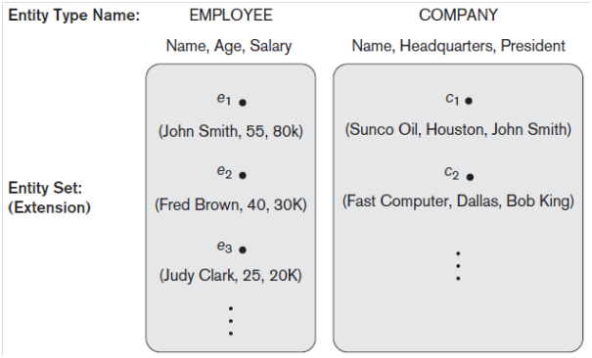
Entity Types, Entity Sets, Keys, and Value Sets
Entity Types and Entity Sets
An entity type defines a collection (or set) of entities that have the same attributes.

Slide 48
Entity Types, Entity Sets, Keys, and Value Sets
The collection of all entities of a particular entity type in the database at any point in time is called an entity set or entity collection.
The collection of entities of a particular entity type is grouped into an entity set, which is also called the extension of the entity type.

Slide 49
Entity Types, Entity Sets, Keys, and Value Sets
Key Attributes of an Entity Type
An entity type usually has one or more attributes whose values are distinct for each individual entity in the entity set. Such an attribute is called a key attribute.
For example, the Name attribute is a key of the COMPANY entity type because no two companies are allowed to have the same name.
In ER diagrammatic notation, each key attribute has its name underlined inside the oval.

Slide 50
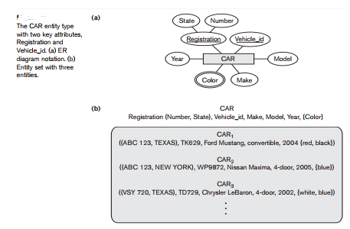
Entity Types, Entity Sets, Keys, and Value Sets

Slide 51
Entity Types, Entity Sets, Keys, and Value Sets
Value Sets (Domains) of Attributes
Each simple attribute of an entity type is associated with a value set (or domain of values), which specifies the set of values that may be assigned to that attribute for each individual entity.
Example, if the range of ages allowed for employees is between 16 and 70, we can specify the value set of the Age attribute of EMPLOYEE to be the set of integer numbers between 16 and 70.

Slide 52
Initial Conceptual Design of the COMPANY Database
An entity type DEPARTMENT with attributes Name, Number, Locations, Manager, and Manager_start_date. Locations is the only multivalued attribute. We can specify that both Name and Number are (separate) key attributes because each was specified to be unique.
An entity type PROJECT with attributes Name, Number, Location, and Controlling_department. Both Name and Number are (separate) key attributes.
An entity type EMPLOYEE with attributes Name, Ssn, Sex, Address, Salary, Birth_date, Department, and Supervisor

Slide 53
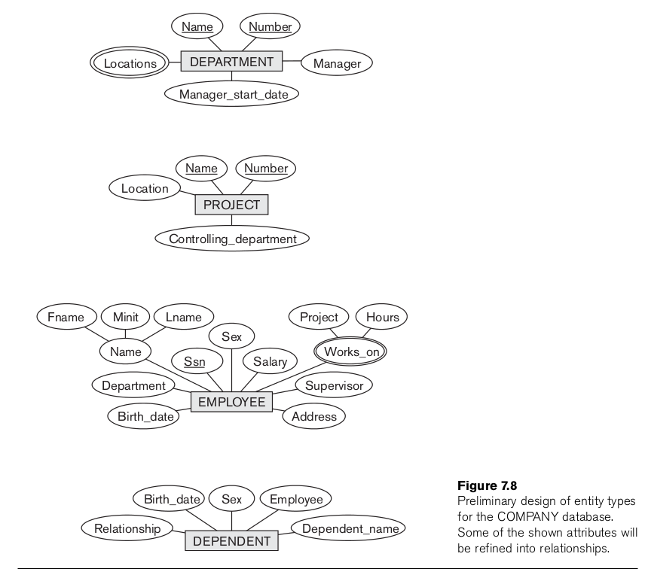
Initial Conceptual Design of the COMPANY Database

Slide 54
Relationship Types, Relationship Sets, Roles, and Structural Constraints
Relationship Types, Sets, and Instances
A relationship type R among n entity types E1, E2, . . . , En defines a set of associations—or a relationship set—among entities from these entity types.
Mathematically, the relationship set R is a set of relationship instances ri, where each ri associates n individual entities (e1, e2, . . . , en), and each entity ej in ri is a member of entity set Ej , 1 ≤ j ≤ n

Slide 55
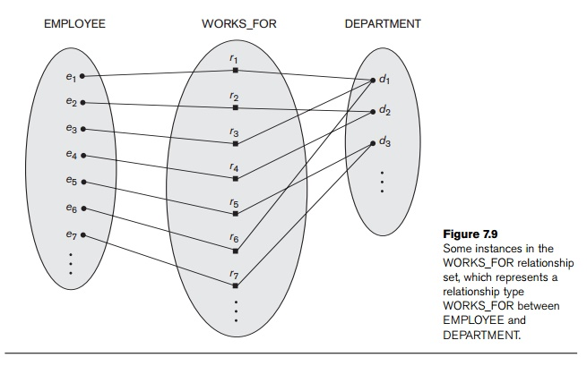
Relationship Types, Relationship Sets, Roles, and Structural Constraints

Slide 56
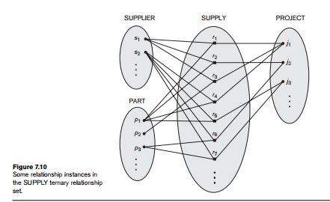
Relationship Degree, Role Names, and Recursive Relationships
The degree of a relationship type is the number of participating entity types.
Example WORKS_FOR relationship is of degree two.
A relationship type of degree two is called binary, and one of degree three is called ternary.

Slide 57
Relationship Degree, Role Names, and Recursive Relationships
Role Names and Recursive Relationships
The role name signifies the role that a participating entity from the entity type plays in each relationship instance.
For example, in the WORKS_FOR relationship type, EMPLOYEE plays the role of employee or worker and DEPARTMENT plays the role of department or employer.
Recursive relationships or self-referencing relationships

Slide 58
Constraints on Binary Relationship Types
Two main types of binary relationship constraints: cardinality ratio and participation.
Cardinality Ratios for Binary Relationships
The cardinality ratio for a binary relationship specifies the maximum number of relationship instances that an entity can participate in.
For example, in the WORKS_FOR binary relationship type, DEPARTMENT:EMPLOYEE is of cardinality ratio 1:N, meaning that each department can be related to (that is, employs) any number of employees (N),9 but an employee can be related to (work for) at most one department (1).
The possible cardinality ratios for binary relationship types are 1:1, 1:N, N:1, and M:N.

Slide 59
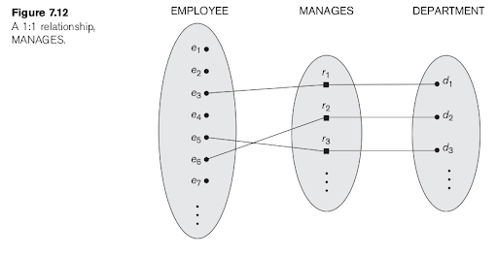
Constraints on Binary Relationship Types

Slide 60
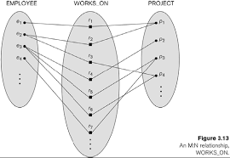
Constraints on Binary Relationship Types

Slide 61
Participation Constraints and Existence Dependencies
The participation constraint specifies whether the existence of an entity depends on its being related to another entity via the relationship type.
There are two types of participation constraints—total and partial.
Example , If a company policy states that every employee must work for a department, then an employee entity can exist only if it participates in at least one WORKS_FOR relationship instance.
Thus, the participation of EMPLOYEE in WORKS_FOR is called total participation, meaning that every entity in the total set of employee entities must be related to a department entity via WORKS_FOR.
Total participation is also called existence dependency.
If it is not expected that every employee to manage a department, so the participation of EMPLOYEE in the MANAGES relationship type is partial.

Slide 62
Attributes of Relationship Types
Relationship types can also have attributes, similar to those of entity types. For example, to record the number of hours per week that a particular employee works on a particular project, we can include an attribute Hours for the WORKS_ON relationship type

Slide 63
Weak Entity Types
Entity types that do not have key attributes of their own are called weak entity types.
Regular entity types that do have a key attribute are called strong entity types.
The relationship type that relates a weak entity type to its owner - the identifying relationship of the weak entity type.
A weak entity type always has a total participation constraint (existence dependency) .

Slide 64
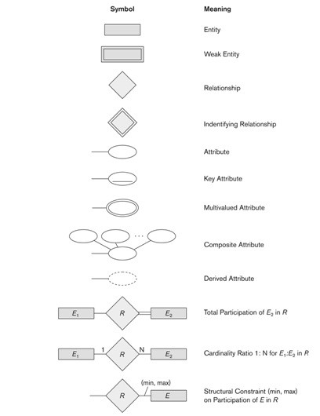
ER Diagrams, Naming Conventions, and Design Issues

