Slide 1

Helping INDIA in Agriculture…
Can we city people contribute?
Here are your answers!!!
Is INDIA a Agricultural country???
If YES!!
Should we contribute?
How can we contribute?
Is it of any use to contribute?

Slide 2

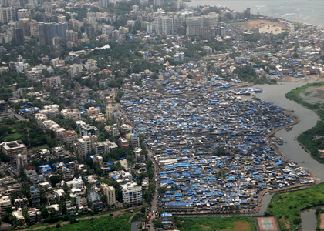
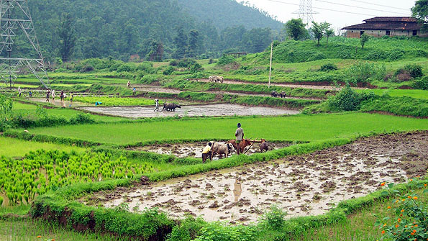

Important facts first!!
Did you know??
There are more than 4000 cities in India
There are 236004 villages in India
68.9% people of India live in Villages!! (2011 census)
Kitchen Waste produced in cities is 80 times than villages!!!
For the first time today I am feeling good about we generating Waste!!!

Slide 3

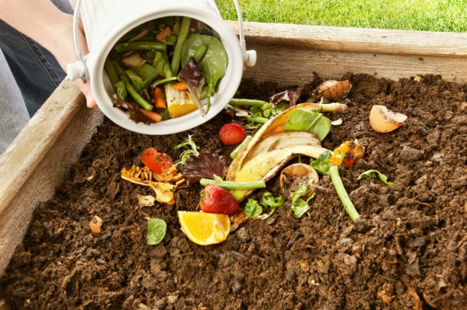
Ready to go….. Action!!!
The basic Idea is that cities will make fertilizer or manure here itself and transport it to villages!!
WOW! Its so simple….but the most effective in the terms of Long Term race…
Because its easy to win a 100 meters race.. So lets be a relay runner!!
Yes!! India will increase its agriculture by this simple technique!! Don’t believe me?

Slide 4
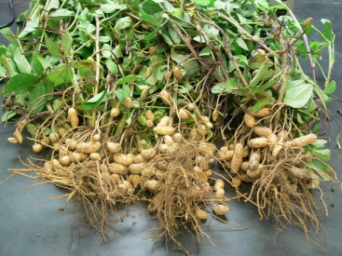
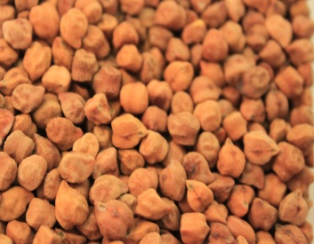
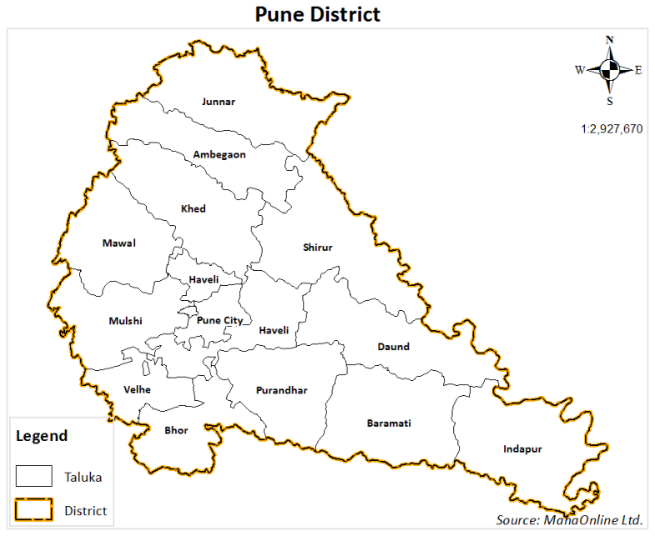
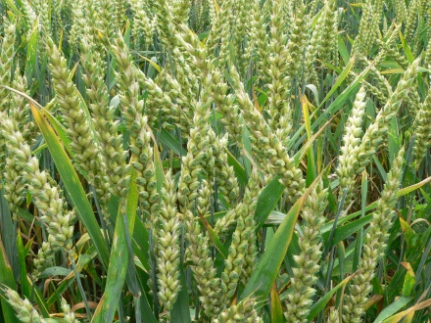

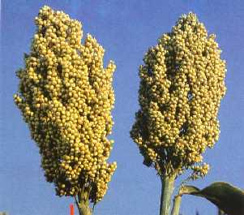
We are TECHIES… We believe in statistics!!!So lets not beat around the bush now… lets stop being HYPOTHETICAL
Lets move on to Facts and Figures…
Lets consider Example of Pune District…and major crops grown here…
Google says 70% of people in Pune are farmers!!

Slide 5

The Magic Vent…
Consider a four floor building each floor with 2 flats
So , we have 8 flats in a building…
If we connect a vent from each kitchen window to a big pit which is 5 feet below the
Ground and put all our organic waste into that Vent…!!!
Just put your waste…and let it fall!!

Slide 6
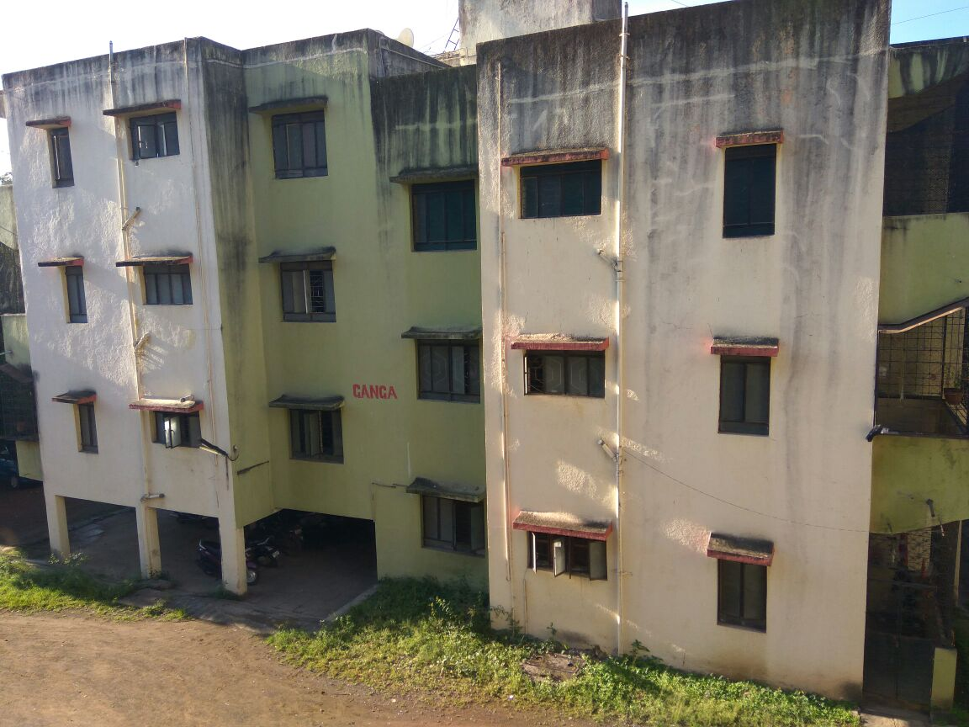
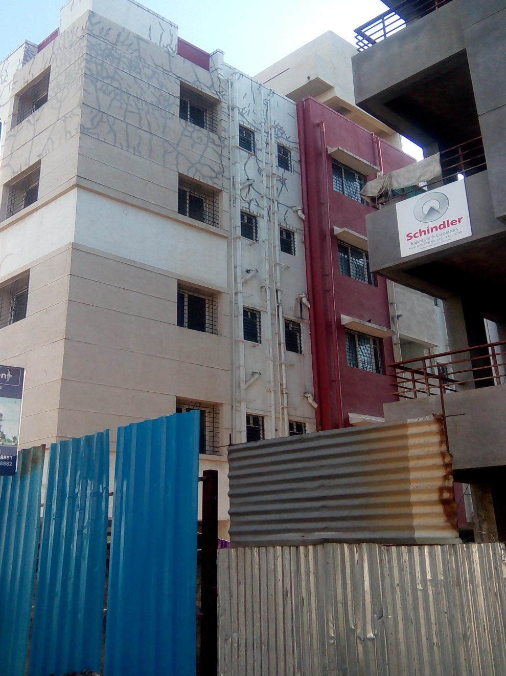
Design of some building with their kitchen windows :

Slide 7
Calculations:
Each house produces 1kg organic waste daily
Therefore … 8X1kg = 8kgs waste daily!
8X 30 days = 240 kgs / month
Pit size should be about minimum 500kgs.
Considering minimum 2 buildings in a society
hence our calculations double..ie 480 kgs /month
Hence we will require 2 pits 500kgs each.
There are 17000 societies in Pune
at an average the waste collected individually by these societies / month will be 480X17000 kgs= 8160000 kgs waste!!

Slide 8
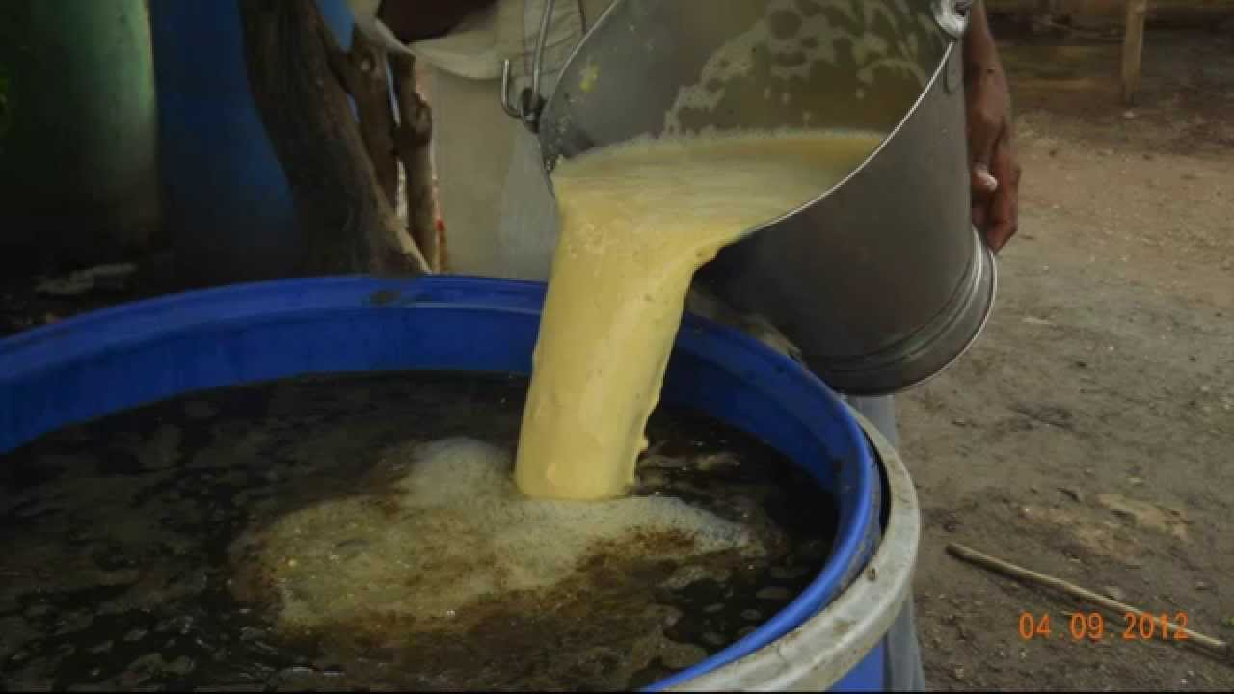
The process…
As we all know the decomposition process takes at least 6 months…
So should we wait for 6 months??
Now comes the traditional Innovative part!!!
‘JEEVAMRUTH’ जीवामृत
This will enhance the rate of decomposition 50 times…so the time span of six Months will be reduced to One month only…
So…Punekars will have a lots of Pure
Organic and best manure to supply to 70%
Farmers across Pune!!!
This is just for PUNE…consider all cities
producing such a pure manure in a large
scale!!!
AGRICULTURE WILL BOOST WITHIN A PERIOD
OF TIME!!!

Slide 9
This was about how…now WHY???
Organic fertilizers are the best fertilizers which is scientifically proved
Chemical fertilizers spoil the quality of soil and also the nutritious values of the product
At an average if chemical fertilizers are used on the same land then land becomes barren in 10 years, and it wont be fit for farming.
So , if we want our lands to be stay fertile so that our grandchildren will see what is farming then we have to create awareness about using organic fertilizers!

Slide 10
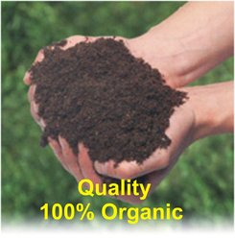
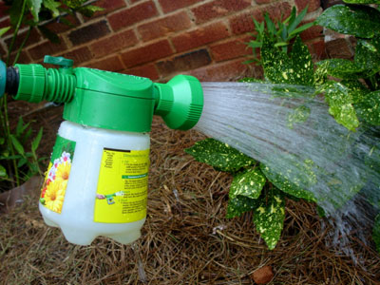
Just the How’s and the Why’s!
Proper Awareness
Proper and regular supply to their fertilizers
Best quality of fertilizers available at cheap rates
Guaranteed results in the upcoming years
Unlimited supply at the doorstep

Slide 11

One time investment!!!
As we have spoken earlier about the buildings and their Vents…
Considering the same 4 floor building then the vent will cost 4000 rupees and the pit will cost 1500 rupees.
Hence the total expenses will be 5500X2= 11000 rupees/ Society (2 buildings).
Individual contribution will be 11000/8= 1375 rupees .
Its quite an affordable price, don’t you think?

Slide 12

Government help?
As the government provides 30% funding for Solar heater.
If the Government provides funding for this project the cost will further reduce
Transportation will be divided amongst the farmers and society people.
Which will add up to the cost by 50 rupees/ individual

Slide 13
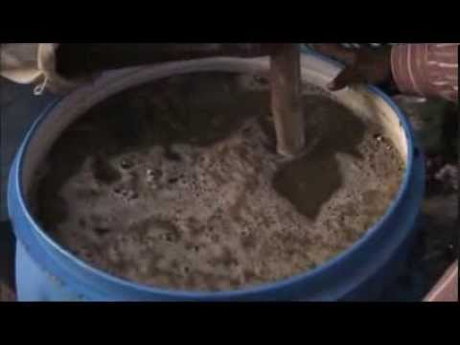
Production of जीवामृत
For 480 kgs of waste we will require 3 litres of जीवामृत .
Making: 1 kg cow dung – 12rupees
2 liters of cow urine- 6rupees / litre =12 rupees
1kg normal soil
Water as per required
Total costing 24 rupees / month
Just in 24 rupees assured quality and results.

Slide 14
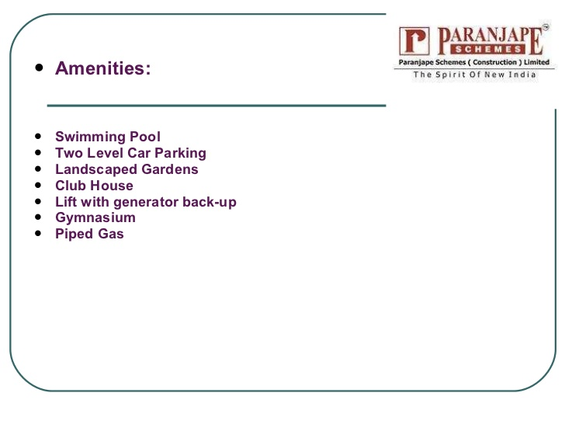

Yes its something new …
They do not provide us with this facility which will benefit the Economy of India!!
Its our turn to contribute now…
LESS TECHNOLOGY….MORE TRADITION…MORE SATISFACTION!!!

Slide 15
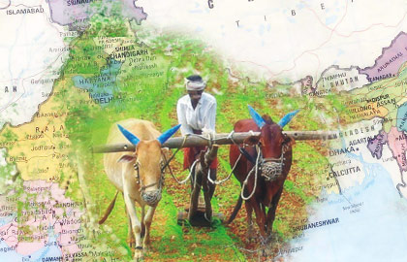
The Great Chanakya Says: Don’t look near the feet…think about the deepest future!!
It starts with me…it starts with us…
We all can be the FACE OF CHANGE…
WE ALL TOGETHER CAN MAKE THIS HAPPEN!!!
THANK YOU!!

