Slide 1

Character segmentation of handwritten text: with focus on cursive English and Indian Languages
Project by,
Tanmay Pandit [B18CSE055]
Venkatesh Kotwade[B18CSE023]
Advisor,
Dr.Gaurav Harit

Slide 2
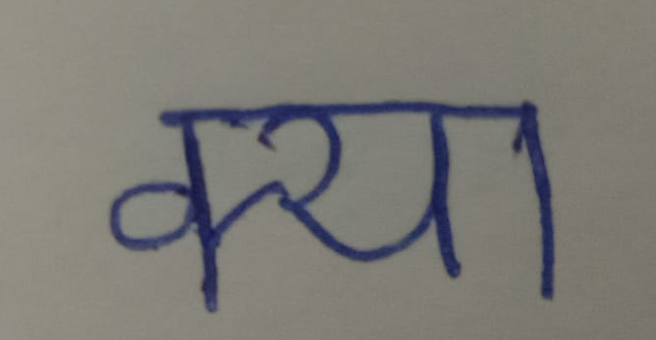
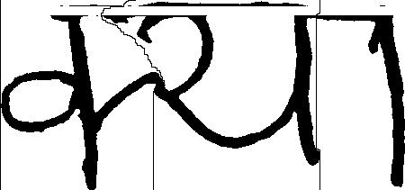

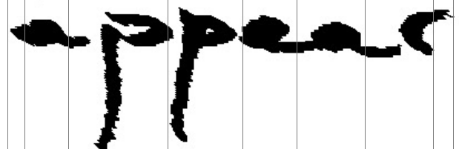
The Problem
Online Heuristic Based Segmentation

Slide 3
Methods Developed
Segmentation Approach using Dijkstra's Algorithm with Randomisation
Zoning Approach with Dynamic Programming Optimisations
Non-uniform Slant Correction of English Handwriting.
Segmentation of English Handwriting using Local Minima Heuristic on Skeletonised Text

Slide 4
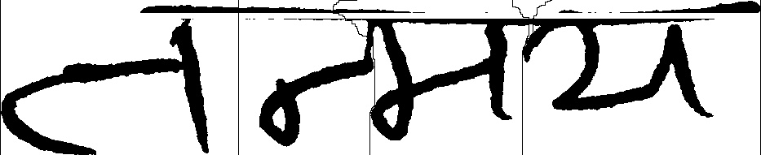
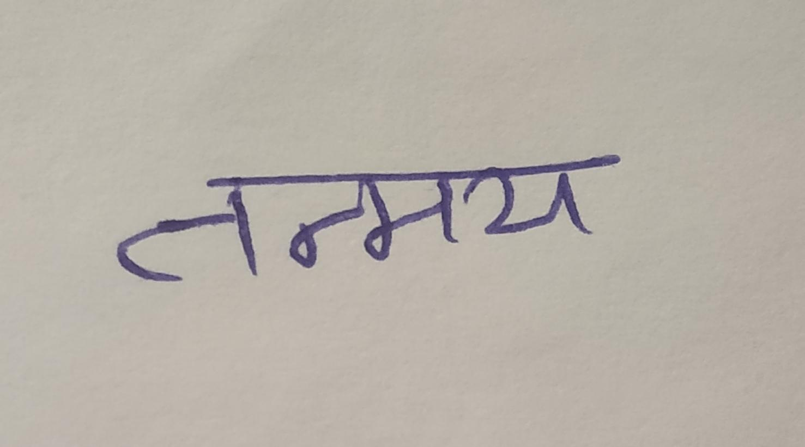
Method 1
Segmentation Approach using Dijkstra's Algorithm with Randomisation
The Problem
How do we segment letters from handwritten text in Devnagari Script? Special focus on, How do we segment two joined letters from handwritings in Devnagari-like scripts?

Slide 5
Method 1
Segmentation Approach using Dijkstra's Algorithm with Randomisation
Observations
Solution
Observations
The ligature at joining of two letters is normally written with less pressure.
Most of the letters in the script are of equal width.
Find approximate segmentation locations.
Consider black pixels as a resistance and find a minimum resistance path.
The ligature at joining of two letters is normally written with less pressure.
Most of the letters in the script are of equal width.

Slide 6
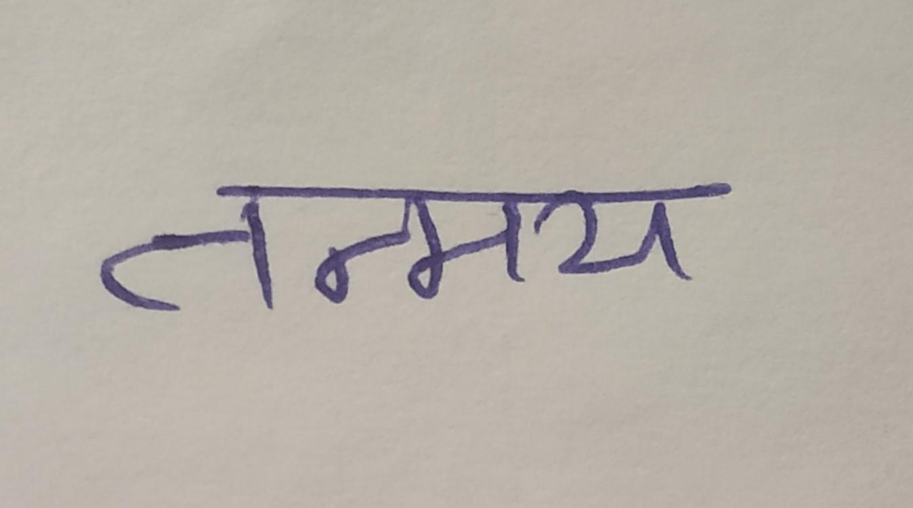
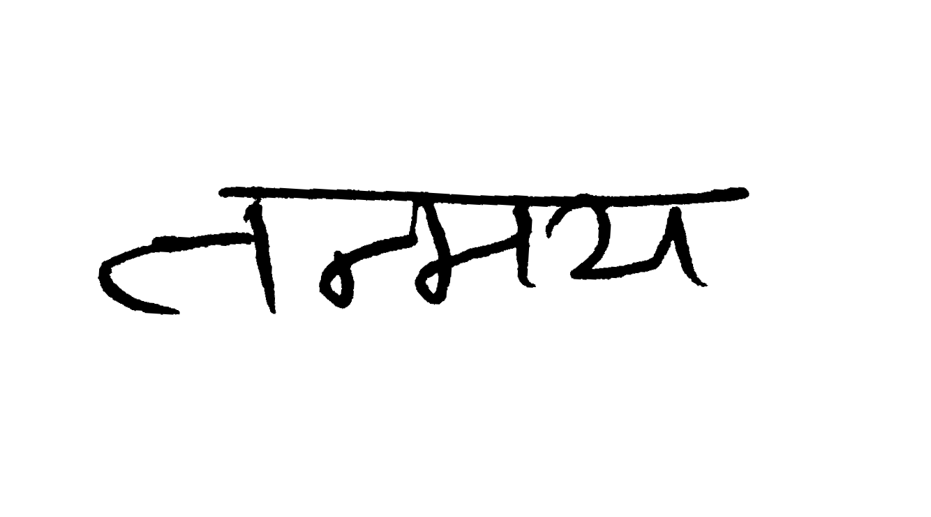
Method 1
Segmentation Approach using Dijkstra's Algorithm with Randomisation
Binarize the image using Otsu’s algorithm
The algorithm returns a single intensity threshold that separate pixels into two classes, foreground and background, such that interclass variance is maximizes while intra-class variance is minimized.
Steps

Slide 7

Method 1
Segmentation Approach using Dijkstra's Algorithm with Randomisation
Crop ROI using first occurring column or row from top, bottom, right or left having a black pixel
Detect header by detecting row with highest number of black pixels and remove header.
Steps

Slide 8


Method 1
Segmentation Approach using Dijkstra's Algorithm with Randomisation
Find candidate segmentation points using cut-off density given by:
Cut-off density = L+ cut_off_factor * (R-L )
cut_off_factor = 0.2 for best results
L : Minimum vertical projection
R : Maximum vertical projection
Obtain optimal subsequence of possible segmentation points by selecting one minimum density point from each cluster.
Steps

Slide 9
Method 1
Segmentation Approach using Dijkstra's Algorithm with Randomisation
Task 1: Remove over-segmentation lines
Task 2: Segment through ligatures by curving segmentation line
Steps

Slide 10
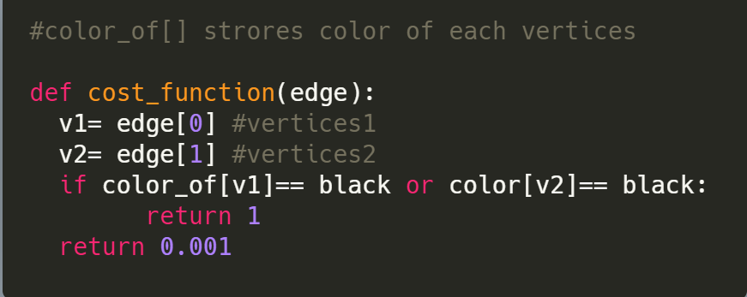
Method 1
Segmentation Approach using Djikstra's Algorithm with Randomisation
Solution
To fulfill Requirement 1, we have to assign a high weight to edges having at least one of the vertices a black pixels. But a very high weight would violate Requirement 2 as traversing horizontally in white pixel area will not add to the net cost.
So, we use a cost function which fulfills both requirements :
We pose it as a graph problem with min-cost path !
Requirement 1: Segmentation curve should cut through minimum number of black pixels
Requirement 2: While completing Requirement 1 it follows minimum horizontal deviation .
G(V,E)= {
V= {x,y} | 0<x<H, o<y<W,
E= {Any two pixels sharing a side will have a edge }
}
This now can be framed as a Dijkstra's problem with domain specific tweaks,

Slide 11
Method 1
Segmentation Approach using Dijkstra's Algorithm with Randomisation
Apply Dijkstra’s Algorithm from each possible segmentation point on top with target as any point in bottommost row.
We will use following tuple for ordering in priority queue,
T={currentMinCost , randomisedSeed , edge}
Why do we need randomisedSeed?
It removes the bias of algorithm for edge in particular direction.
How to avoid over-segmentation ?
After applying Djikstra’s algorithm, we reject the paths with cost > Threshold Cost.
Threshold Cost = 7 gives best results.

Slide 12


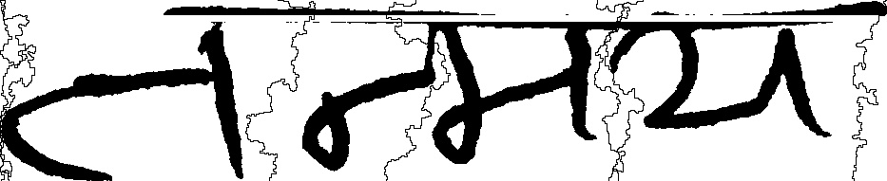
Without randomisation and zero weight to white edges
Without randomisation and minor weight to white edges
With randomisation and zero weight to white edges
With randomisation and minor weight to white edges

Slide 13
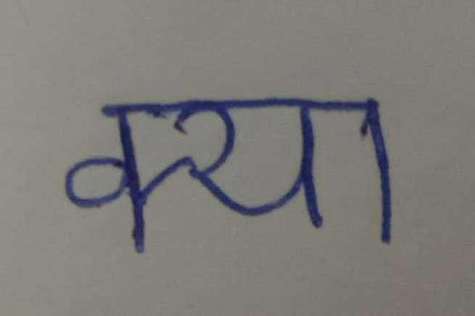
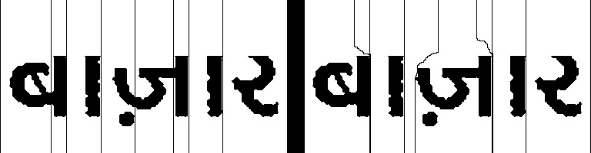

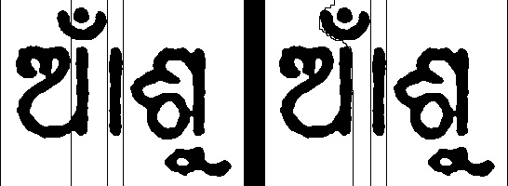
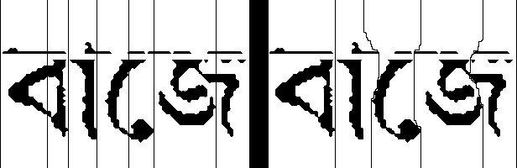
Method 1
Segmentation Approach using Dijkstra's Algorithm with Randomisation
ṅṅ
Results

Slide 14
Method 1
Segmentation Approach using Dijkstra's Algorithm with Randomisation
The complexity of this approach is same as the complexity of Djikstra’s algorithm.
Time Complexity : O (H * W * Log( H * W ) )
Space Complexity : O (H * W)
This method works on non-slanted Indian handwritings as well as standard fonts of Indian languages.
The accuracy of letter segmentation was found to lie in 80%-85%.
The method fails on letters like ‘ग’ and ‘श’.
Conclusions and Notes

Slide 15

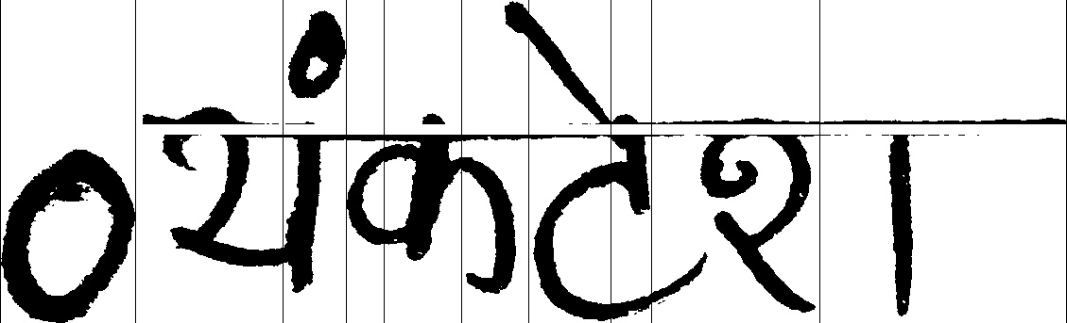

Method 1
Segmentation Approach using Dijkstra's Algorithm with Randomisation
Some failing results

Slide 16
Method 1
Segmentation Approach using Dijkstra's Algorithm with Randomisation
References for this method
Otsu’s Method : https://en.wikipedia.org/wiki/Otsu%27s_method
Original Paper
Dijkstra’s Algorithm for Shortest Path : https://en.wikipedia.org/wiki/Dijkstra%27s_algorithm
*We came up with the main idea of this approach majorly on our own.

Slide 17
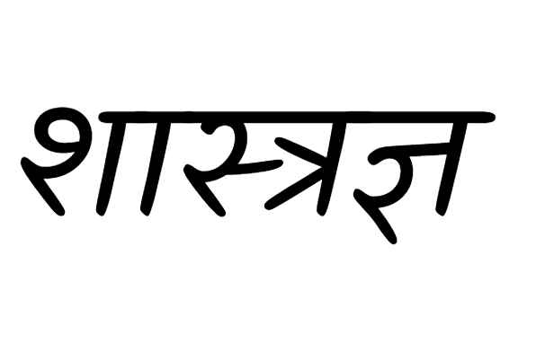
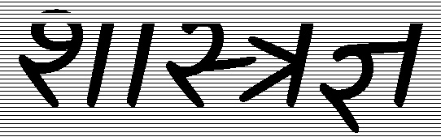
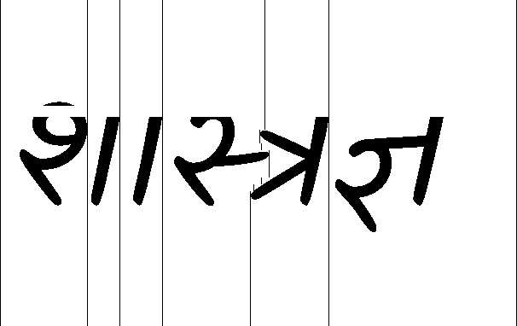
Method 2
Zoning Approach with Dynamic Programming Optimisations
After developing previous approach we decided to explore a simple, more intuitive way to segment Devanagari and alike scripts.
For this method , our major focus was on typed text.
Remove header
Create horizontal zones
What is Zoning Method?
A basic zoning method involves creating horizontal zones and then segment the text by joining nearby vertical pixel bars with no black pixels.
Optimal Sequence of vertical bars for segmentation

Slide 18
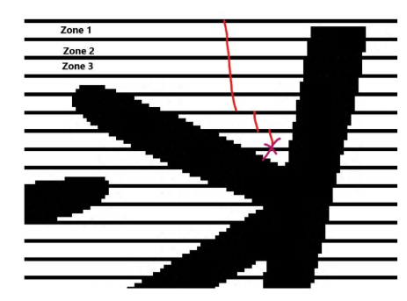
Method 2
Zoning Approach with Dynamic Programming Optimisations
Naive solution involves checking for all possible paths, which will result in exponential time complexity overall.
The solution to this is taking into use the presence of dead ends and keep marking the reverse reachable pixel as unreachable.
Terminologies
Dead End : A pixel from which no further white bar can be reached within specified limit of horizontal deviation.
Unreachable Bars: A vertical bar which will surely eventually lead to a dead end or those bars which are anyway unreachable.
Example of Dead-end

Slide 19
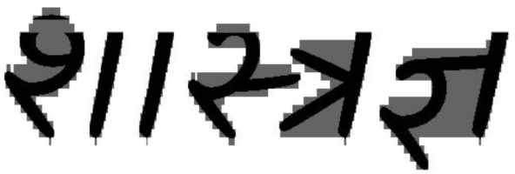
Method 2
Zoning Approach with Dynamic Programming Optimisations
Abstract for the DP
Initially all nodes are marked unreachable except for white pixels in the topmost row.
Inside dp, for a reachable pixel, we mark all white pixels in the next zone in the offset range as reachable and we store the count of these reachable pixels in the next zone.
Abstract for backtracking
If there are no reachable pixels in the next zone from any pixel, it means it’s a dead end so we mark the pixel unreachable. Then we backtrack recursively to the upper zone and decrement their count of reachable pixels. If this count hits zero, this is again a dead end and process continues.
Complexity Analysis
If H_{z} is the width of a zone, then this algorithm requires O(W (H/H_{z}) (2 *offset)) =O(HWC) computations,
where C = (2 * offset / H_{z}) .
For a standard 128-200 heighted pixel,
H_{z} ~ 2.5 and offset = 10 so C < 10.
Time Complexity : O(HW)
Image matrix after marking all unreachable pixels

Slide 20
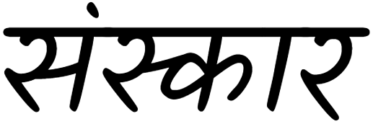
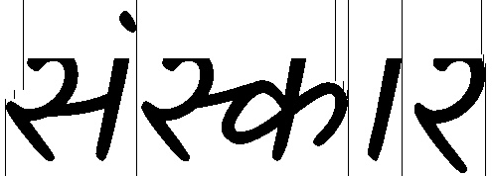
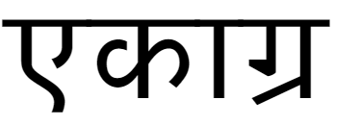
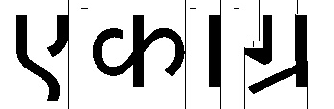

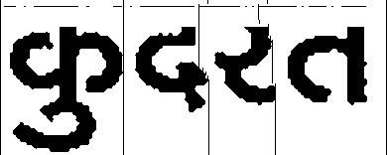
Method 2
Zoning Approach with Dynamic Programming Optimisations
Results :

Slide 21
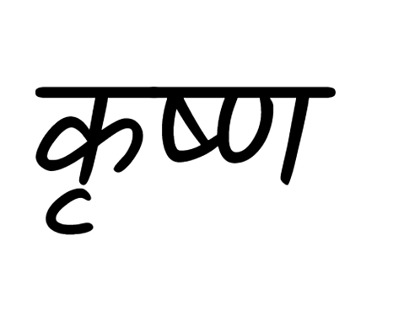
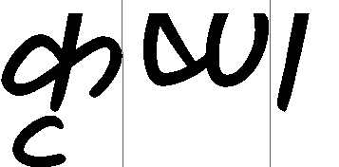
Method 2
Zoning Approach with Dynamic Programming Optimisations
Time and space complexity of this method is O(HW) i .e. linear w.r.t size of image,
This method was mainly focused on single and loosely connected mixed letters in a Hindi text and it works perfectly fine on them.
This method does not work on strongly connected mixed letters since it considers their joining ligatures as dead ends.
The accuracy of this method for letter segmentation is approximately 75%.
*Mixed letters with strong ligatures are not segmented
Conclusions and Notes

Slide 22
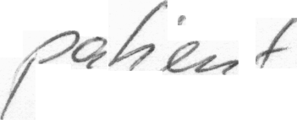
Method 3
Non-uniform Slant Correction of English Handwriting
These two “t” have totally different slant, hence uniform slant correction does not work
Segmentation of Handwritten English Text is fairly difficult task due to following reasons:
The slant can be as high as 45° and hence the Dijkstra’s Method will fail as detecting starting points for segmentation is difficult due to slant.
Slant is not uniform across the word.
It is necessary to detect slant for each column individually.

Slide 23
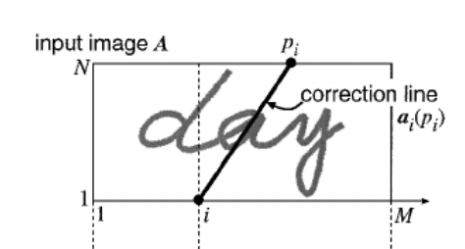
Method 3
Non-uniform Slant Correction of English Handwriting
Non uniform slant correction algorithm finds optimal slant correction lines for each column
The Problem
For every point (1,i ) we have to an optimal correction line ending at (N, p_{i}).
Here the task is to find optimal sequence of (p₁,p₂,p₃,...,p_{M}).
All p_{i}s are subjected to the condition :
|p_{i} - i| ≤ W
We keep the upper bound for slant angle at tan⁻¹(2)
so W = 2*N.
For smoothing the sequence of correction lines and avoiding abrupt changes, it is also subjected to continuity constraints as :
0 ≤ p_{i} - p_{i-1} ≤ 2

Slide 24
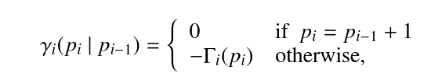
Method 3
Non-uniform Slant Correction of English Handwriting
How to grade a correction line ?
We grade it by considering two factors,
s_{i} : the length of the longest stroke of black pixel across the correction line
γ_{i} : determines how even the correction line is w.r.t. its previous neighbour.
We define a function f(p_{i}, p_{i-1}) which takes the weighted sum of these factors to grade the correction line :
f(p_{i} , p_{i-1}) = ω * s_{i}(p_{i}) + (1 - ω) * γ_{i}(p_{i} , p_{i-1}).
ω = 0.75 gives the best results.
where Γ_{i}(p_{i}) is the number of black pixels on the correction line.

Slide 25
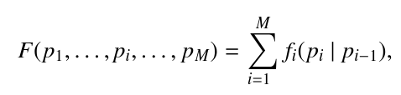
Method 3
Non-uniform Slant Correction of English Handwriting
Abstract for the DP
We store the maximum cummulated value of f(p_{k},p_{k-1}) till k = i in g[i][p_{i}].
DP has mainly 3 steps :
Initialising : Initialise first row of dp with corresponding value of f(p₁).
Building recursion : For every g[i][p_{i}], we store optimal choice of p_{i-1} for the best p_{i} in b[p_{i}].
Backtracking: Find p_{M} which maximises the value of g[M][p_{M}] and then backtrack for previous p values taking help from b[p_{i}].
The optimal sequence of correction lines will maximise above function.
This function has a Markov property since the computation of p_{i} requires only p_{i-1}.
Thus, slant correction problem is reduced to maximisation problem with Markov Property which is solvable by Dynamic Programming.

Slide 26
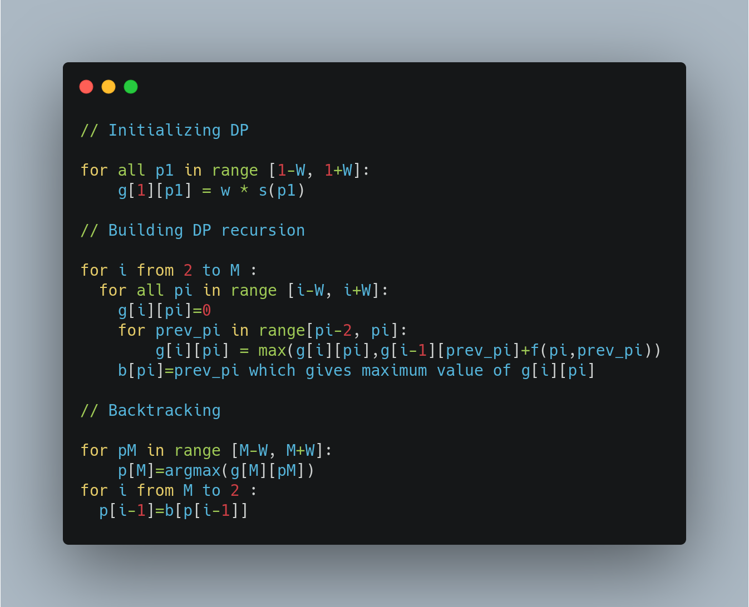
Method 3
Non-uniform Slant Correction of English Handwriting
Pseudo-code
Complexity Analysis
Calculating f(p_{i} , p_{i-1}) : O(N)
DP recursion : O(M W)
Overall time complexity : O(N M W)
Space complexity : O(M W)

Slide 27



Method 3
Non-uniform Slant Correction of English Handwriting

Slide 28
Method 3
Non-uniform Slant Correction of English Handwriting
References for this method
Nonuniform Slant Correction for Handwritten Word Recognition

Slide 29
Method 4
Segmentation of English Handwriting using Local Minima Heuristic on Skeletonised Text
The Approach
There are 2 categories of English characters:
Closed Characters: These characters contain a loop or semi-loop and are closed. E.g. ‘a’, ‘b’, ‘c’, ‘d’, ‘p’ etc.
Open Characters: They don’t have a loop or semi-loop. E.g. ‘u’, ‘v’, ‘m’, ‘n’, etc. It’s extremely difficult to differentiate open characters from ligatures due to cursive nature.
This is a heuristic approach to segment the skeletonised cursive English handwriting. The basic idea is to find the local minimum columns which could be potential segmentation columns and then finalise the actual segmentation columns by appropriate merging of neighbouring columns.

Slide 30
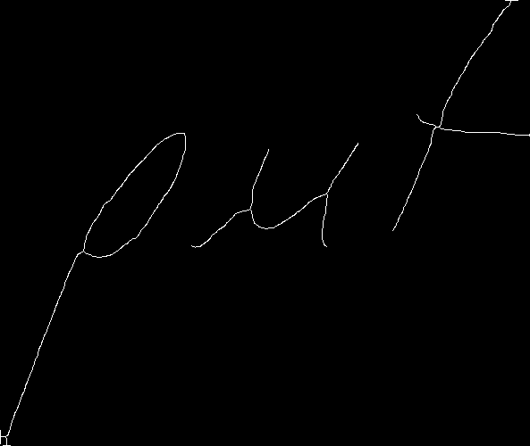
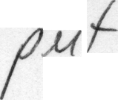
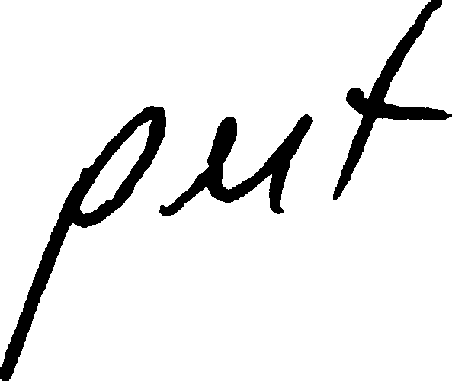
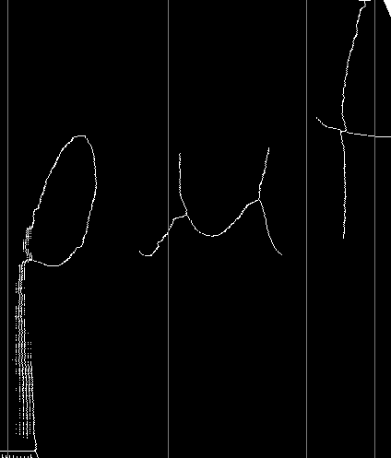
Method 4
Segmentation of English Handwriting using Local Minima Heuristic on Skeletonised Text
Zhang-Suen’s Method of Skeletonisation
Otsu’s Binarization
Thinning the input image to bring uniformity in the thickness of strokes.
We used Zhang-Suen Thinning Algorithm, which keeps on deleting pixels on contours thick strokes, until a single pixel width skeleton is created
Final Segmentation

Slide 31
Method 4
Segmentation of English Handwriting using Local Minima Heuristic on Skeletonised Text
Steps of Segmentation
Deslant with slant correction algorithm.
List all the columns with vertical projection 0(blank space) or 1 (ligatures) as potential segmentation columns (PSCs).
This leads to over-segmentation of characters, since PSCs occur in clusters. To overcome this, we merge all the PSCs at a distance < D into a single segmentation column at mean position
For an image of height 128, experimentally optimal value of D is 7.
Complexity Analysis
The complexity of this approach is same as the complexity of slant correction algorithm since deslanting is the most expensive operation in the approach.

Slide 32
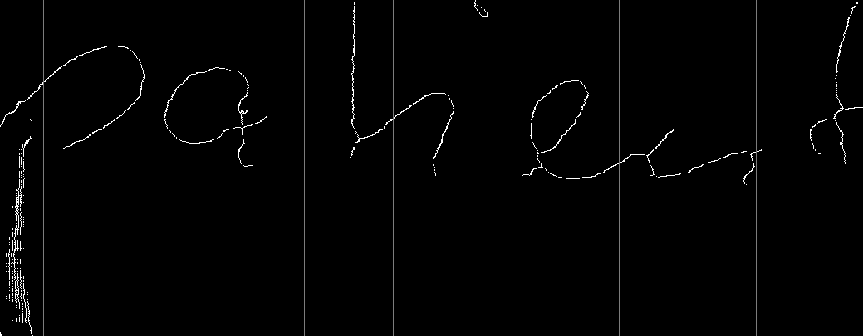
Method 4
Segmentation of English Handwriting using Local Minima Heuristic on Skeletonised Text

Slide 33
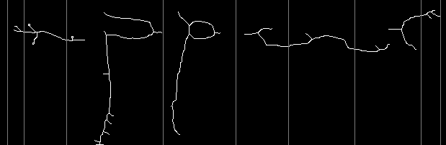
Method 4
Segmentation of English Handwriting using Local Minima Heuristic on Skeletonised Text
Segmentation Plotted on original deslanted text

Slide 34
Method 4
Segmentation of English Handwriting using Local Minima Heuristic on Skeletonised Text
This method is viable for cursive and non-cursive English Handwriting and it gives perfectly fine results on Closed Characters.
Some inaccuracies were found in segmentation of open characters in some words.
Even after setting D to optimal value, letters like ‘m’ were found to be over-segmented in some words.
The accuracy of letter segmentation of this method lies in the range 65%-75%.
Conclusions and Notes

Slide 35
Method 4
Segmentation of English Handwriting using Local Minima Heuristic on Skeletonised Text
References for this method
A New Character Segmentation Approach for Off-Line Cursive Handwritten Words

Slide 36
Conclusions
The results achieved by our approaches were comparable to the results achieved by heuristics algorithms for segmentation of English and Devanagari scripts.
We have to make use of Machine Learning models to achieve better results than this.
However, we can speed up the segmentation process, especially for Devanagari scripts, with a tradeoff of accuracy by using the above proposed (Dijkstra’s approach) novel and highly optimised algorithm.
Further, these techniques could be improved by taking cues from specific users’ handwriting and adjusting the constants accordingly, although it would make the algorithm offline.

Slide 37
Thank You

