Slide 1
SURA REPORT I
Facilitator – Prof. Devendra Kr Dubey
Tanmay Goyal
Kshitij Gupta

Slide 2
Objectives Fulfilled
Height Measurement
Weight Measurement
Body Temperature
Anemometer design
Consolidated Circuit
Storage in SD card

Slide 3
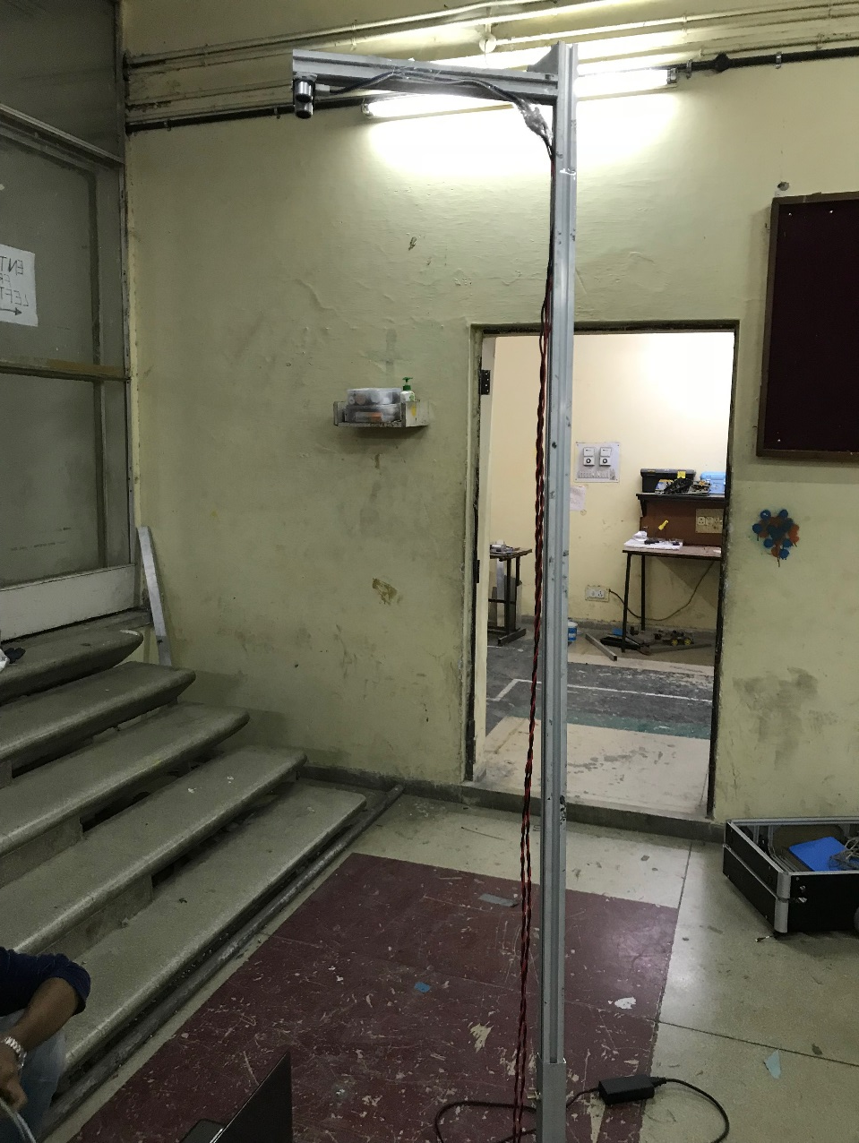
Height Measurement
Designed using hex channels.
Uses ultrasound sensor.

Slide 4
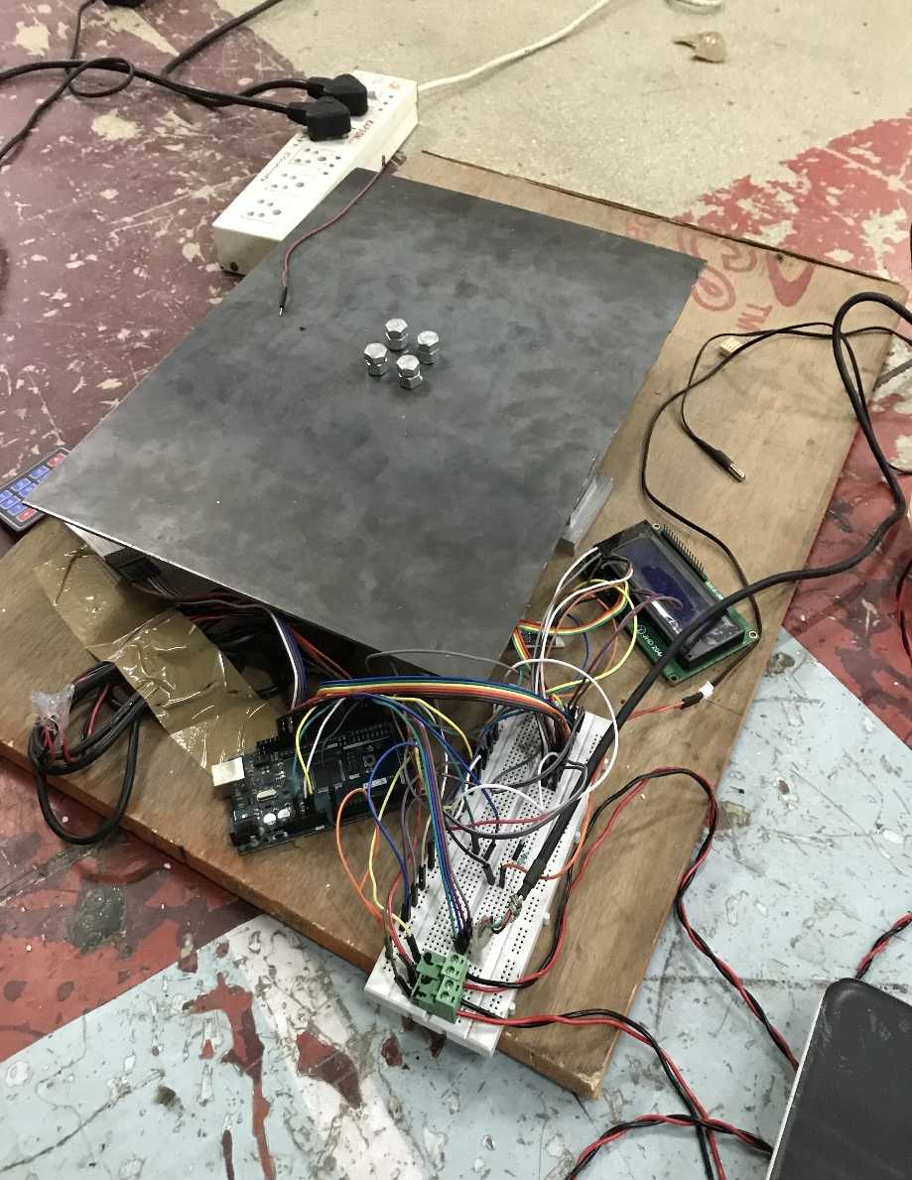
Weight Measurement
Uses load cell CZL642 with amplifier HX711.
Designed using Al blocks, wood and MS sheets.
Shear point force load cell.
Accuracy upto +(-) 0.5 kg.

Slide 5
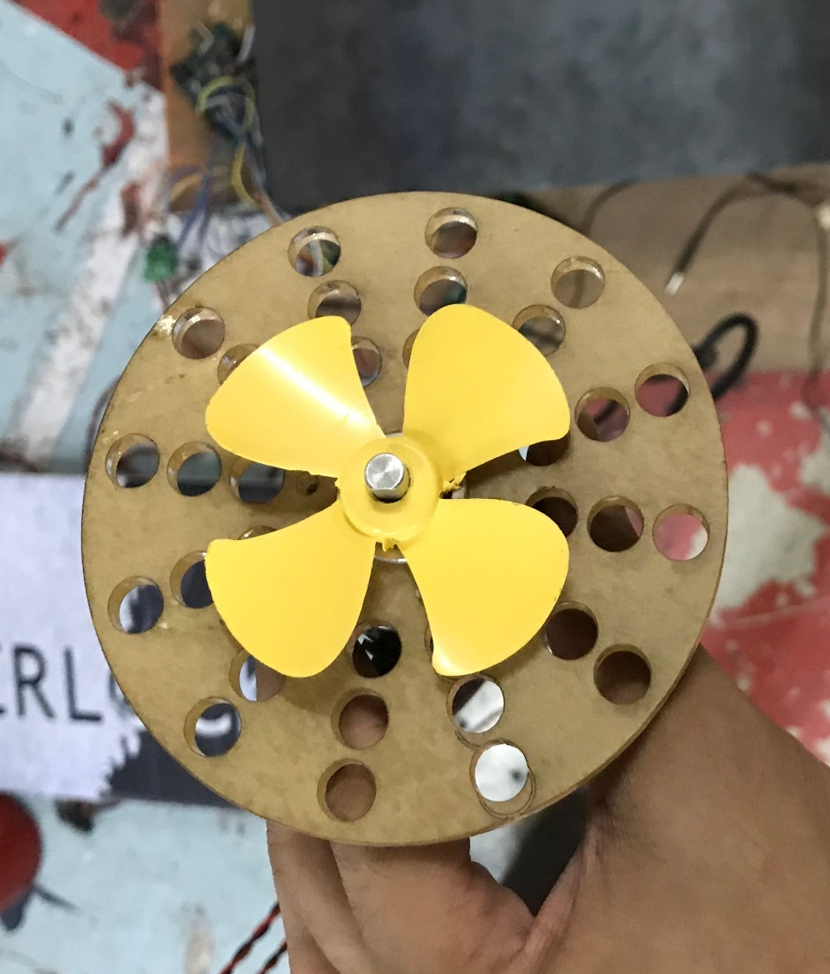
Lung Capacity
Uses rotary encoder.
User required to blow on a small fan.
Measures total number of rotations.
Calculates average and maximum speeds.
Calibration needs to be done.
Outer design to be implemented.

Slide 6
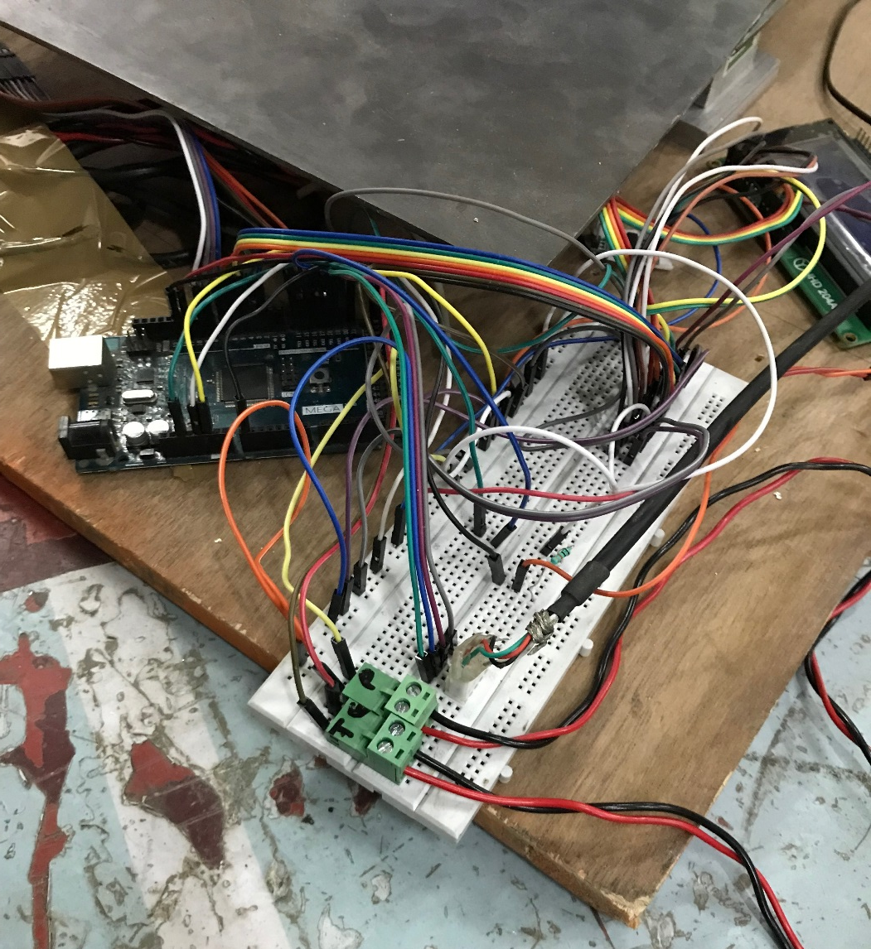
Temperature & Circuitry
Use NTC thermistor.
Complete Circuit →
16X2 LCD output.
SD card storage of data for future
comparison.

Slide 7
Challenges
We faced major issues while designing the weighing machine. First, the output we were getting was very inconsistent and we bought a new amplifier to no improvement, only to realize later on, that the load to be applied was to be a point load.
We had to buy three devices for temperature measurement. The first, LM-35 was taking time in giving stable reading which were as it is, far from accurate. The second second sensor DS18B20 was faulty.

Slide 8
Next Goals
Blood pressure Measurement.
Blood Sugar Level Measurement.
Calibrations (especially for lung capacity).
App development for facilitating storage and analysis of data.

