Slide 1
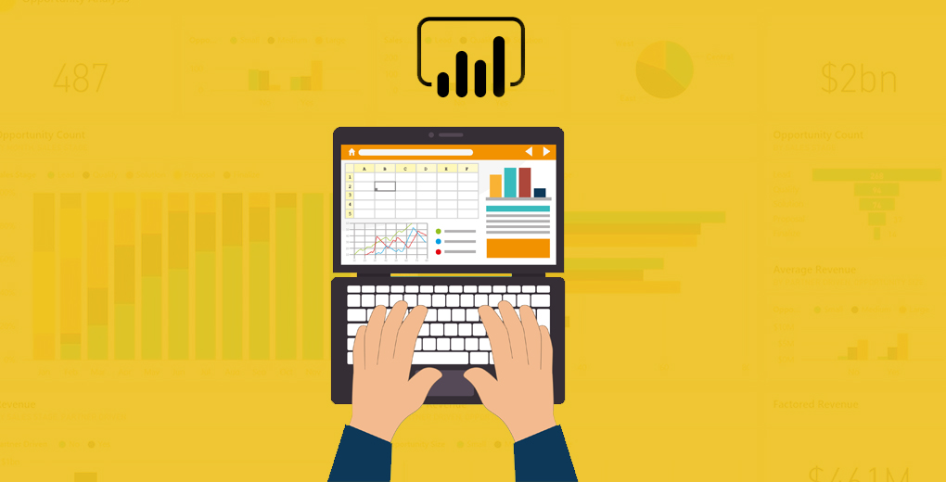
DAX-Measure
Enable complex queries with semantic
models.
--- By ---
1. Tanmay Ashok Khedekar
2. Shantanu Hanuman Jivtode
3. Ritesh Raghunath Dhumal

Slide 2
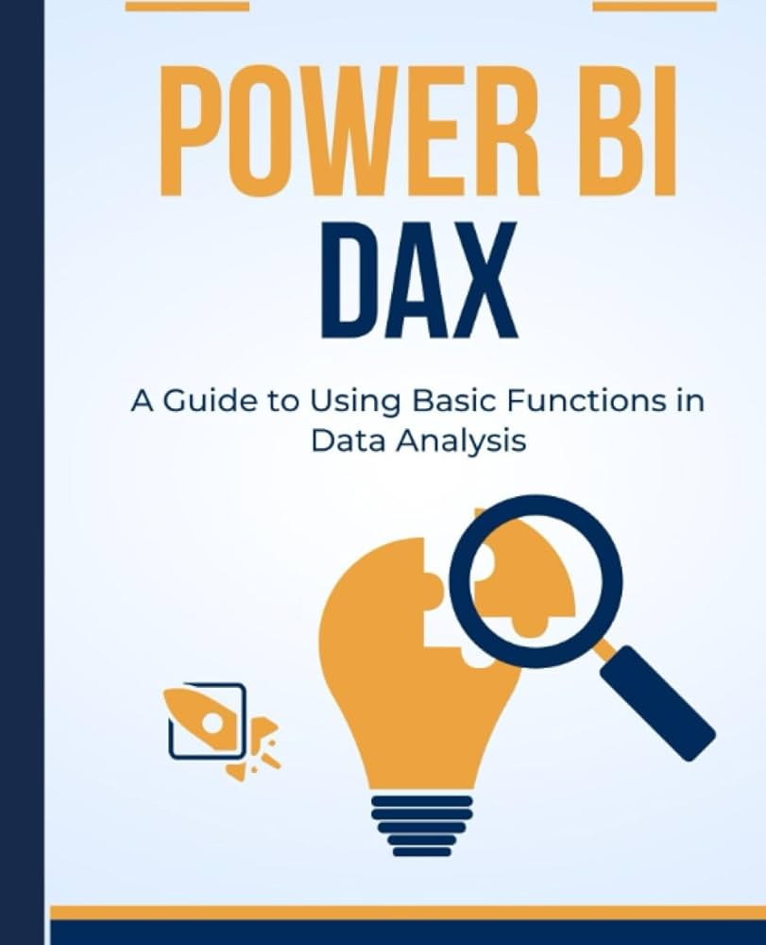
Introduction
What is DAX?
DAX (Data Analysis Expressions) is a formula language used primarily in Microsoft tools like Power BI, Power Pivot, and SQL Server Analysis Services for creating calculated fields, measures, and other analytical computations..
It enables data modeling and analysis by allowing users to define custom calculations and queries on their data.

Slide 3

Importance of DAX
Visual Clarity: Makes data easier to read.
Quick Analysis: Identifies important data points quickly.
Decision Making: Aids in informed decision-making
Creating custom calculation:
DAX allows users to create custom calculations using calculated columns, measures, and tables.
Defining interaction between tables :
DAX can be used to define interactions between tables in a data model.
Securing data:
DAX formulas can be used to secure data by using row-level security.

Slide 4

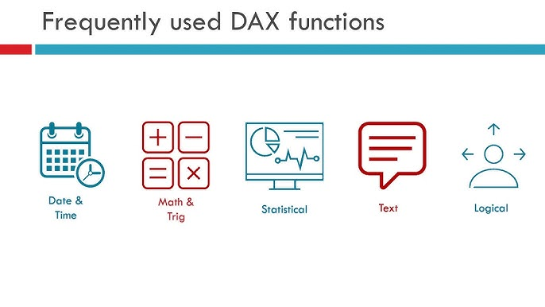

Slide 5
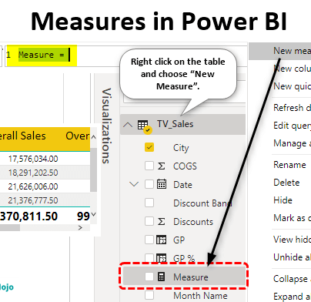
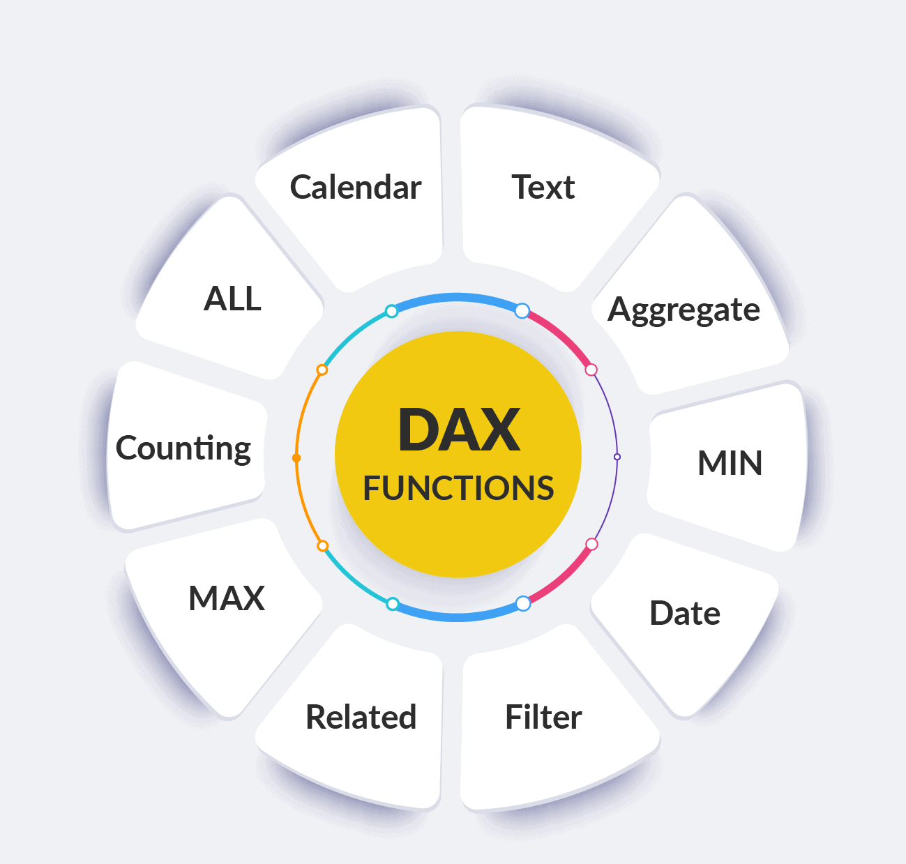
DAX-Measure
Measure is a calculation done on data field, which can perform an arithmetic calculations or aggregate functions. In Power BI, measures are used to create variety of DAX functions like SUM, AVERAGE, MAX, MIN and COUNT.
Examples: Measures include: Total Sales, Total Salaries, Average Quantity, Average Order Value, Count of Customers, Year-to-Date (YTD) Sales and so on.

Slide 6




BEST PRACTICES FOR DAX-Measure
Simplify
Formulas
Use proper Data Modeling
Reduce Redundancy
Use Aggregation

Slide 7

Conclusion
Easy to learn: DAX is a flexible and powerful language that's easy to learn and execute.
Simplifies business data: DAX allows for complex analyses, which can help users understand business data and gain insights.
Enriches data models: DAX can be used to create calculated columns, calculated tables, and measures to enrich data models.
Filters data: DAX can filter data based on specific conditions or segment it into subsets.
Time intelligence: DAX includes many time-intelligence functions.
CALCULATE function: The CALCULATE function is important in DAX because it allows users to modify the context in which a calculation is performed.
Filter context: Understanding filter context is key to creating dynamic reports.

