Slide 1
PHASE 2 · PROJECT 70% COMPLETE
Progress Status
70%
Completed
Pending
Student add / delete
Daily attendance marking
Attendance % calculation
Defaulter identification
Basic report
Dashboard summary
Report screen polish
Input validation
Final testing
of the project completed
Phase 2 review

Slide 2
PHASE 2 · PROJECT 70% COMPLETE
Modules Implemented So Far
1
Student Management
2
Mark Attendance
Add a student by name and remove a student; each student gets a unique ID.
Select a date and set each student as Present, Absent or Late.
3
Calculation Logic
4
Defaulter Check
Counts present, absent and late days and computes the attendance percentage.
Compares the percentage with the 75% threshold to flag defaulters.

Slide 3
PHASE 2 · PROJECT 70% COMPLETE
Remaining Work & Next Steps
Dashboard
Show total students, present / absent today and defaulter count.
Report screen
Present, absent, late, total days, attendance % and status for every student.
Validation & testing
Handle empty names and wrong input, then test with multiple days of data.
Final output
Capture screenshots and prepare the final presentation.

Slide 4
PHASE 3 · PROJECT 100% COMPLETE
Project Completed
Dashboard
Total students, present / absent today, defaulters
100%
Students
Add and delete students with unique IDs
All modules complete and tested
Mark Attendance
Pick a date; Present → Absent → Late on double-click
Report
Per-student totals, attendance % and status

Slide 5
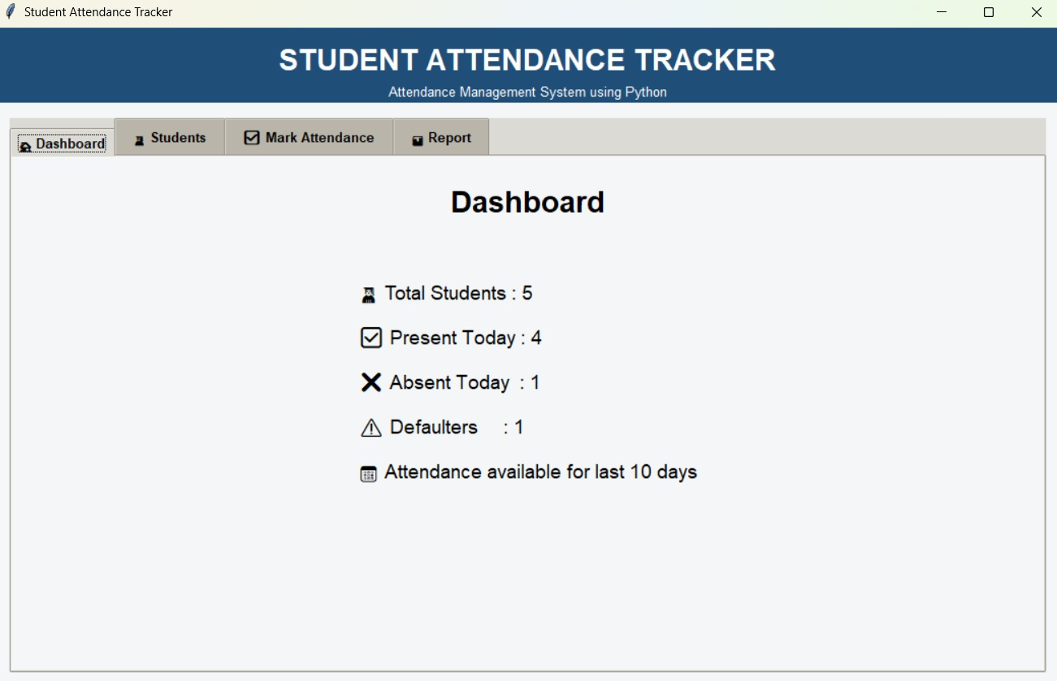
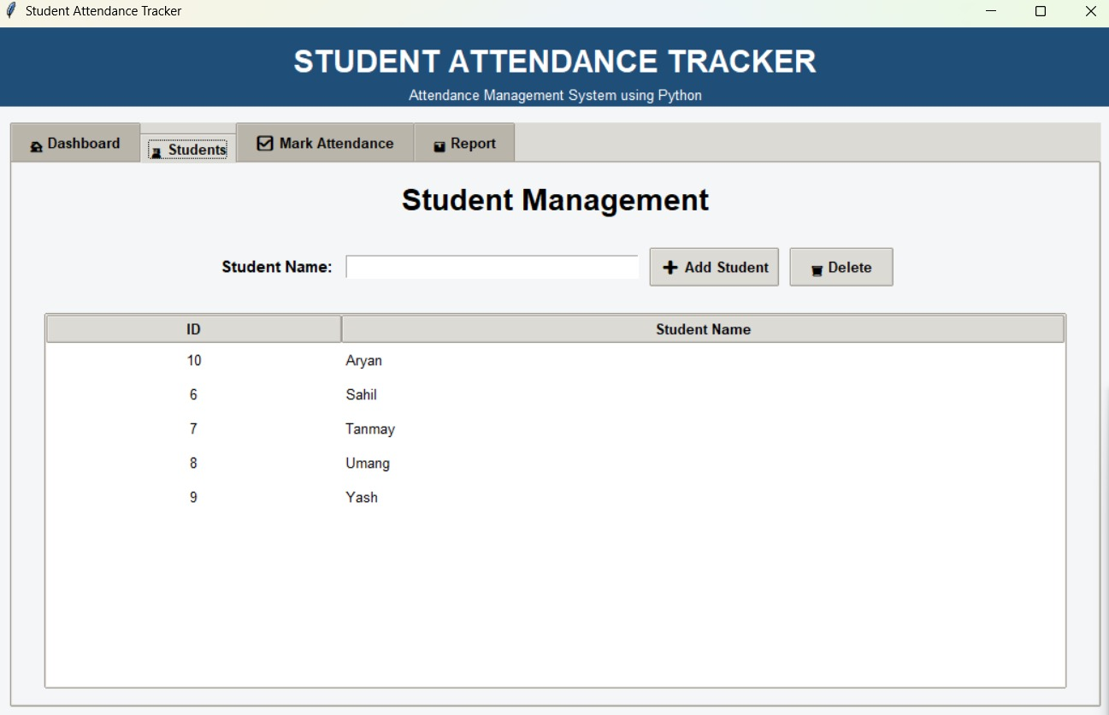
PHASE 3 · PROJECT 100% COMPLETE
Final Output – Dashboard & Students
Dashboard
Student Management
Live summary of students, today's attendance and defaulters
Add or delete students from one screen

Slide 6
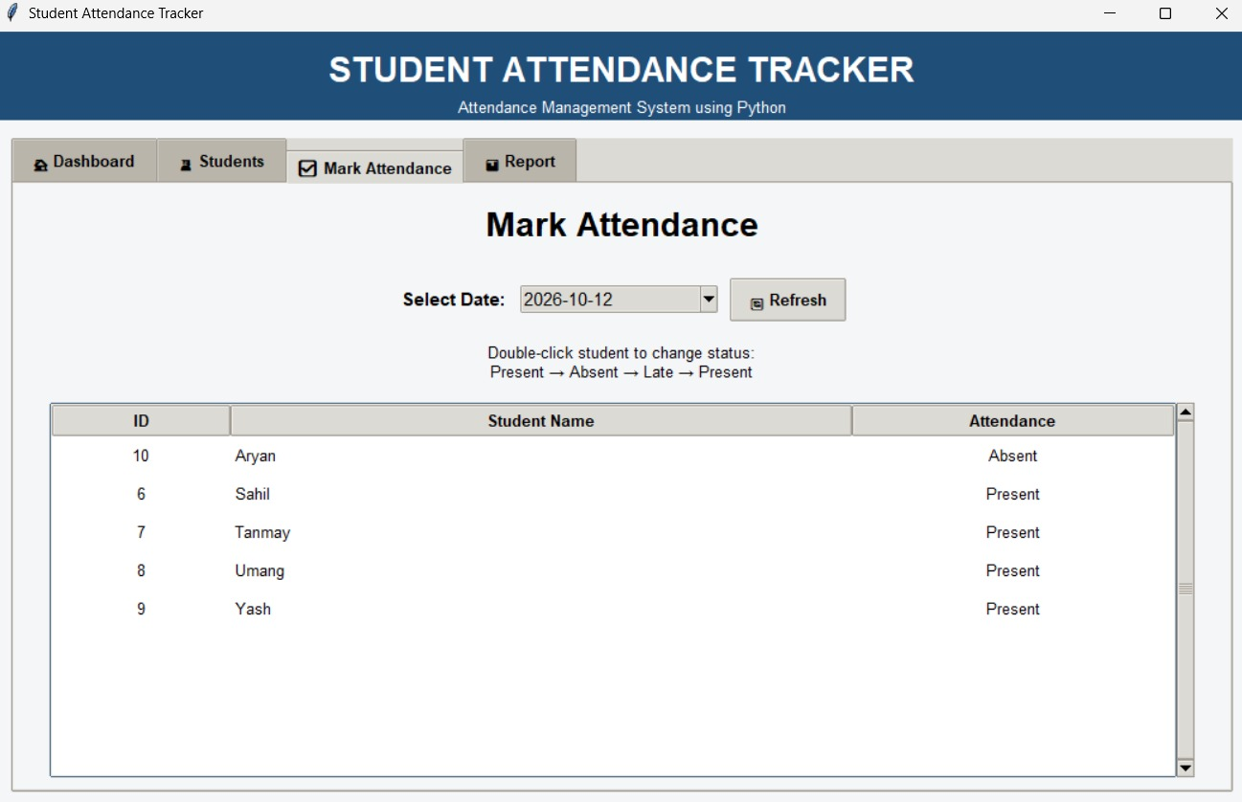
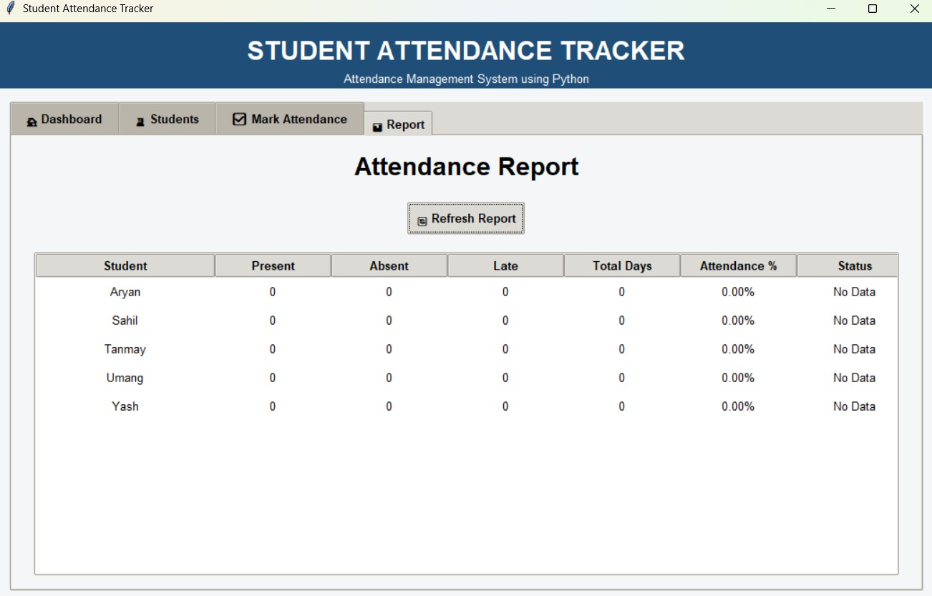
PHASE 3 · PROJECT 100% COMPLETE
Final Output – Attendance & Report
Mark Attendance
Attendance Report
Select a date and double-click a student to change status
Present, absent, late, total days, % and status per student

