Slide 1

Project Code- B41_DA_025_Data Knights
Mobile Device Usage
And
User Behaviour Analysis
Team:
Tanmay Tripathi(Team Lead)
Ankit Sengar Harsh Agarwal

Slide 2

Introduction
This project analyzes user behavior
on mobile devices to uncover actionable insights and improve user engagement.
Data was processed and analyzed using Python and SQL,
leveraging their data extraction and manipulation strengths.
The final interactive dashboard was created in Power BI,
providing stakeholders with a visual and dynamic representation of user behavior trends.
The analysis aims to highlight key metrics such as session duration,
usage frequency, and feature adoption rates.
By combining analytical tools and visualization platforms,
this project bridges the gap between raw data and strategic insights.

Slide 3
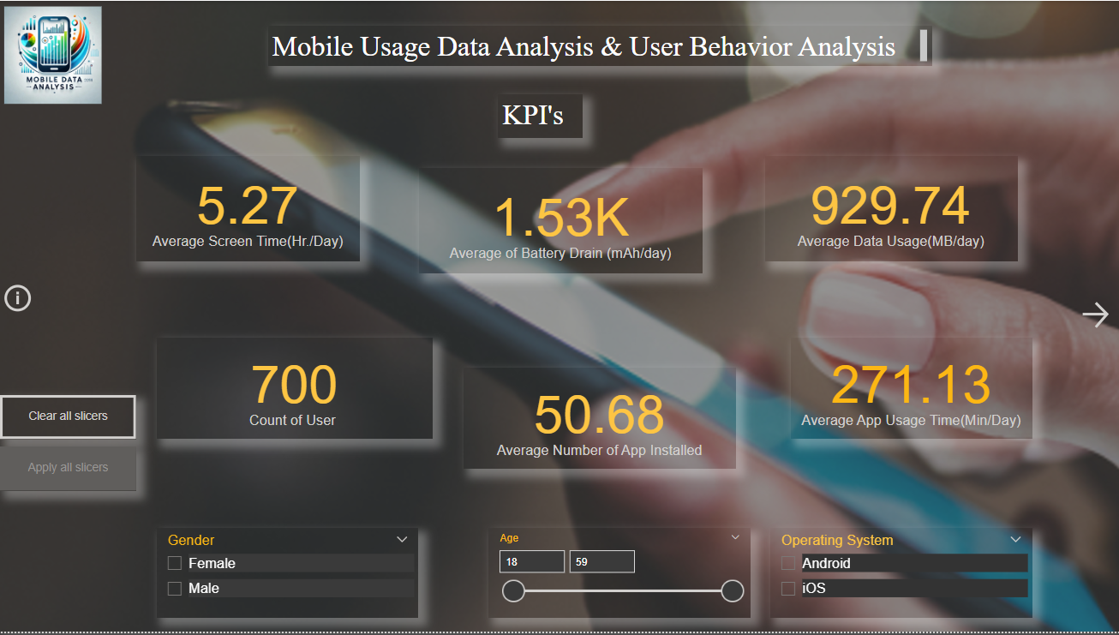
KPIs(Key Performance Indicators')
KPIs (Key Performance Indicators) are measurable metrics that indicate how well an individual, team, or organization is achieving specific goals. They are used to track progress, measure success, and provide insights into areas that need improvement.
Average Screen Time(Hr/Day)
Average of Battery Drain(mAh/day)
Average Data Usage(MB/day)
Count of user
Average Number of App Installed
Average App Usage Time(Min/Day)

Slide 4
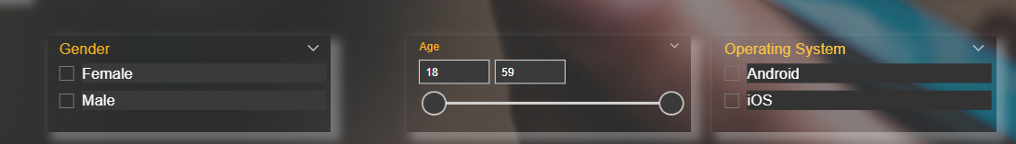
Slicers
Slicers in Power BI dashboards are a type of visual filter used to refine data and allow users to interactively slice and filter the displayed information. Slicers enhance the interactivity and usability of dashboards by enabling dynamic filtering based on specific dimensions or attributes.
Key Features of Slicers:
Interactive Filtering: Slicers allow users to filter dashboard visuals by selecting one or more values from a list.
Visual Representation: Display as drop-down menus, checkboxes, or tiles for a user-friendly experience.
Cross-Filtering: When used, slicers automatically update related charts, tables, and other visuals on the dashboard.
Hierarchical Slicing: For data with parent-child relationships, slicers can drill down into subcategories.
Types of Slicers in Power BI:
Category Slicer: Filters data by categories such as product type, region, or demographic.
Date Slicer: Filters by date range using sliders or specific date selections.
Numeric Slicer: Filters using number ranges with adjustable sliders.
Hierarchical Slicer: Supports nested filters (e.g., Country > State > City)

Slide 5
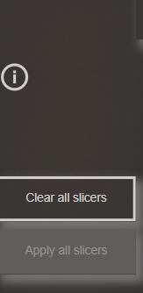
Buttons in Power BI
Buttons in Power BI are interactive elements used to enhance dashboard navigation, trigger actions, or create a more engaging user experience. Buttons allow users to interact with reports dynamically without needing external menu navigation.
Types of Buttons in Power BI
Predefined Buttons: Available in the Power BI ribbon with commonly used options (e.g., Back, Reset).
Custom Buttons: Designed with icons, images, or shapes tailored to specific actions or themes.
Common Actions for Buttons
Page Navigation: Redirect users to different report pages within the same Power BI file.
Back/Reset Navigation: Navigate back to the previous page or reset slicer and filter settings.
Bookmark Activation: Trigger predefined bookmarks for specific data views or layouts.
Drillthrough Activation: Guide users to a detailed analysis page based on a selected category or metric.
URL Redirect: Open an external web page or a resource outside Power BI.

Slide 6
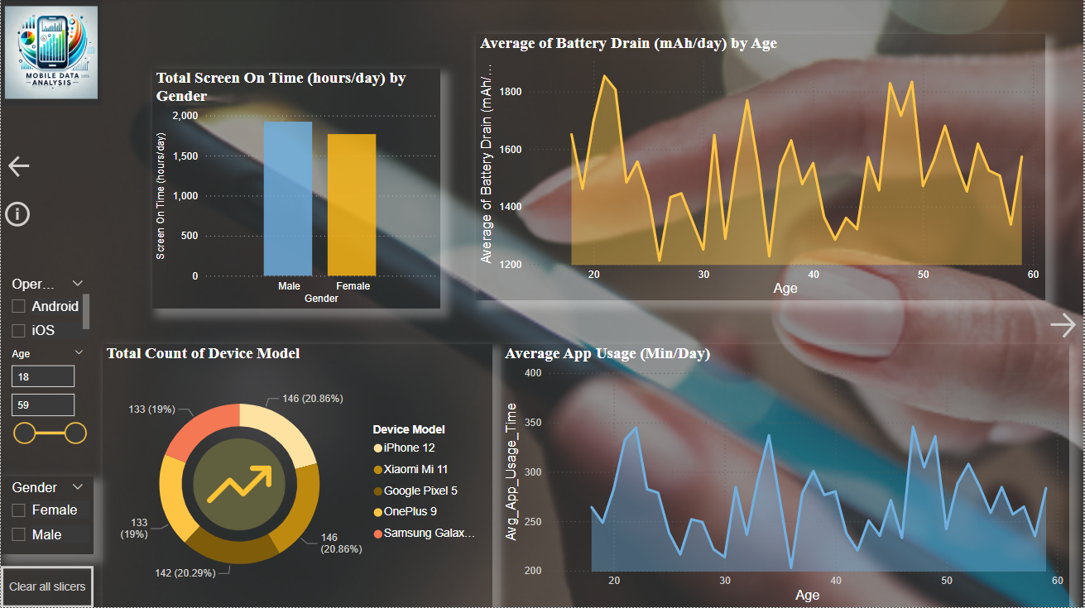
Visualisations in Power BI
Visuals in Power BI are graphical representations of data that help convey insights, trends, and patterns effectively. They are the core of Power BI dashboards and reports, enabling users to interpret complex data simply and interactively.

Slide 7
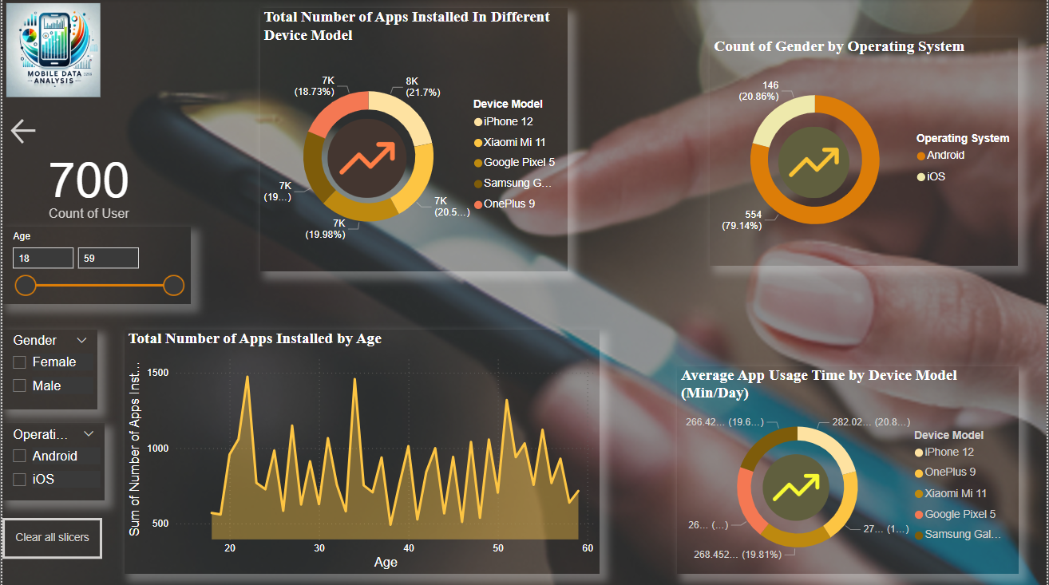
Doughnut Chart: Great for proportions but not ideal for precise comparisons. Use sparingly with 3–5 categories.
Bar Chart: Best for clear comparisons of discrete values and easily accommodates a larger dataset.
Area Chart: Ideal for showing trends or emphasizing the volume of changes over time. Not suited for precise value comparisons.
These chart types offer flexibility for representing different kinds of data, depending on the audience and the key insights you want to highlight.

Slide 8
Thank You

