Slide 1

Commonly used scores in shoulder instability
Dr Himanshu Bhayana
Associate Professor
PGI Chandigarh
Sports Surgery
Shoulder/ Knee Surgery

Slide 2
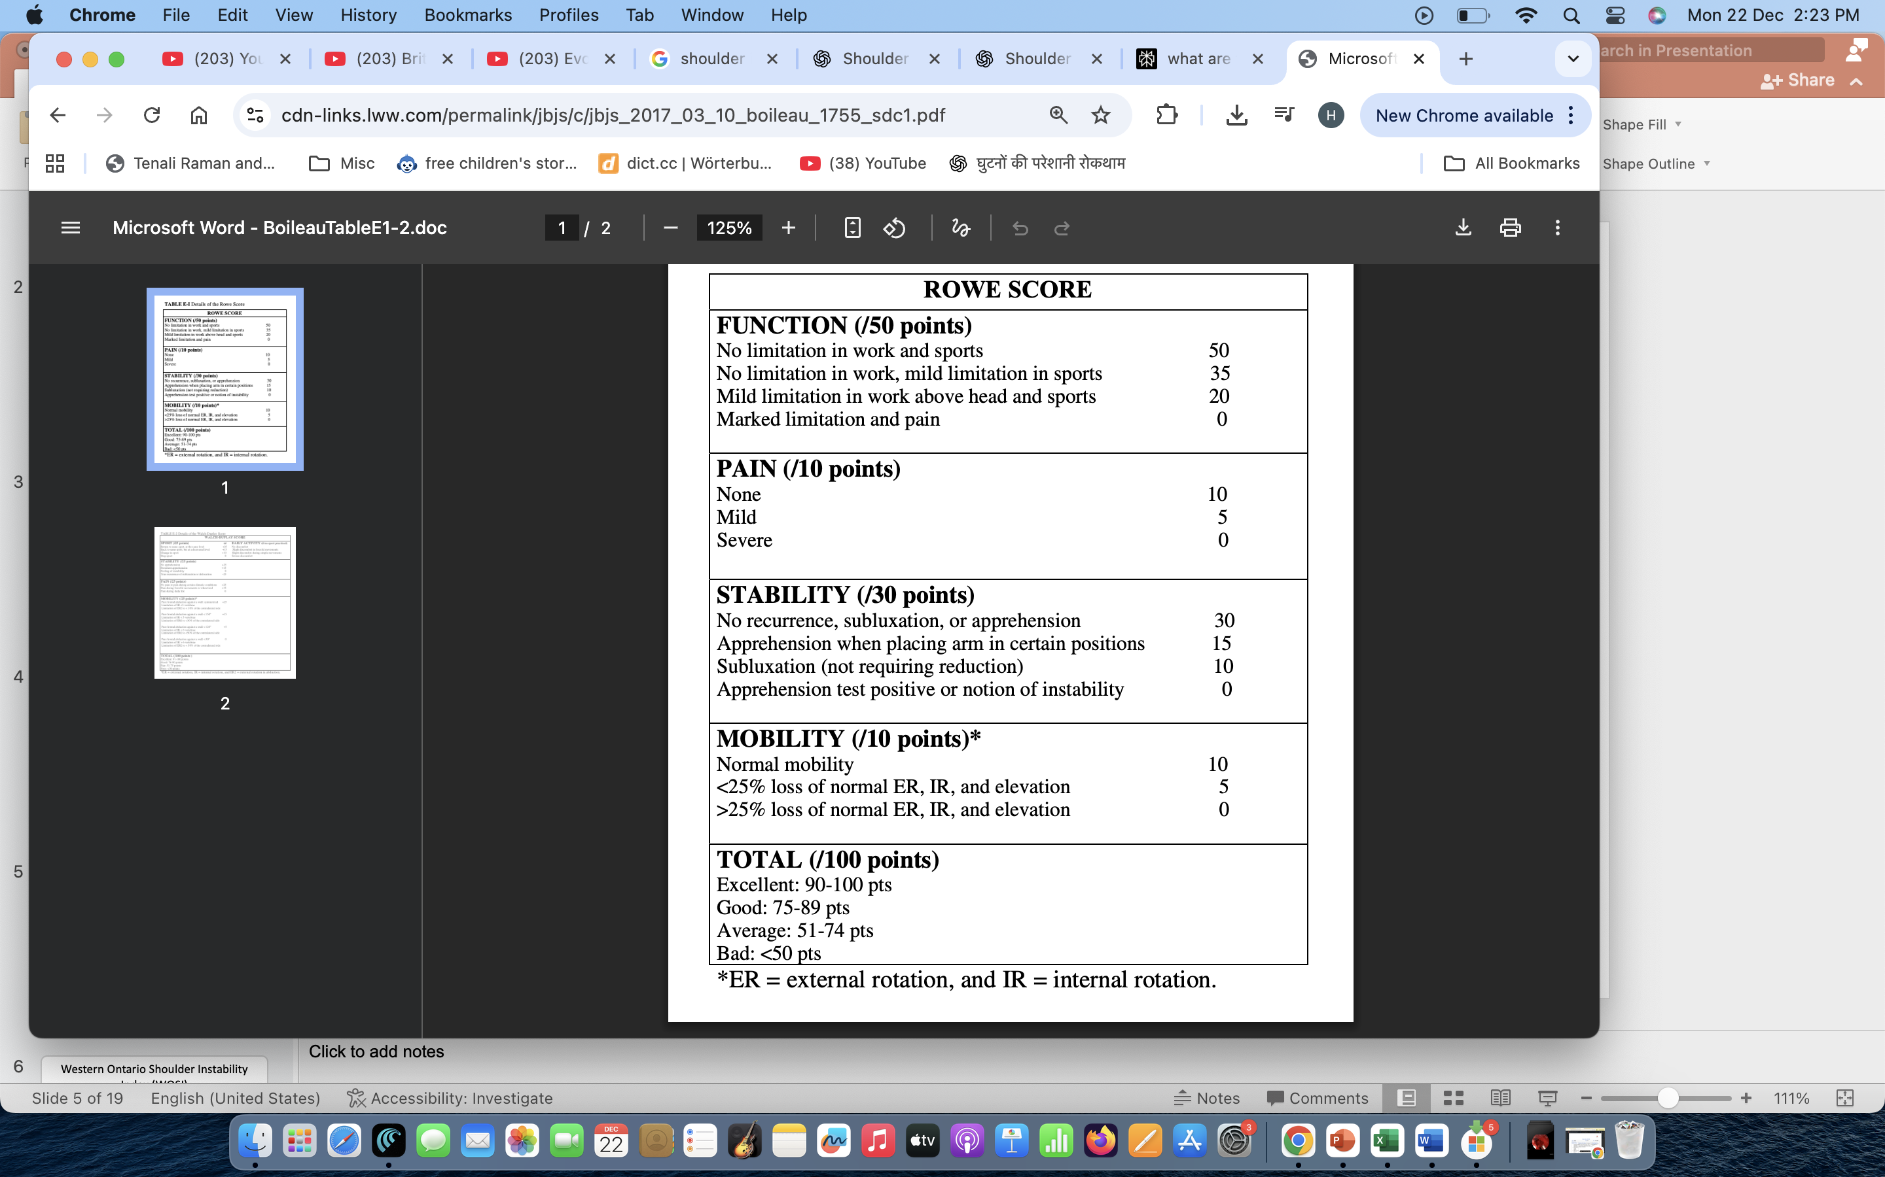
Rowe Score
Score: 0–100
Higher = Better outcome

Slide 3
Clinician-based
Stability Assesses recurrent dislocations, subluxations, and apprehension (fear of dislocation).
Motion Measures range of motion (elevation, rotation) compared to the unaffected shoulder.
Function : Evaluates ability to perform daily activities (ADLs).

Slide 4
Western Ontario Shoulder Instability Index (WOSI)
Quality of life based
Sport, lifestyle, emotions
Total 21 Questions
0% → Best possible outcome
100% → Worst possible outcome

Slide 5
Oxford Shoulder Instability Score (OSIS)
Patient-reported outcome
12 questions
Score: 0–48
Each question has 5 response options (graded severity 0-4
Total score range: 0 to 48
➡️ Higher score = better shoulder function

Slide 6
Shoulder instability score
Parameter | Criteria | Score
Age at surgery | ≤ 20 years | 2
Sports participation | Competitive sports | 2
 | Contact or overhead sports | 2
Shoulder hyperlaxity | Present | 1
Hill-Sachs lesion (AP X-ray) | Visible | 2
Glenoid bone loss (AP X-ray) | Loss of inferior glenoid contour | 2
ISIS Score | Risk
0–3 | Low risk (<10%)
4–6 | Moderate risk
>6 | High risk (≥70%)

Slide 7
ASES Score
American Shoulder and Elbow Surgeons Score
Pain + Function
Score: 0–100
Pain Component (50 points)
Assessed using VAS
Patient rates pain from 0 - 10
Scoring formula: =. ( 10−VAS pain)×5

Slide 8
Function Component – ADL (50 points)
10 daily activities, each scored from:
  0 = Unable to do
  3 = No difficulty
Activities include:
Putting on a coat ; Sleeping on affected side
Washing back; Combing hair
Reaching a high shelf ; Lifting 10 lb (4.5 kg) above shoulder
Throwing a ball; Usual work
Sports / recreational activity

Slide 9
Walch–Duplay Score
Pain, Stability, Sports, Mobility
Score: 0–100
Domain | What it Assesses
Pain | Presence and severity of shoulder pain
Stability | Recurrence of dislocation/subluxation
Mobility | Range of motion compared to normal side
Return to Sport/Activity | Ability to resume previous activity level

Slide 10
Pain (0–25)
No pain → 25
Occasional pain → 20
Pain with activity → 10
Severe/constant pain → 0
2. Stability (0–25)
No instability → 25
Apprehension only → 15
Subluxation → 5
Recurrent dislocation → 0
3. Mobility (0–25)
Normal ROM → 25
Slight limitation → 20
Moderate limitation → 10
Severe limitation → 0
4. Return to Sport/Activity (0–25)
Same level as before injury → 25
Slightly reduced → 20
Recreational only → 10
Unable to return → 0

Slide 11
Take Home Message
Use multiple scores
Combine patient-reported and objective measures

Slide 12
Scores at a Glance
Rowe → Stability focused
SIS: Risk of Recurrence
WOSI → Quality of life
OSIS → Patient-reported
ASES → Pain + function

Slide 13
Which Score to Use?
Clinical outcome → Rowe
Research / QoL → WOSI
OPD follow-up → OSIS
Combined assessment → ASES

