Slide 1
Prompt2Craft
Indian Premier League
Indian Premier League logo
The Premier T20 Cricket League in India
8 slides
Theory-first narrative
Max 3 photos
Minimal. Clean. Editorial.
Hero Visual

Slide 2
Content
History of IPL
From its inception to the present day
Core theory
How to think about it
The IPL was founded by the Board of Control for Cricket in India (BCCI) in 2008.
The first season of the IPL was held in 2008 and was won by the Rajasthan Royals.
The league has since grown in popularity and has become one of the most watched and followed sports leagues in the world.
The first season of the IPL was held in 2008 and was won by the Rajasthan Royals.
The league has since grown in popularity and has become one of the most watched and followed sports leagues in the world.
The IPL has also become a platform for young and talented cricketers to showcase their skills and get noticed by international selectors.
Applied takeaway
The league has also been instrumental in promoting cricket in India and has helped to increase the popularity of the sport in the country.
Generated by Prompt2Craft | Slide 2 of 8

Slide 3
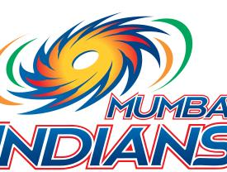
Image
IPL Teams
The 10 teams that compete in the league
Supporting narrative
The IPL is contested by 10 teams, each representing a different city or region in India.
The teams are: Mumbai Indians, Chennai Super Kings, Kolkata Knight Riders, Royal Challengers Bangalore, Delhi Capitals, Sunrisers Hyderabad, Rajasthan Royals, Punjab Kings, Lucknow Super Giants, and Gujarat Titans.
Each team has a unique logo and brand identity, and they compete against each other in a double round-robin format.
Generated by Prompt2Craft | Slide 3 of 8

Slide 4
Stats
IPL Records
Some of the most notable records in the league
Most runs
Most wickets
Virat Kohli (5,034 runs)
Lasith Malinga (170 wickets)
Highest score
Best economy rate
264 (by Mumbai Indians against Kings XI Punjab)
Muttiah Muralitharan (6.95)
Generated by Prompt2Craft | Slide 4 of 8

Slide 5
Timeline
IPL Timeline
A brief history of the league
STEP 1
STEP 2
STEP 3
STEP 4
2008: The IPL is founded by the BCCI.
2009: The first season of the IPL is held and is won by the Rajasthan Royals.
2010: The league is expanded to 10 teams and the format is changed to a double round-robin format.
2011: The IPL is suspended due to a spot-fixing scandal.
Generated by Prompt2Craft | Slide 5 of 8

Slide 6
Two Column
IPL Impact
The impact of the IPL on Indian cricket
Column One
Column Two
The IPL has helped to increase the popularity of cricket in India.
The league has also helped to promote Indian cricket globally.
The IPL has provided a platform for young and talented cricketers to showcase their skills.
The IPL has also helped to increase the revenue of the BCCI.
The league has also helped to reduce the financial burden on the BCCI.
The IPL has also helped to promote the growth of cricket in India.
Generated by Prompt2Craft | Slide 6 of 8

Slide 7
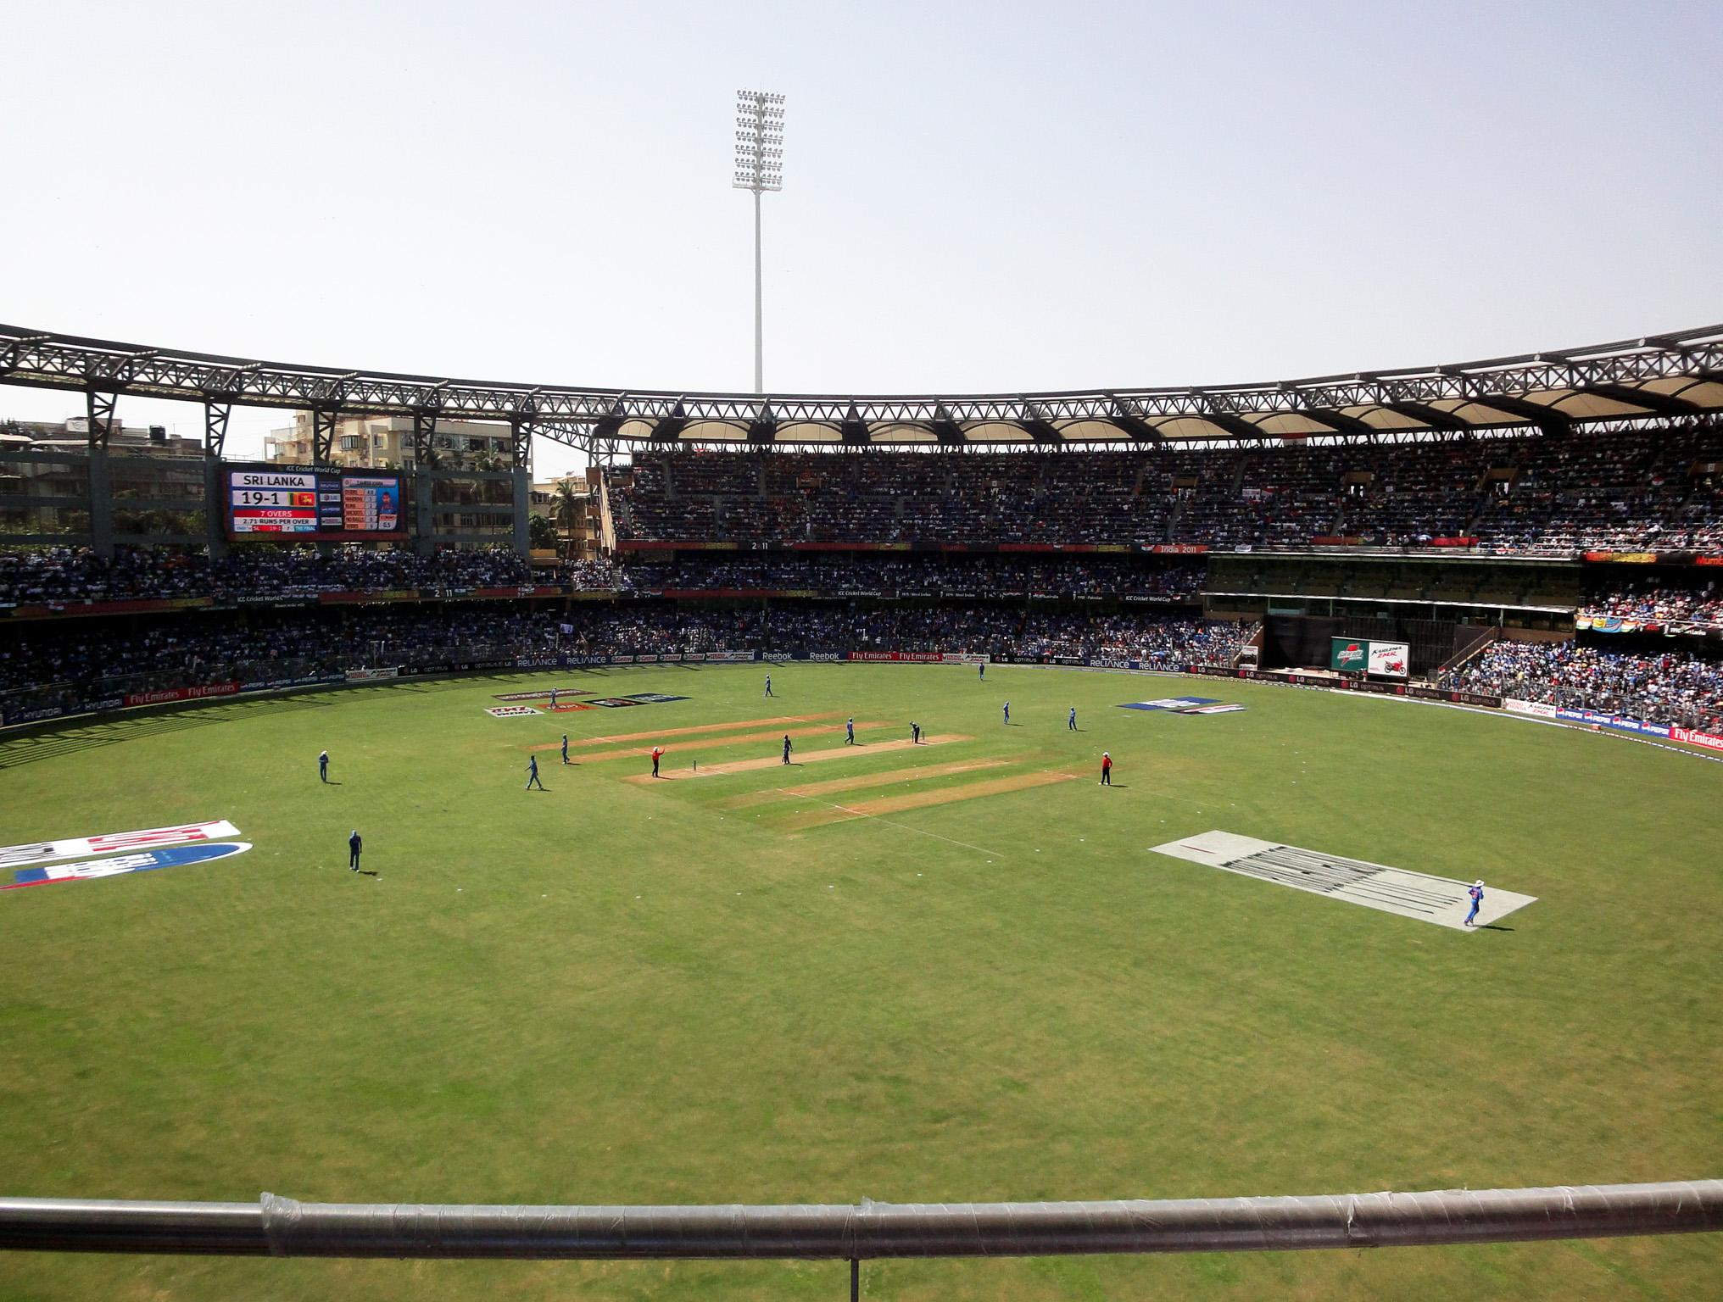
Image
IPL Venues
Some of the most notable stadiums in the league
Supporting narrative
The IPL is played in various stadiums across India.
Some of the most notable stadiums in the league include the Wankhede Stadium in Mumbai, the MA Chidambaram Stadium in Chennai, and the Feroz Shah Kotla Ground in Delhi.
Each stadium has its own unique character and atmosphere, and they provide a great experience for the fans.
Generated by Prompt2Craft | Slide 7 of 8

Slide 8
Stats
IPL Attendance
The average attendance at IPL matches
Average attendance
Highest attendance
30,000 fans per match.
55,000 fans at the Wankhede Stadium in Mumbai.
Lowest attendance
10,000 fans at the Feroz Shah Kotla Ground in Delhi.
Generated by Prompt2Craft | Slide 8 of 8

