Slide 1
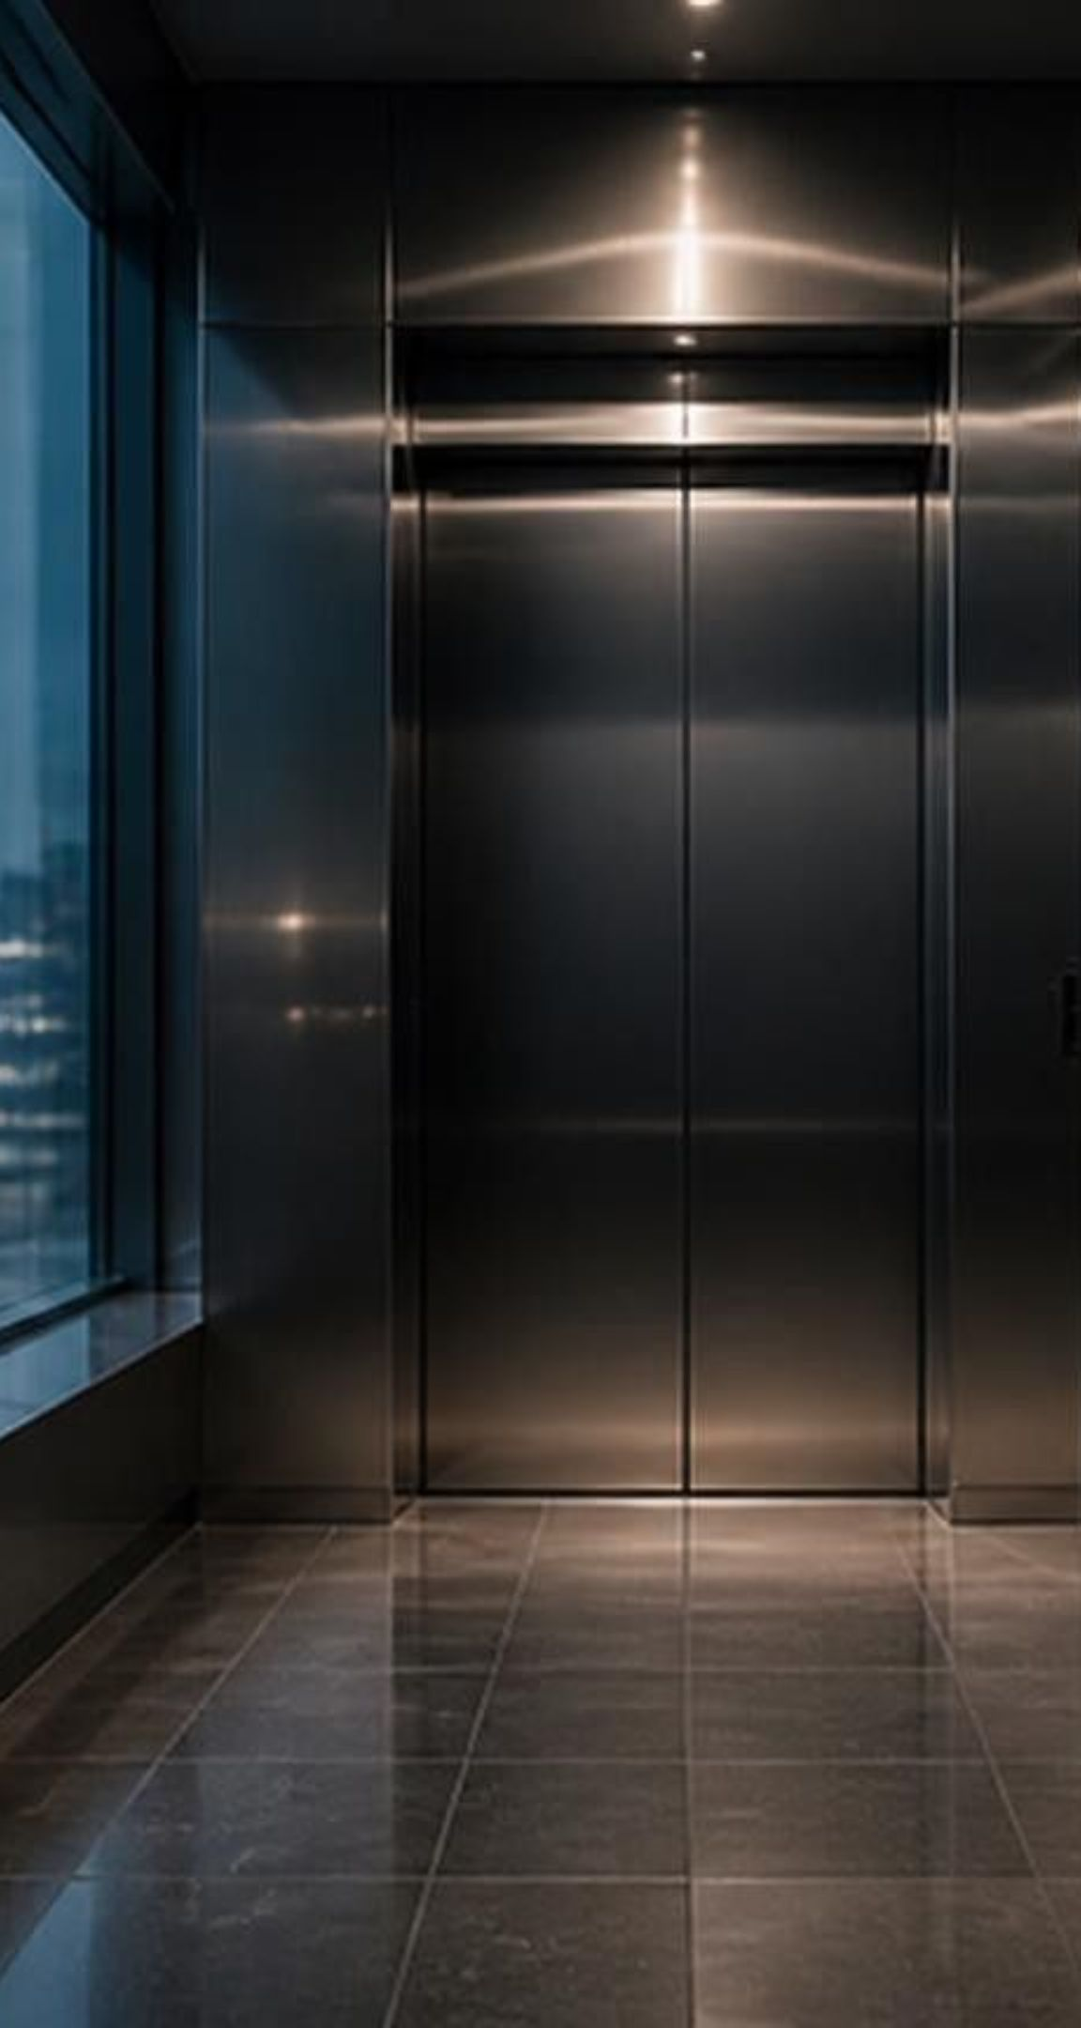
EDGE AI & COMPUTER VISION RETROFIT
LiftMind — Giving Existing Elevators Eyes, Context & an Intelligent Brain
Tagline: A Brand-Agnostic Edge AI & Computer Vision Retrofit Kit for Legacy Elevators
Core Value Proposition: We do not replace elevators; we upgrade existing "dumb" elevators with traffic optimization, emergency priority, and safety intelligence for 1/10th the cost of mechanical modernization.
Built for:
Hospitals
Campuses
IT Parks
Commercial High-Rises
Notes:
Welcome the audience. Introduce LiftMind as an edge AI and computer vision retrofit kit designed to solve the multi-billion dollar problem of legacy elevators operating blindly without passenger context.

Slide 2
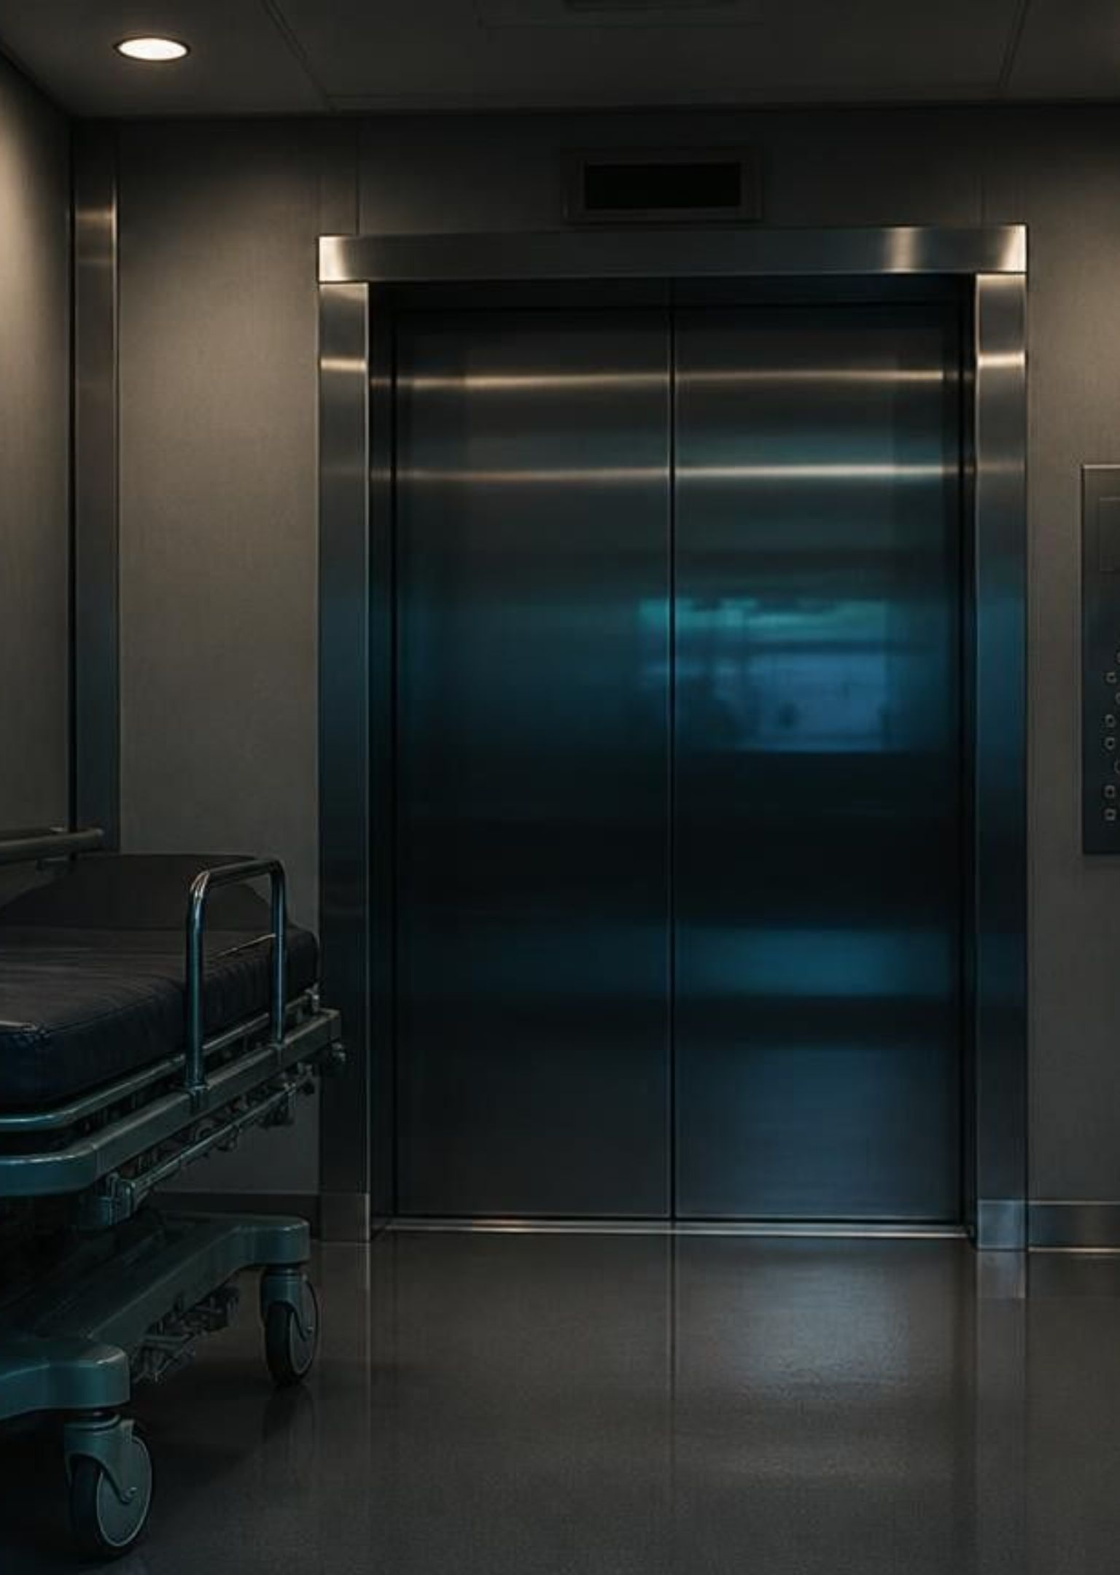




INDUSTRY CHALLENGES
The Problem — Legacy Elevators Are Blind to Passenger Context
Wasted Energy & Time:
Zero Emergency Awareness:
Traditional elevators stop at floors even when passengers walk away (phantom calls) or when the cabin is already physically packed with luggage.
Standard lifts cannot distinguish between a routine hall call and a critical hospital stretcher emergency, nor can they detect if a solo rider collapses inside the cabin.
Prohibitive Upgrade Costs:
Vendor Lock-In:
Replacing an elevator controller costs ₹47.5 Lakh–₹66.5 Lakh ($50K–$70K) globally or ₹3 Lakh–₹8 Lakh in India, while new commercial lifts cost ₹6 Lakh–₹25 Lakh+ in India ($75K–$350K globally).
Smart dispatch systems from Otis, KONE, and Schindler are locked to expensive new OEM installations rather than legacy mixed-brand fleets.
Notes:
Walk through the four core failure modes of legacy elevators: phantom calls wasting power, complete absence of emergency detection, prohibitive capital costs for controller replacement, and restrictive OEM vendor lock-in across commercial real estate.

Slide 3
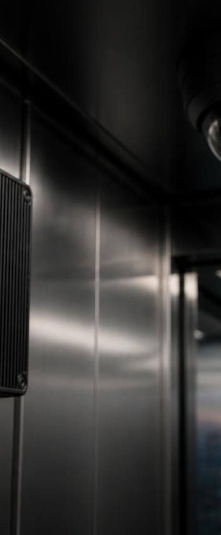


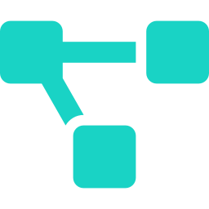



MODULAR ARCHITECTURE
The LiftMind Solution — Universal Plug-and-Play AI Retrofit Kit
Hardware Stack:
1 Hallway Landing Camera
1 Overhead Cabin Camera
Local Edge AI Compute Box
Relay Controller Interface Board
100% On-Device Edge Privacy:
Zero Mechanical Tampering:
Brand-Agnostic:
Video inference (YOLOv8 & MediaPipe) runs locally on the edge box with zero cloud video streaming and zero latency.
Connects via standard button-call relays rather than safety brake wiring, bypassing multi-year mechanical recertification delays.
Works seamlessly across any legacy hydraulic, traction, or MRL (Machine-Room-Less) elevator fleet.
Notes:
Explain the plug-and-play retrofit methodology. Emphasize how the relay interface completely circumvents regulatory re-certification while on-device edge AI guarantees zero video leaks and sub-10ms response times.

Slide 4
LIVE SYSTEM DEMONSTRATION
See LiftMind in action
Real-time perception meets spatial dispatch: our twin engines in action.
DEMO SLOT 01
DEMO SLOT 02
Digital Twin Dashboard
Python Computer-Vision Window
[ User to supply screenshot: Digital Twin Interface ]
[ User to supply screenshot: OpenCV / Inference Feed ]
Telemetry: 3D elevator shaft positions, lobby congestion heatmaps, and fleet dispatch efficiency.
Edge inference: real-time bounding boxes, gesture recognition, and passenger load calculations.
Notes:
Walk through the two views: on the left, facility managers monitor fleet metrics; on the right, the CV model detects people, stretchers, and intent at 30 fps.

Slide 5
SYSTEM CAPABILITIES · PART 1
Core Traffic Intelligence (Features 1 to 4 of 8)
Feature 1 — Dynamic Multi-Car Load Balancing:
When Lift A reaches capacity (Weight ≥ 85% or Cabin Space ≥ 90%), external landing calls are automatically delegated to an idle or empty Lift B.
≥ 85%
01
weight or ≥ 90% space
Feature 2 — Computer Vision Stretcher Priority Preemption:
Hallway cameras detect medical stretchers (99% confidence), immediately overriding normal queues to travel non-stop to the emergency floor while handing routine stops to the secondary lift.
99%
02
detection confidence
Feature 3 — Phantom Call Cancellation:
If a landing button is pressed but the passenger walks away (0 waiting riders), a 3.0-second verification countdown cancels the call, saving 0.18 kWh per avoided stop.
0.18 kWh
03
saved per avoided stop
Feature 4 — Predictive Peak-Hour Floor Staging:
Pre-positions idle lifts ahead of demand based on building schedules—Ground Floor (Flr 1) during 8:55 AM Morning Rush, Floors 1 & 4 during 1:15 PM Lunch, and Top Floors (Flr 6 & 5) during 4:30 PM Campus/Office Exit.
8:55 · 1:15 · 4:30
04
staging times
Notes:
Detail traffic intelligence features 1 through 4: dynamic dispatching, critical hospital priority preemption, direct power savings via phantom call cancellation, and scheduled idle staging.

Slide 6
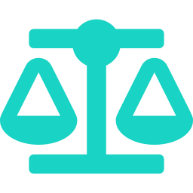



SYSTEM CAPABILITIES · PART 2
Cabin Safety & Gesture UX (Features 5 to 8 of 8)
Feature 5 — Dual-Modal Full-Capacity Bypass:
05
Feature 6 — In-Cabin Distress & Collapse Siren:
06
Combines load-cell weight sensors (85% limit) with overhead CV floor-space tracking (90% limit). If bulky luggage or crowds fill 90%+ of floor space while weight is only 55%, the lift still bypasses external hall calls non-stop.
Overhead CV detects unconscious or collapsed passengers, immediately halting the car at the current floor with doors locked 100% open, triggering an emergency siren, and alerting security.
85% weight · 90% space
Doors locked 100% open
Feature 7 — Multi-Tap Destination Headcount Tracking:
07
Feature 8 — Hallway Palm-Gesture Door Hold:
08
Passengers tap a floor button multiple times (e.g., 5 taps on Floor 6 = 5 riders exiting at Floor 6), letting the AI forecast exact space clearance (-90% space at Flr 6) to pre-schedule subsequent calls.
Rushing passengers hold up an open palm toward the hallway camera (tracked via 21-point MediaPipe hand landmarks) to immediately reverse closing doors and hold them open for 5.0 seconds.
5 taps = 5 riders
21-point · 5.0 s hold
Notes:
Present cabin safety and intuitive gesture UX: dual-modal capacity checking, instant passenger collapse alerts, multi-tap intent capture, and touchless palm-gesture door hold.

Slide 7

MARKET OPPORTUNITY
Market Opportunity (Global & India TAM / SAM / SOM)
Global TAM (Total Addressable Market):
₹2.85 Lakh Crore – ₹3.33 Lakh Crore ($30B–$35B)
India Retrofit Beachhead (SAM)
$1.45B
India elevator retrofit opportunity across healthcare and commercial assets.
Phase 1 Pilot (SOM)
5 hospitals · 25 shafts
$50,000 kit revenue + $7,500/yr SaaS at list price
Notes:
Global TAM is $30B–$35B. The India retrofit beachhead is $1.45B across healthcare and commercial assets. The Phase 1 pilot figure is arithmetic on list prices: 25 shafts × $2,000 kit and 25 shafts × $300 per year.

Slide 8
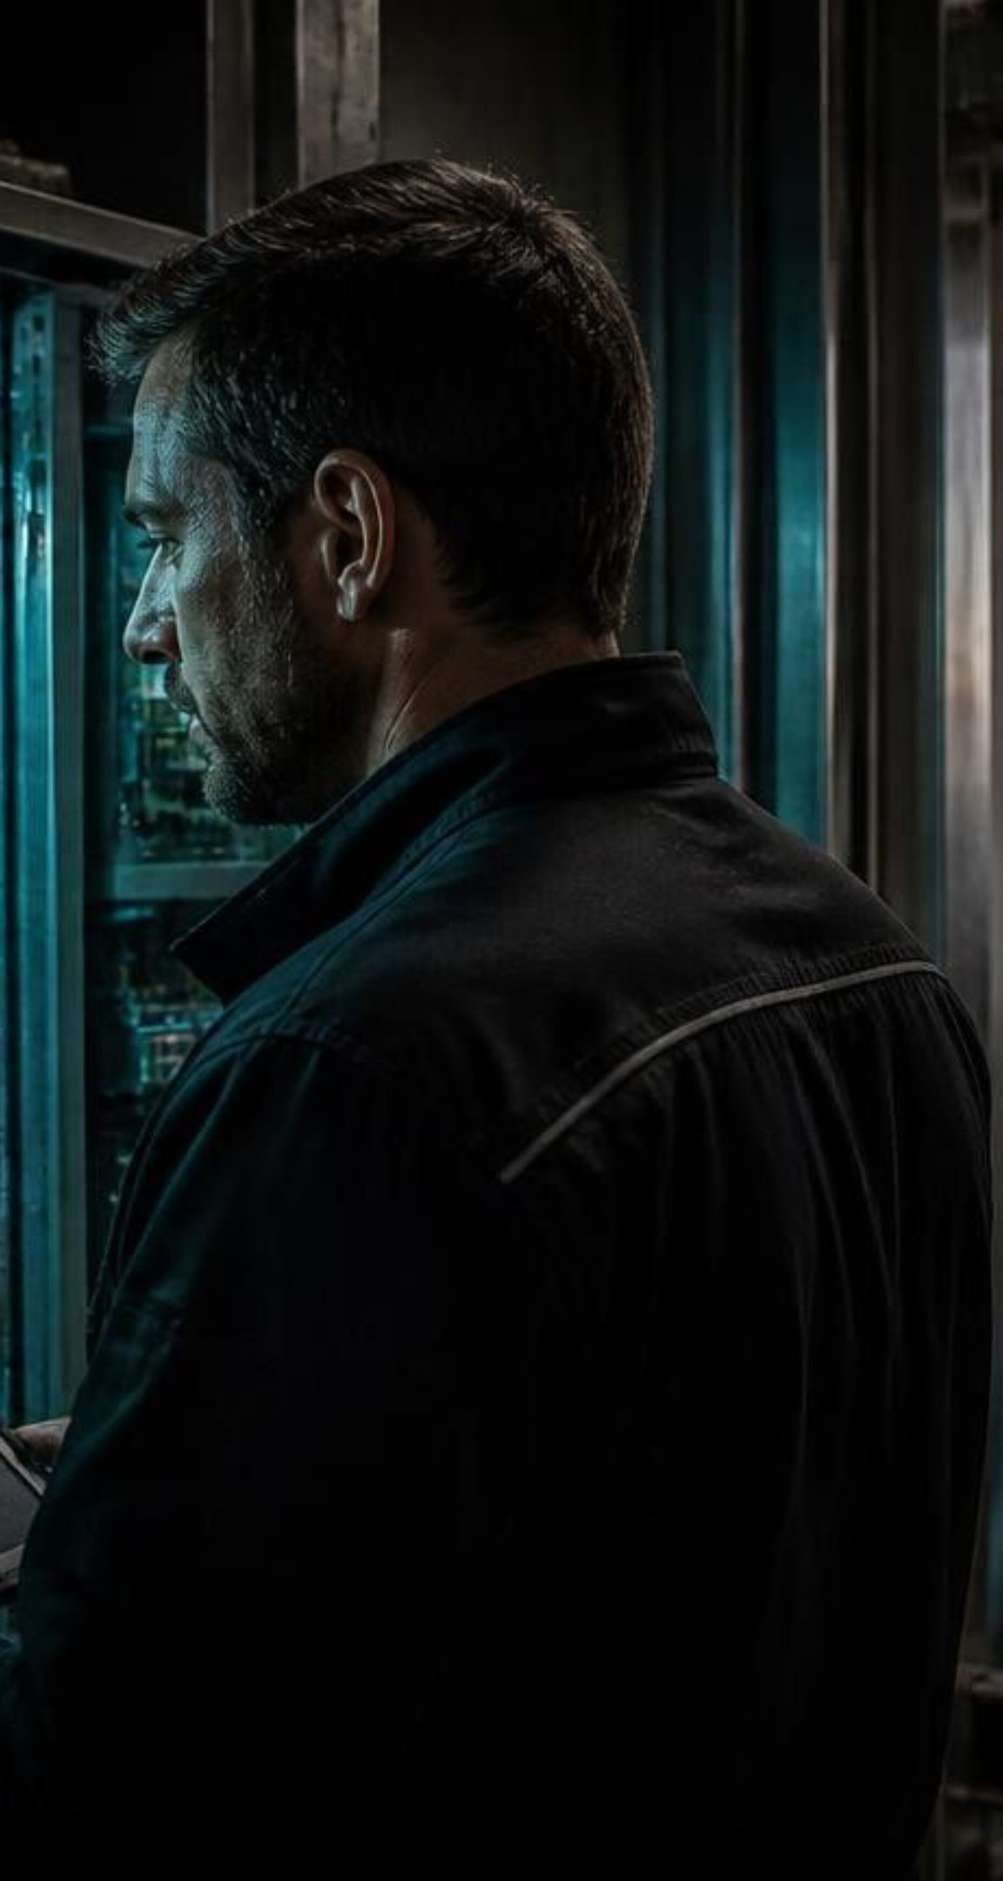
REVENUE ARCHITECTURE
Hardware kit plus $300 a year SaaS
High-margin hardware; recurring enterprise telemetry contracts.
$2,000
$300/yr
One-time Kit
Annual SaaS
Edge compute, dual wide-angle camera pods and plug-and-play relay modules.
Cloud dashboard, predictive health alerts, OTA models and hospital fleet integration.
Distribution Engine: Existing Annual Maintenance Contract (AMC) elevator partners sell, install and service for instant zero-CAC scaling.
Notes:
The unit economics work from day one: $2,000 upfront hardware pays for deployment, $300/year provides sticky high-margin ARR, and AMC channel partners handle distribution and maintenance.

Slide 9



GO-TO-MARKET
Five hospital pilots, then tech parks
PHASE 1
PHASE 2
PHASE 3
5 Hospital Pilots
Commercial Tech Parks
National AMC Scale
Validate Stretcher Priority and zero-delay critical runs across 25 total shafts.
Roll out Phantom Call reduction and peak dispatch optimization across IT corridors.
Bundle LiftMind as a default line-item upgrade across certified AMC maintenance networks.
Hospital validation creates high-urgency proof points, then high-density commercial campuses, then national scale through AMC networks.
Notes:
Summarize our rollout: hospital validation creates high-urgency proof points, followed by high-density commercial office campuses. Close with the ask and introduce the founding team.

Slide 10
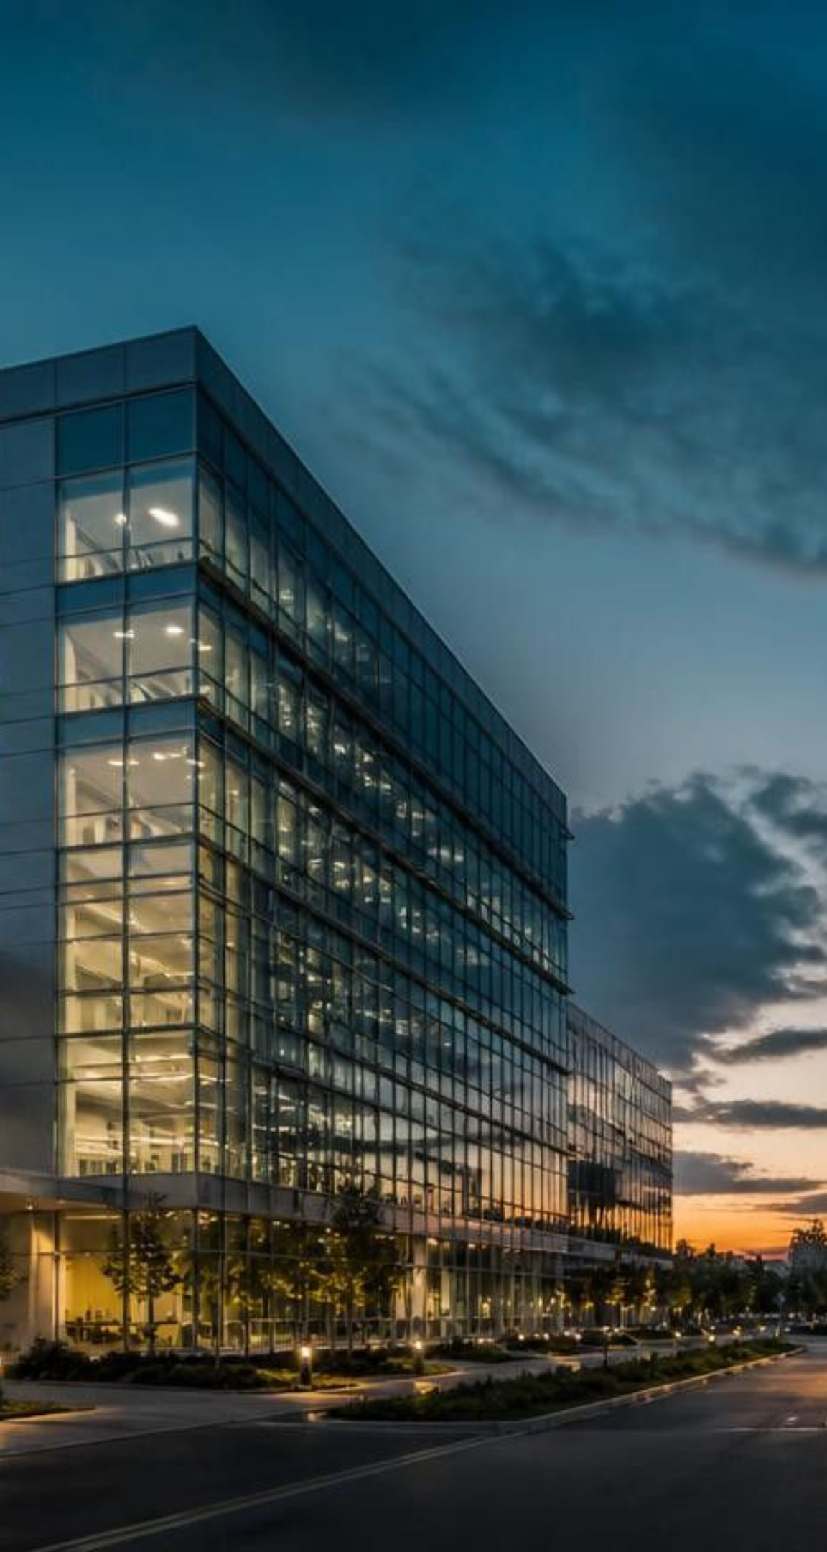

THE TEAM
We do not replace elevators; we give them a brain
FOUNDER / CEO
[ Tanmay Chaudhary ]
Product & AI Engineering
CO-FOUNDER / COO
[Yusuf Khan]
Operations & Hardware Supply
1/10th the cost of mechanical modernization · Brand-agnostic · 100% on-device privacy
Notes:
Introduce the founding team and close with the ask.

