Slide 1
HELPDESK
DevOps Capstone
PROJECT WALKTHROUGH
From application code to automated delivery and observability
React • FastAPI • PostgreSQL • Docker • GitHub Actions • Kubernetes
github.com/tanmay933/helpdesk-capstone
Tanmay Mittal | Roll No. 24BCS10491

Slide 2
01 · OVERVIEW
Project goal
Build a support-ticket application with a usable web interface and REST API.
Automate quality checks and image delivery with CI/CD.
Scan container images before publishing them.
Define AWS infrastructure as code and configure Kubernetes deployments.
Expose application and infrastructure signals through Prometheus and Grafana.
02

Slide 3
02 · SYSTEM DESIGN
End-to-end architecture
SOURCE
→
AUTOMATION
→
ARTIFACTS
→
RUNTIME
Git + GitHub
GitHub Actions
GHCR images
Kubernetes + Helm
APPLICATION
INFRASTRUCTURE
OBSERVABILITY
React frontend
FastAPI backend
PostgreSQL
Terraform
AWS VPC + EKS
Prometheus
Grafana
CI validates and packages code; Kubernetes runs workloads; monitoring makes behavior visible.
03

Slide 4
03 · IMPLEMENTATION
Technology stack
STACK 1
STACK 2
Frontend: React, Vite, Nginx
Backend: Python, FastAPI, REST APIs
STACK 3
STACK 4
Database: PostgreSQL, SQLAlchemy, Alembic
Testing: Pytest
STACK 5
STACK 6
Containers: Docker and Docker Compose
CI/CD and registry: GitHub Actions and GHCR
STACK 7
STACK 8
Security: Trivy
Infrastructure and orchestration: Terraform, AWS, Kubernetes, Helm, Ingress
STACK 9
Observability: Prometheus and Grafana
04

Slide 5
04 · QUALITY GATES
Application and testing
FRONTEND
BACKEND
DATABASE
React + Vite
Ticket management UI
FastAPI REST endpoints
Health / readiness /metrics
PostgreSQL
SQLAlchemy + Alembic
Recorded test evidence: 9 tests passed
PYTHONPATH=backend pytest -v
05

Slide 6
05 · DELIVERY
CI/CD and DevSecOps
TEST
BUILD
SCAN
PUBLISH
Pytest + frontend build
→
Container images
→
Trivy
→
SHA-tagged GHCR images
GitHub Actions runs automated validation and builds the frontend and backend images.
Trivy scans both images for configured HIGH and CRITICAL vulnerabilities.
The workflow is configured to fail when findings meet the defined policy.
Commit-SHA tags improve traceability between source code and published images.
06

Slide 7
06 · TERRAFORM + AWS
Infrastructure as Code
Terraform defines the cloud infrastructure in version-controlled HCL.
Resources included a VPC, subnets, NAT gateway, EKS cluster, and managed node group.
The workflow used init, plan, apply, verification, and destroy.
Cost-control note: AWS resources were destroyed after verification.
AWS screenshots are historical evidence, not a claim that the infrastructure is currently running.
07

Slide 8
07 · WORKLOAD ORCHESTRATION
Kubernetes and Helm
Deployments declare desired replicas and rollout behavior.
Services provide stable network endpoints; Ingress can route HTTP traffic.
Helm packages Kubernetes templates and values into repeatable releases.
Health and readiness checks answer different questions.
Screenshots show captured evidence and should not be interpreted as proof of current cluster health.
08

Slide 9
08 · PROMETHEUS + GRAFANA
Observability
Prometheus scrapes configured targets and stores time-series metrics.
The backend exposes a Prometheus-formatted /metrics endpoint.
Grafana turns metrics into dashboards for inspecting cluster and application behavior.
Useful signals include request volume, latency, errors, CPU, and pod resources.
A target marked UP means it was scrapeable at the time shown.
09

Slide 10
09 · WRAP-UP
Evidence and key takeaways
Repository: github.com/tanmay933/helpdesk-capstone
Evidence includes the application/API, tests, CI pipeline, GHCR, Trivy, Kubernetes/Helm, Prometheus/Grafana, and historical AWS screenshots.
The README documents architecture, setup, endpoints, implementation, and evidence.
The rubric's live-demo goal is to show a code change, pipeline run, and deployment update when the environment is available.
Thank you.
10

Slide 11
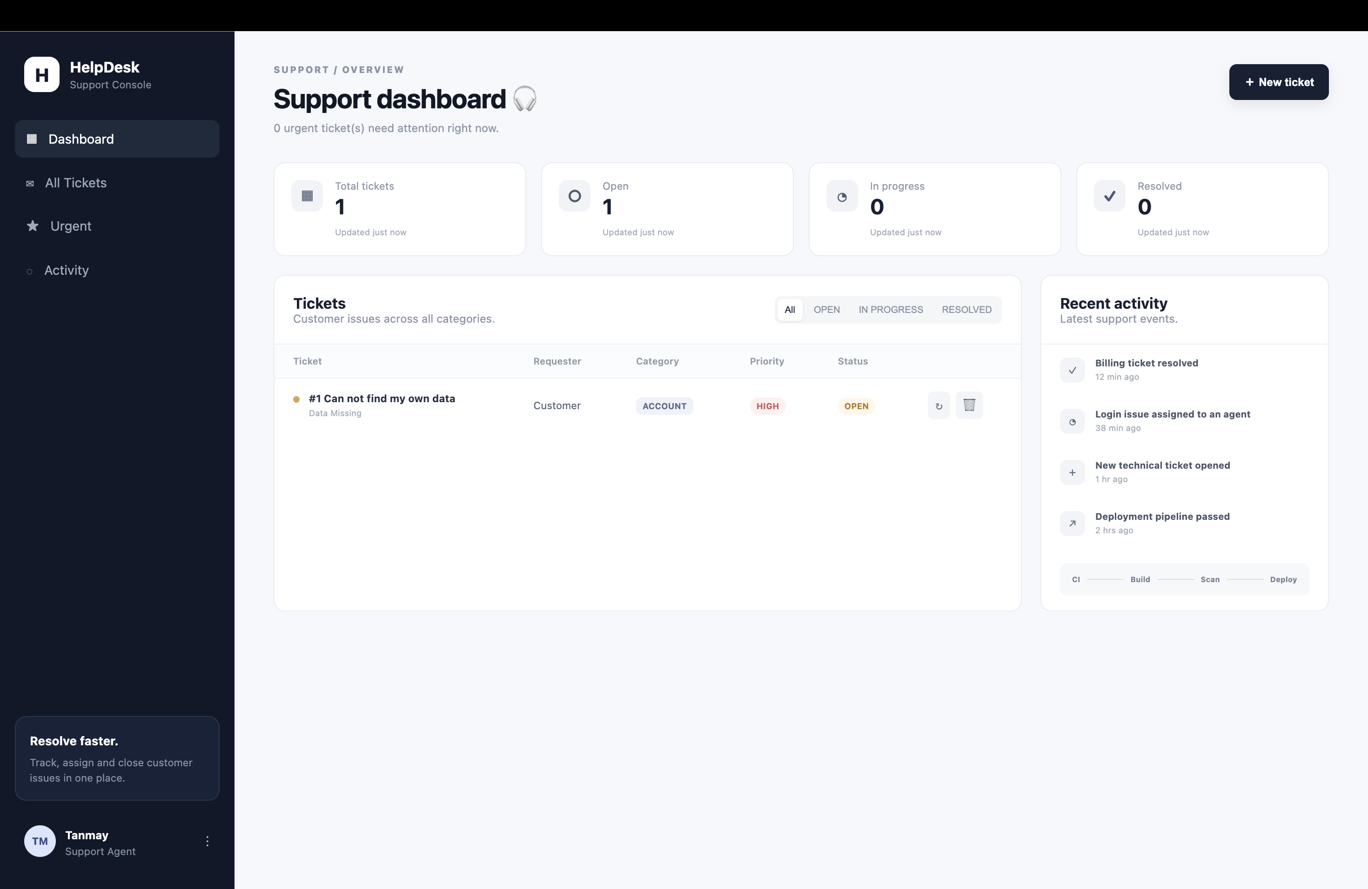
EVIDENCE · APPLICATION
Application UI
The HelpDesk interface running in the browser.
11

Slide 12
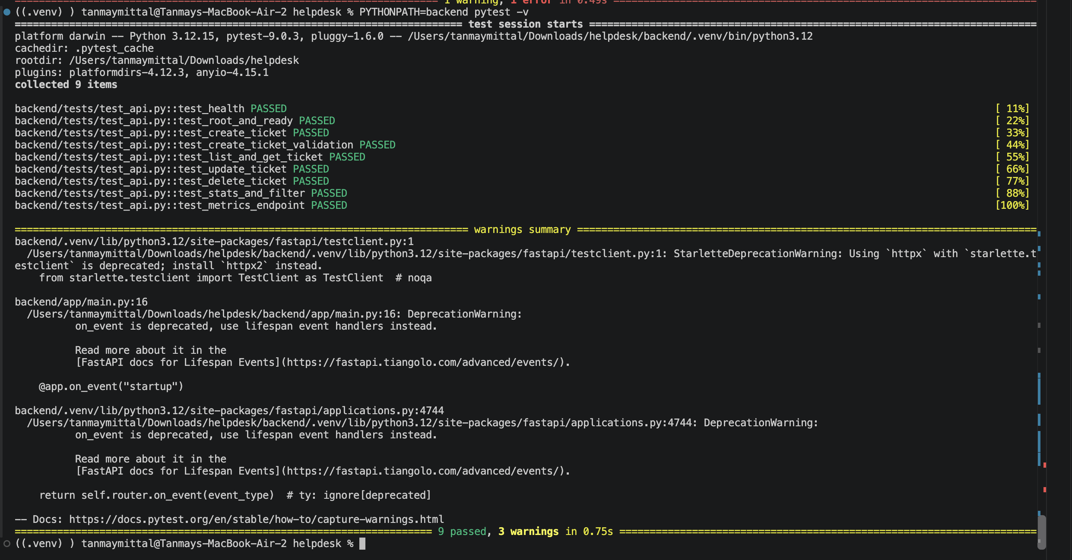
EVIDENCE · TESTING
Automated tests
Recorded test output: 9 tests passed.
13

Slide 13
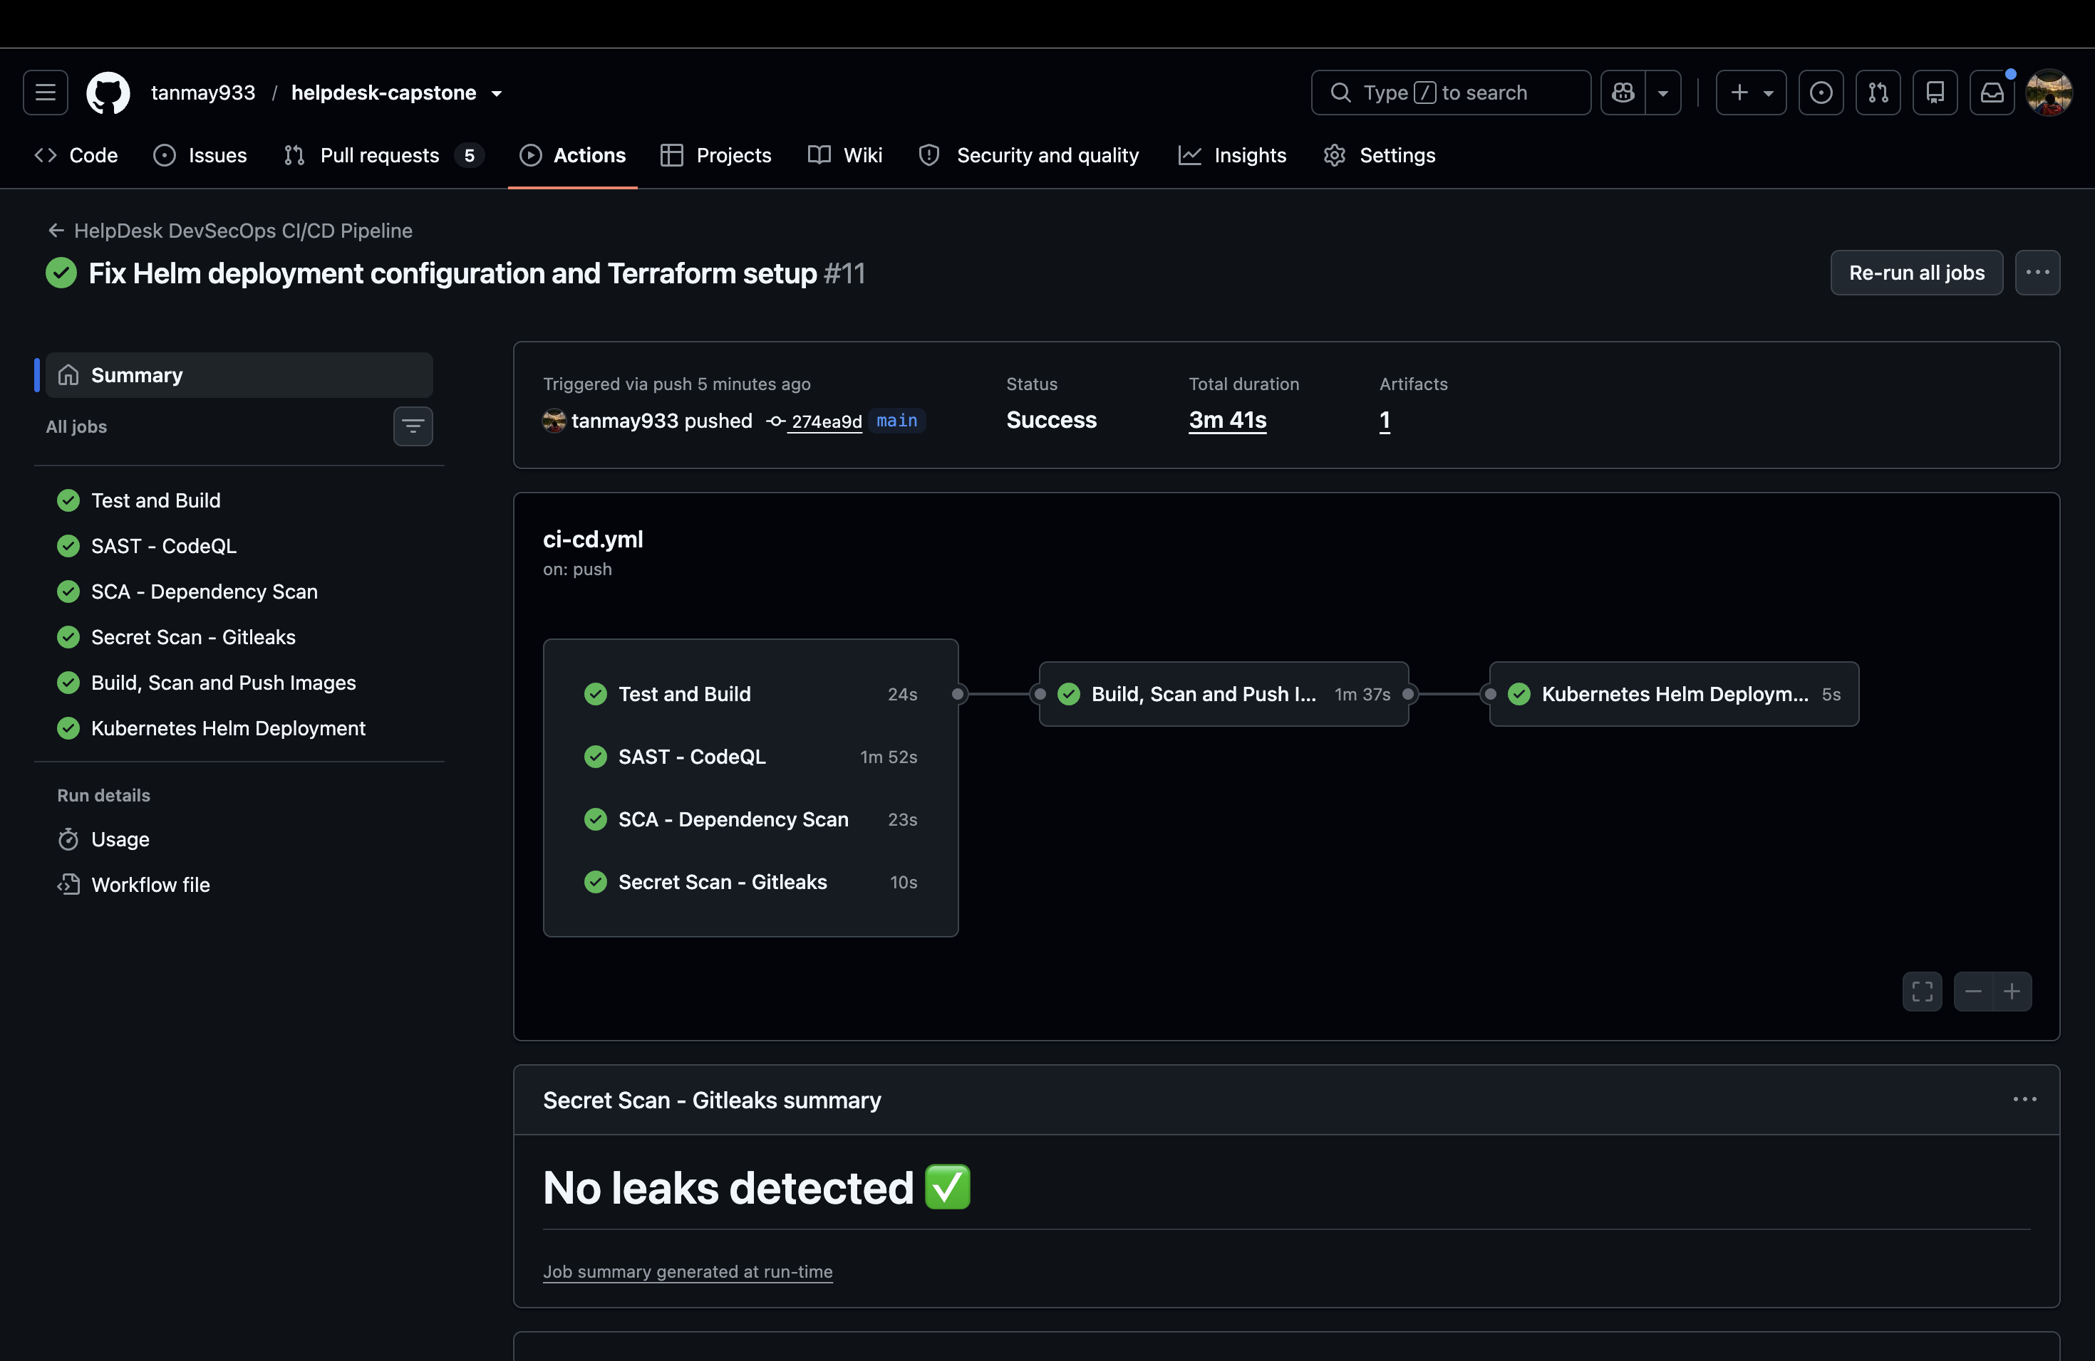
EVIDENCE · CI/CD
GitHub Actions pipeline
Successful workflow run showing automated project checks.
14

Slide 14
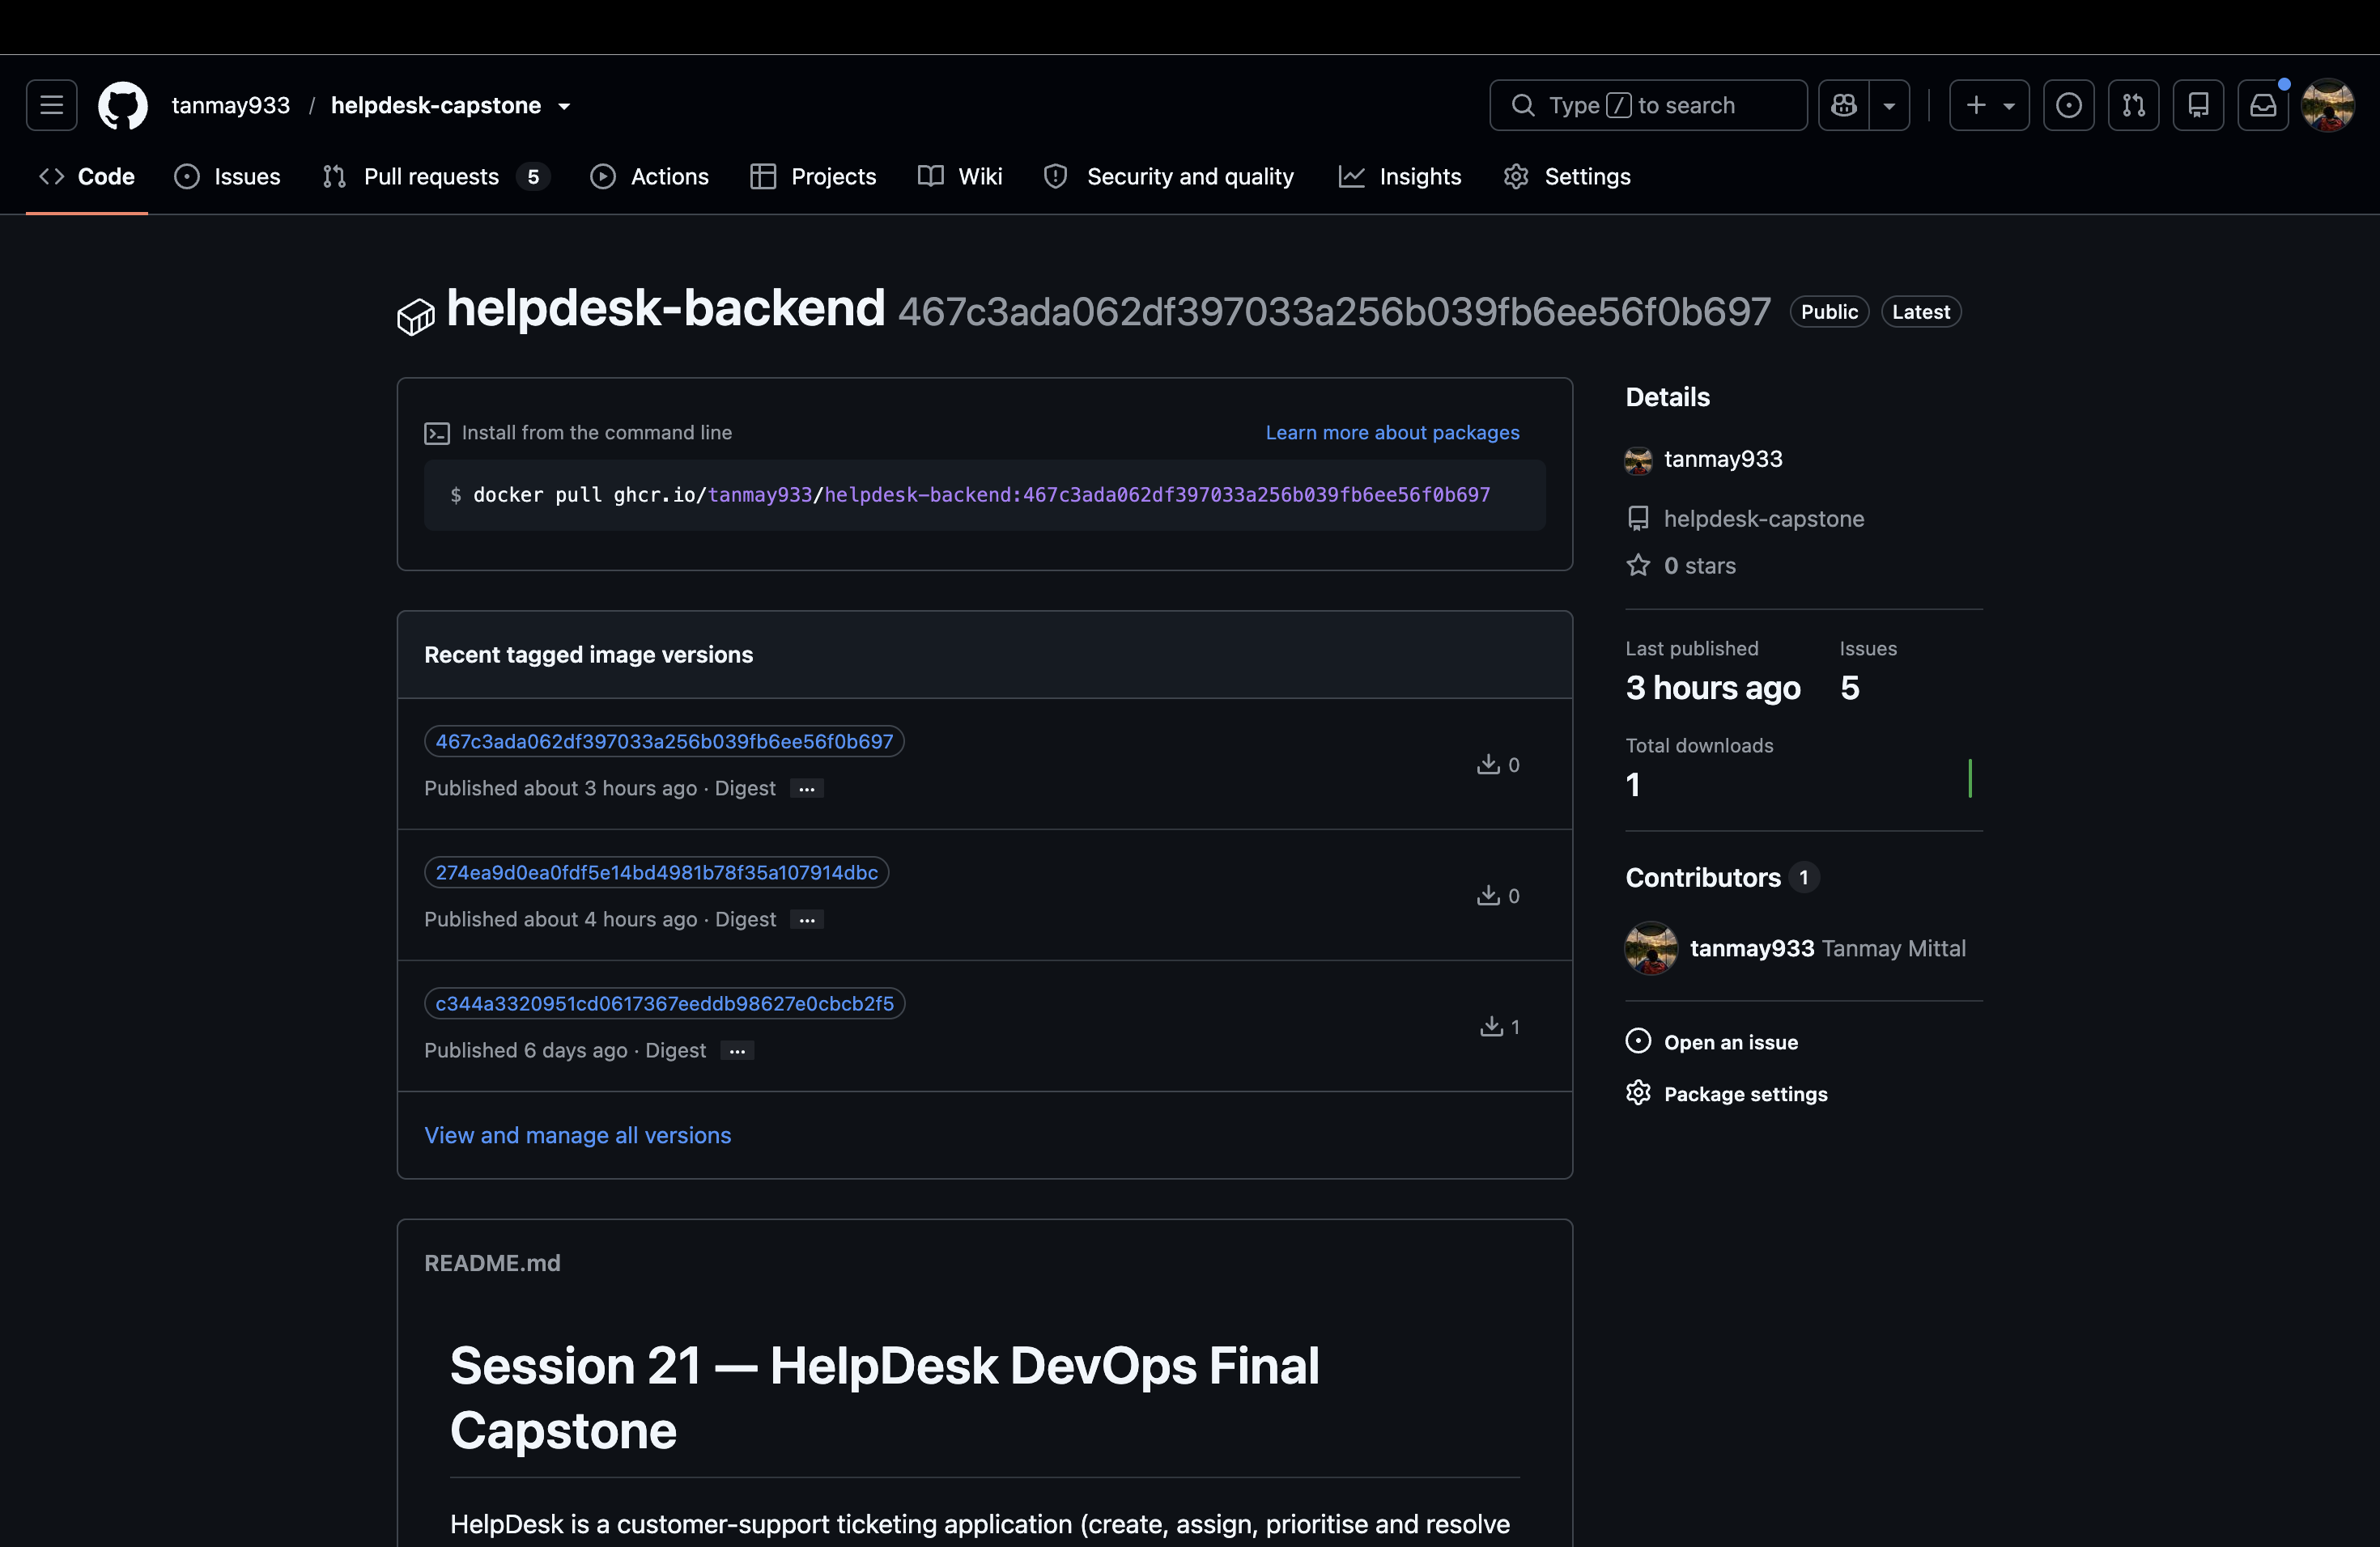
EVIDENCE · CONTAINER REGISTRY
GHCR backend image
Backend container image published to GitHub Container Registry.
15

Slide 15
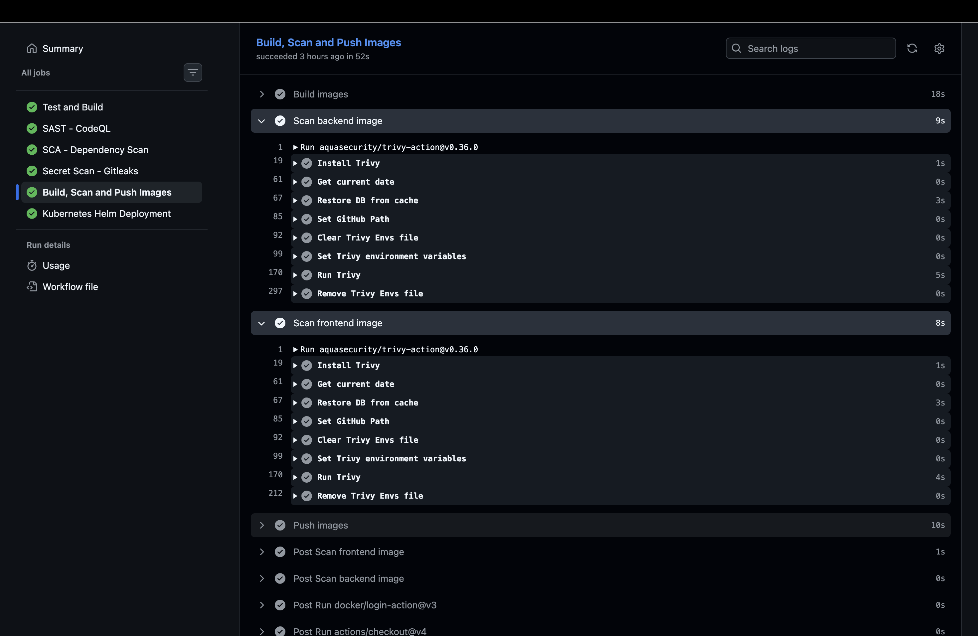
EVIDENCE · DEVSECOPS
Trivy scan
Container vulnerability scan evidence from the recorded workflow.
16

Slide 16
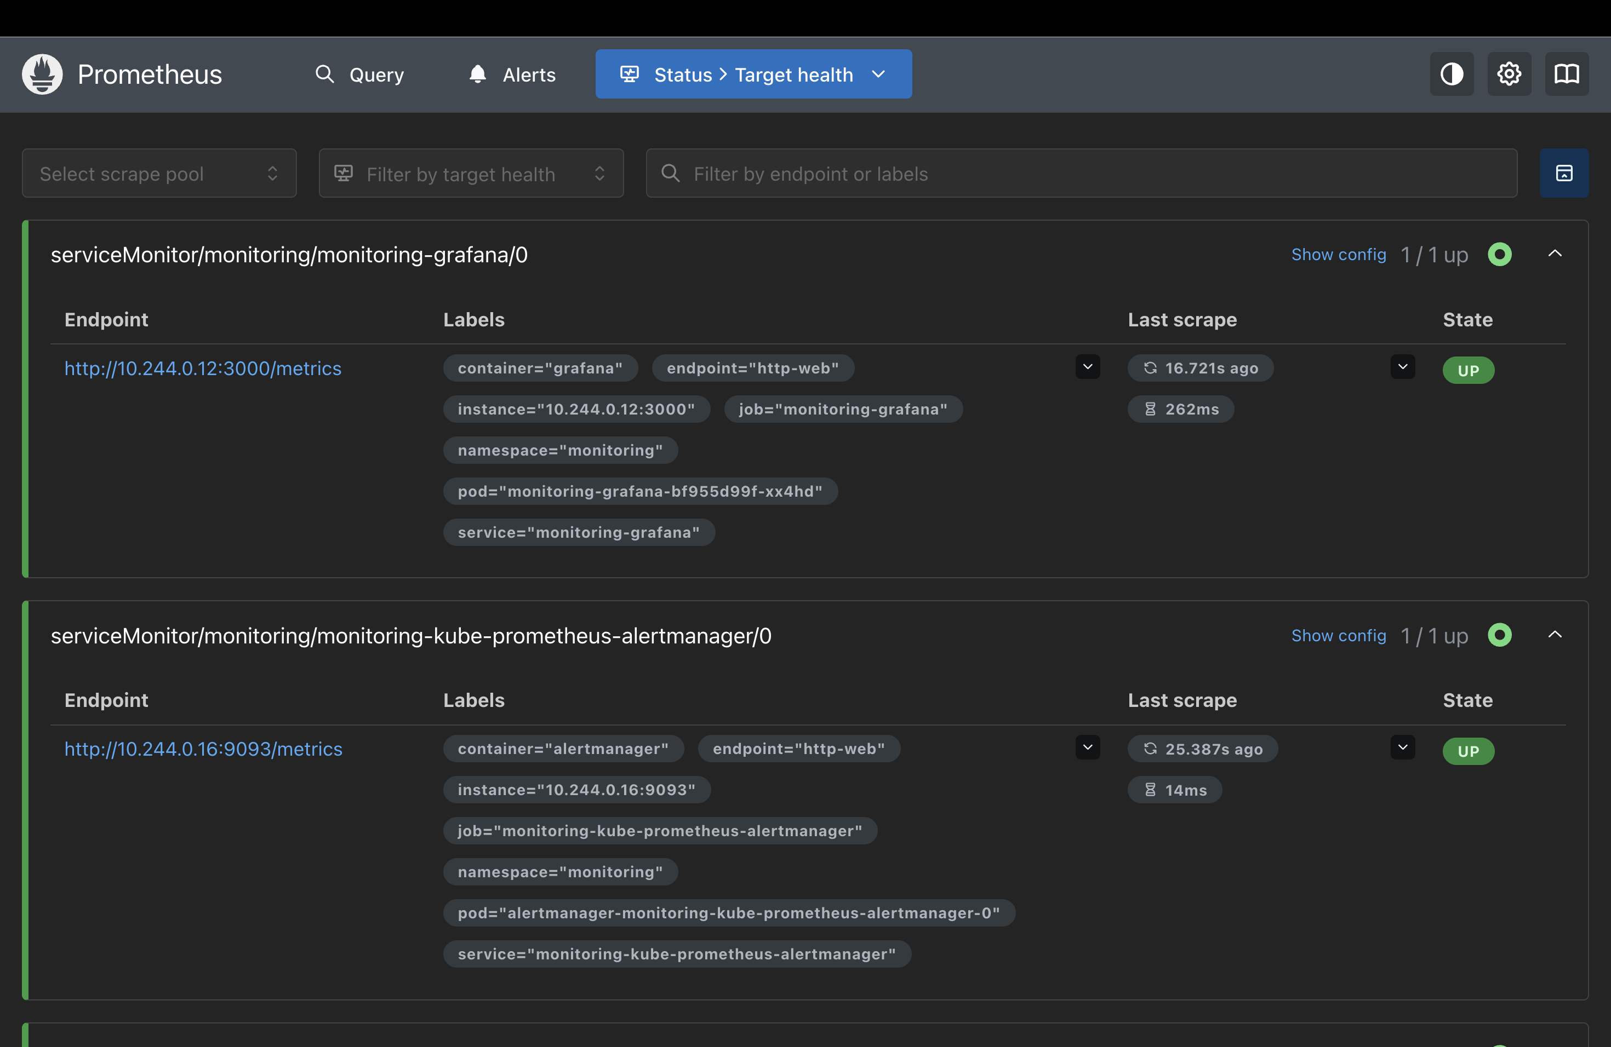
EVIDENCE · OBSERVABILITY
Prometheus targets
Target status at the time of capture.
19

Slide 17
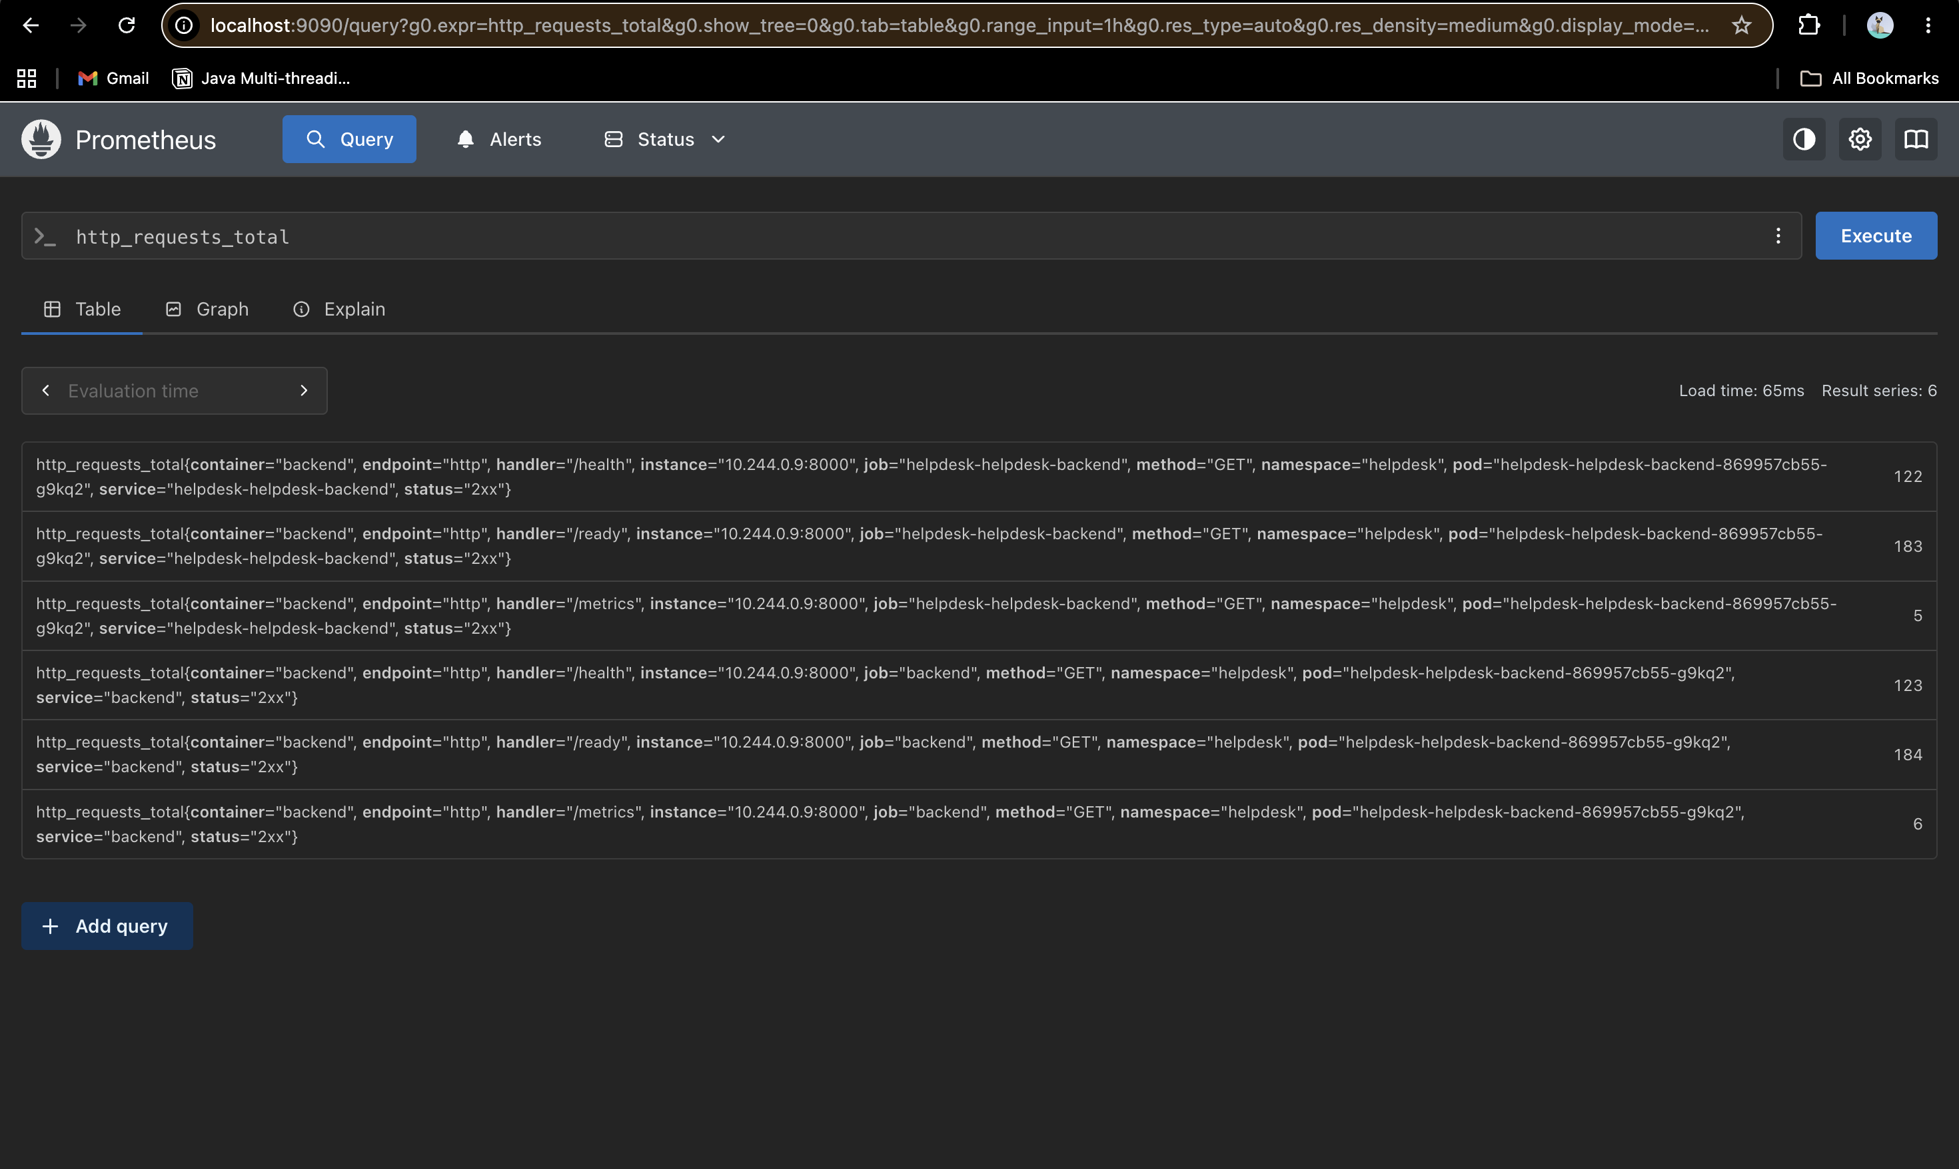
EVIDENCE · OBSERVABILITY
Prometheus application metrics
HelpDesk application metrics collected by Prometheus.
20

Slide 18
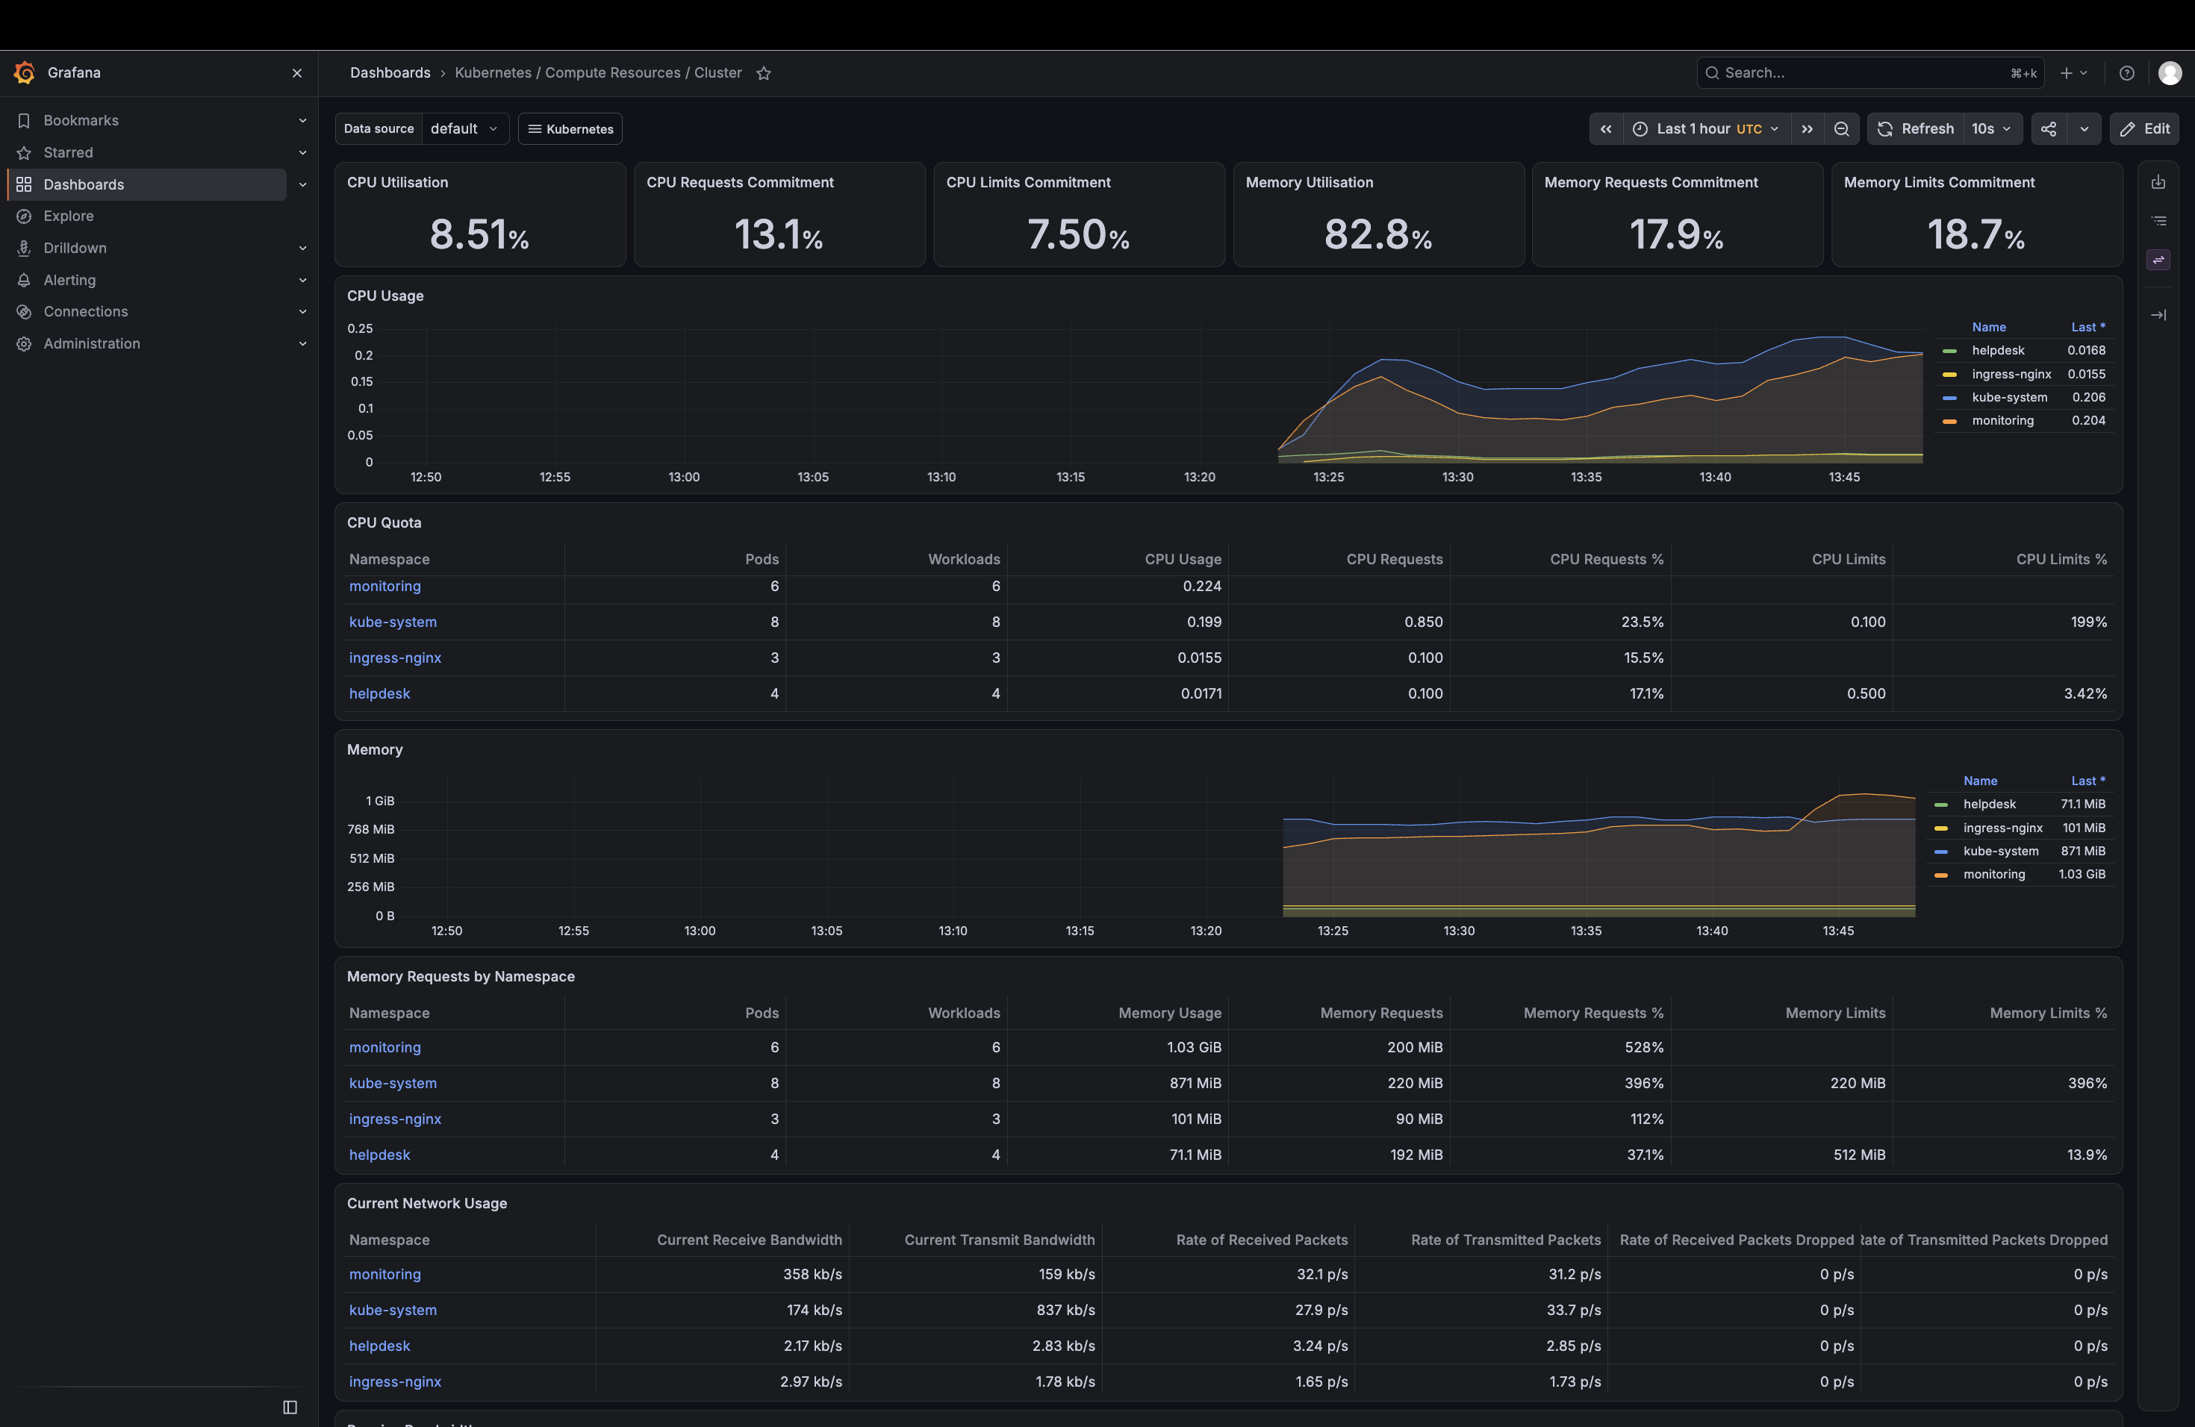
EVIDENCE · OBSERVABILITY
Grafana cluster dashboard
Grafana dashboard for cluster resource monitoring.
21

Slide 19
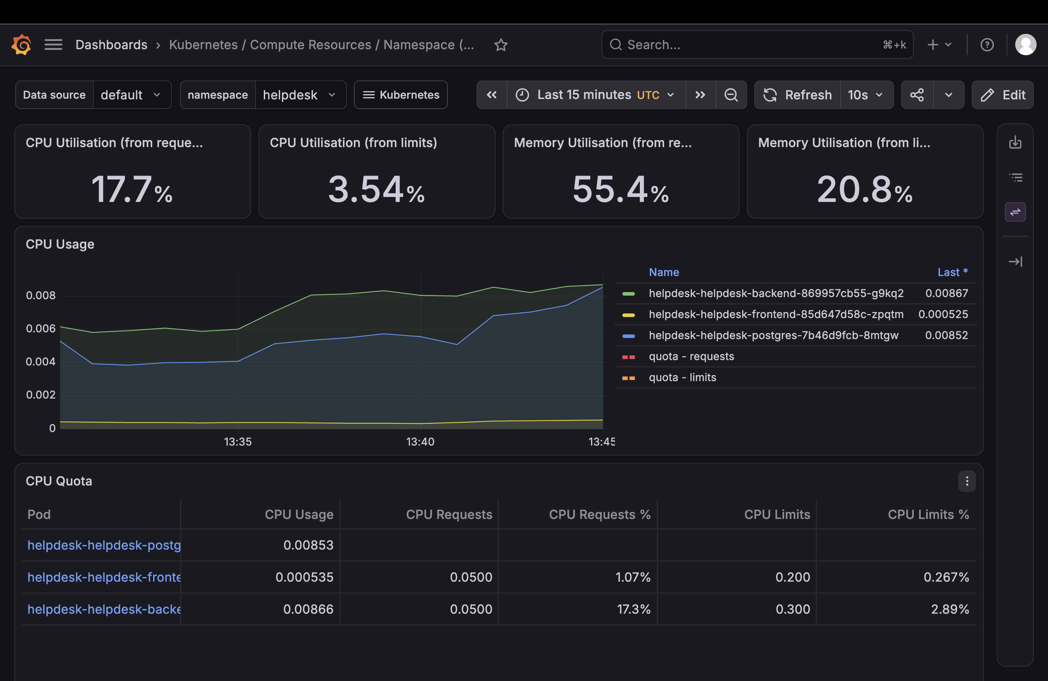
EVIDENCE · OBSERVABILITY
Grafana pod resources
Grafana dashboard focused on HelpDesk pod resources.
22

