Slide 1
🏆 iQOO HACKATHON 2026 • OPEN INNOVATION TRACK
Pune Tree Rakshak
Phone-First Civic Accountability & Urban Forest Preservation Platform
⚠️ The Problem: Broken Evidence & Ghost Closures
🌿 The Solution: Closed-Loop Statutory Platform
• 4.09M+ Pune Trees: Facing rampant illegal felling, concrete choking & decay.
• Vague Complaints: Citizens submit un-timestamped photos with no statutory basis.
• "Paper Closures": Municipal portals close tickets without physical ground action.
• Queue Flooding: Non-tree spam and indoor photos clog municipal response teams.
• 7 Statutory Categories: Grounded in Maharashtra Tree Act 1975.
• Hardware Sensor Telemetry: Measures tree tilt angle with device accelerometer.
• 3-Layer Forensic Standard: Multi-angle capture with AI Anti-Spam Gate.
• PMC 4.09M Tree Census GIS: Attaches official municipal tree records.
• Zero-Trust Re-Audit: Timelock verification + Municipal Commissioner escalation.
📱 LIVE DEMO: Show App Launch / Grievance Tracker on your phone. Introduce problem & vision in 30s.
iQOO Hackathon 2026 • Pune City Battle | Pune Tree Rakshak
Slide 1 of 7

Slide 2
LIVE DEMO • STEP 1
Intelligent Civic Triage & Sensor Telemetry
App Screen: Category Selection & Real-Time Accelerometer Grounding
🌳 7 Statutory Categories
📐 Hardware Sensor Telemetry
📍 Automated Ward Routing
1. Hazardous Leaning Tree (Fall Risk)
2. Illegal Felling (Active / Fresh Stump)
3. Heavy Unauthorized Pruning
4. Snapped / Hanging Broken Limbs
5. Root Concretization (NGT Basin)
6. Disease, Rot & Pest Infestation
7. Tree Vandalism (Nails, Boards, Wires)
Physics Over Guesswork:
• Device accelerometer samples physical tilt angle relative to true gravity vector.
• Embeds mathematically verified tilt degrees (e.g., 23.4° tilt) directly into legal prayer.
• Section 7(b) Trigger: Proves imminent structural collapse threat.
⚖️ Gives officers hard physical sensor evidence.
Zero Guesswork for Citizens:
• Android Geocoder resolves exact landmark, street name, and postal PIN code.
• Backend spatial engine maps GPS coords to PMC 15 Administrative Wards.
• Kharadi / Viman Nagar coordinates automatically target Nagar Road - Vadgaon Sheri Ward Office.
🏛️ Targets the exact responsible Tree Officer.
📱 LIVE DEMO: Tap "New Grievance" -> Select "Dangerous Leaning Tree" -> Physically tilt phone to show live sensor readout.
iQOO Hackathon 2026 • Pune City Battle | Pune Tree Rakshak
Slide 2 of 7

Slide 3
LIVE DEMO • STEP 2
3-Layer Forensic Evidence Standard & AI Anti-Spam
App Screen: CameraX Multi-Angle Guidance & Pre-Submission Quality Gate
🛡️ AI Anti-Spam Quality Gate & Municipal Quota Protection
Computer vision inspects photo before submission. Non-tree content (screens, keyboards, desks, selfies) is rejected instantly with a 3-hour cooldown — shielding municipal officers and LLM compute from civic junk.
Layer 1 (Locus Context)
Layer 2 (Structural Frame)
Layer 3 (Forensic Macro)
Wide Street Perspective
Tree Architecture & Lean
Microscopic Damage Proof
Captures the tree in its overall streetscape: footpath, roadway, adjacent building, and landmark.
🛡️ Eliminates the #1 municipal dismissal: "Not on municipal land / wrong jurisdiction."
Mid-range shot showing trunk-to-crown architecture, lean trajectory relative to vertical reference, and pedestrian strike danger zone.
🛡️ Establishes structural severity & collapse hazard.
Close-up macro of exact damage: fresh chainsaw tooth marks, iron nails in cambium bark, root concrete choke, or decay.
🛡️ Incontrovertible forensic proof for legal prosecution.
📱 LIVE DEMO: Show the 3-Layer CameraX overlay and take the 3 required photos.
iQOO Hackathon 2026 • Pune City Battle | Pune Tree Rakshak
Slide 3 of 7

Slide 4
LIVE DEMO • STEP 3
Hybrid Dual-Engine AI + PMC 4.09M Tree Census GIS
App Screen: Photo Preview & Dual Triage Options (On-Device Edge vs Cloud)
⚡ Hybrid Edge-to-Cloud AI Architecture
🗺️ Government GIS Tree Census Match (4.09M Trees)
1. On-Device Edge AI (Flagship Hardware / iQOO 15):
• Local Gemma 3n execution via MediaPipe / LiteRT
• 100% Offline: Zero latency in low-connectivity zones
• Edge Privacy: Photos remain on-device; zero cloud API cost
2. Cloud Multimodal AI (High-Precision Vision):
• Google Gemini 3.6 Flash / Qwen 3 Multimodal via OpenRouter
• Deep arboricultural morphology, rot assessment & statutory drafting
• Deterministic fallback guarantees response within 5 seconds
Real Municipal Record Verification:
• Live spatial query against PMC official 4.09 Million Tree Census dataset within 10 meters.
• Automatically extracts & binds official municipal data:
- Government Census Tree Tag ID (e.g. #140285)
- Botanical species (Azadirachta indica / Samanea saman)
- Registered trunk girth & historic condition
⚖️ Municipal officers cannot claim the tree is private or unregistered.
📱 LIVE DEMO: Show Preview Screen -> Point out "On-Device AI" vs "Cloud AI" buttons -> Tap "Cloud AI" to run live analysis.
iQOO Hackathon 2026 • Pune City Battle | Pune Tree Rakshak
Slide 4 of 7

Slide 5
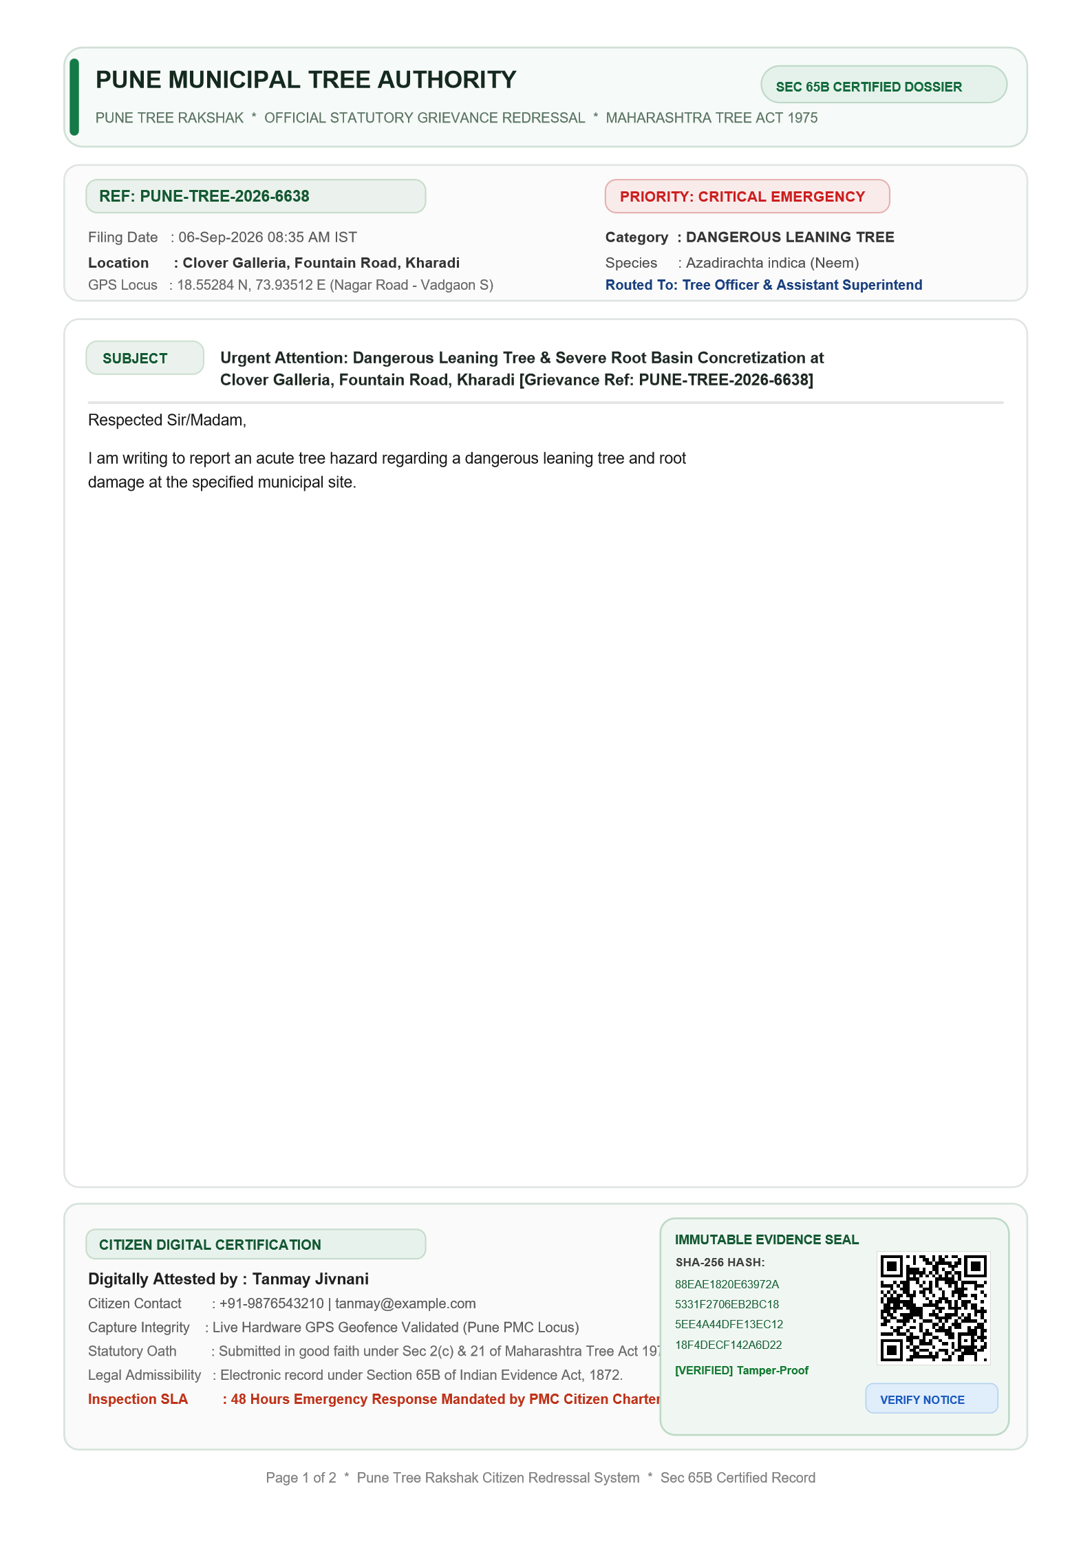
LIVE DEMO • STEP 4
Deterministic Statutory Matrix & Sealed PDF Notice
App Screen: Legal Notice Review, Court-Grade Sealed PDF & Multi-Channel Dispatch
⚖️ Zero-Hallucination Statutory Routing Matrix
📄 Court-Grade Sealed PDF Notice
Hardcoded statutory citations under Maharashtra Tree Act 1975 & NGT orders:
• Active Illegal Felling: Section 21 cognizable offence → Routed to Pune Police (112) + Tree Authority.
• Dangerous Leaning Tree: Section 7(b) public safety mandate → Routed to PMC Disaster Cell (24h SLA).
• Root Concretization: NGT Directives for mandatory 1-meter unpaved green basin → PMC Road Dept.
• Tree Vandalism (Nails/Wires): High Court anti-nail orders → PMC Garden Dept (Tree Ambulance).
📱 LIVE DEMO: Show the generated statutory draft on phone -> Tap to preview the court-grade sealed PDF notice.
iQOO Hackathon 2026 • Pune City Battle | Pune Tree Rakshak
Slide 5 of 7

Slide 6
LIVE DEMO • STEP 5
Zero-Trust Ground Re-Audit & Escalation
App Screen: Reverification Screen, Timelock Status & One-Tap Escalation
⏱️ Ending "Closed on Paper" Resolutions
🚨 One-Tap Commissioner Escalation
The Core Civic Flaw Solved:
Municipal contractors routinely close tickets without touching a shovel.
Our Zero-Trust Re-Audit Architecture:
• Statutory Timelock: Starts 24h, 48h, or 72h countdown based on statutory urgency.
• Mandatory Ground Re-Photography: Ticket cannot be closed without citizen after-action photos.
• Vision AI Re-Audit: Compares before-and-after photos to verify whether the concrete was excavated or if the tree was illegally chopped.
Hierarchical Municipal Accountability:
• If the statutory timelock expires without ground remediation:
App unlocks the RED Escalation Action.
• Dispatched Directly To:
- Municipal Commissioner, PMC
- Additional Municipal Commissioner (Gardens)
- Superintendent of Gardens & Tree Officer
💥 Cites administrative dereliction of statutory duty under Section 7 of Maharashtra Tree Act.
📱 LIVE DEMO: Show Reverification Screen on phone -> Highlight active timelock countdown and the Red Escalation button.
iQOO Hackathon 2026 • Pune City Battle | Pune Tree Rakshak
Slide 6 of 7

Slide 7
PITCH SUMMARY
Production-Ready Civic Impact for Pune City
Why Pune Tree Rakshak Wins the Open Innovation Track
📱 Flagship Mobile Tech
⚖️ 100% Statutorily Grounded
Native Kotlin + Jetpack Compose with CameraX and on-device MediaPipe/LiteRT inference — optimized for iQOO 15 hardware.
Deterministic legal matrix encoding the Maharashtra Tree Act 1975, NGT 1m breathing basin mandates, and High Court orders.
🗺️ 4.09M Tree Census GIS
🔄 Zero-Trust Re-Audit
Real-time spatial correlation against PMC 4.09M tree dataset, connecting citizen photos to official municipal tree IDs.
Guarantees physical follow-through. Ends ghost ticket closures via timelocks, AI re-audit vision, and direct Commissioner escalation.
🌿 Production-grade & ready for immediate ward rollout across all 15 PMC Administrative Wards in Pune.
📱 LIVE DEMO: Show Home Screen with completed audit trail. Conclude with vision for Pune’s green canopy.
iQOO Hackathon 2026 • Pune City Battle | Pune Tree Rakshak
Slide 7 of 7

