Slide 1
ONLINE MEDICINE STORE (Medicure)
By
Tanumoy Das (18871022052)
Sonia Dey (18871022056)
Tanmay Samanta(18871022060)
Bishal Roy (18871022059)

Slide 2
ABSTRACT:
An online pharmacy is a pharmacy that operates over the Internet and sends orders to customers via courier. It provides a platform for customers to purchase medicinal drugs, allowing the customer to receive wide range of medicines/services from the comfort of their homes within a short time.
Our web application helps user view details of the medicines without going anywhere.
WHY HAVE WE CHOSEN THIS PROJECT TOPIC?
We aim to provide affordable medicines to the masses. According to us, healthcare is a basic necessity and should be in everyone’s reach and thus we developed this platform to deliver wide range of medicines to the customers.

Slide 3
MAIN OBJECTIVE OF THE APPLICATION:
The project is on developing an online medical shop website. The objectives of the website are to provide an easy to use interface for customers to search for medicines, view product details, and order products for home delivery. It also allows customers to query about medicines. It also has following objectives: To provide searching facilities on the basis of various factors like price. To manage the user details for analyzing sales and expenses. To keep track and manage all information.

Slide 4
Feasibility Study:
Feasibility study is made to see if the project on completion will serve the purpose the organization for the amount of work. Effort and the time that spend on it. Feasibility study lets the developer foresee the future of the project and the usefulness. A feasibility study of a system proposal is according to its workability, which is the impact on the organization, ability to meet their user needs and effective use of resources.
There are three types of feasibility study such as
Technical feasibility: Technical capability of the projected technologies and the capabilities of the personnel to be employed in the project are considered. In certain examples especially when projects are in third world countries, technology transfer between cultures and geographical areas should be analyzed.
Economic feasibility: Economic feasibility refers to the feasibility of the considered project to produce economic benefits. A benefit-cost analysis is needed. Furthermore, the economic feasibility of a project can also be evaluated by a breakeven analysis.
Operational feasibility: Operational feasibility is dependent on human resources available for the project and involves projecting whether the system will be used if it is developed and implemented.

Slide 5
SYSTEM REQUIREMENT SPECIFICATION:
Functionality:
Adding Products: It adds/edits the product and product details to the site.
Checking product availability: It always checks product’s availability.
Add category: It adds/edits the categories to the site.
Placing Order: It is used to place an order as per the user’s requirements.
Making Payment: It is used to make payments for the order placed.
Search for product: It is used to search for the required products.
ADVANTAGE OF THE PROJECT:
Provides the searching facilities based on various factors, such as category, price, availability.
It stores all the details of the medicines, so the customers can take an informed decision.
Customers can cancel the order and initiate return of their orders.

Slide 6
Non-functional requirements-
Usability Requirement: The system allows the users to access the system from any browsers, no special training is required. The system is written in simple English.
Availability Requirement: The system is available all the users and can be used 24 hours a day and 365 days a year. The system shall be operational 24 hours a day and 7 days a week.
Accuracy: The system should accurately provide real time information taking into consideration various issues. The system shall provide 100% access reliability.
Performance Requirement: The information is refreshed at regular intervals depending upon whether some updates have occurred or not. The system shall respond the member in less than 2 seconds.
Security Requirement: System will use a secured database and the system will have different users and each user has different types of constraints. Only admin have the rights to update database information of other users.
Reliability Requirement: The system has to be 100% reliable due to the importance of data and the damages that can be caused by incorrect data. The system will run 7 days a week and 24 hours a day

Slide 7
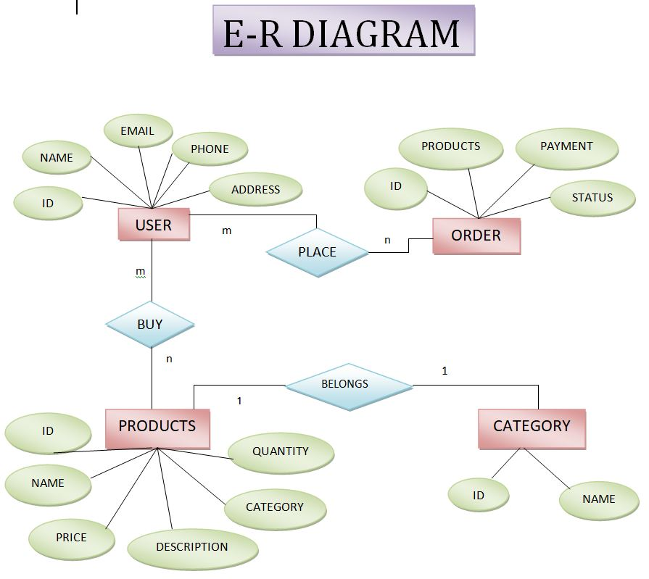
ER-DIAGRAM

Slide 8
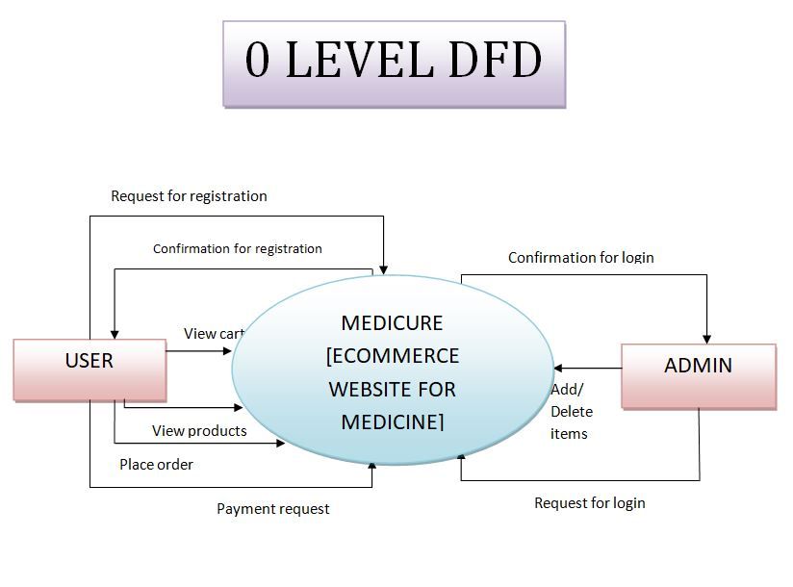
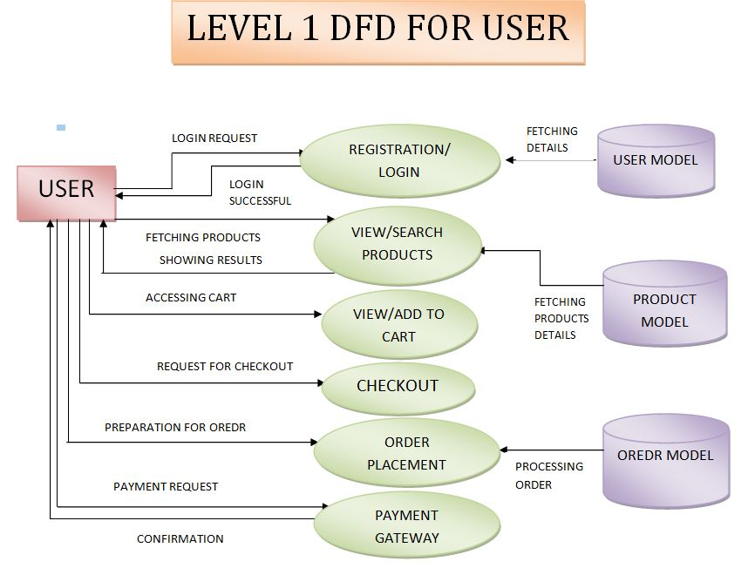
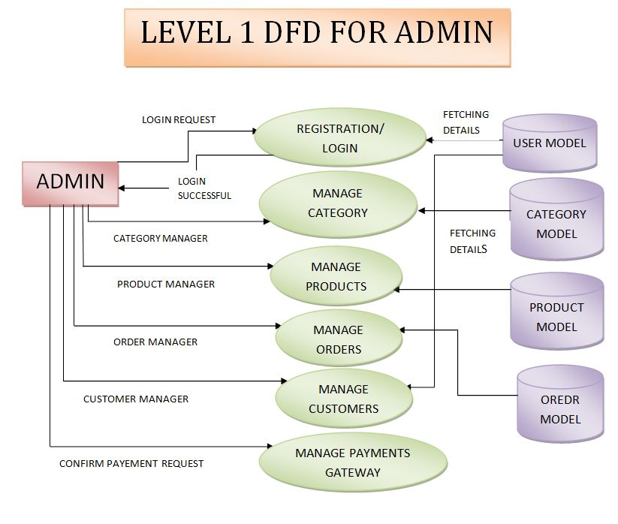
DATA FLOW DIAGRAM

Slide 9
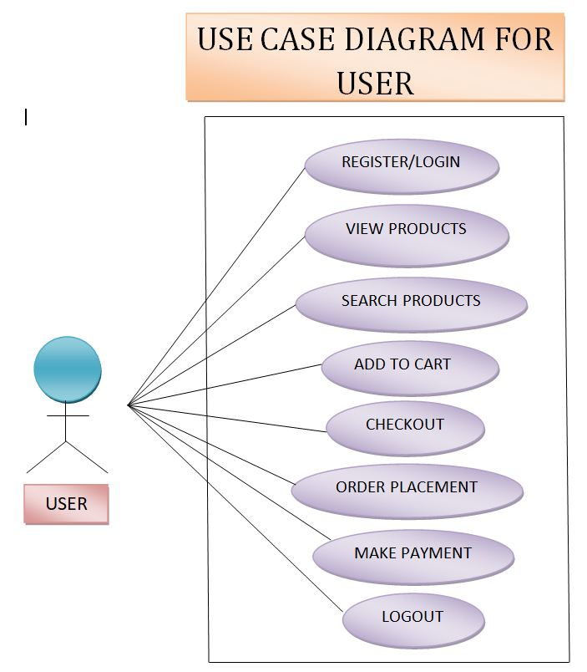
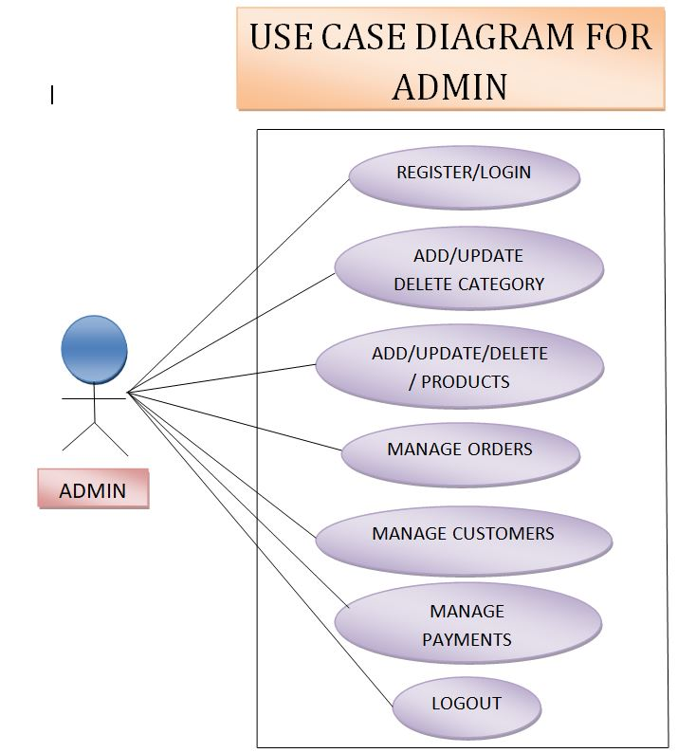
USE CASE DIAGRAM

Slide 10
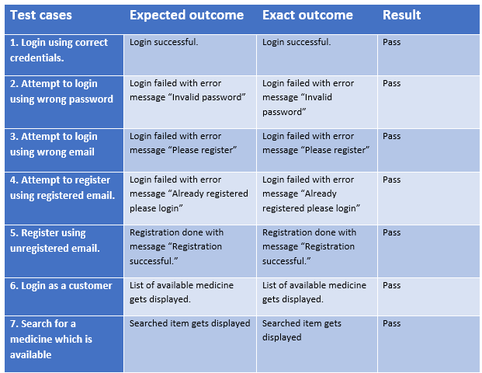
TESTING STRATEGIES AND TEST RESULTS:

Slide 11
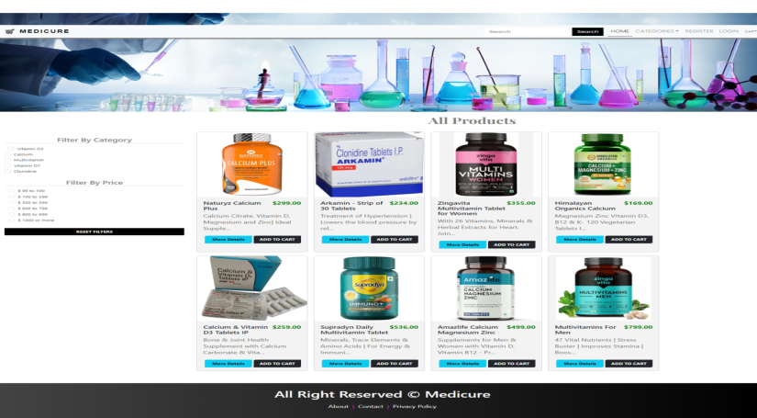
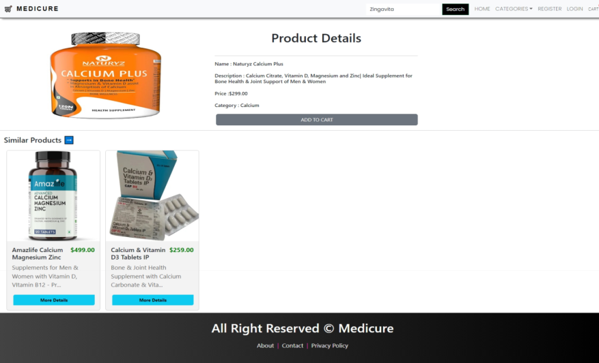
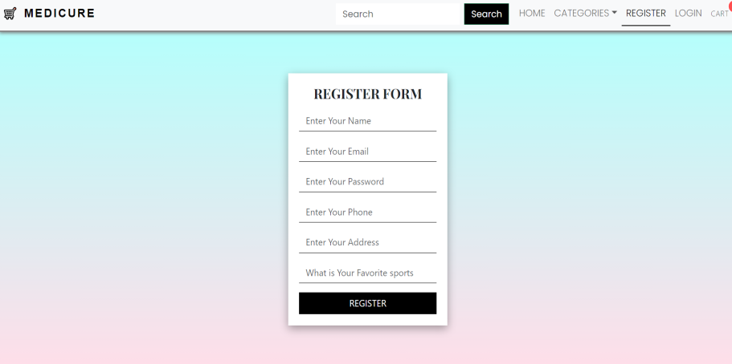
USER MANUAL:
This is our Home page.
It is our product details page
This is our registration form page.

Slide 12
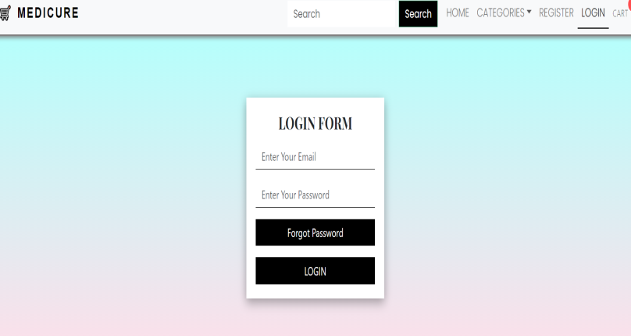
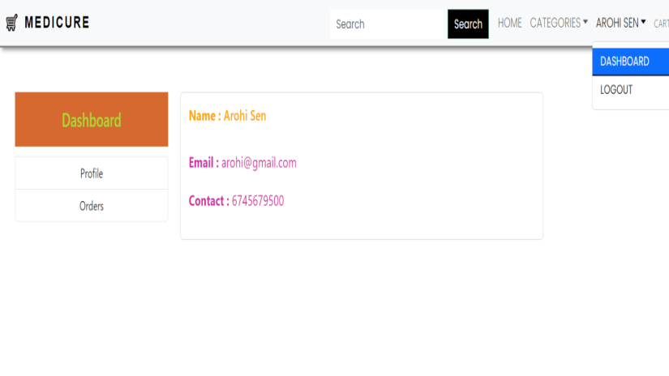
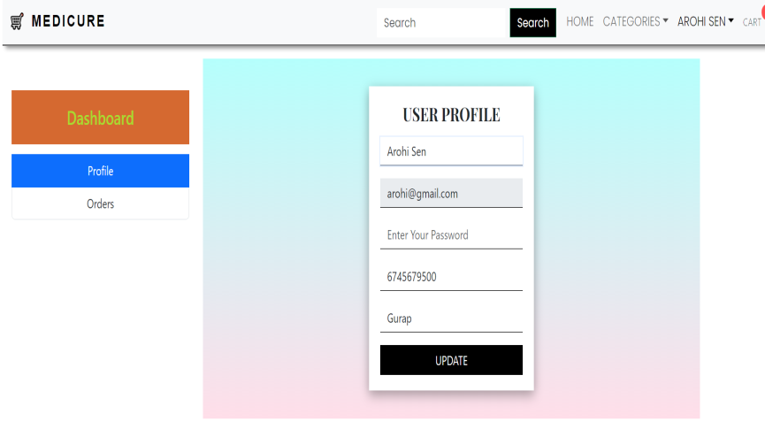
This is our login form page.
This is our user dashboard.
This is our user profile page.

Slide 13
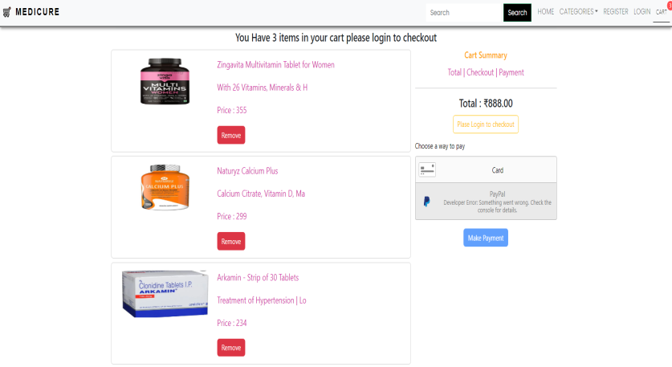
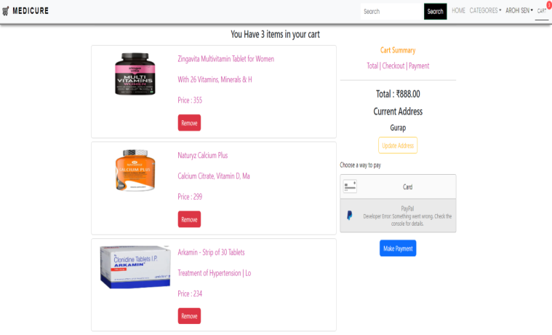
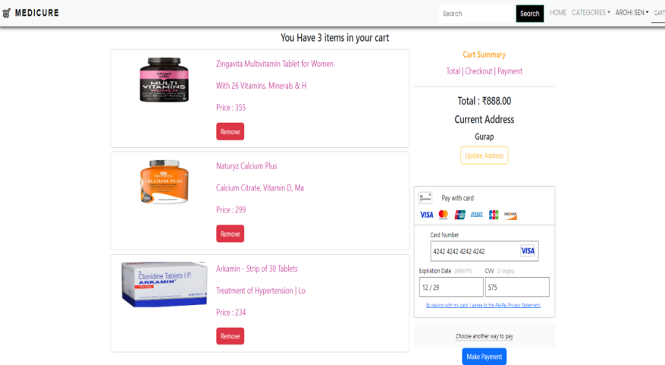
This is our cart page without login.
This is our cart page with login.
This is our cart page with payment option.

Slide 14
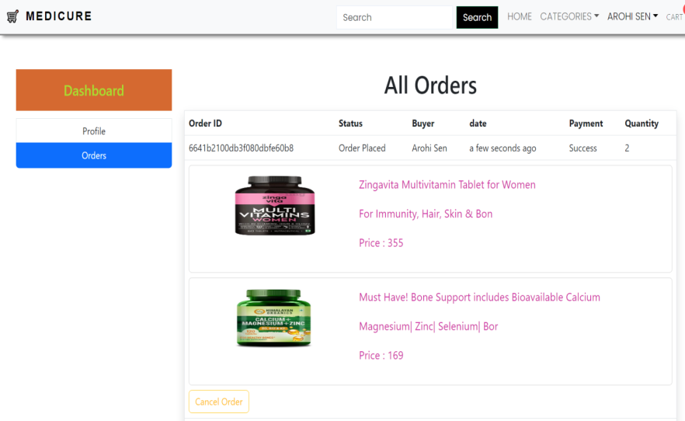
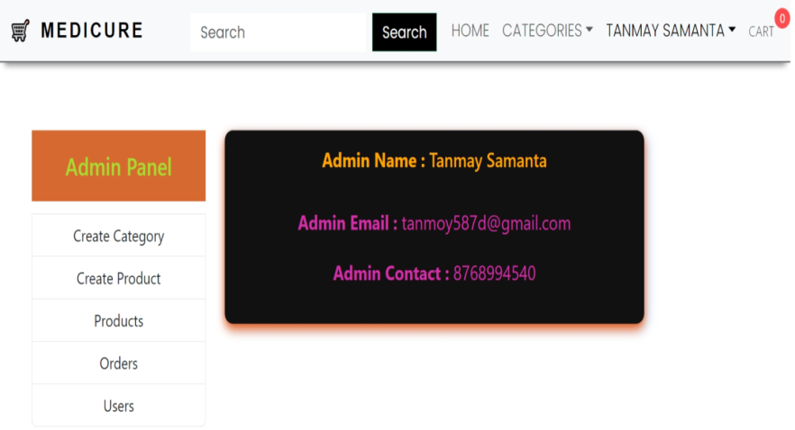
This is our user
order page.
This is our admin dashboard.

Slide 15
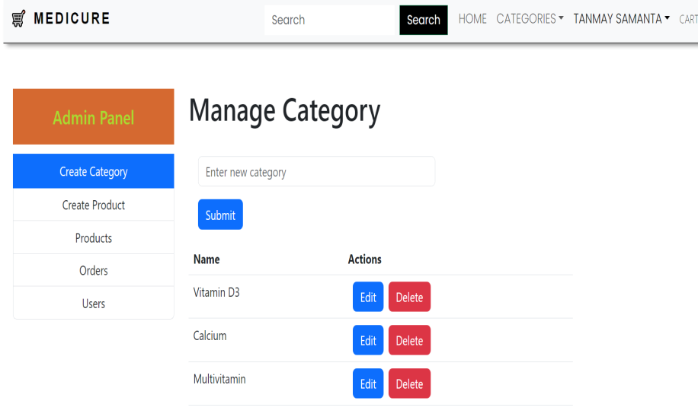
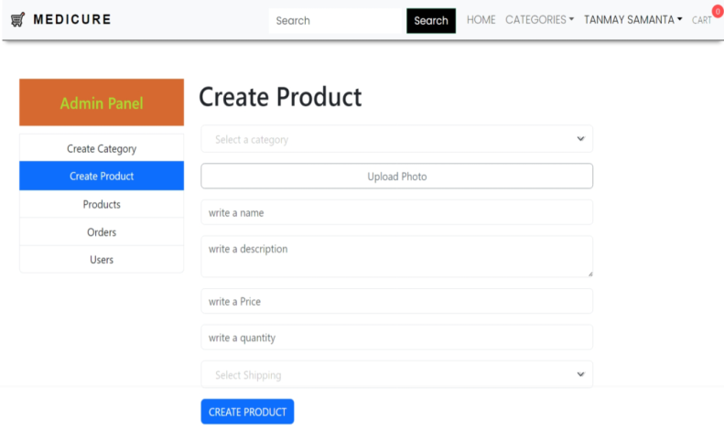
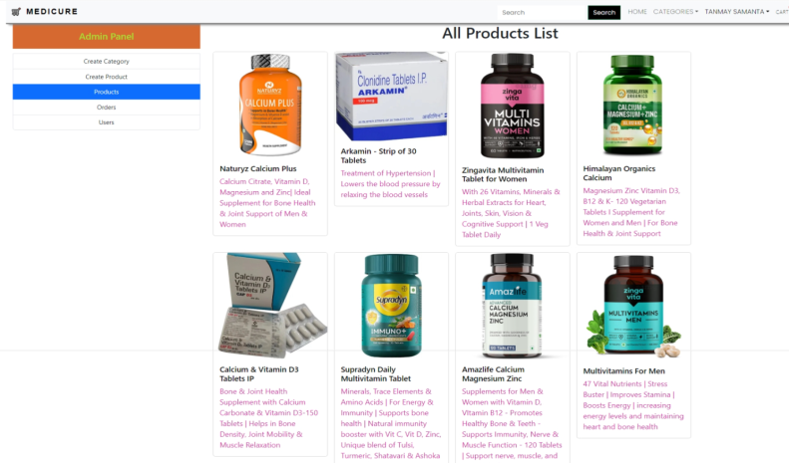
This is our admin create category page.
This is our admin create product page.
This is admin’s product page.

Slide 16
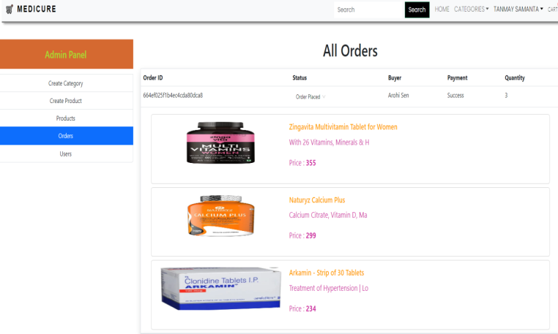
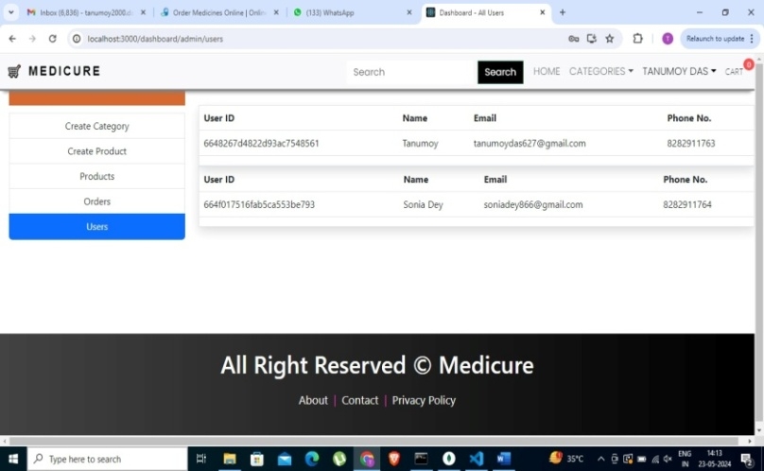
This is admin’s order management page.
This page displays user details to admin

Slide 17
Scope of the project:
Provides the searching facilities based various factors, such as category, price, availability.
It stores all the details of the medicines, so the customers can take an informed decision.
Manage the orders directly by the customers.
To increase efficiency of medicine warehouse.
Manage the information of the user.
Limitations of the project:
Generating pdf of the order details as an invoice.
We can give more advanced software including more facilities like auto-reminders for orders.
We will host the platform on online servers to make it accessible worldwide.
Display similar items as per the composition.

Slide 18
THANK YOU
…… Team MediCure

