Slide 1
WELCOME

Slide 2

Nayagarh Autonomous College, Nayagarh
Project :- E-LIBRARY
Group:-5
Platform: C Programming
1.
Siba Prasad Rout
Rollno :-6101NA1726
2.
Sidharth Mishra
Rollno :-6101NA1727
3.
Soubhagya Sundar Sahoo
Rollno :-6101NA1728
4.
Suditya kumar Badajena
Rollno :-6101NA1729
5.
Suryakanta Behera
Rollno :-6101NA1730
6.
Tanmaya Kumar Sahu
Rollno :-6101NA1732

Slide 3
INTRODUCTION
Library is the collection of different types of books.
It provides Books for large number of readers.
Thus we need software for managing the Library.
E-LIBRARY is a Library Management System Software provides the systematic handling the records of books and readers.

Slide 4
Existing System Overview
Quit Often, in must of librarian today many of the transactions are done manually.
Such system creates haphazard records of library.
Manual system can give only the information about the book issued by the students.
While updating data misplacing records, redundancy problem etc.

Slide 5
Proposed System Overview
We create a computerized solution for such problem.
This system is specially built to track information about all students and book details.
Search for desired book index system make less time consuming.

Slide 6
OBJECTIVES
To record the book’s detail.
To record the member’s details.
Reliable as information is stored logically than physically.
Faster search of available books and members than by hand.
It saves time for the management of library.

Slide 7
FEATURES
ADD, MODIFY and DELETE the book’s and member’s record.
SEARCH Book’s by ID, NAME, AUTHOR, INDEX, SEARCH Member’s by ID, NAME.
ISSUES and DEPOSIT the book’s.
Keep records of the issued book’s by individual member’s.
View the records of book’s stock , member’s and issued book’s.
Help option is provided for the user.

Slide 8
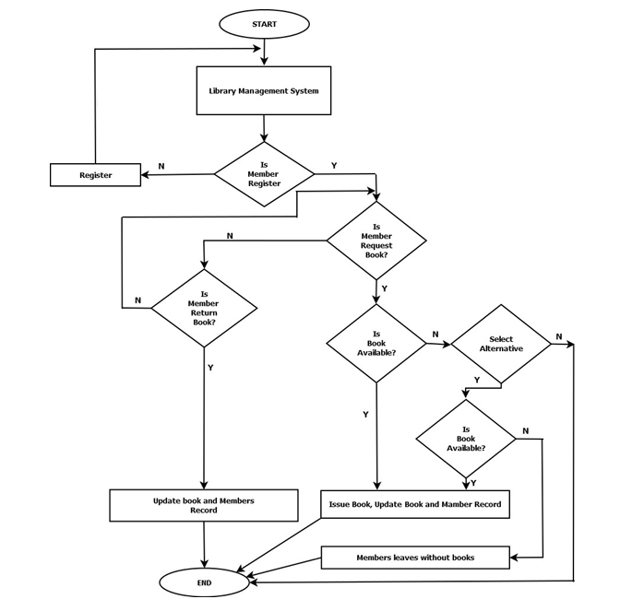
Flow Chart

Slide 9
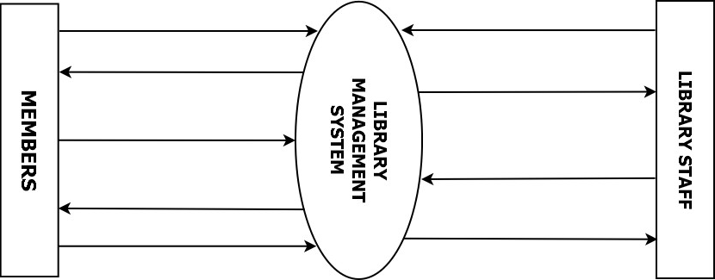
ContextDiagram
Request for membership
Generate student list
Response to the request
Requests for new books
Request for borrow book
Issue new books
Borrow book issued
Book return
Update members & book record

Slide 10
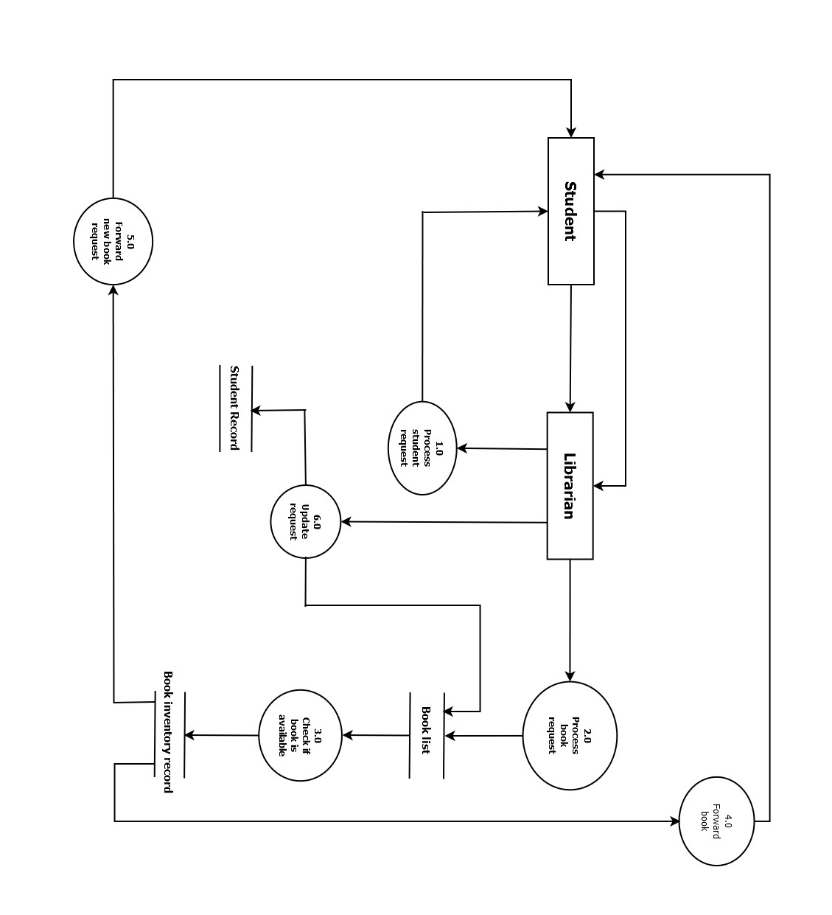
DFD

Slide 11
DATA STRUCTURE
Key Words
char
int
float
for
If
switch
textmode
do while
exit
goto
gotoxy
Header Files
#include<stdio.h>
#include<string.h>
#include<stdlib.h>
#include<ctype.h>

Slide 12
DATA STRUCTURE Contd…
User defined Functions
int main void()
bookarea()
memberarea()
delete()
modify()
search()
issue()
deposit()
reference()
records()
fpassword()
seetings()
mainscreen()
viewbookrecord()
Viewmemberrecord()
rarea()
border()
Choice2()
Choice1()
bookbox()
memberbox()
box()

Slide 13
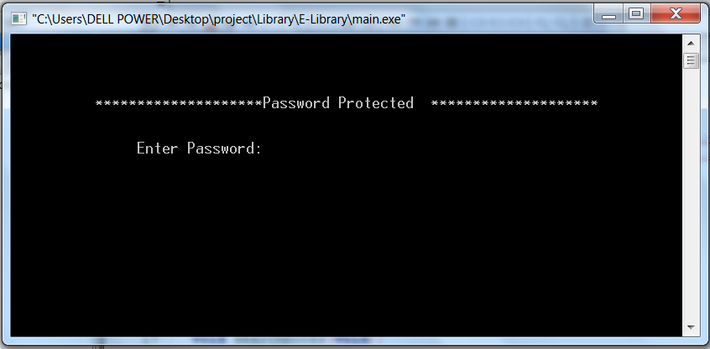
SCREENSHOTS
1St view(Password Protected)
Asking for password

Slide 14
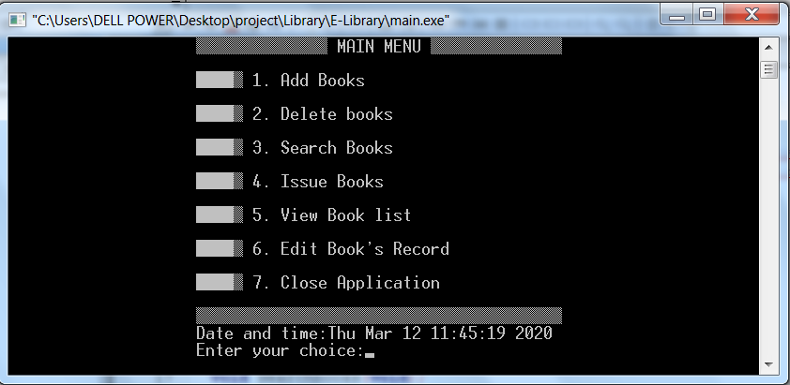
SCREENSHOTS
2nd view
Main menu

Slide 15
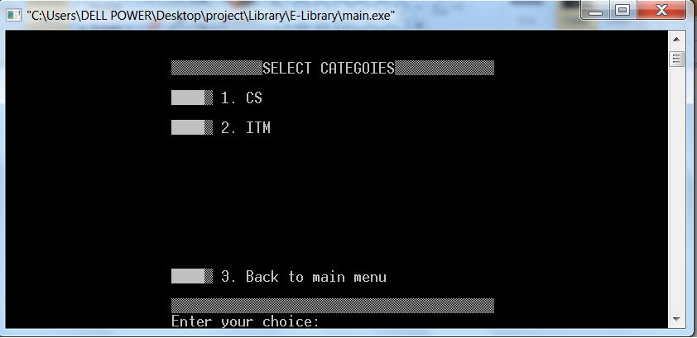
SCREENSHOTS
3rd view
Adding Book (Category Selection)

Slide 16
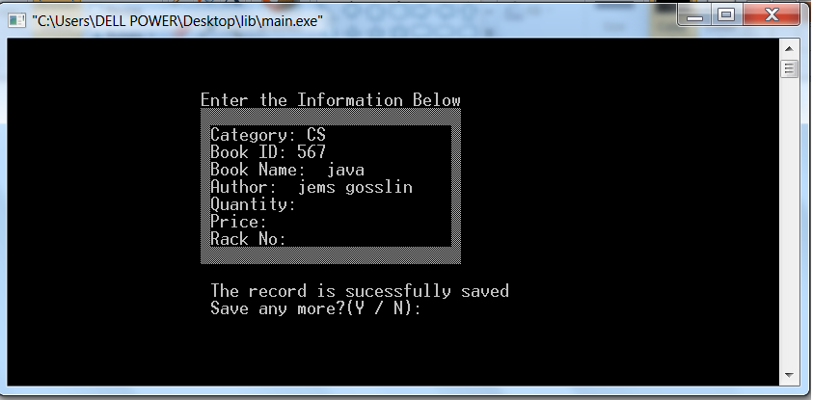
SCREENSHOTS
4th view
Adding Book (Adding Book information)

Slide 17
LMITAIONS
While deleting the student record it does not search for the information that if the student has submitted all the book or not.
Accepting number doesn’t auto increment.
It does not record the fine.
Without care of fine it issues the book.

Slide 18
REFERENCE
E Balaguruswamy, ANSI C, 3rd EDITION, Tata McGraw-Hill Publishing company Ltd.7, West Patel Nagar, New Delhi-110008,2008.
Yashavant P.Kanetkar, Let us c, ₁₁th EDITION, B-14, Cannaught Place,NewDelhi-110001,2011.
Jeffrey A.Hoffer, Joey F.Goerge, Joseph S.Valacich, Parbin K.Panigrahi, System Analysis & Design, 3rd EDITION, Darling Kindersley (India) Pvt. Ltd. Patpargang, Delhi-1110017, 2008
Guide :- Rajasree patel

Slide 19
Any queries ?

Slide 20
Thank you

