Slide 1
Fake News Detection Using NLP and Machine Learning
B.Tech CSE Project — Review 1
Name: ______________ Roll No: ______________ Guide: ______________
Notes:
Introduce yourself and the one-line goal: automatically classify news text as real or fake using NLP and machine learning.

Slide 2
Introduction
Misinformation spreads faster than manual fact-checking can keep up
NLP + ML can flag suspicious content automatically, at scale
This project builds a text-based REAL / FAKE news classifier
News Source → Social Media → Reader
"Is this REAL or FAKE?"
Notes:
Set context: why this matters now, given the scale and speed of social media spread.

Slide 3
Problem Statement
Manual fact-checking cannot scale to the volume of daily content
Need: an automated, content-based first-pass classifier
Goal: given a headline or article, predict REAL or FAKE with a confidence score
Notes:
Be precise: this is a content-based classifier, not a full fact-checking system.

Slide 4
Objectives
Build an NLP preprocessing pipeline for news text
Extract TF-IDF features from cleaned text
Train and compare 3 ML classifiers
Deploy the best model behind a simple demo UI
Notes:
These four objectives map directly to the four architecture stages on Slide 12.

Slide 5
Motivation / Existing System
Manual Moderation
Keyword / Blacklist Filters
ML-Based Classifiers
Accurate but slow
and expensive
Fast but easily
bypassed
Automatable and
adaptable via retraining
(this project)
Notes:
Position this project between the two extremes: fully manual vs naive rule-based filtering.

Slide 6
Literature Survey — Papers 1–3
Paper 1 — Ahmed, Traore & Saad (2017/2018): N-gram + TF-IDF, 6 ML classifiers, 92% accuracy on ISOT dataset
Paper 2 — Shu, Sliva, Wang, Tang & Liu (2017): survey — content vs. social-context detection taxonomy
Paper 3 — Pérez-Rosas, Kleinberg, Lefevre & Mihalcea (2018): crowdsourced datasets, up to 76% accuracy
Notes:
Emphasize the accuracy gap between Paper 1 (92%) and Paper 3 (76%) -- it's dataset-dependent, not a fixed ceiling.

Slide 7
Literature Survey — Papers 4–5
Paper 4 — Wang (2017), LIAR dataset: ~12.8K short political statements, fine-grained 6-way labels
Paper 5 — Zhou & Zafarani (2020) survey: 4-perspective taxonomy — knowledge, style, propagation, source
Notes:
Use Paper 5's taxonomy to state: our project sits in the style/content-based category.

Slide 8
Research Gap
Reported accuracy varies heavily by dataset/domain (92% vs 76% across papers)
Most student-scale projects use content-only signals, ignoring propagation/source-credibility
Our contribution: a clean, reproducible content-based baseline with transparent, non-fabricated evaluation on a clearly documented dataset
Notes:
Be honest: this is a baseline/reproduction-quality contribution, appropriate for Review 1, not a novel algorithm.

Slide 9
Dataset
Fake and Real News Dataset (Kaggle), built on the ISOT Fake News Dataset (Univ. of Victoria)
Columns: title, text, subject, date, label
[Insert actual row counts / class balance from results/eda_summary.json]
Notes:
State clearly that these numbers come from your own EDA run, not from the paper.

Slide 10
Dataset Justification + EDA
Free, widely used, binary-labeled, large enough for TF-IDF + classical ML
[Insert class_distribution.png]
[Insert article_length_distribution.png]
[Insert top_words_FAKE.png / top_words_REAL.png]
Notes:
Point out any class imbalance and how the stratified split handles it.

Slide 11
Proposed Methodology
NLP preprocessing: lowercase → remove HTML/URLs → remove punctuation → tokenize → remove stopwords → lemmatize
Feature extraction: TF-IDF, unigrams + bigrams, max_features = 5000, on title + text
Models: Logistic Regression, Multinomial Naive Bayes, Linear SVM
Notes:
Explain why each preprocessing step is used; examiners often ask why lemmatization and not stemming.

Slide 12
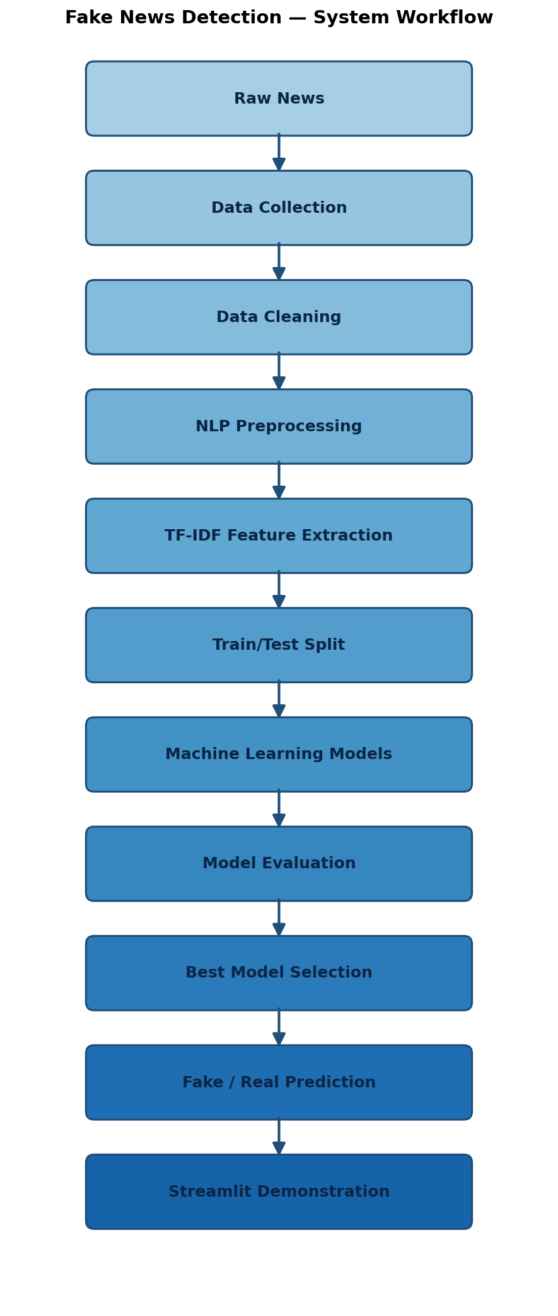
System Architecture / Workflow
Notes:
Walk through the diagram top to bottom, one box per objective from Slide 4.

Slide 13
Technology Stack
Python 3, pandas, numpy
scikit-learn — TF-IDF, models, metrics
NLTK — tokenization, stopwords, lemmatization
matplotlib / seaborn — EDA, confusion matrices
joblib — model serialization
Streamlit — demo UI
Notes:
These are all open-source, standard, well-documented libraries -- a deliberate choice for reproducibility.

Slide 14
Implementation Progress
Component | Status
NLP Preprocessing | Completed
EDA | Completed
TF-IDF Feature Extraction | Completed
Model 1 — Logistic Regression | Completed
Model 2 — Naive Bayes | Completed
Model 3 — Linear SVM | Completed
Evaluation + Confusion Matrix | Completed
Prediction Function | Completed
Streamlit Demo | Completed / In Progress
Advanced Model (LSTM / BERT) | Future Work
Notes:
This slide is the ~50% or more implementation proof -- be ready to demo live or show screenshots.

Slide 15
Initial Results + Confusion Matrix
[Insert comparison table from results/model_comparison.csv — real numbers]
[Insert best model's confusion matrix PNG from results/]
State which model won and why (highest F1-score)
Notes:
If the dataset isn't loaded yet at review time, say so explicitly and show the pipeline running instead of fake numbers.

Slide 16
Demo + Future Work
Live demo: paste a headline into the Streamlit app → REAL/FAKE + confidence
Future work: Word2Vec+LSTM or DistilBERT, cross-domain evaluation, explainability (SHAP/LIME), multilingual support
Thank You — Questions?
Notes:
End on a clear what's-done vs what's-next summary so examiners see scope was managed deliberately.

