Slide 1
Tennis Prediction Engine

Slide 2
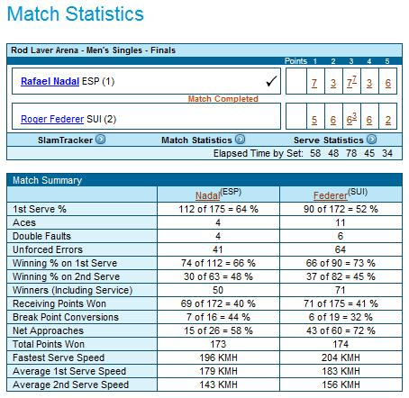
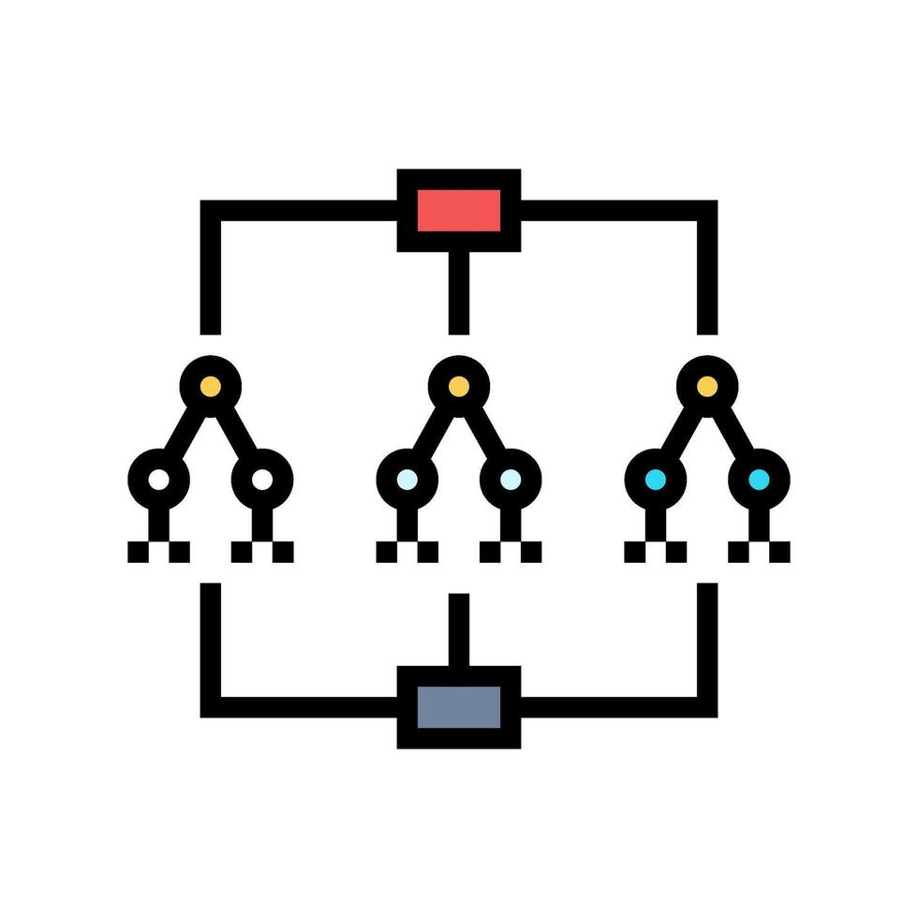
Overview
Problem:
Manually compiling data from matches to make accurate predictions can be time-consuming and inconsistent.
Simple regression models often fail to capture non-linearity in data.
Solution:
Build a user-friendly desktop app that can scrape match data from the official ATP Tour website for updated information (https://www.atptour.com/en) and make basic predictions.
Data from historical records will have to undergo preprocessing in order to clean missing values, perform feature engineering, and split for training/validation.
It will use a custom-built Random Forest algorithm, as it handles tabular data with mixed categorical/numerical features (e.g. match results/player stats), and is robust without requiring significant compute.
For data scraping, the infotennis module can be used.
Data preprocessing and the main model architecture can be implemented in Pandas and NumPy respectively.
For the frontend, a simple framework e.g. Tkinter can be used as the UI will remain static and does not need to be reactive
Historical records, such as those maintained by Jeff Sackmann can be loaded into a database for easier querying during inference. Given the relatively simple and tabular nature of the data (only ~3 interlinked tables), an SQLite database should be sufficient, handling the moderately large record counts. Then, updating the database becomes a matter of converting the raw scraped output to the exact entity structure used in the database.
Considerations:
Data leakage during training must be avoided. Giving the model access to statistics such as updated Elos, ace/double fault counts leads to much higher accuracy on training data but makes it essentially useless for real-world predictions.
Instead, consider rolling averages, e.g. win% on surface _ over last 12 months, average DR over last 5 matches

