Slide 1


Data Analysis of Product Review
P174_GROUP-2:
Group Mentors
Miss. Neha Gupta
Mr. Natarajan S
Group members:
Shubham S Raut
Rutuja Baban Hande
Pravin Panditrao Chandel
Komal Vikas Shinde
Tanmay Sadanand Bhor
Shweta A Mandavkar
Vanthana
7th January, 2023

Slide 2
CONTENTS:
Business Objective
Project Flow
Exploratory Data Analysis (EDA)
Data Visualization
Model Building
Deployment

Slide 3
1. Business Objective:
Need to get daily Analysis of a product such as emotions, sentiment etc. using Amazon data.

Slide 4
2. Project Architecture / Project Flow
EDA
Data Visualization
Model Building
Model Evaluation
Model Deployment

Slide 5
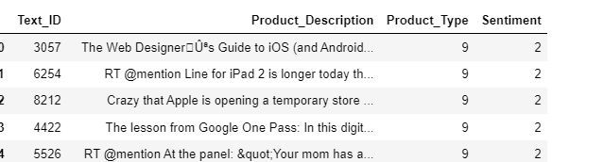

3. Exploratory Data Analysis (EDA)
3.1 Details about the Data Set:
→
Rows = 6364 ; Columns = 4

Slide 6
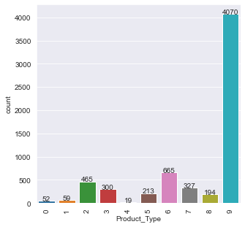
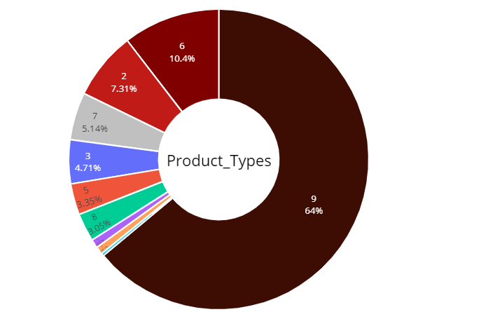
3.2 Insights
→ Analysis of Product Types

Slide 7
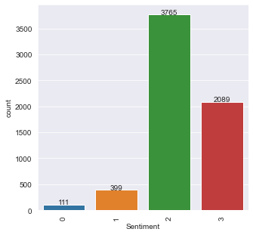
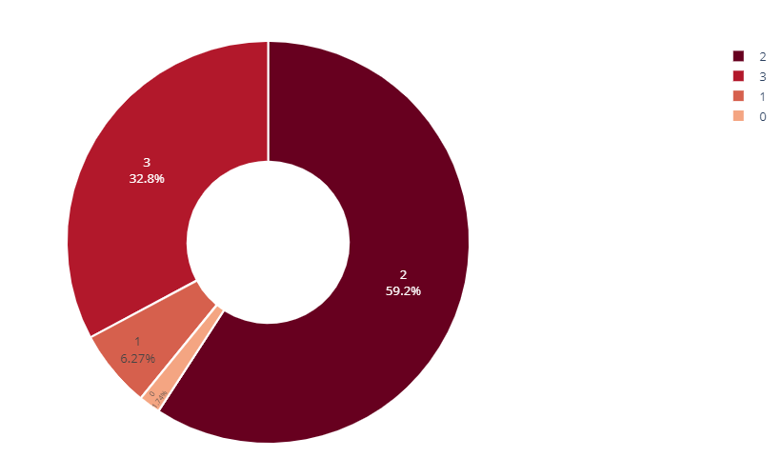
3.3 Sentiment analysis
→ Analysis of Sentiment type

Slide 8
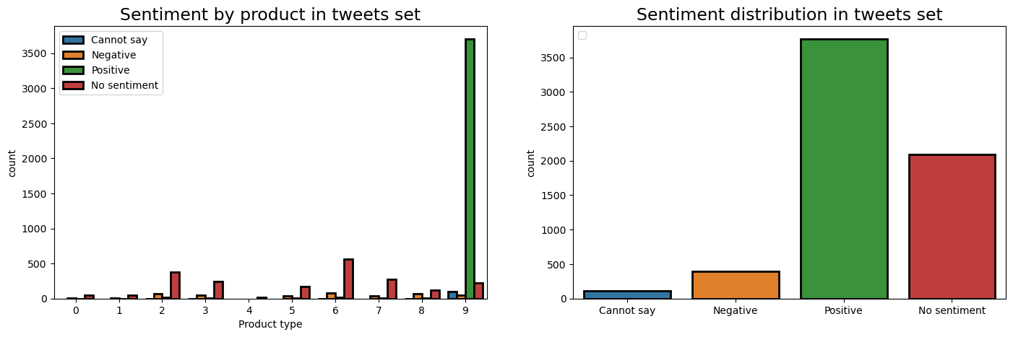
3.4 Bi Variate Analysis:

Slide 9
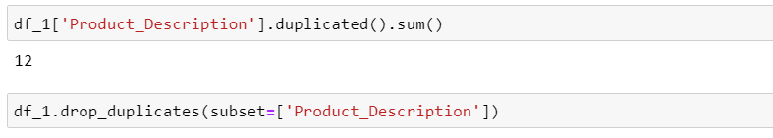
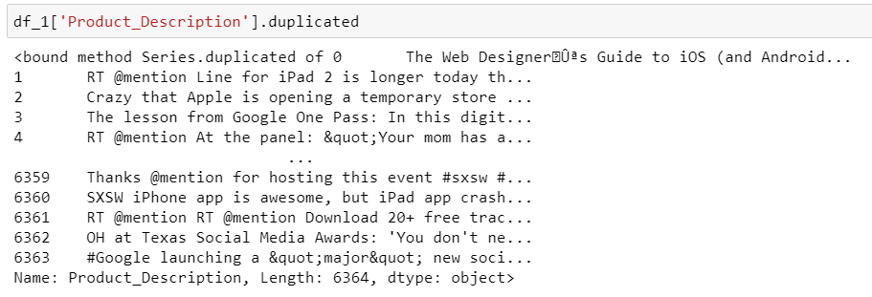
3.5 Treating with the duplicate rows:

Slide 10
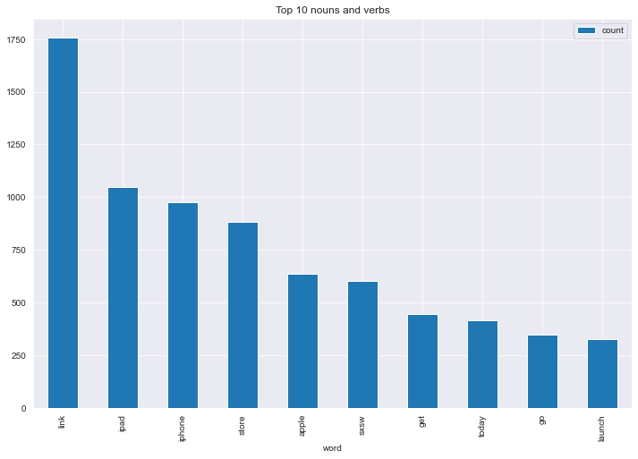
4. Data Visualization
3.5 Top 10 Nouns and Verbs:
→

Slide 11
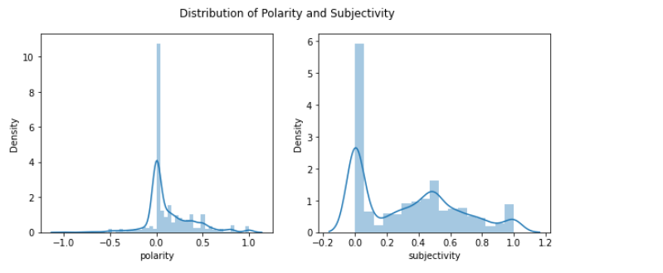
4. Data Visualization
→

Slide 12
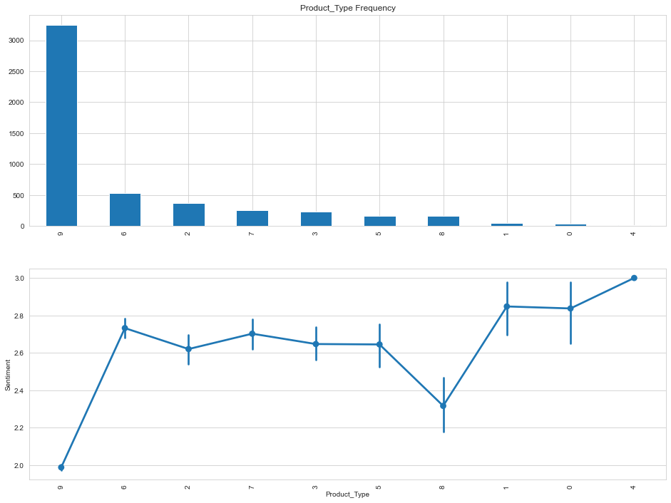
→ Product Vs Sentiment Analysis
4. Data Visualization

Slide 13
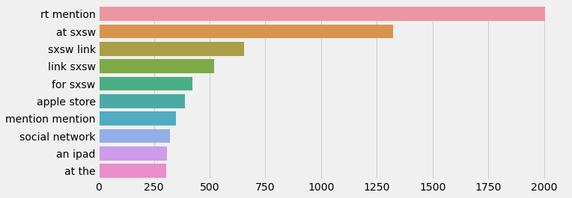
4. Data Visualization
→ Most occurring Bi-grams:

Slide 14
4. Data Visualization
→ Most occurring Tri-grams:

Slide 15
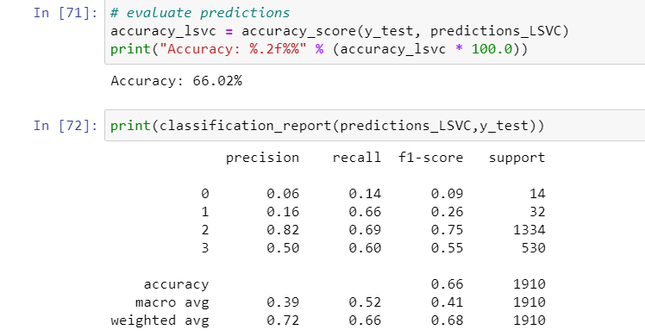
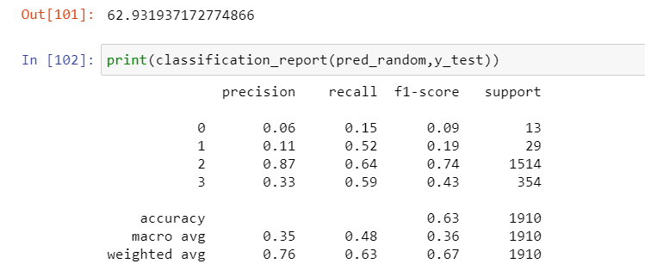
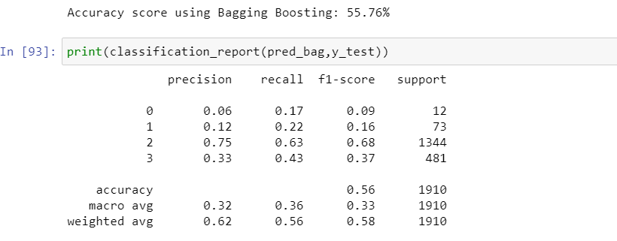
5. Model Building
SVC
Random Forest
Bagging Boosting

Slide 16
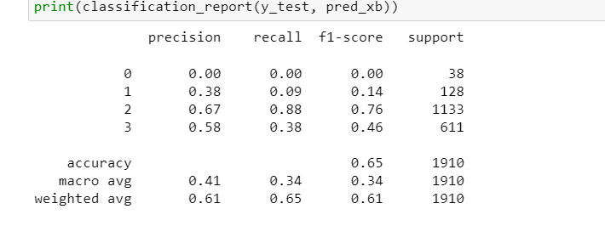

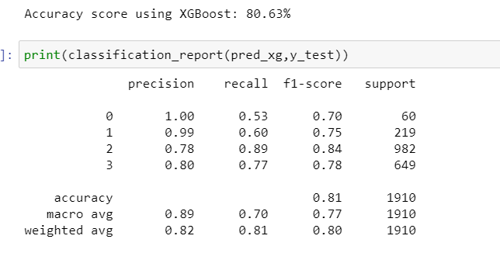







5. Model Building
XGBoost
Used the Balance Class Technique

Slide 17
6. Deployment :
Streamlit →
Is an open-source app framework for Machine Learning and Data Science teams.
It also helps us create web apps for data science and machine learning in a short time.
The Best thing about streamlit is it doesn’t require any knowledge of web development, If you know python you are good to go!
Deployment_link

Slide 18
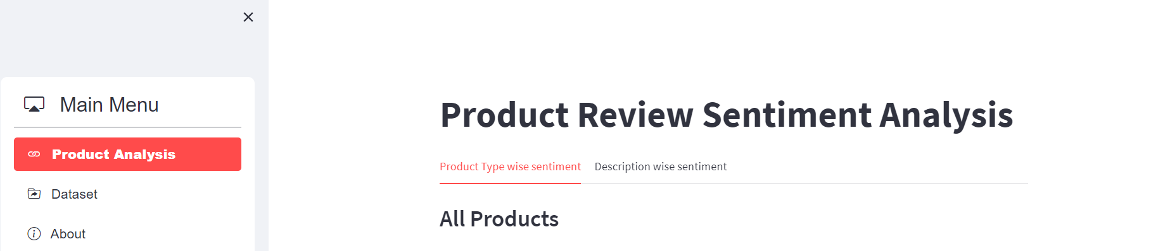
6.1 Deployment UI:

Slide 19
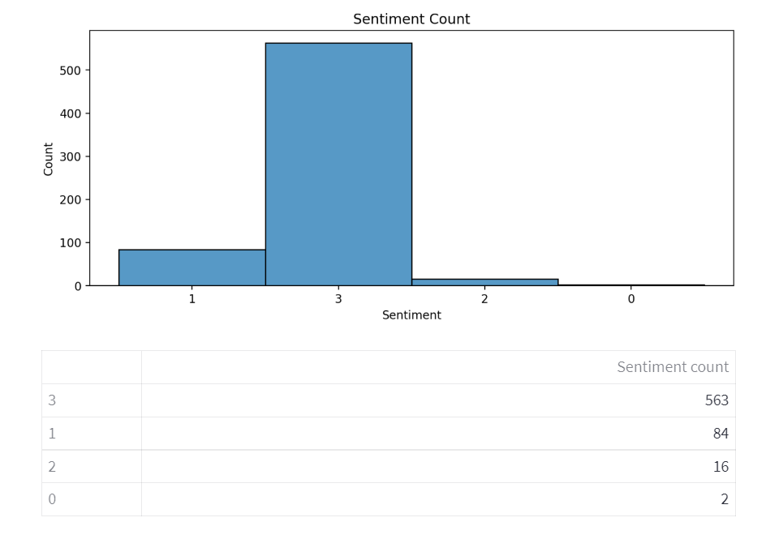
6.2 Quick Analysis:

Slide 20
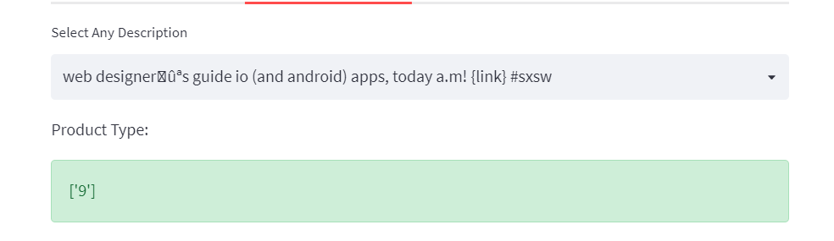
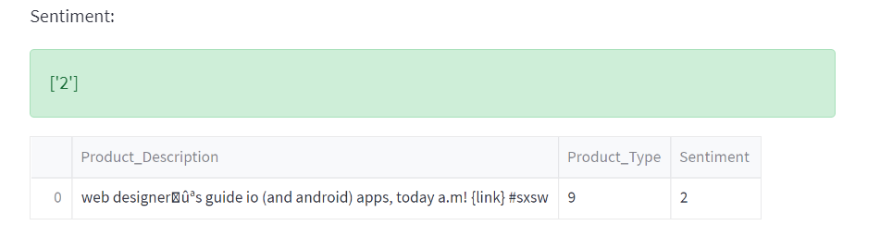


6.3 Input parameters of customer:
6.4 Output parameter:

Slide 21

6.5 Some Insights:
Most occurring Product Type is :
are Product = 9
Most reviews/description fall into:
Here we have most product occurring for 6 the Sentiment of 3.
This is followed by the Product 9 with sentiment most as 2.
We also have the Product Type 4 as the most average rating.
Most occurred sentiment is:
For Sentiment = 2

Slide 22

Thank you
For Your Attention

