Slide 1
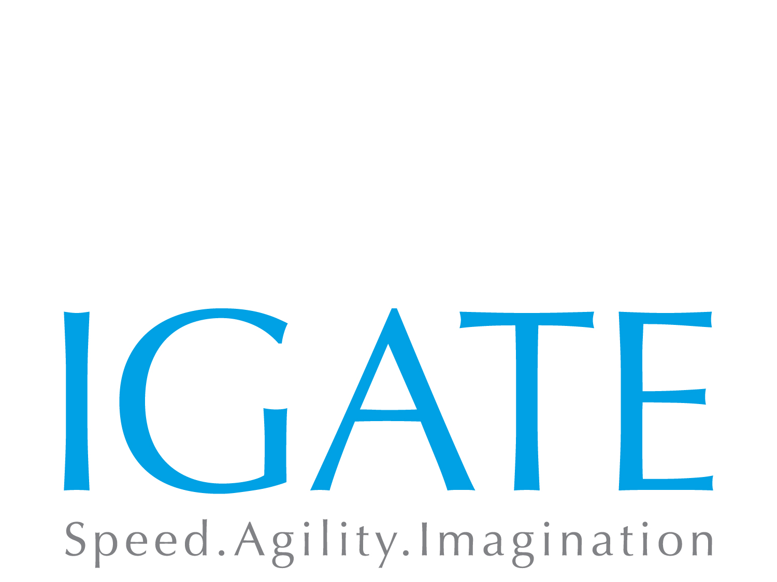
DevOps Transformation
Presented by: Kiran Khathuria
DevOps COP, 07/15/2015

Slide 2
Table of Contents
What is DevOps
DevOps Principles
What DevOps is not
DevOps Maturity Model
Principles of Continuous delivery
What is DevOps Transformation
Steps to DevOps Transformation
Case Studies

Slide 3
What is DevOps
How many deployments do you do in a day/week/month?

Slide 4
What is DevOps
Facebook - twice a day in 2013
Amazon – deployment on a server every 11.6 seconds – 2011
Etsy - 10 deployments a day - 2000. 50 deployments a day - 2014
IMVU - 50 deployments a day
Netflix – 100+ deployments a day
Google – 50M automated test cases run every day

Slide 5
What is DevOps
Priorities?
Developer
How many lines of code per day?
How many defects fixed per day?
I followed all the documented process
Tester
How many test cases per day?
How many defects records per day?
I followed all the documented process
Operations
SLA is 99% up time?
No unstable code allowed in production
I followed all the documented process
Business
How soon can I see this requirement in production?

Slide 6
What is DevOps
Failure Reasons
Developer
It works on my machine
I don’t have production data to test
I followed all the documented process
Tester
1 issue fixed, 2 issues introduced
I don’t have production data to test?
I followed all the documented process
Operations
Unstable code deployed by developers
Proper testing not done
I followed all the documented process
Business
How soon can I see this requirement in production?

Slide 7
What is DevOps
DevOps is a blend of Development & Operations. It’s a development method that puts focus on communication & colloboration between different teams and stresses on integration and automation to achieve faster time to market
DevOps is a philosophy; it’s a way of life that you can use to transform your methodology to improve business value
Devops is not about a technology it's about a business. Need to optimize the whole and not the individual ‘silos’

Slide 8
Silo organization
Hand off
Hand off
BA
Tech
Mgmt
Manual
Auto
Perf
Deploy
Support
Dev
QA
Ops
Feedback
Feedback

Slide 9
What DevOps is not
Common misconceptions
DevOps is just PR
One resource does everything
DevOps is a technology movement
We don’t need Systems Administrators – NoOps strategy
Let's buy DevOps
DevOps will solve all my problems
DevOps will keep me on my toes 24X7
DevOps will add more stress and demotivate the team

Slide 10
DevOps history
2008 - Software developer Patrick Debois plant the seeds of the DevOps movement at the Agile conference in Toronto
2009 - At the O’Reilly Velocity Conference, two Flickr employees deliver a seminal talk known as “10+ Deploys per Day: Dev and Ops Cooperation at Flickr
2010 - The first US Devopsdays is organized. #DevOps Twitter hashtag becomes a rich and essential stream of information
2011 - Gartner predicts that by 2015, 20 percent of global 2000 businesses will embrace DevOps
2012 - Devopsdays are popping up around the world, from Bangalore to Boston
2014 – 16% respondents in a survey say they are part of a DevOps effort within their organization

Slide 11
DevOps Maturity Model
Levels in a maturity model
Base: Any process that is not completely manual will fit in here
Beginner: The team is trying to adopt some practices in earnest but is still performing them at a rudimentary level
Intermediate: Practices are somewhat mature and are delivering fewer errors and more efficiency. For many teams, Intermediate practices may be sufficient.
Advanced: The team is doing something well beyond what most of the rest of the industry and is seeing a great deal of efficiency and error prevention
Extreme: Elements within the Extreme category are ones that are expensive to achieve but for some teams should be their target

Slide 12
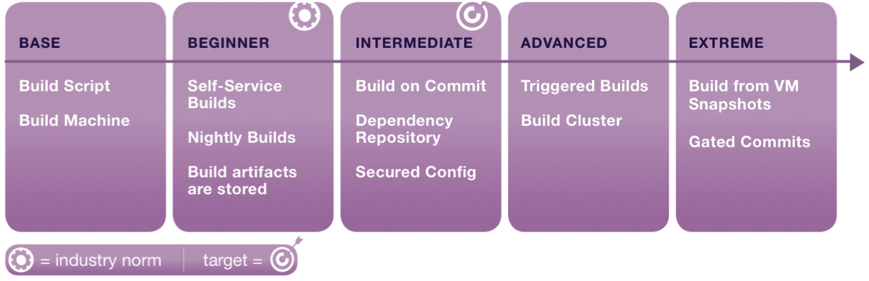
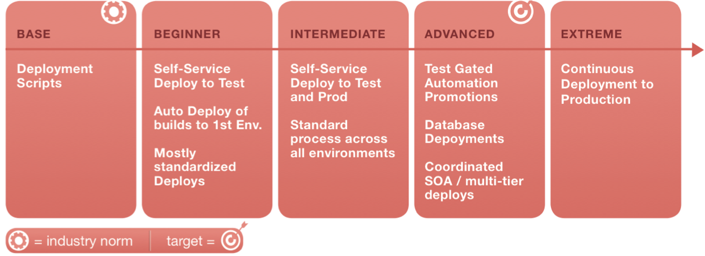
DevOps Maturity Model
Build
Deployment

Slide 13
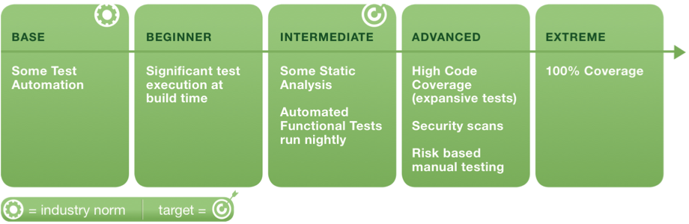
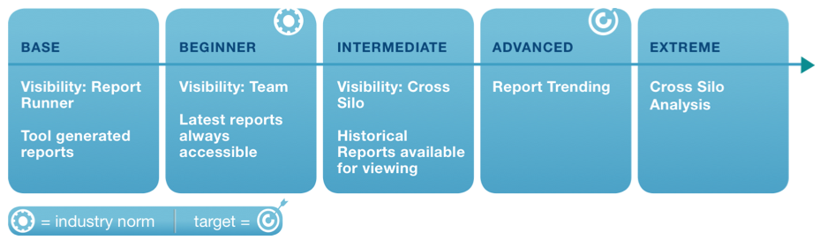
DevOps Maturity Model
Testing
Reporting

Slide 14
What is DevOps Adoption
Journey for adoption of DevOps practices from the current state to a future state to achieve the set project/organization goals
Building blocks of the journey
Culture – People matter the most in DevOps. If all stakeholders are not sharing the same vision, goal and mindset, DevOps will not be successful
Process – Once the culture is setup, development, testing and operation practices need to be modified to achieve the goals. More importantly, teams need to collaborate
Automation/Tools – DevOps is not about automation but a successful DevOps implementation will rely heavily on automation & tools. These are decided depending on the goals and processes agreed in point 1 & 2
Measure/Share – Measure progress and Share learning's
Step 1,2 & 3 are iterative in nature keeping the maturity model into consideration. Measurement is a key aspect which drives future iterations of continuous improvement

Slide 15



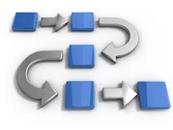
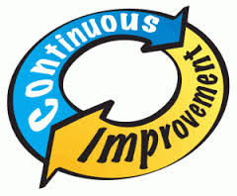
Steps to DevOps Adoption
Why
Where
How
Execute
CI
Why do you want to go with DevOps
What is the end goal
By When do you want to achieve this goal
Dev & Ops need to share the same Why
Assess Where you are today
Capture existing Metrics
What is the budget/ resource availability
Dev & Ops need to agree on current state
Setup DevOps Culture
Analyze existing roadblocks and workarounds
Create the Roadmap
Create new process for DevOps
Dev & Ops need to agree on the Roadmap
Use/Evaluate tools
Implement automation
Measure Metrics at every stage
Tools & Process should be common between Dev & Ops
Plan & Execute iteratively
DevOps is all about continuous improvement
DevOps is a Journey & not a destination
Share what you learn
Notes:
Look at the system as a whole.. Identify bottlenecks, deployment to Prod was a bottleneck
Automated the same to ensure frequent deliveries

Slide 16
Continuous Delivery
Continuous Delivery is a software engineering approach in which teams keep deploying quality software in short cycles
It is dependent on the following
Continuous Integration – Code is continuously integrated
Continuous Testing – Code is continuously tested
Continuous Deployment - Code is continuously deployed
Continuous Monitoring – Deployed code is continuously monitored

Slide 17
HP Case Study
Background - Group was responsible for the firmware code that ran on all the enterprise LaserJet products
Current State
Commits – 1 per day
5% of Development time spent writing new features
Integrating code into branch – 10% of Dev time
Build cycle time - 1 week
Regression test cycle – 6 weeks
Slow feedback loop. Developers fixing defects introduced 6 weeks back
Notes:
Look at the system as a whole.. Identify bottlenecks, deployment to Prod was a bottleneck
Automated the same to ensure frequent deliveries

Slide 18
HP Case Study
Transformation
Use of Agile as a development process
Change in branching & merging strategy. Getting everyone to the same code base
Change build policy to create printer specific builds
Implement continuous integration
Implement automated testing using Simulators
Faster feedback
Stop when build, test fails and get it back on track - gated commits
Notes:
Look at the system as a whole.. Identify bottlenecks, deployment to Prod was a bottleneck
Automated the same to ensure frequent deliveries

Slide 19
HP Case Study
Future State
Commits – 100 per day
40% of Development time spent writing new features
Integrating code into branch – 2% of Dev time
Build cycle time – 3 hours
Regression test cycle – 24 hours
Fast feedback loop. Defects logged and reported immediately
Notes:
Look at the system as a whole.. Identify bottlenecks, deployment to Prod was a bottleneck
Automated the same to ensure frequent deliveries

Slide 20
BFS Case Study
Background – organization of independent financial advisors in the United States. The customer provides an integrated platform of proprietary technology, brokerage, and investment advisory services to over 14,000 financial advisors.
Current State
No Continuous integration
No Continuous deployment
No Continuous testing
No continuous monitoring
Agile Scrum used universally for all projects
Existing staff picked up as scrum masters
Ops team works independently on its own calendar
Notes:
Look at the system as a whole.. Identify bottlenecks, deployment to Prod was a bottleneck
Automated the same to ensure frequent deliveries

Slide 21
BFS Case Study
Transformation
Use of SAFe Agile as a development process
Invest in training resources
Hiring Agile coaches to improve effectiveness of Agile
Setup culture & tools for Continuous Integration, Continuous Deployment, Continuous monitoring and Continuous testing
Create a maturity model for Build, Deploy, Test, Report & Monitor
Invest in creating a DevOps automated framework for the technology.
Heavy focus on measurement. A custom dashboard developed to report DevOps adoption progress
Notes:
Look at the system as a whole.. Identify bottlenecks, deployment to Prod was a bottleneck
Automated the same to ensure frequent deliveries

Slide 22
BFS Case Study
Future State
Continuous integration implemented using Teamcity
Continuous deployment implemented using OctopusDeploy
Heavy focus on continuous testing using automation
Continuous monitoring implemented using Dynatrace
Skills/trained staff for effectiveness of Agile processes
Dev, QA & Ops team under the same roadmap and agreement on setup of common goals
Executive dashboard created for live monitoring of project adoption of DevOps
240 PD’s of effort savings per year for 20 applications on DevOps platform
Notes:
Look at the system as a whole.. Identify bottlenecks, deployment to Prod was a bottleneck
Automated the same to ensure frequent deliveries

Slide 23
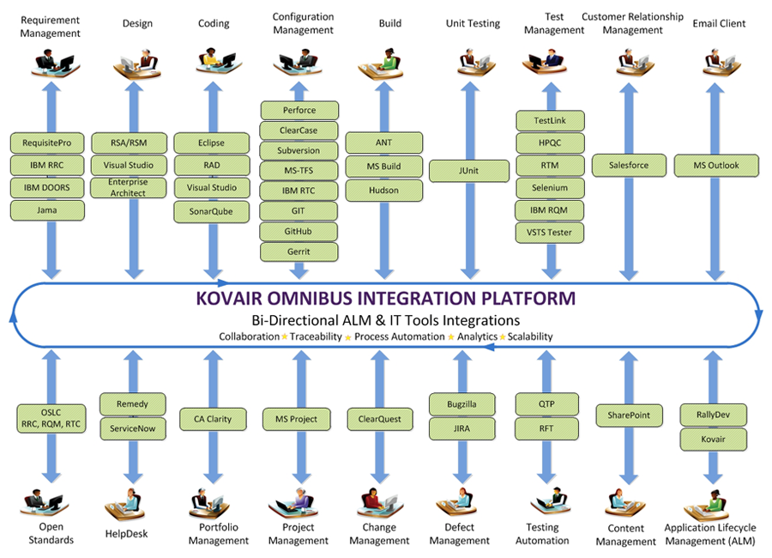
BFS Case Study
Code Review
Unit Testing
Integration
Testing
Functional
Testing
Regression
Testing
FxCop
MS Test
NDepend
Jasmine
QTP
JSHint
LPL Automation Factory
Tibco Custom
Software Engineering Framework
Teamcity(CI), Service & Database
Process Automation Training Collaboration
Veracode
dynaTrace
HPQC
Teamcity/ OctopusDeploy
AngularJS Reporting
CBTs
TFS
LPL U
Security
Review
Application Monitoring
Deployment
Dashboard/
Reporting
Training
Defect Management

Slide 24
DevOps @ IGATE
DevOps COE
DevOps COP
DevOps Maven
Project Case Studies
Notes:
Look at the system as a whole.. Identify bottlenecks, deployment to Prod was a bottleneck
Automated the same to ensure frequent deliveries

Slide 25
References
http://itrevolution.com/the-amazing-devops-transformation-of-the-hp-laserjet-firmware-team-gary-gruver/
https://www.usenix.org/conference/lisa11/devops-transformation
https://developer.ibm.com/urbancode/docs/continuous-delivery-maturity-model/
http://blog.devopsguys.com/
http://en.wikipedia.org/wiki/DevOps
http://www.informationweek.com/strategic-cio/enterprise-agility/6-steps-to-survive-a-devops-transformation/a/d-id/1319704
Notes:
Look at the system as a whole.. Identify bottlenecks, deployment to Prod was a bottleneck
Automated the same to ensure frequent deliveries

Slide 26
Thank You

