Slide 1

Project Presentation
On
Heart Disease Detection and Patient’s Sickness Prediction System
By
MITU19BTCS0271 Sakshi Singh
MITU19BTCS0197 Chaitanya Pandey
MITU20BTCSD043 Tanmay Patil
MITU19BTCS0271 Gurjeet Singh
Guided By
Prof. Shahin Shoukat Makubhai
Department of Computer Science & Engineering, MITSoE, Loni Kalbhor

Slide 2
Outline
1 INTRODUCTION
2 CONCEPTS AND METHODS
3 LITERATURE SURVEY
4 PROJECT PLAN
5. SOFTWARE REQUIREMENT SPECIFICATION
6 RESULTS
7 SOFTWARE TESTING
8 CONCLUSION AND FUTURE WORK
BIBLIOGRAPHY
ANNEXURE A: List of Publications and Research Paper (In its Original formats)
ANNEXURE B: Plagiarism Report
Department of Computer Science & Engineering, MITSoE, Loni Kalbhor
<number>

Slide 3
1. Introduction
There are a variety of diseases that cause human deaths therefore identification and prediction of such disease is very important to prevent extremity of it.
Most of the deaths in India are due to the Heart Attacks especially those who are older in age and are affected by a Cardiovascular Disease.
Our Prediction System intends to predict the risk level of the diseases using different Machine Learning Algorithms.
Department of Computer Science & Engineering, MITSoE, Loni Kalbhor
<number>

Slide 4
2. Problem Statement
Due to the substantial amounts of data, medical doctors are facing challenges to analyze symptoms accurately and identify diseases at an early stage. However, Supervised ML algorithms have showcased significant potential in surpassing standard systems for disease diagnosis and aiding medical experts in the early detection of high-risk diseases.
Department of Computer Science & Engineering, MITSoE, Loni Kalbhor
<number>

Slide 5
3. Objectives
Predicting disease epidemic on both the personal and the public level.
Informs about the available risk factors hence reduces the costs of tests.
Can assist doctors in diagnosing the heart patients effectively.
Repeatedly classified illustration data, such as x-rays or scans, etc.
Utilization of the extracted data from the customers to find the hidden patterns.
Department of Computer Science & Engineering, MITSoE, Loni Kalbhor
<number>

Slide 6
4. Concept
Concepts :
1 : The website will collect input data from users and utilize a training dataset to determine the outcome.
2 : When the user clicks the result button, it will trigger a request to the Streamlit server containing their inputs, which the server will subsequently restructure.
3 : Subsequently, the inputs will be fed into a trained model.
4: The model will analyze the provided data and generate a forecasted output
5: The server will transmit the forecasted output to the web application as a response, and the web application will exhibit the projected outcome.
Such is the methodology we shall employ to predict heart disease and patients' illnesses using trained models.
Department of Computer Science & Engineering, MITSoE, Loni Kalbhor
<number>

Slide 7
5. Literature Survey
Sr. No | Paper | Remarks | Limitations
1. | Disease Prediction using Machine Learning, 2005 by Raj H. Chauhan, Daksh N. Naik, Rinal A. Halpati, Sagarkumar J. Patel, Mr. A.D.Prajapati | Analyzes the symptoms provided by the user as input and gives the probability of the disease using Decision tree classifier | Accuracy of Decision tree is lesser as compared to Random Forest
2. | Disease Prediction Using Machine Learning by Marouane Fethi Ferjani | Use of CNN algorithm to predict the common diseases and breast cancer | CNN requires images from different angles which only a human visual system can identify
3. | Disease prediction using machine learning by Rinkal Keniya, Aman Khakharia, Vruddhi Shah, Vrushabh Gada Ruchi Manjalkar, Tirth Thaker, Mahesh Warang, Ninad Mehendale | Uses weighted KNN algorithm on various symptoms to predict from 200 diseases that are provided | The KNN model gives less accuracy when compared to Random Forest
4. | Using Machine Learning for Heart Disease Prediction by Dhai Eddine Salhi , Abdelkamel Tari , and M-Tahar Kechadi | Uses neural networks for heart disease prediction because it is more accurate as compared to SVM and KNN | Neural networks are computationally expensive and also it requires much more data as compared to other ML algorithms
5 | Prediction of Heart Disease using Machine Learning Algorithm, 2021 by Aadar Pandita, Siddharth Vashisht, Aryan Tyagi, Prof. Sarita Yadav | Uses KNN, Logistic Regression and Random Forest Classifier for the prediction of cardiovascular diseases | Even after applying 3 algorithms the system gives less accuracy which Logistic Regression can alone provide
Department of Computer Science & Engineering, MITSoE, Loni Kalbhor
<number>

Slide 8
6. Tools and Languages
Python : For the backend, the programming language used is Python and for implementing prediction models
Streamlit : It is an open- source app framework for machine learning and data science teams. We have used this for the frontend development
Jupyter : Jupyter notebook for training and testing data and for creating models
Spyder : Spyder for implementing the logic
Libraries : NumPy to deal with huge dataset in numerical form, Pandas to analyze the data, Pickle for creating model.sav files, Streamlit and streamlit_option_menu for creating website, Sklearn for train_test_split , logistics regression for accuracy and Sklearn for random forest classifier
Department of Computer Science & Engineering, MITSoE, Loni Kalbhor
<number>

Slide 9
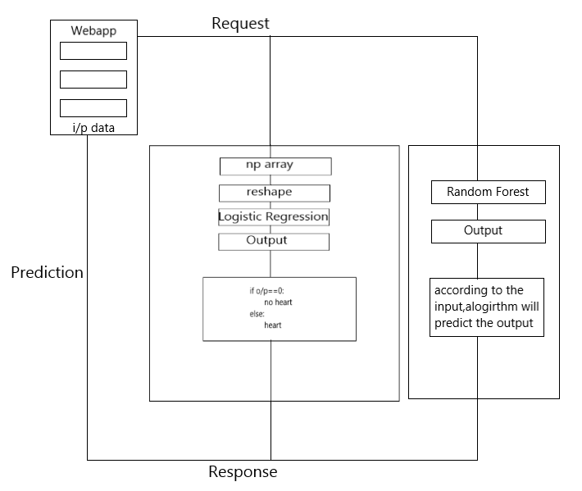
7. Process and Architecture
Department of Computer Science & Engineering, MITSoE, Loni Kalbhor
<number>

Slide 10
8. Testing
We have used ITERATIVE MODEL. In this type of model possible key steps in the process start with a simple implementation of a subset of the system requirements and iteratively enhance the evolving versions until the full system is implemented.
During the training and testing phase of our project, we evaluated multiple machine learning models for predicting common diseases. The Random Forest Classifier model emerged as the most effective and accurate model with a precision of 95 percent. For the prediction and detection of heart disease, we utilized Logistic Regression which yielded an accuracy of 81 percent. There are various possibilities to further improve the accuracy of this model in the future
Department of Computer Science & Engineering, MITSoE, Loni Kalbhor
<number>

Slide 11
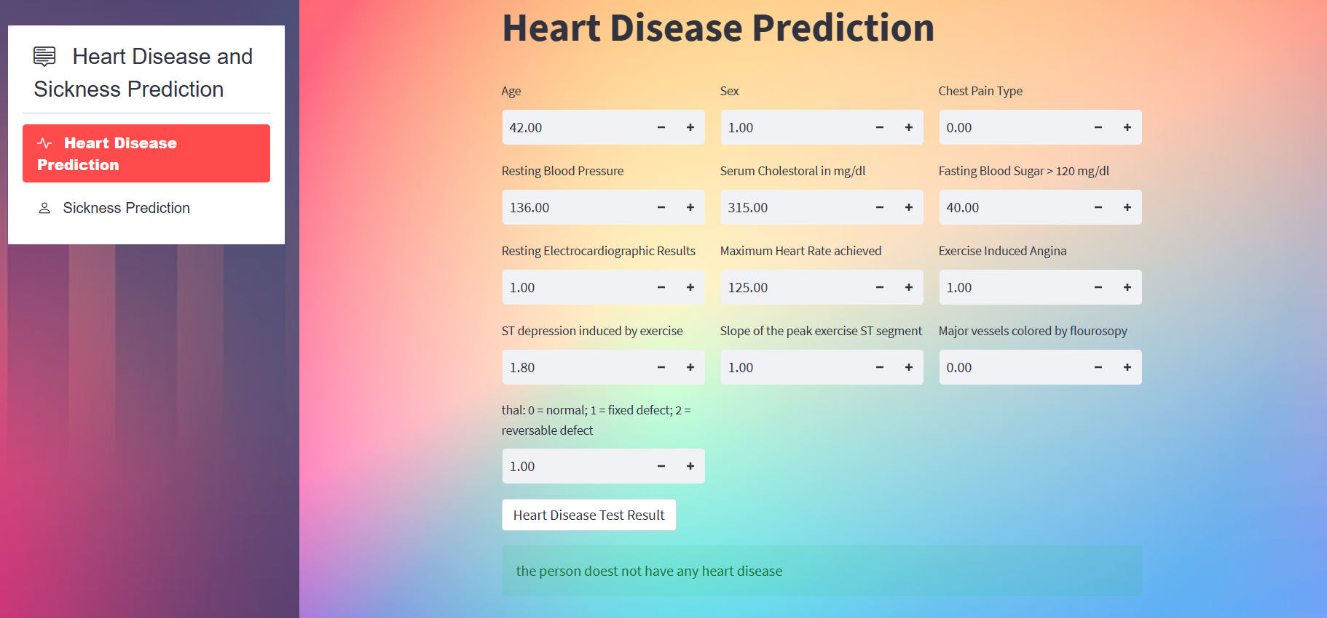
9. Implementation
Department of Computer Science & Engineering, MITSoE, Loni Kalbhor
<number>

Slide 12
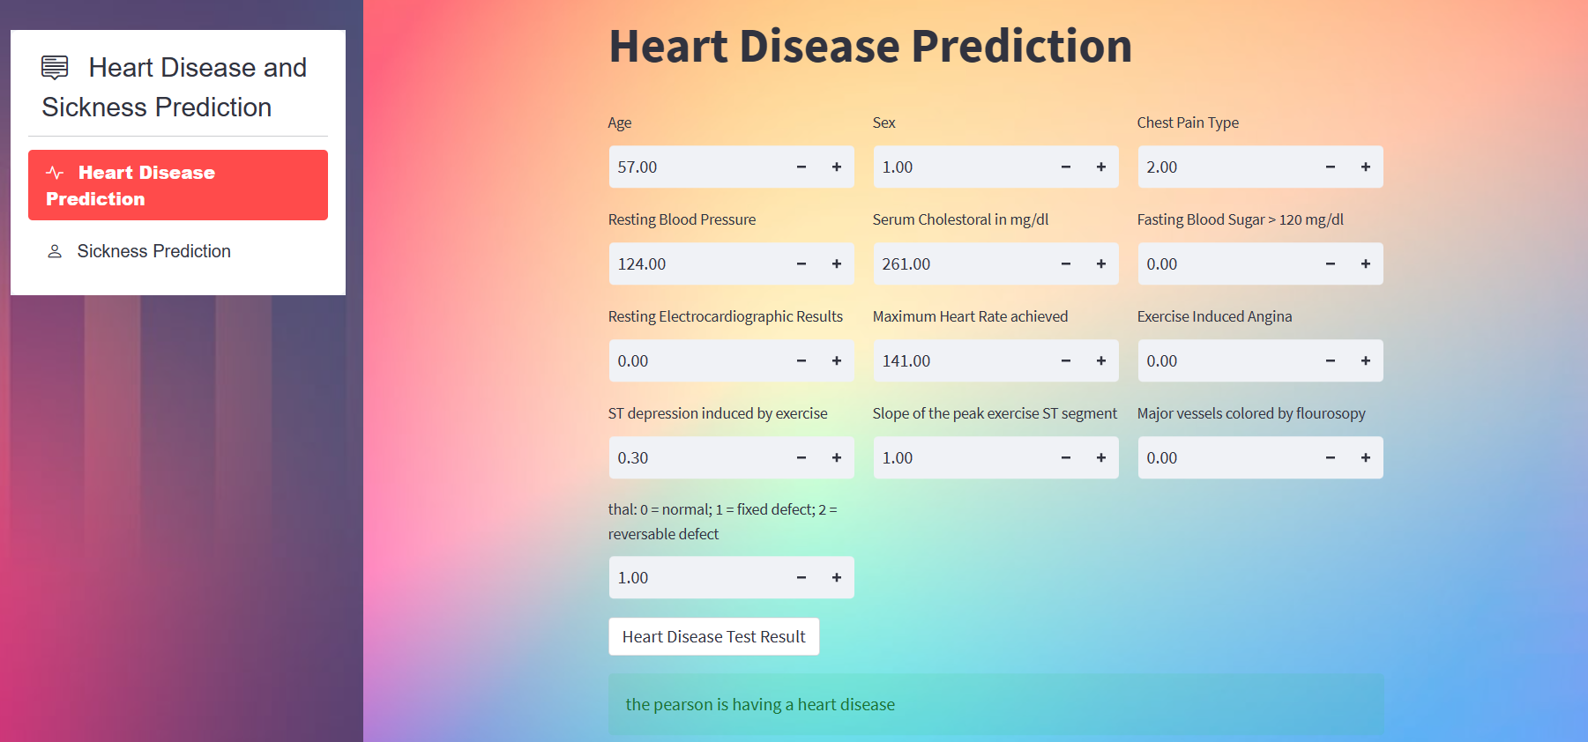

Slide 13
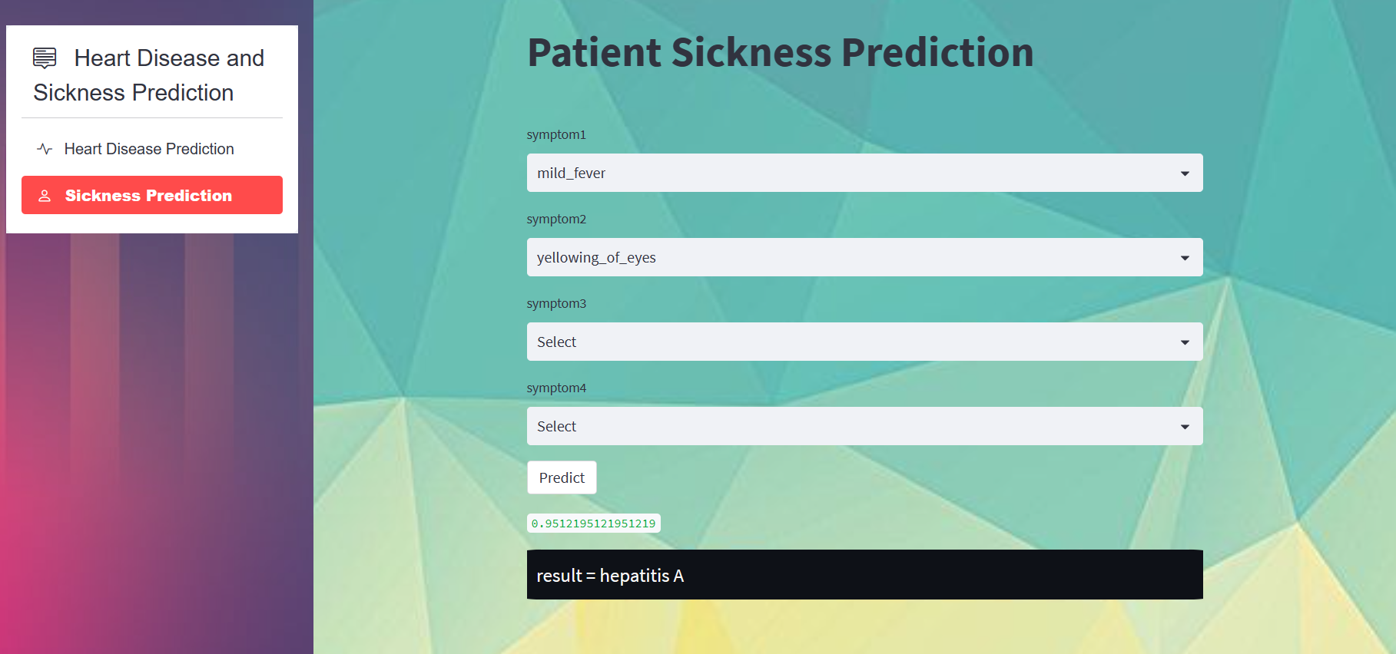

Slide 14
Attributes Used
Heart Disease Detection Dataset
Sickness Prediction Dataset
1) Age
2) Sex
3) Chest-pain
4) Resting blood pressure
5) Serum Cholesterol
6) Fasting Blood Sugar
7) Resting ECG
8) Max heart rate achieved
9) Exercise induced angina
10) ST depression induced by exercise relative to rest
11) Peak exercise ST segment
12) Number of major vessels(0-3) coloured by fluoroscopy
13) Thalassemia
14) Diagnosis of heart disease
1) fever
2) Sweating
3) Chills and shivering
4) Headache
5) Muscle aches
6) Loss of appetite
7) irritability
8) Dehydration
9) general weakness
10) Cold
11) Vomiting
12) feeling uneasy
<number>

Slide 15
10. Results
The prediction system that we have built consists of Sickness Prediction as well as Heart Disease Prediction for patients. It uses Random Forest Classifier for predicting a disease after giving the symptoms as input and it provides the accuracy of 95%. The Heart disease prediction part uses Logistic Regression which is the best algorithm to train the models with large datasets and get the discrete value Yes or No as answer. The accuracy of this part is better than any other algorithm used in combinations provided that patients need to put some of the medicals details related to bp, cholesterol, diabetes, LDL, etc.
Department of Computer Science & Engineering, MITSoE, Loni Kalbhor
<number>

Slide 16
11. Conclusion and Future Work
The use of different ML algorithms enabled the early detection of many maladies such as heart, kidney, breast, and brain diseases, including simple flu and viral diseases. The Random Forest Classifier model proved to be the most adequate at predicting common diseases. It provides the best accuracy of 95%.
Heart diseases have become more and more frequent among people including our country. For the detection and prediction of heart disease we have used Logistic Regression and arrived at the accuracy of 81%. This accuracy can be improved in several aspects, for example applying deep Learning algorithms, using other methods for attribute selection, and even increasing the size of the data set in future to avoid overfitting and for the better performance.
Department of Computer Science & Engineering, MITSoE, Loni Kalbhor
<number>

Slide 17
References
[1]. Cai, J., Luo, J., Wang, S., Yang, S.: Feature selection in machine learning: A new perspective.
Neuro computing 300, 70–79 (2018)
[2]. Raju, C., Philipsy, E., Chacko, S., Suresh, L.P., Rajan, S.D.: A survey on predicting heart
disease using data mining techniques. In: 2018 Conference on Emerging Devices and Smart
Systems (ICEDSS). pp. 253–255. IEEE (2018)
[43] Fang, X., Hodge, B.M., Du, E., Zhang, N., Li, F.: Modelling wind power spatial temporal
correlation in multi-interval optimal power flow: A sparse correlation matrix approach. Applied
energy 230, 531–539 (2018)
[4]. Gavhane, A., Kokkula, G., Pandya, I., Devadkar, K.: Prediction of heart disease using machine
learning. In: 2018 Second International Conference on Electronics, Communication and Aerospace
Technology (ICECA). pp. 1275–1278. IEEE (2018)
[5]. S. Chae, S. Kwon, D. Lee, Predicting infectious disease using deep learning and big data,
International journal of environmental research and public health 15(8), 1596 (2018)
[6]. A.U. Haq, J.P. Li, M.H. Memon, S. Nazir, R. Sun, A hybrid intelligent system framework for
the prediction of heart disease using machine learning algorithms, Mobile Information Systems
2018 (2018)
[7]. M. Maniruzzaman, M.J. Rahman, B. Ahammed, M.M. Abedin, Classification and prediction
of diabetes disease using machine learning paradigm, Health Information Science and Systems
8(1), 7 (2020)
Department of Computer Science & Engineering, MITSoE, Loni Kalbhor
<number>

Slide 18
Thank You
Department of Computer Science & Engineering, MITSoE, Loni Kalbhor
<number>

Slide 19
Questions
Department of Computer Science & Engineering, MITSoE, Loni Kalbhor
<number>

