Slide 1

Team Name : [Team name]
Team Leader Name : [Team leader name]
Team Size : [Team size]
Problem Statement : Track 3 – Predictive Maintenance & OEE Command Center · Plant Brain
Notes:
Plant Brain: a maintenance memory for a factory. When your best technician retires, their knowledge doesn't. Fill in team name, leader and size before submitting.

Slide 2

1. Problem Brief
Sensor data can tell you that a machine is drifting. It can't tell you what fixed it last time.
Business problem
Unplanned downtime, and repeat failures where the right fix was already known, but only in a senior technician's head or a scribbled shift note. Illustrative: ~₹1 crore/year lost output for a 12-asset plant.
Anjali
Maintenance planner, Deccan Precision Components, Pune (fictional)
3
production lines
12
critical assets
Target user
Maintenance planners and technicians in discrete manufacturing. Persona: Anjali, maintenance planner (fictional plant, synthetic data).
Pain point → improvement
Today: alarms, phone calls, digging through old work orders; a bearing-only fix recurred in 9 days. With Plant Brain: the anomaly arrives with the cited known fix, the "don't do this" warning, parts risk and the right technician. A human approves, and the closing note becomes new knowledge.
8
technicians
2
retire in 2027
Industry / domain context
Manufacturing OEE and predictive maintenance. OT sensor data sits apart from maintenance context, and an ageing workforce is retiring across GCC and Indian plants.
“When Press P3 acts up, everyone calls Ravi. Ravi retires next year.”
Notes:
The problem statement says OT data sits apart from maintenance context. We think the missing context is tribal knowledge. The rupee figure is illustrative. Anjali needs to know, the moment an alarm fires: has this happened before, what fixed it, what didn't, do we have the part, who should go.

Slide 3
2. Architecture Diagram
All Snowflake. Structured + unstructured sources → Brain → Cortex services → human-approved actions.
DATA SOURCES
LAND
PROCESS
SERVE (CORTEX)
ACT + UI
Sensors
311k readings · structured
CORE
OEE_DAILY, ASSET_HEALTH
Semantic View
10 verified queries (Analyst)
APP procs (Snowpark)
DRAFT_WORK_ORDER
APPROVE (human only)
CLOSE_JOB → new card
RESET_DEMO
Production log
OEE inputs · structured
RAW
stage +
COPY INTO
BRAIN: anomalies
z-score + slope, pattern match, failure window
Cortex Agent
cites, refuses, never approves
Parts, technicians
stock, skills · structured
Work-order notes
144, messy · unstructured
Streamlit in Snowflake
Command Center · Anomaly → Brain · Approval · Close Job · Ask the Plant
BRAIN: knowledge cards
Cortex AI_COMPLETE → cards + graph (recurrence, staleness)
Cortex Search
CARD_SEARCH over cards
Shift handovers
295, Hinglish · unstructured
learning loop: the closing note becomes a new knowledge card
CoCo CLI skills: card-extractor (extraction rules → AI_COMPLETE prompt + mock) and work-order-drafter (drafting rules → DRAFT_WORK_ORDER). Modular: one SQL file per box (00–09); one core Python package runs in Streamlit, the stored procedures and a local mock that executes the same SQL on DuckDB.
Notes:
Left to right. Structured and unstructured sources land in RAW. CORE computes OEE and health. BRAIN holds the anomalies from plain deterministic SQL and the knowledge cards extracted by Cortex AI_COMPLETE with a JSON schema, cached so each note is processed once. Cortex Search, a Semantic View and a Cortex Agent serve them. Stored procedures draft, approve and close work orders; approval is human only. The orange line is the learning loop.

Slide 4
3. Impact Statement
Measured on the synthetic golden scenario; business outcomes are illustrative targets.
25/25
golden questions answered correctly
naive keyword-RAG baseline: 10/25
5/5
out-of-scope questions correctly refused
baseline: 3/5
12/12
expected knowledge cards found in messy, Hinglish notes
incl. the one clear note, HN-0163
21–54 h
failure-window estimate for P3
contains the true ~24 h remaining
Local mock run, no LLM (retrieval, routing, graph, guard). Cortex numbers: eval/run_eval.py --snowflake.
Measurable outcomes (targets)
• Time to find the known fix: phone calls and digging → under a minute, on screen
• Repeat failures avoided: the 9-day bearing recurrence is flagged before work starts
• Parts risk caught early: BRG-6312 at 1 in stock, 21-day lead time
Scalability
• Snowflake-native: no data leaves the account; XS warehouse, auto-suspend
• Incremental: one AI_COMPLETE call per new note, cached by text hash
• Same schema per plant; cards shareable across sister plants
Beyond the demo
• Knowledge survives retirements: every closed job adds cards
• Staleness alerts when an asset changes (basic flag live)
• Voice notes and an MCP server for technician apps
Notes:
The four numbers are measured on our synthetic scenario in a local run without an LLM; say so. The first eval run was 22 of 25: it caught three routing and ranking bugs, which we fixed. The business outcomes are targets, not measurements.

Slide 5
The solution: one loop: detect, recall, act, learn
Demo scenario: Press P3 has failed this way three times; on the last day the same pattern starts again.
01
Anomaly detected
P3 vibration +9%, temperature following: CRITICAL (matches 4 past failures)
02
Brain recall
Ravi's fix: bearing AND grease LG-2 → HT-3, cited from handover note HN-0163
03
Failure window
Estimate 21–54 h to threshold, shown as a range, never one number
06
Close job → new card
The technician's closing note becomes knowledge (SUPERSEDES the failed fix)
05
Human approves
The agent can draft but never approve; agent approvals are refused
04
Drafted work order
Cited fix, "Do NOT" list, parts at risk, suggested technician
The gotcha the graph found: the junior's July note says "trial run ok". Only the link to the work order 9 days later shows that the bearing-only fix failed, so Plant Brain warns against repeating it.
Notes:
Walk the loop clockwise. Point at step 6: the closing note flows back in as a new card. That's how Ravi's knowledge outlives Ravi's employment.

Slide 6
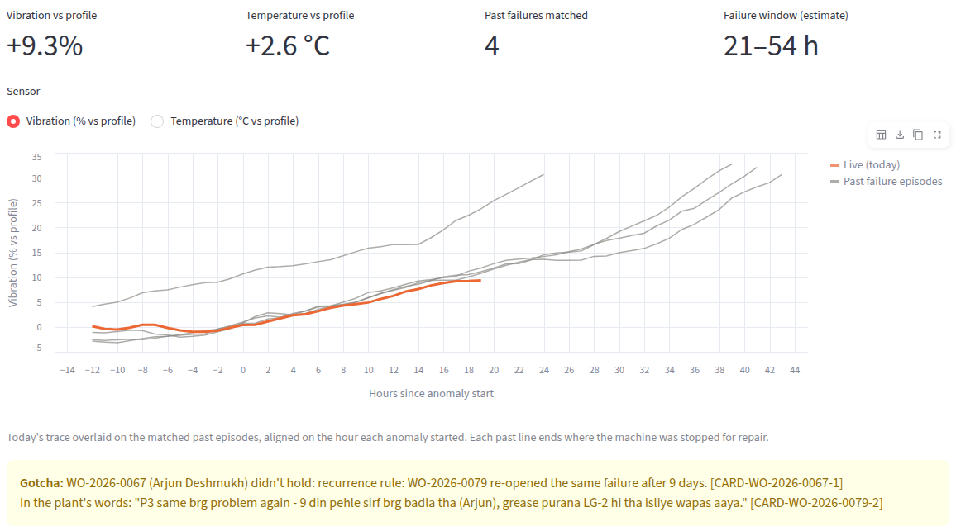
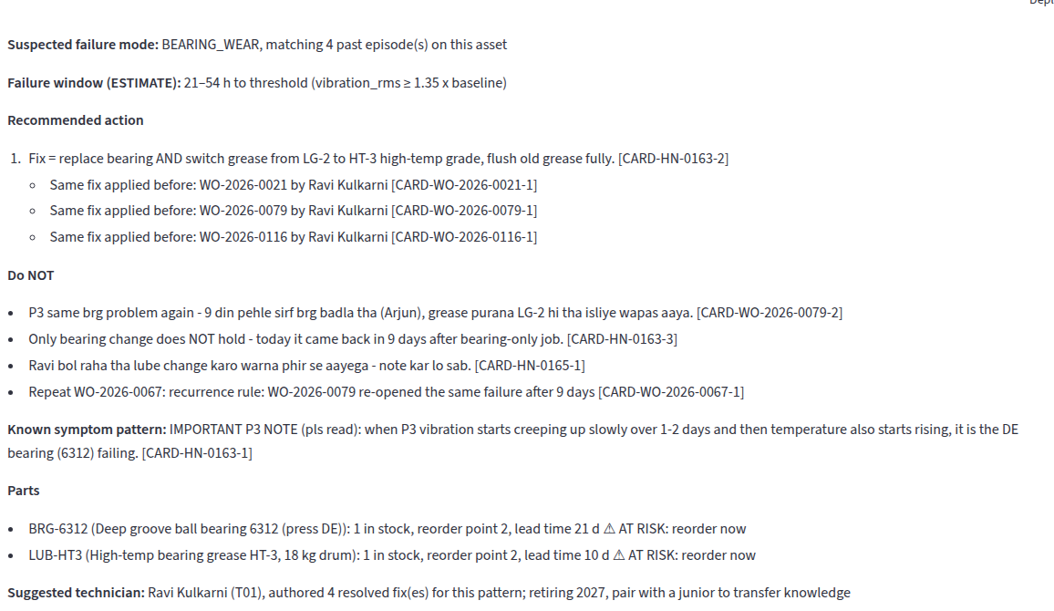
The product: Streamlit in Snowflake, five pages
Real screens from the built app (local mock backend, same code as Snowflake).
Anomaly → Brain: today's P3 trace (orange) over past failures, failure window and the 9-day gotcha
Work Order Approval: cited fix, "Do NOT" list, parts at risk, Ravi suggested; a human approves
Also: Command Center (OEE by line, active anomalies) · Close Job (closing note → new card + graph links) · Ask the Plant (cited answers, verified-query analytics, refusals).
Notes:
These are screenshots of the running app. The demo video walks through all five pages in three minutes.

Slide 7
Evaluation: Plant Brain vs a naive baseline
25 golden questions + golden-anomaly retrieval. Baseline = keyword search over raw notes (no cards, graph, verified queries or guard).
Overall: 25/25 vs 10/25
• Golden anomaly hit@3: both find HN-0163, but only Plant Brain ranks Ravi's explicit fix first
• Citations: 20/20 answerable answers cite card ids or a verified query
Honest caveats
• Local mock run without an LLM: measures retrieval, routing, graph and guard, not fluency
• Tuned and tested on the same synthetic scenario we designed
• First run 22/25: the eval caught 3 bugs, fixed and logged in coco/PROMPTS.md
Notes:
We didn't just demo the happy path. Same 25 questions for both systems. Be explicit that this is the offline mock run; re-run on Cortex with run_eval.py --snowflake before final judging if the account is live.

Slide 8
How it's built: CoCo CLI + Snowflake-native services
Prompts, skills and guard rails are in the repo, so judges can see exactly how CoCo was used.
How CoCo CLI was used
Skills: card-extractor and work-order-drafter encode the rules the agent and the procedures follow
Prompt log: coco/PROMPTS.md records each phase, what was produced, and every bug our own checks caught
Guard rails: AGENTS.md: synthetic data only, GA features, seed=42, human approval, cost discipline
Verification: generator --verify, 25 PASS/FAIL checks, smoke test, headless browser run, eval
Repo: [repo link] (public before submission)
Run it: make setup test app (local, 5 min) · scripts/deploy_snowflake.py · JUMPSTART.md
Cortex AI_COMPLETE
JSON-schema card extraction, incremental
Cortex Search
CARD_SEARCH with attribute filters
Semantic View
Cortex Analyst + 10 verified queries
Cortex Agent
Search + Analyst + draft tool
Snowpark procs
draft / approve / close job
Streamlit in Snowflake
5-page app
Tasks + monitor
backfill task, 20-credit cap
Plain SQL
OEE, anomalies, graph views
Notes:
Repo: [repo link]. Everything needed to reproduce is in the repo, including a local mock that runs the same SQL. Snowflake-only objects follow current docs; say honestly which ones have run on a live account.

Slide 9


