Slide 1
ST. Vincent Pallotti College of Engineering and Technology
★
ARISE & SHINE
DEPARTMENT OF INFORMATION TECHNOLOGY
Academic Year 2026-27
Summer Internship Seminar on
“Smart Campus Issue & Facility Management System”
Name of Industry: AD Infocom Systems
Industry Mentor: Mr. Prabhakar Dorge
Name of Guide: Prof. Shankar Gadhve
Alumni Mentor:
Project Member: [Your Name]
Class: B.Tech Information Technology
19-10-2026
1

Slide 2
TABLE OF CONTENT
1. Introduction
2. Literature Survey
3. Problem Definition
4. Proposed System
5. Project Flow
6. Hardware & Software Requirements
7. Outputs
8. Conclusion
9. Future Scope
10. References
19-10-2026
2

Slide 3
1. INTRODUCTION:
A Smart Campus Issue & Facility Management System needs reliable backend and frontend services to process student maintenance complaints, manage facility requests, and support administrative operations. The system connects student mobile applications and web dashboards with the database through server-side logic and REST APIs. My primary contribution focuses on End-to-End Issue Lifecycle Management, Photo Evidence Uploads, SLA Deadline Engine, and Admin Back-Office Operations.
Key Features / Contributions:
• Complaint creation, unique ticket code generation (TICK-2026-XXXX), and category routing.
• Role-based authentication routes (Student, Technician, Admin) with BCrypt hashing and HMAC tokens.
• Issue status workflow execution: OPEN ➔ ASSIGNED ➔ IN_PROGRESS ➔ RESOLVED ➔ CLOSED.
• Admin APIs for back-office operations, technician dispatching, and live dashboard metrics.
• Safe multipart file upload validation for issue photographs with strict MIME type checking.
• Database operations for users, categories, locations, tickets, ticket_history, and ticket_comments.
• REST API integration, client error handling, and CSV export for campus maintenance audits.
19-10-2026
3

Slide 4
2. LITERATURE SURVEY
Sr. No. | Title of Paper | Author Name | Publisher | Year | Findings
1 | Redesigning the Campus Maintenance Reporting System UI/UX Using Design Thinking | Z. N. F. Falaq, S. D. Anggita, and A. Baita | Journal of Applied Informatics | 2025 | Applies Design Thinking to campus facility reporting UI/UX. Emphasizes intuitive navigation, category routing, and reports a SUS score of 72.
2 | Design of Interactive Systems: Self-Service Reporting Technology in Academic Institutions | L. Martínez, J. Pérez, and C. Gómez | Computers & Education Reports | 2025 | Examines interface design for college self-service kiosks. Clear category information and photo attachments improved accuracy and reduced task errors.
3 | Analysis of System Usability Scale (SUS) for Web-Based Campus Facility Management | A. A. N. H. Susila and D. M. S. Arsa | Majalah Ilmiah UNIKOM | 2023 | Presents a web-based campus maintenance and ordering design. Uses the System Usability Scale (SUS) to evaluate usability, reporting an average score of 74.
19-10-2026
4

Slide 5
2. LITERATURE SURVEY (Contd.)
Sr. No. | Title of Paper | Author Name | Publisher | Year | Findings
4 | Assessing the Usability of Campus Problem Reporting Portals Using Fuzzy Kano Method | A. Taimouri, K. Emamisaleh, and D. Mohammadi | Int. Journal of Tech & Management | 2021 | Evaluates usability of campus issue tracking websites. Highlights photo uploads, room metadata, and SLA tracking as critical satisfaction factors.
5 | A Grounded Theory Approach to Understanding Digital Facility Management for Students | Y. Namkung, S. Y. Shin, and I. S. Yang | Journal of Facility Management Research | 2019 | Identifies platform transparency, live technician status updates, and discussion threads as key drivers of institutional trust.
19-10-2026
5

Slide 6
3. PROBLEM DEFINITION:
Campus facility and maintenance operations can become inefficient when complaints, technician assignments, and issue administration are handled manually through physical registers or informal WhatsApp messages. This leads to lost complaints, unverified issue details, delayed technician dispatch, and difficulty maintaining reliable maintenance records.
The problem is to provide backend services and web/mobile interfaces that securely and consistently manage complaints, role authorizations, technician allocations, and administrative tasks. My contribution focuses on implementing REST API routes and controllers for complaint management, status workflow execution, admin back-office operations, and photo uploads, with database support for users, categories, locations, tickets, ticket_history, and ticket_comments.
19-10-2026
6

Slide 7
4. PROPOSED SYSTEM:
The proposed Smart Campus Issue & Facility Management System uses an Android mobile app and web frontend connected to backend services and a MySQL database. The backend processes requests, applies business logic, stores records, and returns responses through REST APIs.
Key Aspects of My Backend Contribution:
• Issue Lifecycle Management: api/tickets/create.php, list_user.php, details.php
• Workflow Status Progression: api/admin/update_status.php (OPEN ➔ ASSIGNED ➔ IN_PROGRESS ➔ RESOLVED ➔ CLOSED)
• Admin Back-Office & Allocation: api/admin/assign.php, stats.php, list_all.php
• Photo Upload Validation: Safe MIME checking for damage photographs into uploads/tickets/
• Database tables covered: users, categories, locations, tickets, ticket_history, ticket_comments
• API-based communication between Android/Web frontend and PHP backend
19-10-2026
7

Slide 8
4. PROPOSED SYSTEM: (Modules)
System Modules:
1. Authentication Module:
Student and staff login with BCrypt hashing
User registration and role-based access
2. Category & Location Module:
Retrieve categories, locations, rooms, and QR tokens
Support dropdowns used by mobile and web
3. Issue Reporting Module:
Create and submit maintenance complaints
Process issue details, priority, and photo uploads
Backend Modules Implemented:
1. Complaint Management:
api/tickets/create.php, list_user.php
2. Status Transition & History:
api/admin/update_status.php
Immutable audit logs in ticket_history
3. Admin Back-Office & Allocation:
api/admin/assign.php, stats.php
CSV report export for campus audits
Database Tables Covered:
users, categories, locations, tickets, ticket_history, ticket_comments
19-10-2026
8

Slide 9
5. PROJECT FLOW:
Step 1: User Request: A student or administrator performs an action through the frontend.
Step 2: API Request: The frontend sends a request to the relevant PHP endpoint.
Step 3: Controller Processing: The controller validates request data and applies complaint, priority, or admin logic.
Step 4: Database Operations: Relevant ticket, category, or location records are read or updated in MySQL.
Step 5: Assignment Processing: The administrator assigns a technician and status automatically transitions to ASSIGNED.
Step 6: Image Upload: Issue damage images are safely validated and saved in uploads/tickets/.
Step 7: API Response: The backend returns a standardized JSON response for the frontend to display.
19-10-2026
9

Slide 10
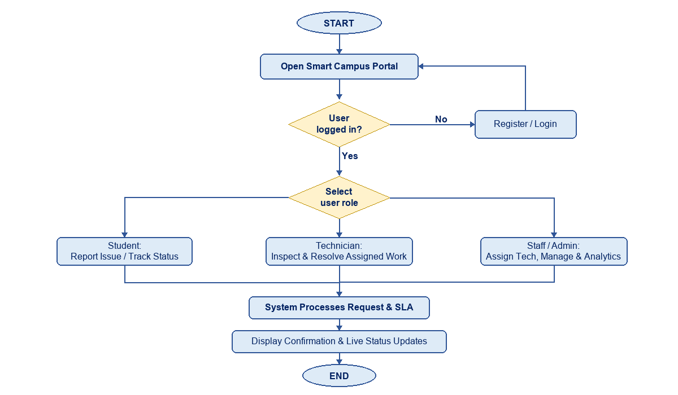
5. PROJECT FLOW: (Architecture Diagram)
19-10-2026
10

Slide 11
6. HARDWARE & SOFTWARE REQUIREMENTS:
Software Requirements:
Frontend (overall project):
• Android Studio (Java, XML)
• HTML5 and CSS3
• Bootstrap 5.3 & JavaScript (ES6)
• Chart.js for data visualization
• Volley for Android REST communication
Backend (my contribution):
• Core PHP 8.1+
• REST API routes and controllers
• PDO database transactions
• Multipart image upload validation
Database:
• MySQL 5.7+ / MariaDB
• Tables: users, categories, locations, tickets, ticket_history, ticket_comments
Hardware Requirements:
User Devices:
• Laptop/Desktop computer for campus administrators and technicians
• Smartphone (Android 7.0+) or laptop for students accessing the portal
• Stable campus Wi-Fi or local area network (LAN) connection
Development Machine:
• PC/Laptop with Intel Core i3/i5 or AMD Ryzen 3/5
• 8 GB RAM (recommended for Android Studio)
• 500 MB Free Storage space
19-10-2026
11

Slide 12
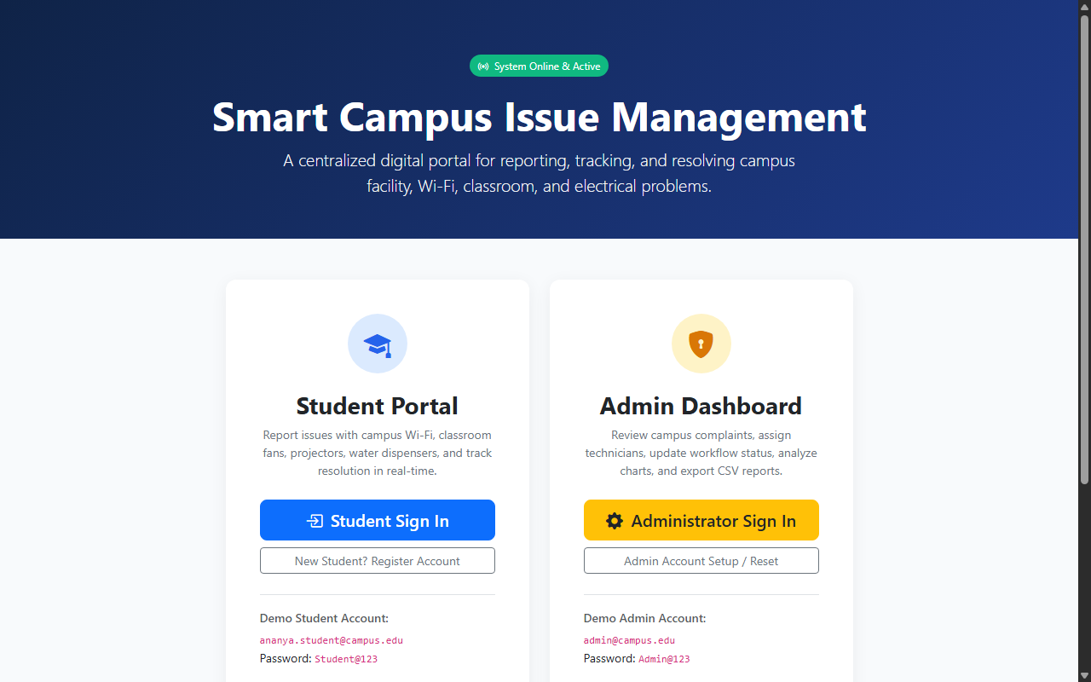
Outputs: Main Campus Dual Portal
19-10-2026
12

Slide 13
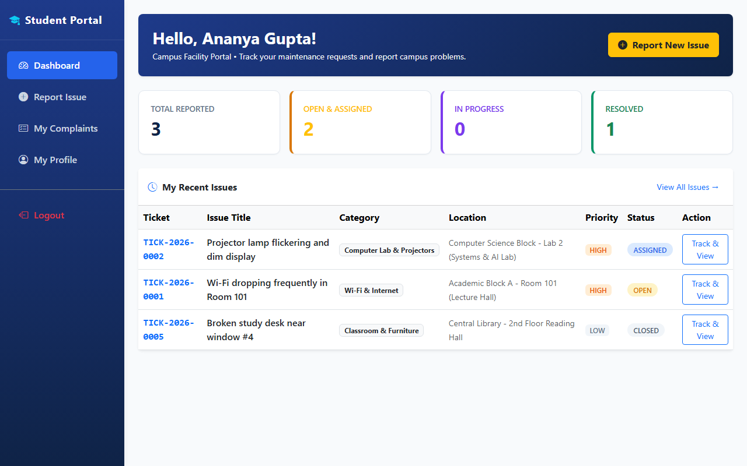
Outputs: Student Portal Dashboard & Issues
19-10-2026
13

Slide 14
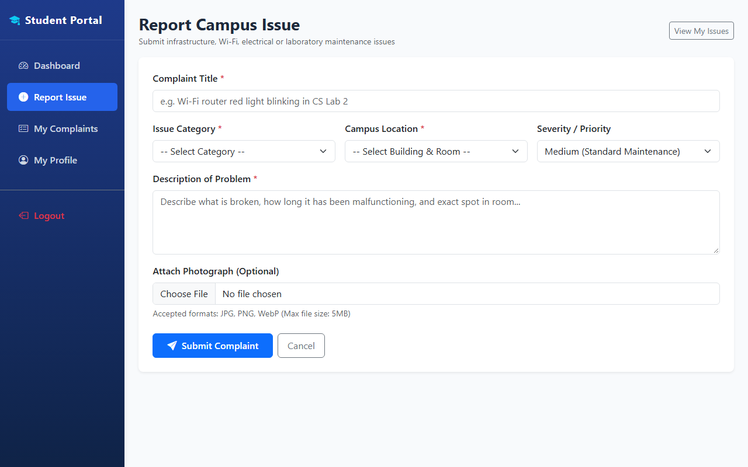
Outputs: Report New Issue Form
19-10-2026
14

Slide 15
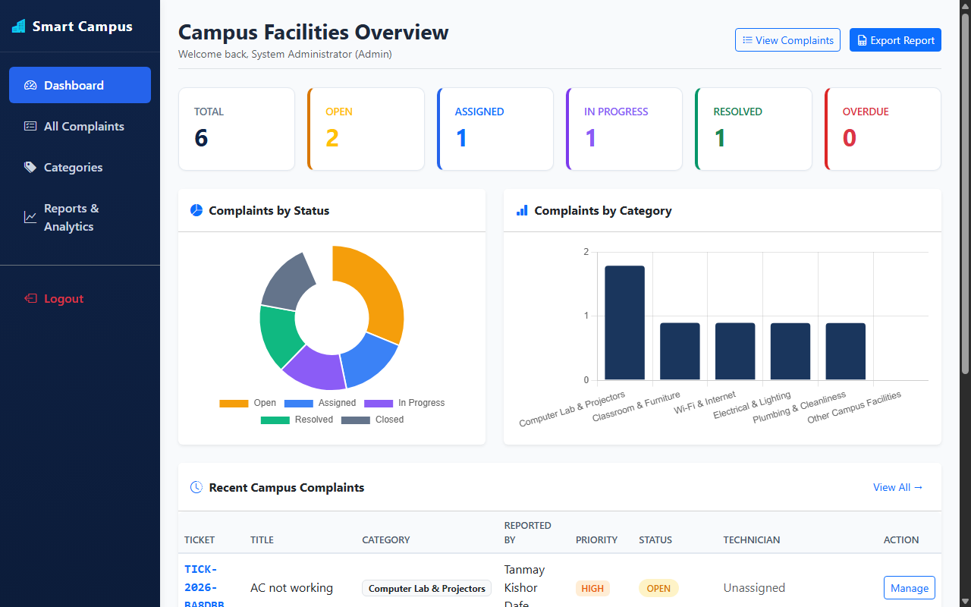
Outputs: Admin Dashboard & Analytics
19-10-2026
15

Slide 16
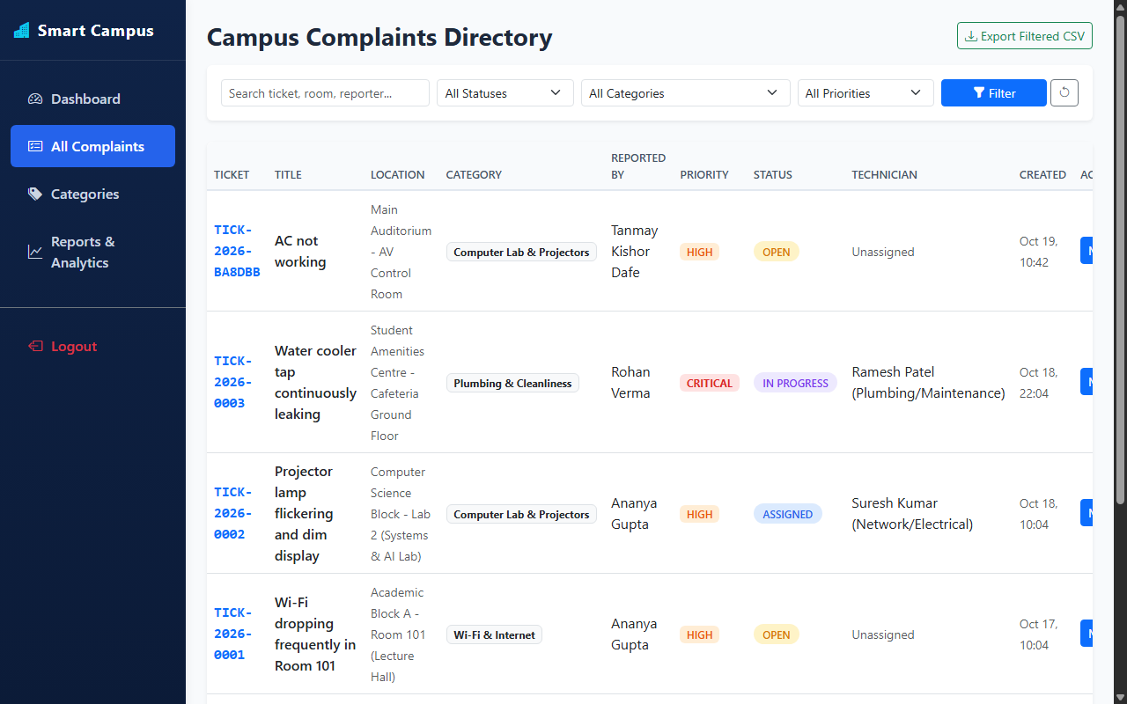
Outputs: Admin Complaints Management Directory
19-10-2026
16

Slide 17
7. CONCLUSION:
The Smart Campus Issue & Facility Management System provides a centralized digital platform for campus maintenance operations.
My contribution covers:
• Implemented complaint-management routes and controller logic.
• Worked on automated SLA deadline tracking and priority queues.
• Developed admin back-office routes and technician dispatch logic.
• Configured safe multipart file storage for damage photo uploads.
• Covered database operations involving tickets, history, and comments.
• Connected backend functionality with the frontend through REST APIs.
8. FUTURE SCOPE:
• Improve API security with stronger validation, authorization, and rate limiting.
• Add automated backend tests for ticket, assignment, and admin endpoints.
• Integrate Firebase Cloud Messaging (FCM) for instant push alerts.
• Implement camera QR code scanning for automatic room selection.
• Add reporting APIs for technician turnaround times and recurrent equipment failures.
• Optimize database queries and add monitoring for reliability and performance.
19-10-2026
17

Slide 18
9. REFERENCES:
A. F. K. Al Jufri, S. A. Paskalis, and N. Rukhviyanti, “Design of a Web-Based Regional Problem Reporting Information System at Academic Institutions,” INOVTEK Polbeng – Seri Informatika, vol. 10, no. 1, pp. 401–410, 2025.
“Design of Interactive Systems: Information Visualization Methods of Self-Service Technology in Facility Management,” Computers in Human Behavior Reports, vol. 17, article 100585, 2025.
A. L. Toombs and C. M. Gray, “Web Augmentation for Institutional Well-Being: Human-Centred Design of an Issue Reporting Digital Platform,” Interacting with Computers, vol. 33, no. 4, pp. 335–352, 2022.
A. Taimouri, K. Emamisaleh, and D. Mohammadi, “Assessing the Usability of Online Campus Issue Reporting Websites Using a New Fuzzy Kano Method: Implications for Improvement,” International Journal of Business and Management, vol. 14, no. 10, 2021.
B. L. Tong and N. A. Samsudin, “Development of Facility Management Web Based System for University Campus,” Applied Information Technology and Computer Science, 2020.
19-10-2026
18

Slide 19
THANK YOU!
19-10-2026
19

Slide 20
ANY SUGGESTIONS ?
19-10-2026
20

