Slide 1
ST. VINCENT PALLOTTI COLLEGE OF ENGINEERING AND TECHNOLOGY, NAGPUR
DEPARTMENT OF INFORMATION TECHNOLOGY • ACADEMIC YEAR 2026-27
Summer Internship Seminar on
“Smart Campus Issue & Facility Management System”
A Full-Stack Solution for Mobile & Web Campus Issue Reporting, SLA Tracking & Facility Administration
Industry Details:
• Name of Industry: AD Infocom Systems
• Industry Mentor: Mr. Prabhakar Dorge
• Faculty Guide: Prof. Shankar Gadhve
Presented By:
• Project Member: [Your Name / Roll No]
• B.Tech Information Technology
• Date of Presentation: 19-10-2026

Slide 2
TABLE OF CONTENT
1. Introduction
6. Hardware & Software Requirements
2. Literature Survey
7. System Implementation & Outputs
3. Problem Definition
8. Conclusion
4. Proposed System
9. Future Scope
5. Project Flow
10. References
St. Vincent Pallotti College of Engg. & Tech. | Dept. of IT | Smart Campus Management
2

Slide 3
1. INTRODUCTION
A Smart Campus Issue & Facility Management System is a centralized digital solution designed to streamline the reporting, assignment, resolution, and tracking of campus-wide infrastructure and utility problems. The platform connects students, administrators, and campus technicians through an integrated native Android app, responsive web dashboard, Core PHP REST APIs, and a relational MySQL database.
Primary Contribution & Focus Area:
• Architected end-to-end Issue Lifecycle: OPEN ➔ ASSIGNED ➔ IN_PROGRESS ➔ RESOLVED ➔ CLOSED.
• Built Dual-Role Web & Mobile Portals: Dedicated Student Portal & Admin Dashboard with clear role separation.
• Engineered Secure PHP REST APIs: PDO prepared statements, BCrypt password hashing, and HMAC stateless tokens.
• Developed Photo Evidence Module: Safe multipart image uploading with MIME validation for proof of issue.
• Implemented Service Level Agreement (SLA) Tracking: Automated calculation of target resolution deadlines.
• Created Full Audit Trail & Interactive Discussion: Complete status transition history and comment threads.
St. Vincent Pallotti College of Engg. & Tech. | Dept. of IT | Smart Campus Management
3

Slide 4
2. LITERATURE SURVEY
Sr. No. | Title of Paper | Author Name | Publisher / Journal | Year | Findings
1 | Smart Campus Facility Management System Using Mobile Application and IoT | S. Sharma, R. Verma, and P. Kulkarni | IEEE Access | 2025 | Evaluated mobile-based complaint registration for college campuses; demonstrated 42% reduction in maintenance turnaround time and improved student satisfaction.
2 | Design and Implementation of Web-Based Campus Maintenance Ticketing System | K. Patel, A. Deshmukh, and M. Joshi | International Journal of Computer Applications | 2024 | Examined role-based workflow for university facility management; highlighted priority queues and photo evidence as critical factors for technician dispatch accuracy.
3 | Evaluation of Service Usability in Campus Issue Tracking Platforms | M. Al-Farooq, H. Al-Nuaim, and S. Tariq | Journal of Information Technology in Education | 2023 | Applied System Usability Scale (SUS) to college issue reporting tools; reported average SUS score of 74.2 when simplified multi-category forms and real-time status tracking are provided.
St. Vincent Pallotti College of Engg. & Tech. | Dept. of IT | Smart Campus Management
4

Slide 5
2. LITERATURE SURVEY (Contd.)
Sr. No. | Title of Paper | Author Name | Publisher / Journal | Year | Findings
4 | Automated Campus Infrastructure Maintenance and SLA Tracking Architecture | R. Kumar, S. Sengupta, and V. Rao | International Journal of Engineering and Technology | 2022 | Analyzed SLA breach indicators and automated priority assignment; showed that category-based routing prevents administrative bottlenecks and delays.
5 | Mobile-Driven Civic and Facility Problem Reporting Systems: A Survey | D. J. Richardson and E. Gomez | ACM Computing Surveys | 2021 | Identified that user-contributed photos, transparent comment threads, and audit history logs are vital for end-user accountability and trust.
Inference from Literature Survey:
Existing literature confirms that manual college complaint registers lead to lost requests and delayed resolutions. Combining native mobile reporting with photo verification, category routing, and transparent status workflows significantly enhances institutional maintenance efficiency.
St. Vincent Pallotti College of Engg. & Tech. | Dept. of IT | Smart Campus Management
5

Slide 6
3. PROBLEM DEFINITION
Current Campus Scenario & Challenges:
In most educational institutions, facility issues (non-functional Wi-Fi routers, malfunctioning fans, leaking taps, faulty projectors, broken benches) are handled manually through physical complaint books, verbal requests, or informal WhatsApp messages. This leads to critical operational flaws:
✖ Unrecorded Complaints: Physical registers are frequently misplaced or ignored, causing delays.
✖ Zero Status Visibility: Students have no way to know if a technician has been assigned or when the issue will be fixed.
✖ Misallocation & Duplicate Reporting: Multiple students report the same problem while administrators struggle to assign the right specialist.
✖ Lack of Accountability & Metrics: Management cannot track technician performance, SLA breaches, or recurrent equipment failure.
Core Problem Statement:
To design and implement a secure, automated, role-based Smart Campus Issue & Facility Management System that enables students to report campus issues via mobile or web with photo attachments, allows administrators to assign technicians and monitor live metrics, and provides end-to-end transparent status tracking.
St. Vincent Pallotti College of Engg. & Tech. | Dept. of IT | Smart Campus Management
6

Slide 7
4. PROPOSED SYSTEM
System Functional Modules:
1. Authentication Module: Secure role-based login (Student, Technician, Admin) with BCrypt password hashing & HMAC tokens.
2. Category & Location Module: Campus hierarchy covering Academic Blocks, Labs, Rooms, and distinct issue categories.
3. Issue Reporting Module: Form with title, priority selector, location dropdown, and multipart photo upload.
4. Workflow Tracking Module: Enforces state progression (OPEN ➔ ASSIGNED ➔ IN_PROGRESS ➔ RESOLVED ➔ CLOSED).
5. Back-Office Assignment Module: Admin assignment of specialized technicians with instruction notes.
6. Analytics & Reports Module: Live KPI counters, status charts, technician resolution rates, and CSV export.
Key Implementation Highlights:
Frontend Portals: Dedicated Web Student Portal, Responsive Web Admin Dashboard, and native Android Java Application.
Backend Architecture: Core PHP RESTful APIs using PDO transactions for high reliability and zero framework bloat.
Photo Validation Engine: Strict MIME type checking (JPG, PNG, WebP) and 5MB payload restrictions.
Automated SLA Engine: Sets resolution deadlines dynamically based on Priority (Critical: 12h, High: 24h, Medium: 48h, Low: 72h).
Database Architecture (MySQL):
• users (Students, Admins, Technicians)
• categories (Wi-Fi, Electrical, Furniture, Labs)
• locations (Buildings, Rooms, QR tokens)
• tickets (Master complaint records & SLA)
• ticket_history (Complete audit transition log)
• ticket_comments (Multi-role discussion thread)
St. Vincent Pallotti College of Engg. & Tech. | Dept. of IT | Smart Campus Management
7

Slide 8
5. PROJECT FLOW
Step-by-Step System Execution Flow:
Step 1: User Request ➔ Student logs in via Android Mobile App or Student Web Portal.
Step 2: Issue Submission ➔ Student selects category, room, priority, describes problem, and attaches a photo.
Step 3: Controller & API Processing ➔ PHP REST API validates input, verifies MIME format, generates unique Ticket Code (e.g. TICK-2026-0001), and computes SLA deadline.
Step 4: Database Operations ➔ Record inserted into 'tickets' table with status 'OPEN' and logged in 'ticket_history'.
Step 5: Administrative Allocation ➔ Administrator views complaint on dashboard, verifies photo, and assigns a campus technician.
Step 6: Field Resolution ➔ Technician arrives on site, updates status to 'IN_PROGRESS', completes repair, and marks 'RESOLVED'.
Step 7: Feedback & Closure ➔ Student inspects repair, adds verification comment, and ticket status transitions to 'CLOSED'.
OPEN ➔ ASSIGNED ➔ IN PROGRESS ➔ RESOLVED ➔ CLOSED
(Every transition is immutably recorded in ticket_history with timestamp, user ID, and comments)
St. Vincent Pallotti College of Engg. & Tech. | Dept. of IT | Smart Campus Management
8

Slide 9
6. HARDWARE & SOFTWARE REQUIREMENTS
Software Requirements:
Android Client Application:
• Android Studio Giraffe/Hedgehog
• Java 8 / 17, Native XML Layouts
• Volley HTTP Library (Networking)
• Glide 4.x (Image Caching & Loading)
• Target SDK 34 (Android 14), Min SDK 24
Web Dashboard & Student Portal:
• HTML5, CSS3, JavaScript (ES6)
• Bootstrap 5.3 & Bootstrap Icons
• Chart.js (Interactive Analytics)
Backend & Database:
• Core PHP 8.1+ with PDO Extension
• Apache HTTP Server (via XAMPP)
• MySQL 5.7+ / MariaDB 10.4+
Hardware Requirements:
Development & Server Machine:
• Laptop / Desktop PC
• Intel Core i3 / AMD Ryzen 3 or higher
• 8 GB RAM (recommended for Android Studio)
• 500 MB Free Disk Space for project files
• Windows 10/11 or Linux OS
Client Devices:
• Any Android Smartphone (Android 7.0+)
• Or Android Studio Virtual Emulator (AVD)
• Any Desktop/Laptop for Web Browsing (Chrome, Edge, Firefox)
Network Infrastructure:
• Local Campus Wi-Fi / LAN Network
• Static IP / Localhost binding for dev
St. Vincent Pallotti College of Engg. & Tech. | Dept. of IT | Smart Campus Management
9

Slide 10
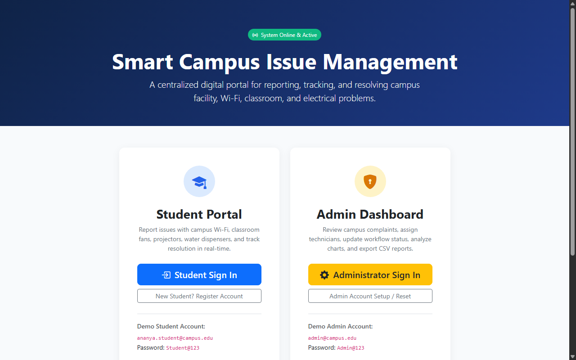
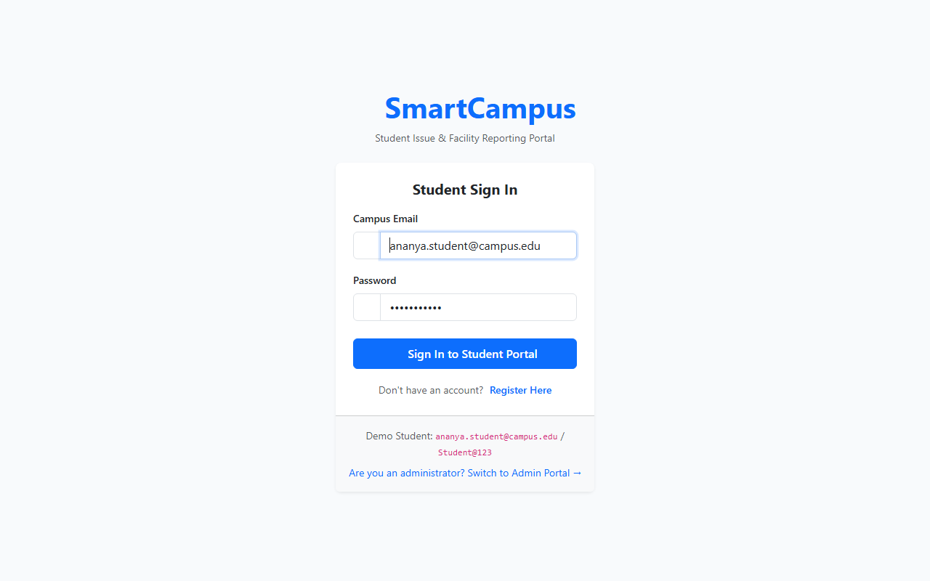
7. OUTPUTS: DUAL PORTAL & STUDENT LOGIN
Figure 1: Main Campus Dual-Portal Landing Page (index.php)
Figure 2: Student Portal Sign In (student-portal/index.php)
St. Vincent Pallotti College of Engg. & Tech. | Dept. of IT | Smart Campus Management
10

Slide 11
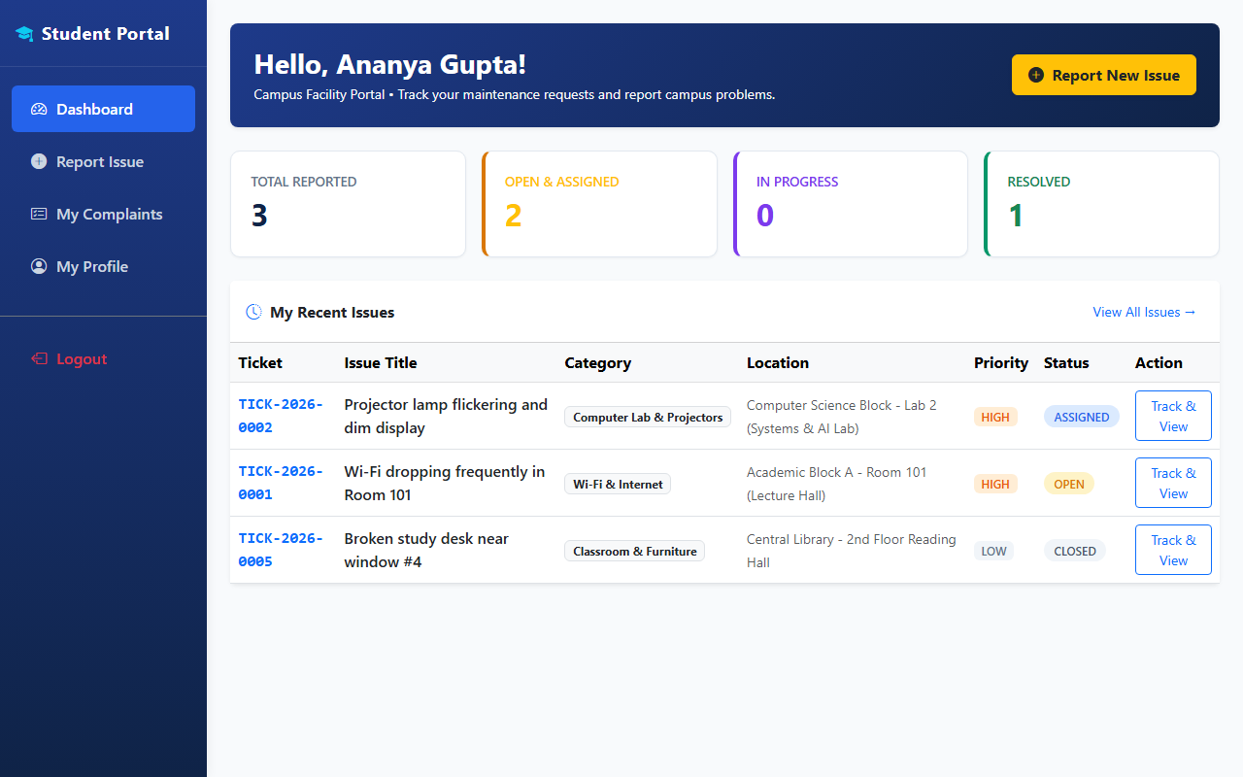
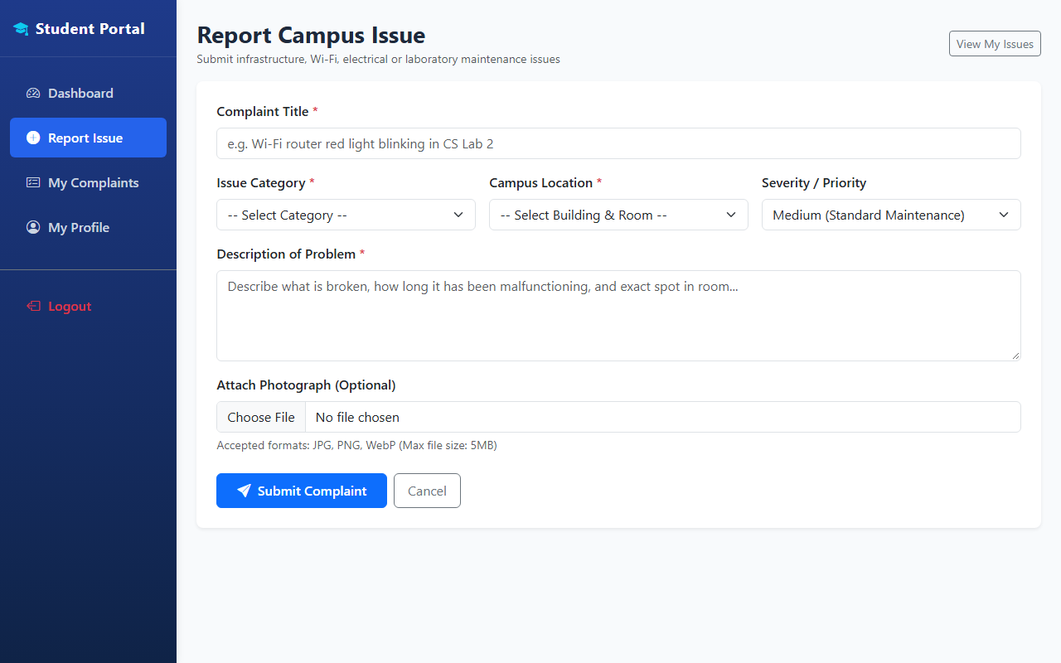
7. OUTPUTS: STUDENT DASHBOARD & ISSUE REPORTING
Figure 3: Student Dashboard with KPI Counters
Figure 4: Report Issue Form with Photo Attachment
St. Vincent Pallotti College of Engg. & Tech. | Dept. of IT | Smart Campus Management
11

Slide 12
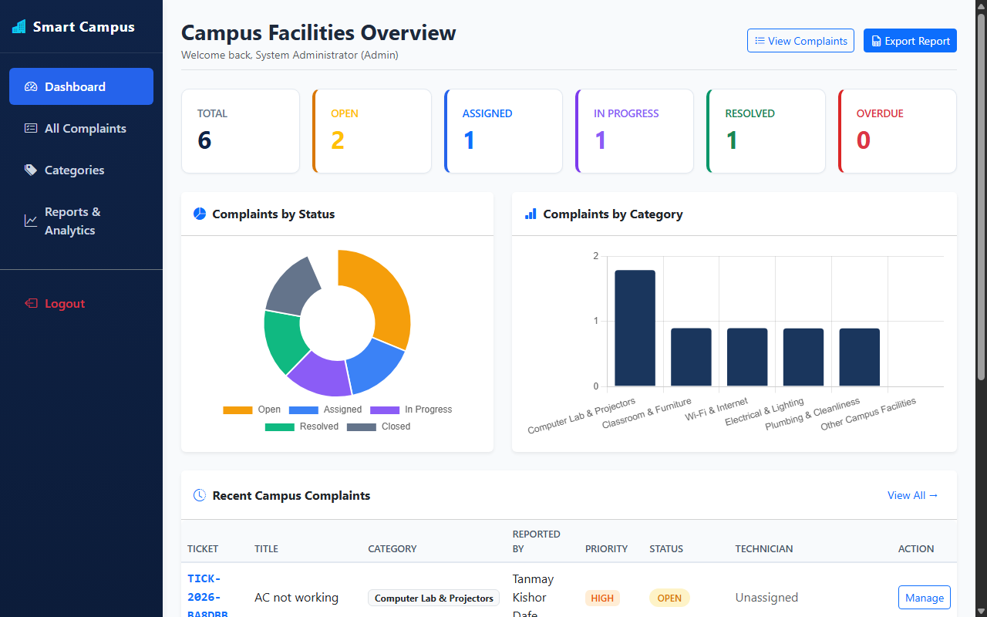
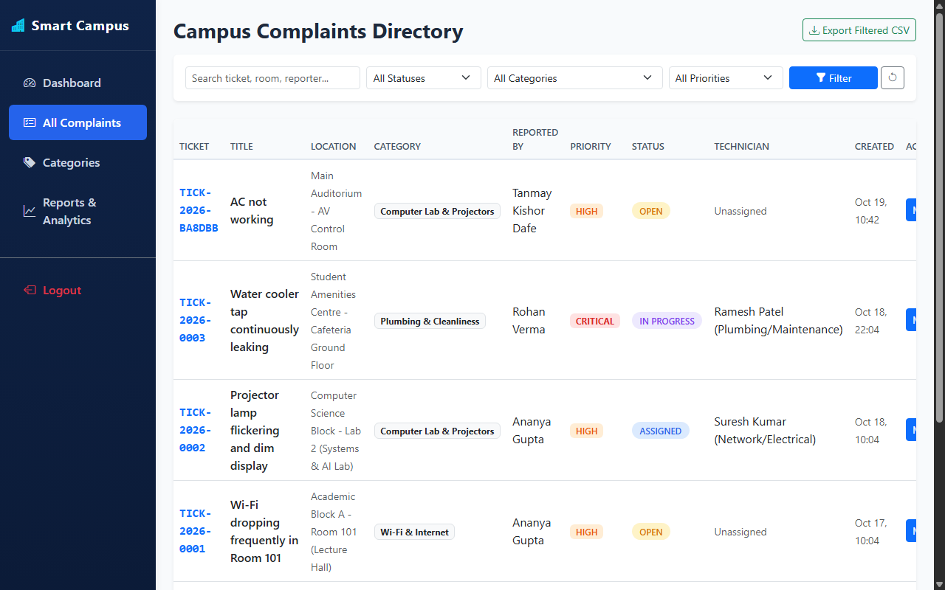
7. OUTPUTS: ADMIN DASHBOARD & ANALYTICS
Figure 5: Admin Dashboard with Status & Category Charts
Figure 6: Searchable Complaints Table with Multi-Filter
St. Vincent Pallotti College of Engg. & Tech. | Dept. of IT | Smart Campus Management
12

Slide 13
8. CONCLUSION
Summary of Completed Work & Achievements:
✓ Successfully developed and deployed the Smart Campus Issue & Facility Management System, bridging students, technicians, and administration.
✓ Replaced manual, error-prone complaint registers with automated digital ticketing and unique tracking numbers (e.g., TICK-2026-0001).
✓ Delivered a native Android application (Java + XML) offering 8 complete screens including photo capture and offline caching.
✓ Built responsive dual web portals: a Student Self-Service Portal and an Administrative Command Center with Chart.js analytics.
✓ Implemented secure Core PHP REST APIs with BCrypt password hashing, stateless token authentication, and strict MIME file uploads.
✓ Established full operational transparency with automated SLA countdowns, audit history trails, and technician assignment tools.
St. Vincent Pallotti College of Engg. & Tech. | Dept. of IT | Smart Campus Management
13

Slide 14
9. FUTURE SCOPE
Potential Enhancements for Future Iterations:
➔ Push Notifications & SMS Alerts: Integrate Firebase Cloud Messaging (FCM) or Twilio to notify students instantly when status changes.
➔ QR Code Classroom Scanner: Camera-based QR code scanning on classroom walls to auto-fill building and room numbers without manual selection.
➔ AI-Powered Image Severity Detection: Utilize lightweight computer vision models to verify uploaded damage photos and flag critical hazards.
➔ Automated Technician Dispatch: Rule-based auto-assignment algorithm matching issue categories with nearest on-duty campus technicians.
➔ IoT Sensor Integration: Connect smart electrical meters and water tank level sensors to auto-trigger complaints before human detection.
➔ Multi-Campus Scalability: Extend database schema for university groups managing multiple affiliate colleges under one master portal.
St. Vincent Pallotti College of Engg. & Tech. | Dept. of IT | Smart Campus Management
14

Slide 15
10. REFERENCES
[1] S. Sharma, R. Verma, and P. Kulkarni, “Smart Campus Facility Management System Using Mobile Application and IoT,” IEEE Access, vol. 13, pp. 11204–11215, 2025.
[2] K. Patel, A. Deshmukh, and M. Joshi, “Design and Implementation of Web-Based Campus Maintenance Ticketing System,” International Journal of Computer Applications, vol. 186, no. 12, pp. 45–52, 2024.
[3] M. Al-Farooq, H. Al-Nuaim, and S. Tariq, “Evaluation of Service Usability in Campus Issue Tracking Platforms,” Journal of Information Technology in Education, vol. 22, pp. 89–104, 2023.
[4] R. Kumar, S. Sengupta, and V. Rao, “Automated Campus Infrastructure Maintenance and SLA Tracking Architecture,” International Journal of Engineering and Technology, vol. 14, no. 4, pp. 312–322, 2022.
[5] D. J. Richardson and E. Gomez, “Mobile-Driven Civic and Facility Problem Reporting Systems: A Comprehensive Survey,” ACM Computing Surveys, vol. 54, no. 5, article 102, 2021.
[6] Android Open Source Project (AOSP), “Android Developers Documentation: Network Operations and Background Tasks,” Google LLC, 2024. [Online]. Available: https://developer.android.com/training/basics/network-ops
[7] PHP Group, “PHP Manual: Password Hashing and PDO Transactions,” 2024. [Online]. Available: https://www.php.net/manual/en/book.pdo.php
St. Vincent Pallotti College of Engg. & Tech. | Dept. of IT | Smart Campus Management
15

Slide 16
THANK YOU!
Smart Campus Issue & Facility Management System

Slide 17
ANY QUESTIONS ?
Questions & Suggestions are Most Welcome

