Slide 1


Kadi Sarva Vishwavidyalaya
S.K. Patel Institute of Management & Computer Studies- MCA
MCA SEMESTER–IV MCA-41
“INDUSTRY PROJECT”
PharmaCentral
Group No. : 60
STUDENT NAME | ENROLLMENT NUMBER | Exam Number
Tanmay Darji | 24MCA02017 | 1144022
Parth Patel | 24MCA02083 | 1144078

Slide 2
Introduction :-
PharmaCentral is a pharmacy management system that helps make pharmacy work easier and faster. It allows the pharmacy to store, update, and check information such as medicines, sales and customers in real time. The system also helps users quickly find medicines by searching using the drug name, drug code, or description.
The system keeps track of medicine quantity and expiration dates. It gives alerts when a medicine is running low or when it has expired. This helps the pharmacist manage stock properly and avoid selling expired drugs. As the number of customers increases, PharmaCentral reduces the workload of the pharmacist by saving time and keeping records organized. Overall, it helps the pharmacy work efficiently and provide better service to customers.

Slide 3
Current / Existing System
The existing system flowchart describes the manual process followed in a pharmacy for handling customer prescriptions and dispensing medicines. The process begins when a customer visits the pharmacy and submits a prescription. The pharmacist then checks whether the required drug is available. If the medicine is not immediately found, a manual search is performed using the drug name or drug code.
Once the drug is located, the pharmacist manually verifies the expiry date. If the medicine is expired, it is marked as unavailable and not dispensed to the customer. If the drug is valid and not expired, the pharmacist dispenses the medicine to the customer. After dispensing, payment is collected and the process ends.
This existing system relies heavily on manual searching, manual stock checking, and manual expiry verification. As a result, the process is timeconsuming, prone to human errors, and inefficient, especially when handling a large number of medicines and customers.

Slide 4
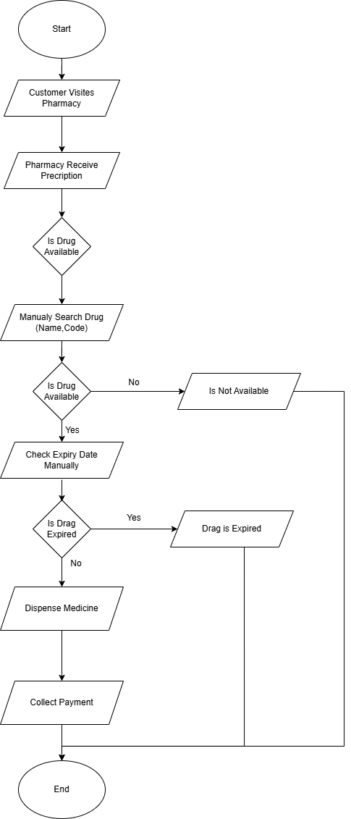
Flow Process :-

Slide 5
Drawbacks :-
The existing system is mostly manual and time-consuming.
In the current system, all pharmacy activities such as searching for medicines, checking stock, verifying expiry dates, and recording sales are performed manually. The pharmacist must go through registers or files to find information, which takes a significant amount of time and slows down customer service.
There is a high chance of human errors in maintaining records.
Since the records are maintained manually, mistakes such as incorrect drug entries, wrong quantity updates, and missing expiry dates may occur. These errors can lead to incorrect inventory information, financial losses, and difficulty in tracking medicines accurately.

Slide 6
Drug availability and expiry dates are not monitored automatically.
The pharmacist must manually check whether a medicine is available and verify its expiry date. There is no automatic alert for expired medicines or low stock levels. This increases the risk of selling expired drugs or running out of essential medicines.
Managing inventory and customers becomes difficult as the business grows.
As the number of customers and medicines increases, maintaining records manually becomes more complex. Tracking customer details, debtor information, and stock levels becomes harder, leading to delays, poor inventory control, and reduced customer satisfaction.

Slide 7
Proposed System(Modules, Features, Scopes)
The proposed system is an automated pharmacy management system called PharmaCentral designed to manage medicine inventory, sales, customer records, and expiry tracking efficiently. The system replaces manual operations with a computerised solution that allows real-time data entry, quick searching of medicines, and automatic monitoring of stock levels and expiry dates. This improves accuracy, reduces workload, and enhances customer service.
The proposed PharmaCentral system automates all pharmacy operations including medicine management, customer handling, sales tracking, and stock monitoring. The system uses string searching techniques to quickly locate medicines using drug name, drug code, or description. It also monitors minimum quantity levels and expiry dates automatically, generating alerts when stock is low or medicines are expired.

Slide 8
The administrator can efficiently control inventory, track customer data, and manage pharmacy operations from a single system. This reduces manual effort, minimises errors, and improves overall efficiency.

Slide 9
Modules :-
User Management Module :- - Admin login and authentication
- Role-based access (Admin, Pharmacist)
2. Inventory Management Module :-
- Add, update, and delete drug records
- Track stock quantity and minimum stock levels
- Expiry date monitoring and alerts

Slide 10
3. Sales Management Module :-
- Record sales transactions
- Generate invoices and receipts
- Manage customer orders
4. Customer Management Module :-
- Store customer details
- Track purchase history
- Manage debtor information

Slide 11
5. Reporting & Analytics Module :-
- Generate daily, weekly, and monthly sales reports
- Stock level reports and expiry alerts
- Data visualization for decision making
6. Search Module :-
- Search drugs using name, code, or description
- Quick access to inventory information
7. Medicine Request Module :-
- Request Medicine
- View Medicine Requests
- Update Request Status
- Track Request History

Slide 12
Feature :-
Real-time inventory updates
The system automatically updates the inventory whenever a medicine is added, sold, or removed. This ensures that the stock quantity displayed in the system is always accurate. Real-time updates help pharmacists know the exact availability of medicines at any moment and reduce the chances of stock mismanagement.
Automated expiry date alerts
The proposed system continuously monitors the expiry dates of medicines stored in the database. If a medicine is close to its expiry date or already expired, the system generates an alert for the pharmacist. This feature helps prevent the sale of expired medicines and ensures patient safety.

Slide 13
Minimum stock quantity notifications
Each medicine in the system has a predefined minimum stock level. When the quantity of a drug falls below this level, the system automatically sends a notification to the administrator. This helps the pharmacy reorder medicines on time and avoid stock shortages.
Fast and intelligent drug search using string matching
The proposed system continuously monitors the expiry dates of medicines stored in the database. If a medicine is close to its expiry date or already expired, the system generates an alert for the pharmacist. This feature helps prevent the sale of expired medicines and ensures patient safety.

Slide 14
Efficient sales and customer record management
The system records all sales transactions automatically and maintains customer information in a structured database. It also keeps track of debtor records and purchase history. This helps the pharmacist manage customer relationships and maintain accurate financial records.
Secure access with role-based permissions
The system provides secure login access to different users such as administrators and staff members. Each user is given specific permissions based on their role. For example, administrators can manage inventory and generate reports, while staff members can handle sales transactions.

Slide 15
Reports for sales, stock, and customer trends
The system can generate detailed reports related to sales performance, stock availability, and customer purchasing patterns. These reports help pharmacy administrators analyse business performance and make better decisions regarding inventory management and sales strategies.
Providing Medicines Requested by Customers
The system allows pharmacists to quickly check the availability of medicines requested by customers. If the medicine is available and not expired, it can be dispensed immediately. This improves service speed, increases customer satisfaction, and ensures accurate billing and record keeping.

Slide 16
Scope :-
After billing, an SMS notification is not sent to the customer.
In the proposed system, SMS notification functionality is not included after billing. Once the payment is completed and the bill is generated, the system only records the transaction internally. Customers do not receive any SMS confirmation regarding their purchase, bill details, or payment information. This limitation means customers must rely on printed receipts for transaction records.

Slide 17
Hardware and Software Specification
Hardware (Server):-
Processor :- Pentium 2.0 GHz or Above
RAM :- 1GB – 2GB
Hard Disk :- Minimum 10GB Free Space
Internet :- 3G / 4G / 5G

Slide 18
Hardware (Client):-
CPU :- 2.66 GHz or Higher (Intel / AMD)
RAM :- 1GB or Higher
Hard Disk :- 1.5GB or Higher
Internet :- Stable Internet Connection (Wi-Fi / 3G / 4G / 5G)

Slide 19
Software (Server):-
Operating System :- Windows 7 or Higher
Frontend :- HTML, CSS, JavaScript
Backend :- Python with Django
Database :- SQLite3

Slide 20
Software (Client):-
Operating System :-Windows XP or Higher
Web Browser :- Chrome, Firefox, Edge
Mobile Browser :- Chrome, Opera Mini

Slide 21
Analysis
Fact Finding Method :-
Fact finding method is used to collect information about the existing system and user requirements. This information is gathered through techniques such as interviews, observation, and document analysis.

Slide 22
Feature | Manual Pharmacy (Existing System) | Dava India(Existing System)
Digital Record Management | NO | YES
Real-time Medicine Stock Monitoring | NO | YES
Medicine Search by Name / Code | NO | YES
Expiry Date Alert | NO | NO
Low Stock Alert | NO | NO
Customer Management | NO | YES
Debtor Management | NO | NO
Medicine Request | NO | NO
Automatic Sales Calculation | NO | YES
Invoice Generation | NO | YES
Report Generation | NO | NO
Real-time Data Access | NO | NO
Error Reduction | NO | NO

Slide 23
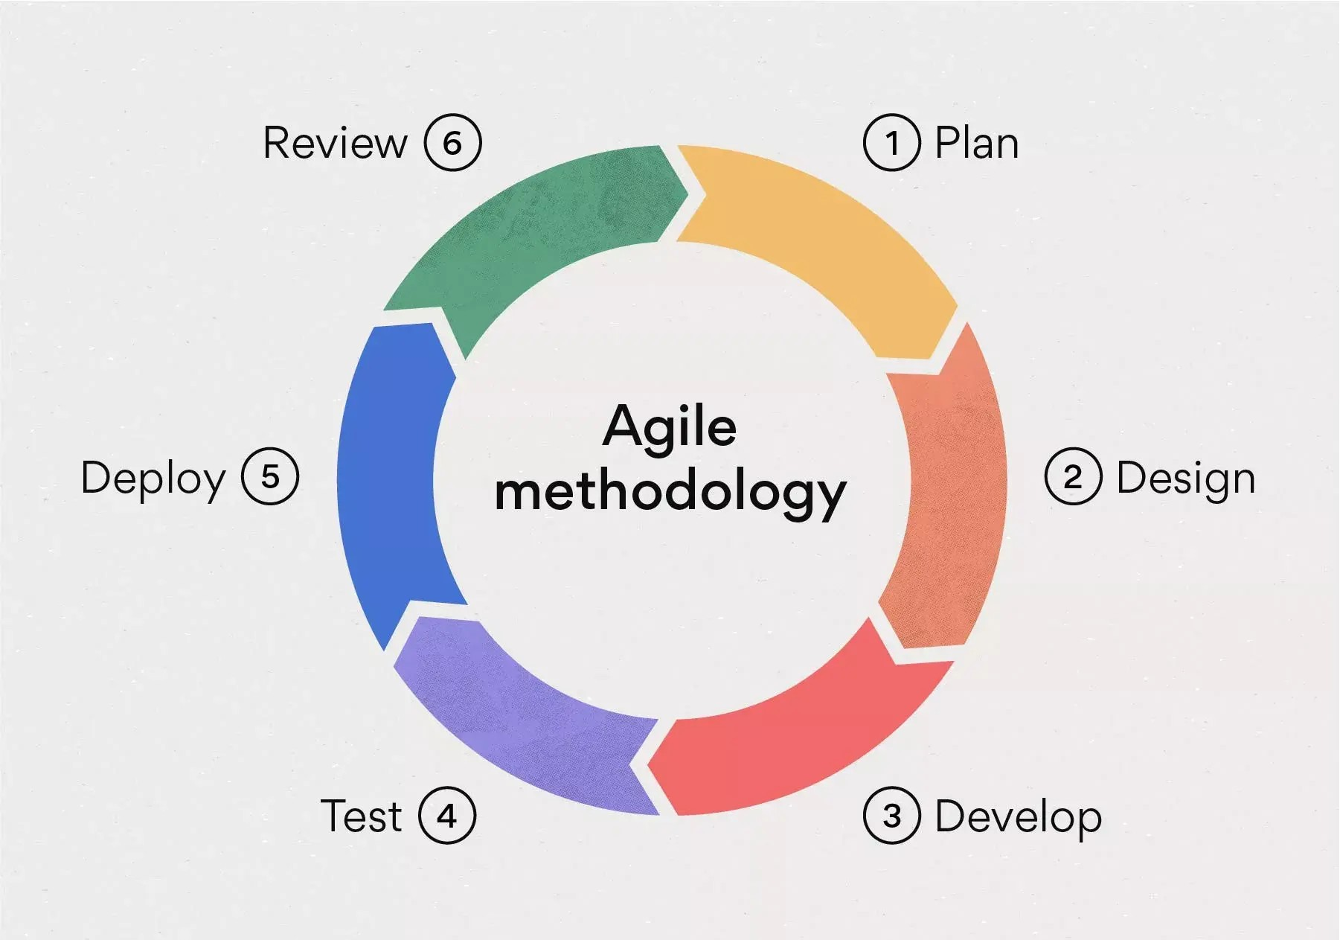
Process Model :-
Agile Model :-

Slide 24
Agile Model is an iterative development approach where the system is developed in small parts. Each part is designed, developed, and tested step by step.
This model allows easy changes and continuous improvement of the system.
Agile development can also lead to cost savings due to its flexible and adaptable process structure.

Slide 25
Development Strategy
PharmaCentral will be developed using an Agile approach, where the system is built step by step and improved regularly. First, the project requirements will be collected, such as medicine management, sales tracking, customer records, debtor management, and alert features. After that, the system design will be prepared using database tables, class diagrams, and module planning.
The development will be divided into main modules such as user management, inventory management, sales, customer records, debtor tracking, alerts, and reports. Django will be used for backend development, while HTML, CSS, and JavaScript will be used for the user interface.
The system will then be tested properly to make sure all functions work correctly, especially stock alerts, expiry checking, and billing. Finally, the project will be deployed and maintained with regular updates and improvements.

Slide 26
Type of System :-
PharmaCentral is a Web-Based, Database-Driven, Inventory Management, Sales Monitoring, and Multi-User Pharmacy Management System.
Web-Based: It is accessible through any web browser without requiring installation.
Database-Driven: It uses a database to store medicine details, customer records, sales transactions, debtor information, alerts, and reports.
Inventory Management System: It monitors medicine stock, minimum quantity, and expiry dates in real time.
Sales Monitoring System: It manages billing, payments, and customer purchase records efficiently.
Multi-User System: It supports different user roles such as Admin, Pharmacy Owner, Pharmacist, and Cashier.

Slide 27
Diagram
1. Estimated Gantt Chart/ Time Line Chart
2025 | Dec 10, 2025 | Dec 25, 2025 | Jan 10, 2026 | Jan 18, 2026 | Feb 7, 2026 | Feb 14, 2026 | Feb 21, 2026 | Feb 28, 2026 | Mar 7, 2026 | Mar 14, 2026 | Mar 21, 2026
Title | ███
Project Introduction |  | ███
Existing System |  |  | ███
Flow Chart of Existing |  |  |  | ███
Proposed System |  |  |  |  | ███
Fact Finding & Hardware and Software Specification |  |  |  |  |  | ███
Process Model, Development Strategy, Type of System |  |  |  |  |  |  | ███
UML Diagrams |  |  |  |  |  |  |  | ███
Data Dictionary |  |  |  |  |  |  |  |  | ███
Design |  |  |  |  |  |  |  |  |  | ███
Development |  |  |  |  |  |  |  |  |  |  | ███

Slide 28
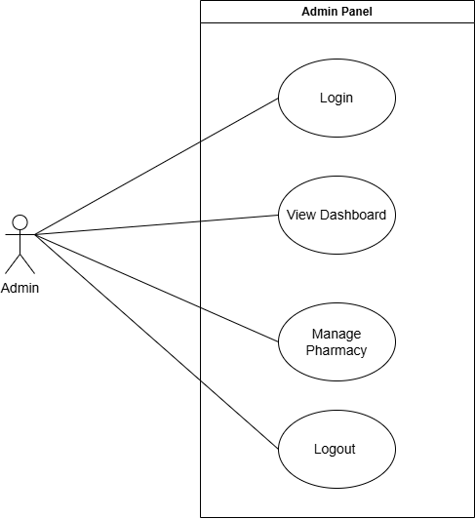
UML Diagrams(Use Case, Activity and Class )
Use case Diagram Admin :-

Slide 29
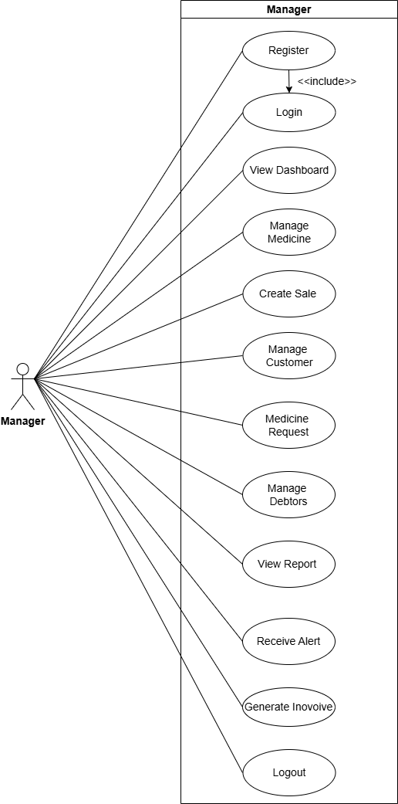
Use case Diagram Manager :-

Slide 30
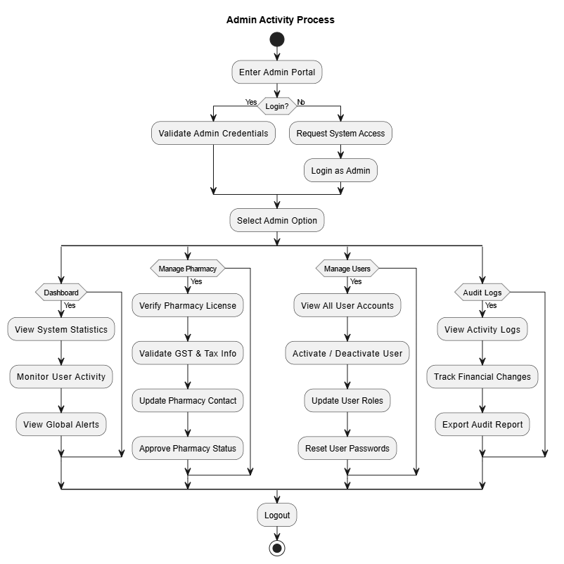
Activity Diagram Admin :-

Slide 31
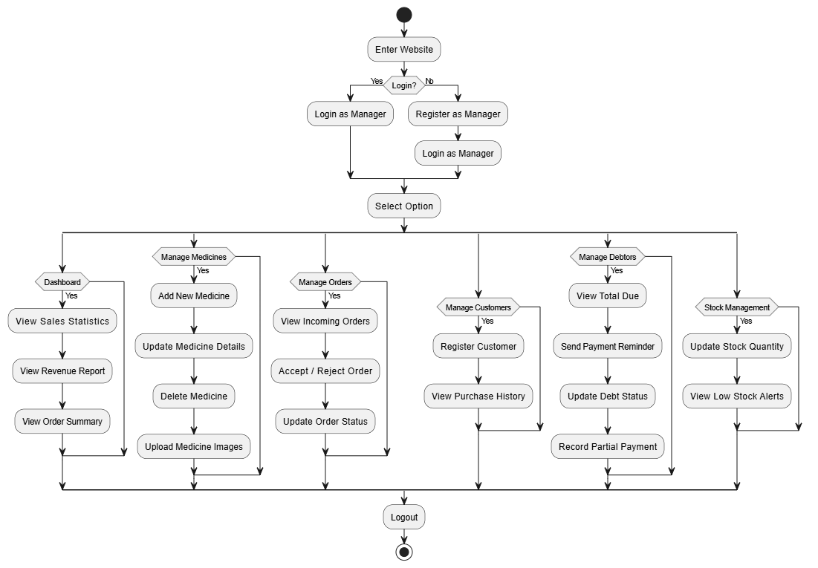
Activity Diagram Manager :-

Slide 32
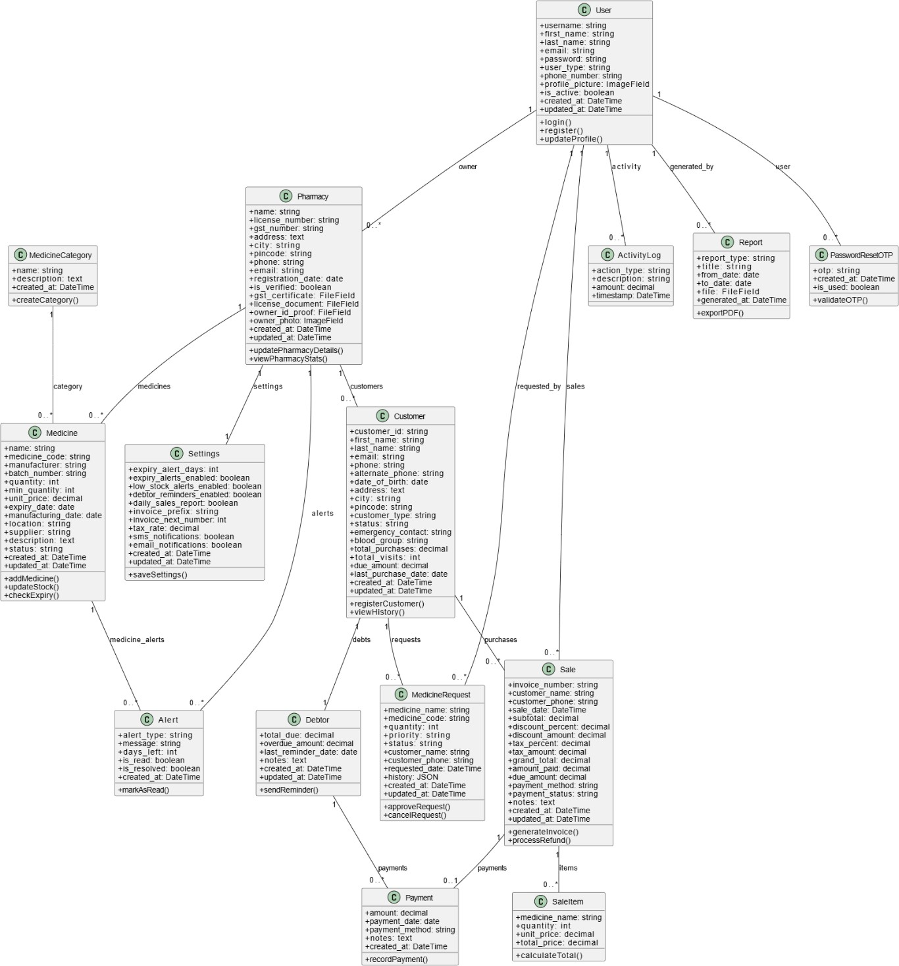
Class Diagram :-

Slide 33
Design :-
SR.NO. | FILD NAME | DATA TYPE | SIZE | CONSTRAINT | DESCRIPTION
1. | User_Id | Integer | 4 | Primary key | Unique identifier for user
2. | Username | Varchar | 20 | Not null, Unique | Stores username
3. | First_name | Varchar | 20 | Not null | Stores first name
4. | Last_name | Varchar | 20 | Not null | Stores last name
5. | Email | Varchar | 20 | Not null | Stores email
6. | Password | Varchar | 10 | Not null | Stores password
7. | Phone_number | Varchar | 10 | Not null | Stores contact number
8. | Profile_picture | Image/file | - | Not null | Stores user profile image
9. | Is_active | Boolean | 1 | Not null | Indicates active status
10. | Create_at | Date time | - | Not null | Stores record creation date and time
11. | Update_at | Date time | - | Not null | Stores last update date and time
Database :-
User Table

Slide 34
Pharmacy Table
SR.NO | FILD NAME | DATA TYPE | SIZE | CONSTRAINT | DESCRIPTION
1. | Pharmacy_Id | Integer | 4 | Primary key | Unique identifier for pharmacy
2. | Name | Varchar | 20 | Not null | Stores pharmacy name
3. | user_id | Integer | 4 | Foreign key | References User
4. | Licence_number | Varchar | 50 | Not null | Stores pharmacy licence number
5. | Gst_number | Varchar | 50 | Not null | Stores GST number
6. | Address | Varchar | 100 | Not null | Stores pharmacy address
7. | City | Varchar | 50 | Not null | Stores city name
8. | Pincode | Integer | 7 | Not null | Stores postal code
9. | Phone | integer | 10 | Not null | Stores contact number

Slide 35
SR.NO | FILD NAME | DATA TYPE | SIZE | CONSTRAINT | DESCRIPTION
10. | Email | varchar | 50 | Not null | Stores pharmacy email
11. | Registration_date | Date | - | Not null | Stores registration date
12. | Is_verified | Boolean | 1 | Not null | Indicates verification status
13. | Gst_certificate | File | - | Not null | Stores GST certificate file
14. | Licence_document | File | - | Not null | Stores licence document
15. | Owner_id_proof | File | - | Not null | Stores owner ID proof
16. | Owner_photo | File | - | Not null | Stores owner photo
17. | Create_at | Datetime | - | Not null | Stores creation date and time
18. | Update_at | Datetime | - | Not null | Stores last modified time

Slide 36
Medicine_category Table
SR.NO | FILD NAME | DATA TYPE | SIZE | CONSTRAINT | DESCRIPTION
1. | Medicine_category_Id | Integer | 4 | Primary key | Unique identifier for category
2. | Name | Varchar | 50 | Not null | Stores category name
3. | Description | Text | - | Null allow | Stores category description
4. | Create_at | Datetime | - | Not null | Stores creation time

Slide 37
Medicine Table
SR.NO | FILD NAME | DATA TYPE | SIZE | CONSTRAINT | DESCRIPTION
1. | Medicine_id | Integer | 4 | Primary key | Unique identifier for medicine
2. | Pharmacy_id | integer | 4 | Foreign key | References Pharmacy
3. | Name | Varchar | 40 | Not null | Stores medicine name
4. | Medicine_code | Varchar | 50 | Not null | Stores medicine code
5. | Category_id | Integer | 4 | Foreign key | References Medicine Category
6. | Manufacture | Varchar | 50 | Not null | Stores manufacturer name
7. | Batch_number | Varchar | 50 | Not null | Stores batch number
8. | Quantity | Integer | 4 | Not null | Stores stock quantity
9. | Min_quantity | integer | 4 | Not null | Stores minimum stock level

Slide 38
SR.NO | FILD NAME | DATA TYPE | SIZE | CONSTRAINT | DESCRIPTION
10. | unit_price | Decimal | 10,2 | Not null | Stores price per unit
11. | expiry_date | Date | - | Not null | Stores expiry date
12. | manufacturing_date | Date | - | Not null | Stores manufacturing date
13. | Location | Varchar | 50 | Not null | Stores rack or shelf location
14. | Supplier | Varchar | 50 | Not null | Stores supplier name
15. | Description | Varchar | 100 | Not null | Stores medicine details
16. | Status | varchar | 50 | Not null | Stores stock/expiry status
17. | created_at | Datetime | - | Not null | Stores creation time
18. | updated_at | Datetime | - | Not null | Stores last update time

Slide 39
Customer Table
SR.NO | FILD NAME | DATA TYPE | SIZE | CONSTRAINT | DESCRIPTION
1. | Customer_id | Integer | 4 | Primary key | Unique identifier for customer
2. | pharmacy_id | Integer | 4 | Foreign Key | References Pharmacy
3. | First_name | Varchar | 20 | Not null | Stores first name
4. | Last_name | Varchar | 20 | Not null | Stores last name
5. | Email | Varchar | 50 | Null allow | Stores email address
6. | Phone | Integer | 10 | Not null | Stores phone number
7. | Alternate_phone | Integer | 10 | Null allow | Stores alternate number
8. | Date_of_birth | Integer | 15 | Not null | Stores date of birth
9. | Address | Varchar | 100 | Not null | Stores address
10. | city | varchar | 20 | Not null | Stores city

Slide 40
SR.NO | FILD NAME | DATA TYPE | SIZE | CONSTRAINT | DESCRIPTION
11. | pincode | Varchar | 7 | Not null | Stores postal code
12. | customer_type | Varchar | 15 | Not null | Stores customer category
13. | status | Varchar | 20 | Not null | Stores customer status
14. | blood_group | Varchar | 5 | Not null | Stores blood group
15. | total_purchases | Decimal | 12,2 | Not null | Stores total purchase amount
16. | total_visits | Integer | 4 | Not null | Stores visit count
17. | due_amount | Decimal | 12,2 | Not null | Stores pending due amount
18. | last_purchase_date | Date | - | Not null | Stores last purchase date
19. | created_at | Date | - | Not null | Stores creation date
20. | updated_at | datetime | - | Not null | Stores last update time

Slide 41
Sale Table
SR.NO | FILD NAME | DATA TYPE | SIZE | CONSTRAINT | DESCRIPTION
1. | sale_id | Integer | 4 | Primary key | Unique identifier for sale
2. | Pharmacy_id | integer | 4 | Foreign key | References Pharmacy
3. | Invoice_number | Varchar | 20 | Not null | Stores invoice number
4. | Customer_id | Integer | 4 | Foreign Key | References Customer
5. | Customer_name | Varchar | 50 | Null allow | Stores walk-in customer name
6. | Customer_phone | Integer | 10 | Null allow | Stores walk-in phone number
7. | Date | Date | - | Not null | Stores sale date and time
8. | Subtotal | Decimal | 5,2 | Not null | Stores subtotal amount
9. | Discount_amount | Decimal | 5,2 | Not null | Stores discount amount

Slide 42
SR.NO | FILD NAME | DATA TYPE | SIZE | CONSTRAINT | DESCRIPTION
10. | grand_total | Decimal | 5,2 | Not null | Stores final bill amount
11. | amount_paid | Decimal | 5,2 | Not null | Stores paid amount
12. | due_amount | Decimal | 5,2 | Not null | Stores remaining due
13. | payment_method | Varchar | 25 | Not null | Stores payment mode
14. | payment_status | Varchar | 25 | Not null | Stores payment status
15. | notes | Varchar | 100 | Not null | Stores additional notes
16. | created_at | Datetime | - | Not null | Stores creation time
17. | updated_at | Datetime | - | Not null | Stores update time

Slide 43
Sale_item Table
SR.NO | FILD NAME | DATA TYPE | SIZE | CONSTRAINT | DESCRIPTION
1. | Sale_item_id | Integer | 4 | Primary key | Unique identifier for sale
2. | sale_id | Integer | 4 | Foreign key | References Pharmacy
3. | Medicine_id | Integer | 4 | Not null | Stores invoice number
4. | Medicine_name | Varchar | 25 | Foreign Key | References Customer
5. | Quantity | Integer | 4 | Null allow | Stores walk-in customer name
6. | Unit_price | Decimal | 5,2 | Null allow | Stores walk-in phone number
7. | Total_price | Decimal | 5,2 | Not null | Stores sale date and time

Slide 44
Debtor Table
SR.NO | FILD NAME | DATA TYPE | SIZE | CONSTRAINT | DESCRIPTION
1. | debtor_id | Integer | 4 | Primary key | Unique identifier for debtor record
2. | Pharmacy_id | integer | 4 | Foreign key | References Pharmacy
3. | Customer_id | integer | 4 | Foreign key | References Customer
4. | Total_due | Decimal | 5,2 | Not null | Stores total due amount
5. | Overdue_amount | Decimal | 5,2 | Not null | Stores overdue amount
6. | last_reminder_date | Date | - | Null allow | Stores last reminder date
7. | Notes | Varchar | 200 | Null Allow | Stores remarks
8. | created_at | Datetime | - | Not null | Stores creation time
9. | updated_at | Datetime | - | Not null | Stores update time

Slide 45
Payment Table
SR.NO | FILD NAME | DATA TYPE | SIZE | CONSTRAINT | DESCRIPTION
1. | payment_id | Integer | 4 | Primary key | Unique identifier for payment
2. | debtor_id | integer | 4 | Foreign key | References Debtor
3. | sale_id | integer | 4 | Foreign key | References Sale
4. | Amount | Decimal | 12,2 | Not null | Stores payment amount
5. | Payment_date | Date | - | Not null | Stores payment date
6. | Payment_method | varchar | 25 | Null allow | Stores payment type
7. | Notes | Varchar | 200 | Null Allow | Stores remarks
8. | Recived_by_id | integer | 4 | Foreign key | References User
9. | updated_at | Datetime | - | Not null | Stores update time

Slide 46
Activity_log Table
SR.NO | FILD NAME | DATA TYPE | SIZE | CONSTRAINT | DESCRIPTION
1. | log_id | Integer | 4 | Primary key | Unique identifier for log
2. | user_id | integer | 4 | Foreign key | References User
3. | Action_type | Varchar | 20 | Not null | Stores activity type
4. | description | Varchar | 100 | Not null | Stores action description
5. | Amount | Decimal | 5,2 | Null allow | Stores related amount
6. | timestamp | date | - | Not null | Stores action time

Slide 47
Alert Table
SR.NO | FILD NAME | DATA TYPE | SIZE | CONSTRAINT | DESCRIPTION
1. | alert_id | Integer | 4 | Primary key | Unique identifier for alert
2. | pharmacy_id | integer | 4 | Foreign key | References Pharmacy
3. | Alert_type | Varchar | 25 | Not null | Stores alert type
4. | Medicine_id | Integer | 4 | Foreign key | References Medicine
5. | Customer_id | Integer | 4 | Foreign key | References Customer
6. | Message | Varchar | 200 | Not null | Stores alert message
7. | Day_left | integer | 4 | Null Allowed | Stores remaining days
8. | created_at | Datetime | - | Not null | Stores creation time

Slide 48
Report Table
SR.NO | FILD NAME | DATA TYPE | SIZE | CONSTRAINT | DESCRIPTION
1. | report_id | Integer | 4 | Primary key | Unique identifier for report
2. | Report_type | varchar | 20 | Not null | Stores report category
3. | Title | Varchar | 200 | Not null | Stores report title
4. | Form_date | Date | - | Not null | Stores start date
5. | To_date | Date | - | Not null | Stores end date
6. | File | file | - | Null allowed | Stores generated report file
7. | Generated_by_id | integer | 4 | Foreign key | References User
8. | generated_at | Datetime | - | Not null | Stores generation time

Slide 49
Setting Table
SR.NO | FILD NAME | DATA TYPE | SIZE | CONSTRAINT | DESCRIPTION
1. | setting_id | Integer | 4 | Primary key | Unique identifier for settings
2. | pharmacy_id | Integer | 4 | Not null | References Pharmacy
3. | expiry_alert_days | Integer | 4 | Not null | Stores alert days before expiry
4. | expiry_alerts_enabled | Boolean | 1 | Not null | Enables/disables expiry alerts
5. | low_stock_alerts_enabled | Boolean | 1 | Not null | Enables/disables low stock alerts
6. | debtor_reminders_enabled | Boolean | 1 | Not null | Enables/disables debtor reminders
7. | daily_sales_report | Boolean | 1 | Not null | Enables daily sales report

Slide 50
SR.NO | FILD NAME | DATA TYPE | SIZE | CONSTRAINT | DESCRIPTION
8. | invoice_prefix | varchar | 10 | Not null | Stores invoice prefix
9. | invoice_next_number | Integer | 4 | Not null | Stores next invoice number
10. | created_at | Datetime | - | Not null | Stores creation time
11. | updated_at | Datetime | - | Not null | Stores last update time

Slide 51
Medicine_request Table
SR.NO | FILD NAME | DATA TYPE | SIZE | CONSTRAINT | DESCRIPTION
1. | Medicine_req_id | Integer | 4 | Primary key | Unique identifier for medicine request
2. | pharmacy_id | Integer | 4 | Foreign Key | References Pharmacy
3. | Customer_id | Integer | 4 | Foreign Key | References Customer
4. | medicine_name | Varchar | 25 | Not null | Stores requested medicine name
5. | medicine_code | Varchar | 20 | Null allow | Stores requested medicine code
6. | quantity | Integer | 4 | Not null | Stores requested quantity
7. | priority | Varchar | 20 | Not null | Stores priority level
8. | status | Varchar | 20 | Not null | Stores request status

Slide 52
SR.NO | FILD NAME | DATA TYPE | SIZE | CONSTRAINT | DESCRIPTION
9. | notes | varchar | 100 | Primary key | Stores additional notes
10. | customer_name | Varchar | 25 | Foreign Key | Stores customer name
11. | customer_phone | Integer | 10 | Foreign Key | Stores customer phone
12. | requested_by_id | integer | 4 | Not null | References User
13. | requested_date | Datetime | - | Null allowed | Stores request date
14. | created_at | Datetime | - | Not null | Stores creation time
15. | updated_at | Datetime | - | Not null | Stores update time

Slide 53
Password_reset_otp Table
SR.NO | FILD NAME | DATA TYPE | SIZE | CONSTRAINT | DESCRIPTION
1. | Pass_id | Integer | 4 | Primary key | Unique identifier for OTP record
2. | user_id | Integer | 4 | Foreign Key | References User
3. | Otp | Varchar | 6 | Not Null | Stores one-time password
4. | created_at | DateTime | - | Not null | Stores OTP creation time
5. | is_used | Boolean | 1 | Not null | Indicates whether OTP is used

Slide 54
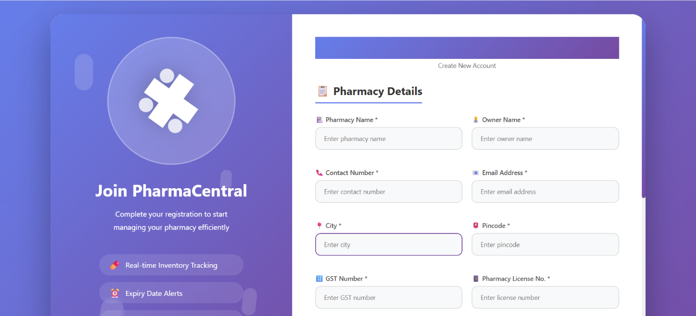
Screen/ Forms :-
Manager :-
Registration page

Slide 55
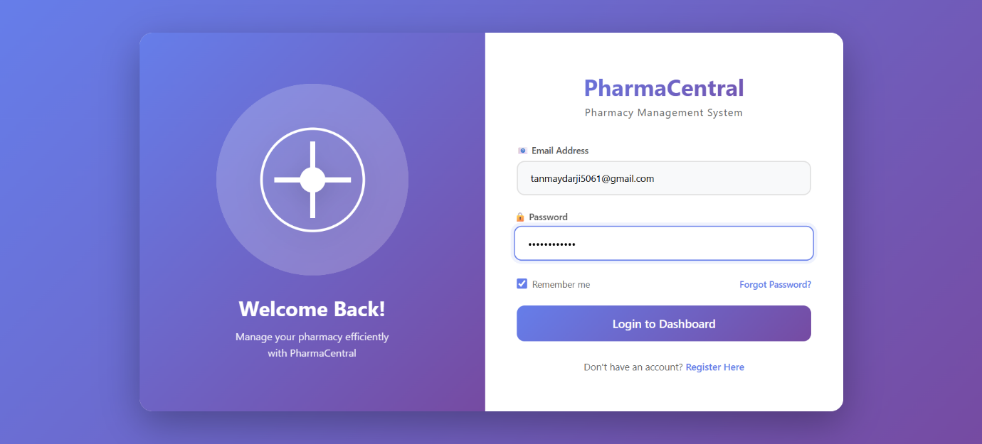
Login page

Slide 56
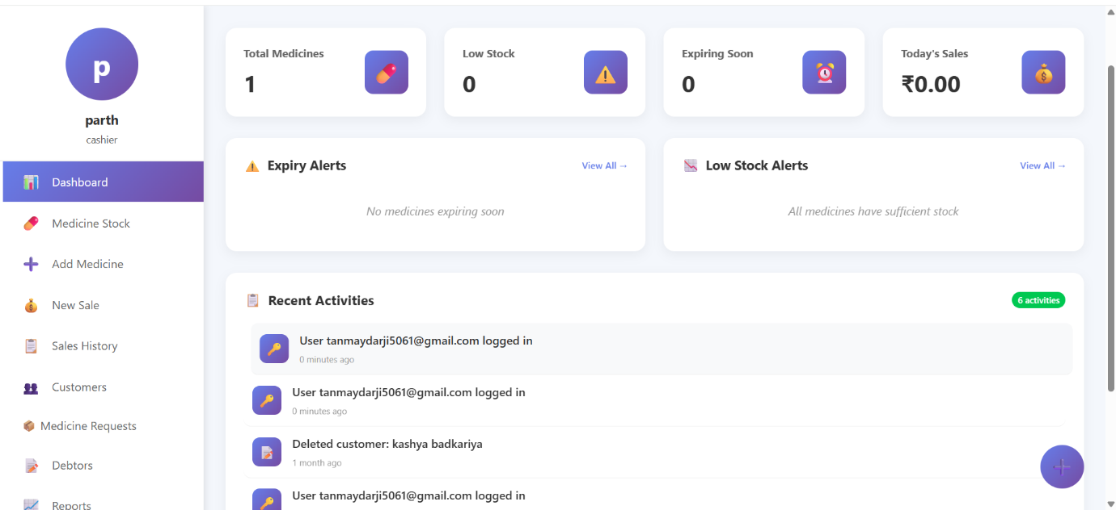
Dashboard Page

Slide 57
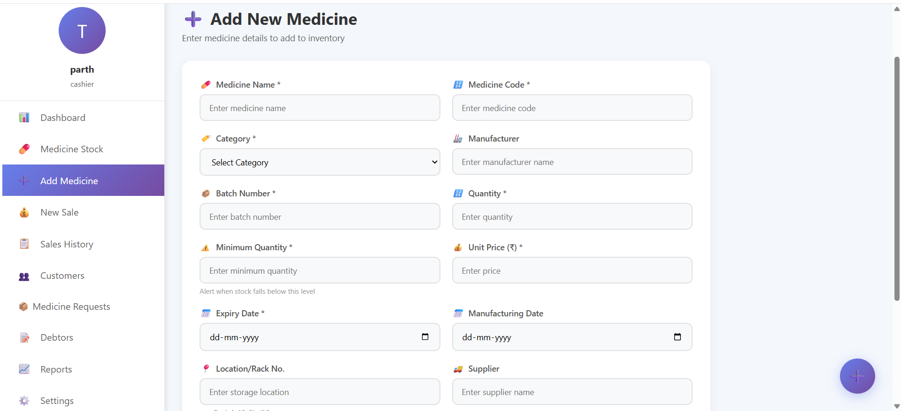
Add Medicine Page

Slide 58
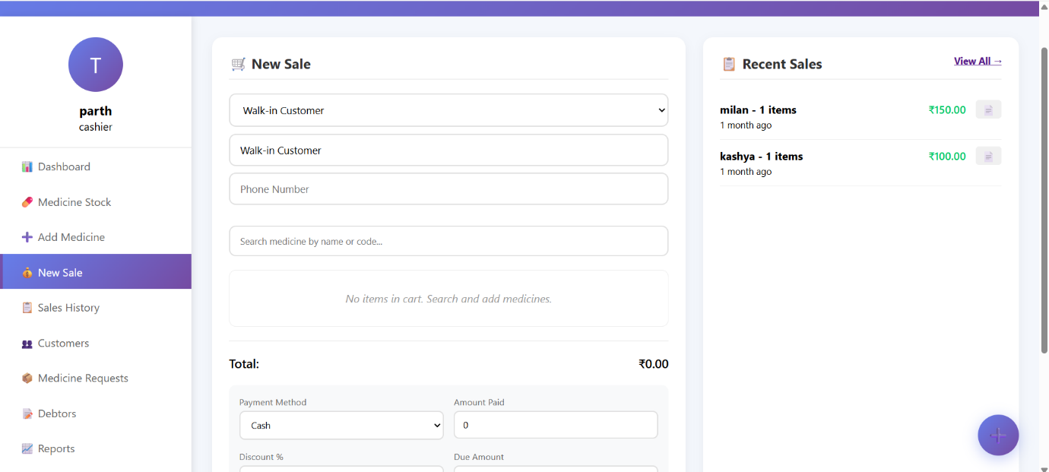
New Sales Page

Slide 59
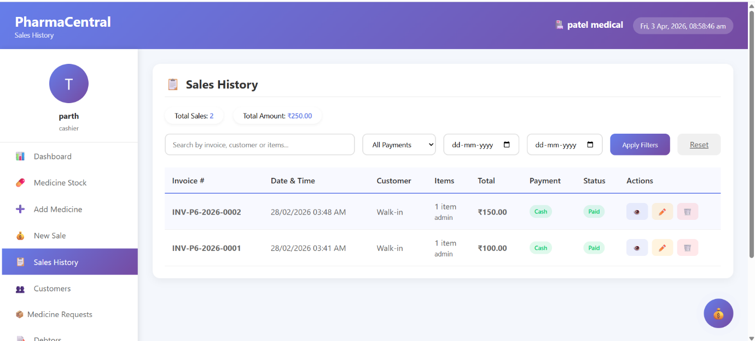
Sales History Page

Slide 60
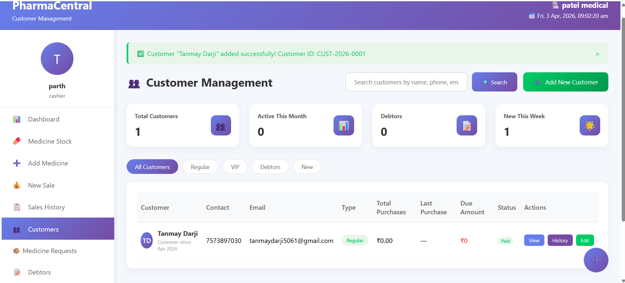
Customer Page

Slide 61
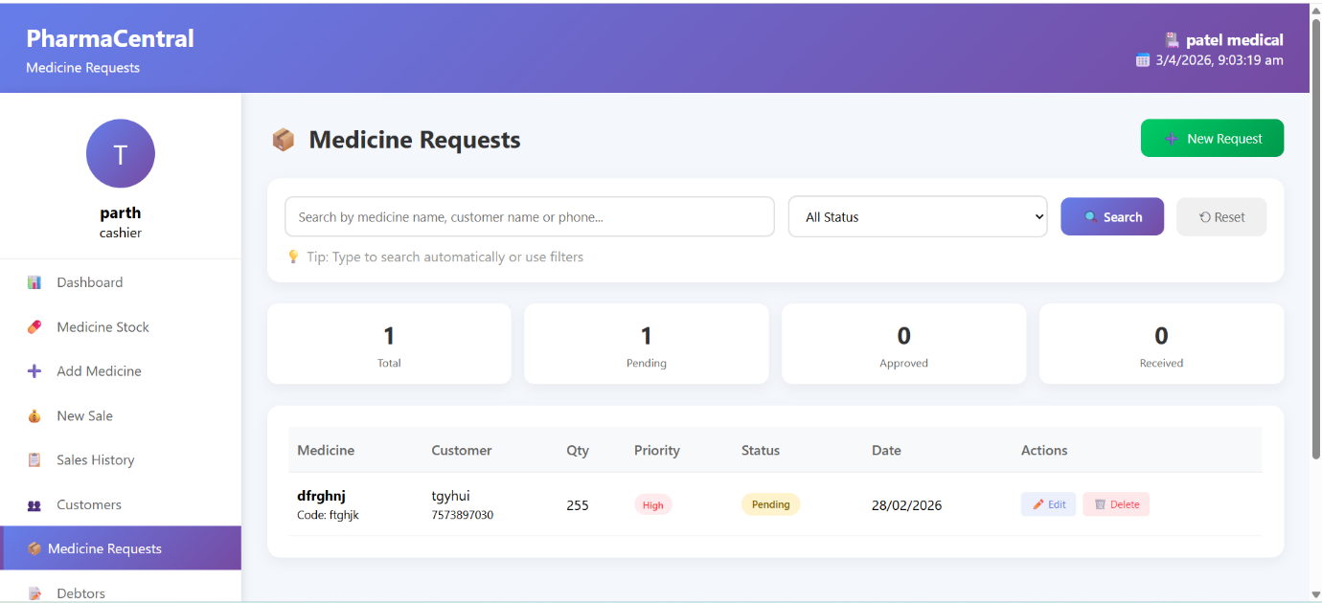
Medicine Request Page

Slide 62
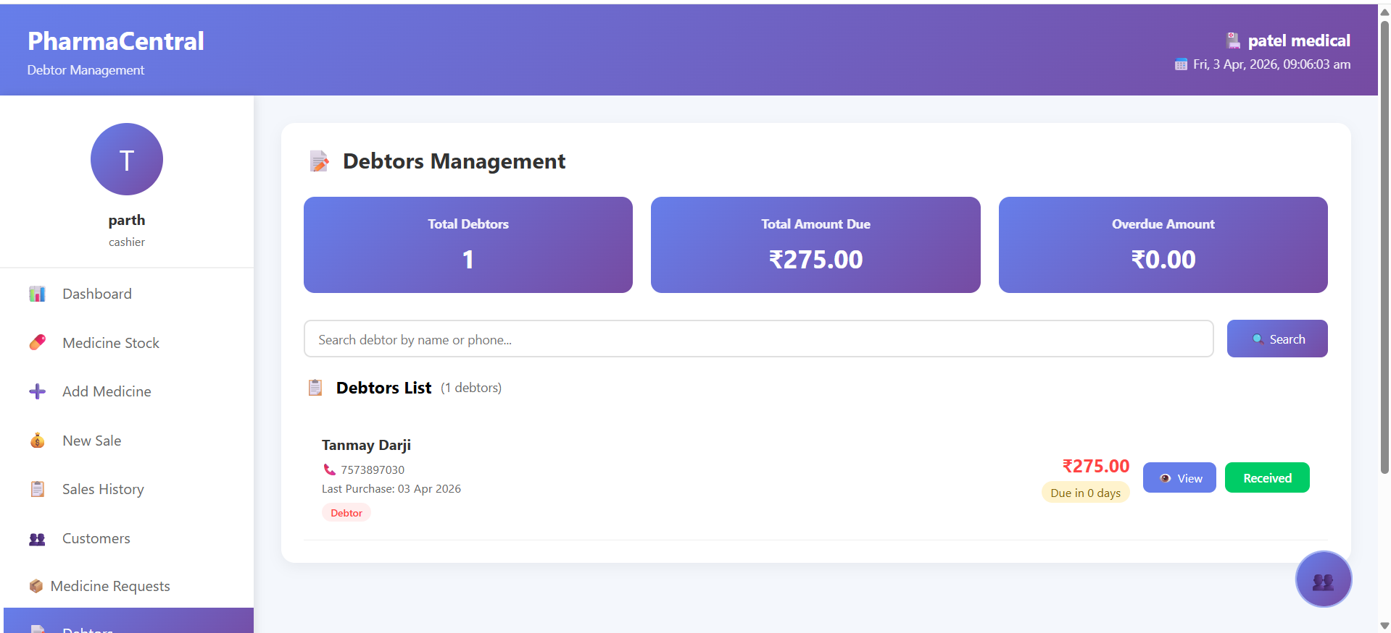
Debtors Page

Slide 63
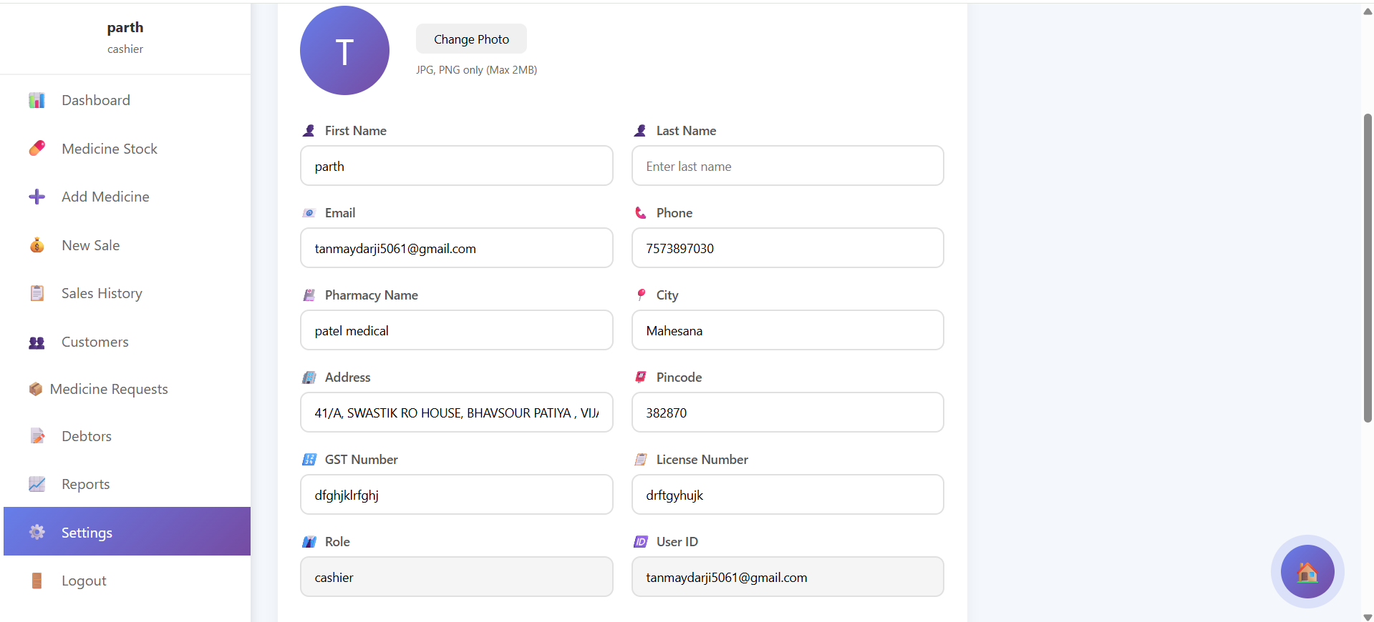
Setting Page

Slide 64
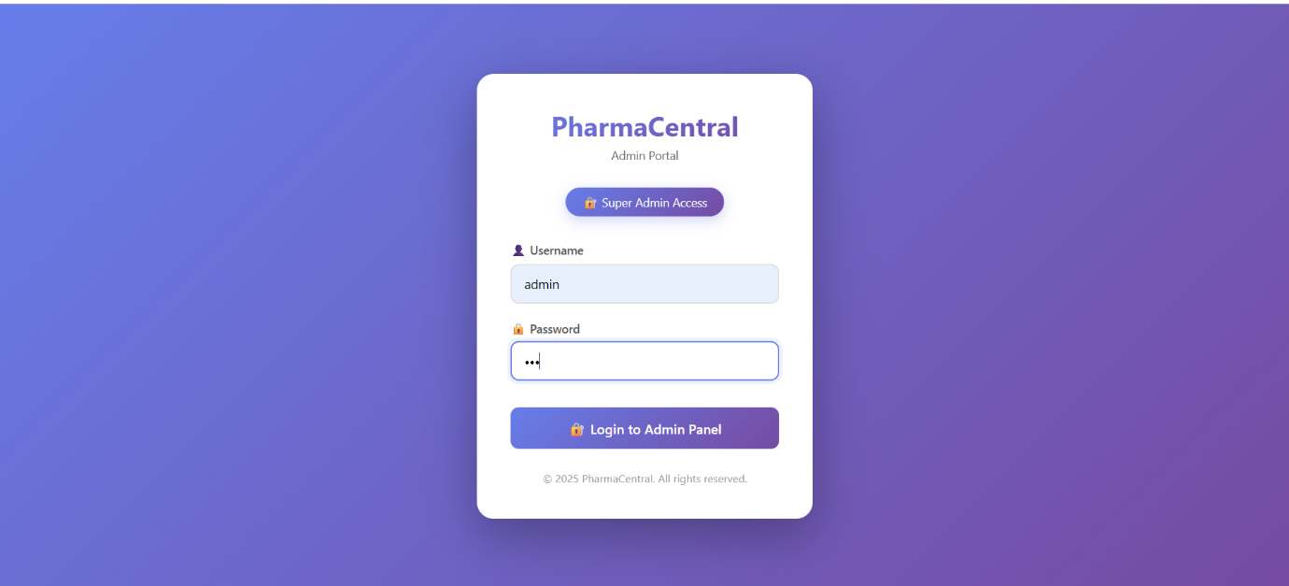
Admin :-
Login page

Slide 65
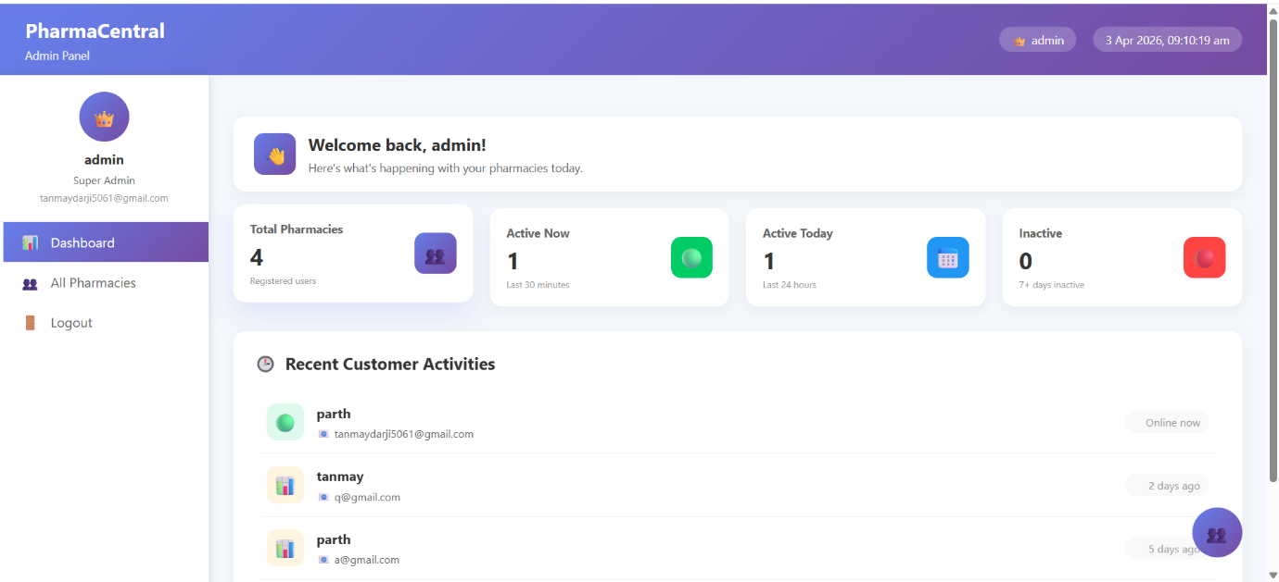
Dashboard Page

Slide 66
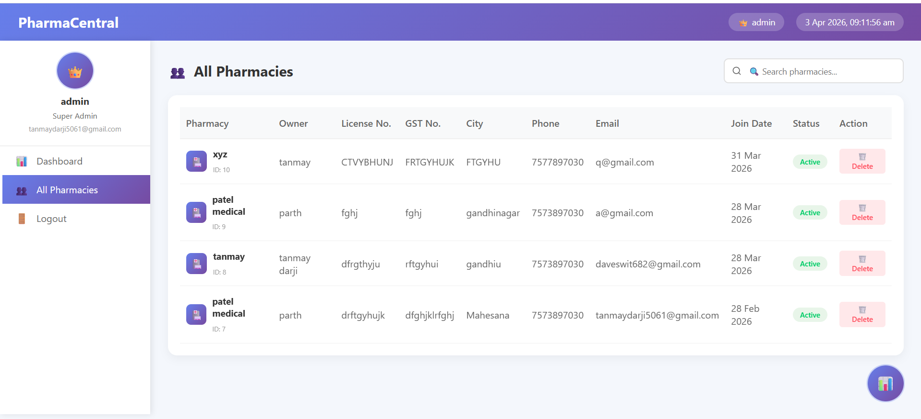
All Pharmacies Page

Slide 67
Reports
Financial & Stock: Generate revenue trend reports based on sales and medicine data, identify top-selling items, track expiry alerts, and prepare low-stock valuation reports.
Customer & Audit: Provide debtor ageing reports, analyse customer loyalty insights, and maintain admin user activity logs for system security and audit purposes.

Slide 68
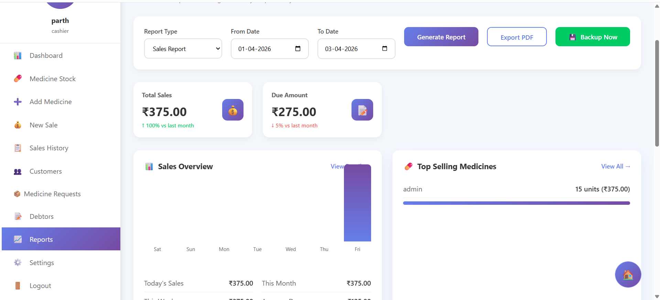
Reports

Slide 69
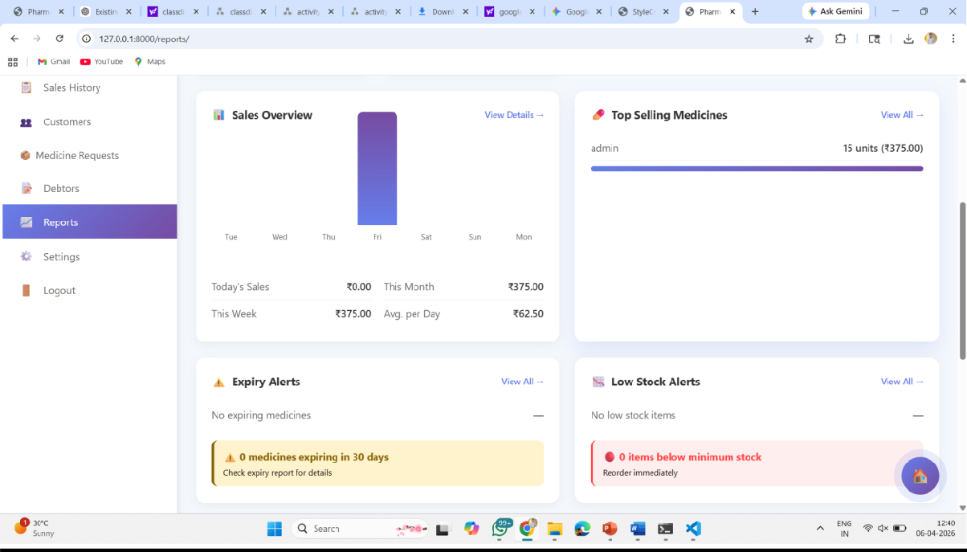

Slide 70
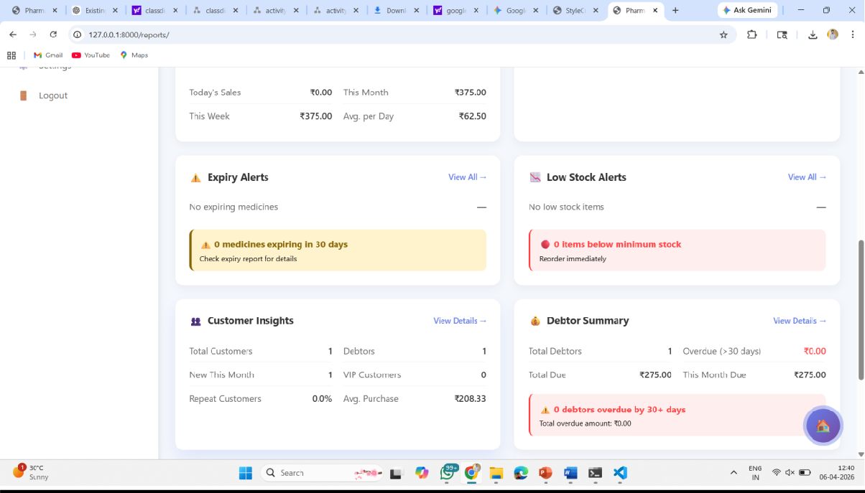

Slide 71
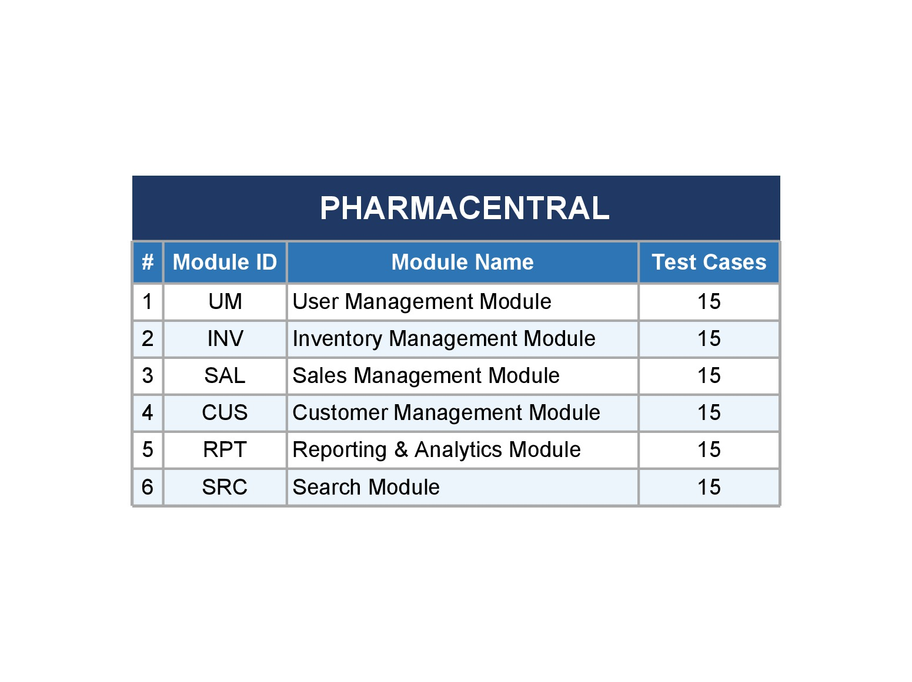
Testing
Test Cases

Slide 72
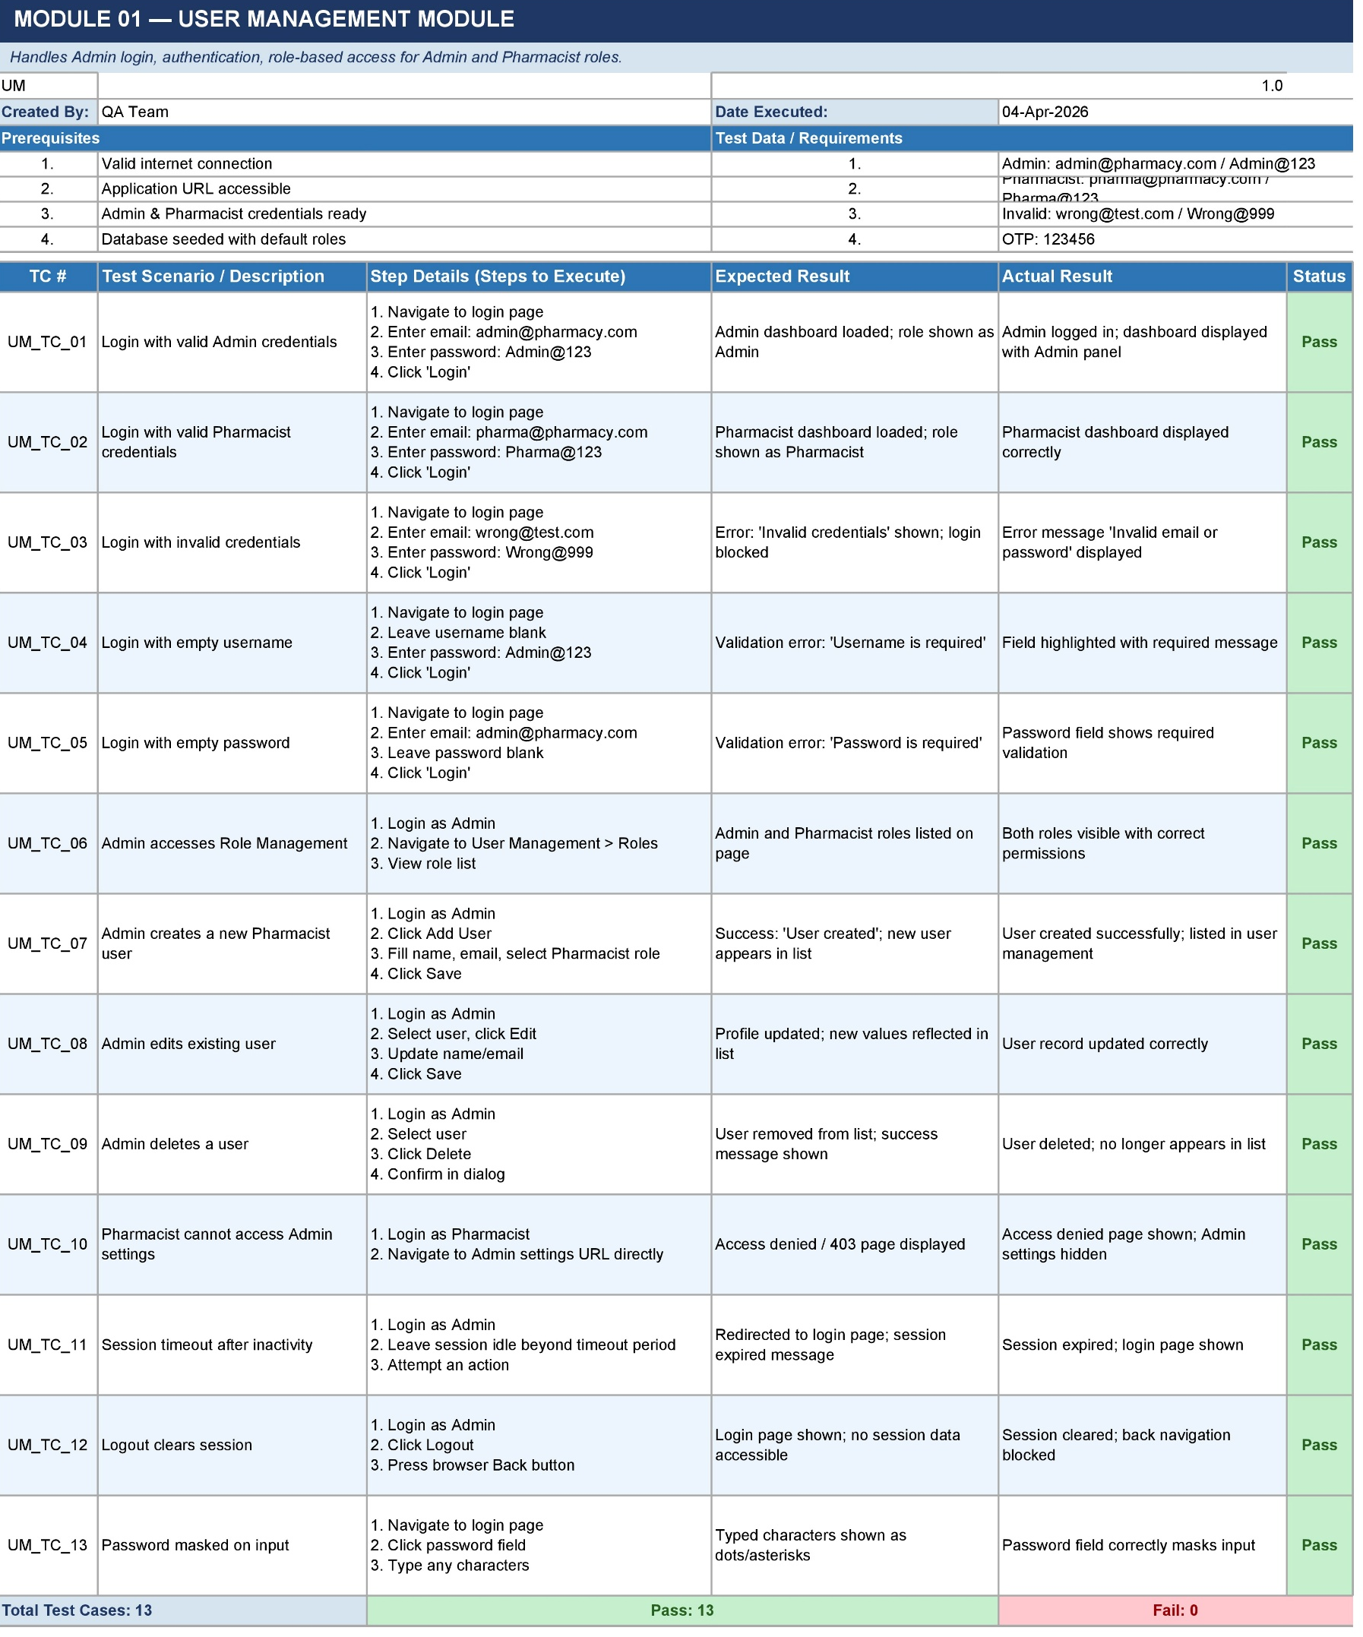

Slide 73
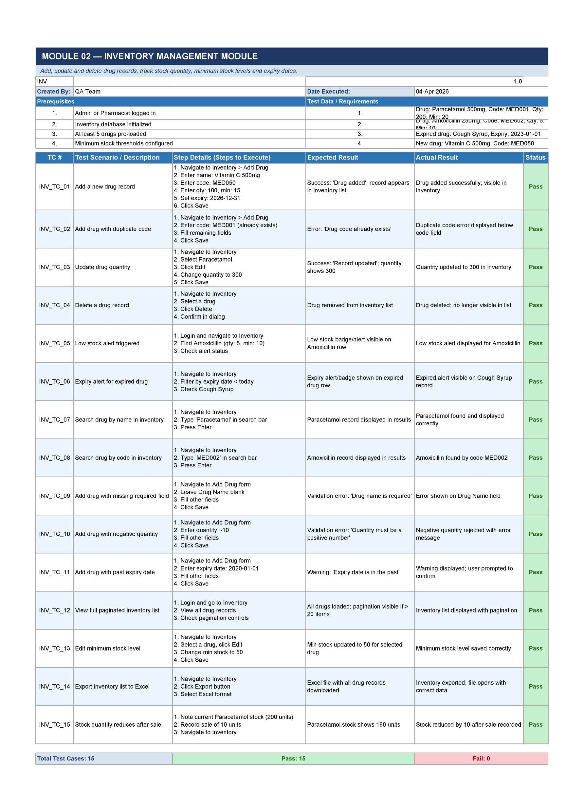

Slide 74
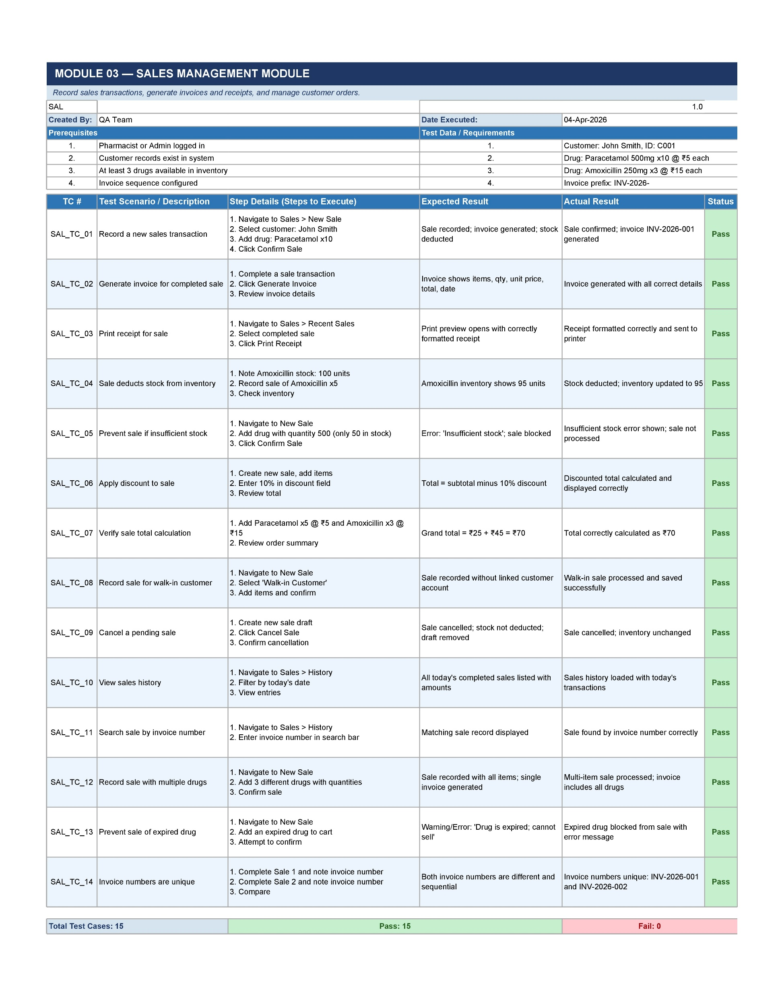

Slide 75
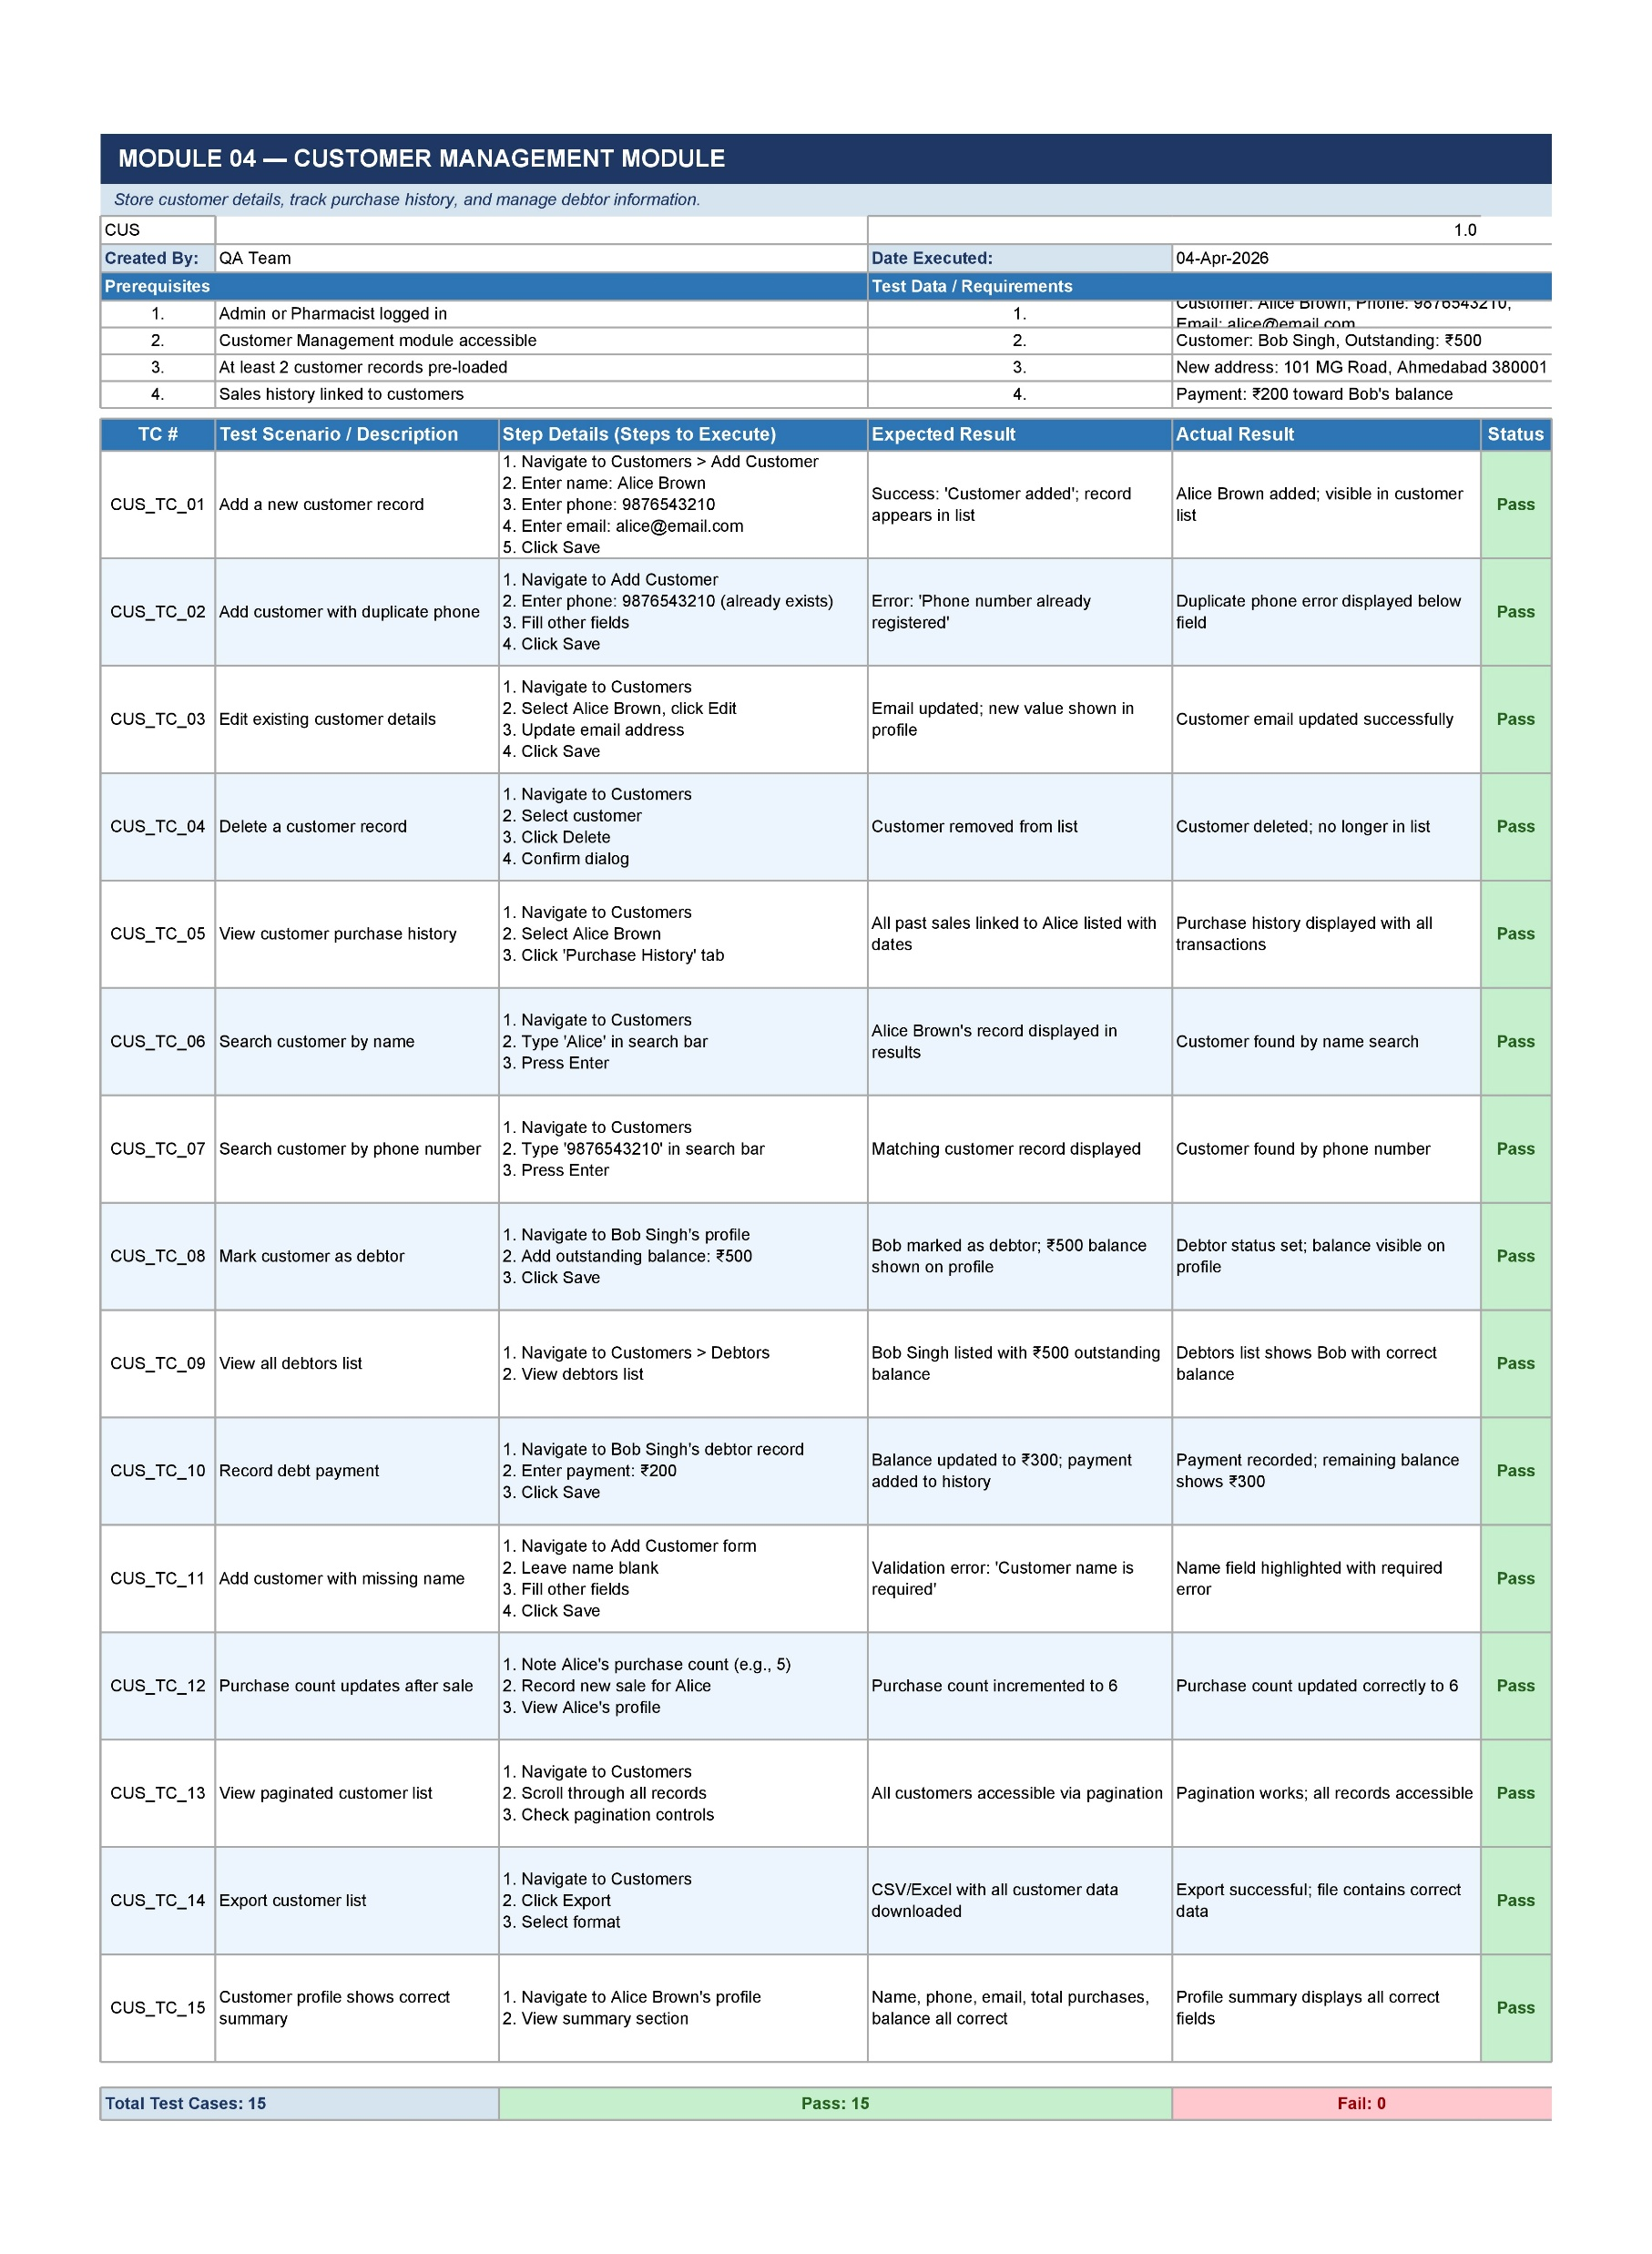

Slide 76
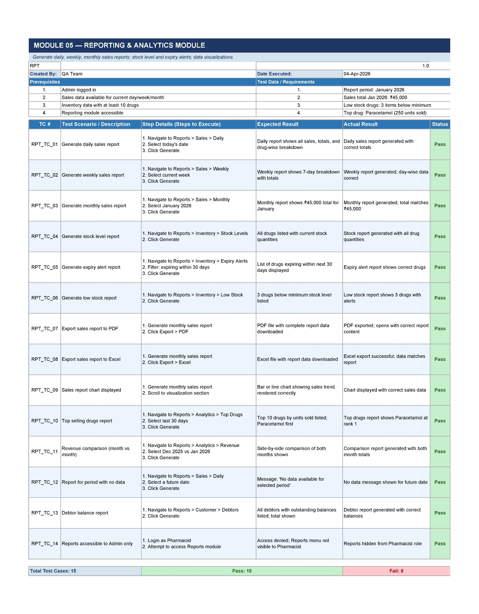

Slide 77
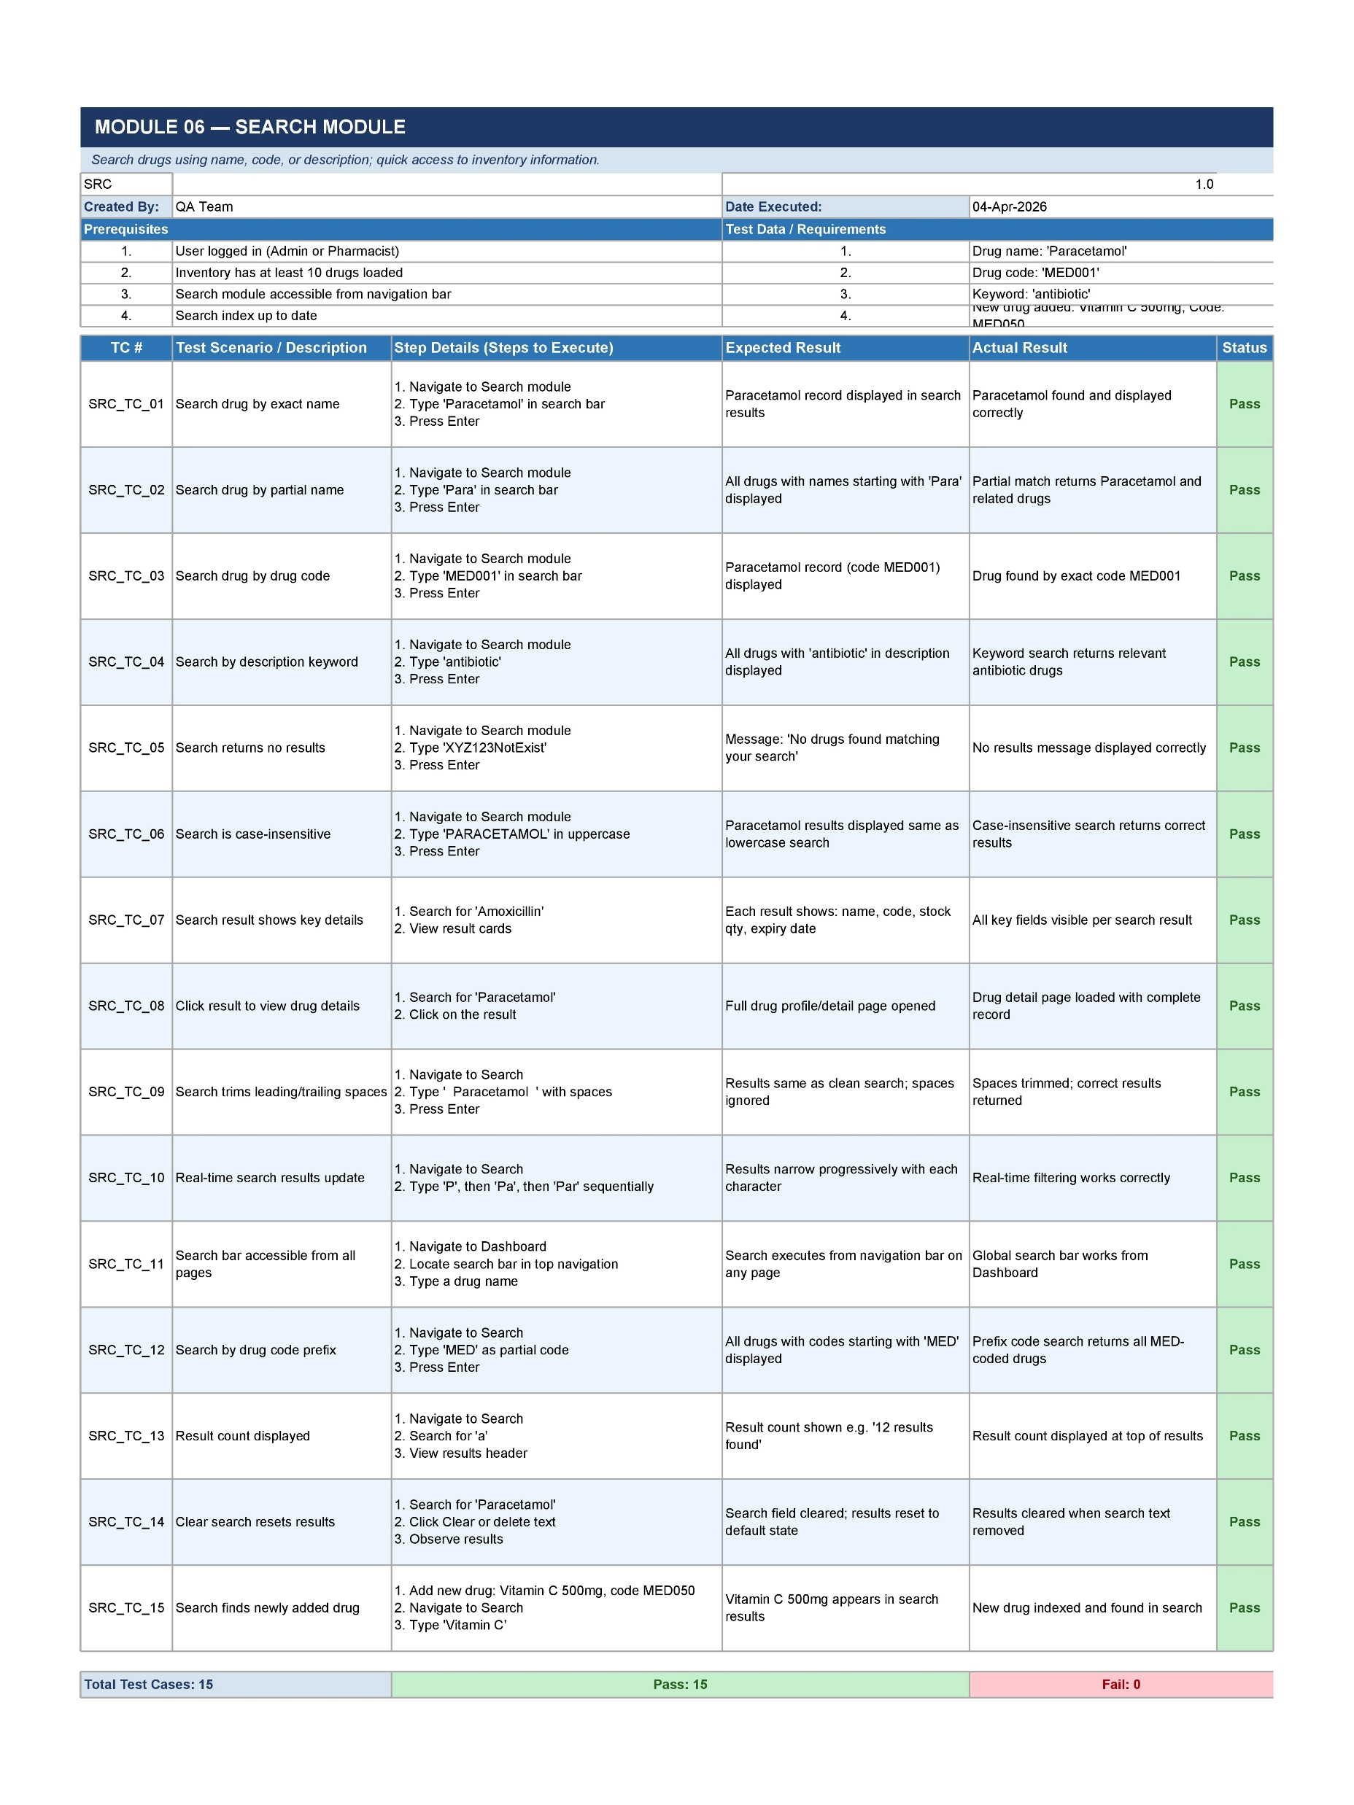

Slide 78
Thank You !!!

