Slide 1


HackY Spinters
Challenge – AR-VR

Slide 2
Solution Synopsis, Demonstration
Idea Summary
To create an APP using VR/AR technology that can help to scan the surface and provide a design to identify and place the plants accordingly.
Patent Potential
Novel idea
Problem Statement
Unique in its Approach
In a Rapid Growing Society and people living in multistory Apartments, Gardening is a challenge. People these days are interested in gardening due to various reasons
Room Purifier
Interiors
Organic food
Given limited space and climate variation this is always a question how will my garden look like if I place my Pots at this place? Can I setup a mini garden. What kind of Pots / shapes looks good.
Benefits
Make a plan to use every inch of space, think unusual and creative ideas
Help in providing Low Maintenance Solutions
Help in making a Herbal Garden by identifies if the climates suits it
Grow vines or hanging plants on railing to create shade for the plants growing on balcony floor.
Light up your Balcony Garden with Different colors of flowers
Use stack planters, railing planters, vertical wall planters and hanging baskets. Arrange old shelves and pallets to keep pots in them.
Grow plants that tolerate shade or grow in less sunlight.
MarketPlace for Plants etc
Ecommerce / Online / Offline Hybrid Model
Ease of use
Propose Solution
Create a mobile application which uses Augmented Reality which helps to clear my dilemma of not only which plant but where to place that plant around.
Current / Future Scope
As a part of MVP
We create a mobile app on Android Platform which can scan any Surface and allows you the place the Plants. User can select a max of 5 plants at this point of time. On Scan it provides the design on organizing the plants in order
Future Scope
App can be made available on Play Store/AppStore
Identifies the different type of plants that can be grown in different climate
Based on the climate/plants suggest the type of soil/fertilizer that gives a better growth.
Business Value
Time to Value / Time to Market

Slide 3
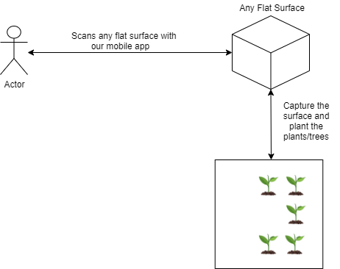
Technology stack / High Level Flow
ANDRIOD
ARCORE
BLENDER
ANDRIOD STUDIO

Slide 4

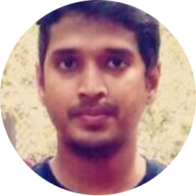


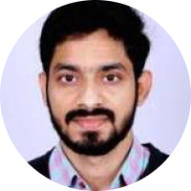
Team Member Profiles
Pic
Pic
Pic
Tanmay Darmorha
Kunal Kishore Singh
Kranthi Kumar Mannava
Team Captain
Pic
Pic
Rahul Goel
Veeranjaneyulu Golakoti

