Slide 1

DON BOSCO INSTITUTE
OF TECHNOLOGY
COMPUTER DEPARTMENT
GROUP NUMBER : 7
Class Attendance Management System using Facial Recognition
Under the guidance of Ms. Dipti J.

Slide 2
GROUP MEMBERS :
Name | Roll Number
Sagar Chanchal | 08
Tanmay Desai | 15
Clyde Gomes | 26

Slide 3
Contents-
Background
Problem statment
Architecture
Data collection
Implementation
Results
References

Slide 4
Background:
The idea for this project came to us in class as we saw the amount of time that has to be skipped for attendance and the nonchalance of students who had already marked their attendance which leads to the method being delayed further, we then decided that this would be a good and interesting field to delve into for our Project as the field of Image processing, recognition etc; has a world of scope and would help us culcate our skills and make us a tad bit ready for any or most challenges ahead.

Slide 5
Motivation
To save time in a lecture, by replacing the monotonous method of traditional attendance marking which is prone to cunning and shrewdness to turn in one’s favour(Proxies).
To make an attendance marking system that is beneficial to both the faculty as well as the students.

Slide 6
Problem Statement:
To provide a reliable and accurate automated attendance marking system by making use of Haar Cascade algorithm and Local Binary Patterns Histogram Algorithm.

Slide 7
SYSTEM ARCHITECTURE

Slide 8


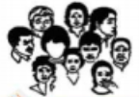
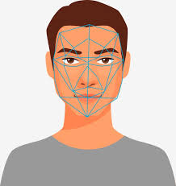


Region of Interest for each face is obtained using Haar Cascade
Live video capture using android smartphone
Captured video is segmented and individual faces are obtained
Histogram value of each face is calcualted using LBPH
Database(contains saved images, where the histogram value of each image is stored)
Attendance is marked if the captured images match trained images in the database.

Slide 9
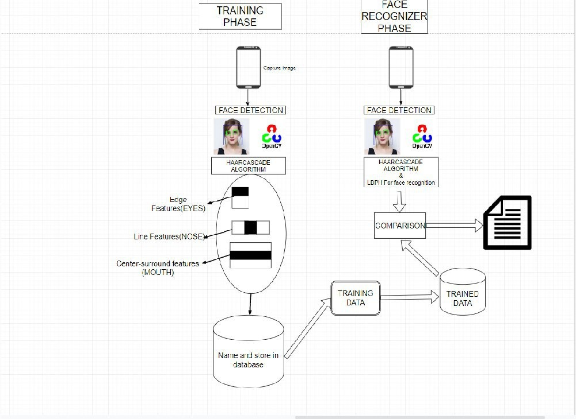

Slide 10
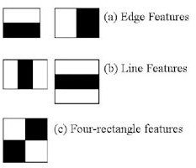
Harr Cascade
The Haar cascade algorithm here is being used for face detection on the captured image.
The ﬁrst processing step is to detect and crop the region of interest ROI which is the human face.
It can be done by applying the Haar Feature-based Cascade algorithm.

Slide 11

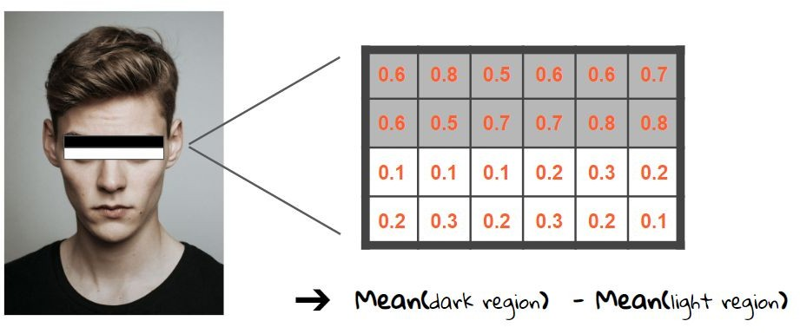
Eg:- Haar Cascade Algorithm edge feature detection
If the delta value is closer to 1 then mostly we have found a haar feature.

Slide 12
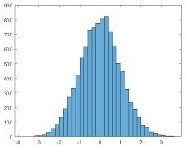
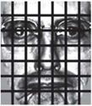

Local Binary Patterns Histograms Face Recognizer:
(LBPH) is a very popular face recognition model, it has a signiﬁcant improvement over Eigenfaces and FisherFaces as both of these are affected by light. LBPH however tries to ﬁnd the local structures images as it compares each pixel to its neighbouring pixel.
(7 x 7) equally sized cells of the face image

Slide 13

So the algorithm output is the ID from the image with the closest histogram. The algorithm should also return the calculated distance, which can be used as a ‘confidence’ measurement. Lower confidences are better because it means the distance between the two histograms is closer.
We can then use a threshold and the ‘confidence’ to automatically estimate if the algorithm has correctly recognized the image. We can assume that the algorithm has successfully recognized if the confidence is lower than the threshold defined.

Slide 14
THANK YOU!!

