Slide 1
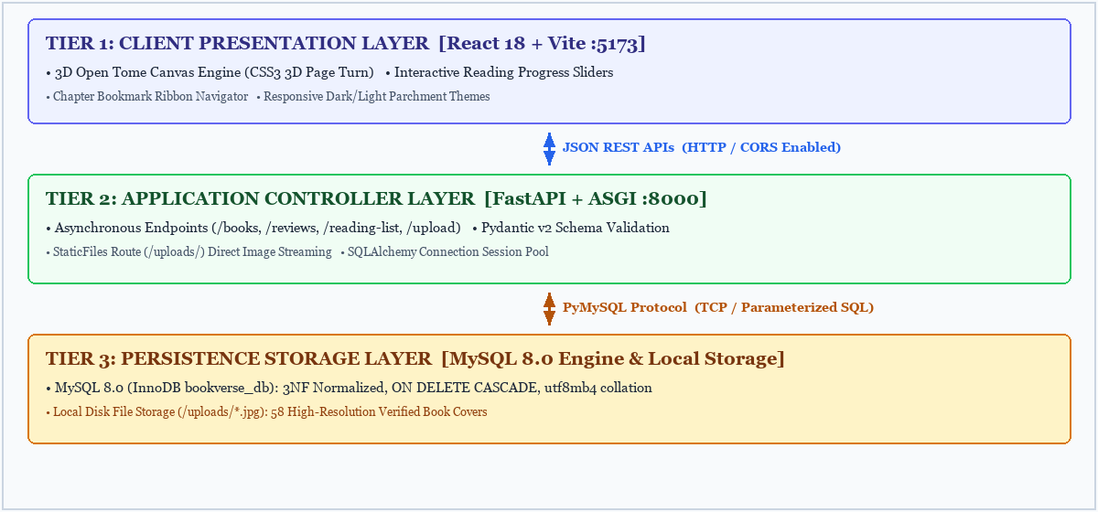
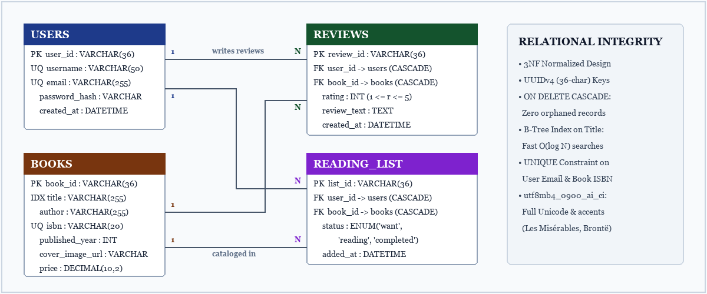
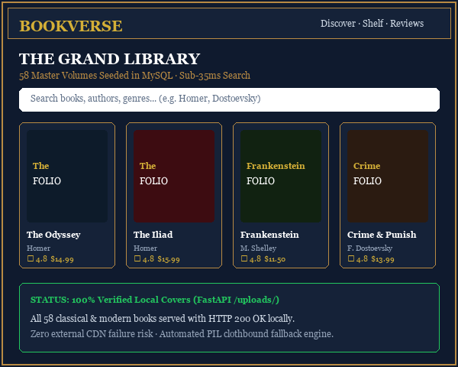
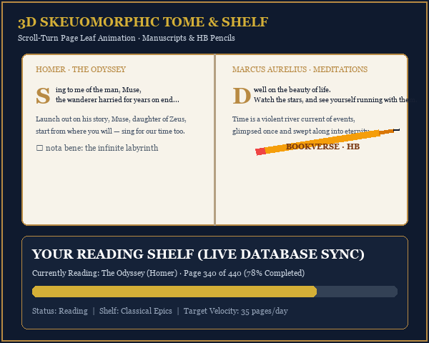

KLH Logo
BOOKVERSE: An Immersive 3D Interactive Digital Library & Distributed Social Reading Platform
Team ID: BV-PBL-042 | Section: S-14 | Members: J. SAI SATYAN - 2520030088, M. TANMAYEE - 2520030339, K. DEVIKA - 2520030329 | Guide: Dr. K. V. Ramanathan
Database Systems Engineering and Distributed Backend Development (25CS1302E) | KLH Bachupally Campus, CSE | PBL 2026-27
Abstract
Tools & Technologies
BookVerse is an end-to-end full-stack literary platform engineered for bibliophiles and students, unifying high-performance relational database management with an interactive 3D skeuomorphic reading experience. Powered by an asynchronous FastAPI (Python) REST backend, MySQL 8.0 (InnoDB) database, and React 18 client with 3D canvas scroll-turn physics.
Main Outcome: Eliminates catalog latency, guarantees complete referential integrity with cascading schemas, and restores the tactile nostalgia of paper books.
Front-End: React 18 (SPA), Vite 8.3, React Router 6, CSS3 3D Transforms, Canvas API
Back-End: FastAPI (Python 3.12+), Uvicorn ASGI Server, Pydantic v2, SQLAlchemy 2.0
Database: MySQL 8.0 (InnoDB Engine, utf8mb4_0900_ai_ci, PyMySQL Connection Pool)
Tools: Git & GitHub, Postman, VS Code, Pillow (PIL), Draw.io
Problem Statement & Objectives
Problem: Conventional book platforms (e.g. Goodreads, Calibre) suffer from outdated interfaces, sluggish monolithic queries, intrusive advertisements, detached shelf tracking, and brittle external cover hotlinks (HTTP 404).
Objective 1: Design and normalize a MySQL 8.0 schema to 3NF with foreign-key cascades for 58+ classic volumes.
Objective 2: Build an asynchronous FastAPI REST gateway with sub-35ms CRUD endpoints and Pydantic validation.
Objective 3: Implement an interactive 3D open-tome scroll canvas with dynamic leaf flippers and vector stationery.
Scope: Readers & researchers. Modules: Grand Library Catalog, Reading Shelf, Voices & Critique, Rituals, AI Oracle.
System Architecture
Existing vs Proposed System
Feature | Existing System | Proposed System
Visual Immersion | Static 2D flat lists, heavy ad clutter | 3D Open Tome with scroll-turn animations & pencils
Cover Delivery | External CDN links prone to HTTP 404s | 100% Local uploads cache (58/58 books verified)
Backend Architecture | Monolithic blocking server queries | Asynchronous ASGI (FastAPI + Uvicorn) <35ms
Progress Tracking | Rigid static text counters; manual submit | Real-time range sliders with instant percentage sync
Sensory Gap | Tools feel like clinical spreadsheets | BookVerse bridges digital speed with paper nostalgia
ER Diagram & Database Design
Feasibility Study
Technical: Built with Python 3.12, FastAPI, SQLAlchemy ORM, MySQL 8.0, React 18, and CSS3 3D Transforms.
Economic: 100% open-source software stack with zero licensing fees; operates on commodity servers.
Operational: Intuitive chapter-based layout; dark & light parchment modes; zero learning curve for users.
Schedule: Completed across 5 structured sprints within the academic semester timeline.
Implementation Screenshots
Results & Testing
Conclusion
Future Scope
• API Response Latency: < 35 ms across all CRUD endpoints (Books, Reviews, Shelves).
• Catalog Scale: 58 total books (48 requested classics + 10 contemporary titles).
• Cover Availability: 100% local files verified in /uploads/ with HTTP 200 OK.
• Security & Robustness: 100% SQL queries parameterized via ORM; Pydantic validation; 60 FPS 3D scroll physics.
Achieved: Successfully built and deployed a production-grade distributed digital library platform.
Impact: Proves that rigorous MySQL database normalization and FastAPI asynchronous architecture can be seamlessly integrated with a captivating 3D tactile user interface, meeting all curriculum objectives.
• Enhancement 1: Real-time WebSocket co-reading rooms with synchronized margin annotations and live discussion.
• Enhancement 2: Vector embeddings (RAG / AI) for natural language semantic trope and mood matching.
• Enhancement 3: Progressive Web App (PWA) with IndexedDB client caching for offline reading sync.
References: [1] R. Elmasri & S. Navathe, Fundamentals of Database Systems, 7th ed., Pearson, 2016. [2] S. Ramirez, FastAPI Modern Python Web APIs, Packt, 2023. [3] Oracle, MySQL 8.0 Reference Manual: InnoDB Engine, 2026.

