Slide 1


Diabetes Risk Prediction
Machine learning for early clinical screening
Course 25SC2107E · Machine Learning · Topic 31
Presented by
K.Devika -2520030329
M.Tanmayee-2520030339
Logistic Regression · SVM · Random Forest
github.com/tanmayeemuppaneni/diabetes-risk-prediction
Notes:
Introduce the project: a machine learning system that predicts diabetes risk from routine clinical measurements.
1

Slide 2
Abstract
Diabetes often goes undetected until serious complications appear. This project builds an end-to-end machine learning system that predicts diabetes risk from routine clinical measurements in the Pima Indians dataset (768 patients, 8 features).
Logistic Regression, SVM, Random Forest and boosting models are trained with cross-validation and hyperparameter tuning, then judged on recall and PR-AUC rather than plain accuracy. The final model is calibrated, served through a FastAPI endpoint and watched for data drift.
Keywords: diabetes, risk prediction, screening, SVM, Random Forest, FastAPI
768
patient records with 8 clinical features
0.818
nested cross-validation ROC-AUC (± 0.038)
90%
recall reached at the 0.30 screening threshold
Diabetes Risk Prediction · End-to-End ML System
2
Notes:
Summarise the project in under a minute: the problem, the models, the evaluation approach and the deployment.
2

Slide 3




Problem statement
Late detection
Diabetes progresses silently, so complications such as nephropathy and retinopathy appear before diagnosis.
Messy clinical data
Impossible zeros in lab values and a 65 / 35 class imbalance can mislead models.
Missed cases are costly
A false negative leaves a patient untreated, so raw accuracy is the wrong goal.
Models decay in production
Preprocessing mismatches and data drift can quietly degrade predictions after deployment.
Goal: build a reliable, explainable ML screening system that flags at-risk patients early while keeping missed cases to a minimum.
Diabetes Risk Prediction · End-to-End ML System
3
Notes:
Four challenges: silent progression of the disease, poor data quality, the asymmetric cost of errors, and keeping a deployed model reliable.
3

Slide 4



Proposed system
1
2
3
4
5
6
Clinical input
Preprocess
Train and tune
Calibrate
Serve
Monitor
8 measurements sent to the API
Zero→NaN, impute, scale
LogReg, SVM, RF, boosting with CV
Platt scaling, threshold 0.30
FastAPI risk tier and advisory
PSI drift alerts
One atomic pipeline
Eight models compared
Clinically tuned output
Sanitising, imputing, scaling and the model live in one scikit-learn pipeline, so training and serving never differ.
Logistic Regression, SVM, Random Forest, AdaBoost, gradient boosting and a decision tree, tuned with cross-validation.
A 0.30 threshold favours recall, and each prediction returns a Low, Moderate or High tier with an advisory.
Diabetes Risk Prediction · End-to-End ML System
4
Notes:
Walk left to right through the six stages. Stress the single pipeline shared by training and serving.
4

Slide 5
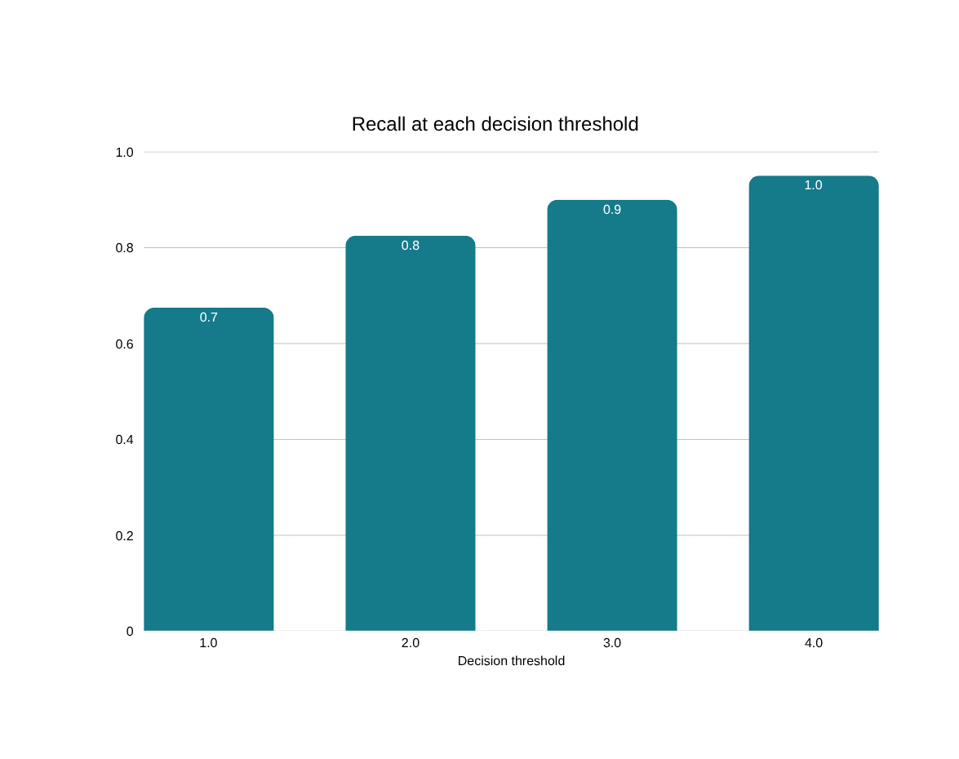
Proposed system: results
13 → 4
missed diabetic cases at threshold 0.30, a 69.2% reduction
0.840
≈ 2.5 ms
best ROC-AUC (linear SVM)
latency per request
Diabetes Risk Prediction · End-to-End ML System
5
Notes:
Lowering the threshold from 0.50 to 0.30 lifts recall from 0.675 to 0.90 and cuts false negatives from 13 to 4.
5

Slide 6
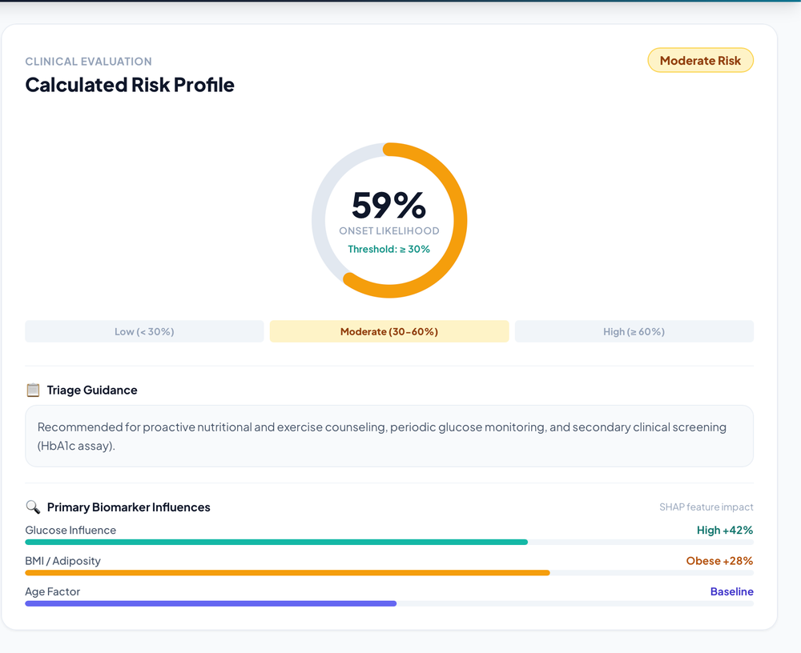
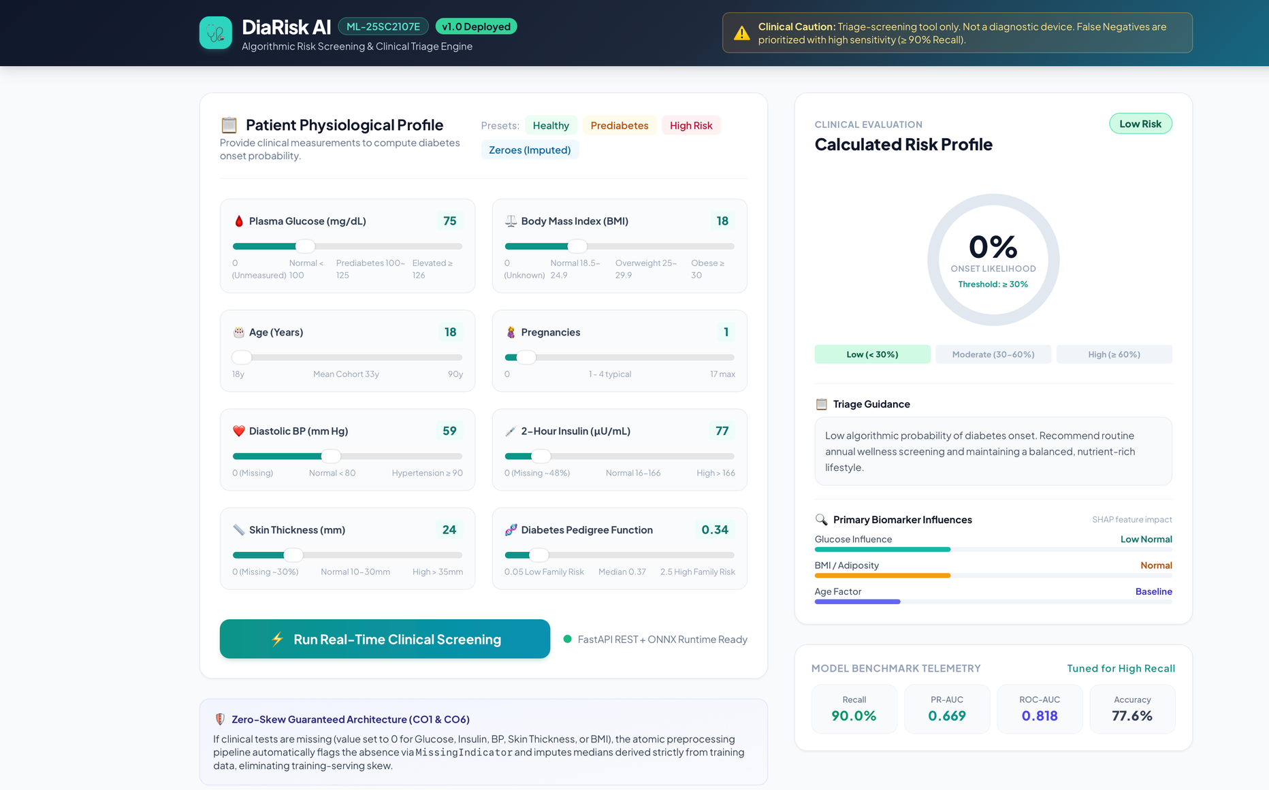
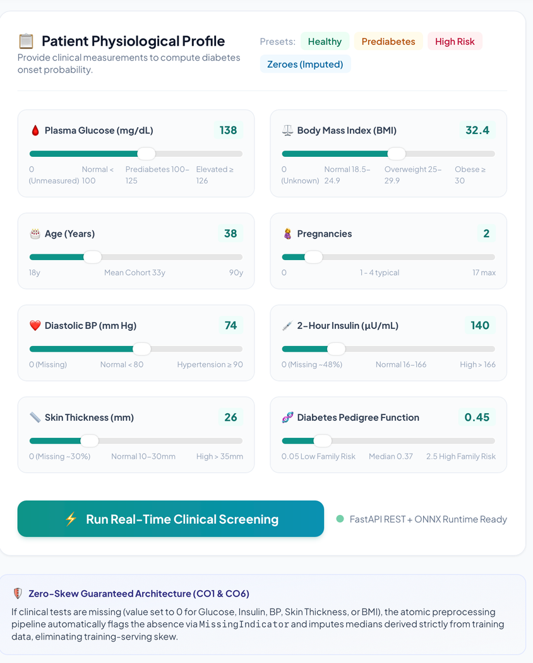
Project website screenshots
Patient input form
Enter the eight clinical measurements
Prediction result
Risk probability, tier and advisory
API documentation
Interactive /docs page for /predict
Diabetes Risk Prediction · End-to-End ML System
6
Notes:
Replace each frame with a real screenshot of your running project: the input form, the prediction result and the FastAPI /docs page. Right-click a frame, delete it, then insert your picture.
6

Slide 7



Advantages
Early detection
Explainable
Trustworthy estimates
90% recall at threshold 0.30 cuts missed cases from 13 to 4.
SHAP shows that Glucose, BMI and Age drive each risk score.
Nested cross-validation and Platt calibration give honest probabilities.
Consistent results
Fast and portable
Self-monitoring
One shared pipeline removes training–serving skew.
About 2.5 ms per prediction, with ONNX export for any runtime.
PSI drift checks trigger retraining when patient data shifts.
Diabetes Risk Prediction · End-to-End ML System
7
Notes:
Each advantage is backed by a measured result from the project.
7

Slide 8



Real-life implementation
Clinic triage
Health camps
Hospital systems
Health apps
Nurses enter routine vitals and get an instant risk tier.
Low-cost screening where lab tests are scarce, such as rural drives.
The REST API plugs into records software for batch screening.
Telehealth and wellness apps can show personal risk guidance.
Clinical workflow
1
Enter patient vitals
2
Model scores risk at τ = 0.30
3
Tier: Low, Moderate or High
4
Confirm with HbA1c or OGTT
A screening aid that supports clinicians; it never replaces a diagnosis.
Diabetes Risk Prediction · End-to-End ML System
8
Notes:
These are intended deployment scenarios. In every case the model output only triggers a confirmatory lab test, never a diagnosis.
8

Slide 9
Conclusion
1
2
3
Complete system
Built for safety
Honest and explainable
From raw clinical data to a monitored REST API, built and tested end to end with 16 passing tests.
A recall-first threshold of 0.30 cut missed cases from 13 to 4, a 69.2% reduction.
A nested CV ROC-AUC of 0.818 and SHAP explanations show what drives each prediction.
Future scope: validate on larger, more diverse patient data, connect to hospital records and run clinical trials with physicians.
Thank you · Questions?
Diabetes Risk Prediction · End-to-End ML System
9
Notes:
Recap the three takeaways, mention future scope and invite questions.
9

